Slide 1
Chicago Food Inspection Failure Analysis

Slide 2
Research Questions and Hypotheses
Questions:
Which types of food establishments (i.e. restaurants, bars, cafes, school cafeterias) are most likely to fail food inspections in the city of Chicago?
Which neighborhoods in Chicago are most likely to fail food inspections?
Hypothesis:
The neighborhoods in Chicago most likely to fail food inspections are also relatively impoverished compared to those likely to pass inspections.

Slide 3
Data

Slide 4
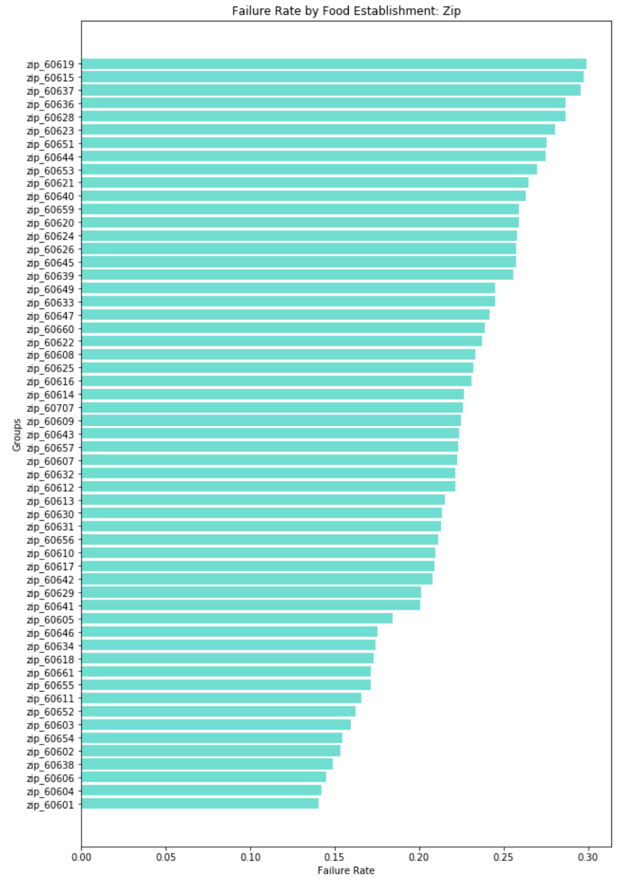
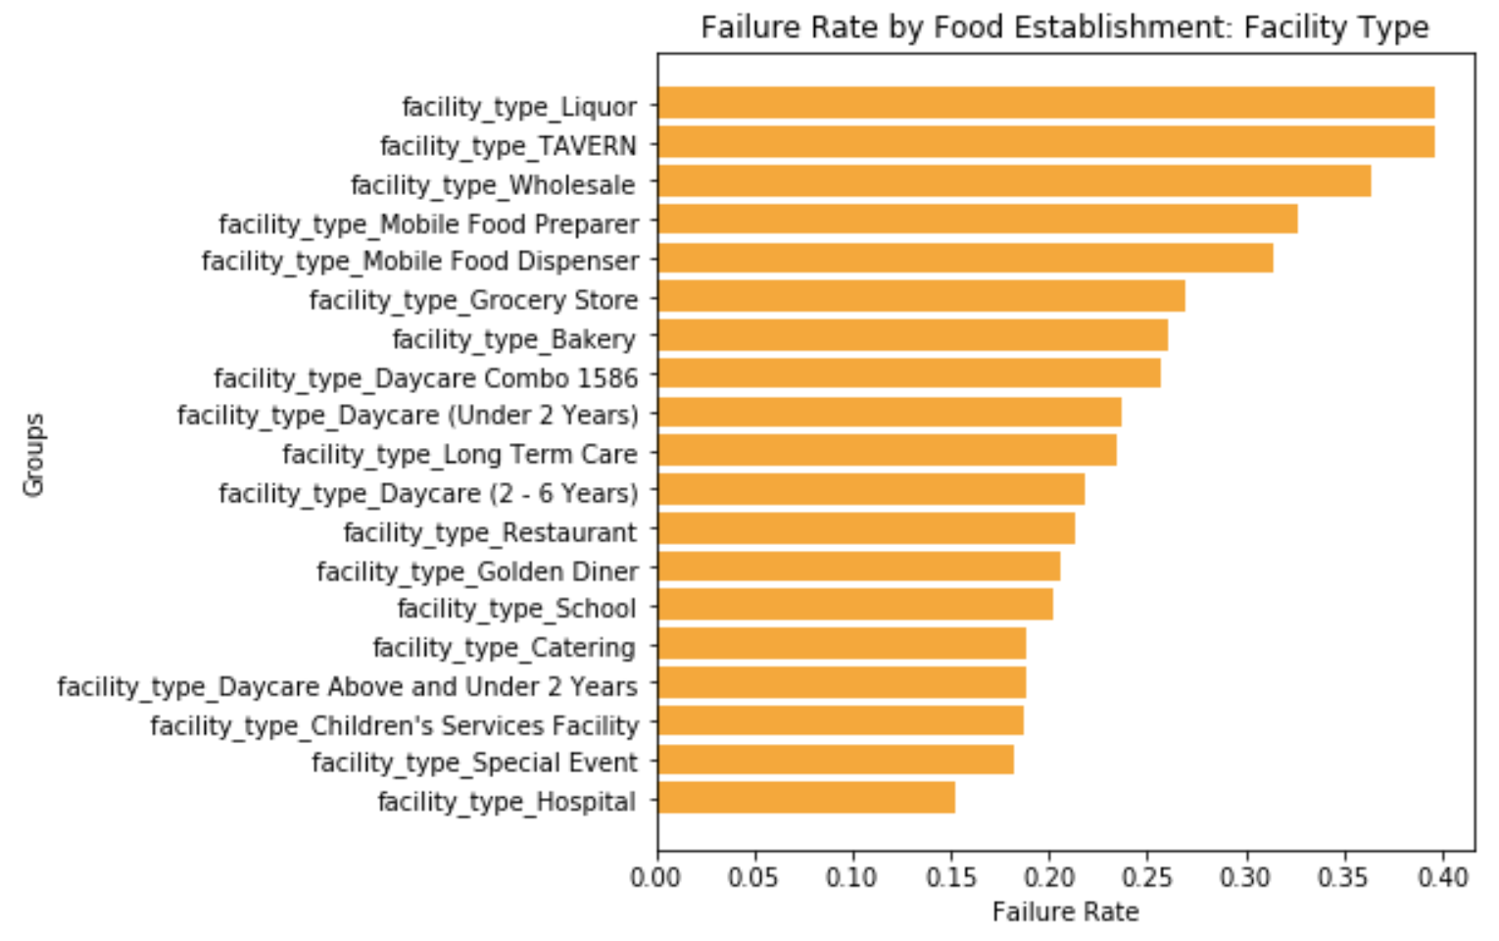
Failure Rates by Establishment and Zip

Slide 5
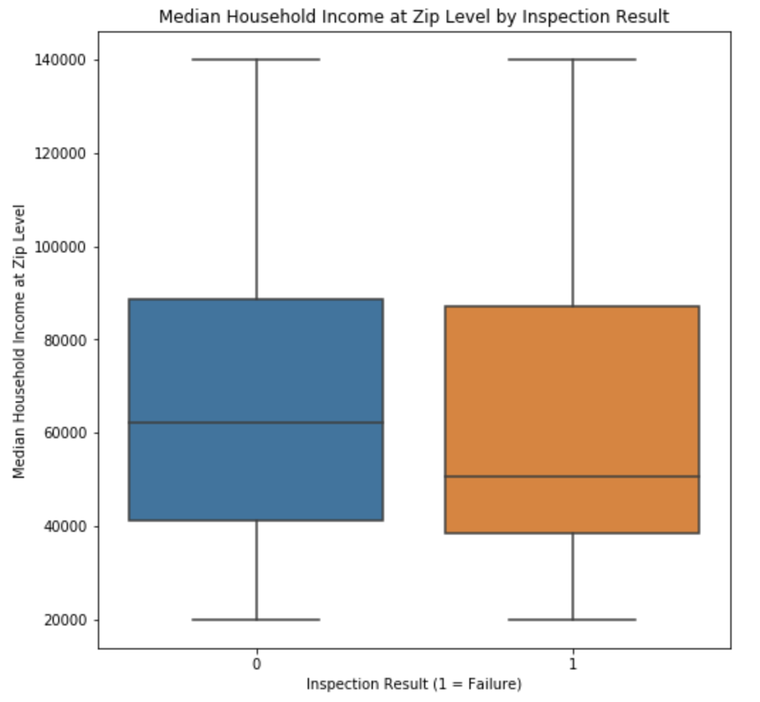
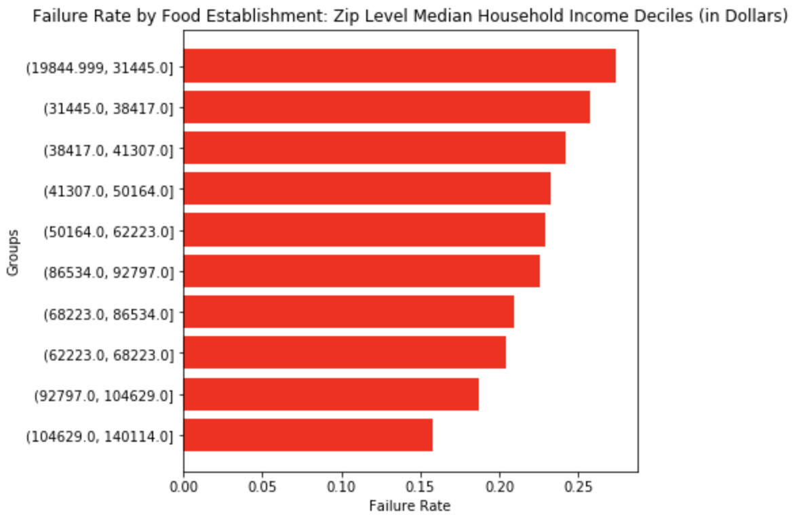
Failure Rates by Median Household Income Group

Slide 6
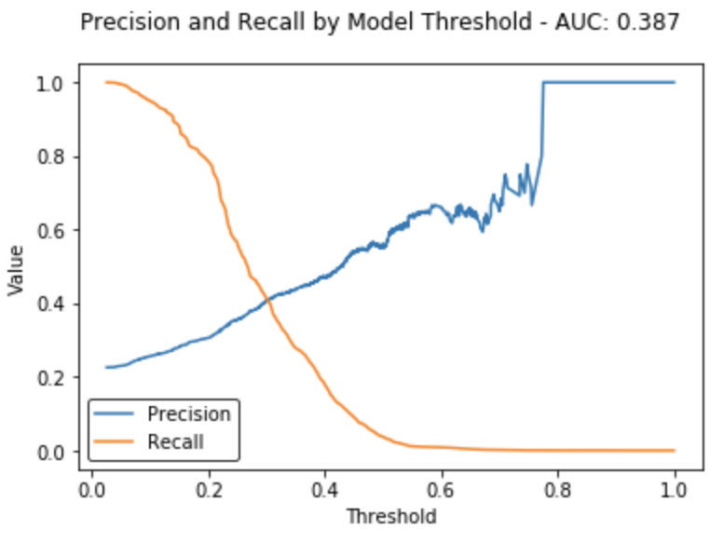
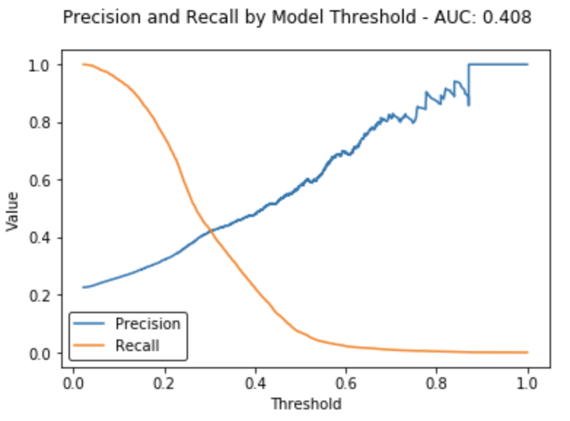
Classifier Performance
Lasso Logistic Regression
XGBoost

Slide 7
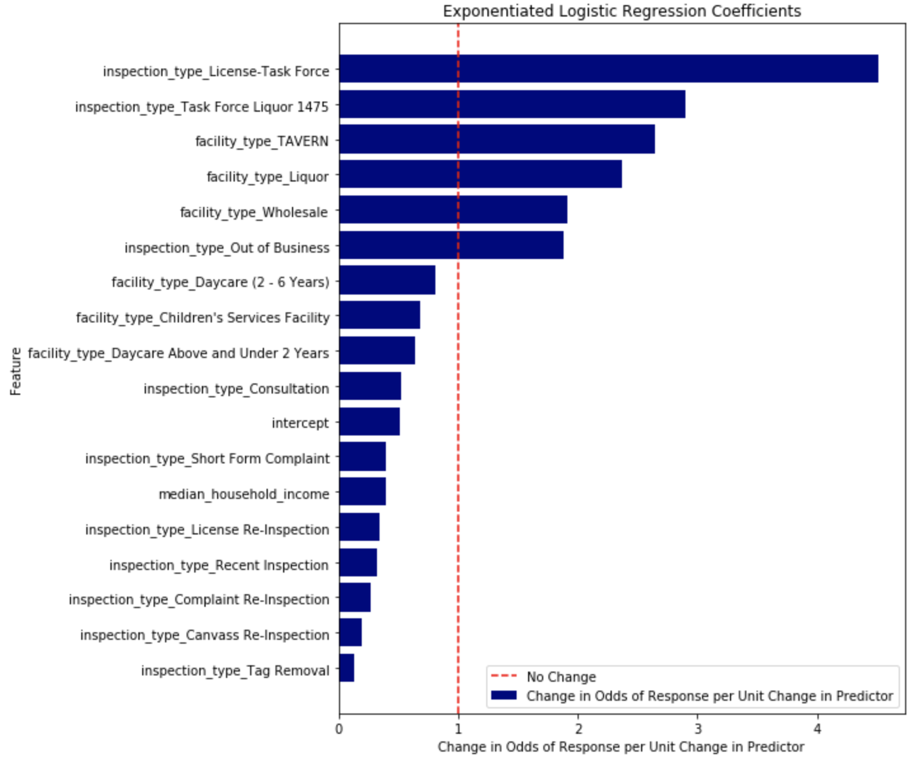
Refitting with Predictive Features to Measure Effects
All features statistically significant with p < 0.001
WHAT DO WE GET BY INCLUDING MEDIAN HOUSEHOLD INCOME?
WHAT COULD WE GET BY ADDING MORE CENSUS OR DATA OR OTHER CONTROLS?

Slide 8
Reflection

