Slide 1
Chicago Food Inspection Failure Analysis
DATA512 Autumn 2019
University of Washington
Joel Stremmel
12-05-12

Slide 2
Research Questions and Hypothesis
Questions:
Which types of food establishments (i.e. restaurants, bars, cafés, school cafeterias) are most likely to fail food inspections in the city of Chicago? (Q1)
Which neighborhoods in Chicago are most likely to fail food inspections? (Q2)
Hypothesis:
The neighborhoods in Chicago most likely to fail food inspections are also relatively impoverished compared to those likely to pass inspections. (H1)

Slide 3
Data
Chicago Food Inspections since 2010 from healthdata.gov
Source: https://healthdata.gov/dataset/food-inspections
License: http://opendefinition.org/licenses/odc-odbl/
Inspection ID | DBA Name | AKA Name | License # | Facility Type | Risk | Address | City | State | Zip | Inspection Date | Inspection Type | Results | Violations | Latitude | Longitude | Location
2320831 | OGDEN PLAZA INC. | OGDEN PLAZA INC. | 2475982.0 | Grocery Store | Risk 3 (Low) | 3459 W OGDEN AVE | CHICAGO | IL | 60623.0 | 10/31/19 | Canvass | Out of Business |  | 41.85526591 | -87.71240156 | (-87.71240156240032, 41.85526590922669)
2320793 | TACO MARIO'S LIMITED | TACO MARIO'S LIMITED | 2622418.0 | Mobile Food Preparer | Risk 2 (Medium) | 2300 S THROOP ST | CHICAGO | IL | 60608.0 | 10/30/19 | License | Pass |  | 41.85045102 | -87.65879786 | (-87.65879785567869, 41.85045102427)

Slide 4
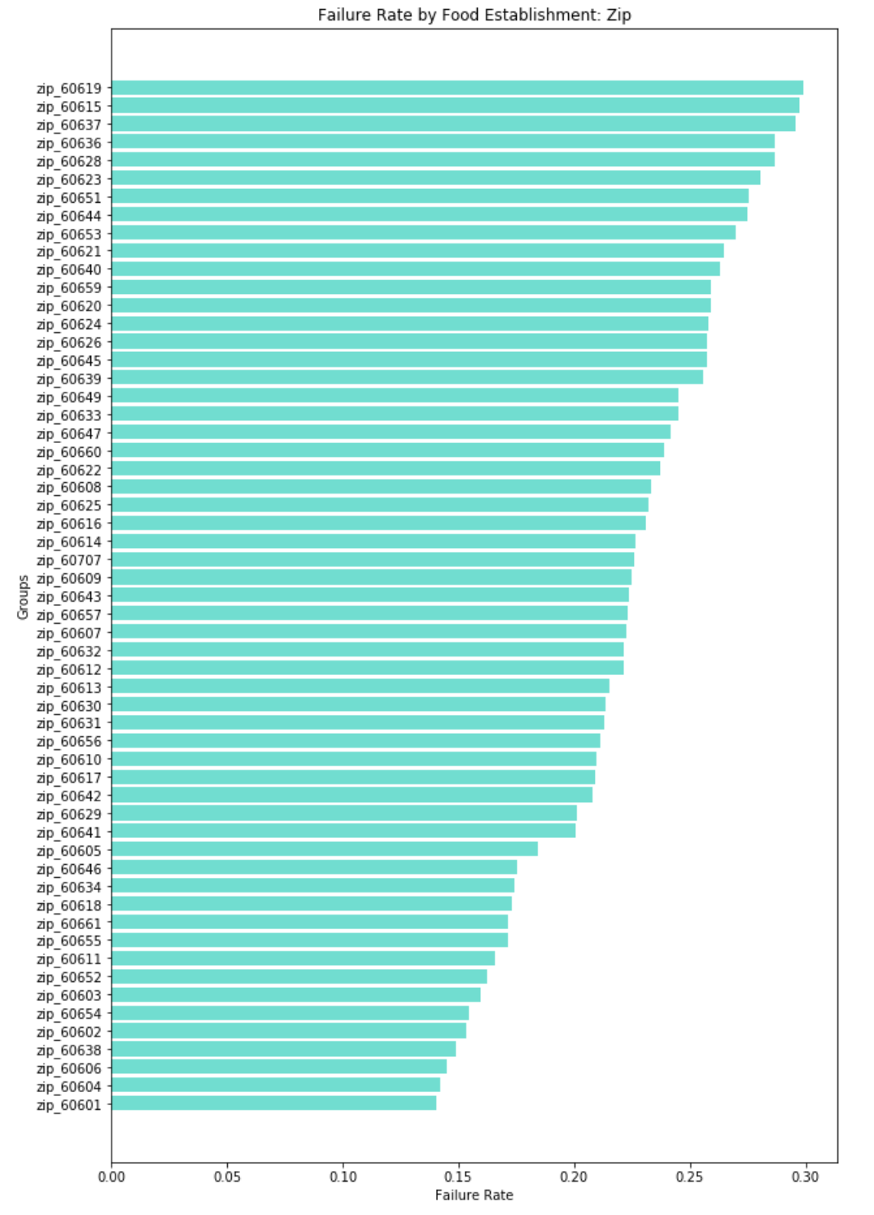
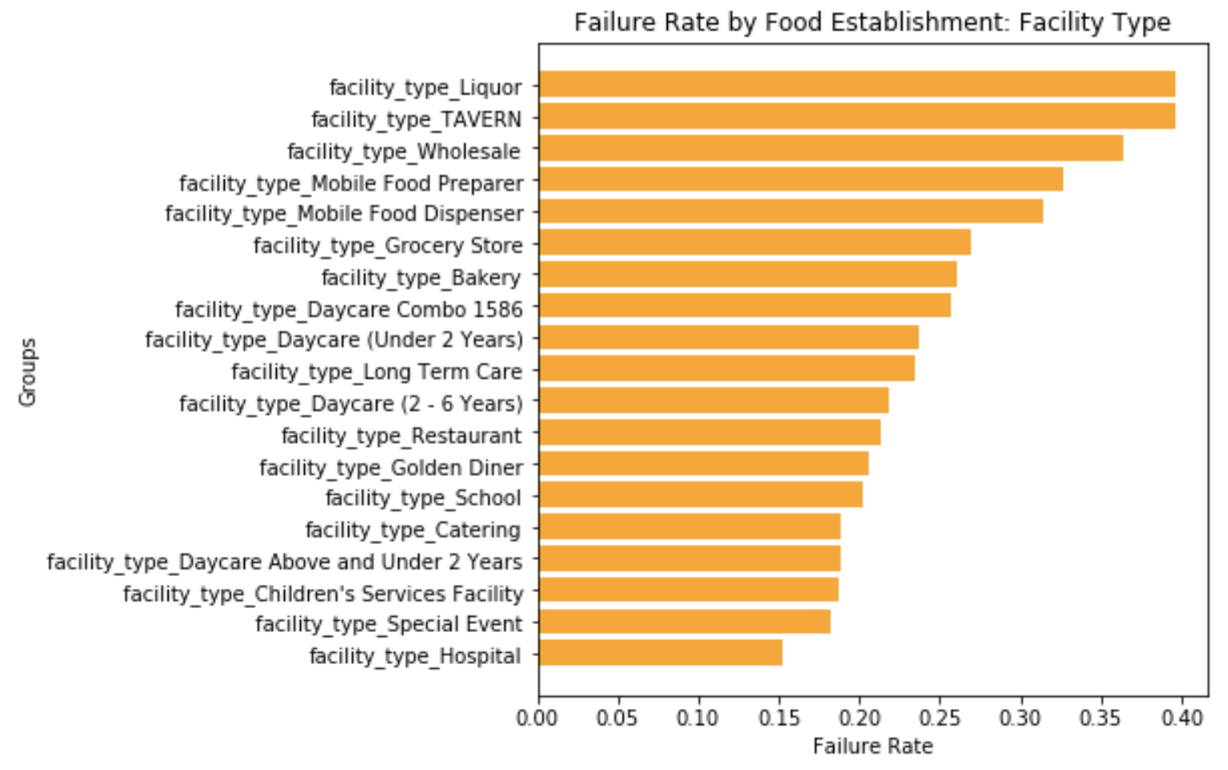
Failure Rates by Zip (Q2)
Failure Rates by Facility Type (Q1)

Slide 5
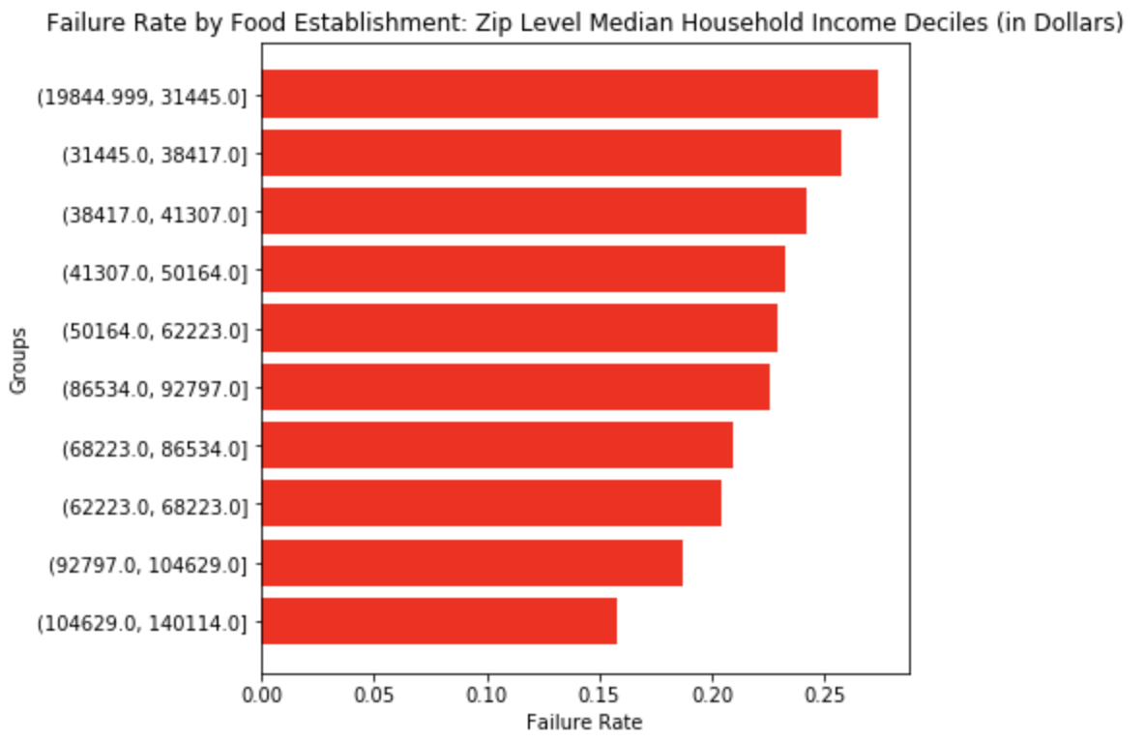
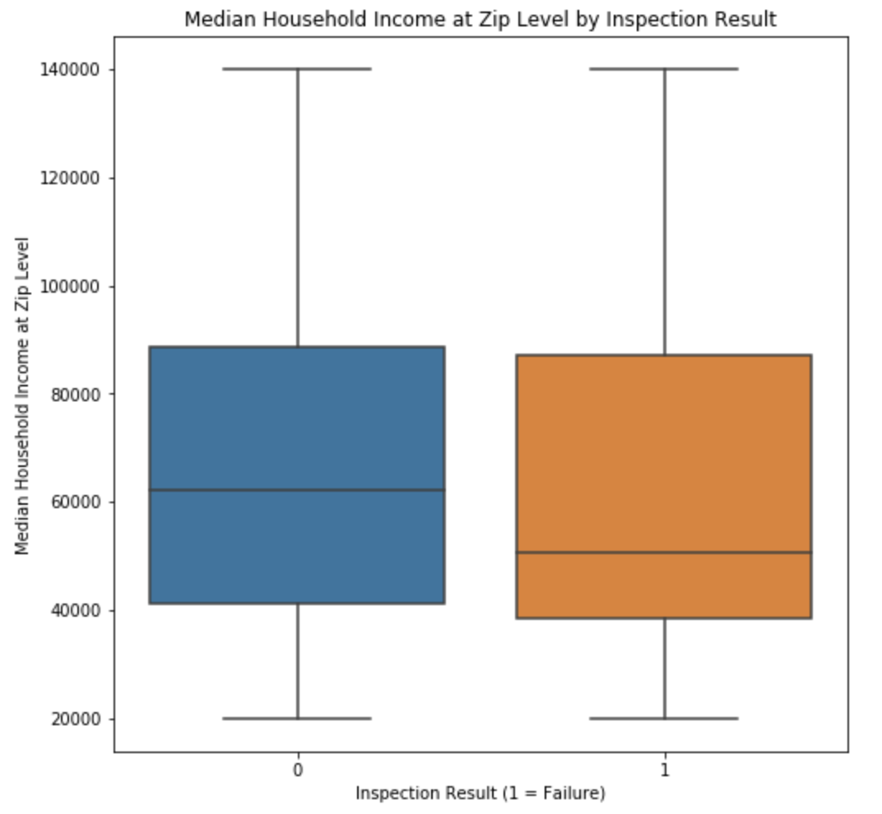
Failure Rates by Median Household Income Group
Median Household Income at Zip Level by Inspection Result
(H1)

Slide 6
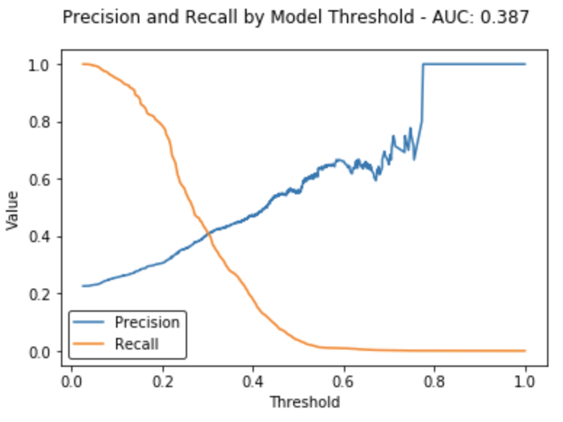
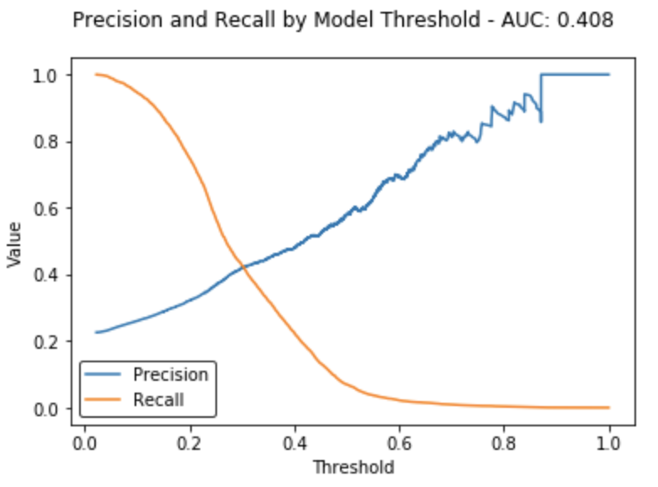
Classifier Performance
The response rate is ~22% with accuracy ~78%, so precision (actual failures out of predicted failures) and recall (rate of failures captured) are a bit more informative.
Lasso Logistic Regression
XGBoost

Slide 7
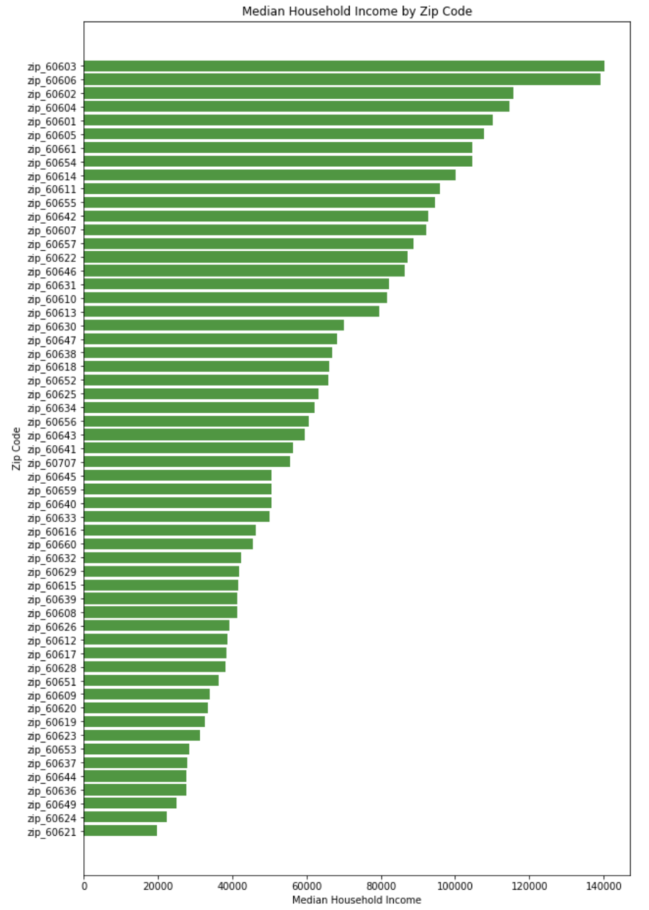
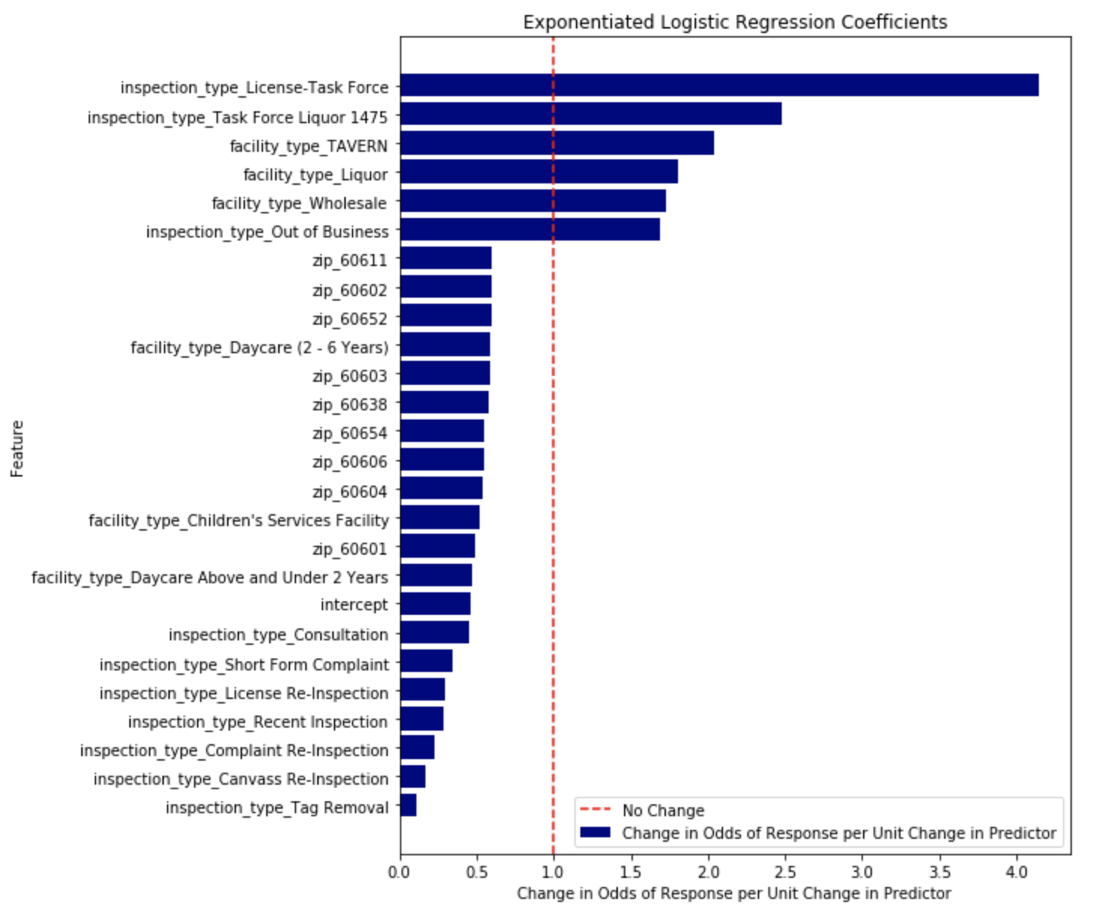
Most Predictive Features from the Lasso Model without Median Household Income
(H1)
Median Household Income by Zip
Exponential Logistic Regression Coefficients
Only top predictors from full Lasso model shown: abs(coefficient) > 0.5
PR AUC is about the same as with median household income included: delta < 0.01
Protective zip code predictors are among the highest by median household income

Slide 8
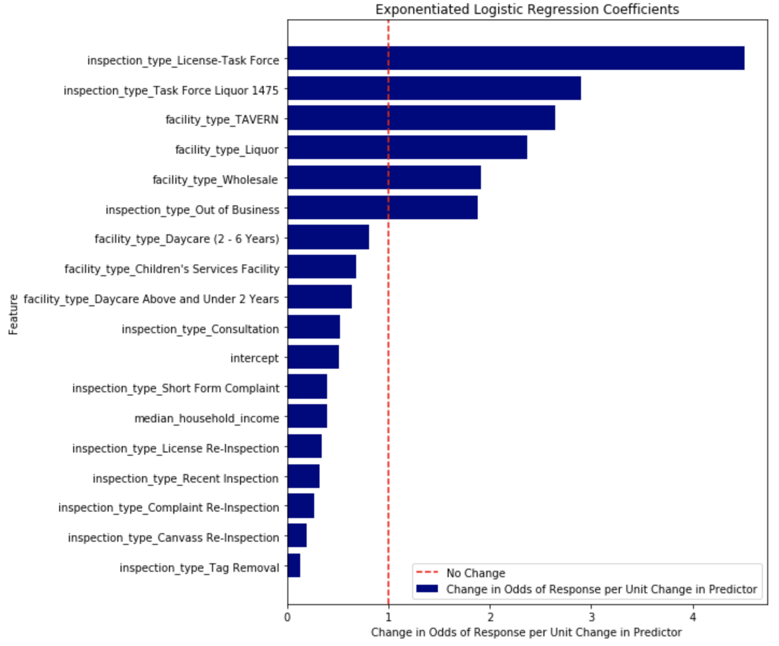
Refitting with Predictive Features to Measure Effects and Controlling for Median Household Income
(H1)
Only top predictors: abs(coefficient) > 0.5 from full Lasso model included in new Logistic Regression model with no penalization
All features statistically significant with p < 0.001
0.322 PR AUC vs 3.87
With household income included, zip features are no longer among the most predictive

Slide 9
Reflection
Median household income dominates zip, latitude, and longitude in the regression model
Would we want to classify food establishments as likely to fail based on median household income? (No)
Can other variables be included, from census data or otherwise, to identify factors that contribute to failing inspections in an effort to:
Increase precision and recall
Ensure that aspects related to food safety and the quality of the food preparation environment are driving predictions

Slide 10
Appendix

Slide 11
Definitions
RR: ratio of the probability of the outcome in the exposed group to the probability of the outcome in the unexposed group
RR = (exposed cases / (exposed cases + unexposed cases)) / (exposed controls / (exposed controls + unexposed controls))
OR: ratio of the odds of being exposed as a case to the odds of being exposed as a control
OR = (exposed cases / unexposed cases) / (exposed controls / unexposed controls)

