Slide 1
Operating Systems - Project 1
Jordan Strine, Amal Allas A Alqahtani, Ngoc Lan Anh Nguyen

Slide 2
Problem 1: Classic CPU Scheduling Algorithms
Requirements: Implement the following fundamental CPU scheduling algorithms
First-Come, First-Served (FCFS)
Shortest Job First (SJF)
Shortest Time-to-Completion First (STCF)
Round Robin (RR)
Input Specifications:
N, where N is the number of processes expected
Pid, arrival_time, run_time; properties of a process needed for analysis.

Slide 3
Challenges
The core challenges of this problem were managing complex data structures to handle the list of processes that were input, and the queues created and populated by the 4 different algorithms. Developing the logic criteria for each of the algorithms also created complications as the variables to consider increased in number as the algorithms became more complex.
Round robin scheduling in particular required management of two different queues that had to stay in sync, as well as consideration of 3 different boolean checks.

Slide 4
Solutions
Creating copies vs passing pointers to protect the source of truth
Defining structs to have the same expected behavior across algorithms
Structs allow us to track and manage the multiple variables necessary to correctly process the different logic criteria.
Expanding from least to most complex implementations allowed for solutions to be built up on top of one another.

Slide 5
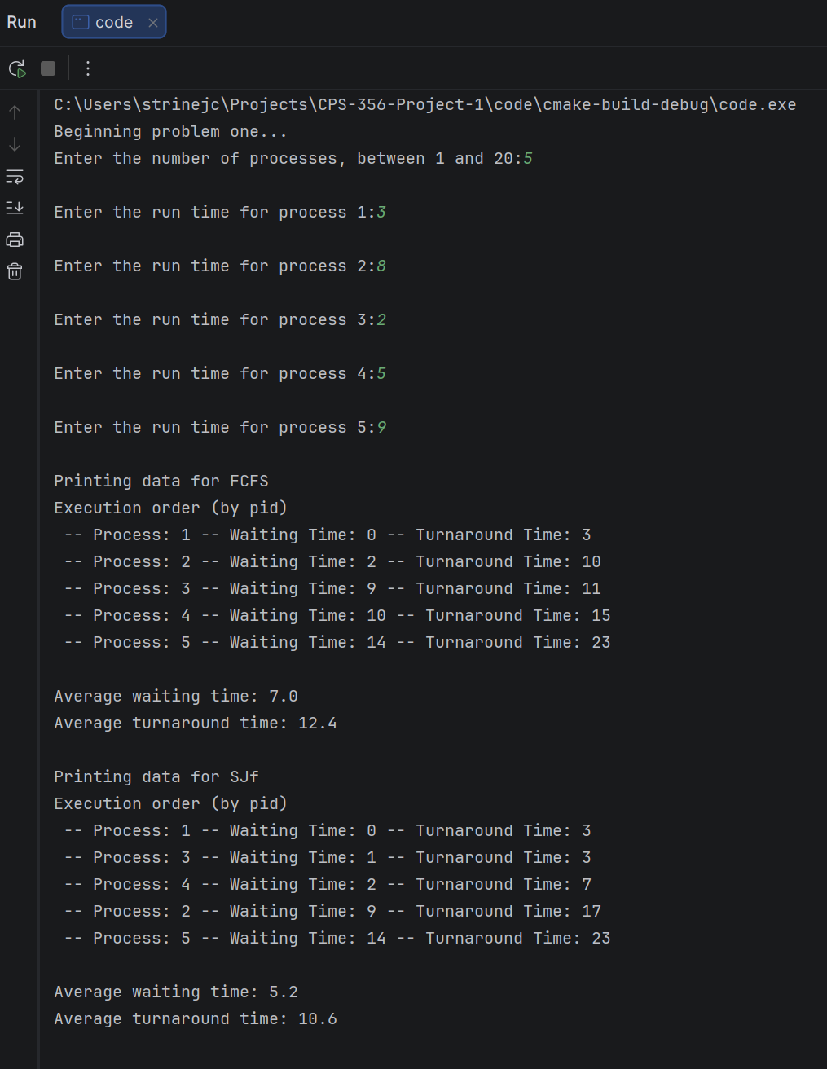
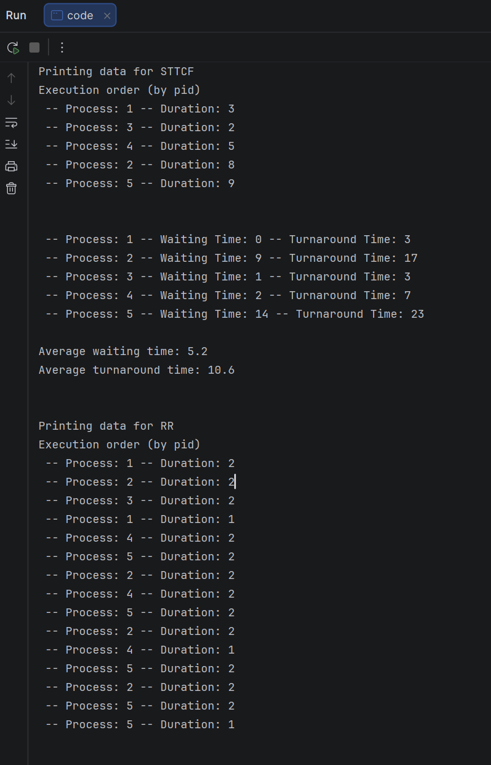
Results

Slide 6
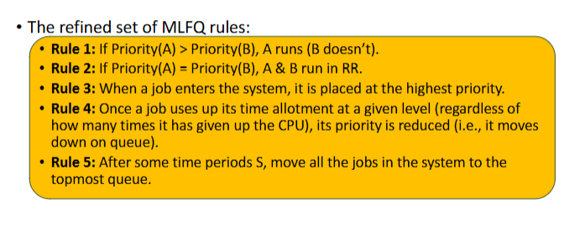
Problem 2 - The Multilevel Feedback Queue
Challenges
In MLFQ scheduler, the priority is dynamic and changes based on processes behavior.
Gantt chart generated
  Time management
    Time allotment
    Time period
Resource: 05.SchedulingMulti-level_Feedback_Queue.pdf
Notes:
In MLFQ scheduler, the priority is dynamic and changes based on processes behavior => Because of this inconsistency in priority, the challenge is to maintain and keep checking the priority of each processes.
The time allotment: keep track

Slide 7
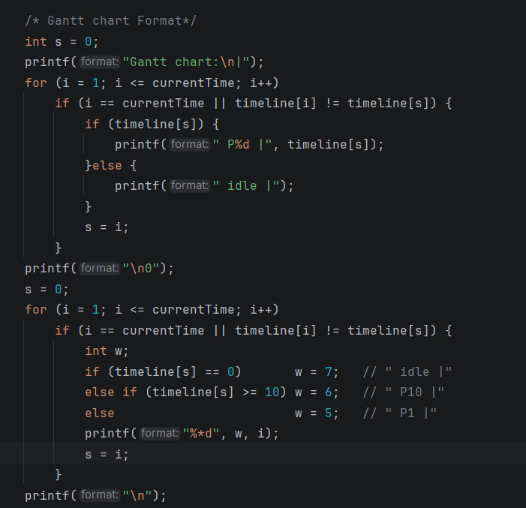
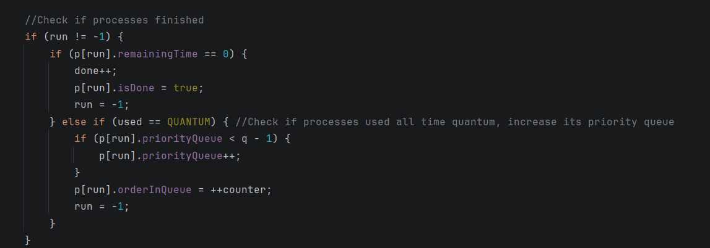
Solution
Have a big loop condition to keep track of time allotment and time period. Immediately updated priority queue and order in queue when demoted.
Gantt Chart generated
  Stored every data required to generate a Gantt chart
    Having separated timeLine to stored data
  Format it using a for loop to run from 0 to currentTime

Slide 8
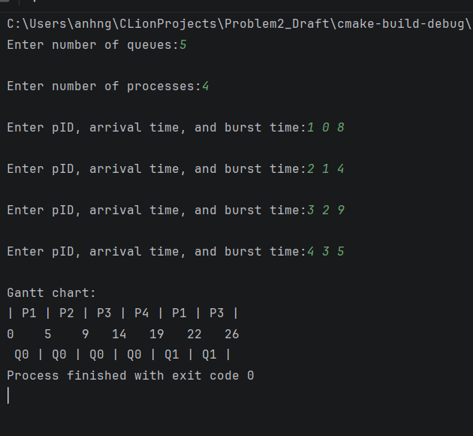
Result

Slide 9
Problem 3
Multiprocessor Scheduling with Work Stealing
-Amal Alqahtani

Slide 10
Multiprocessor Scheduling with Work Stealing
Requirements:
Implement a multiprocessor CPU scheduling simulation.
Manage processes across multiple CPUs.
Maintain scheduling queues for each CPU.
Implement work stealing to balance workloads.
Track process execution and completion.
Goal: Improve CPU utilization by allowing idle processors to take work from busy processors.

Slide 11
Challenges
Managing multiple CPU queues simultaneously.
Keeping track of processes assigned to each CPU.
Determining when an idle CPU should steal work.
Preventing incorrect process execution or duplication.
Maintaining accurate scheduling and completion times.
Biggest Challenge: Coordinating process execution and workload balancing across multiple CPUs.

Slide 12
Solutions
Used C structs to store process and CPU information.
Assigned processes to CPUs using round-robin distribution.
Implemented First-Come, First-Served (FCFS) scheduling for each CPU queue.
Allowed idle CPUs to steal waiting processes from the busiest CPU queue.
Used a single-threaded simulation to manage scheduling events and track performance.
Approach: Built the scheduling logic step by step and tested work stealing using different process inputs.

Slide 13
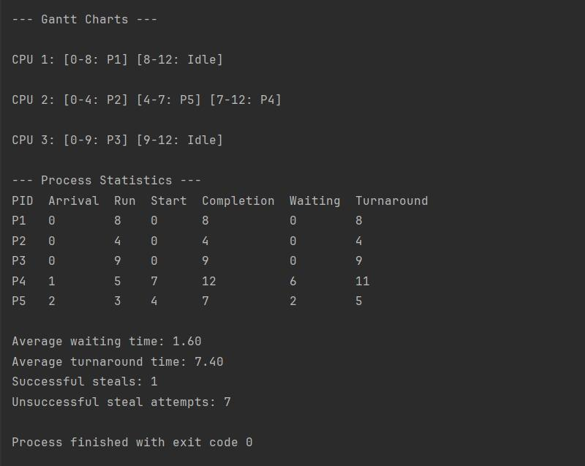
Results
Successfully simulated scheduling across 3 CPUs.
Demonstrated work stealing when CPU 2 took Process 4 at time 7.
Average waiting time: 1.60 units
Average turnaround time: 7.40 units
Successful steals: 1
Unsuccessful steal attempts: 7
Outcome: Demonstrated how work stealing can redistribute waiting processes across CPUs.
Outcome: Demonstrated how work stealing can redistribute waiting processes across CPUs.

Slide 14
Contribution
Problem 1: Jordan Strine
Problem 2: Ngoc Lan Anh Nguyen
Problem 3: Amal Allas A Alqahtani

