Slide 1
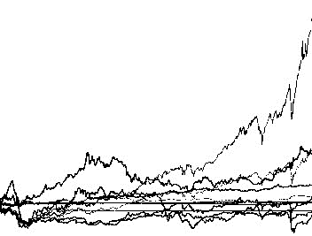
5
Investment replica
Business case 4 – Fintech Ferrari I. – Fiecchi S. – Stringara J. – Venturini G.

Slide 2
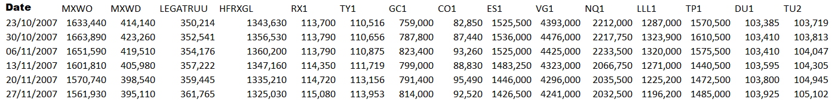
INRODUCTION
A quick overview of data
We are given a dataset of financial data representing the HFRX Index, the MSCI World Index, the MSCI World All Country Index, the Barclays Bloomberg Global Aggregate Bond Index and a range of Futures contracts on equity indices, benchmark bonds, currencies and commodities.
There is a secret portfolio which publicly reports its returns weekly. The system is completely black box, we do not know either which instruments the portfolio contains or what weight each instrument has.
Our aim was that of guessing what is inside the black box and replicate that portfolio.
INVESTMENT REPLICA FINTECH BC 4

Slide 3
PIPELINE
Data exploration
Replica of a target portfolio
- Comparison of different rolling windows and alphas
- Financial statistics
VaR
-
-
INVESTMENT REPLICA FINTECH BC 4
Preprocessing & Feature selection:
Rendiamo i dati stazionari
Selezioniamo le feature tramite uno studio di correlazione (No PCA perché si basa sulla varianza)
Classification:
Supervised (KNN with Naive oversampling)
Unsupervised (Kmeans and Hierarchical Clustering)
Copule (Non so come scriverlo)
Strada alternativa: Autoencoder con ANN (Jacopo dimmi tu come inserirlo)

Slide 4
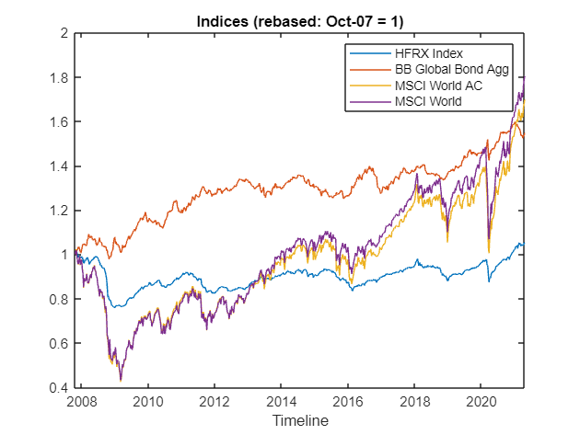
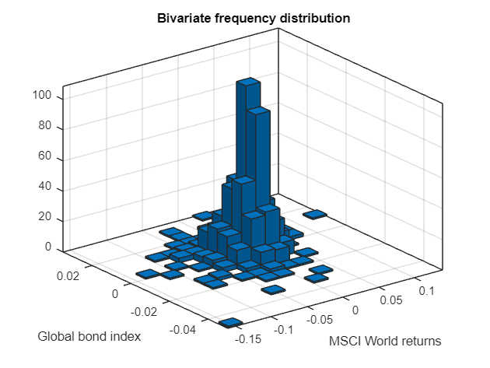
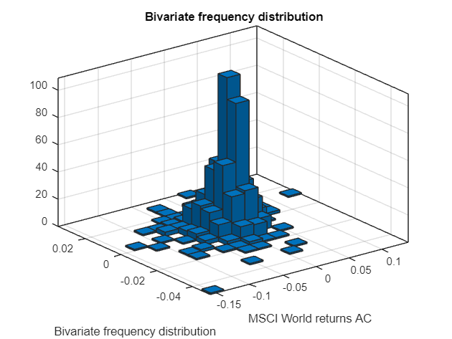
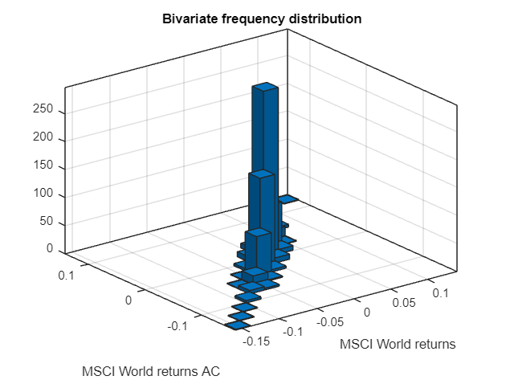
DATA EXPLORATION
Creation of a Monster Index
We begin with the plot of time series of HFRX Index versus global equities and Barclays Bloomber Bond Index. Then, we observe some empirical probability distributions and study correlation between gloabal equities indexes.
Early Warning Systems FINTECH BC 3
INVESTMENT REPLICA FINTECH BC 4

Slide 5
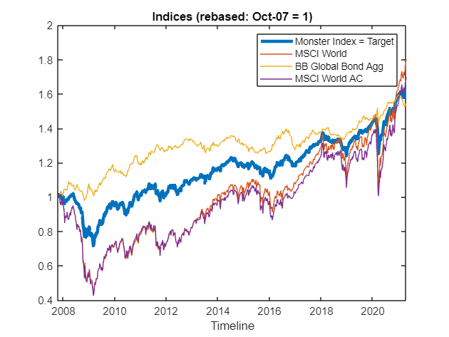
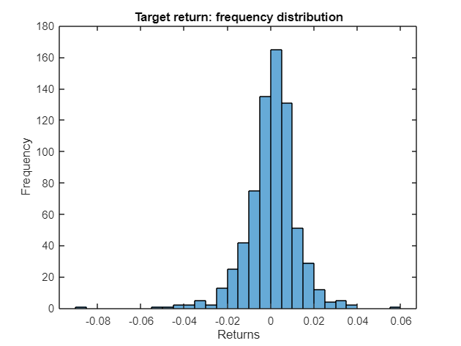
Reducing the number of input variables
REPLICA OF TARGET PORTFOLIO
We create a Monster Index, a weighted index made of MSCI World, MSCI World AC and Barclays Bloomberg Global Aggregate Index. Weights were choosen considering the correlation among global equities indices. We also check the hypothesis of gaussianity by a histogram.
$$0.2∗MXWD+0.2∗MXWO+0.6∗LEGATRUU$$
Early Warning Systems FINTECH BC 3
INVESTMENT REPLICA FINTECH BC 4
Media significativa + grafico

Slide 6
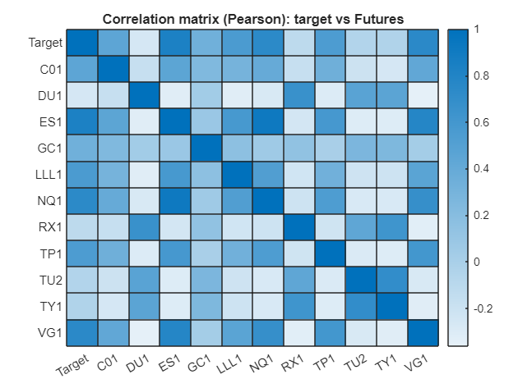
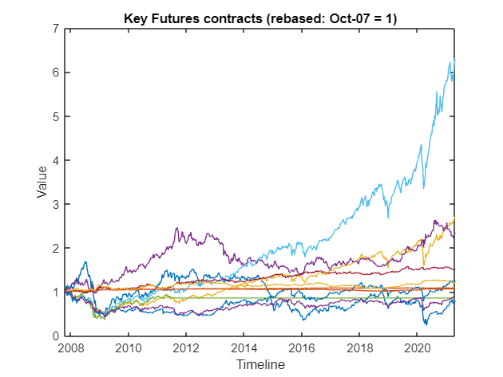
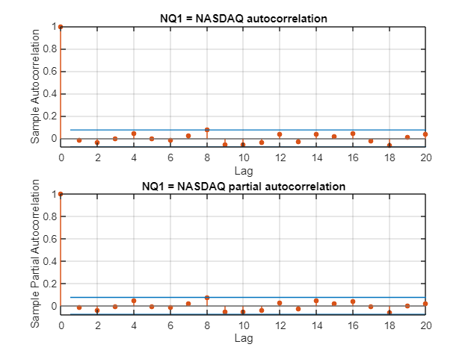
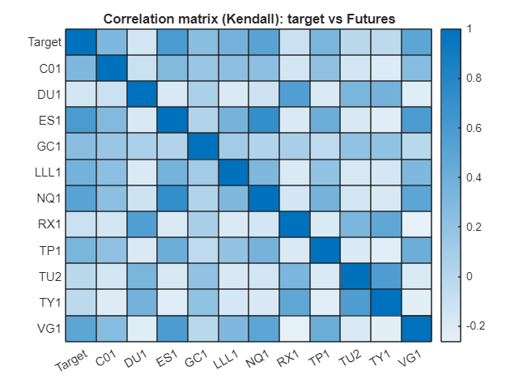
Replicating with Futures
REPLICA OF TARGET PORTFOLIO
Looking at time series of Future contracts, we see that they have heterogeneous paths, so they can be used to replicate our Monster Index. Furthermore, we get a look at correlation among variables, both linear and rank-correlation ( Pearson and Kendall ), willling to feature selection. Then we plot Autocorrelation and partial autocorrelation of some indeces.
Early Warning Systems FINTECH BC 3
INVESTMENT REPLICA FINTECH BC 4
Media significativa + grafico

Slide 7
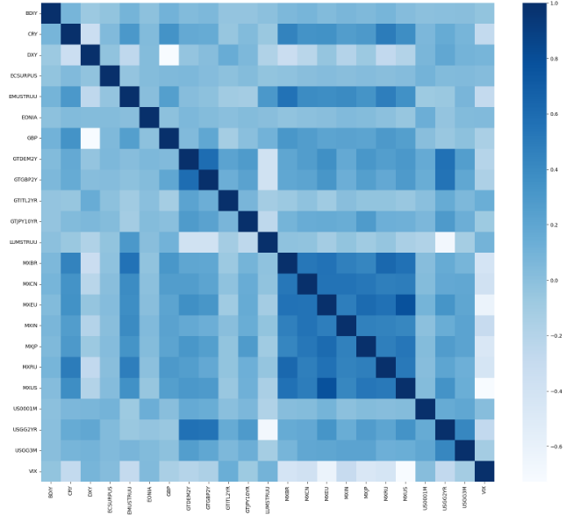
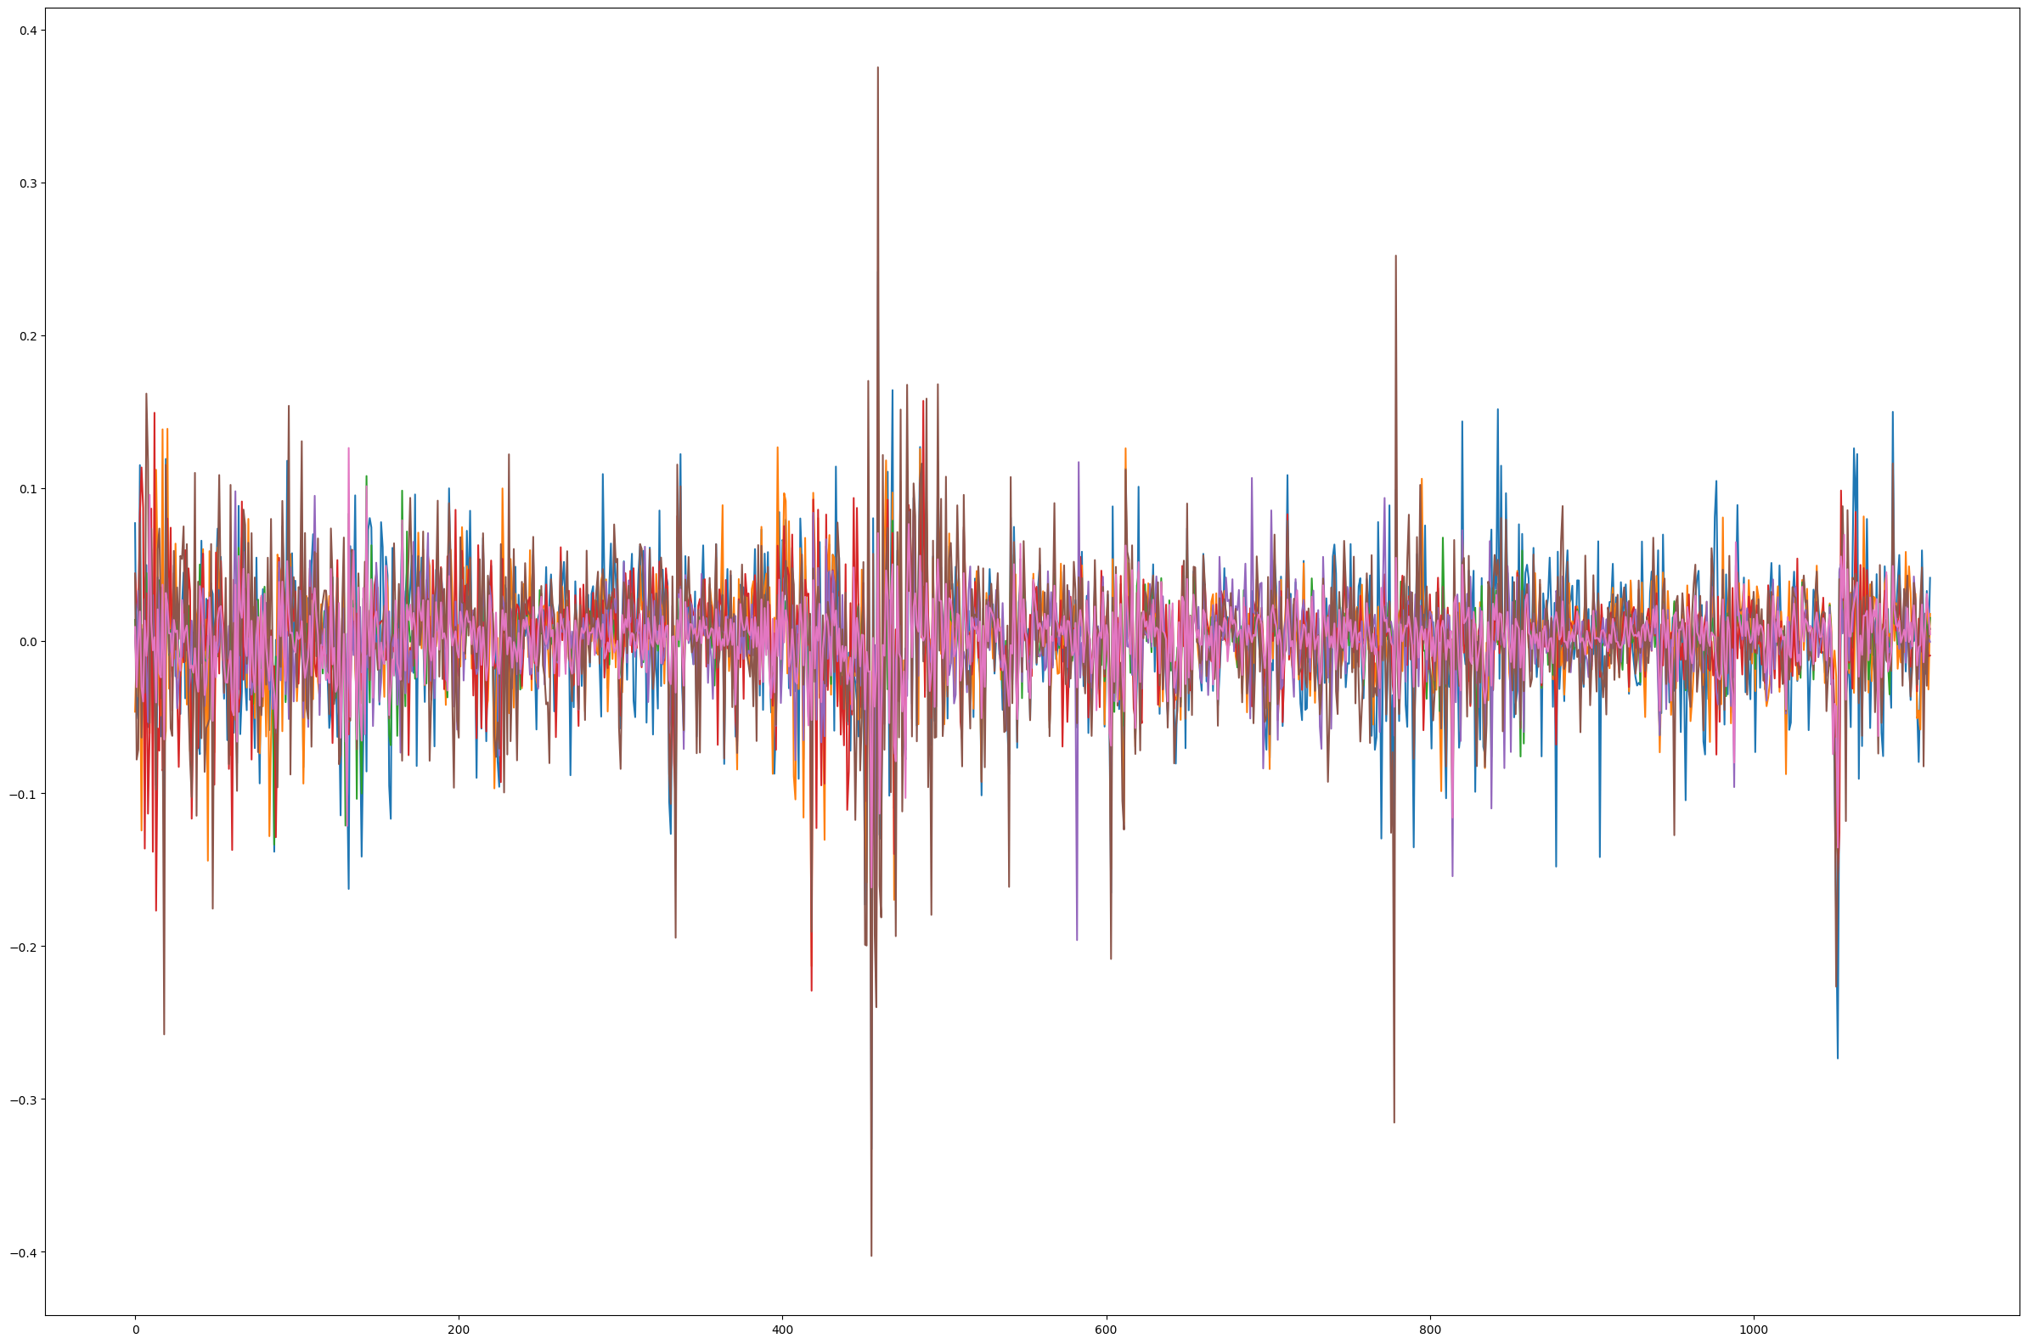
Reducing the number of input variables
FEATURE SELECTION
We can remove other variables observing correlations. We end with 23 stationary and significant variables.
PCA was not possible as it is based on variance.
Early Warning Systems FINTECH BC 3
Ad occhio con studio di correlazione (se serve due slides)

Slide 8


We let the software analyse
UNSUPERVISED CLASSIFICATION
We initialize the Kmeans objects for two clusters and fit to the selected variables obtaining the labels and the following confusion matrix
Then we performe a hierarchical clustering, plotting the dendrogram to determine the optimal number of clusters. Then, we cut at the desired number.
We can, then, compare the two confusion matrices.
Kmeans
Hierarchical clustering
Early Warning Systems FINTECH BC 3
Clusteriamo e vediamo se ha beccato i due gruppi
Ultra sbilanciato

Slide 9
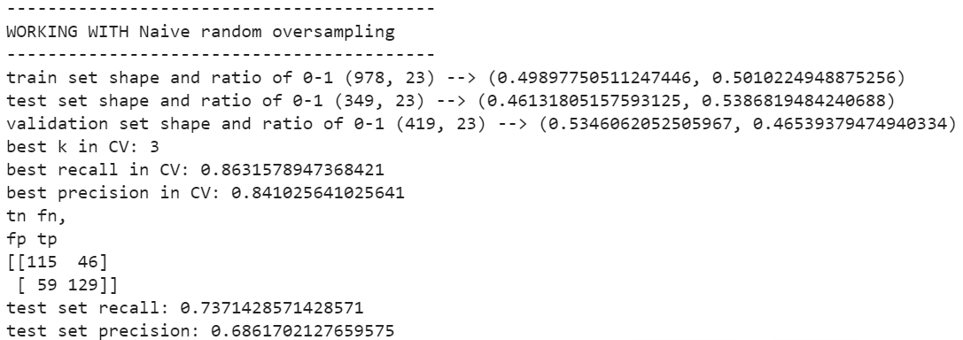
SUPERVISED CLASSIFICATION
We tried a naive Oversampling: Number of new anomalies added: 636
NROS has added 268.354% more anomalies New ratio of 0-1: {0: 0.5, 1: 0.5}
At this point, we used a K-Nearest Neighbours algorithm, obtaing the following results:
We then tried an Isolation Forest, which seems to be too unbalanced
Early Warning Systems FINTECH BC 3

Slide 10
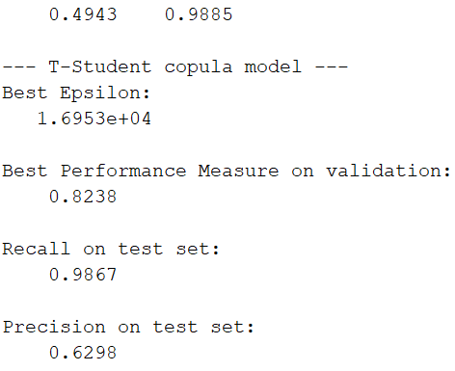
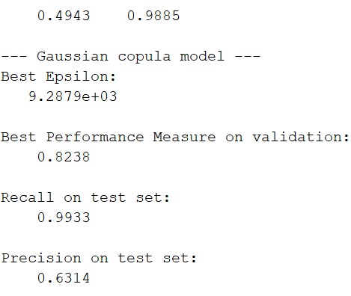
COPULAS
We tried to detect anomalous data by means of copula
We chose at first the t-student distrubtion, obtaining the following results
Then, we tried the Gaussian distribution, and obtained
In both cases, the results seems good in terms of recall.
But we’re aware there’s still the problem of unbalanced data.
Early Warning Systems FINTECH BC 3

Slide 11
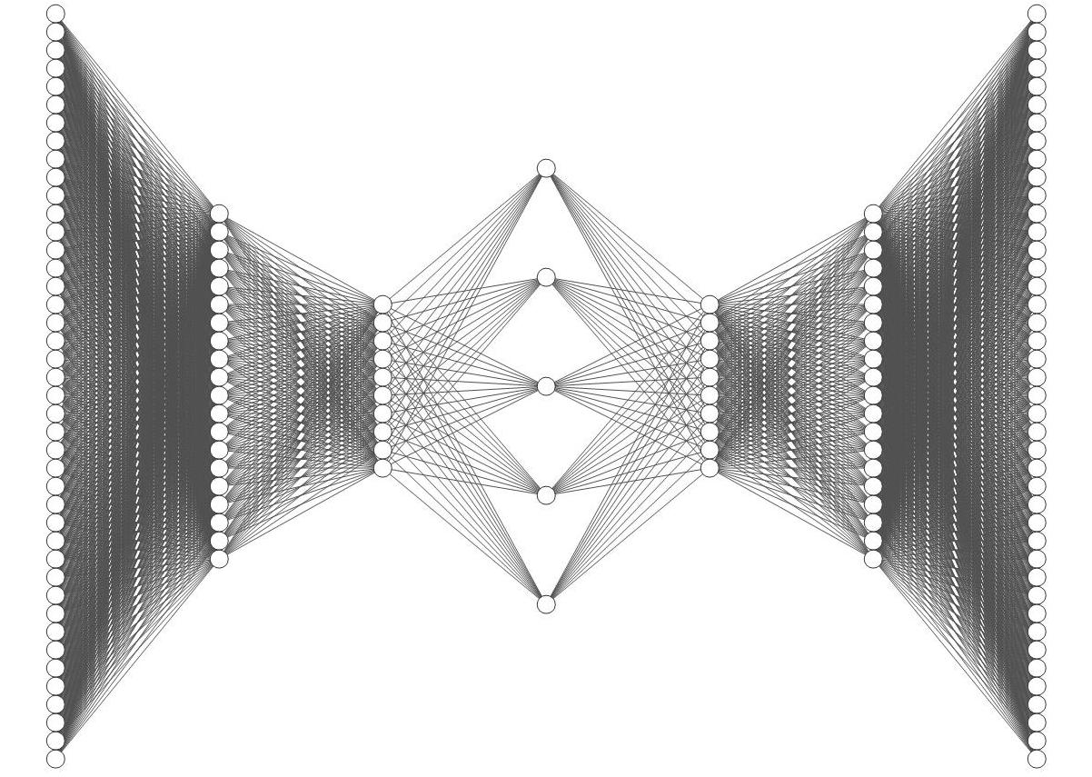
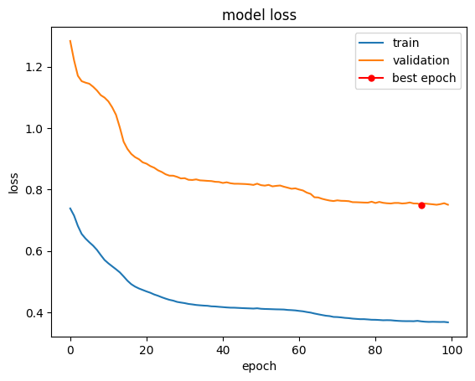
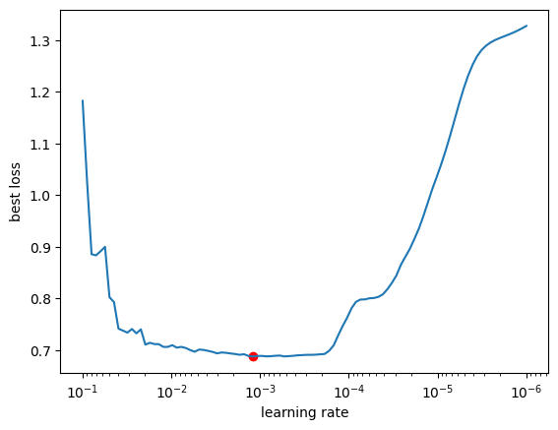
AUTOENCODER
We tested 100 LR’s and select the one with the lowest validation loss
Best Learning rate: 0.0012
Early Warning Systems FINTECH BC 3

Slide 12
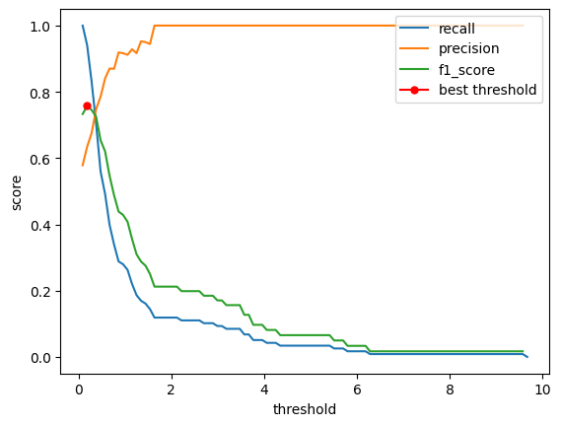
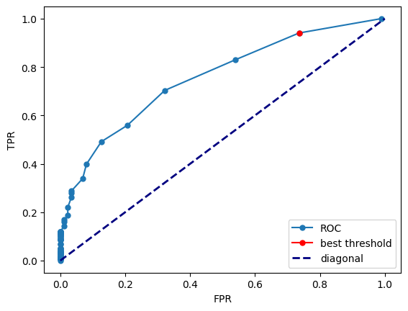
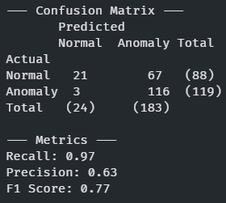
MODEL EVALUATION
Best threshold
We select the best threshold based on the F1 score
AUC score: 0.743
Best threshold: 0.1846
Results
We obtain the following results:
Recall 0.97: we are correctly identifying almost all the anomalies
Precision 0.63: we are misidentifying many normal days
Early Warning Systems FINTECH BC 3

Slide 13
NEXT STEPS
Since the dataset is unbalanced, we can try multiple techniques of oversampling (such as Smote)
Try to use different criteria in the feature selection
Early Warning Systems FINTECH BC 3

