Slide 1
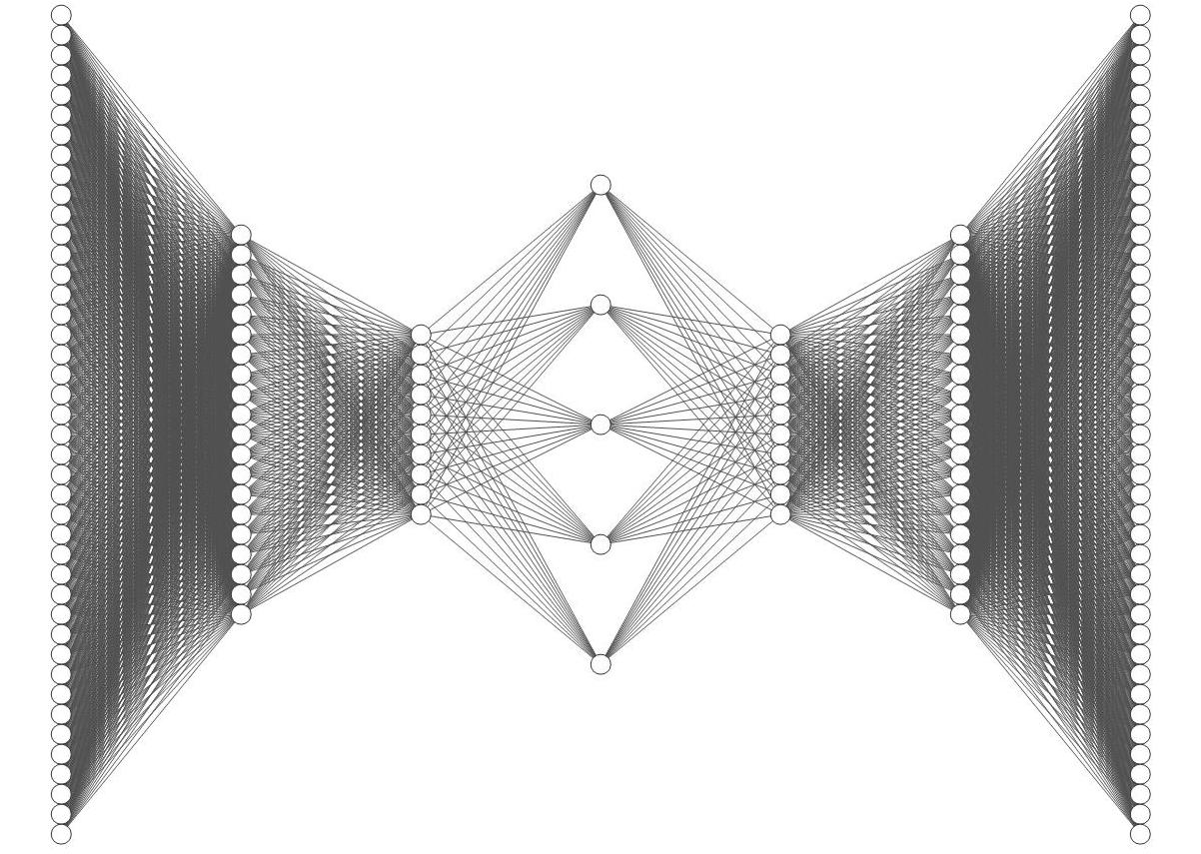
Anomaly Detection
Business case 3 – Fintech Ferrari I. – Fiecchi S. – Stringara J. – Venturini G.

Slide 2
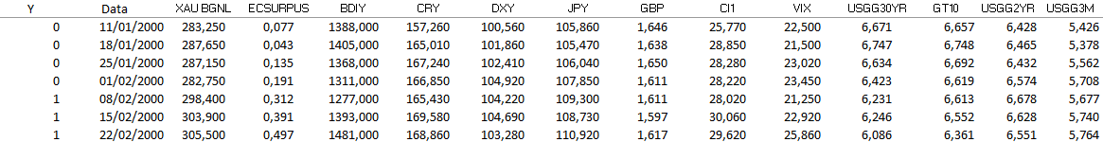
INRODUCTION
A quick overview of data and Anomaly Detection
We are given a dataset of financial data, representing a broad spectrum of financial variables, as interest rates, bond yields, bond indices, currencies, and so on. Those data are taken from Bloomberg, covering a period from January 2000 to April 2021, reporting weekly data in local currency.
The dataset contains a response variable Y which indicates if we are in a risk-off ( Y = 1 ) or risk-on ( Y = 0 ) period.
Our aim was that of creating an Early System based on Anomaly Detection, in order to identify a crisis at its early stage.
Early Warning Systems FINTECH BC 3

Slide 3
PIPELINE
Processing & Feature selection
Unsupervised classification
- Kmeans and Hierachical Clustering
Supervised classification
- KNN with Naive oversampling
- Copulas
Autoencoder
- Model evaluation
Early Warning Systems FINTECH BC 3
Preprocessing & Feature selection:
Rendiamo i dati stazionari
Selezioniamo le feature tramite uno studio di correlazione (No PCA perché si basa sulla varianza)
Classification:
Supervised (KNN with Naive oversampling)
Unsupervised (Kmeans and Hierarchical Clustering)
Copule (Non so come scriverlo)
Strada alternativa: Autoencoder con ANN (Jacopo dimmi tu come inserirlo)

Slide 4
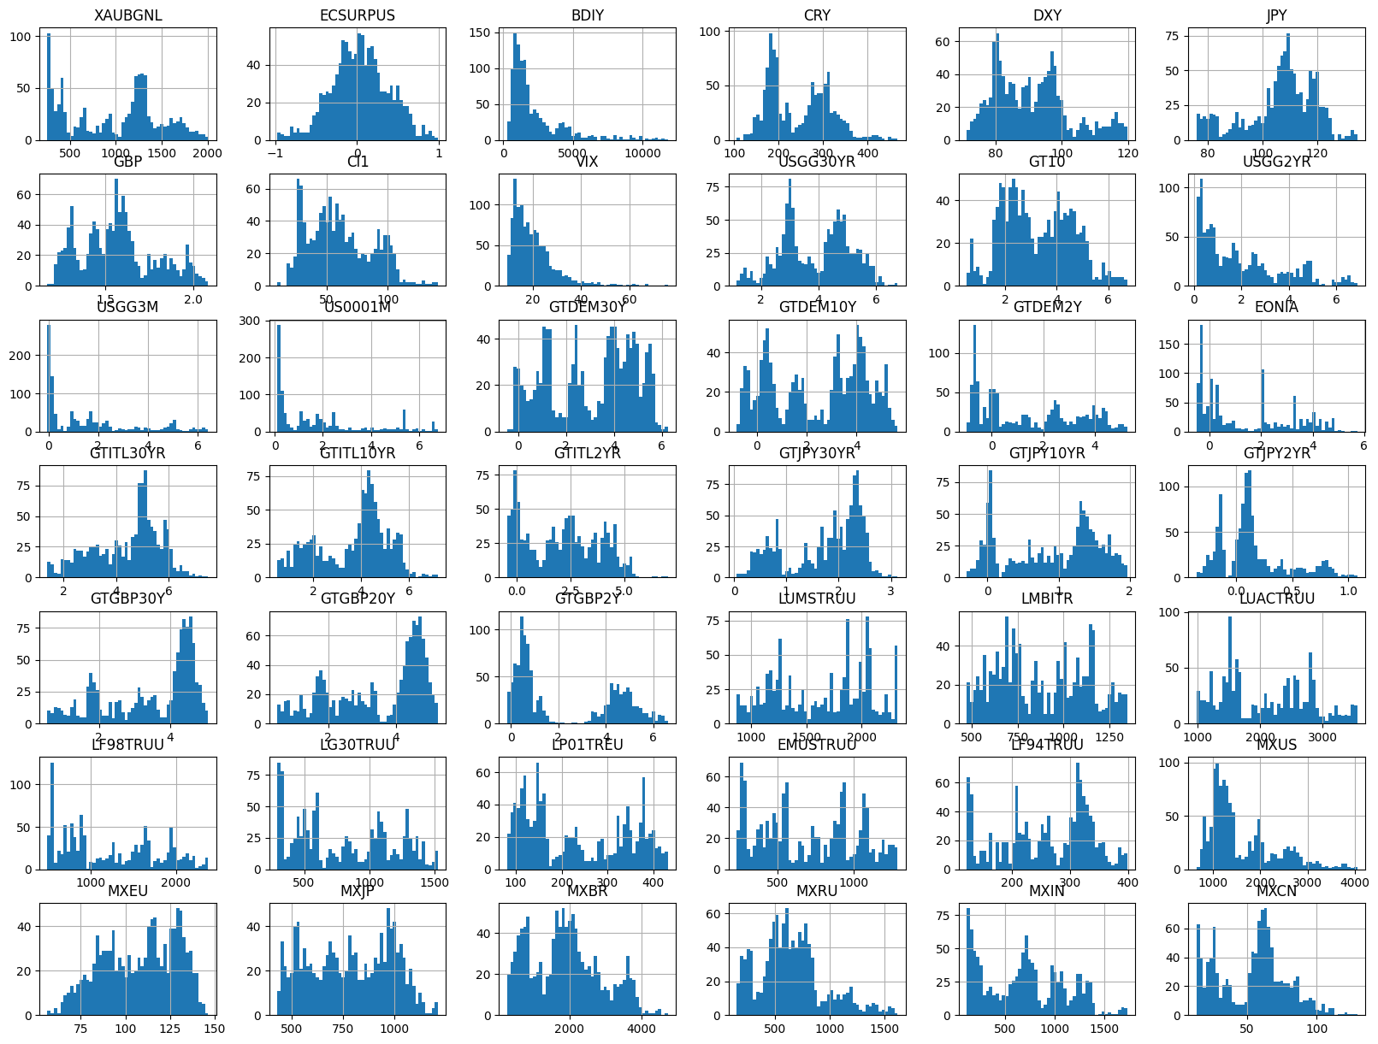
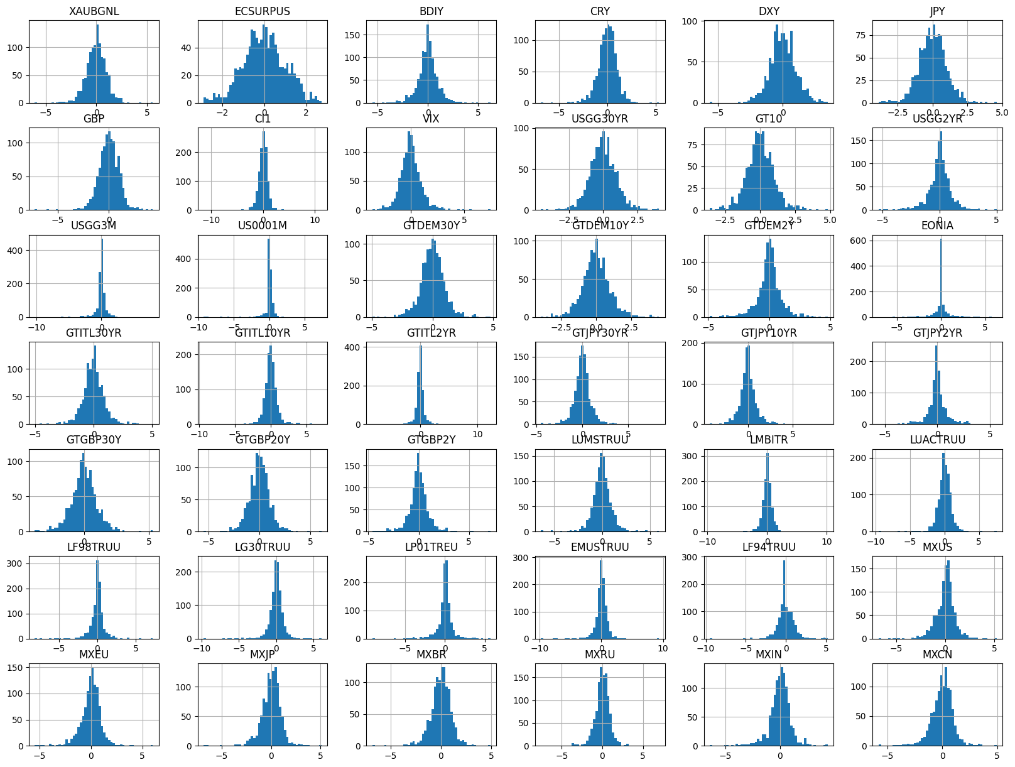
PREPROCESSING
Before proceeding we have to process our data
We load the data from ‘EWS.csv’, take the first column as Y and the rest as X. We convert the ‘Data’ column to int and maintain the others as floats. For always positive data we take logarithmic differences, otherwise just the difference, dropping the NaN values and normalize by zscoring.
Early Warning Systems FINTECH BC 3

Slide 5
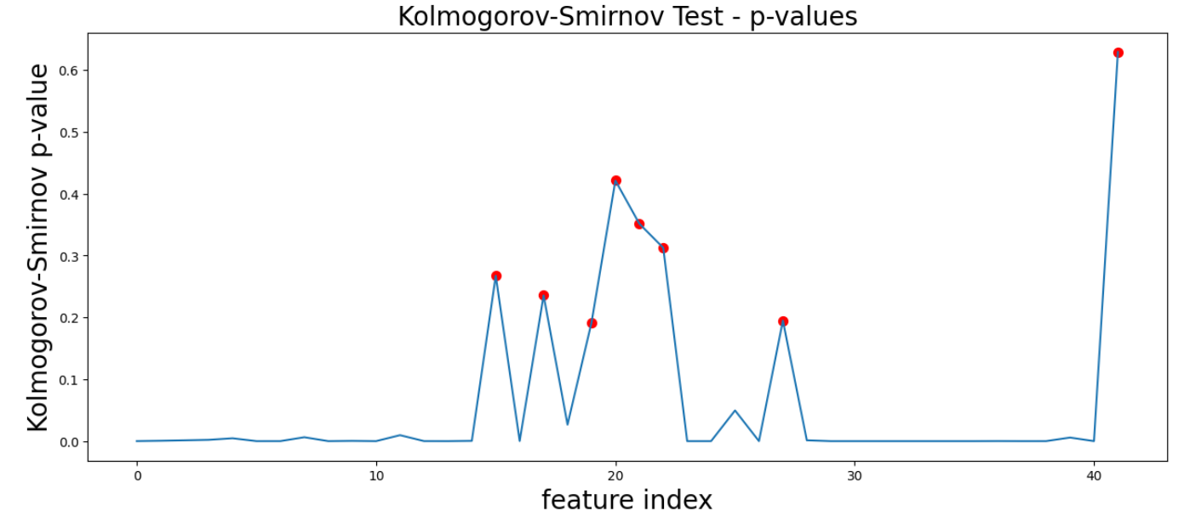
Reducing the number of input variables
FEATURE SELECTION
By means of a K-S Test we remove those variables with a non-significant mean difference between risk-periods.ù
The returned features with high p-valus are ‘GTITL30YR’, ‘GTJPY2YR’, ‘GTJPY30YR’, ‘JPY’, ‘LF94TRUU’, ‘LUACTRUU’ and ‘XAUBGNL’.
Early Warning Systems FINTECH BC 3
Media significativa + grafico

Slide 6
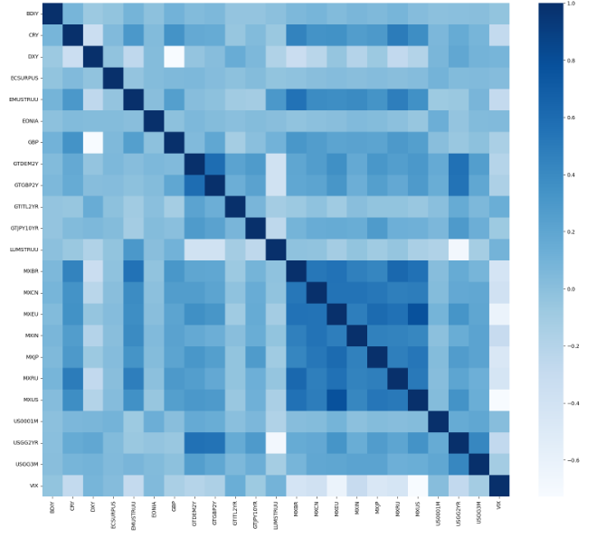
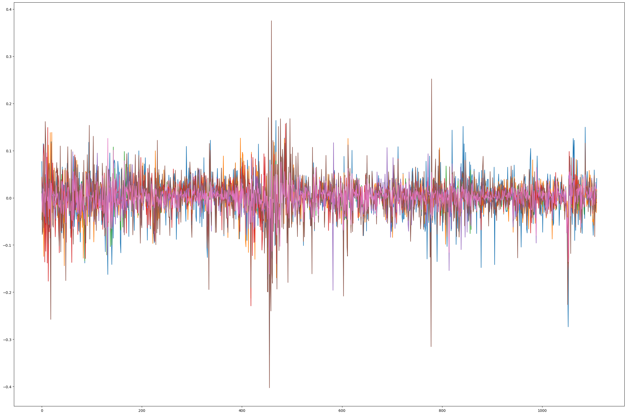
Reducing the number of input variables
FEATURE SELECTION
We can remove other variables observing correlations. We end with 23 stationary and significant variables.
PCA was not possible as it is based on variance.
Early Warning Systems FINTECH BC 3
Ad occhio con studio di correlazione (se serve due slides)

Slide 7
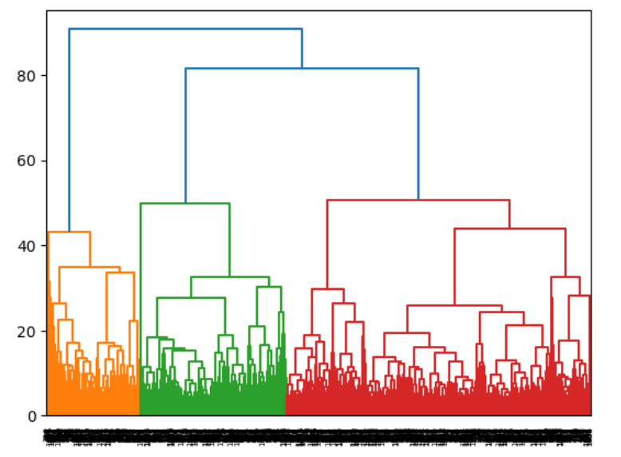


We let the software analyse
UNSUPERVISED CLASSIFICATION
We initialize the Kmeans objects for two clusters and fit to the selected variabled obtening the labels, obtaining the following confusion matrix
Then we performe a hierarchical clustering, plotting the dendrogram to determine the optimal number of clusters. Then, we cut at the desired number.
We can, then, compare the two confusion matrices.
Kmeans
Hierarchical clustering
Early Warning Systems FINTECH BC 3
Clusteriamo e vediamo se ha beccato i due gruppi
Ultra sbilanciato

Slide 8
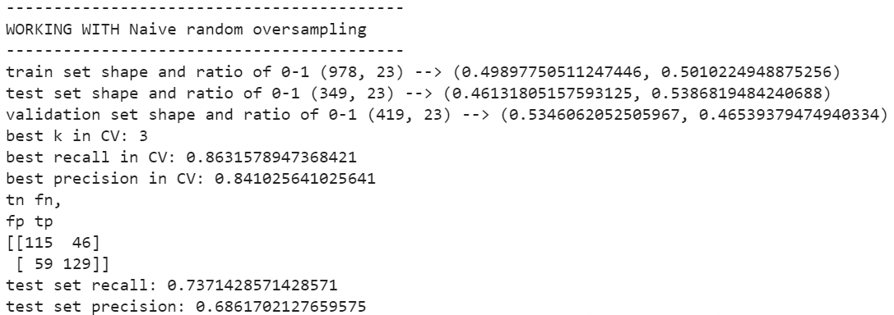
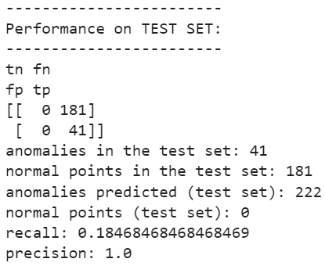
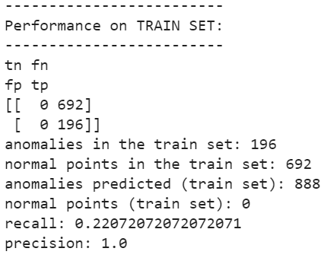
SUPERVISED CLASSIFICATION
We tried a naive Oversampling:
Number of new anomalies added: 636
NROS has added 268.354% more anomalies
New ratio of 0-1: {0: 0.5, 1: 0.5}
We then tried an Isolation Forest, which seems to be too unbalanced
Early Warning Systems FINTECH BC 3

Slide 9
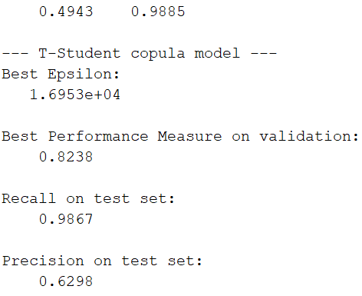
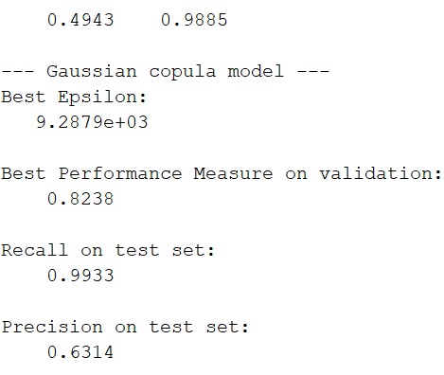
COPULAS
We tried to detect anomalous data by means of copula
We chose at first the t-student distrubtion, obtaining the following results
Then, we tried the Gaussian distribution, and obtained
In both cases, the results seems good in terms of recall.
But we’re aware there’s still the problem of unbalanced data.
Early Warning Systems FINTECH BC 3

Slide 10
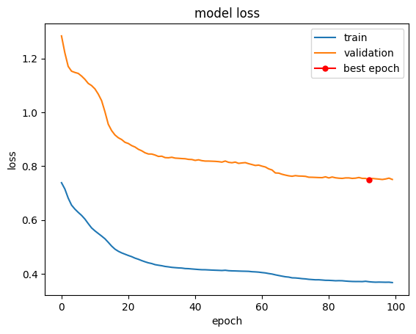
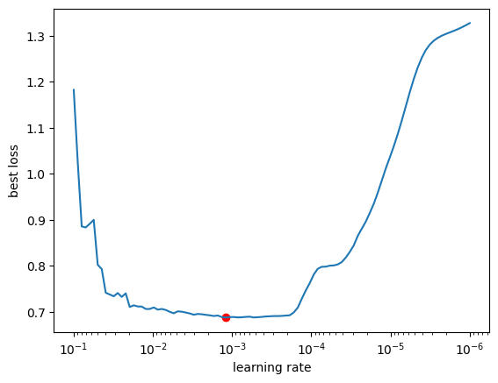
AUTOENCODER
We tested 100 LR’s and select the one with the lowest validation loss
Best Learning rate: 0.0012
Early Warning Systems FINTECH BC 3

Slide 11
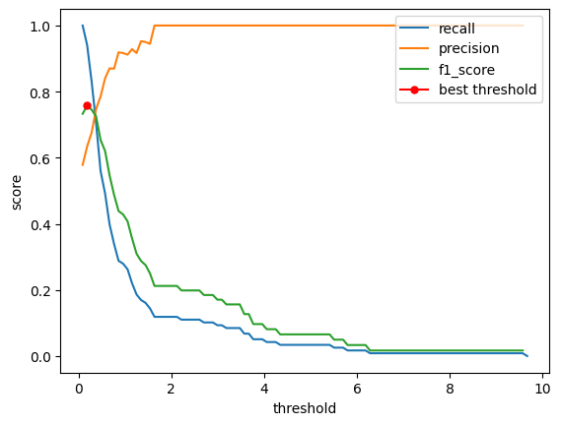
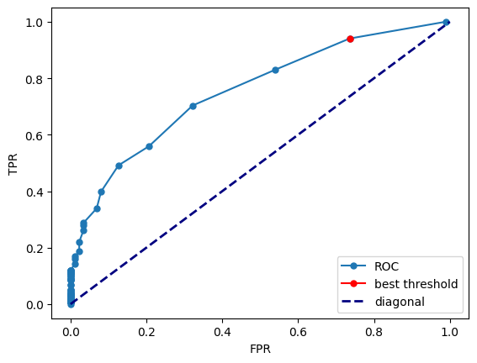
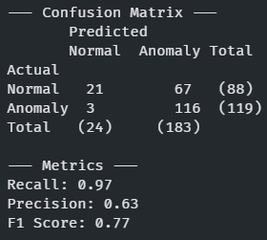
MODEL EVALUATION
Best threshold
We select the best threshold based on the F1 score
AUC score: 0.743
Best threshold: 0.1846
Results
We obtain the following results:
Recall 0.97: we are correctly identifying almost all the anomalies
Precision 0.63: we are misidentifying many normal days
Early Warning Systems FINTECH BC 3

Slide 12
NEXT STEPS
Since the dataset is unbalanced, we can try multiple techniques of oversampling (such as Smote)
Try to use different criteria in the feature selection
Early Warning Systems FINTECH BC 3

