Slide 1
Anomaly Detection

Slide 2
Che dati abbiamo?
I dati che abbiamo

Slide 3
Che Problema dobbiamo risolvere?
Anomaly detection

Slide 4
Pipeline:
Preprocessing & Feature selection:
Rendiamo i dati stazionari
Selezioniamo le feature tramite uno studio di correlazione (No PCA perché si basa sulla varianza)
Classification:
Supervised (KNN with Naive oversampling)
Unsupervised (Kmeans and Hierarchical Clustering)
Copule (Non so come scriverlo)
Strada alternativa: Autoencoder con ANN (Jacopo dimmi tu come inserirlo)

Slide 5
Preprocessing
Stationarization: 2 Grafici

Slide 6
Feature selection
Media significativa + grafico

Slide 7
Feature selection
Ad occhio con studio di correlazione (se serve due slides)

Slide 8
Unsupervised Classification
Clusteriamo e vediamo se ha beccato i due gruppi
Ultra sbilanciato

Slide 9
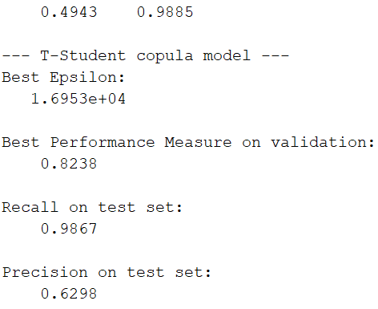
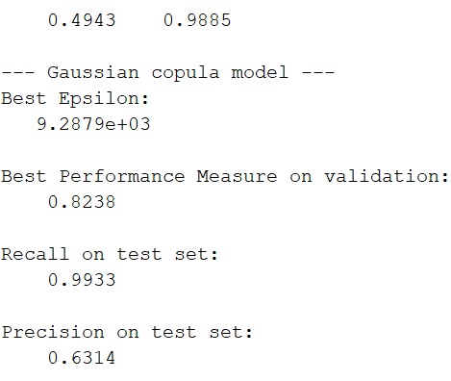
COPULA
We tried to detect anomalous data by means of copula
We chose at first the t-student distrubtion, obtaining the following results
Then, we tried the Gaussian distribution, and obtained
In both cases, the results seems good in terms of recall.
But we’re aware there’s still the problem of unbalanced data.

Slide 10
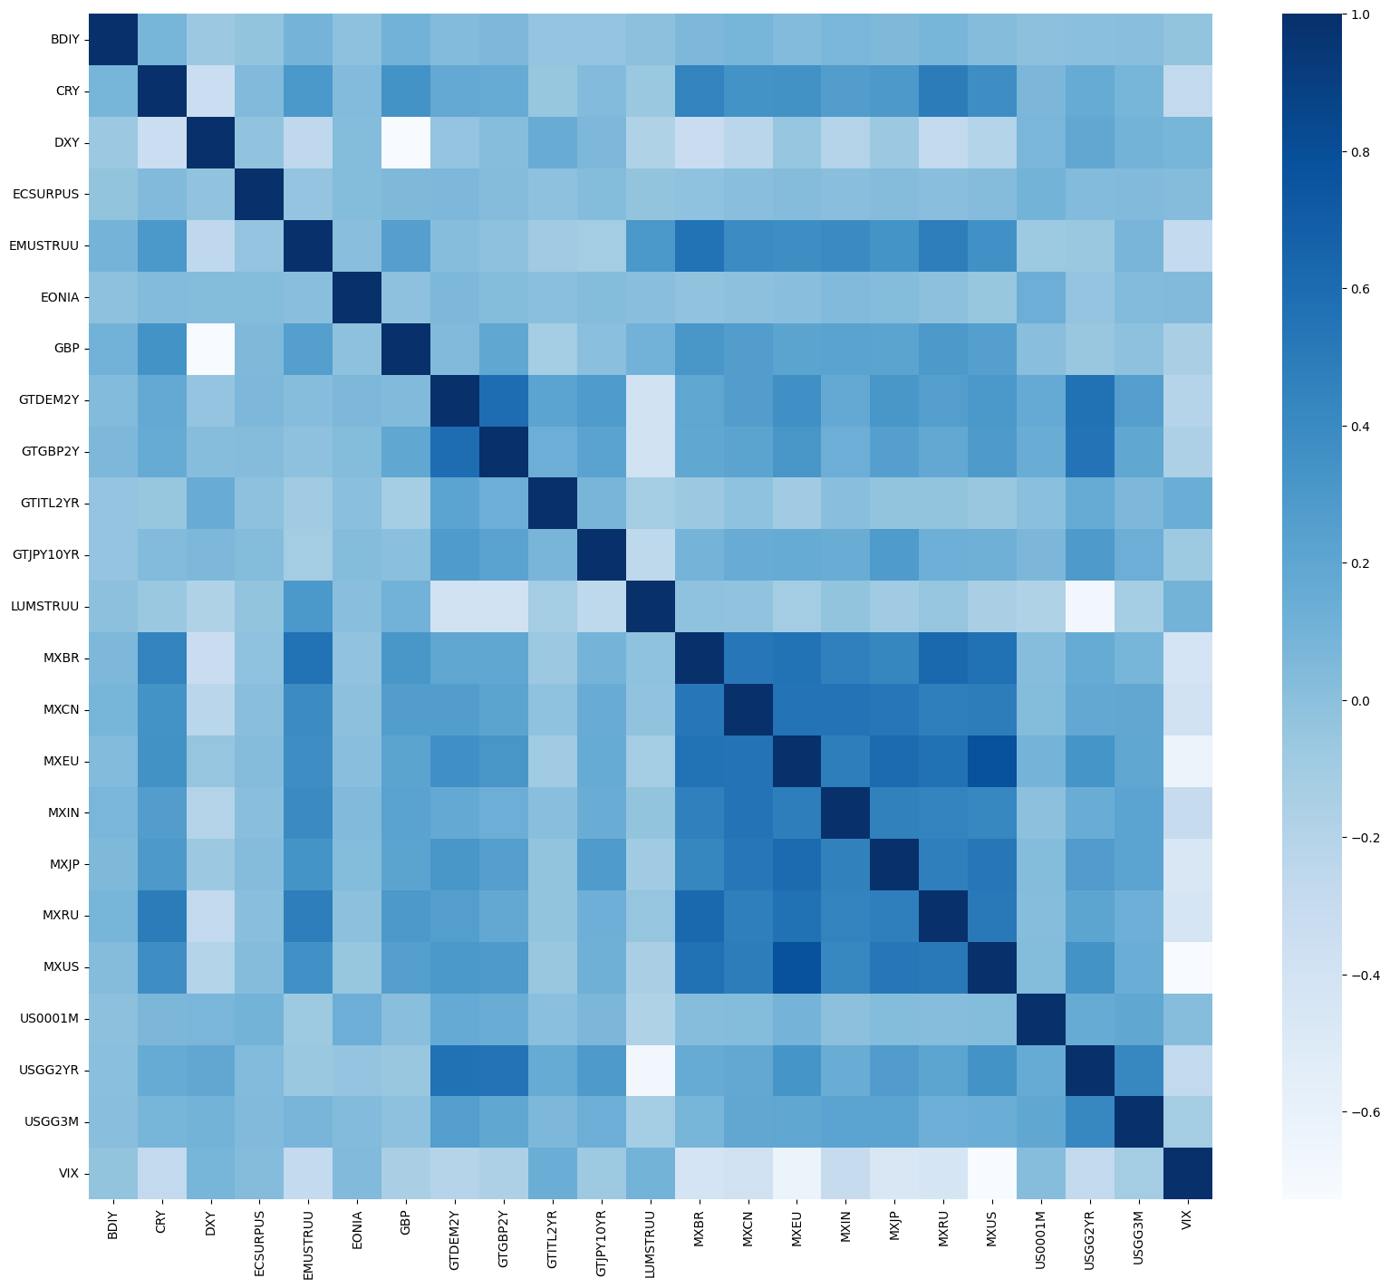
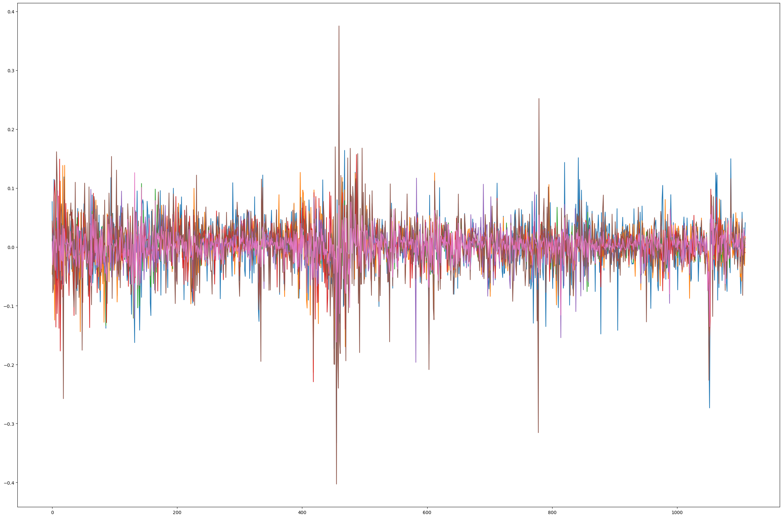
SUPERVISED CLASSIFICATION
We assured stationarity
Through a K-S test we eliminated all the variables characterized by a nonsignificant mean between more and less risky periods
After some correlation study, we eliminated some other variables
These plots show that we’re now working with significant and balanced data

Slide 11
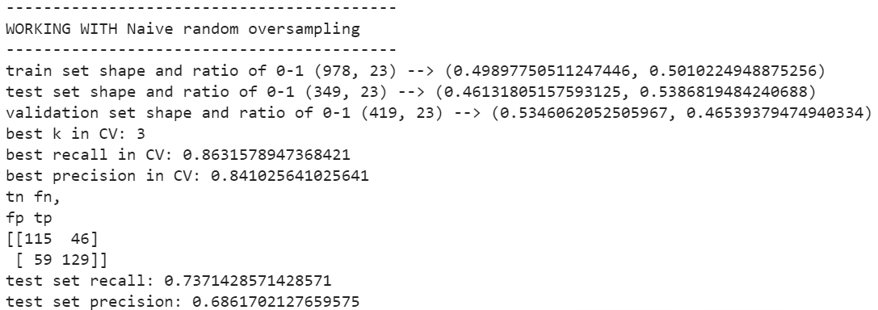
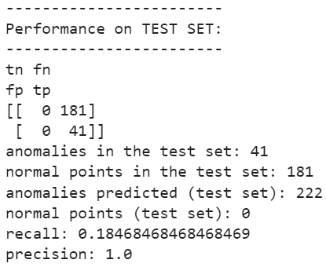
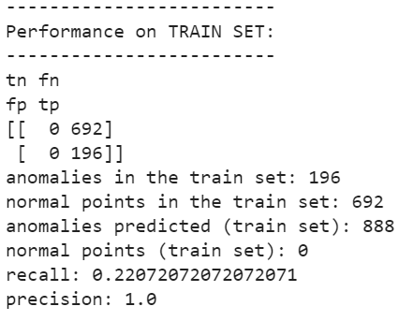
SUPERVISED CLASSIFICATION
We tried a naive Oversampling:
Number of new anomalies added: 636
NROS has added 268.354% more anomalies
New ratio of 0-1: {0: 0.5, 1: 0.5}
We then tried an Isolation Forest, which seems to be too unbalanced

Slide 12
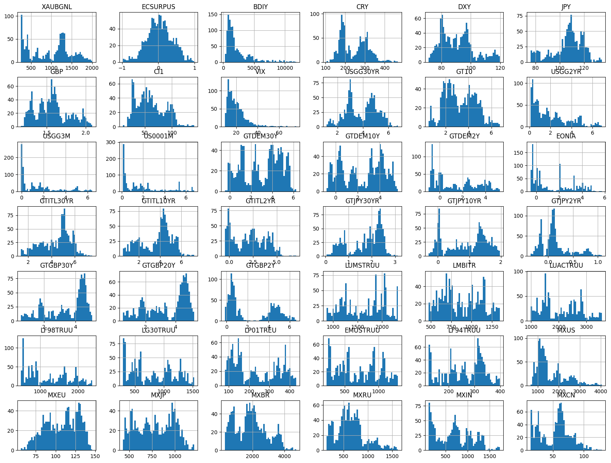
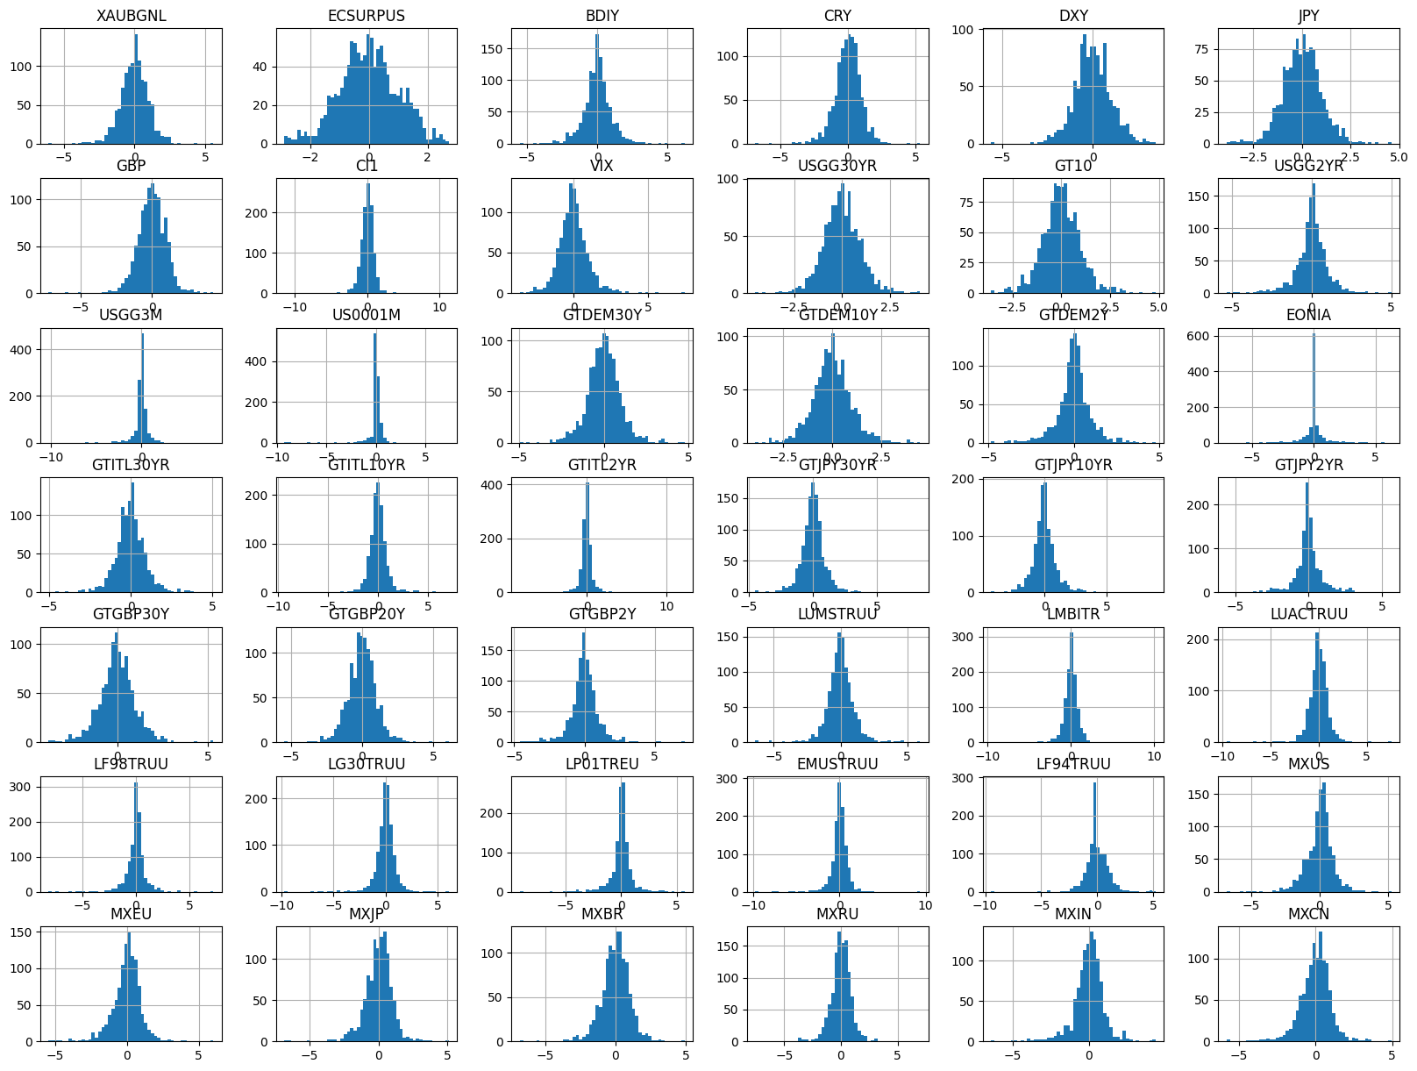
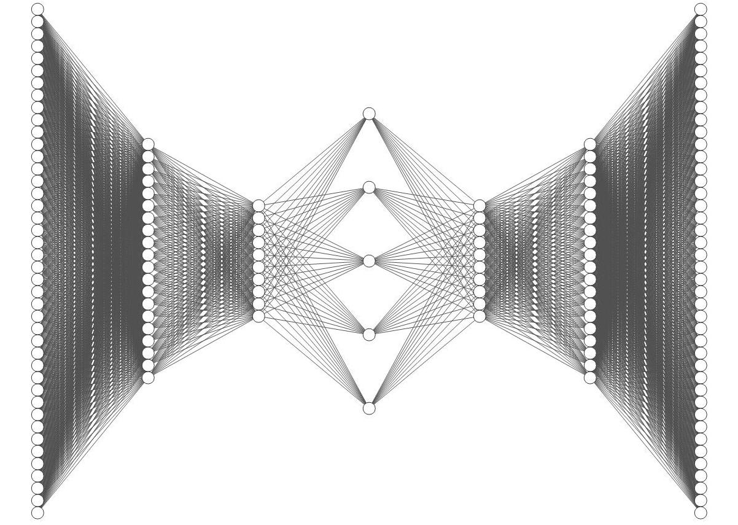
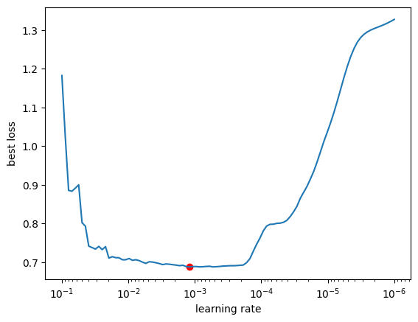
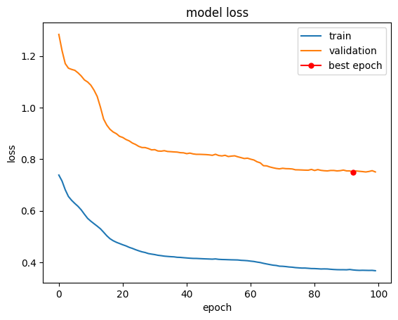
AUTOENCODER
Data processing
We stabilize the data and apply z-scoring
We tested 100 LR’s and select the one with the lowest validation loss
Best Learning rate: 0.0012

Slide 13
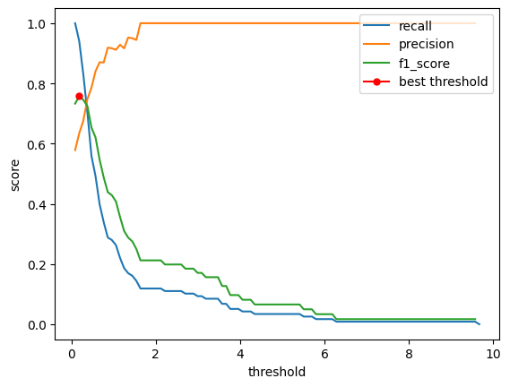
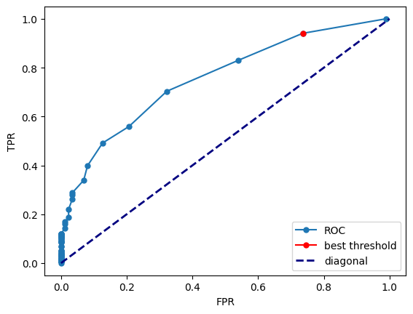
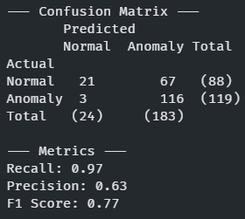
MODEL EVALUATION
Best threshold
We select the best threshold based on the F1 score
AUC score: 0.743
Best threshold: 0.1846
Results
We obtain the following results:
Recall 0.97: we are correctly identifying almost all the anomalies
Precision 0.63: we are misidentifying many normal days

Slide 14
NEXT STEPS
Since the dataset is unbalanced, we can try multiple techniques of oversampling (such as Smote)
Try to use different criteria in the feature selection

