Slide 1





Flow matrix avoids problems of the popular Markov matrix
The United States National Science Foundation’s Division of Environmental Biology supported this work via grant OCE-1637630 for the Plum Island Ecosystems Long Term Ecological Research site. The Edna Bailey Sussman Trust supplied additional funding. Clark Labs facilitated this work by creating the GIS software TerrSet®.
1
Notes:
Hello and welcome to my presentation. I hope you’ve all been enjoying AAG so far. Today I will be speaking about the Flow matrix in comparison to the Markov matrix as an alternative means of categorical extrapolation. Thank you to the SAM specialty group for accepting my paper into the competition and to the organizers of this session.

Slide 2

Student in the Master of Science in GIS program at Clark University
Recipient of undergraduate degree in Environmental Science and Mathematics
Young professional interested in quantitative explorations of human-environment interactions
Jess Strzempko
Notes:
My name is Jess Strzempko and I am a student at Clark University in Worcester, Massachusetts where I am working to complete my Master’s degree in GIS as part of an accelerated degree program. Last year, I received my undergraduate degree from Clark in Environmental Science and Mathematics. I’m born and raised in the small town of Holliston, Massachusetts. Post-graduation I hope to begin full-time work as a GIS professional with an interest in applying my education and technical skills in the field of conservation GIS.

Slide 3
Why all the Markov matrix hype?
The Markov matrix:
Was first developed in the early 1900s
Is used ubiquitously in categorical extrapolation
Struggles to extrapolate on a time continuum
Behaves in complex ways
Is there a suitable alternative?
Notes:
The main impetus of my work is to examine and critique the Markov matrix as a means of categorical extrapolation. The Markov matrix, also called a stochastic matrix, is a square matrix with entries describing the probability of transitioning from one state to another in a dynamic system. The Markov matrix, as the building block of the Markov chain, was developed by Andrey Markov in the early 1900s and is now used in land change models such as DINAMICA, the CLUE family of models, and TerrSet’s Land Change Modeler. The Markov matrix struggles to extrapolates on a time continuum and demonstrates complex and not well-understood long-term behavior. This leads us to ask – is there another way?

Slide 4
Go with the Flow (matrix)
The Flow matrix:
Was introduced by Runfola & Pontius Jr. in 2012
Directly fixes the problems of the Markov matrix
Extrapolates on a time continuum
Computes time of zero persistence
Extrapolates constant net change
Comprises straightforward mathematical concepts
Notes:
The answer is yes, the Flow matrix. Introduced by Runfola and Pontius Jr. in 2012, the Flow matrix offers an alternative paradigm for categorical extrapolation. The Flow matrix is a square matrix with entries describing the size of transition from one state to another per unit time. The Flow matrix extrapolates constant net change in a linear process allowing for extrapolation through continuous time with the potential to calculate the end point of the extrapolation, i.e., when the first category to reach zero persistence does so. The Flow matrix is simple and straightforward in both its mathematical concepts and long-term behavior, positing it as a beneficial foil to the Markov matrix.

Slide 5
Methodology
Developed equations to quantify change
Wrote code to create linked spreadsheets and self-updating figures to demonstrate concepts
Employed two case studies concerning land change to illustrate the characteristics
Notes:
In order to demonstrate this comparison and delve deeper into the implications of each method, I first developed equations to quantify the long-term behavior exhibited by the Flow and Markov methods. From these equations, I wrote code in Excel that takes the input transition values for the calibration time interval and transforms them into self-updating figures that quantify future transitions and demonstrate the contrasting conceptualizations of the Flow and Markov methods. I employed two cases studies of land change in the Long Term Ecological Research network’s Plum Island Ecosystems to illustrate the characteristics and concepts. For the sake of brevity, I will only be discussing one of these case studies today.

Slide 6
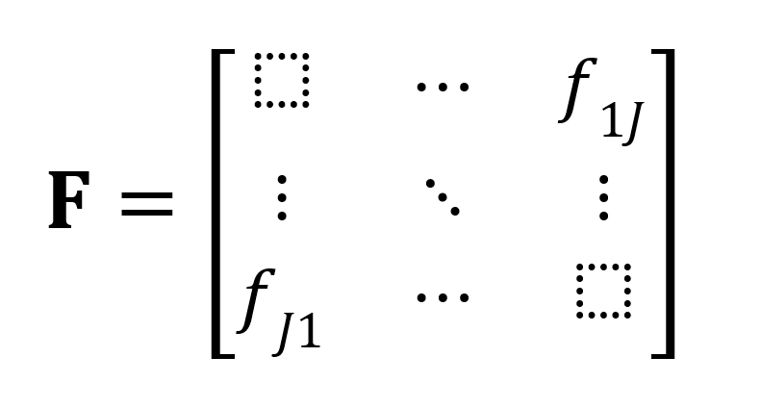
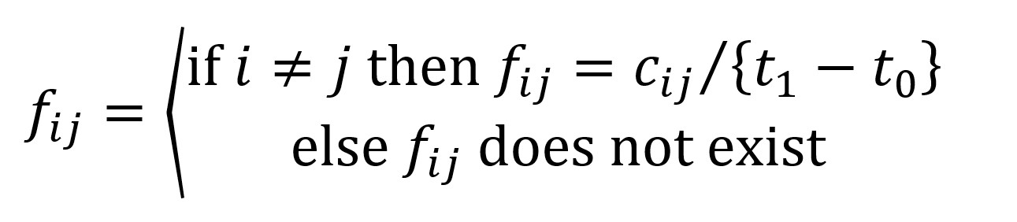
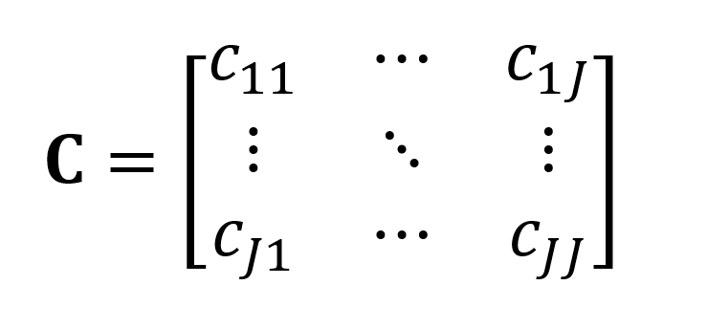
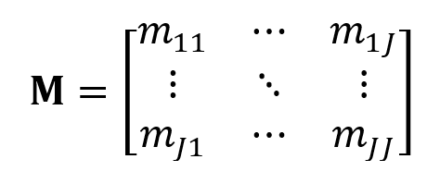
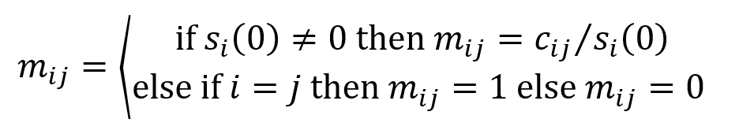
Flow Matrix
(extrapolation from t₀ to t)
Raw Transition Matrix
(calibration from t₀ to t₁)
Markov Matrix
(extrapolation from t₁ to t_{n})
Notes:
In these two slides, I will give a brief example of how each of the matrices is calculated and used. On the left, we see the raw transition matrix which contains values c sub ij, in other words, the size of transition from category I to category j during the calibration time interval. The Flow and Markov methods directly follow. To obtain value f sub ij in the Flow matrix, we divide by the duration of the calibration time interval to get transition sizes per unit time. In the Flow matrix, diagonal entries of persistence do not exist. To obtain values m sub ij in the Markov matrix, we divide by the size of the initial category I at time 0.

Slide 7
Flow Matrix
(extrapolation from t₀ to t)
 | A | B | C | Loss
A |  | 8 | 0 | 8
B | 0 |  | 4 | 4
C | 8 | 0 |  | 8
Gain | 8 | 8 | 4 | 20
Raw Transition Matrix
(calibration from t₀ to t₁)
Time 1
 | A | B | C | Sum
A | 32 | 8 | 0 | 40
B | 0 | 16 | 4 | 20
C | 8 | 0 | 32 | 40
Markov Matrix
(extrapolation from t₁ to t_{n})
Time 0
 | A | B | C | Sum
A | 0.8 | 0.2 | 0 | 1
B | 0 | 0.8 | 0.2 | 1
C | 0.2 | 0 | 0.8 | 1
Notes:
Here, I provide example numbers to demonstrate these calculations. Again, on the left we see the raw transition matrix with transition sizes between categories A, B, and C for time 0 to time 1 with a total size of 100. In the Flow matrix, the duration of the calibration time interval is one, so values are the same as in the raw transition matrix, without the diagonal values. From the rows, we can derive how much a category loses per unit time and from the columns, how much each gains. The Flow matrix is then able to extrapolate from time 0 to any time t on a continuum. In the Markov matrix, the transition sizes are divided by category size at time 0 (the sum column) to obtain proportions of persistence and transition. The Markov matrix then extrapolates in time intervals from time 1 to time n.

Slide 8
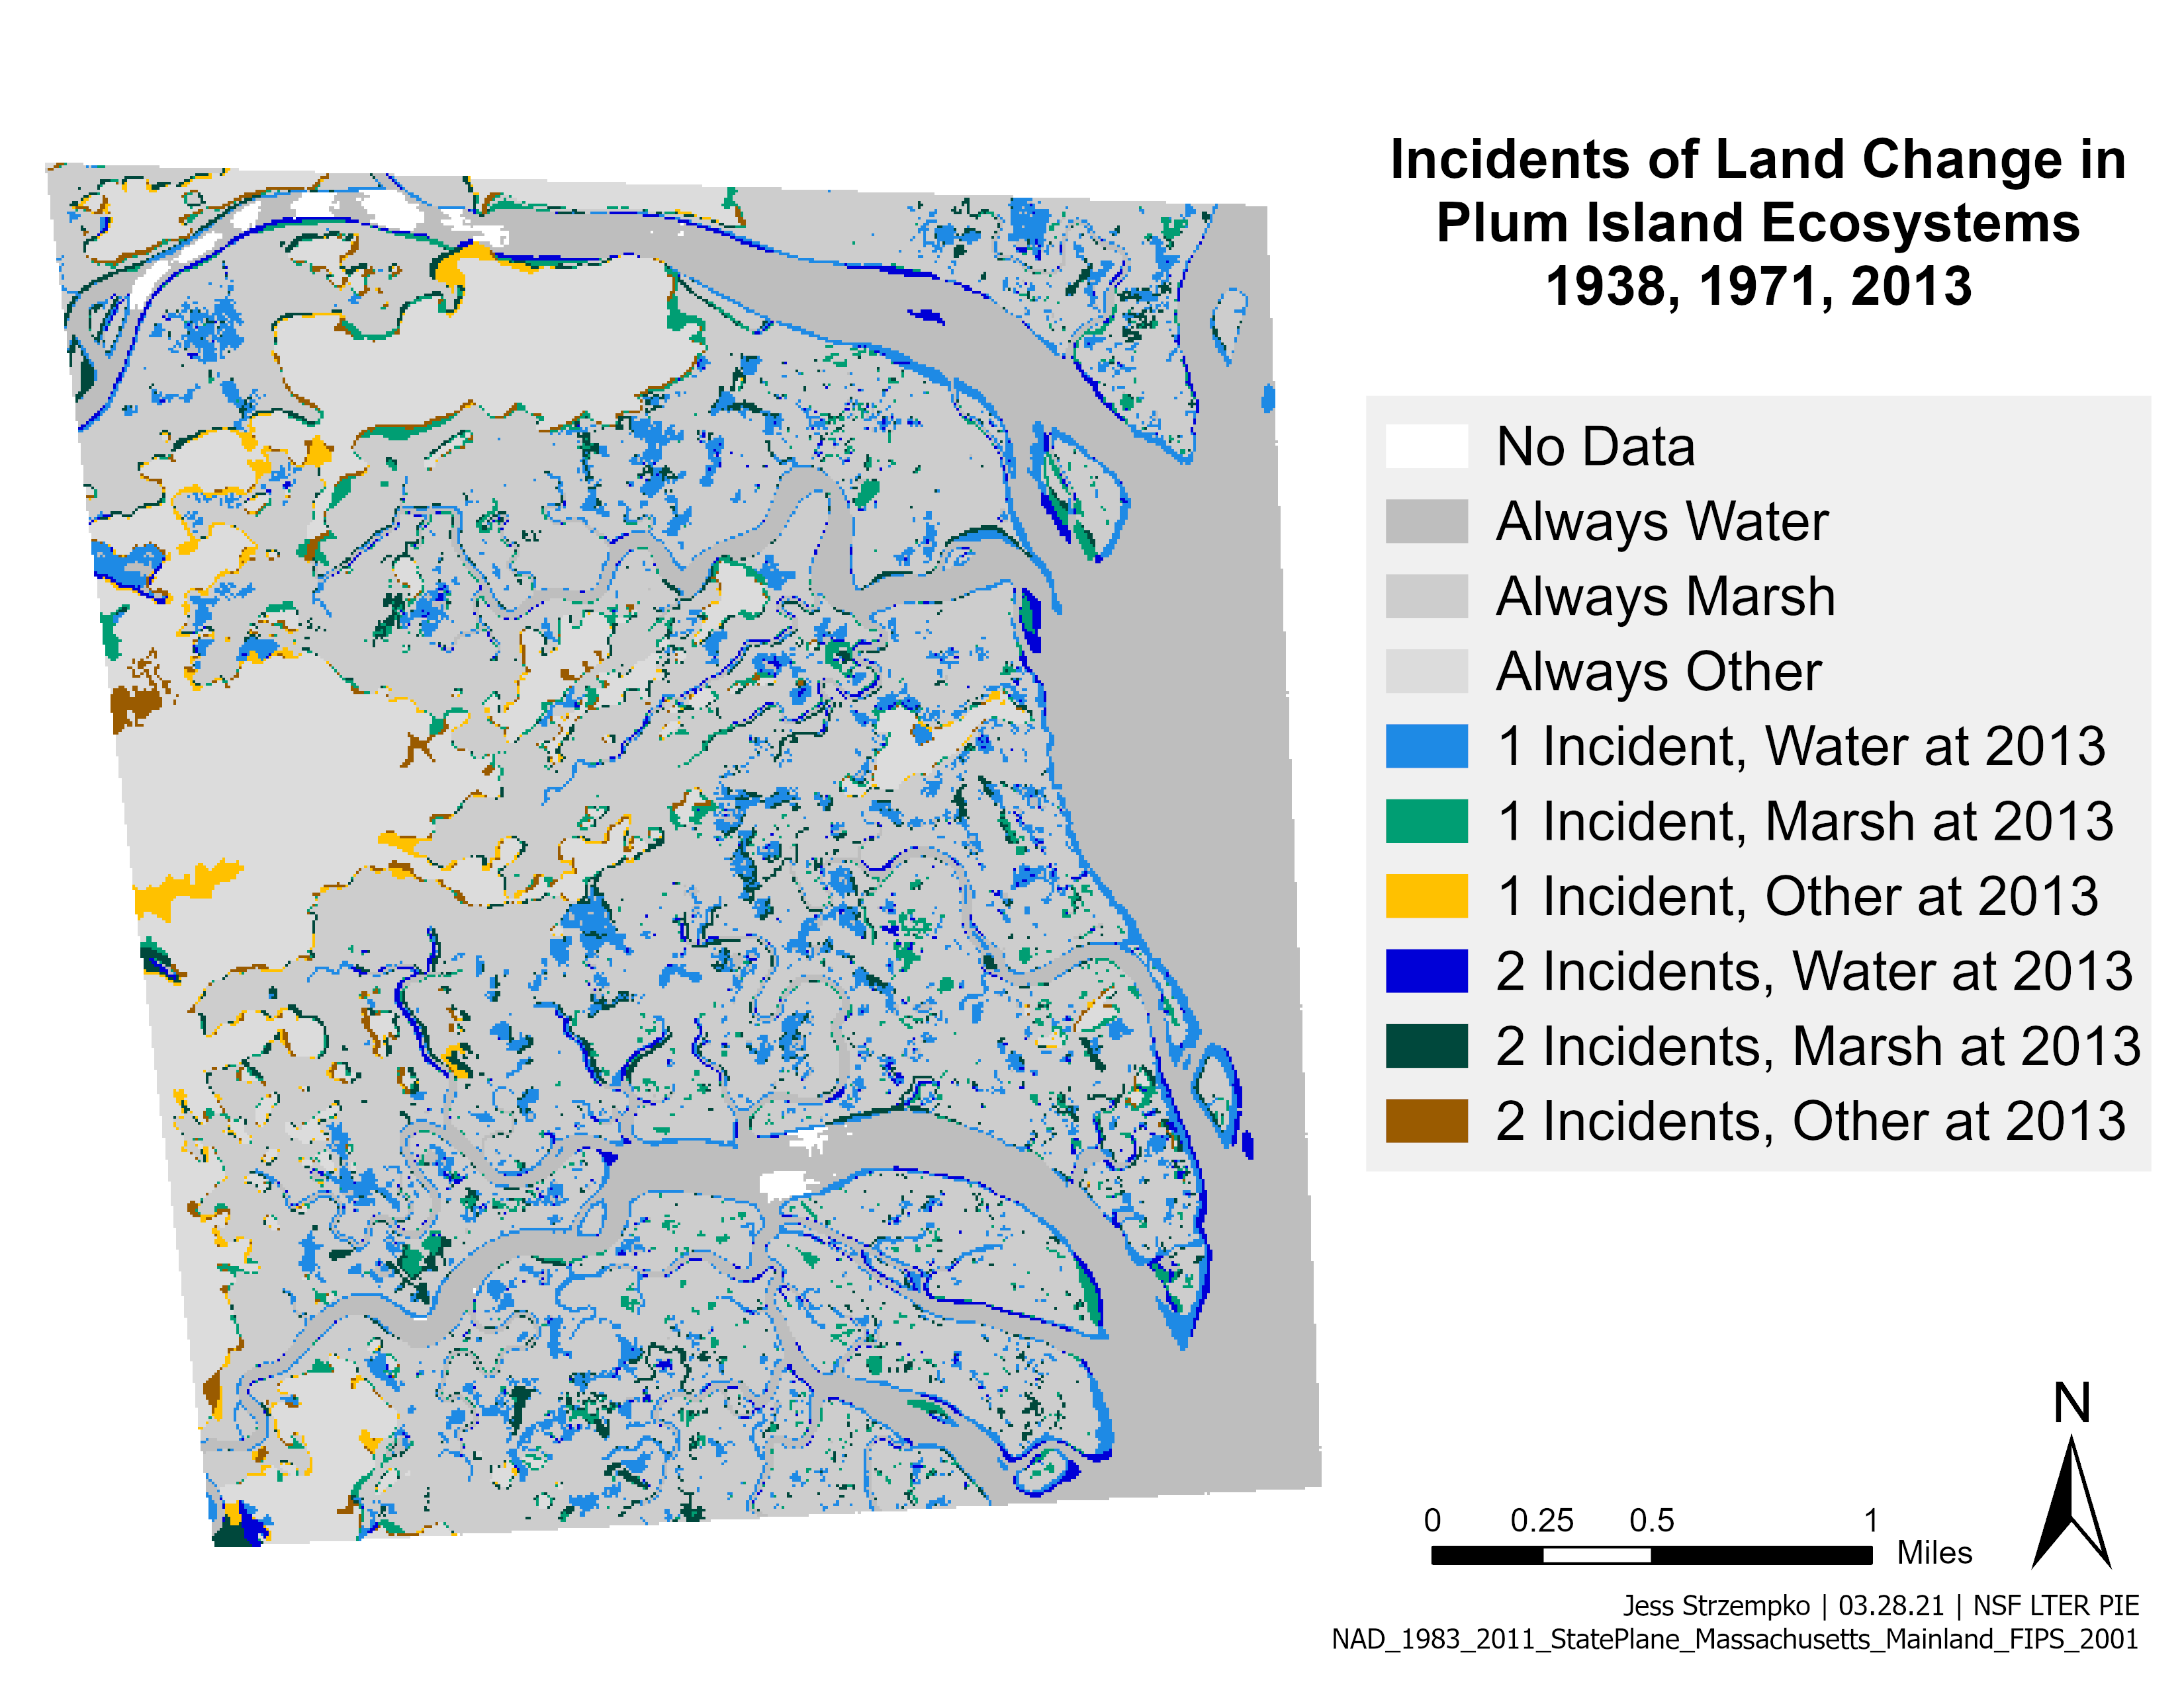
Case Study
Notes:
The case study we will look at is from a coastal region of the Plum Island Ecosystems. We use classified maps of Marsh, Water, and Other from 1938, 1971, and 2013. Incidents of land change are the cumulative number of times an observation, or pixel, changes category across time intervals. In the grey, we see areas of no change across all three time points. The hue, blue, green, or yellow, indicates the final category of an observation while the value, light or dark, indicates the number of incidents. Observations with one incident could have transitioned from 1938 to 1971 or from 1971 to 2013 while those with two incidents are known to have transitioned during both time intervals. This map provides context for the following bar graph.

Slide 9
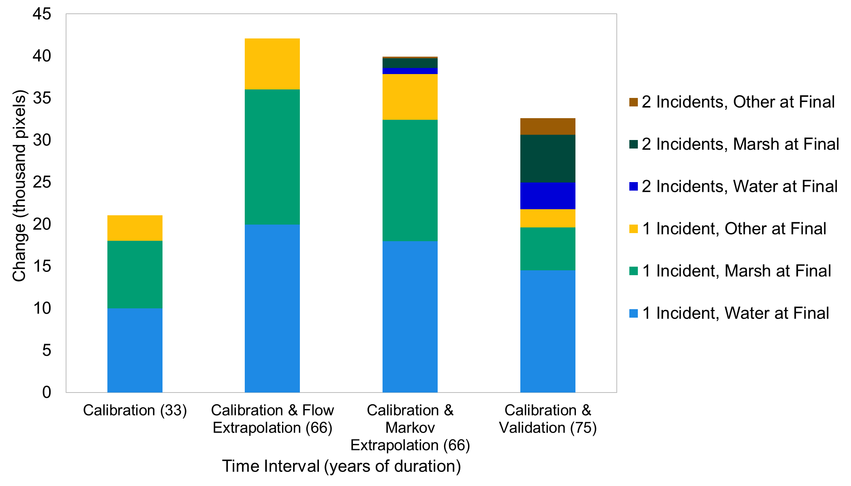
Notes:
On the x-axis are the four time intervals: the calibration, the flow extrapolation, the markov extrapolation, and the combined calibration and validation intervals seen in the map on the previous slide. On the y-axis is the size of change in thousands of pixels. On the left is the quantities of change form the calibration time interval, which is 33 years long. The Markov matrix can thus only extrapolate in time steps of 33 years meaning the extrapolation ends in 2004, not 2013. The Flow matrix is also extrapolated out 66 years for direct comparison. The size of the Flow bar components are two times those in the calibration interval because the extrapolation is performed over 66 years, two times the calibration duration of 33 years. The Markov predicts similar amounts and allows for two incidents as the extrapolation includes both the time interval of change from 1938 to 1971 and 1971 to 2004. Both the Markov and Flow predict greater change than actually occurred. Instead from 1971 to 2013, a deceleration of change is seen in the final bar.

Slide 10
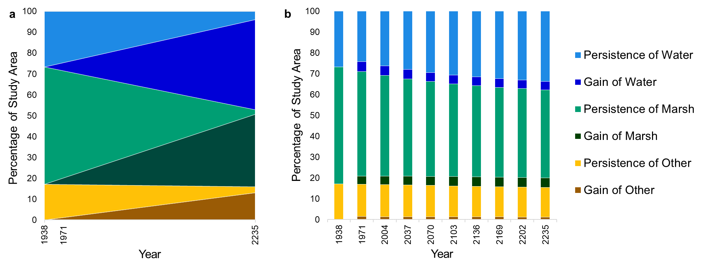
Flow Matrix
Markov Matrix
Notes:
The next three slides are composed of pairs of figures displaying the long-term behavior of the Flow extrapolation (on the left) and the Markov (on the right) in the case study. Time is displayed on the x-axis while the sizes are given in percentage of total study area extent on the y-axis. The colors correspond to the same categories as in the previous slides. The persistence segments indicate no transition from 1938 for the Flow extrapolation and no transition in the previous time interval for the Markov. The gain segments demonstrates the size each category gained over these same time intervals. With the Flow, we see immediately the linear behavior of the category sizes with persistence slowly decreasing to zero and gain increasing as all of the observations transition to new categories. With the Markov, we see the proportional change and asymptotic behavior in category sizes.

Slide 11
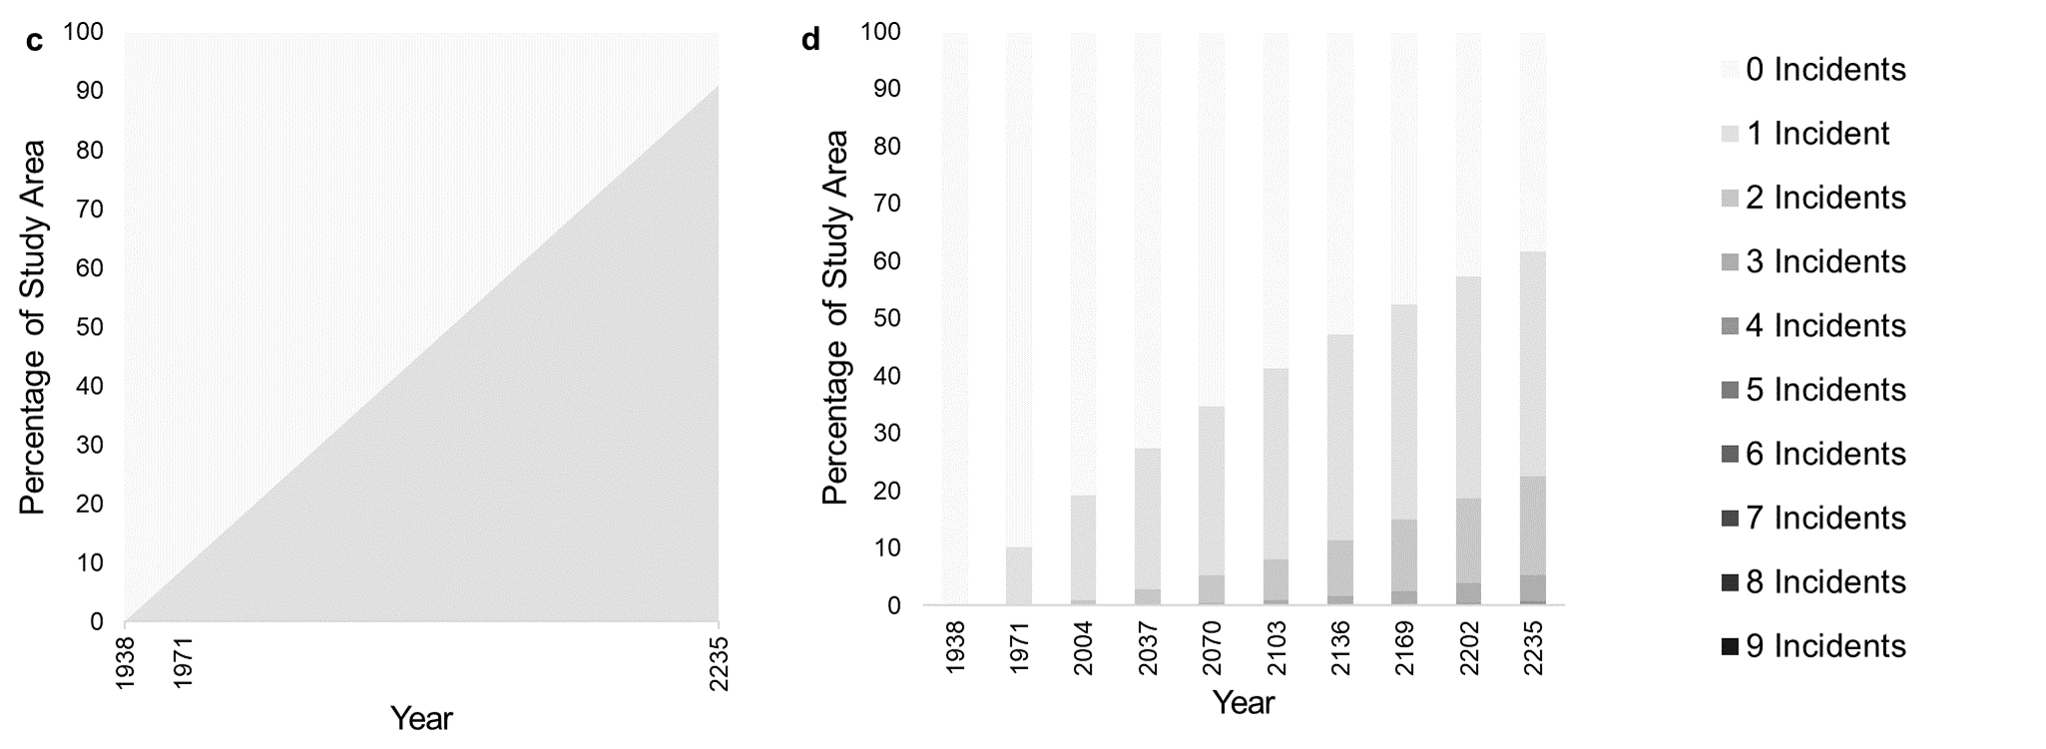
Flow Matrix
Markov Matrix
Notes:
The axes are consistent with the previous slide. The accumulation of incidents of land change in the two methods vary. Because the Flow matrix extrapolates from time 0 directly to the end time point, observations either transition or they don’t – meaning that the Flow extrapolation allows for a maximum of one incident. This quantity grows linearly as time progresses. On the other hand, the Markov matrix extrapolates in incremental time from time 0 to time 1, time 1 to time 2, and so on. On the right, we display extrapolation to time nine meaning the maximum allowable incidents per observation is nine. Most observations don’t transition or transition 1, 2, or 3 times in the Markov method.

Slide 12
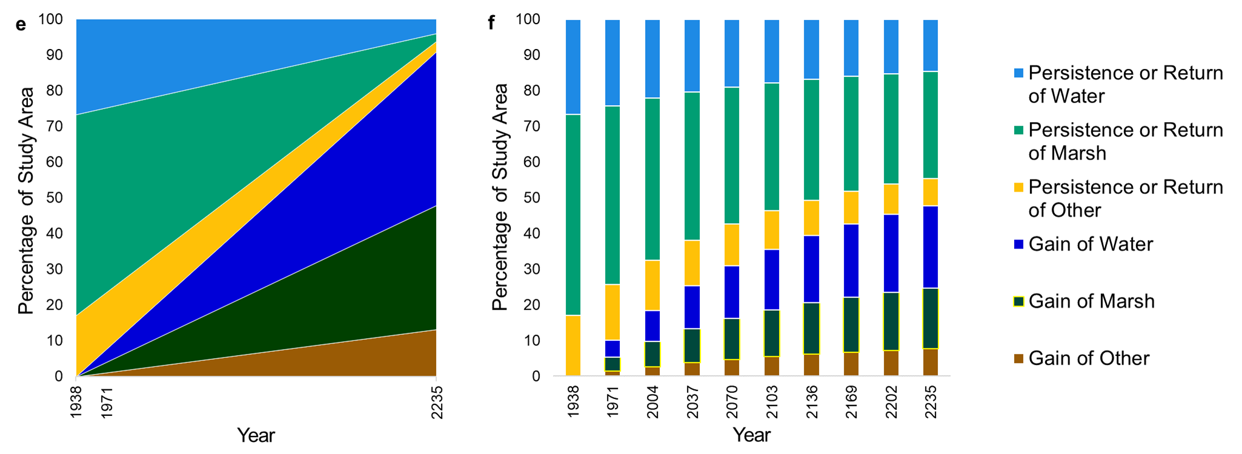
Flow Matrix
Markov Matrix
Notes:
Again, the axes are consistent with the previous two slides. Here, the categories in the legend are slightly altered. Instead of simply persistence and gain, referring to the action of an observation in the previous time interval, there is persistence or return and gain. Return refers to the case in the Markov extrapolation in which an observation begins at a category, transitioned away, and then transitioned back to its original category in a subsequent time interval. In this sense, for a given time point in the figure on the right, the bar segments are the sizes of persistence or gain in comparison to the original time 0. The Flow extrapolation only allows for one incident, so the distinction between persistence and return is indistinguishable. For this reason. The Flow figure here and the one two slides ago are identical with reordered categories.

Slide 13
How do they stack up?
Flow
Is a novel method
Extrapolates constant transition size per unit time
Projects through continuous time
Allows one incident per observation per extrapolation
Can terminate with extinction of the persistence of a category
Markov
Is a popular method
Extrapolates constant transition proportion per time interval
Projects through incremental time
Allows one incident per observation per time interval in extrapolation
Can extrapolate infinitely
Notes:
How do the two methods compare? Well, the Flow method is new, with little literature addressing it, while the Markov method is old and popular, with widespread use. The Flow matrix extrapolates linearly for an easy to understand modeling approach. It projects through continuous time with the possibility for an end time point, so a researcher can predict quantities at any future time point or know the time of extinction of persistence. The Flow method solely accounts for net change meaning it quantifies the change from the start category to the end category with no consideration of intermediate categories. In contrast, the Markov matrix extrapolates proportionally through incremental time with multiple incidents possible per observation. For this reason, the Markov extrapolation can often extrapolate infinitely and asymptotically approaches constant category sizes.

Slide 14
Conclusion
Flow and Markov offer contrasting paradigms
The Flow matrix is an alternative approach that address the problems of the Markov matrix
Researchers should consider the trade-offs when deciding on a method
Contact information:
JeStrzempko@clarku.edu (Jess Strzempko)
Notes:
While the Flow and Markov matrices offer contrasting paradigms for categorical extrapolation, the Flow matrix is both a new and straightforward method that addresses the problems of the Markov extrapolation. When performing categorical extrapolation, in land change modeling or other applications, researchers should be aware of the trade-offs and select a method that best suites their needs. We anticipate the publication of a journal article in the coming summer, so if you would like to know more about the subject and my work you can reach me at my email here. Thank you!

