Slide 1
SMART Benefit Wallet on FHIR

Slide 2
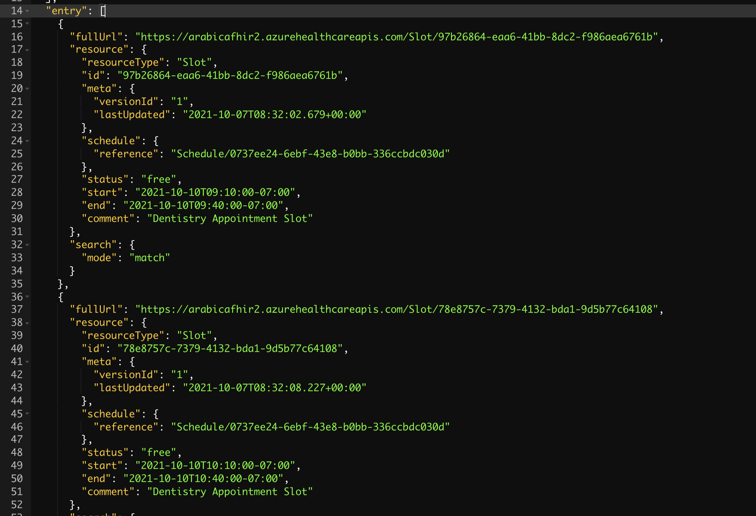
FHIR Slot

Slide 3
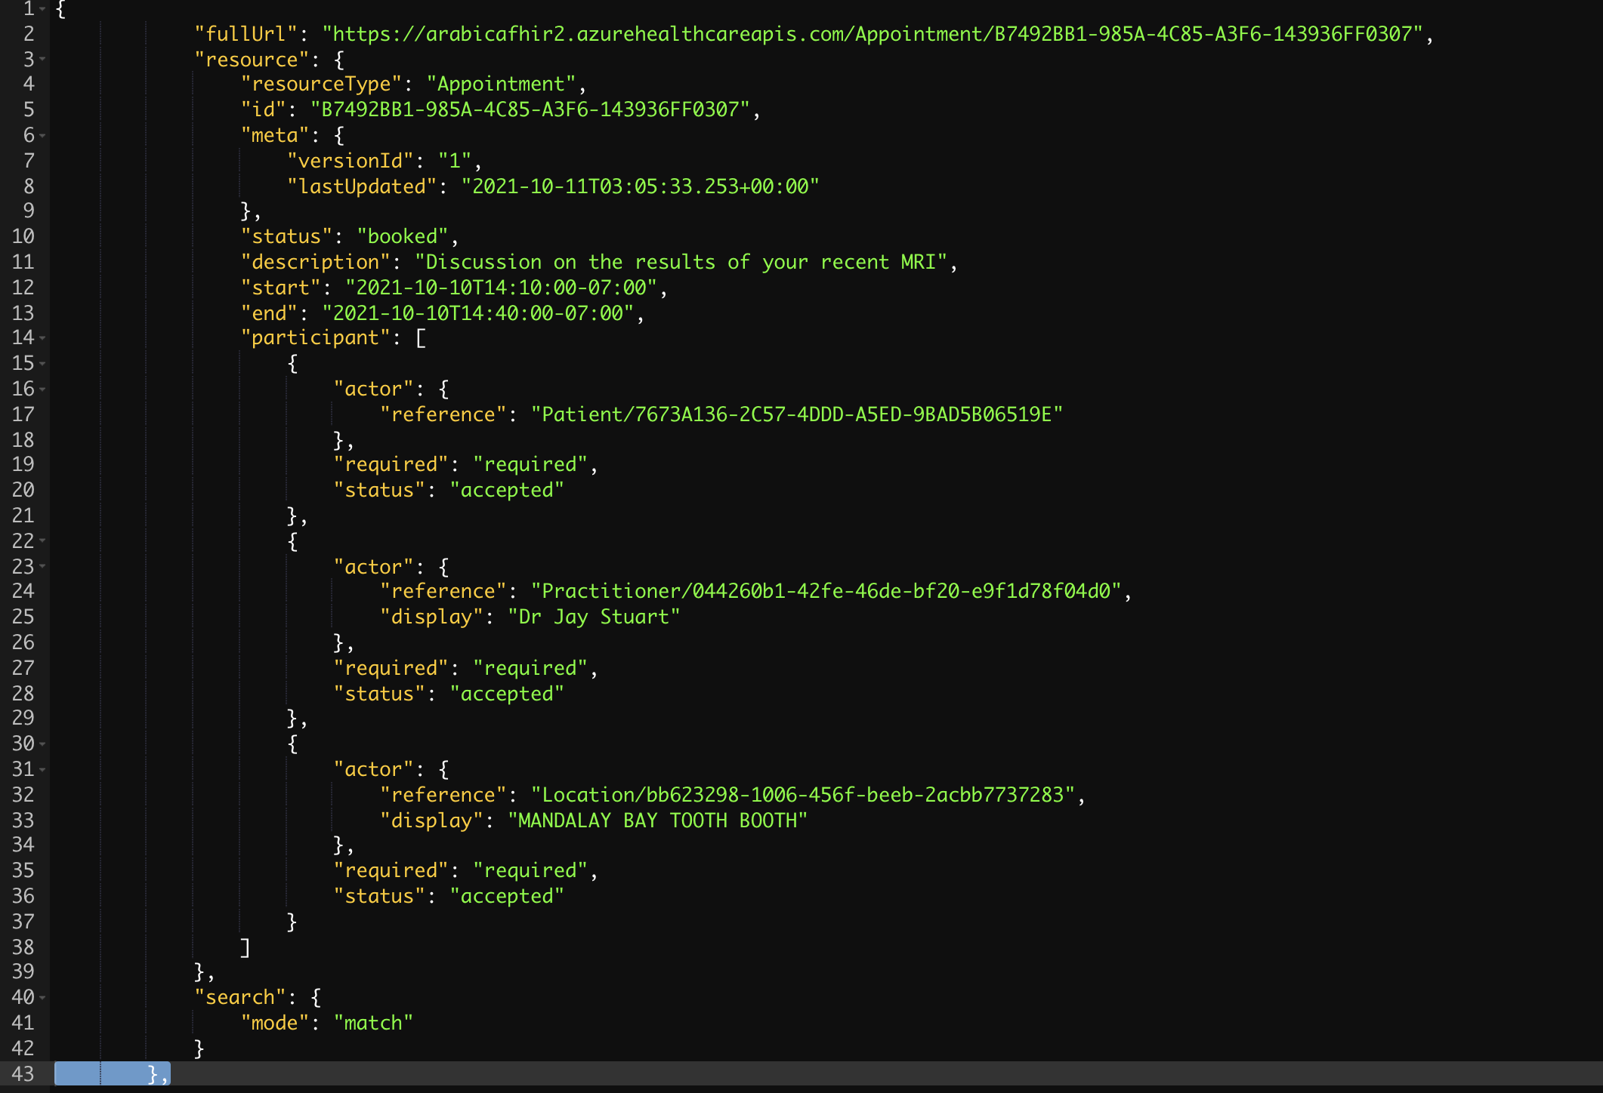
FHIR Appointment

Slide 4
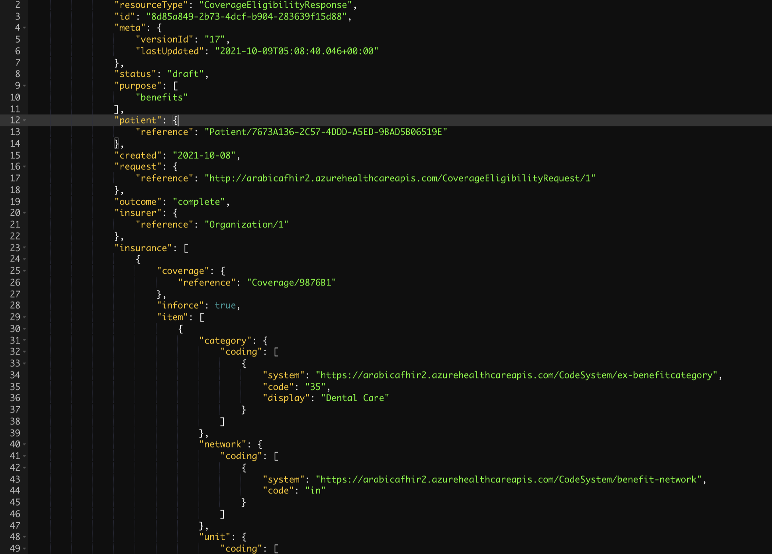
FHIR Coverage Eligibility Response

