Slide 1
THE SUPERNOVA HISTORY OF CYGNUS OB2
How many stars have exploded, when,
and what that means for the Cygnus PeVatron
A probabilistic ledger of massive-star deaths from a homogeneous Gaia DR3 census
V. Voitsekhovskyi
Gaia DR3 · INTEGRAL/SPI · forecast for COSI
Notes:
15-20 min. Aim: the ledger is the measurement; the PeVatron verdict is one application of it. Do not oversell the verdict.

Slide 2
1
The puzzle
A PeVatron in Cygnus, and five candidate engines

Slide 3
THE OBSERVATION
LHAASO sees a cosmic-ray PeVatron in Cygnus
A γ-ray 'cocoon' around Cyg OB2, emitting above 100 TeV — protons accelerated to PeV energies.
Candidate engines all live in the same region:
· collective winds of the massive-star population
· a supernova exploding into the wind-blown cavity
· the Cyg X-3 microquasar
· the γ Cygni supernova remnant
· PSR J2032+4127
Notes:
Set up: the field argues about which engine. Härer et al. 2025 argue for a supernova ~50 kyr ago into the cavity. Every one of these depends on the SAME population property.

Slide 4
THE GAP
Every candidate engine depends on one number nobody had measured: how many supernovae Cyg OB2 has actually produced, and when.
Wind power, cavity structure, remnant population, pulsar birth — all of them are set by the association's death history. That history is a MEASUREMENT problem, and it is the subject of this talk.
Notes:
This is the pivot. The talk is a measurement first; the PeVatron interpretation is one application at the end.

Slide 5
2
Cygnus OB2
The best target in the Galaxy, and why it is hard

Slide 6
WHAT WE ARE LOOKING AT
Cygnus OB2 — the target
1.62
kpc
distance
1,392
members
at P > 0.5
2.92
×10⁴ M⊙
stellar mass
2.52–4.09
Myr
subgroup ages
Young enough that the first supernovae have only just begun, close enough for Gaia to resolve individual stars, and massive enough that the statistics are meaningful. Three kinematic subgroups (A, B, C) — the association is not coeval.
Notes:
Emphasise: nearest laboratory where you can count the progenitors star by star instead of assuming an IMF.

Slide 7
THE DIFFICULTY
Why this has not been settled before
Extinction is severe and patchy — A_V ≈ 6 mag, varying star to star across the field.
The stars that matter have already died. You must infer the dead from the living, through an IMF.
Every step carries a model choice: isochrones, extinction law, IMF slope, explodability, star-formation duration.
Those choices are not decorative — they move the answer by more than an order of magnitude.
Notes:
This motivates the branch discipline: we carry model choices as explicit branches and never average them.

Slide 8
SCOPE
The questions this work answers
1. How many core-collapse supernovae has Cyg OB2 produced?
2. When did they happen — and how likely is a recent one?
3. What were the progenitors?
4. Is the supernova-driven PeVatron scenario supported?
Design rule fixed before any result existed: every model choice is a BRANCH, carried in parallel and never averaged; every comparison is PRE-REGISTERED before it is scored.
Notes:
Stress the pre-registration: thresholds and predictions were frozen in JSON before the numbers were computed. Failed predictions are reported as failed.

Slide 9
3
Method
From a Gaia catalogue query to a supernova ledger

Slide 10
PIPELINE
The chain, and the one out-of-sample test in it
Gaia DR3 + 2MASS → membership & three subgroups
→ per-star extinction and de-reddened CMD
→ subgroup ages and per-star masses
→ IMF normalization from 2–8 M⊙ counts + completeness
→ census closure above 8 M⊙ · runaway recovery
→ the supernova ledger: how many died, and when
The IMF is fitted on 2–8 M⊙ stars only. The >8 M⊙ census never enters that fit — so comparing predicted to observed massive stars is a genuine out-of-sample test.
Notes:
The closure test is the credibility anchor. Say clearly that we deliberately did NOT spend it to fit alpha.

Slide 11
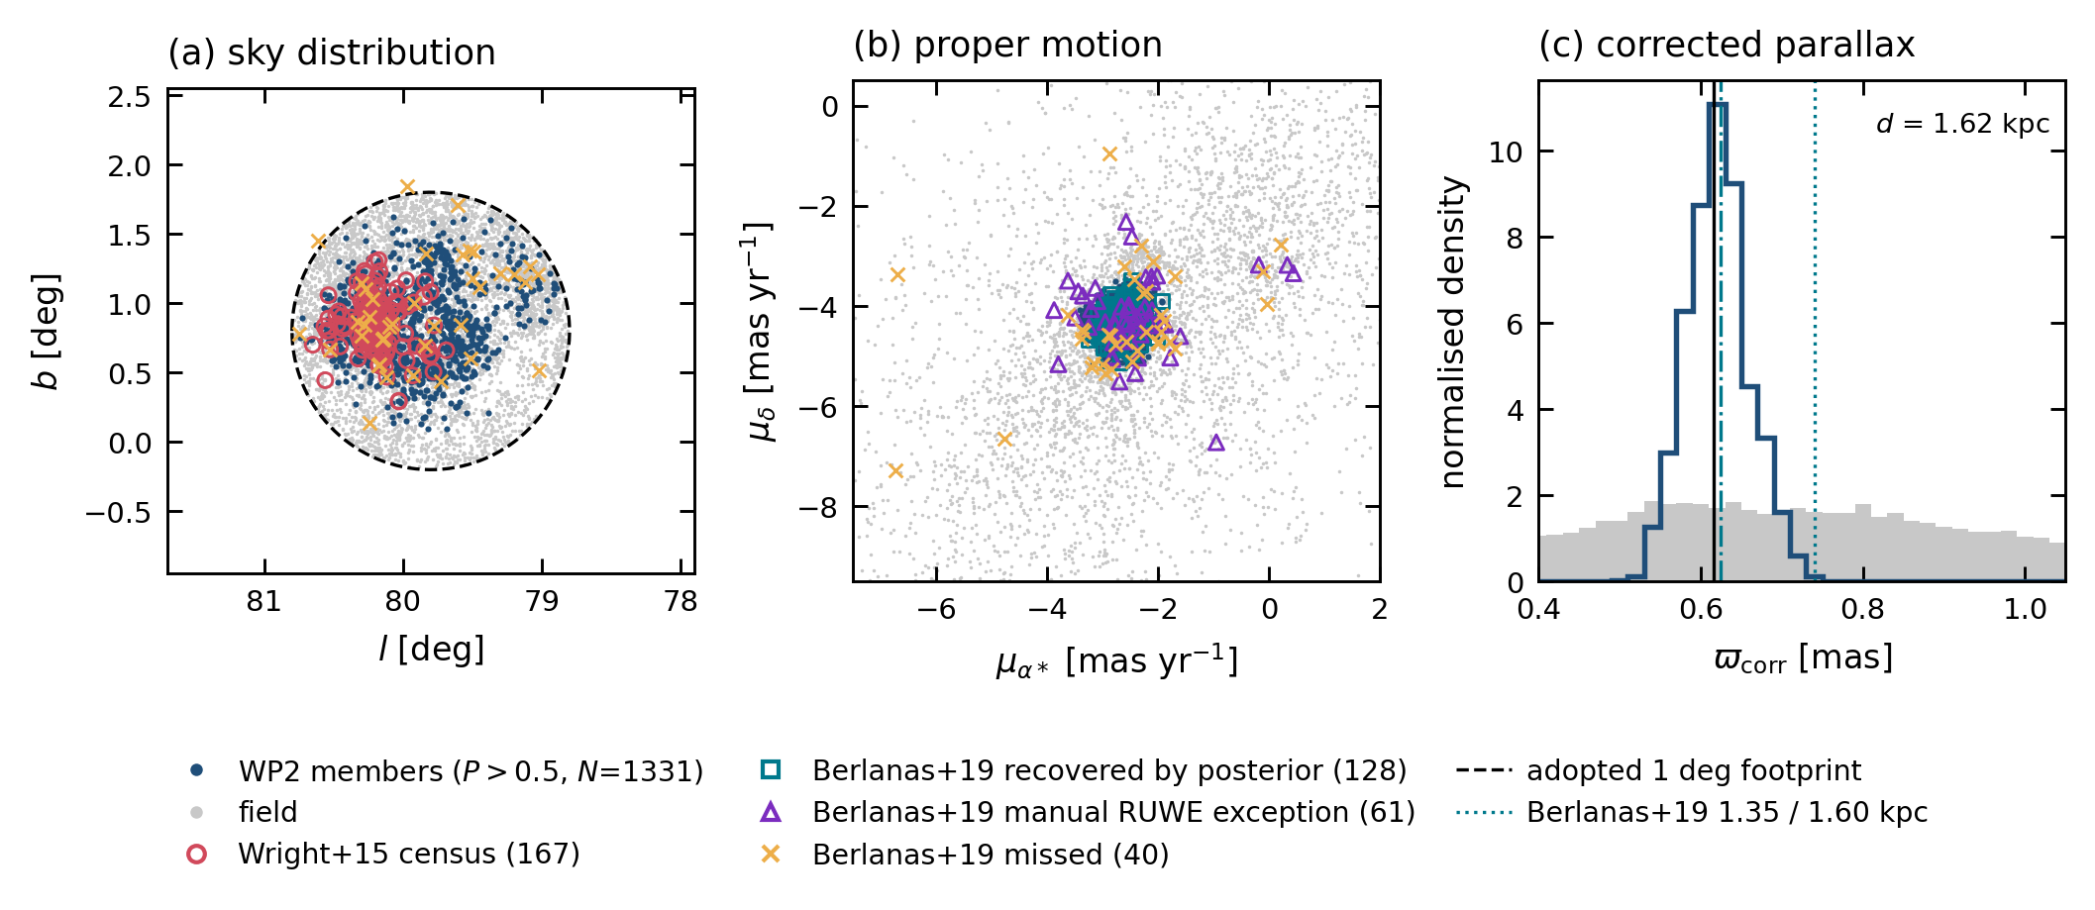
STEP 1
Membership: 1,392 members, three subgroups
Clustering in position and proper motion; parallax deliberately excluded (one population at 1.62 kpc, its depth exhausted at DR3 precision). Literature recall 0.825; control-field yield 3.7%.
Notes:
Do not dwell. One line: the membership is validated against Berlanas+19 and against control fields.

Slide 12
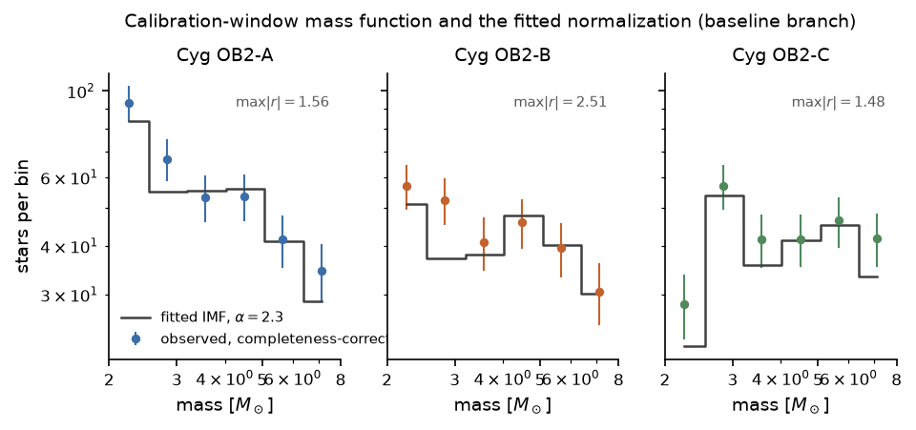
STEP 2
The mass function, and what normalizes it
Forward-modelled counts against observation for the three subgroups. 40 of 54 model branches pass the residual gate. The normalization k is fitted here, below 8 M⊙, and then extrapolated upward.
Notes:
The injection/recovery machinery behind completeness is the expensive part; mention it exists, move on.

Slide 13
STEP 3 · THE VALIDATION THAT MATTERS
The census closes at Salpeter — out of sample
6.7%
observed massive stars
exceed prediction (α = 2.3)
2.25
slope α at which the
census closes exactly
18/18
cells inside the
carried branch grid
The IMF was normalized on low-mass counts alone, yet it predicts the observed massive-star population to within 7%. Nothing was tuned to make this happen.
Notes:
This is the single most persuasive slide for a sceptic. Let it breathe.

Slide 14
STEP 4
Runaways: stars that left, and still count
119 raw candidates recovered by traceback of PECULIAR proper motions → 54.9 after a measured false-positive rate.
They bound the fraction of supernovae that occurred outside the association at ≤ 14.6%.
External check: BD+43 3654, the canonical ejected O star, is recovered at probability 1.000 — 38.8 km/s and 1.36 Myr against a literature ~40 km/s and 1.6 Myr.
That check also caught a real bug: the first version traced back ABSOLUTE proper motions, which measure the association's bulk drift, not ejection. Result withdrawn and re-run.
Notes:
Being open about the withdrawn result buys credibility and pre-empts the obvious referee question.

Slide 15
4
Results
The ledger, and the two findings that dominate it

Slide 16
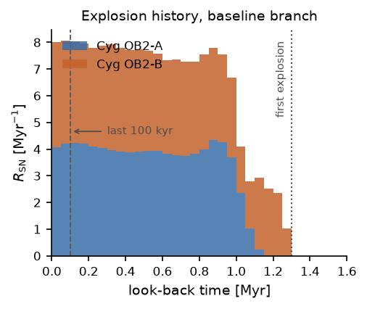
RESULT 1
The supernova ledger
Supernova rate against look-back time. Baseline branch: N_SN = 8.43 for the association, P(≥1) = 0.9997, and P(last SN < 100 kyr) = 0.552 — median time since the last explosion 86 kyr.
Notes:
P(recent SN) = 0.55 is the number the PeVatron people care about. Note it is 7x an ignorance baseline.

Slide 17
RESULT 1 · HONESTY ABOUT BRANCHES
The number is not a number
8.43
supernovae
baseline branch
5.63–28.7
across the 36
headline branches
×5.1
spread, driven
mainly by the IMF slope
We report the range, not a consensus value, and we never average branches. A single headline number here would be a fiction — the model choices are not resolved by the data.
Notes:
If you take one methodological point away, this is it.

Slide 18
RESULT 2 · THE STRUCTURAL FINDING
The entire supernova budget lies above 30 M⊙.
For any black-hole threshold at or below 30 M⊙, the ledger returns EXACTLY ZERO on every branch. The lowest-mass star that has died anywhere in the grid is 33.9 M⊙. So the whole result is conditional on whether very massive stars explode at all — which is unsettled physics.
Notes:
This is a genuine discovery about the system, not a caveat. It also sets up the pulsar slide.

Slide 19
EXTERNAL CROSS-CHECK
An observation we already had rules out the zero branch
PSR J2032+4127 is a neutron star inside Cyg OB2 — and neutron stars require a SUCCESSFUL explosion.
Ledger: P(≥1 SN) = 0.9997 if massive stars explode, against exactly 0 on the black-hole branch.
Its companion MT91 213 is our own census star — a B0V of 17 M⊙, 0.115° from the CygOB2-A centroid, already counted.
Age agrees too: characteristic age widened to 151–401 kyr against a ledger probability of 0.960 that the last supernova falls in that window.
Three readings remain degenerate — high-mass explodability, an older population, or binary stripping. All three give a non-zero budget, which is what the argument needs.
Notes:
Strongest single piece of evidence in the talk. The companion being our own star is the detail people remember.

Slide 20
5
The verdict
One application of the ledger — decided by a rule fixed in advance

Slide 21
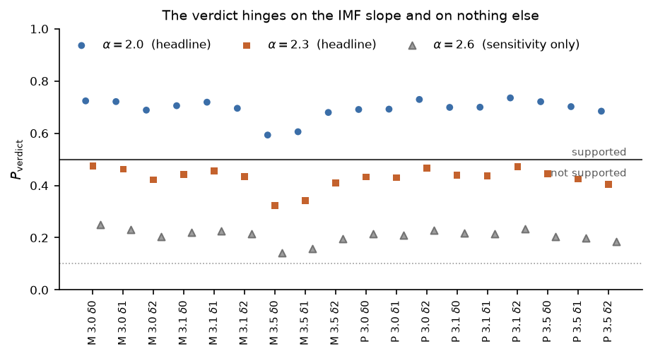
RESULT 3
Is the supernova-PeVatron scenario supported?
P(verdict) per branch = P(right age) × P(right progenitor type) × P(in situ). Range 0.323–0.735, median 0.533. The explosion energy is NOT multiplied in — it is reported as a stated conditional.
Notes:
Explain we refuse to invent an energy probability. The framing rule was mechanical: INCONCLUSIVE.

Slide 22
RESULT 3 · WHERE THE UNCERTAINTY LIVES
The verdict hinges on one axis, and only one
0.593–0.735
α = 2.0 branches
18/18 support the scenario
0.323–0.474
α = 2.3 branches
0/18 support it
0.264
spread from α, against
0.045 for isochrones
The 0.5 boundary falls exactly between the two arms. The pre-registered rule therefore returns INCONCLUSIVE — and we wrote a regular article rather than a Letter, mechanically, because that is what the rule said.
Notes:
Emphasise: we let a rule written in advance decide the framing, including against our own interest.

Slide 23
6
A forward prediction
Making the ledger falsifiable — with an instrument launching in 2027

Slide 24
THE PROBLEM WITH WAITING
Gaia DR4 will not settle the axis that matters
DR4 gives radial velocities (3D traceback), sharper ages, deeper membership. All useful.
None of it constrains the high-mass IMF slope — which is the one axis the verdict turns on.
So we looked for an independent observable that does.
⁶⁰Fe is the supernova-specific tracer: Wolf–Rayet winds produce ²⁶Al but NO ⁶⁰Fe. It counts explosions, not a combination.
Notes:
Transition slide. Keep it quick.

Slide 25
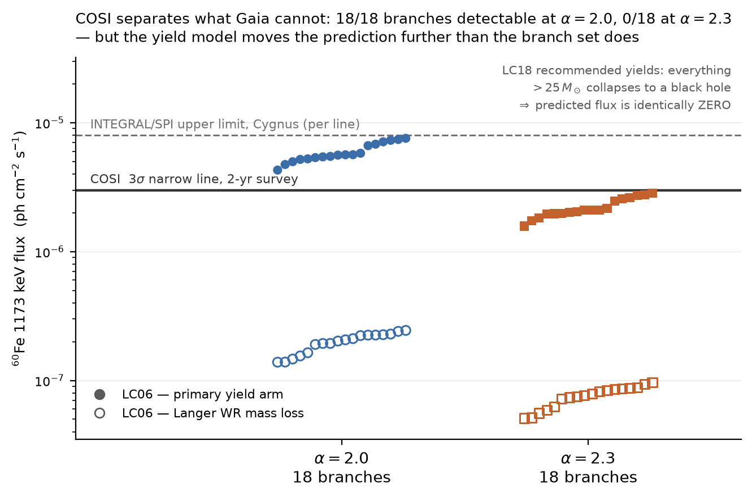
THE FORECAST
COSI can separate the branches Gaia cannot
Predicted ⁶⁰Fe line flux per branch against COSI's 3σ sensitivity. 18/18 branches at α = 2.0 are detectable; 0/18 at α = 2.3. Yields were declared as a branch BEFORE any flux was computed.
Notes:
The punchline of the new work. But immediately give the caveat on the next slide - do not oversell.

Slide 26
HONESTY
Two things bound that claim — and we give them equal weight
The yield model moves the prediction by a factor 30, against 4.8 for the whole branch set. A non-detection constrains BOTH, not α alone.
The current standard yield compilation predicts nothing at all: it collapses everything above 25 M⊙, and 0 of the 315 million supernovae we sample fall below that — so its ⁶⁰Fe flux is identically zero.
A COSI non-detection would then favour exactly the explodability that the pulsar disfavours — and that tension would itself be the result.
Existing INTEGRAL data are already within 5% of excluding our richest branch.
Notes:
Never let the COSI slide stand alone. This slide is what makes the forecast credible rather than promotional.

Slide 27
7
Conclusions
What is measured, what is not

Slide 28
Conclusions
Cyg OB2 has produced 5.63–28.7 core-collapse supernovae; P(≥1) = 0.9997 and P(last < 100 kyr) = 0.552, seven times an ignorance baseline.
The census closes out of sample to 6.7% at Salpeter — the IMF extrapolation is validated, not assumed.
The whole budget sits above 30 M⊙, so the result is conditional on very massive stars exploding. PSR J2032+4127 says at least one did.
The PeVatron verdict is INCONCLUSIVE by a rule fixed in advance, and hinges on the IMF slope alone.
⁶⁰Fe makes it falsifiable: COSI discriminates the branches — if the yield model cooperates.
Notes:
Land on: this is a measurement others can build on, with every branch and every failed prediction on the record.

Slide 29
Thank you
Every number in this talk is generated from a versioned artifact — the same macro file the paper uses. Pre-registrations, failed predictions and withdrawn results are all in the repository.
Notes:
Backup slides follow: systematics, pre-registration, the 26Al correction, age sensitivity.

Slide 30
—
Backup
For questions

Slide 31
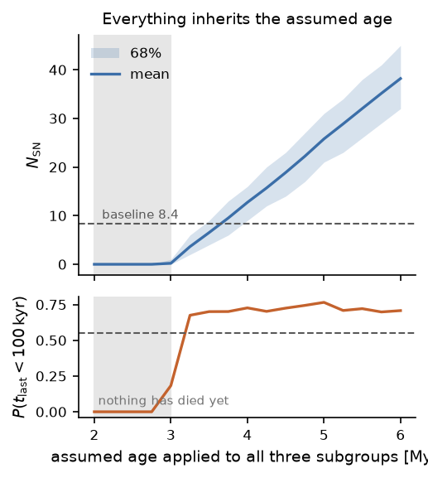
BACKUP
Backup · How the answer depends on the assumed age
Below ~3 Myr nothing has died yet. The steep dependence on age is why the counts-based ages, not the CMD ages, are what the ledger consumes.

Slide 32
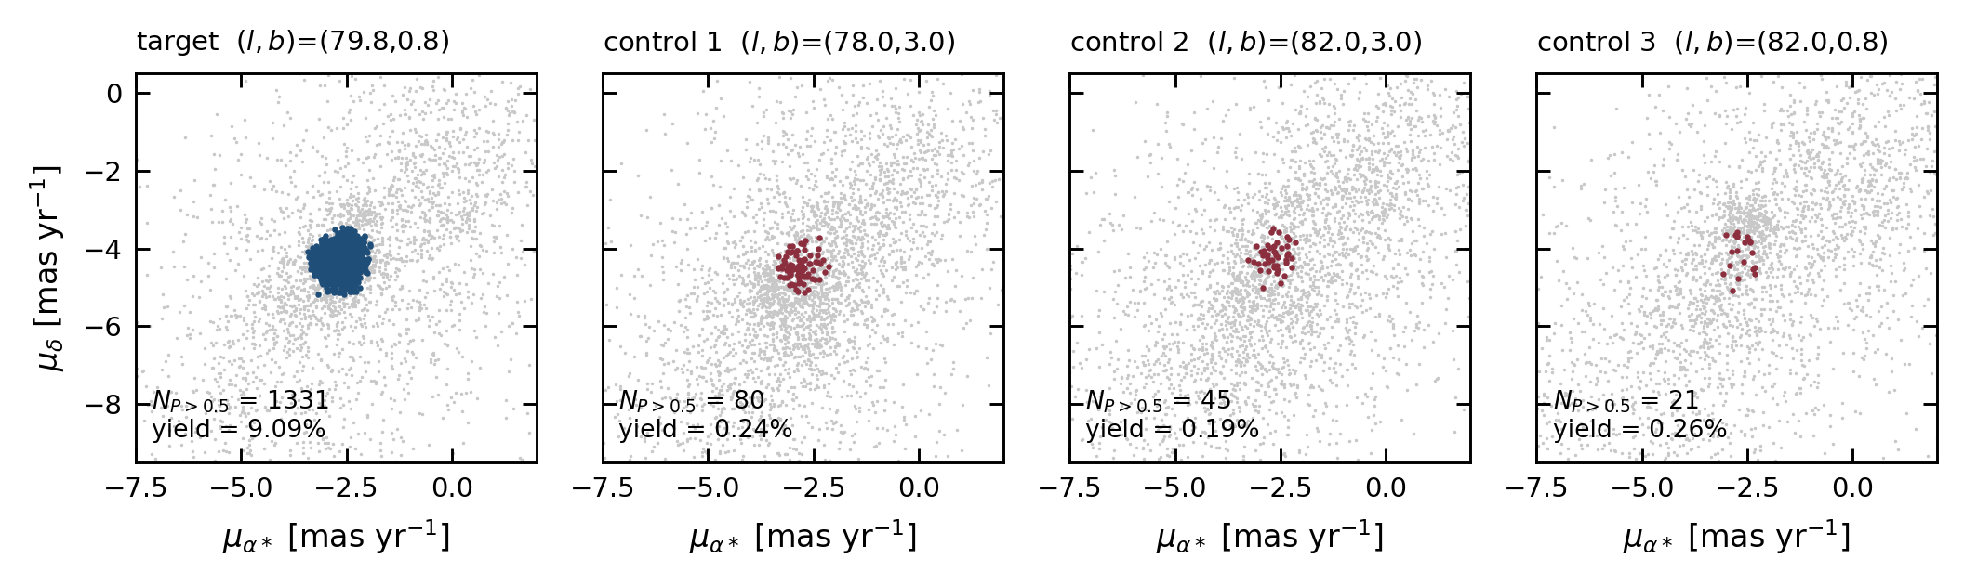
BACKUP
Backup · Control fields and the false-positive rate
Membership contamination and the runaway chance-alignment rate are both measured from control fields rather than assumed.

Slide 33
BACKUP
Backup · ²⁶Al, and a correction we found
²⁶Al traces winds AND supernovae, so it constrains a combination and is never inverted for a supernova count.
Run forward, the ledger's supernovae supply 10–42% of the measured complex-wide 1809 keV flux — sub-dominant but not negligible.
This corrected an earlier internal comparison that was wrong by ~100× (a Galactic ²⁶Al mass had been used for the Cygnus complex). Recorded as a finding; nothing upstream retuned.
Notes:
Only if asked. Shows the one-way validation rule working.

Slide 34
BACKUP
Backup · What this cannot do
It cannot compute explosion energies — C2 is a stated conditional, never a multiplied probability.
It cannot resolve whether γ Cygni is associated with Cyg OB2 (P = 7.7% within its ~7 kyr age).
It cannot separate Cyg OB2 from the wider Cygnus complex in any existing ²⁶Al measurement — SPI resolution is ~3°.
It cannot distinguish high-mass explodability from binary stripping as the origin of the pulsar.
Absent remnants are weak evidence: even at a generous 100 kyr visibility the ledger predicts only 0.80 visible remnants.

