Slide 1
Ways to create and customize .NET MAUI Controls

Slide 2
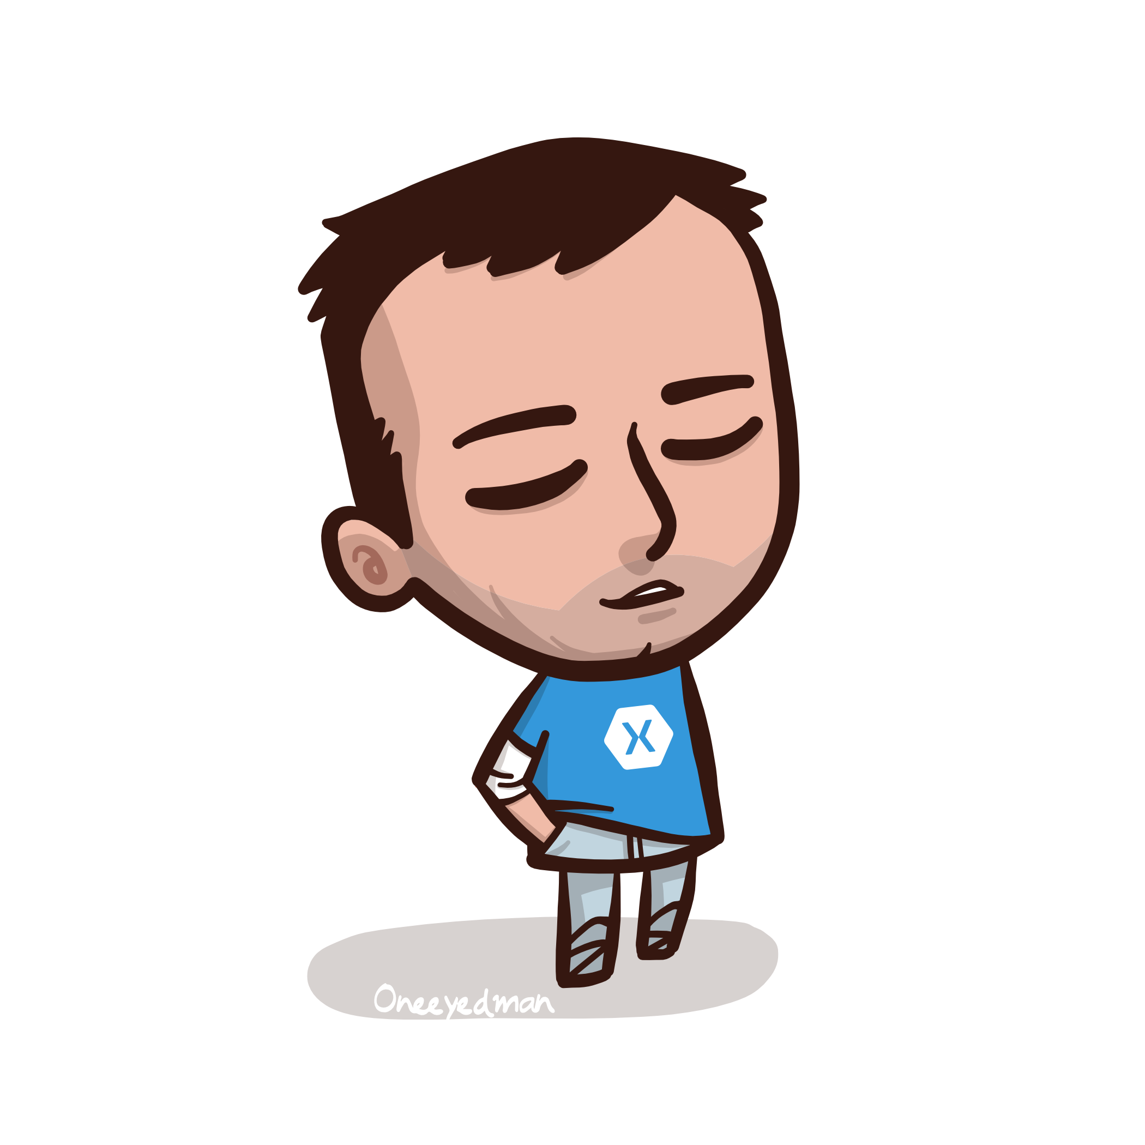
Javier Suárez Ruiz
Software Engineer at Microsoft
.NET MAUI Team
Blog: http://geeks.ms/blogs/jsuarez
Email: javiersuarezruiz@hotmail.com
Twitter: @jsuarezruiz

Slide 3
The agenda
Using Custom Renderers (Xamarin.Forms Architecture).
Using existing Handlers.
Using Custom Handlers.
Using ContentView.
Using TemplatedView (Templated Controls).
Using GraphicsView (Drawn controls).
Questions & Answers.

Slide 4
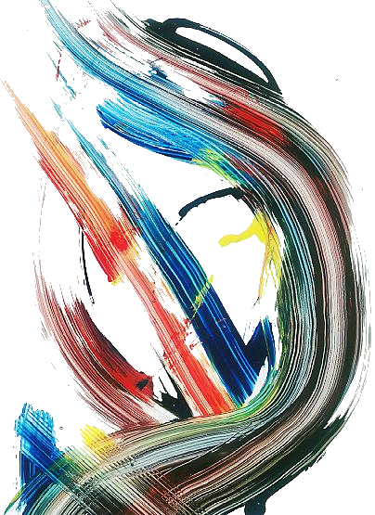
Abstractions
.NET MAUI uses abstractions to define the elements. Subsequently, each abstraction is transformed, offering an implementation and mechanisms on each platform.

Slide 5
1. Using Custom Renderers (Xamarin.Forms Architecture)

Slide 6
2. Using existing Handlers

Slide 7
3. Using Custom Handlers

Slide 8
4. Using ContentView

Slide 9
Create custom controls
ContentView is a type of Layout that contains a single child element and is typically used to create custom, reusable controls.
The process for creating a custom control is:
Create a new class that inherits from ContentView.
Define properties (BindableProperty) or events.
Create the user interface.

Slide 10
Rememer to consider
For the best possible performance:
Have exhaustive control of the hierarchy to create with the control. The higher the hierarchy, the greater the negative impact on performance.
Create controls that implement IDisposable and remember to free up resources.

Slide 11
Pros & cons
Pros
Simple to create. No platform-specific knowledge required; everything is built using the .NET MAUI abstraction.
Define the control only once for all platforms.
Cons
If to define a control, we create it via composition using 5 .NET MAUI views, it is required to instantiate those 5 views with a performance impact.

Slide 12
Using ContentView
DEMO

Slide 13
5. Using TemplatedView
Templated Controls

Slide 14
Allow customize everything?
With a good specification for a control, creating properties, events, etc. we can cover most requirements, but it would be impossible to cover all cases.
Let's take an example. In our CheckBox, we can add a property to customize the border color, but what if someone wants a dotted border? Okay, we can add another property, but what if someone needs…?

Slide 15
ControlTemplate
The ControlTemplate allows you to define the visual structure of the control.
<ControlTemplate>
<Grid>
<Grid.ColumnDefinitions>
<ColumnDefinition Width="*"/>
<ColumnDefinition Width="Auto"/>
</Grid.ColumnDefinitions>
<Rectangle
x:Name="PART_Background"
Stroke="{TemplateBinding Color}"/>
<Path
x:Name="PART_Glyph"
Data="M30.561941,0L31.997,1.393004 10.467954,23.597999 0,15.350999 1.2379759,13.780992 10.287961,20.909952z"
Stroke="White"/>
<ContentPresenter
x:Name="PART_Content"
Content="{TemplateBinding Content}"
Grid.Column="1"
HorizontalOptions="Center"
VerticalOptions="Center"/>
</Grid>
</ControlTemplate>

Slide 16
Many possibilities
With APIs like Brushes and Shapes we can draw and “paint” practically whatever we need.
Think a little, how would you compose a Slider? It is a line, with an ellipse that we can move.
And a CheckBox? At the end is a rectangle to draw the background along with a markup indicator.

Slide 17
Templated Control
The element called ContentPresenter, often used within control templates, is an element that allows to insert content at runtime.
The TemplateBinding markup extension, on the other hand, binds a property of an element that is in a ControlTemplate class to a public property defined by the custom control.

Slide 18
Templated Control
After a control template has been instantiated, the OnApplyTemplate method is invoked. In this method we can use the GetTemplateChild method to access the views that compose the control.

Slide 19
Rememer to consider
For the best possible performance:
Control template elements are typically accessed for generic operations related to assigning sizes, positions, or basic properties such as colors. Use base elements. This way, if the template is modified it has no impact.
Do not access elements of the template if you are not going to use them.
Create controls that implement IDisposable and remember to free up resources.

Slide 20
Pros & cons
Pros
Simple to create. No platform-specific knowledge required; everything is built using the .NET MAUI abstraction.
Define the control only once for all platforms.
It allows not only to customize the control via properties, but also to access the template and modify anything!
Cons
If to define a control, we create it via composition using 5 .NET MAUI views, it is required to instantiate those 5 views with a performance impact.

Slide 21
Using TemplatedView
DEMO

Slide 22
Using GraphicsView
Drawn Controls

Slide 23
Microsoft.Maui.Graphics
Microsoft.Maui.Graphics is a cross-platform graphics library for iOS, Android, Windows, macOS, Tizen and Linux written completely in C#. With this library you can use a common API to target multiple abstractions allowing you to share your drawing code between platforms or mix and match graphics implementations within a singular application.
In .NET MAUI a new control is included, GraphicsView, which exposes a Canvas where we can draw using MAUI Graphics.

Slide 24
Use GraphicsView: The Canvas
To start drawing, just call the drawable Draw method.
public class CheckBoxDrawable : IDrawable
{
public void Draw(ICanvas canvas, RectF dirtyRect)
{
}
}

Slide 25
Use GraphicsView: Draw
To draw something, we can directly add a point, line, rectangle, circle, rounded rectangle, text or image to the canvas.
canvas.DrawRoundedRectangle(0, 0, 24, 24, 6);

Slide 26
Use GraphicsView : User Input
Controls typically receive some input from the user. To make our control interactive, we can use .NET MAUI gestures, native gestures, or GraphicsView Touch events.
StartInteraction += OnCheckBoxStartInteraction;
void OnCheckBoxStartInteraction(object sender, TouchEventArgs e)
{
}

Slide 27
Create controls with MAUI Graphics
We will mainly make use of a Canvas where we will draw most of the control. MAUI Graphics, as we have seen, also allows us to manage user interaction, etc. To allow customization we rely on the use of BindableProperties.

Slide 28
Rememer to consider
For the best possible performance:
Avoid using multiple Canvas and draw as much as possible on a single Canvas.
When creating controls, you can use a GraphicsView as a base element instead of a ContentView if you don't need to compose (add other elements) besides the Canvas.

Slide 29
Pros & cons
Pros
Drawing directly on a Canvas and even with the possibility of using GPU, very high performance.
Define the control only once for all platforms.
Cons
“We are not using native elements; we are drawing on a canvas.”
Requires knowledge of SkiaSharp APIs.

Slide 30

Questions and answers
Questions?
Q&A

Slide 31
¡ Thank you all!

