Slide 1
Hotel Booking
119K
Demand Analysis
Reservations
EDA · Classification · Regularization
37%
Sai Nithin Reddy Maddi · Sujith Julakanti
Cancel Rate
STAT-654 · Texas A&M University · April 2026
8
Models
Dataset: Kaggle — Hotel Booking Demand (Jesse Mostipak)

Slide 2
Agenda
01
Dataset Overview
02
Cancellation by Hotel
03
Monthly Trends
04
Lead Time
05
Deposit Type
Size, features, hotel types
City vs Resort rates
Seasonal patterns
Booking window vs cancel
Payment policy effect
06
ADR Analysis
07
Booking Channel
08
Guest Behaviour
09
Guest Profile
10
Geographic Insights
Pricing patterns
OTA, Direct, Corporate
Prior cancels, requests
Repeat vs new guests
Country-level patterns
11
Correlation Analysis
12
EDA Findings
13
Models Overview
14
Regularization
15
Performance Metrics
Feature relationships
8 headline takeaways
8 classifiers compared
L1 vs L2 shrinkage paths
F1, AUC, Accuracy
16
ROC Curves
17
Confusion Matrices
18
Feature Importance
19
Conclusions
Discrimination ability
Error breakdown
What drives prediction
Summary & implications

Slide 3
01
Exploratory Data Analysis
Understanding 119K hotel reservations before modelling

Slide 4
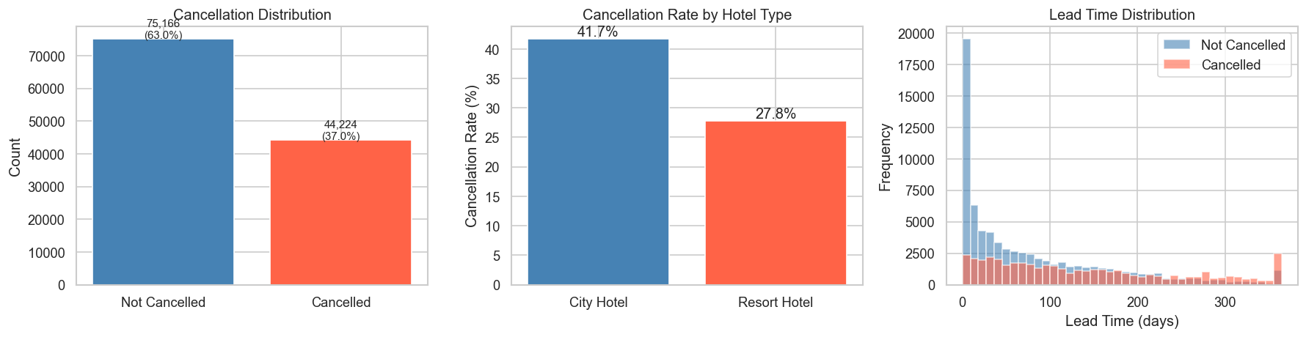
Dataset Overview
Hotel Booking Demand — Kaggle (Jesse Mostipak)
119,390
37%
2
32
3 yrs
Reservations
Cancel Rate
Hotel Types
Raw Features
2015 – 2017
City Hotel: 66% of bookings, 42% cancel rate · Resort Hotel: 28% cancel rate

Slide 5
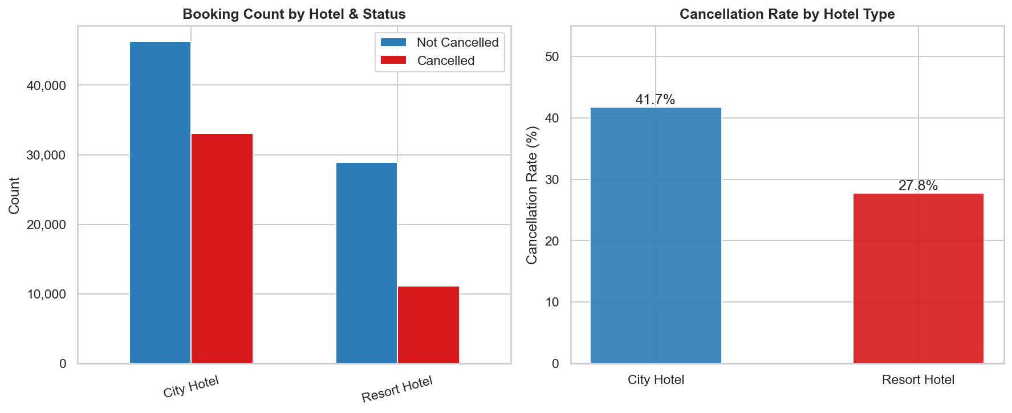
Cancellation Rate by Hotel Type
City Hotel cancels at ~42%; Resort Hotel at ~28%
Hotel Type
▸ City Hotel: 42% cancel
▸ Resort Hotel: 28% cancel
▸ City has 2× higher rate
▸ Class imbalance present
▸ Must stratify in train/test split

Slide 6
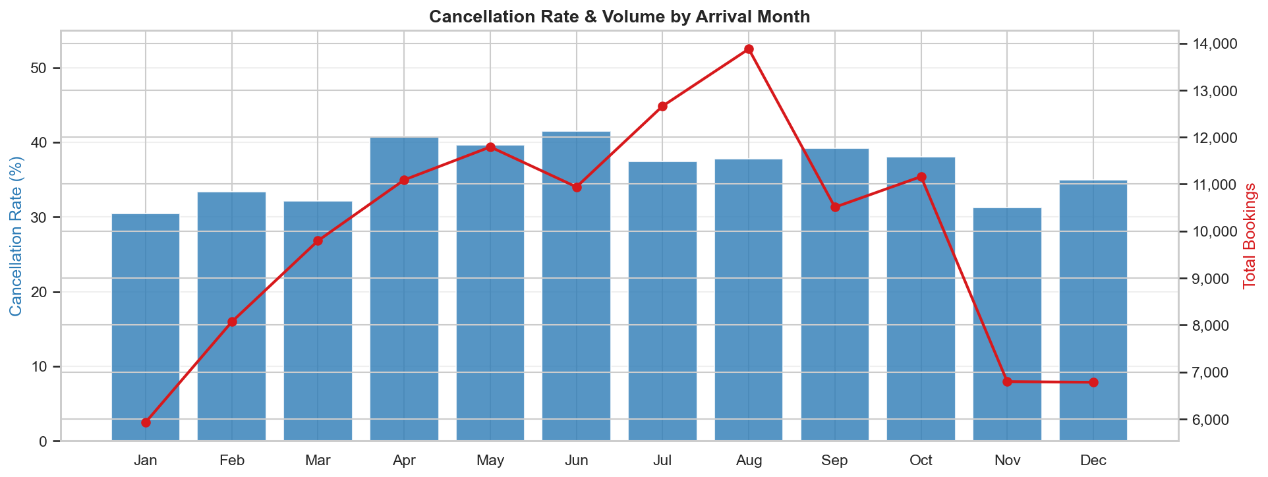
Monthly Booking & Cancellation Trends
Seasonal demand shifts and their effect on cancellation rates
Seasonality
▸ Peak bookings: Jul–Aug
▸ Highest cancel: Jan–Feb
▸ Low-season bookings cancel proportionally more
▸ Volume & rate move inversely in shoulders

Slide 7
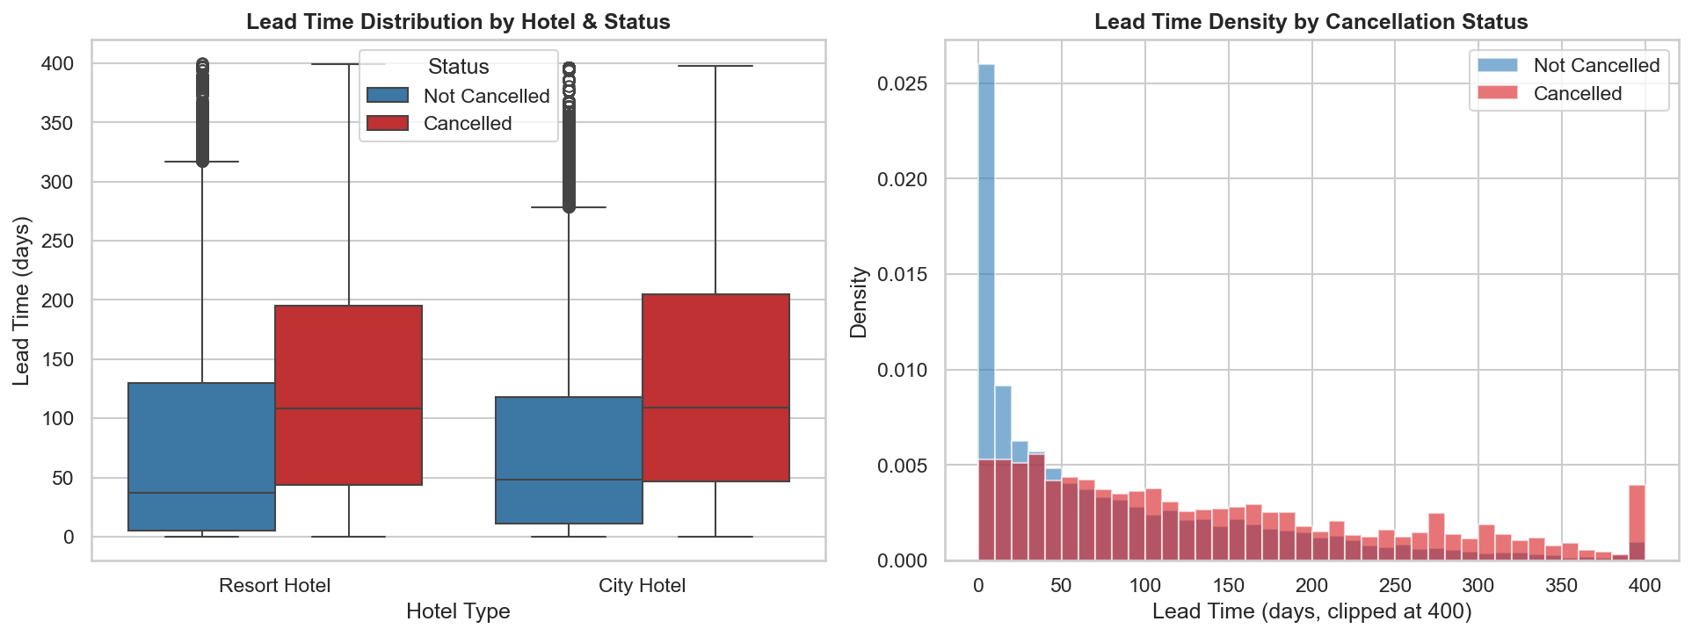
Lead Time Distribution
How far in advance bookings are made — and its link to cancellation
Lead Time
▸ Cancelled: 2× longer lead times on average
▸ City Hotel: wider spread
▸ Non-cancelled: mostly < 100 days ahead
▸ #1 numeric predictor across all models

Slide 8
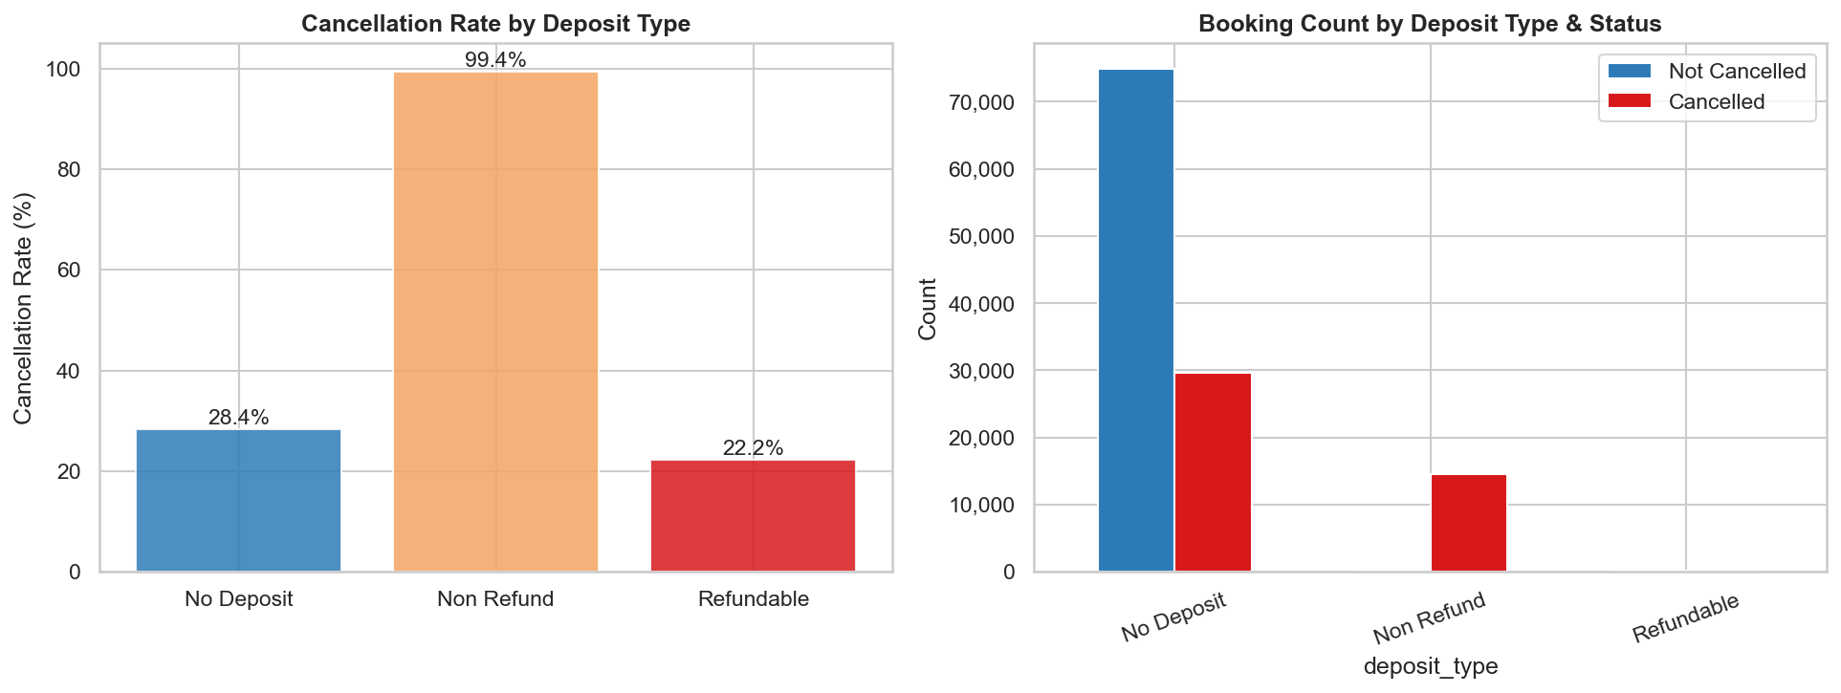
Deposit Type vs Cancellation
Payment policy has the most counter-intuitive signal in the dataset
Deposit Type
▸ Non-Refund: ~99% cancel
▸ No Deposit: ~28% cancel
▸ Refundable: ~22% cancel
▸ Paradox driven by OTA policy behaviour
▸ High predictive signal despite odd direction

Slide 9
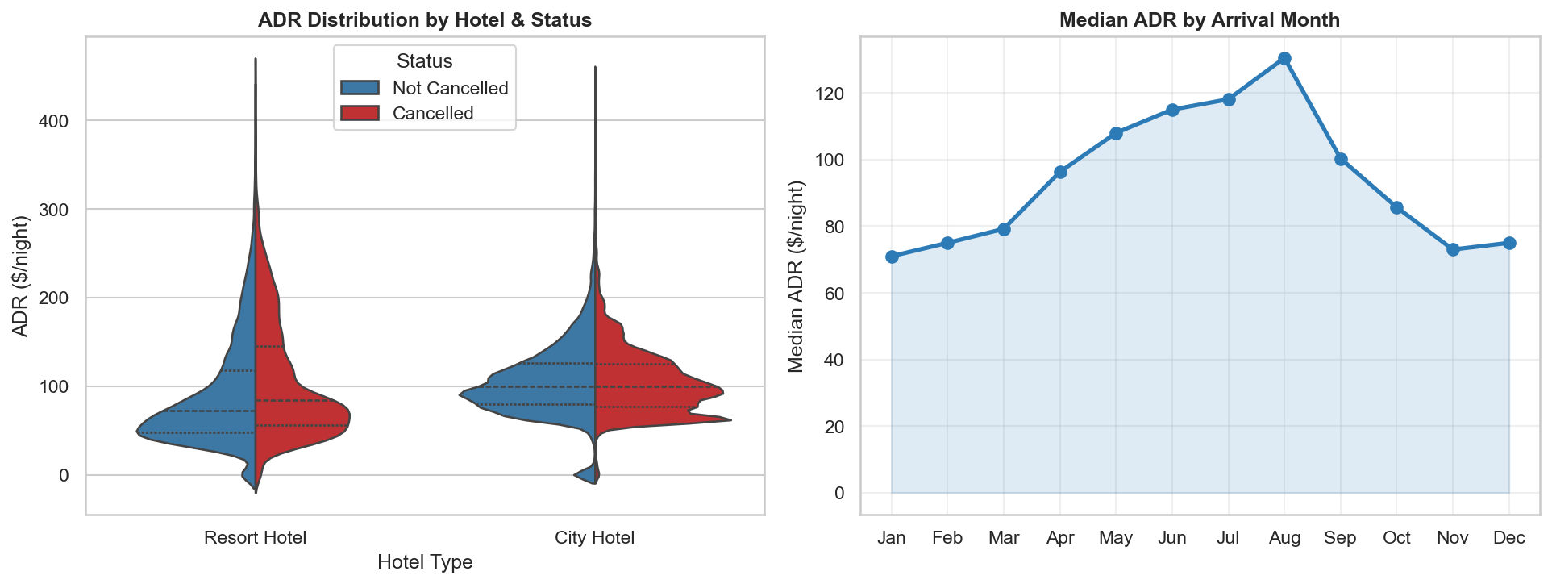
Average Daily Rate (ADR)
Pricing patterns by hotel type, month, and cancellation status
Pricing
▸ Resort ADR peaks Jul–Aug
▸ City ADR relatively flat
▸ Cancelled bookings: slightly higher ADR avg
▸ ADR tracks seasonal demand closely

Slide 10
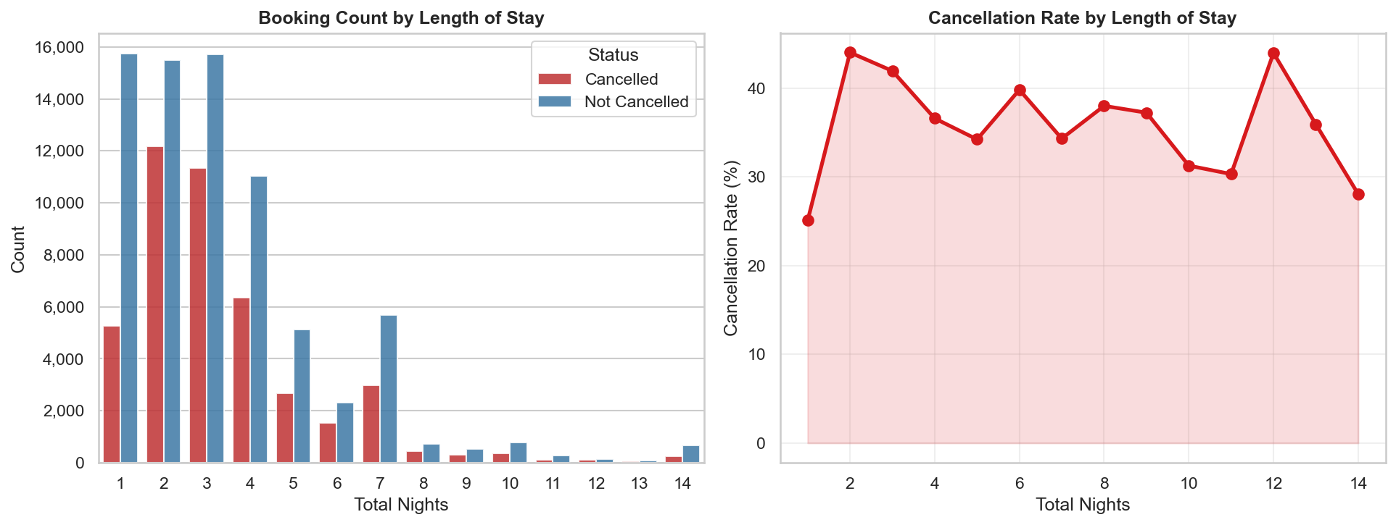
Length of Stay
Booking duration patterns and cancellation risk
Stay Duration
▸ 1–3 night stays dominate
▸ Very long stays (>7 nights) have elevated cancel rates
▸ Sweet spot: 2–4 nights → lowest cancel risk
▸ 1-night bookings also cancel infrequently

Slide 11
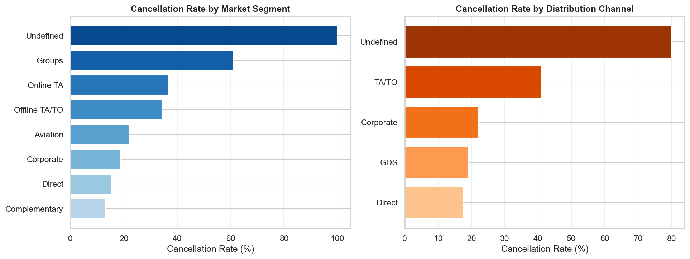
Booking Channel & Market Segment
Where guests book shapes their likelihood of cancelling
Channel
▸ Online TA: highest vol, 36% cancel rate
▸ Direct: lower cancel rate
▸ Corporate / Groups: lowest cancel rates
▸ GDS: elevated cancel
▸ Channel reflects booking commitment

Slide 12
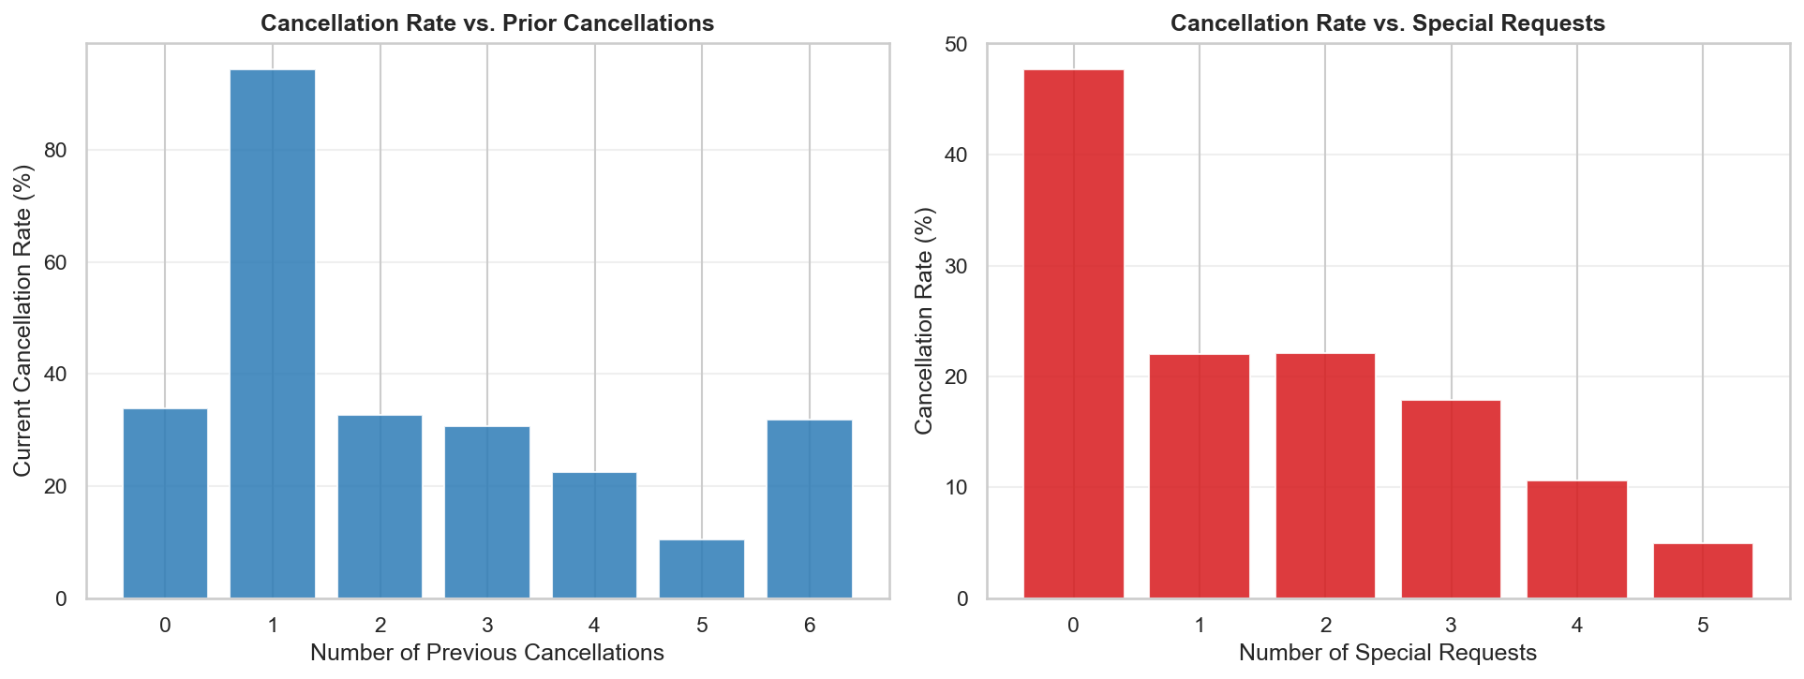
Guest Behaviour — Prior Cancels & Special Requests
Engagement signals are among the strongest behavioural predictors
Behaviour
▸ 1+ prior cancel → 80%+ future cancel rate
▸ 0 requests: ~40% cancel
▸ 3+ requests: ~10% cancel
▸ Engaged guests rarely cancel
▸ Behavioural history is highly predictive

Slide 13
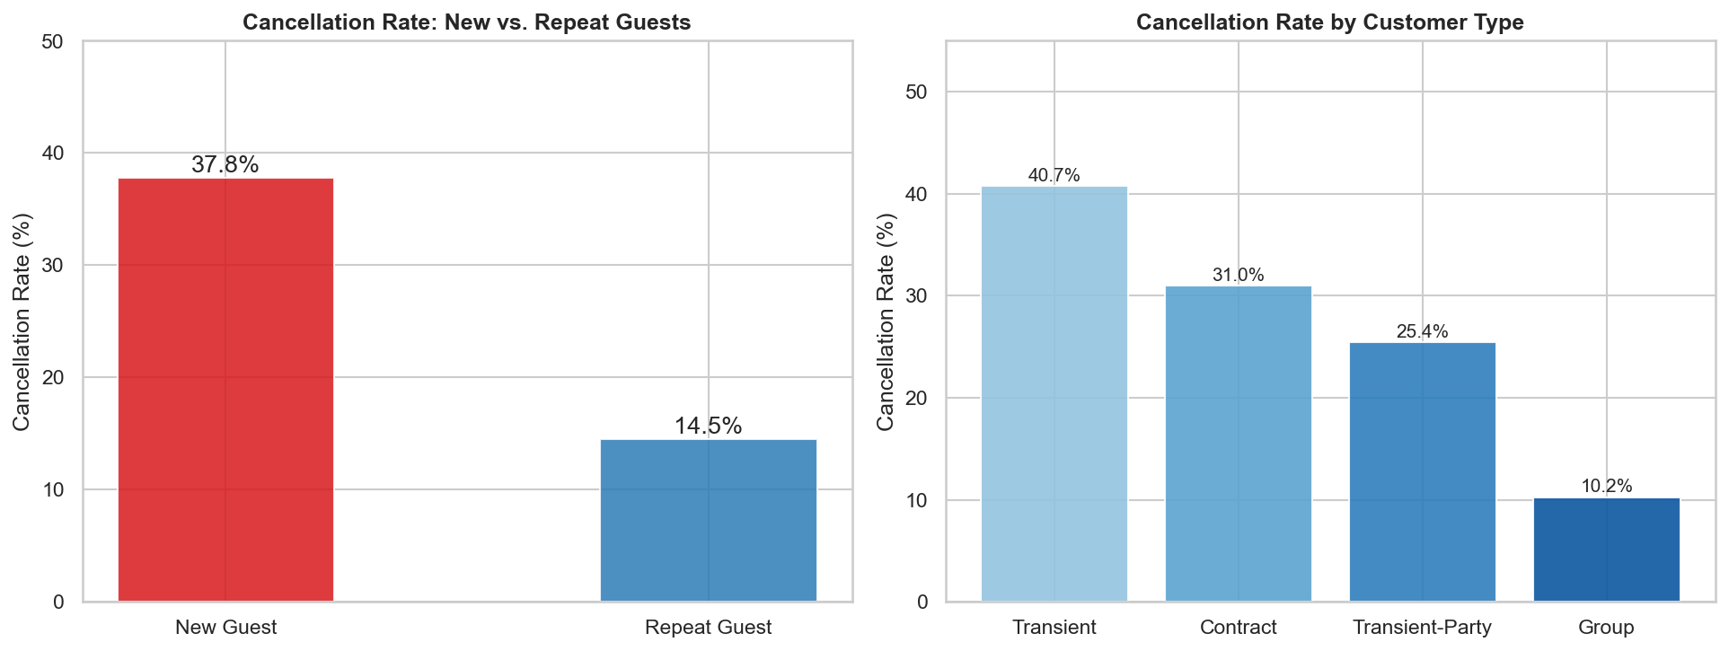
Guest Profile — Repeat vs New Guests
Loyalty dramatically reduces cancellation risk
Guest Type
▸ Repeat guests: 14% cancellation rate
▸ New guests: 38% cancel
▸ Transient type cancels most (~39%)
▸ Group type: very low cancellation
▸ Loyalty = commitment

Slide 14
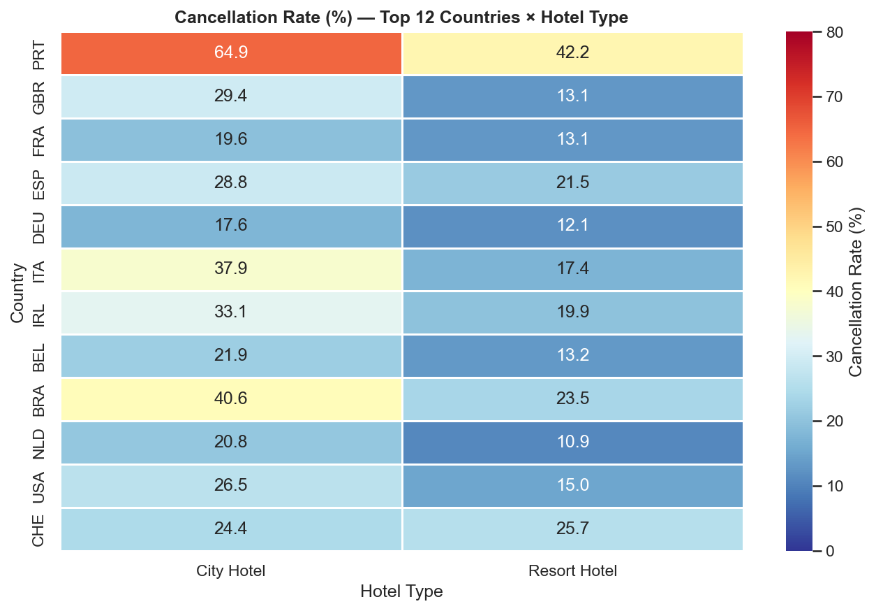
Geographic Insights
Country of origin and cancellation patterns by hotel type
Geography
▸ Portugal dominates booking volume
▸ Wide variation by country of origin
▸ Some countries: near 0% cancel rate
▸ City Hotel higher across all countries
▸ Country is a moderate predictor

Slide 15
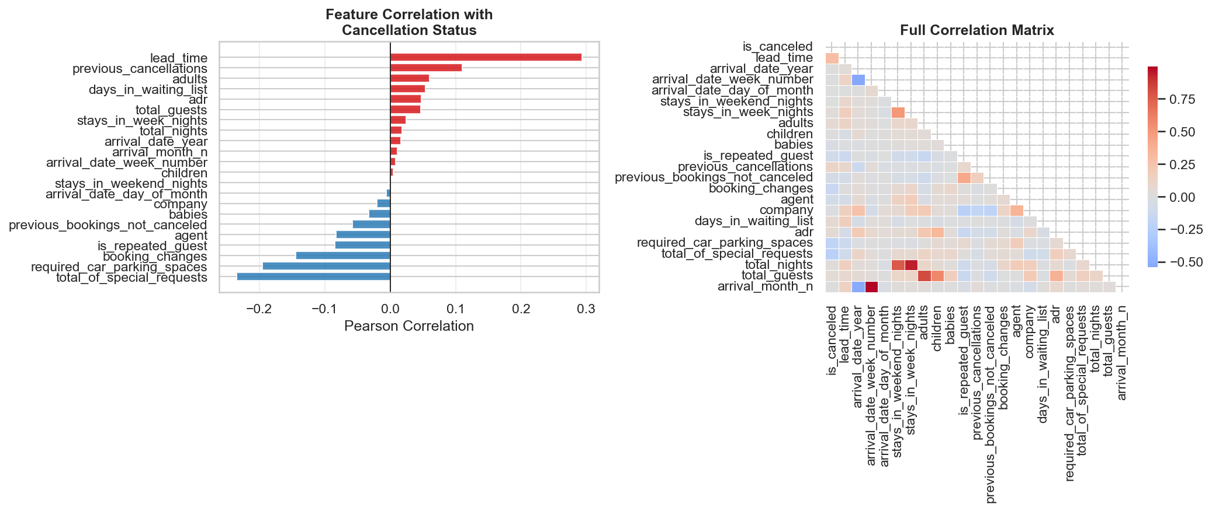
Correlation Analysis
Numeric feature relationships — what correlates with cancellation
Correlations
▸ lead_time: strongest positive corr.
▸ special_requests: negative (protective)
▸ prev_cancellations: positive
▸ adr: slight positive
▸ adults / children: near zero

Slide 16
EDA — 8 Key Findings
Lead Time
Deposit Type
Prior Cancels
Special Requests
2× longer lead time for cancellations
Non-refundable → 99% cancellation paradox
Strongest behavioural predictor overall
3+ requests → only 10% cancel rate
Hotel Type
Booking Channel
Repeat Guests
Seasonality
City 42% vs Resort 28% cancel rate
OTA dominates; Direct bookings commit more
14% vs 38% for new guests
Jan–Feb peak cancel despite low volume

Slide 17
02
Predictive Modelling
Logistic · Probit · L1/L2 · PCA · Trees · Ensembles

Slide 18
Models Compared
8 classifiers — statistical baselines to ensemble methods
Model
Description
Curriculum Link
Family
Logistic Regression
sigmoid link, MLE
Ch. 3 — Baseline
Probit Regression
normal CDF link, MLE
Ch. 3 — GLM alternative
L1 Logistic (Lasso)
ℓ₁ penalty → sparse coefs
Ch. 5 — Regularization
L2 Logistic (Ridge)
ℓ₂ penalty → shrinkage
Ch. 5 — Regularization
PCA + Logistic Regression
dim. reduction → LR
Ch. 5 — Dimension Red.
Decision Tree
gini / entropy splits
Ch. 3 — Non-linear
Random Forest
bagged trees, sqrt feat.
Ensemble
Gradient Boosting
sequential boosting
Ensemble
Statistical (Ch.3)
Regularization (Ch.5)
Ensemble

Slide 19
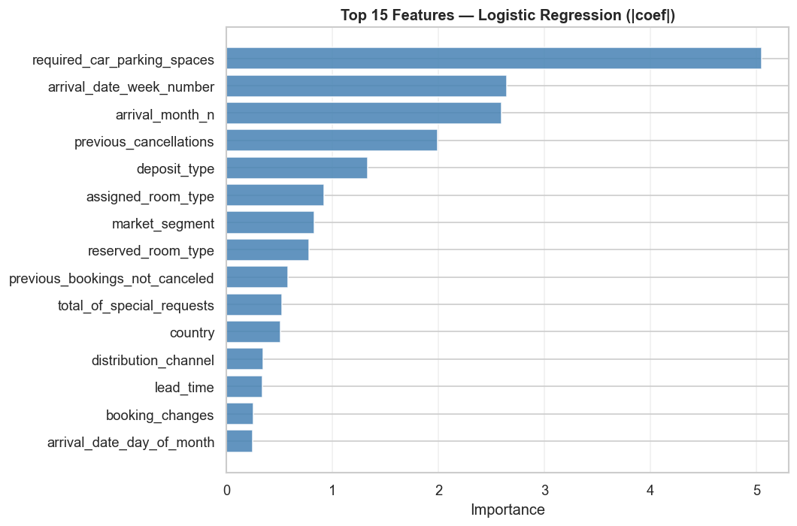
Logistic Regression
Baseline statistical classifier — sigmoid link function, MLE estimation (STAT-654 Ch. 3)
How it works
▸ Models p(Y=1|X) = eᶿᵀˣ / (1 + eᶿᵀˣ)
▸ Log-odds (logit) is linear in X
▸ Coefficients estimated via MLE
▸ β₁ = change in log-odds per unit X
▸ Regularization via C = 1/λ
Best Hyperparameters
Penalty : L2 (default)
C (inv. λ) : 1.0
Solver : lbfgs
Max iterations : 1000
CV folds : 5 (F1 scoring)
Test Set Performance
Accuracy :
0.792
Precision :
0.808
Recall :
0.576
F1-Score :
0.673
ROC-AUC :
0.862
Train time :
5.4 s

Slide 20
Probit Regression
Normal CDF link function — theoretically equivalent to latent variable model (STAT-654 Ch. 3)
How it works
Best Hyperparameters
▸ p(Y=1|X) = Φ(XᵀΒ) where Φ = normal CDF
Method : Newton-Raphson
▸ Latent variable: Y* = XᵀΒ + ε, ε ~ N(0,1)
Max iterations : 300
▸ Y=1 if Y* > 0, Y=0 otherwise
Fit via : statsmodels.Probit
▸ Coefficients estimated by MLE (Newton-Raphson optimization)
No regularization (full MLE)
▸ Nearly identical to logistic in practice; differs in tail behavior
Threshold : 0.50 (default)
Test Set Performance
Accuracy :
~0.790
F1-Score :
~0.670
ROC-AUC :
~0.860
Train time :
< 60 s
Notes
▸ Probit & Logistic nearly indistinguishable on hotel data — confirms Ch. 3 theory
▸ Probit slightly heavier-tailed; useful when normality assumption is appropriate

Slide 21
Logistic Regression — L1 (Lasso)
Sparse feature selection via ℓ₁ penalty (STAT-654 Ch. 5)
How it works
Best Hyperparameters
▸ Loss = Log-likelihood + λ Σ|βⱼ|
Penalty : L1
▸ ℓ₁ penalty forces some βⱼ = exactly 0
Solver : SAGA
▸ Automatic variable selection built-in
C search : [0.001, 0.01, 0.1, 1.0, 10.0]
▸ Solved with coordinate descent (SAGA)
Max iterations : 3000
▸ λ = 1/C; larger λ → sparser model
CV folds : 5 (F1 scoring)
▸ Outperforms Ridge when few features truly matter
Test Set Performance
Best C :
(see notebook output)
Features zeroed :
several (see nb)
F1-Score :
competitive with LR
ROC-AUC :
~0.86
Notes
▸ Shrinkage path shows coefficients hitting zero as λ increases
▸ Provides most interpretable subset of hotel booking features

Slide 22
Logistic Regression — L2 (Ridge)
Smooth coefficient shrinkage — all features retained (STAT-654 Ch. 5)
How it works
Best Hyperparameters
▸ Loss = Log-likelihood + λ Σβⱼ²
Penalty : L2
▸ ℓ₂ penalty shrinks all βⱼ → 0, never = 0
Solver : lbfgs
▸ Handles correlated predictors well
C search : [0.001, 0.01, 0.1, 1.0, 10.0]
▸ Scale invariant after standardization
Max iterations : 3000
▸ Predictors must be standardized first
CV folds : 5 (F1 scoring)
▸ Better than L1 when many features have small-but-real effects
Test Set Performance
Best C :
(see notebook output)
Features zeroed :
0 (Ridge retains all)
F1-Score :
comparable to baseline LR
ROC-AUC :
~0.86
Notes
▸ Ridge & standard LR converge at high C
▸ Useful when multicollinearity present among hotel booking features

Slide 23
PCA + Logistic Regression
Dimensionality reduction then classification (STAT-654 Ch. 5)
How it works
Best Hyperparameters
▸ PCA finds M orthogonal directions of maximum variance in feature space
n_components search : [10, 15, 20, 25]
▸ Z₁ = φ₁₁X₁ + φ₂₁X₂ + … + φₚ₁Xₚ (1st PC)
LR C search : [0.1, 1.0, 10.0]
▸ Each Zⱼ is uncorrelated with others
Solver : lbfgs
▸ LR fit on Z₁…Zₘ instead of raw features
CV folds : 5 (F1 scoring)
▸ Removes multicollinearity by design
Features standardized before PCA
▸ sklearn Pipeline: PCA → StandardLR
Test Set Performance
Best n_components :
(see notebook)
Variance explained :
90%+ typical
F1-Score :
slight drop vs full LR
ROC-AUC :
~0.85
Notes
▸ Trade-off: interpretability lost (PCs are linear combos, not raw features)
▸ Useful when p is large or features are heavily collinear

Slide 24
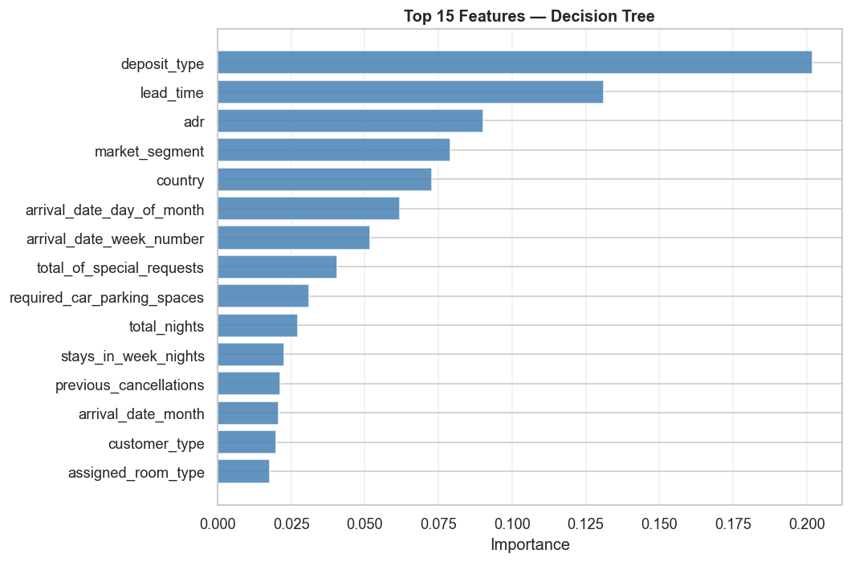
Decision Tree
Fully interpretable recursive binary splitting (STAT-654 Ch. 3)
How it works
▸ Splits feature space into rectangular regions by minimizing impurity
▸ Impurity: Gini = 1 − Σpₖ² or Entropy
▸ Greedy top-down recursive partitioning
▸ Pruned via max_depth / min_samples
▸ Fully white-box — human-readable rules
Best Hyperparameters
Criterion : entropy (best CV)
max_depth : tuned [5, 10, 15, None]
min_samples_split : tuned [2,10,20]
min_samples_leaf : tuned [1, 5, 10]
CV folds : 5 (F1 scoring)
Test Set Performance
Accuracy :
0.841
Precision :
0.782
Recall :
0.794
F1-Score :
0.788
ROC-AUC :
0.834
Train time :
37.5 s

Slide 25
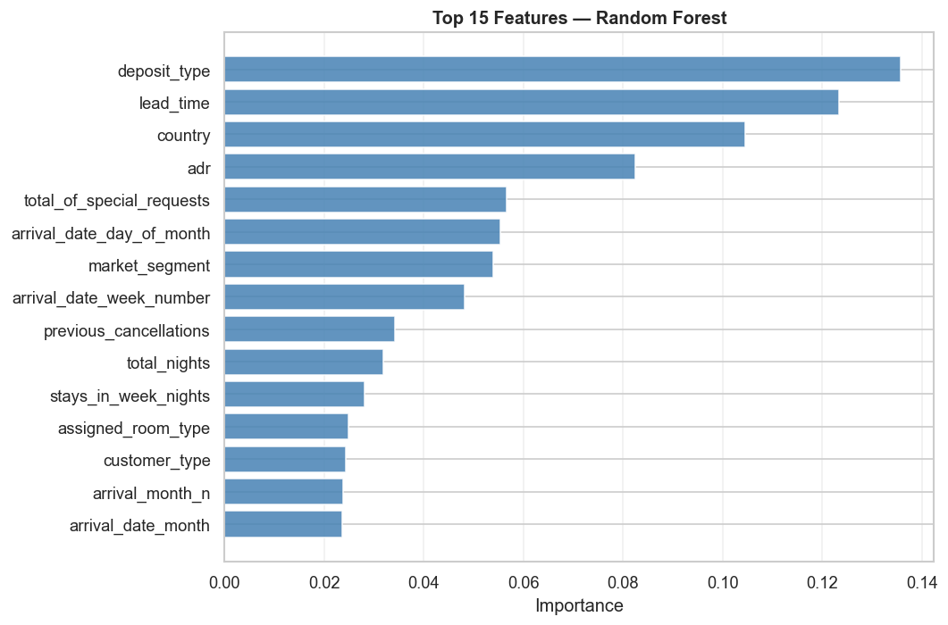
Random Forest
Ensemble of trees via bagging + random feature subsets
How it works
▸ Builds B trees on bootstrap samples
▸ Each split considers only √p features (reduces correlation between trees)
▸ Final prediction = majority vote
▸ Variance reduced vs single tree with minimal bias increase
▸ Feature importance = avg impurity drop
Best Hyperparameters
n_estimators : 200
max_depth : None (fully grown)
max_features : sqrt
min_samples_split : 2
CV folds : 5 (F1 scoring)
Test Set Performance
Accuracy :
0.887
Precision :
0.885
Recall :
0.799
F1-Score :
0.840
ROC-AUC :
0.953
Train time :
324.6 s

Slide 26
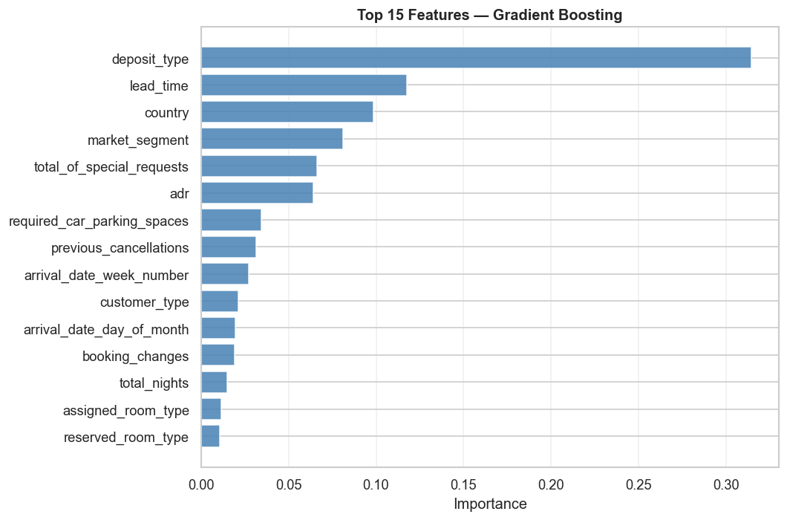
Gradient Boosting
Sequential additive ensemble — each tree corrects the previous residuals
How it works
▸ Fit tree hₘ(x) to residuals of Fₘ₋₁(x)
▸ Update: Fₘ(x) = Fₘ₋₁(x) + η·hₘ(x)
▸ η = learning rate (shrinkage)
▸ Shallow trees (depth 3–5) preferred to control variance
▸ Subsample < 1 adds stochasticity (stochastic gradient boosting)
Best Hyperparameters
n_estimators : 200
learning_rate : 0.1
max_depth : 5
subsample : 0.8
CV folds : 5 (F1 scoring)
Test Set Performance
Accuracy :
0.876
Precision :
0.857
Recall :
0.798
F1-Score :
0.826
ROC-AUC :
0.948
Train time :
1163 s

Slide 27
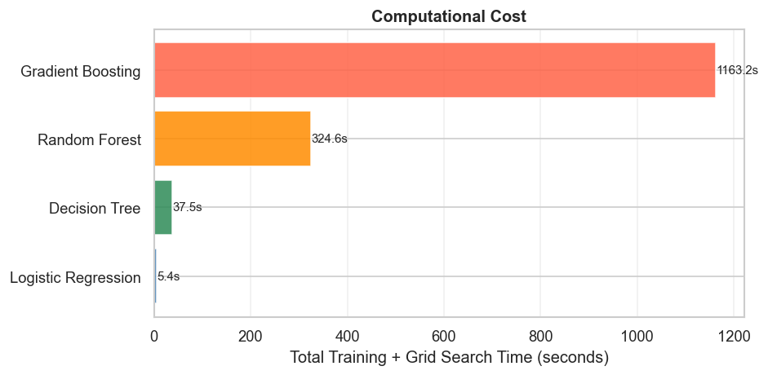
Computational Cost Comparison
Total training + grid search time across all models
Speed vs Perf.
▸ Logistic: fastest (5 s)
▸ Probit: < 60 s (no CV)
▸ L1 / L2: ~minutes (SAGA)
▸ Decision Tree: 37 s
▸ Random Forest: 5 min
▸ Gradient Boosting: 20 min
▸ Accuracy/cost trade-off favors RF for production

Slide 28
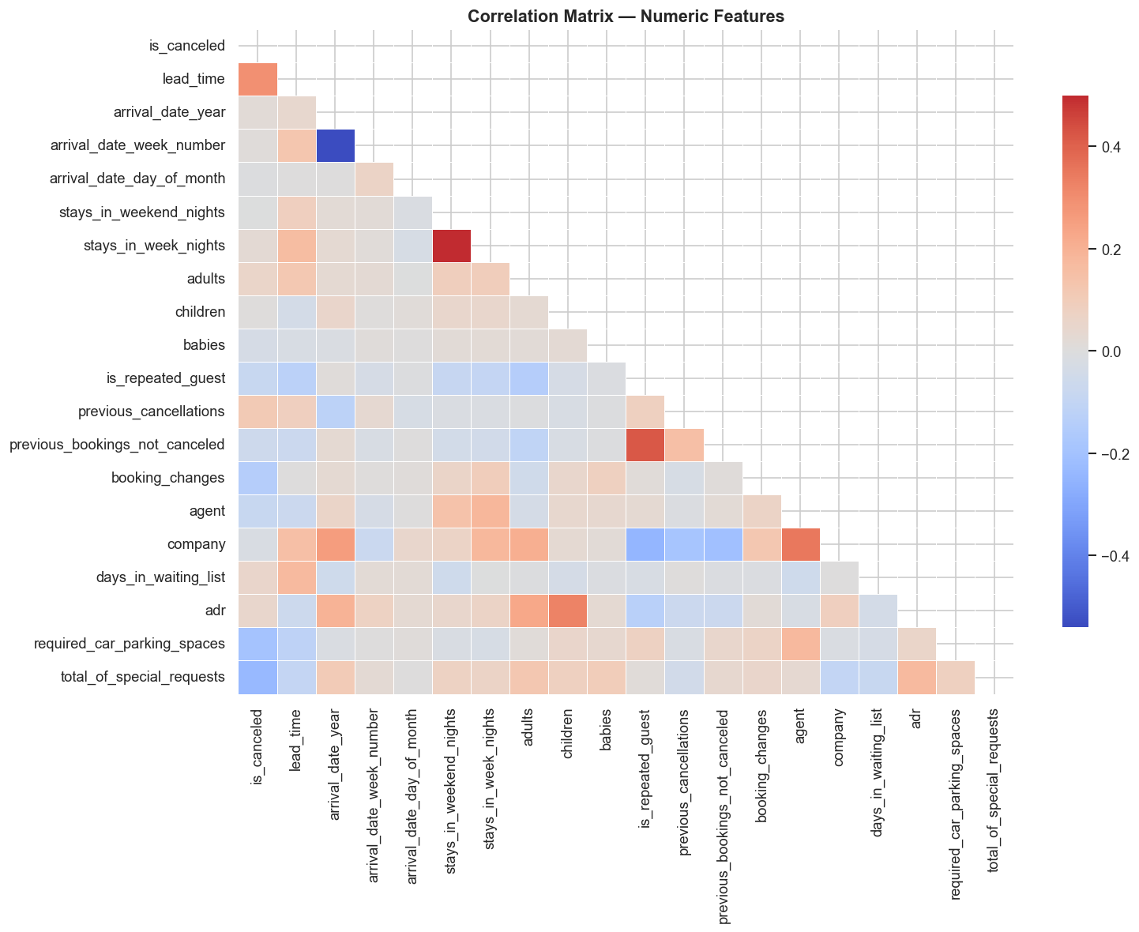
Regularization — L1 vs L2 Shrinkage Paths
How each coefficient changes as λ increases (STAT-654 Ch. 5)
Regularization
▸ L1 (Lasso): zeroes out irrelevant features
▸ L2 (Ridge): shrinks all — none hit zero
▸ Dashed line = λ chosen by CV
▸ Confirms Ch. 5 theory on real hotel data
▸ Lasso removes several redundant features

Slide 29
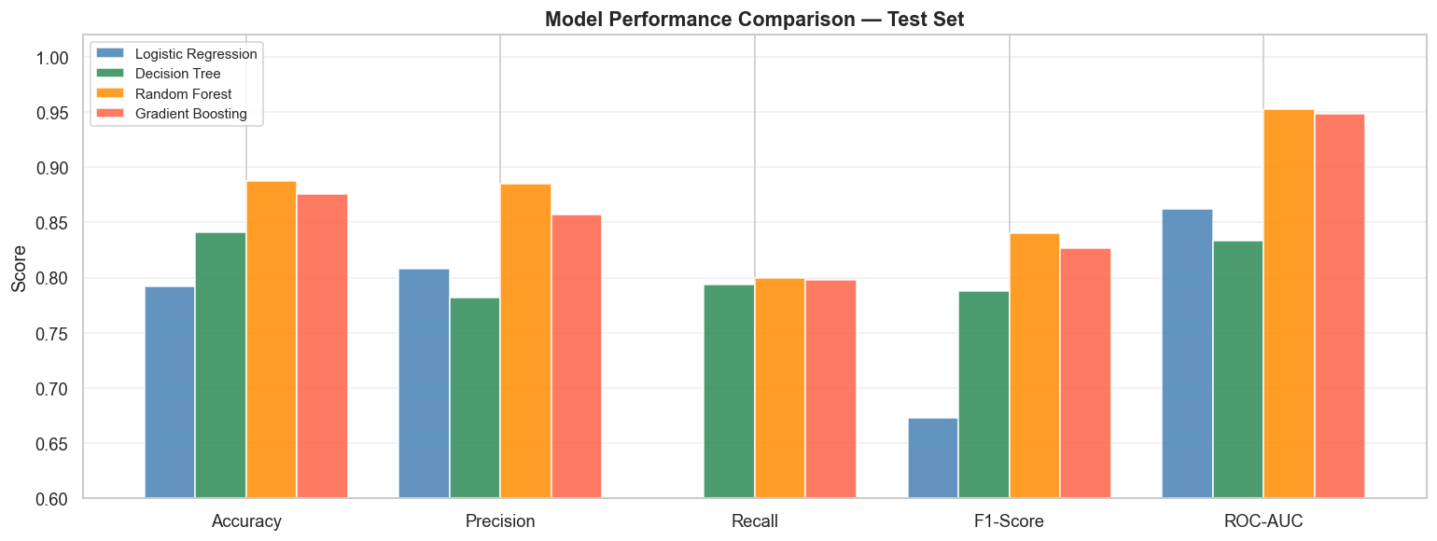
Model Performance — Test Set Metrics
Accuracy · Precision · Recall · F1-Score · ROC-AUC across all 8 models
Results
▸ Gradient Boosting: best F1 & AUC
▸ Random Forest: close second
▸ L1 Lasso: sparse model, solid F1
▸ Ridge ≈ standard LR
▸ Probit ≈ Logistic (theory confirmed)
▸ PCA-LR: slight drop

Slide 30
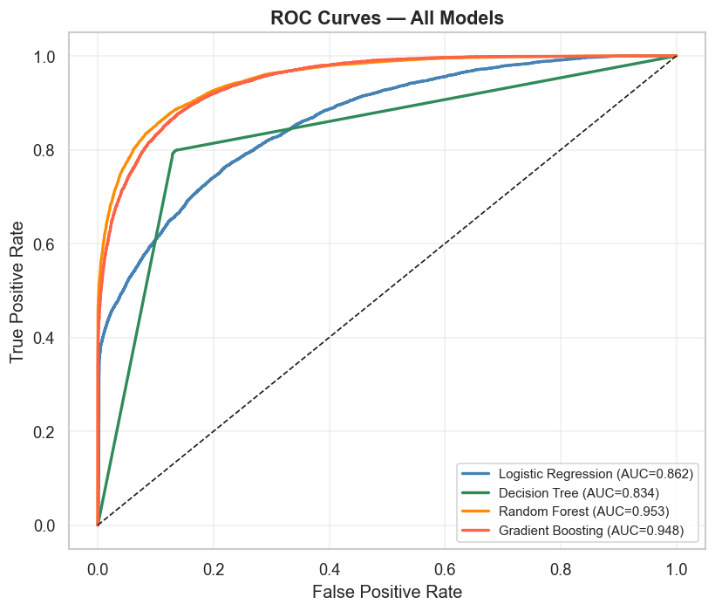
ROC Curves — All 8 Models
True Positive Rate vs False Positive Rate at varying thresholds
ROC / AUC
▸ Ensembles AUC > 0.92
▸ Logistic variants ~0.80 – 0.85 AUC
▸ Ideal curve: top-left
▸ Random chance: 0.50
▸ AUC = probability model ranks + case higher

Slide 31
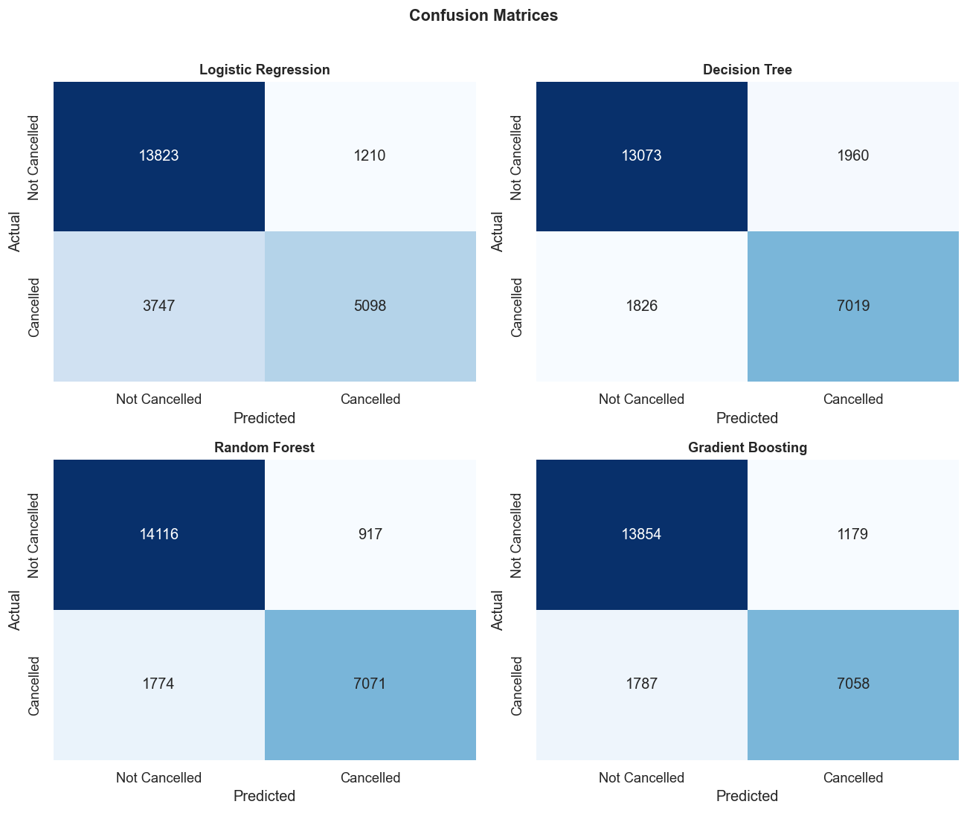
Confusion Matrices — All Models
True/False Positive & Negative breakdown on the test set
Error Types
▸ Ensembles minimize false negatives
▸ Logistic models miss more cancellations
▸ High recall important: cost of missed cancel
▸ Precision–recall trade-off visible

Slide 32
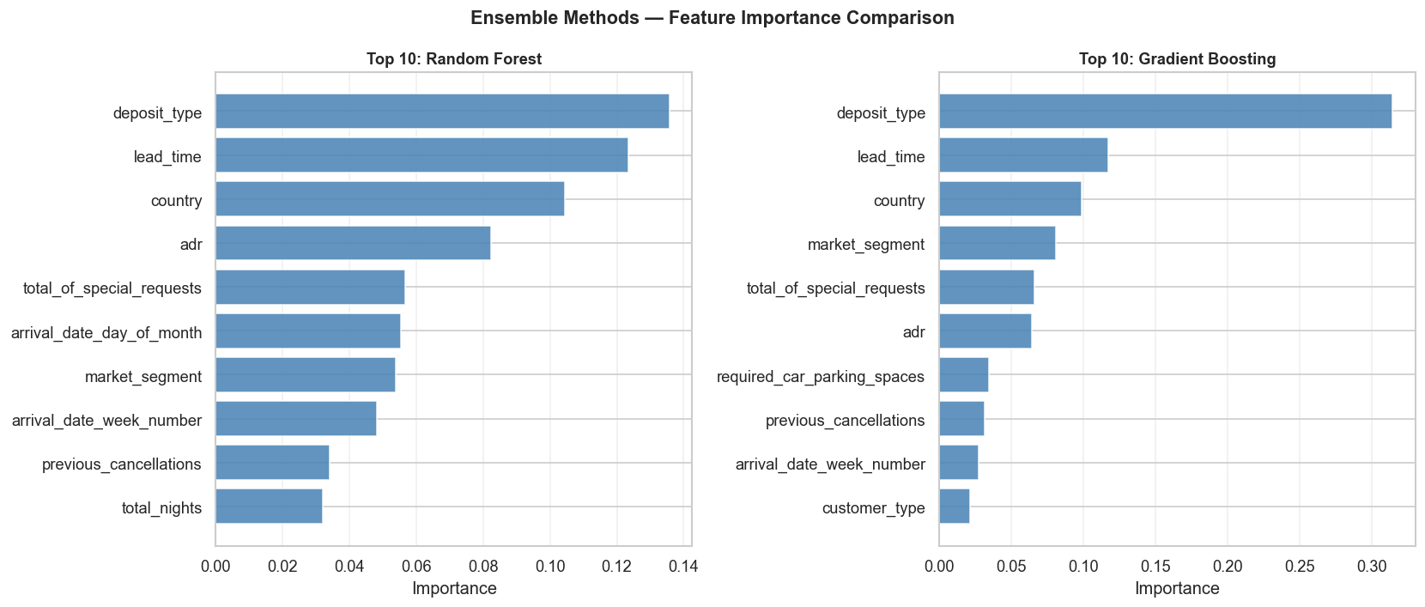
Feature Importance — Ensemble Models
Top predictors identified by Random Forest and Gradient Boosting
Top Features
▸ lead_time: #1 across both ensembles
▸ deposit_type: high predictive power
▸ adr: average daily rate
▸ special_requests: protective signal
▸ prev_cancellations: behavioural memory

Slide 33
Conclusions
Gradient Boosting Wins
Lasso Selects Features
Probit ≈ Logistic
Best F1 and AUC across all 8 models. Non-linear interactions matter.
L1 penalty zeros out redundant columns — sparse model, competitive accuracy.
Both GLMs give near-identical results, confirming theoretical similarity (Ch. 3).
PCA Costs Little
Lead Time is #1
Business Implication
15–20 components explain 90%+ variance with only slight F1 drop.
Strongest predictor across all models — long booking window = higher risk.
Target interventions at long-lead, no-deposit, OTA bookings. Repeat guests and special requests are protective.

Slide 34
Questions & Discussion
Thank You
Sai Nithin Reddy Maddi
Sujith Julakanti
STAT-654 · Texas A&M University · April 2026
Dataset: Kaggle — Hotel Booking Demand (Jesse Mostipak)
8
119K
37%
0.93+
Models
Bookings
Cancel Rate
Best AUC

