Slide 1
Hotel Booking Demand
Exploratory Data Analysis
Sai Nithin Reddy Maddi · Sujith Julakanti
STAT-654 · March 2026

Slide 2
Agenda
What we will cover today
01
Dataset Overview
02
Target Distribution
Source, size, key variables
Overall and by hotel type
03
Temporal Patterns
04
Pricing Analysis
Monthly trends in bookings & cancellations
Average Daily Rate (ADR) patterns
05
Booking Behavior
06
Customer Segmentation
Lead time, deposit type, length of stay
Market segment, distribution channel
07
Guest Profile
08
Geographic Insights
New vs repeat guests, customer type
Top countries and their cancellation rates
09
Correlation Analysis
10
Key Takeaways
Feature relationships with cancellation
Summary findings

Slide 3
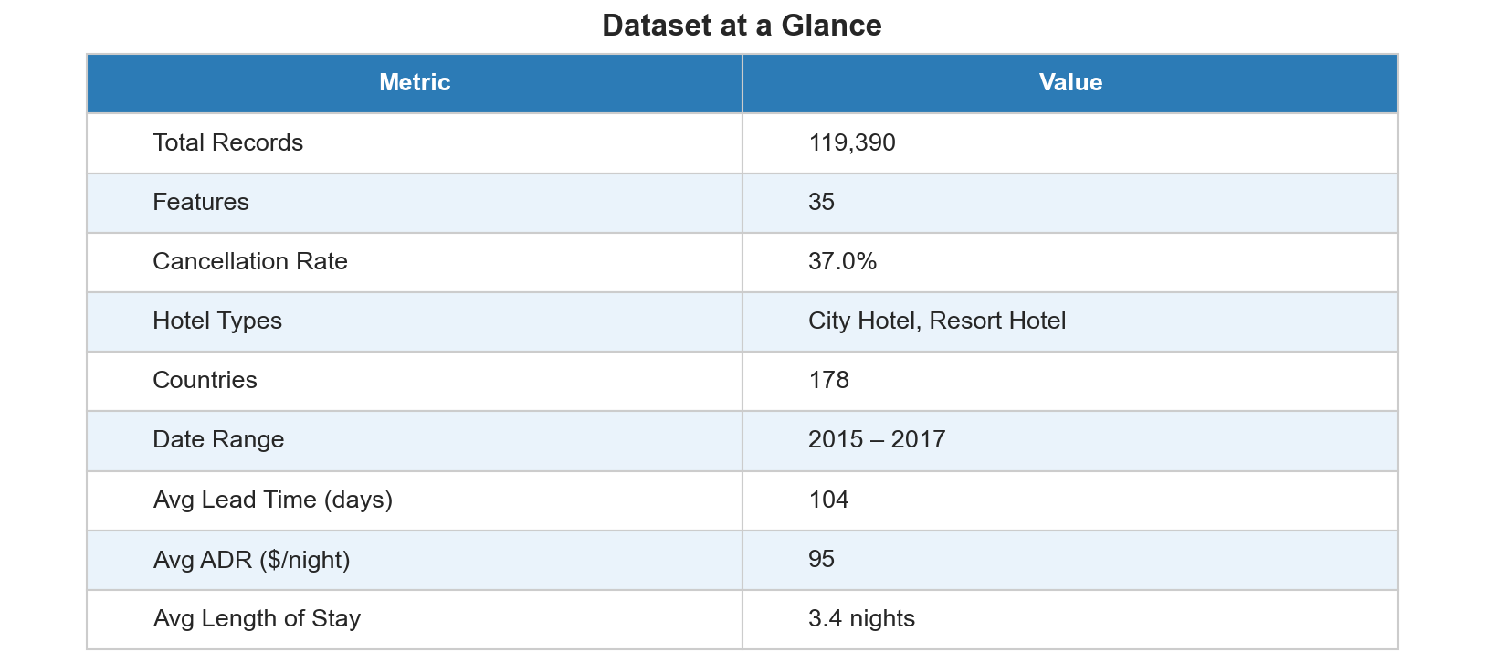
01 · Dataset Overview
Hotel Booking Demand — Kaggle
• 119,390 hotel reservations
• City Hotel & Resort Hotel
• July 2015 – August 2017
• 37% overall cancellation rate
• 32 raw features
• Source: Kaggle (Jesse Mostipak)

Slide 4
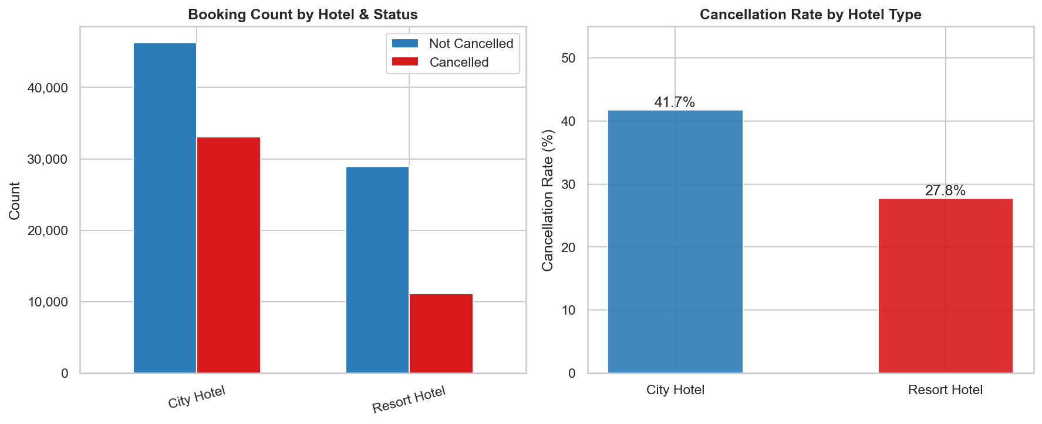
02 · Target Distribution
Cancellation rates overall and by hotel type
• 37% of all bookings cancelled
• City Hotel: ~42% cancel rate
• Resort Hotel: ~28% cancel rate
• City Hotel has ~2× more cancellations than Resort Hotel
• Class imbalance must be addressed in modelling

Slide 5
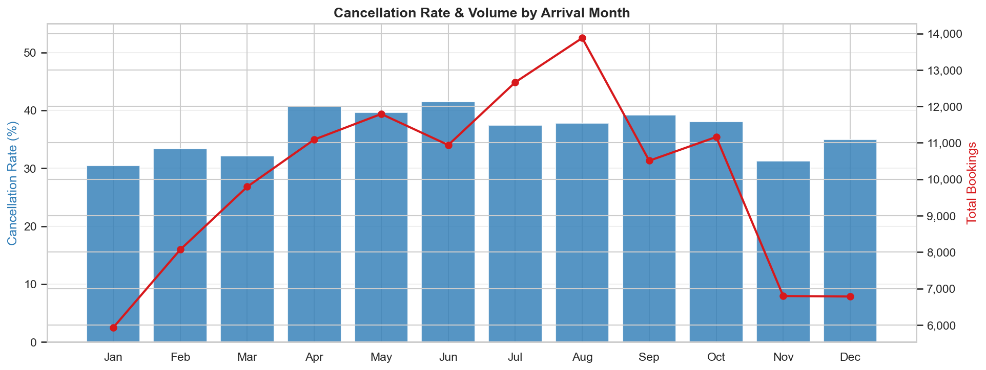
03 · Temporal Patterns
Monthly cancellation rate and booking volume
• Peak bookings: Jul–Aug (summer)
• Highest cancel rate: Jan–Feb
• Low season bookings show higher relative cancellations
• Volume & rate move inversely in shoulder months

Slide 6
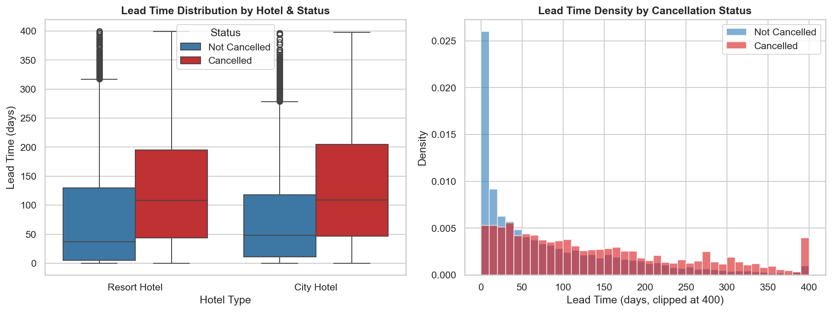
04 · Lead Time Analysis
How far in advance bookings are made
• Cancelled bookings have significantly longer lead times
• City Hotel: wider lead time spread
• Most non-cancelled bookings: < 100 days ahead
• Lead time is a strong predictor of cancellation

Slide 7
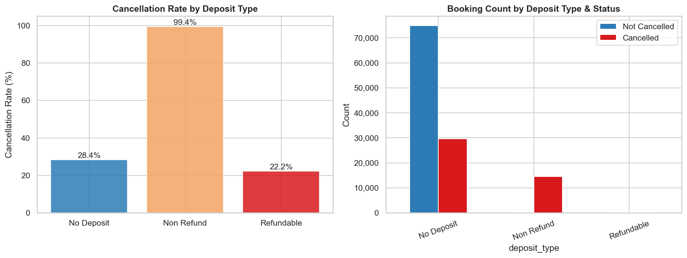
05 · Deposit Type Analysis
Cancellation behaviour by payment policy
• Non Refund: ~99% cancel rate (!)
• No Deposit: ~28% cancel rate
• Refundable: ~22% cancel rate
• Non-refundable paradox likely due to OTA policy behaviour
• High predictive signal despite counter-intuitive direction

Slide 8
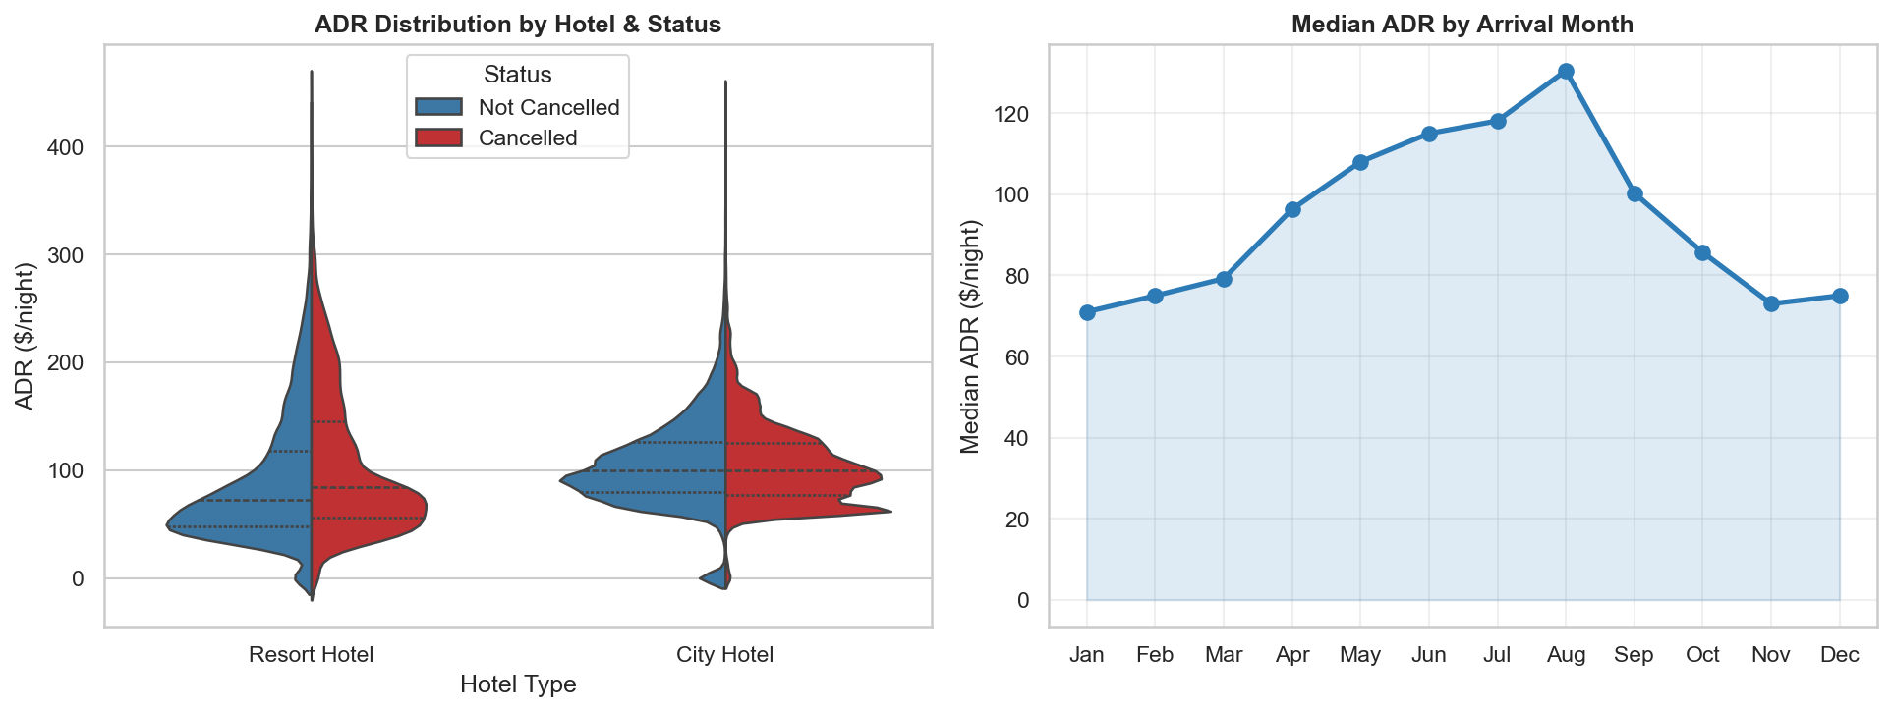
06 · Pricing Analysis (ADR)
Average Daily Rate by hotel and month
• Resort Hotel ADR peaks in Jul–Aug
• City Hotel relatively flat throughout year
• Cancelled bookings slightly higher ADR (on average)
• ADR strongly follows seasonal demand

Slide 9
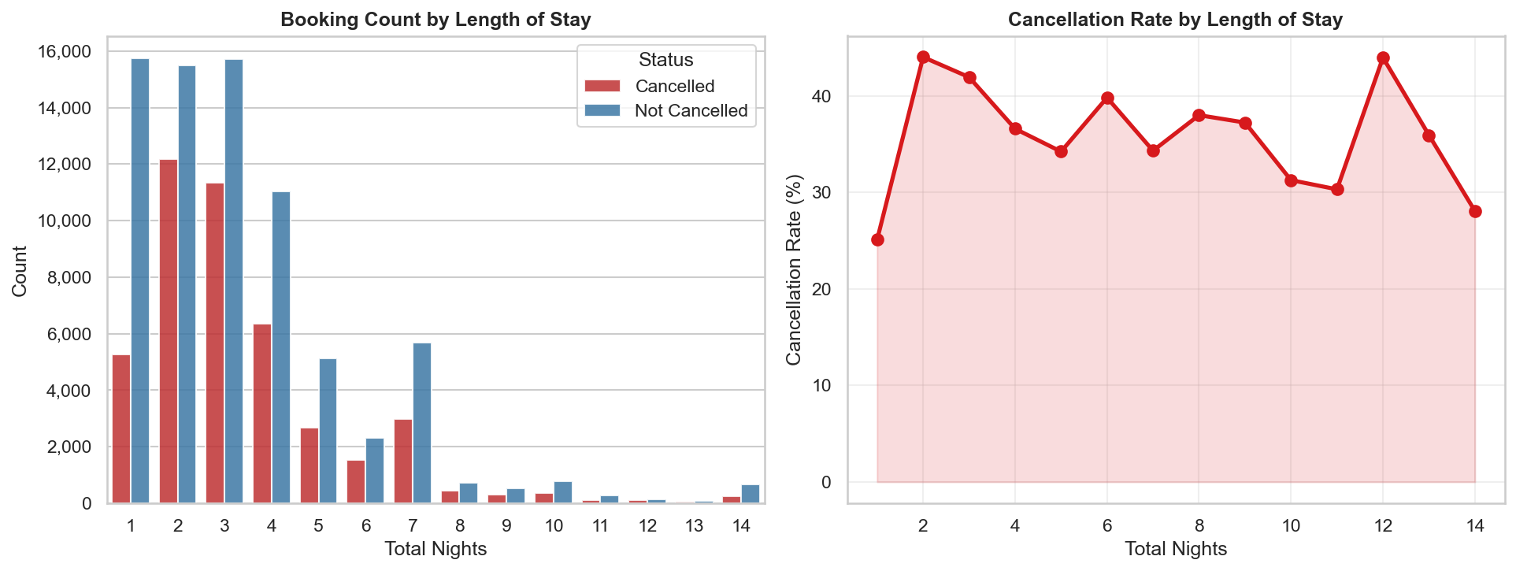
07 · Length of Stay
Booking patterns and cancellation by stay duration
• 1–3 night stays dominate bookings
• Very long stays (> 7 nights) have elevated cancel rates
• Sweet spot: 2–4 nights — lowest cancellation risk
• Very short (1 night) bookings also cancel less

Slide 10
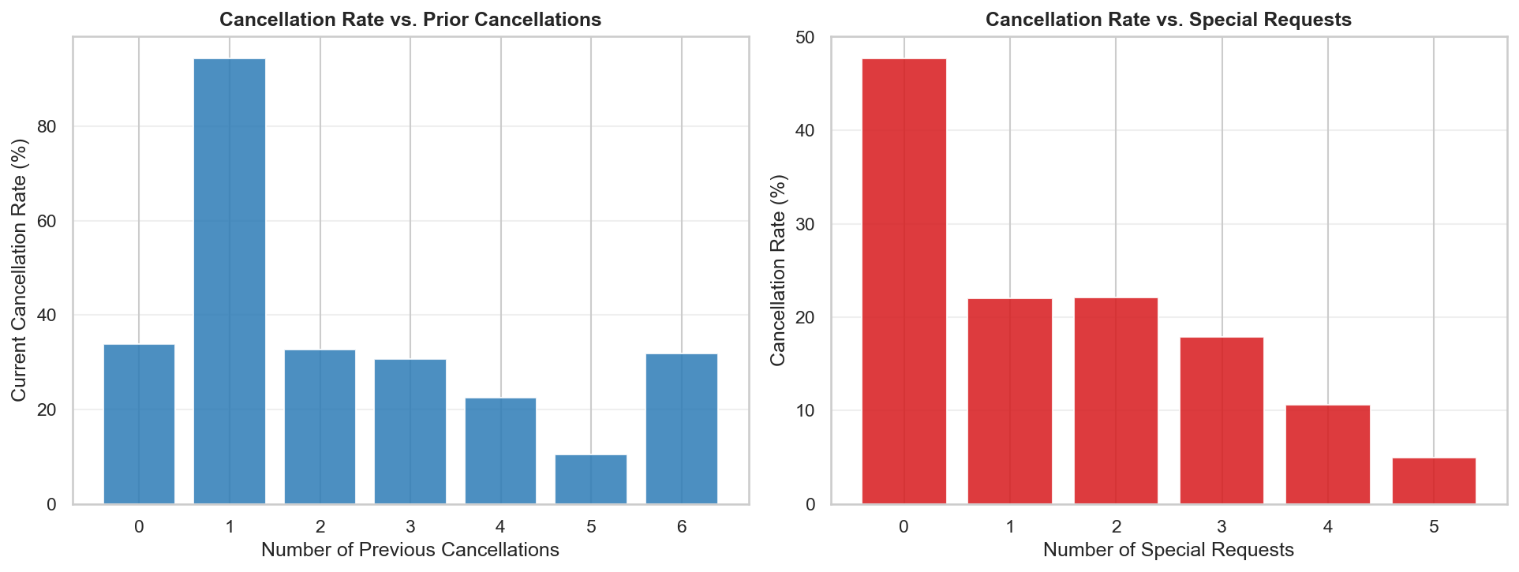
08 · Customer Behaviour
Prior cancellations & special requests
• Prior cancellations → strong predictor of future cancellations
• 1+ past cancellation → ~80% cancel rate
• More special requests → lower cancellation risk
• 0 requests: ~40% cancel vs 3 requests: ~10% cancel
• Engaged guests are less likely to cancel

Slide 11
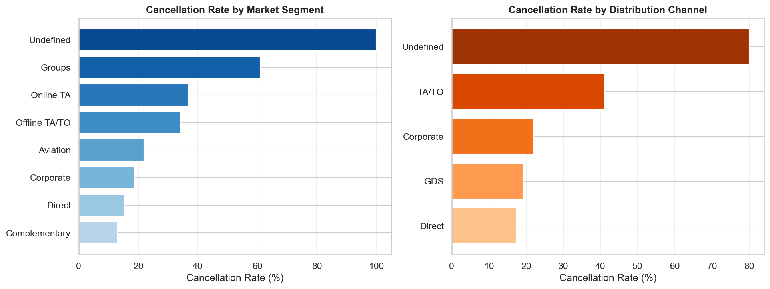
09 · Booking Channel & Market Segment
Where bookings originate
• Online TA: highest volume, ~36% cancel rate
• Groups segment: very low cancel rate
• Direct & Corporate bookings: lower cancel rates
• GDS channel: elevated cancellation
• Channel choice reflects booking intent & commitment

Slide 12
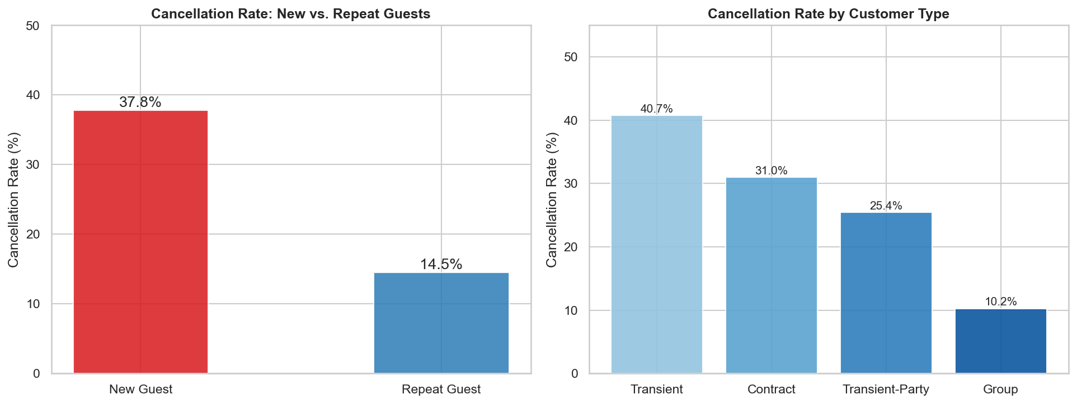
10 · Guest Profile
Repeat guests and customer type
• New guests: ~38% cancel rate
• Repeat guests: only ~14% cancel rate
• Transient customers cancel most (~39%)
• Group bookings have very low cancellation
• Loyalty and familiarity reduce cancellation risk

Slide 13
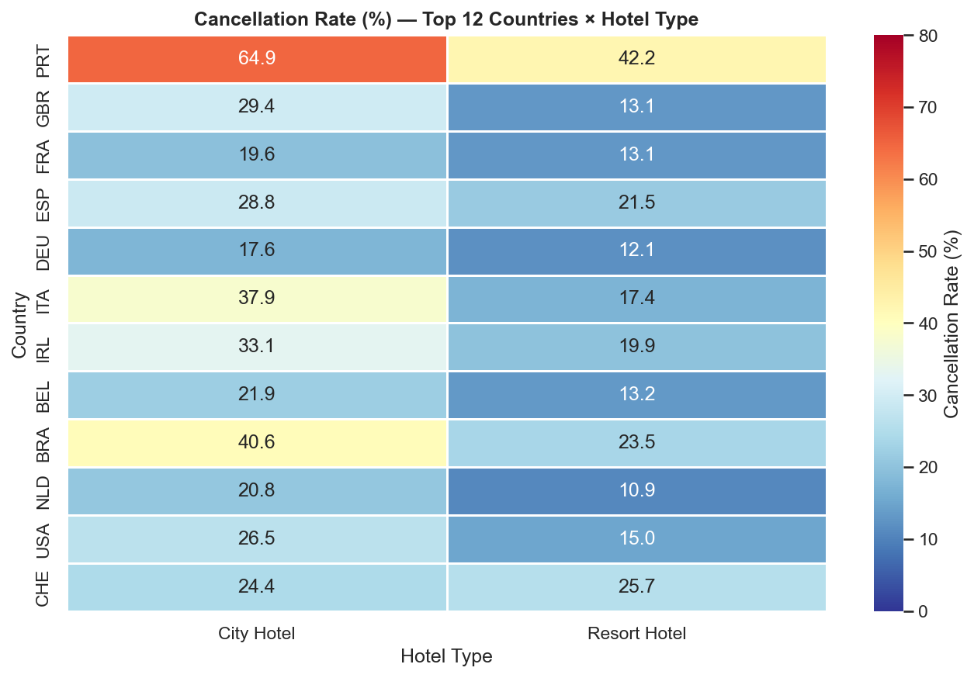
11 · Geographic Insights
Cancellation rates by country and hotel type
• PRT (Portugal) dominates bookings
• Wide variation by country of origin
• Some countries show near 0% cancel
• City Hotel generally higher across all countries
• Geographic origin is a moderate predictor

Slide 14
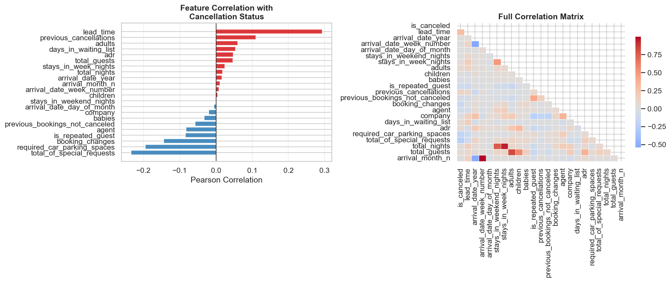
12 · Correlation Analysis
Feature relationships with cancellation
• lead_time: strongest positive correlation
• total_of_special_requests: negative (protective)
• previous_cancellations: positive
• adr: slight positive correlation
• total_nights: minor positive
• adults/children: near zero

Slide 15
13 · Key EDA Takeaways
Lead Time
Deposit Type
Longer booking windows strongly correlate with cancellations
Non-refundable policies paradoxically associate with ~99% cancel rate
Prior Cancellations
Special Requests
Past behaviour is the strongest behavioural predictor
More requests = more engaged guest = lower cancel risk
Hotel Type
Booking Channel
City Hotel cancels at ~42% vs Resort at ~28%
Online TA dominates volume but has moderate cancel rate
Repeat Guests
Seasonality
Loyal guests cancel at just 14% vs 38% for new guests
Jan–Feb peak cancel rates despite low booking volume

Slide 16
Thank You
Questions & Discussion
Sai Nithin Reddy Maddi · Sujith Julakanti · STAT-654 · April 2026
Dataset: Kaggle — Hotel Booking Demand (Jesse Mostipak)

