Slide 1
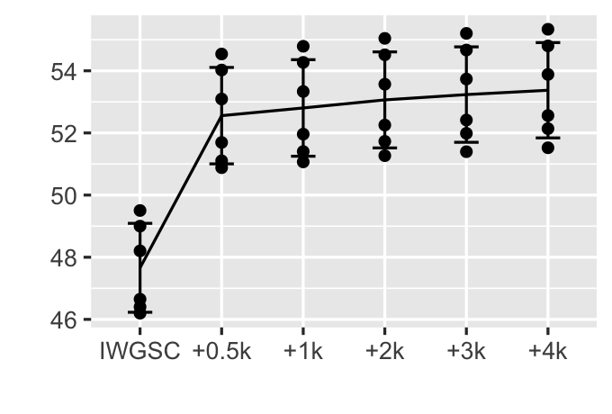
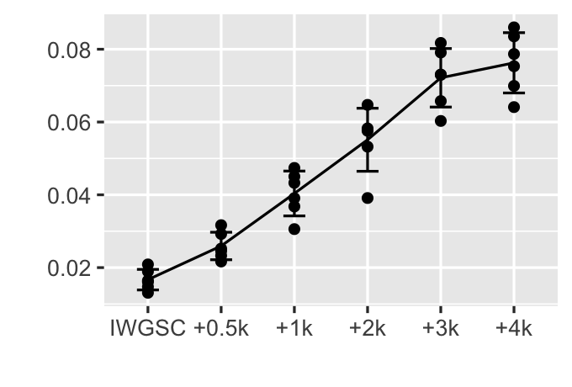
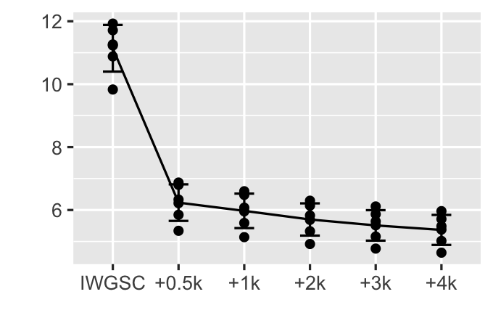
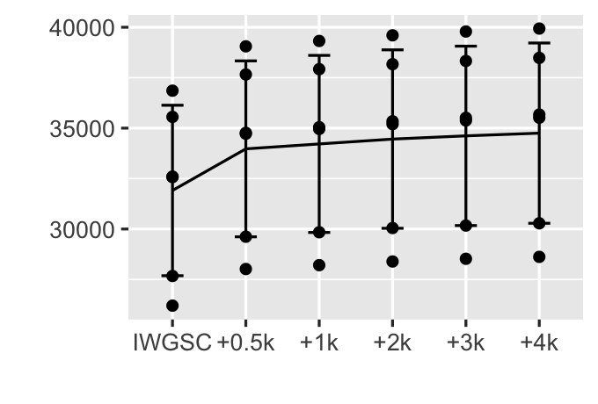
Figure 1
A
B
% reads
% reads
C
D
% reads
number of genes

Slide 2
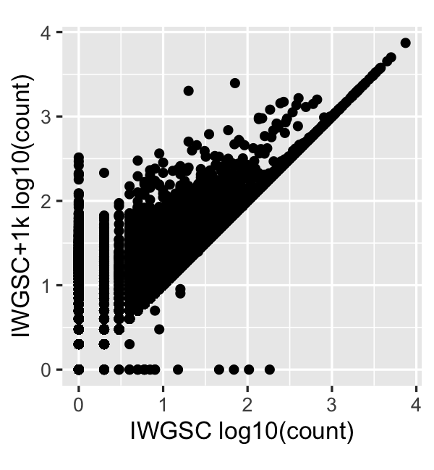
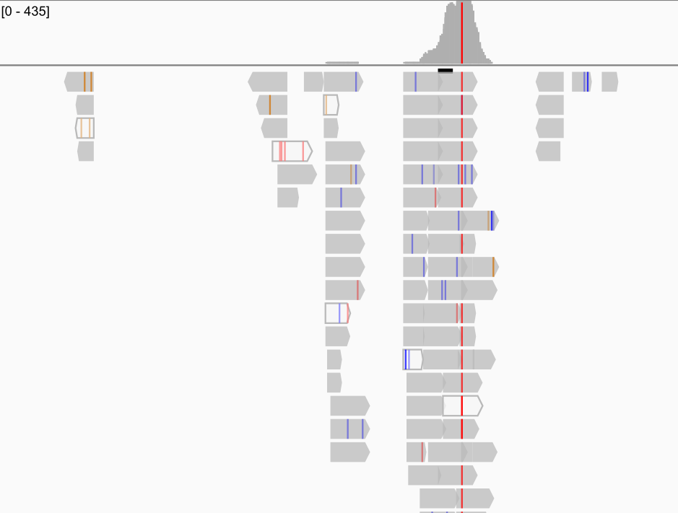
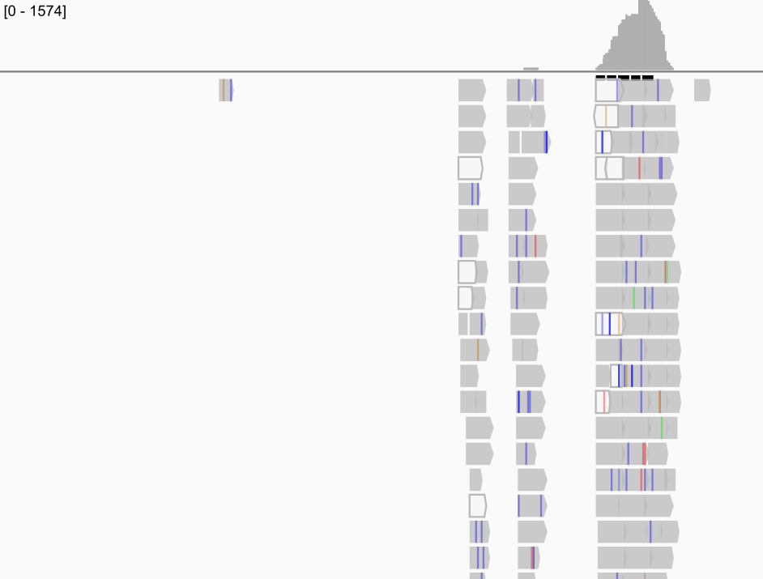
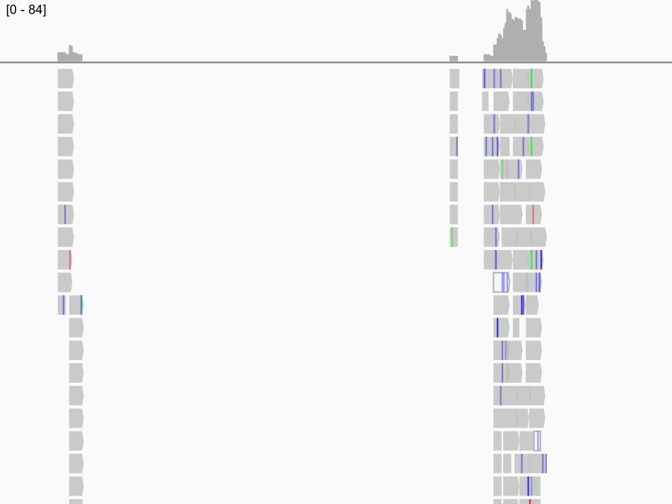
Figure 2
A
TraesCS4D02G145400
B
depth
435
0
TraesCS2B02G330500
TraesCS4D02G263300
2,154 bp
IWGSC
TraesCS2B02G330500
TraesCS2B02G330600
IWGSC+1k
C
depth
1,574
D
depth
84
0
0
3,297 bp
5,022 bp
IWGSC
TraesCS4D02G145500
TraesCS4D02G145400
TraesCS4D02G263200
TraesCS4D02G263300
TraesCS4D02G263400
IWGSC+1k

Slide 3
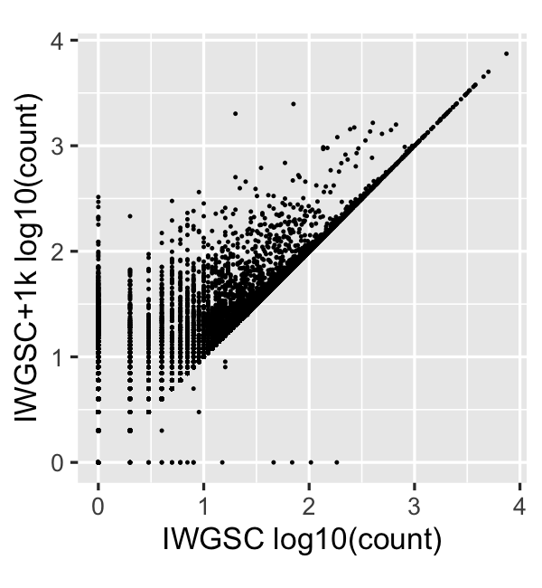
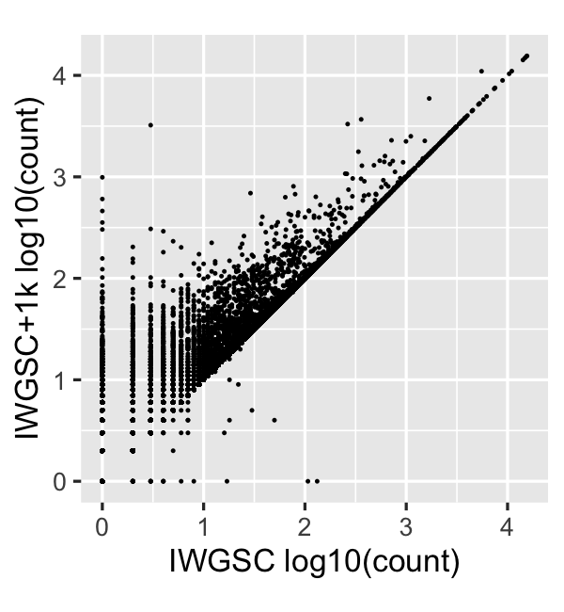
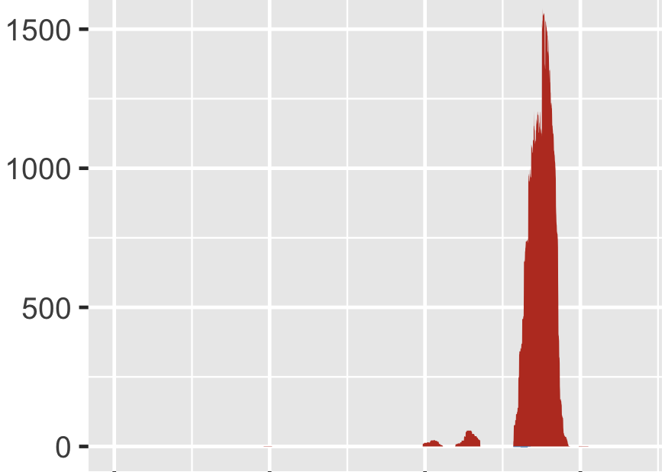
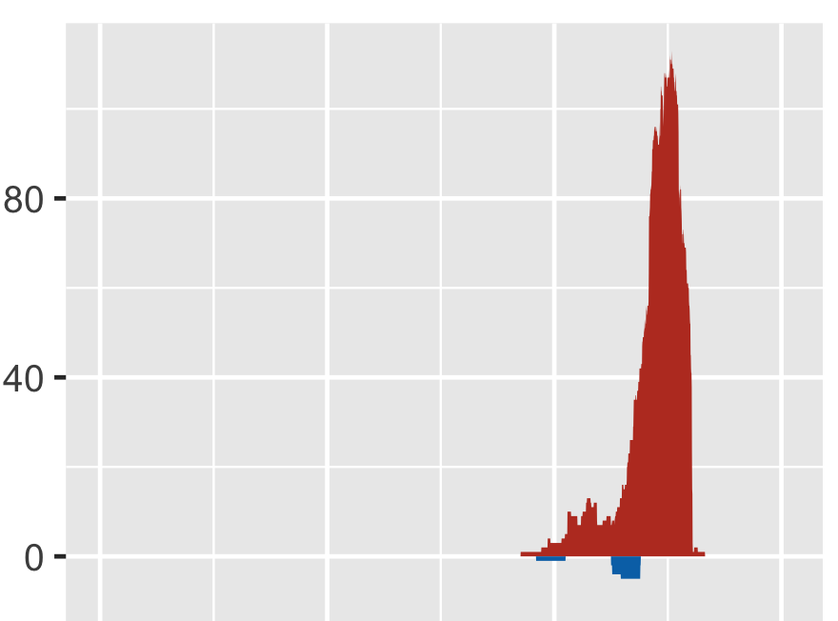
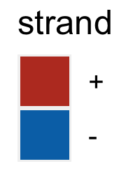
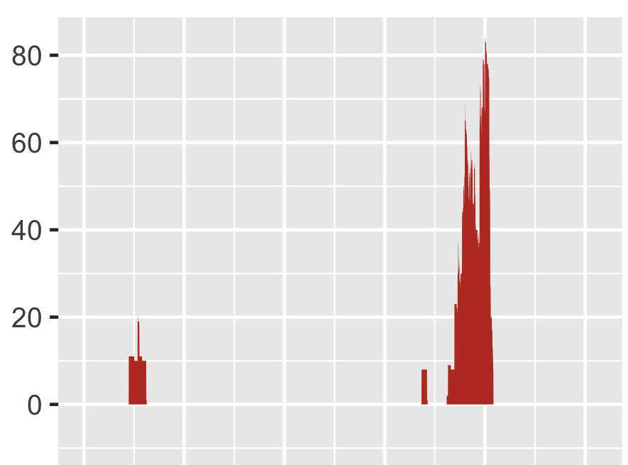
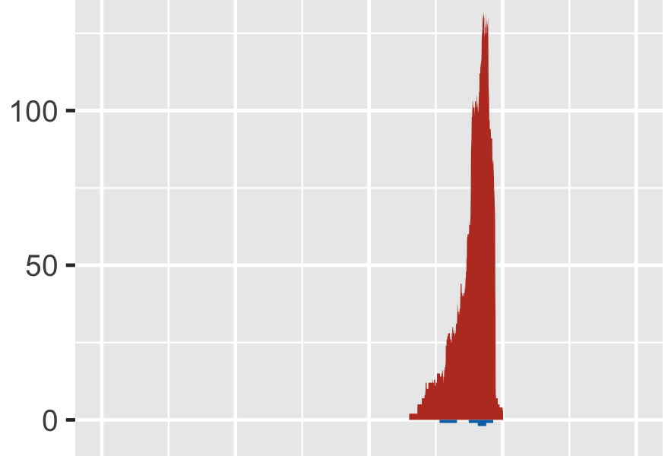
A
TraesCS4D02G145400
D
TraesCS7A02G115400
TraesCS7B02G013100
TraesCS4D02G263300
B
E
depth
depth
3,500 bp
3,000 bp
IWGSC
TraesCS4D02G145400
TraesCS4D02G145500
IWGSC
TraesCS7A02G115400
IWGSC+1k
IWGSC+1k
C
F
depth
depth
5,000 bp
4,000 bp
IWGSC
TraesCS4D02G263300
IWGSC
TraesCS7B02G013100
TraesCS4D02G263400
IWGSC+1k
IWGSC+1k

Slide 4
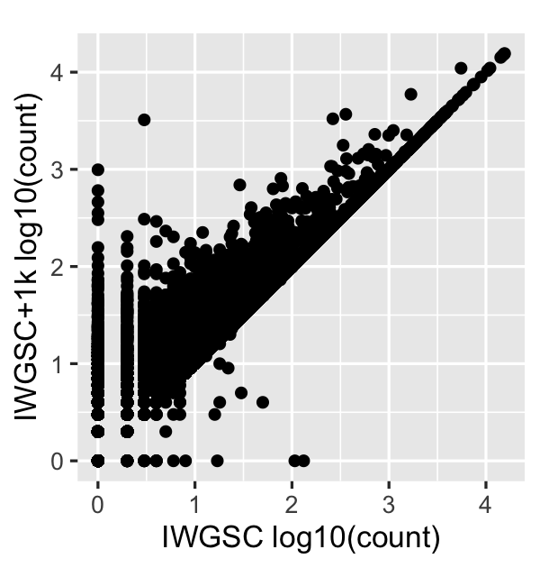
Figure 2
A
TraesCS4D02G145400
D
TraesCS7A02G115400
TraesCS7B02G013100
TraesCS4D02G263300
B
E
depth
depth
D
3,500 bp
3,000 bp
IWGSC
TraesCS4D02G145400
TraesCS4D02G145500
IWGSC
TraesCS7A02G115400
IWGSC+1k
IWGSC+1k
C
F
depth
depth
5,000 bp
4,000 bp
IWGSC
TraesCS4D02G263300
IWGSC
TraesCS7B02G013100
TraesCS4D02G263400
IWGSC+1k
IWGSC+1k

Slide 5
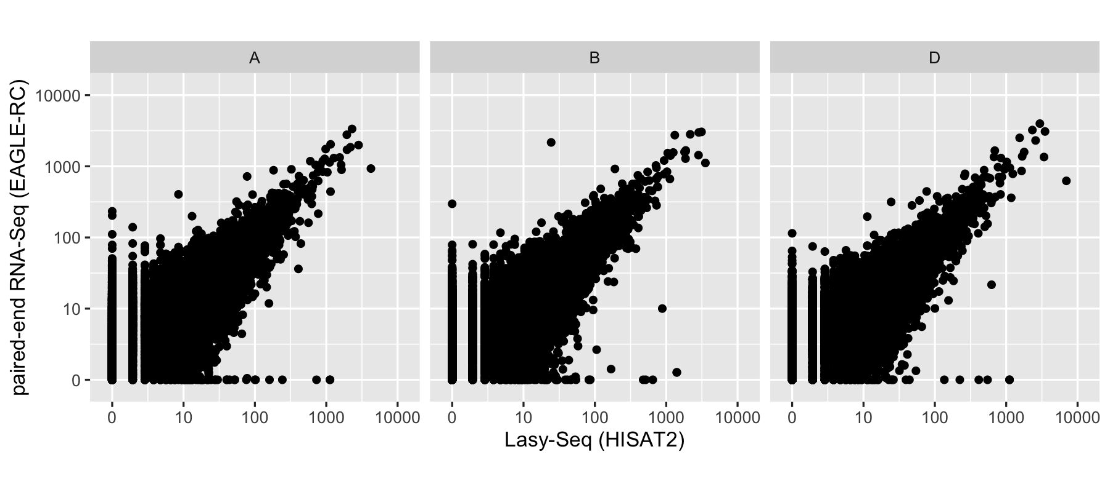
Figure 3

Slide 6
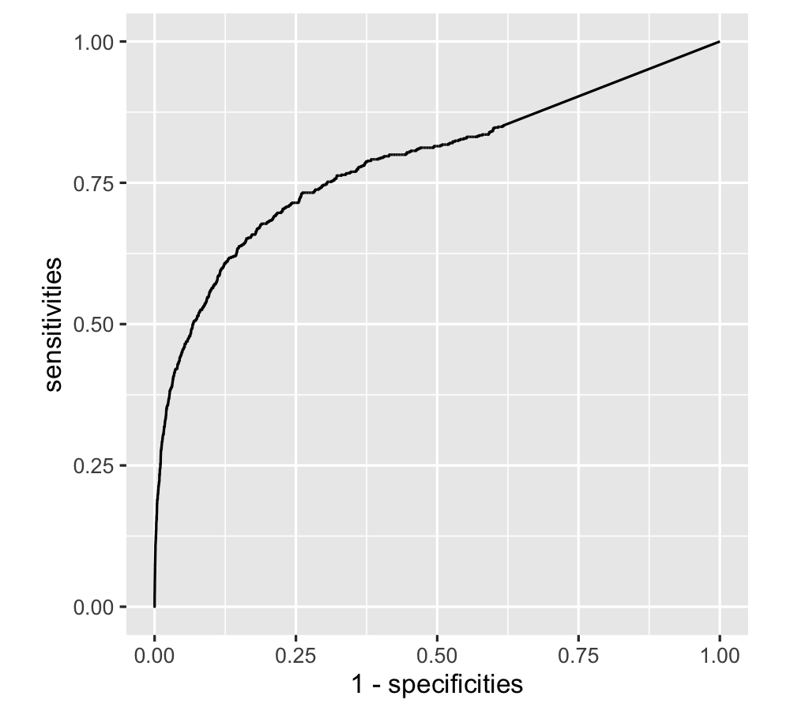
Figure 4
0.068

Slide 7
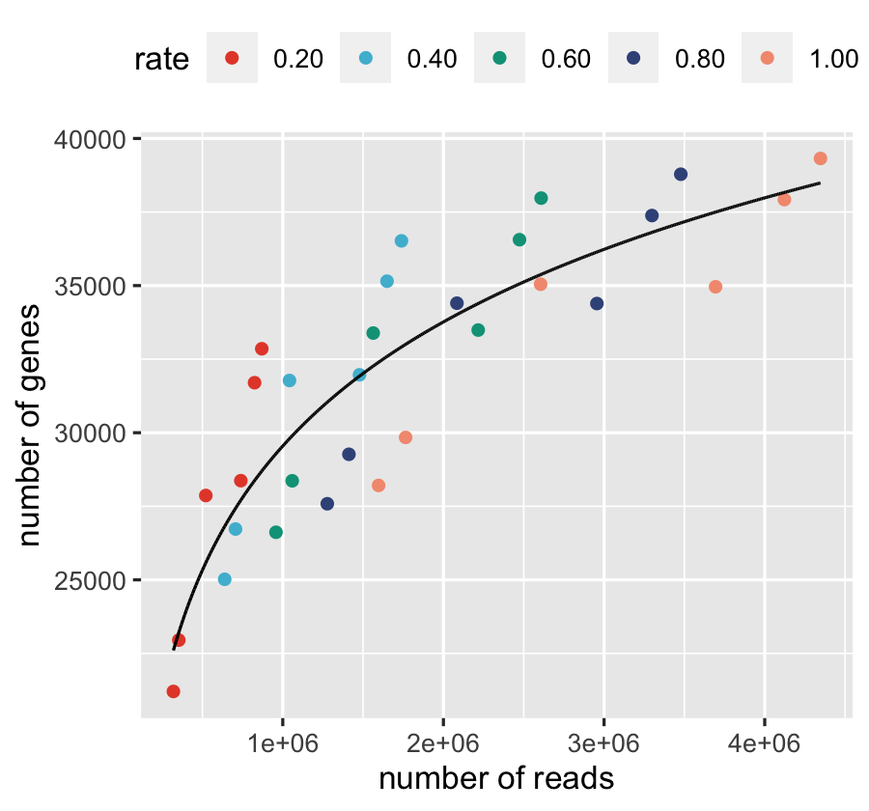
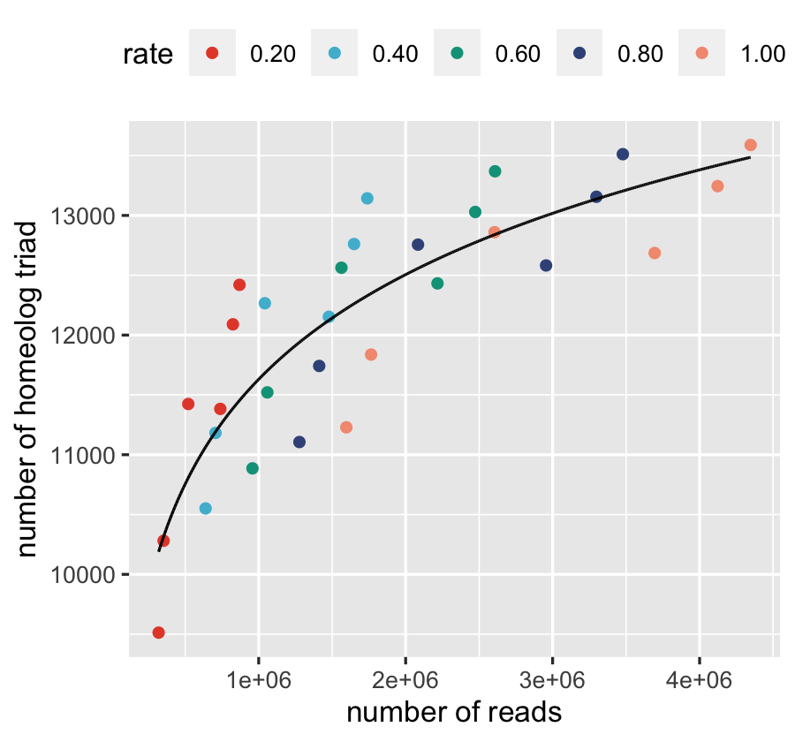
Figure 5
A
B

Slide 8
Figure ?
A-origin reads
B-origin reads
D-origin reads
HISAT2
HISAT2
HISAT2
EAGLE-RC
EAGLE-RC
EAGLE-RC
312,230
307,030
312,920
83,764
8,905
88,179
11,629
82,155
8,421

Slide 9
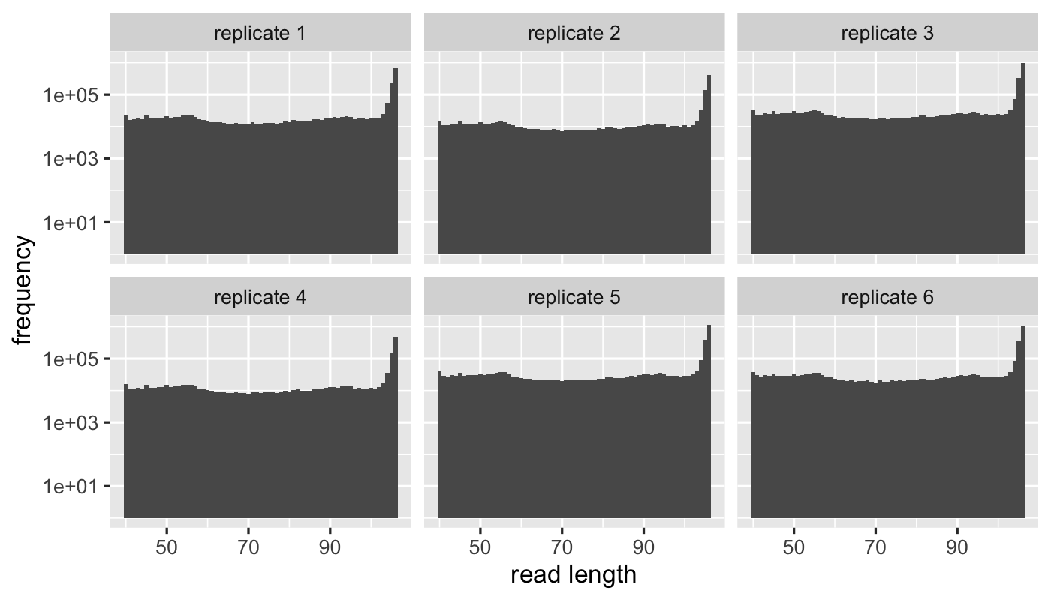
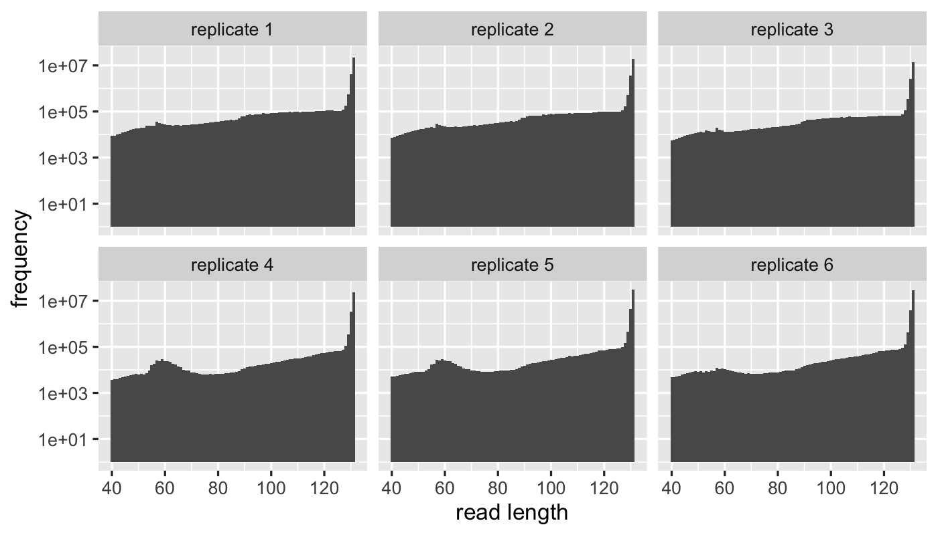
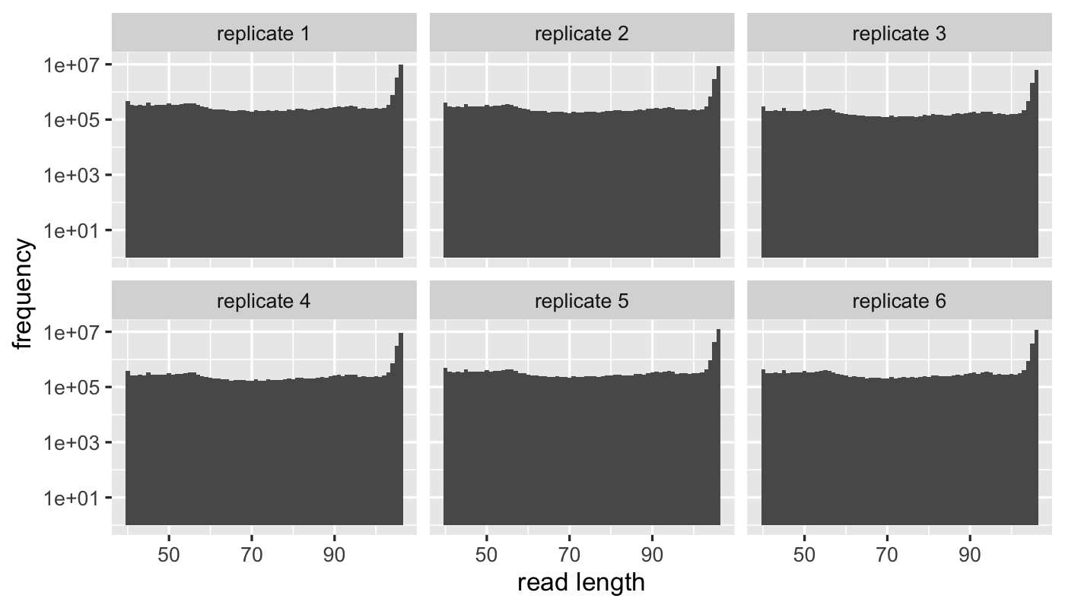
A
B
C

