Slide 1


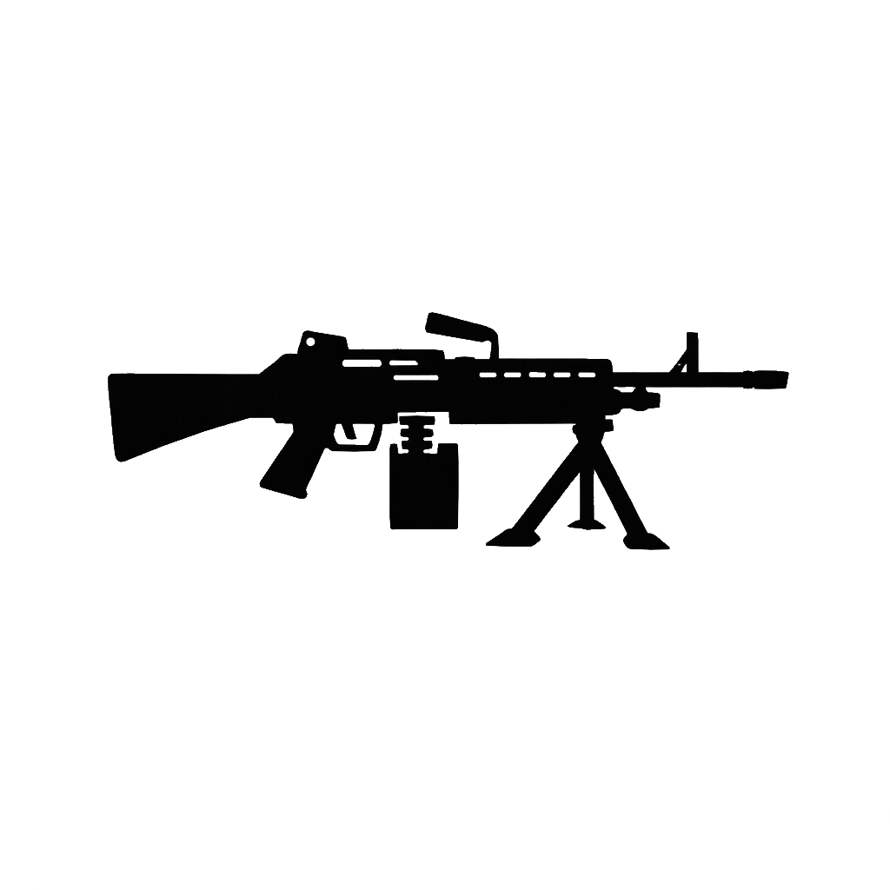





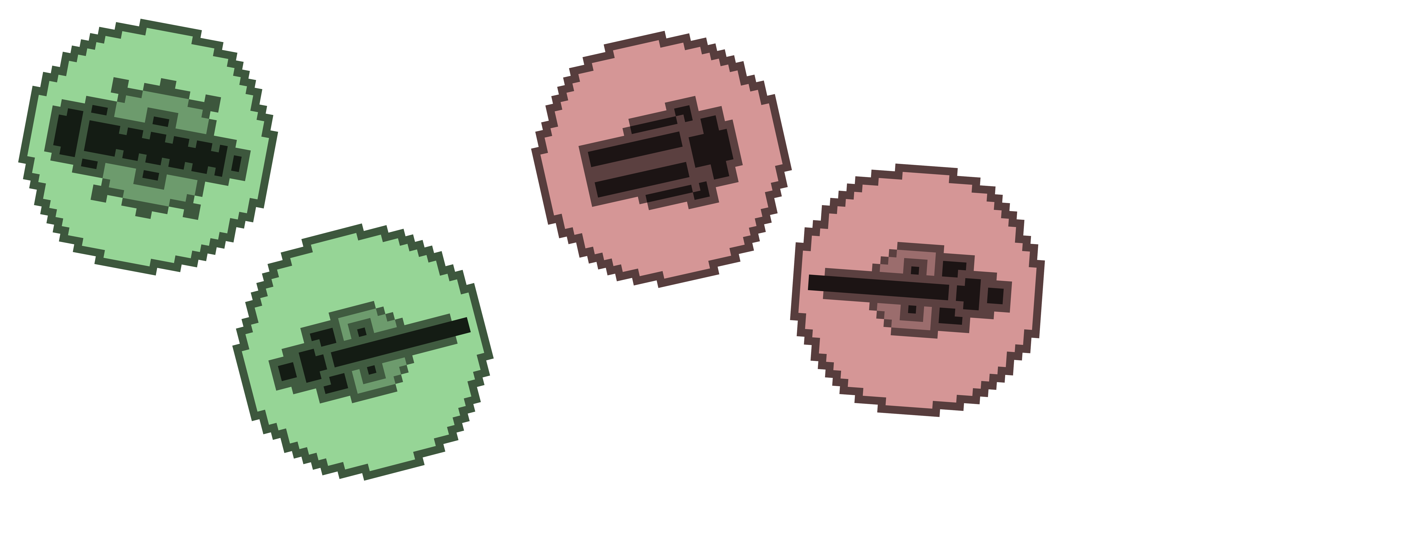



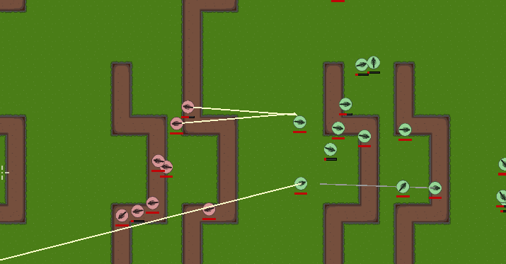
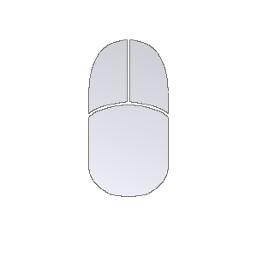





OpenTrenches
Justin Sun
Faculty Advisors
Laurie Anderson and Dharma Dailey
Online Multiplayer Team Battle Game
Computer Science & Software Engineering
About
Components
2D top down multiplayer trench warfare game
The objective is to destroy three bases on the opponent’s side
Blend of gameplay inspired by Foxhole and style inspired by IO titles such as Diep.io, with the target audience encompassing the two niches
Currently in closed beta, and not yet published online
Features
Network
Clients connect to a master server which serves them a list of available servers. The client only sends requests, the server is authoritative on the interpretation which prevent client-side game state manipulation cheats.
Non Player Intelligence
Uses a hierarchical time-sliced architecture. A strategy layer assigns simple tasks and characters reason about those tasks. Only a set number of characters can think each game tick to prevent overloading
Feature Frameworks
The available equipment and ability systems base their behavior on stats, allowing for easy additions of new features
Logistics
Transient in-game currency that accumulates passively
Weapons
Three different weapons with unique firing mechanics
Activated Ability
Temporarily Raises user defense in exchange for logistics
Trenches
A character that’s entrenched has a significantly lower chance of being hit
Controls
Movement Keys
(Up, Left, Down, Right)
Non Player Character AI
NPCs defend a dynamic front line and periodically launch assaults
Next Steps
Dig Trench
Reload
Move to release or an open beta by setting up a server and publishing the client on a platform like Itch
Explore experimental web assembly migration; currently not officially supported by Godot, but forks testing out the behavior exist
The Game
Exit Trench
Fire Weapon
Zoom Camera
Aim out of trench
Tools
Move Mouse to Aim

