Slide 1
Predictive Modelling to Predict Students Dropout and Academic Success
James Kibiro | Joshua Balderas | Neelkumar Patel

Slide 2
Recap: Project Motivation and Research Questions
WHY THIS TOPIC?
KEY STUDY QUESTIONS
Student dropout and academic failure have high costs for students and institutions:
lost tuition revenue
delayed career progress
lower graduation and retention rates
What are the biggest contributors to student dropout and academic failure?
Can we predict whether a student will drop out, remain enrolled, or graduate?
Can we predict dropout using only first-semester data?
Using data-inclined approaches, Universities can:
Boost Graduation Rates
Optimize Resource Allocations
Develop Evidence-Based Policies

Slide 3
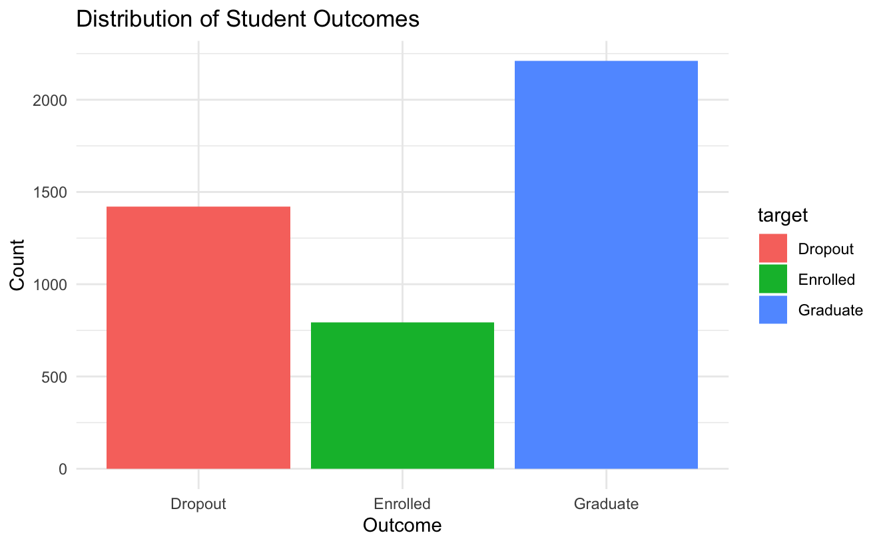
Recap: Data Overview
Polytechnic Institute of Portalegre, Portugal | 2008-2019| 4,424 Student Records| 37 features
Features in the data include:
Marital status
Application order
Daytime/ evening attendance
Gender
Tuition fees up to date
Scholarship holder
International
Debtor
Curricular units 1st sem (enrolled)
Curricular units 1st sem (credited)
Inflation rate
etc
Our dependent variable is categorical with 3 classes (Dropout, Enrolled, Graduate)
Methodology Note: Data was split 70/30 for training and testing on all models.
Data source: UCI Machine Learning Library

Slide 4
Logistic Regression: Data Modelling
Dependent variable: ‘target’
Independent variable: All other variables remaining (36)
The dependent variable is of categorical type with 3 classes: ‘ Dropout’, ‘Graduate’, and ‘Enrolled’.
We developed a Multinomial Logistic Regression - our reference level in the dependent variable was ‘Graduate’
Data Splitting (70:30) |  |  | Data Size
Graduate | Dropout | Enrolled | Training Data
1546 | 994 | 555 | 3095
Graduate | Dropout | Enrolled | Testing Data
663 | 427 | 239 | 1329
We checked for collinearity using the Variable inflation factor and removed more than 10 variables, some of which include:
Mother’s occupation
Father’s qualification
Curriucular units 1st sem credited
Curriucular units 1st sem enrolled
Curriucular units 1st sem approved
Curriucular units 1st sem grade
Curriucular units 2nd sem credited
Curriucular units 2nd sem enrolled
Class balance was preserved in both data sets
Graduate | Dropout | Enrolled
0.4995153 | 0.3211632 | 0.1793215
Graduate | Dropout | Enrolled
0.4988713 | 0.3212942 | 0.1798345

Slide 5
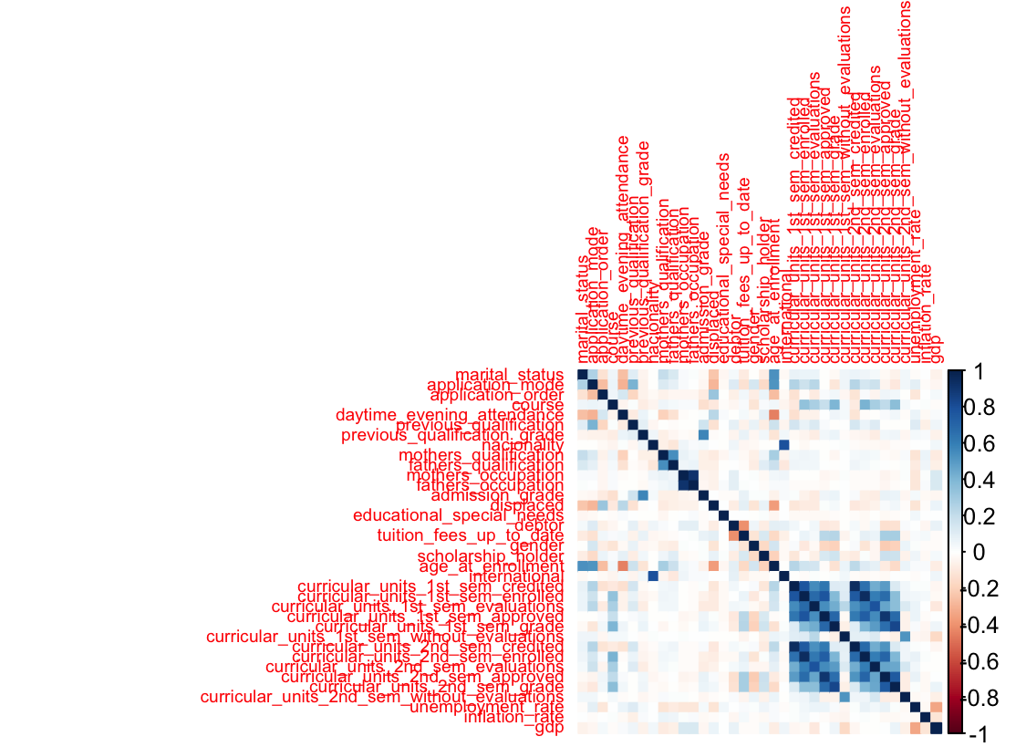
Logistic Regression: Data Modelling
Variables with a VIF of more than 10 were removed (very high correlation)
We did a pairwise correlation for variables with a VIF with more than 5 but less than 10 (moderate correlation and pick the variable that was more meaningful.

Slide 6
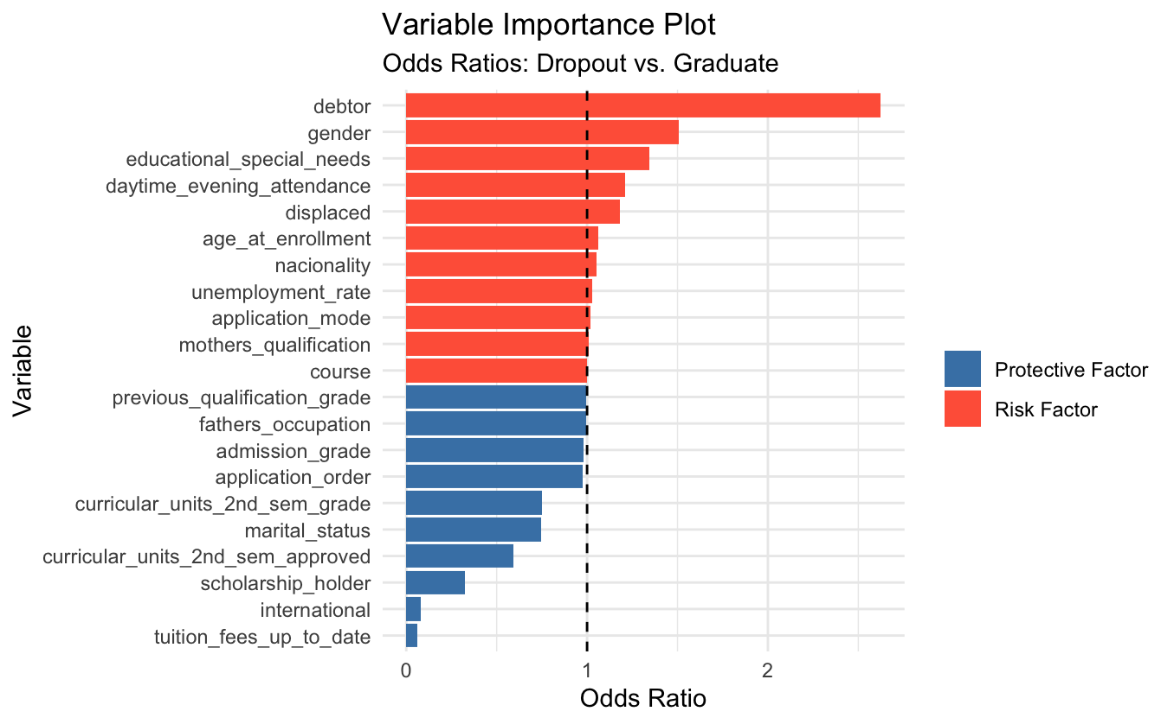
Logistic Regression: Model Results
AIC | 4101.955 | This is a good model, 36% of the variation in the data can be explained by the model. A McFadden's Pseudo R squared of between 0.2 - 0.4 is considered a good fit for logistic regression.
McFadden Pseudo R-squared | 0.3641
Which predictors matter most?
Our strongest risk factor to dropout is debt.
Being a debtor makes a student 2.6x more likely to dropout than graduate.
Having tuition fees up to date (financial stability) is the strongest positive factor.
Students with fees paid are 94% less likely to drop out.
Financial factors dominate both sides.
Financial support such as education bursaries, scholarships, etc are the single most powerful intervention point.
Academic performance in the 2nd semester (units approved) is the second most important domain.
Demographics like gender, age, special needs play a role but are less dominant than financial and academic factors.
Everything to the right of the dashed line (0R>1) = increases dropout risk compared to graduating and viceversa.

Slide 7
Logistic Regression: Model Evaluation
Model Size
 | Graduate | Dropout | Enrolled
Testing data | 663 | 427 | 239
Confusion Matrix
Prediction | Graduate | Dropout | Enrolled
Graduate | 613 | 69 | 126
Dropout | 28 | 326 | 63
Enrolled | 22 | 32 | 50
The model is struggling to capture the ‘Enrolled Class’.
Model Accuracy | 74.40%
Statistics by Class
 | Graduate | Dropout | Enrolled
Sensitivity | 92.40% | 76.40% | 20.90%
Balanced Accuracy | 81.50% | 83.30% | 57.90%

Slide 8
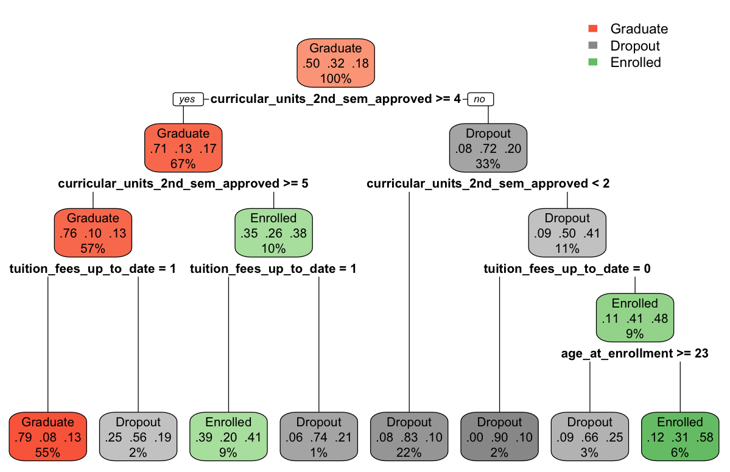
Classification Tree: Model Results
Most important variable: “Curricular_units_2nd_sem_approved”.
Financial factor is still critical, 'tuition_fees_up_to_date' appears on both branches. Even good students drop out without it.
The tree confirms our logistic regression model since both models agree on the same top predictors i.e., curriucular_units_2nd_sem_approved (strongest positive factor), tuition_fees_up_to_date (strongest protective factor), age_at_enrollment(mild risk factor).

Slide 9
Classification Tree: Model Evaluation
Model Size
 | Graduate | Dropout | Enrolled
Testing data | 663 | 427 | 239
The model struggles to capture students who fall in the 'Enrolled class' (37.2%)
This is most likely because the 'Enrolled Class' is a middle ground category, so its features overlap with both other categories.
Comparing the logistic regression model to the classification model, the classification model wins! The classification model has a higher accuracy (75.5% vs 74.4%), and higher enrolled balanced accuracy (64.4% vs 57.9%).
Confusion Matrix
Prediction | Graduate | Dropout | Enrolled
Graduate | 590 | 52 | 95
Dropout | 32 | 324 | 55
Enrolled | 41 | 51 | 89
Model Accuracy | 75.47%
Statistics by Class
 | Graduate | Dropout | Enrolled
Sensitivity | 88.99% | 75.88% | 37.23%
Balanced Accuracy | 83.46% | 83.12% | 64.39%

Slide 10
Random Forest: Model Results
Model Size
 | Graduate | Dropout | Enrolled
Testing data | 663 | 427 | 239
Training data | 1546 | 994 | 555
High error rate stands out.
While the model is great at identifying students who graduate, it is struggling significantly to distinguish between students who are have Dropped out and those who have Graduated.
Our accuracy is still good but lower than the classification model (75.28% vs 75.47%); however, it is better than the logistic regression model (74.40%)
Confusion Matrix
Prediction | Graduate | Dropout | Enrolled | Class Error
Graduate | 1437 | 50 | 59 | 0.07050453
Dropout | 161 | 745 | 88 | 0.25050302
Enrolled | 256 | 151 | 148 | 0.73333333
OOB Error Rate | 24.72%
Accuracy | 75.28%
Check for Class Imbalance
Graduate | Dropout | Enrolled
1546 | 994 | 555
Class imbalance confirmed.
We have nearly three times as many Graduates as Enrolled students.
The model is biased toward the "Graduate" class because it has the most observations (1,546). The "Enrolled" class is the smallest, leading the model to misclassify 256 Enrolled students as Graduates!

Slide 11
Balanced Random Forest: Model Results
Goal: To sample an equal number of rows from each class when building the tree.
Reference sample size: 555 (smallest class size)
Model Size
 | Graduate | Dropout | Enrolled
Testing data | 663 | 427 | 239
Training data | 555 | 555 | 555
Enrolled vs. Graduate: 182 Graduates were mistaken for Enrolled, and 181 Enrolled were mistaken for Graduates. These two classes are still bleeding into each other, likely because their academic data (grades/credits) looks very similar.
The Trade-off: The Graduate error doubled (from ~7% to 15%). This is the standard "price" of balancing; the model is no longer biased toward the majority, so it makes more mistakes there to get the minority class right.
Confusion Matrix
Prediction | Graduate | Dropout | Enrolled | Class Error
Graduate | 1309 | 55 | 182 | 0.1533
Dropout | 119 | 711 | 164 | 0.2847
Enrolled | 181 | 102 | 272 | 0.5099
OOB Error Rate | 25.95%
Accuracy | 74.05%
Much better results!
By downsampling, we cut the Enrolled error rate from 73% down to 51%.
Model accuracy dropped slightly (from 75.28% to 74.05%); however, the model is now significantly more honest about the Enrolled class. It's no longer just defaulting to the majority labels.

Slide 12
Balanced Random Forest: Model Evaluation
Model Size
 | Graduate | Dropout | Enrolled
Testing data | 663 | 427 | 239
The model is now able to capture more than 50% (53.56%) of the enrolled class; which it was struggling with previously, 37.23% in the classification model, and 20.90% in the logistic model.
The model’s accuracy is 77% (76.8%) which is the highest of all the models we’ve built, i.e.,Unbalanced random forest model (75.28%), logistic regression (74.4%), classification tree (75.5%).
Confusion Matrix
Prediction | Graduate | Dropout | Enrolled
Graduate | 572 | 45 | 73
Dropout | 20 | 321 | 38
Enrolled | 71 | 61 | 128
Model Accuracy | 76.82%
Statistics by Class
 | Graduate | Dropout | Enrolled
Sensitivity | 86.27% | 75.18% | 53.56%
Balanced Accuracy | 84.28% | 84.37% | 70.72%

Slide 13
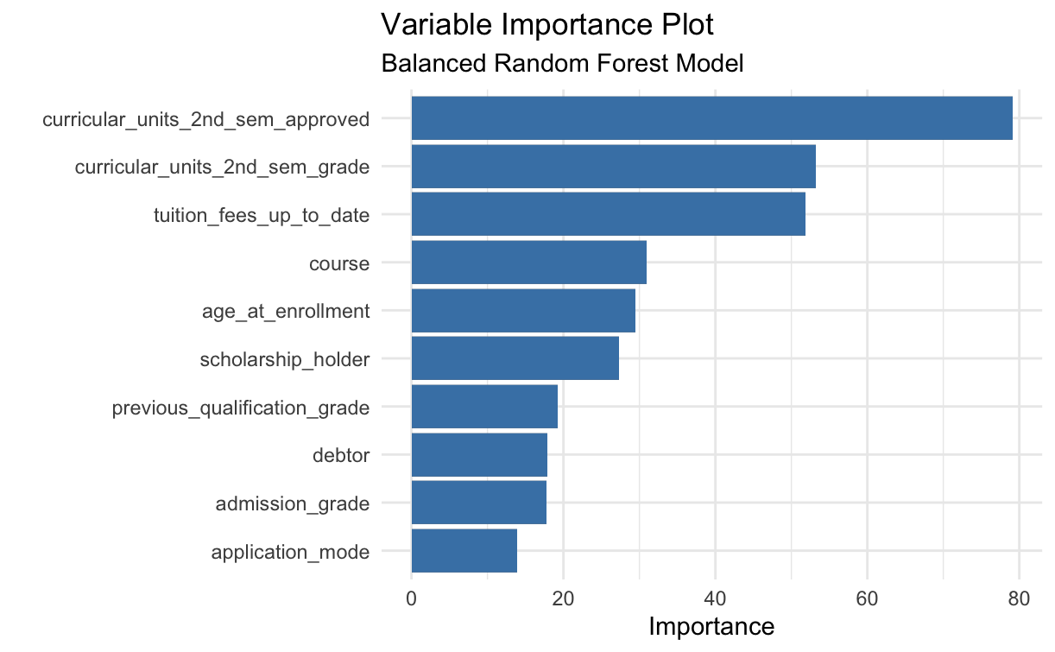
Balanced Random Forest: Model Evaluation
'curricular_units_2nd_sem_approved' is the most important variable in predicting outcomes for our model.
This confirms our finding from the classification tree.
Tuition is the most important non-academic variable.
Variables such as 'international', 'educational_special_needs', and 'application_order' have near zero importance.

Slide 14
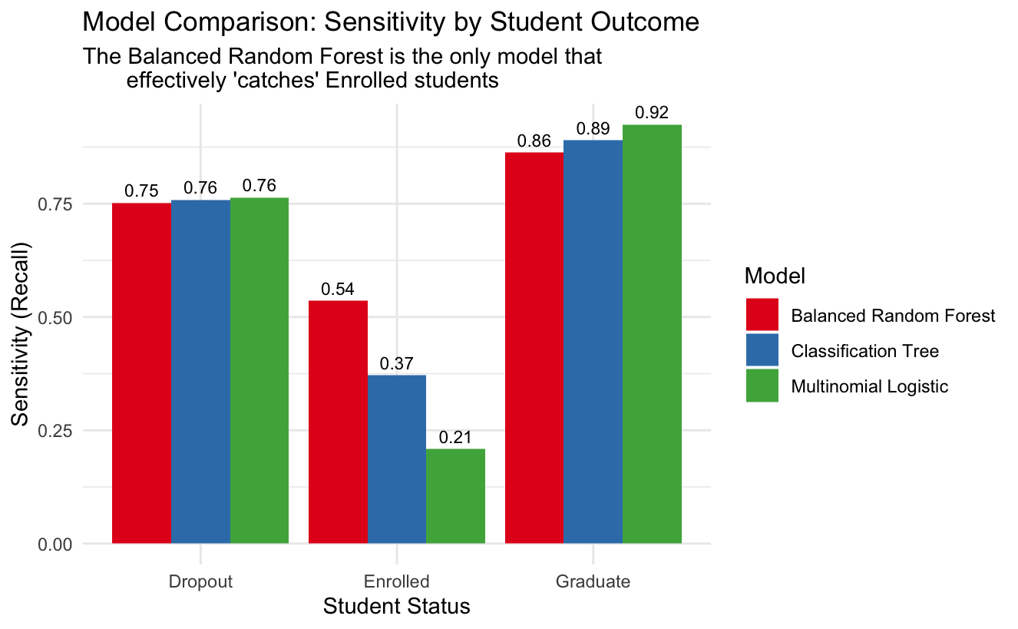
Conclusion: Model Comparison
The balanced Random Forest is our most fair and useful model as it provides the best 'safety net' for the Enrolled students without sacrificing too much performance on Graduates and Dropouts.
The logistic regression remains the most accurate overall.

