Slide 1
Final Project Presentation
Hire Heroes USA
Surbhi Jain

Slide 2
Overview
About Hire Heroes
Tasks
Data Description
Data Exploration
Data Challenges
Summary Statistics
Data Cleaning
Model Specification
Results, Recommendations

Slide 3

About Hire Heroes
National Non Profit Organization
Headquartered in Alpharetta, GA
Creates job opportunities for US Military Veterans and their spouses.
Provides Online as well In personal workshop trainings to the veterans.
These services are provided at no cost to veterans.

Slide 4
Recruitment Process Flow
Assessment
Training
Mentorship
Veteran Hired ☺
Registration

Slide 5
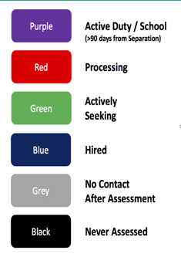
Color Codes

Slide 6
Overview
About Hire Heroes
Tasks
Data Description
Data Exploration
Data Challenges
Summary Statistics
Data Cleaning
Model Specification
Results, Recommendations

Slide 7
Tasks to study
Study relationship between amount of time spent working with individual and how quickly are they employed
Measures should we utilize to process efficiency and program performance
Does working with volunteer raise the probability of client getting
Hired ?
Study relationship between client and employer demographic data and how they contribute to the veteran hire.

Slide 8
Dataset
Accounts
Consists of Employer Details
Contacts
Consists of veterans information
Case
Consists of Volunteer Information
Task
Consists o task conducted by HHUSA staff
User
Consist of HHUSA staff information and their roles

Slide 9
Dataset Description
Contacts table has most of the data.
Veterans demographic information.
Details from veteran registration, assessment, training, mentorship, hiring details.
66k records and 675 attributes.

Slide 10
Data Exploration
Summary Statistics

Slide 11
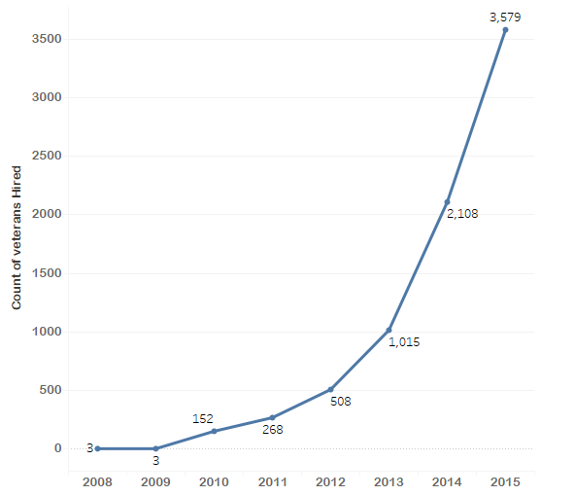
Veterans Hired vs Year
Increasing Trend
Almost 7776 veterans got placed till 2015.

Slide 12
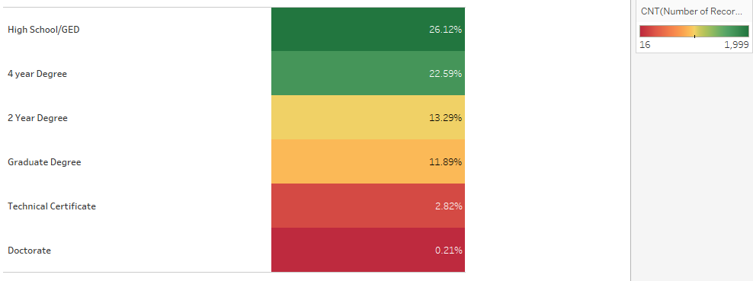
Contribution of Education Level

Slide 13
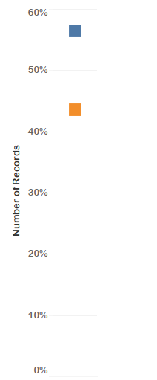

Desired Location Match
Desired Location given by Employer : 43%
Desired Location Not given by Employer : 57%

Slide 14
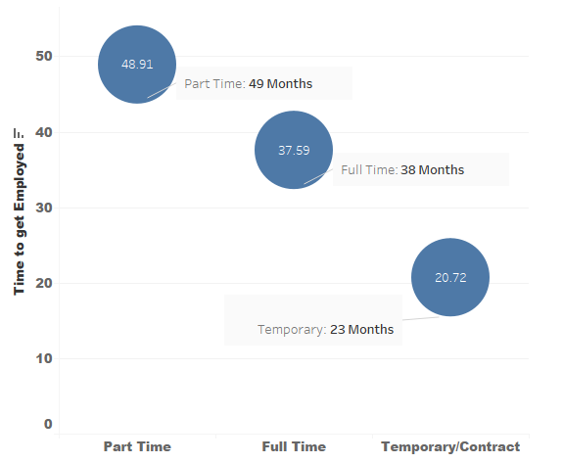
Time to get Employed after Registration

Slide 15
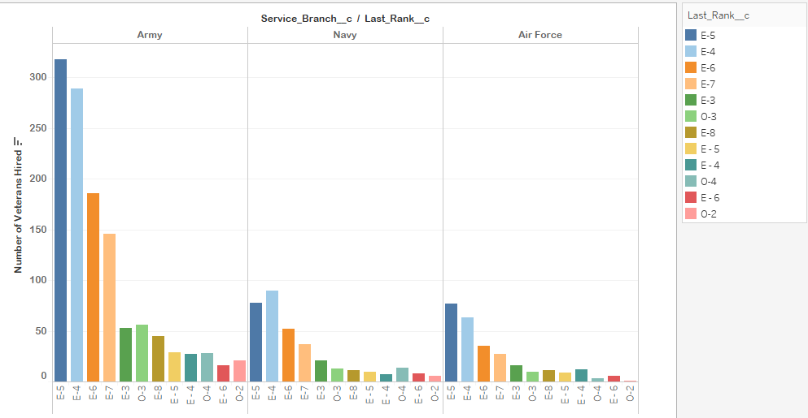
Service/Rank of Hired Veterans
Army veterans have higher hired rate.
Ranks E5, E4, E6, E7 have higher hired rates.
Ranks greater than E4 are considered to be senior and hence are more responsible.

Slide 16
Target Variable : Confirmed Hired Date : which is how many clients are able to successfully obtain employment after using HHUSA services.

Slide 17
Data Wrangling and Feature Engineering
Removed covariates with almost zero variance.
Reduced dimensionality from 653 covariates to 96.
Total of around 66000 observations.
Removed highly-correlated features.
Transformation and Discretization
Salary, Education, Military Rank
Computed columns for date fields
“Areas of Expertise”, “Desired Job Description”
How to classify text data?

Slide 18
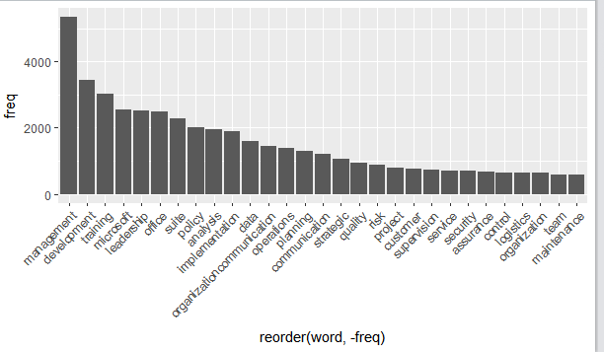

Area of Expertise

Slide 19
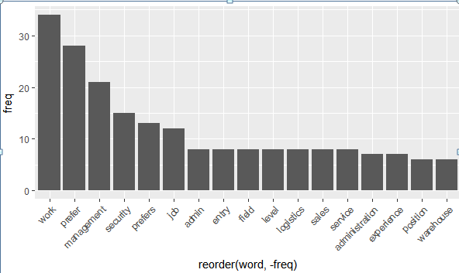

Desired Work Preference

Slide 20
Measures to increase efficiency

Slide 21
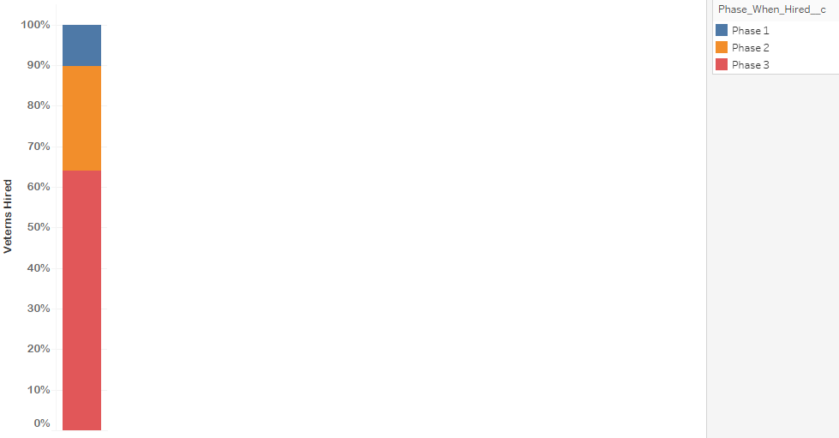
Measures to increase efficiency
Phase 1 : Assessment
Phase2:
Training
Phase3 :
Mentor assigned

Slide 22
Measures to increase efficiency
Average Time taken to complete resume once assessment is done
13 Days
Average amount spent per veteran
Dollars Donated/Confirmed Hires
$249
Resume presented to Employee Partners
8703

Slide 23
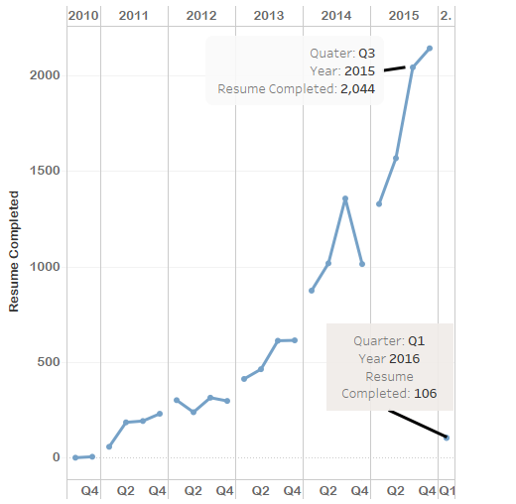
Measures to increase efficiency
Resumes Completed Per Quarter

Slide 24
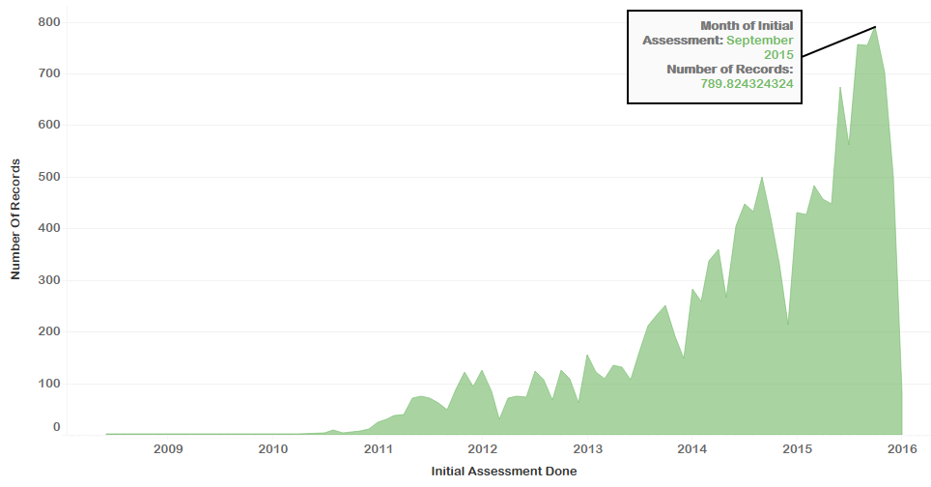
Measures to increase efficiency
Initial Assessment Done per month

Slide 25
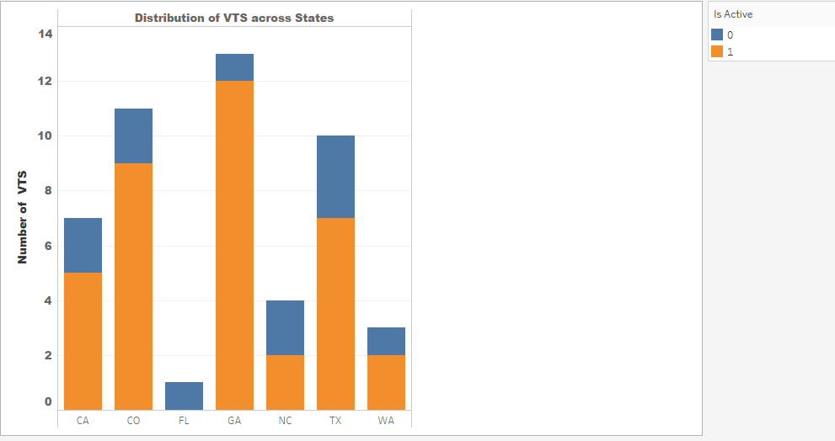
VTS Distribution
VTS : Veteran Transition Specialist
Georgia and Colorado have the highest number of VTS.
Florida is the only state with no VTS.

Slide 26
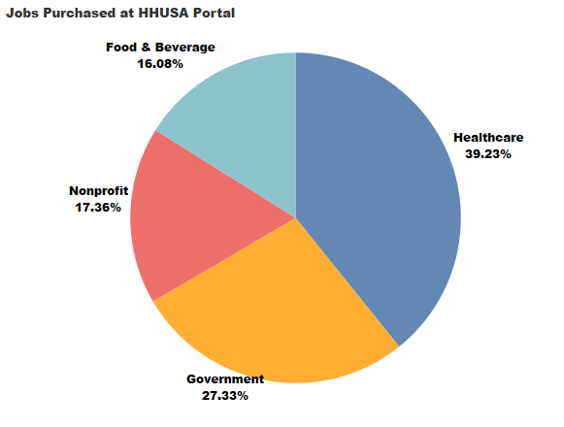
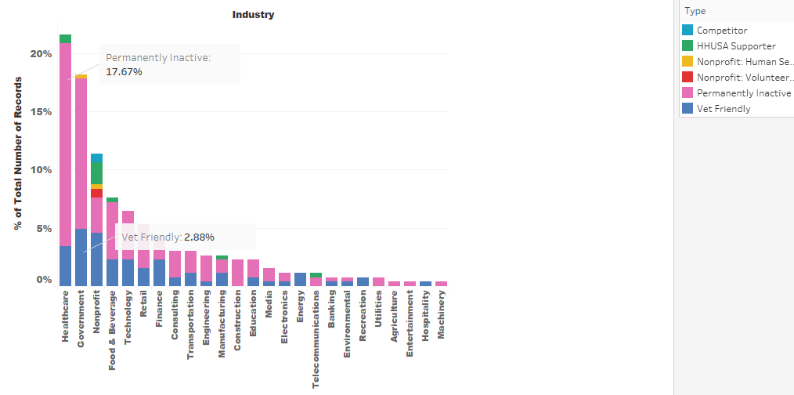
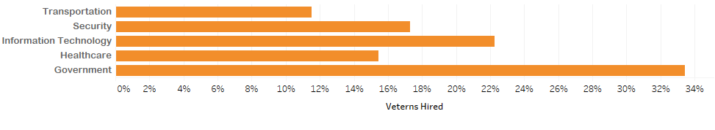
Employers Detail

Slide 27
Suggested Measures to improve Efficiency
Improved Efficiency
For the veterans who got rejected, there should be some mechanism for HHUSA to track it.
Raise their funding through some special events or their job boards
Apply some more measures so that they can target veterans to attend workshops
May give bonus to those VTS who got more Veterans hired.
Time for resume building can be reduced

Slide 28
Recommendations
Years of Education and Years of Experience data has lot missing. Since, these are important factors in hiring process, they must have proper details for it.
Inconsistencies with state codes.
Many records they have init assessment date lesser than resume date. I assume that for these veterans they did not work on resume as their resume was might be appropriate. Hence they should keep a proper resume date in that case or should have some other mechanism to handle it.
They don’t update records uniformly. for ex : there are many records for which init assessment date but init assessment completed flag was populated.
Most of the major hiring employment records are permanently inactive, they may check the reason why.

Slide 29
Tools Used
SAS E Miner
SAS E Guide
Tableau
R
Excel

Slide 30
F

