Slide 1
Software Project
University of Tartu, 2014
Üllar Lindmaa

Slide 2
What is going to happen in the course?
You are going to build real software
For a real customer
Using some minor constraints
  Iterative development
  Some requirements on infrastructure
  In a team of four

Slide 3
What you can expect from your customer
(Some) understanding what, why and for who the software needs to be delivered
  To find it out is your task
  How it can be done is your task
  Explaining and agreeing what you are about to deliver is your task
Knowledge about 500 hours time limit
Time for at least an hourly meeting each week
(Fast) feedback after each iteration

Slide 4
What can you expect from me?
We have in this room only three more lectures
  12. September – for infrastructure introduction
  19. September – introducing requirements for 2nd iteration
  10. October – introducing requirements for 3rd iteration
But we also meet here for demos
  17. October – for intermediate demo
  12. December– for the final demo
Meanwhile – weekly 30 min coaching sessions with team
  Progress report
  Problem analysis
  Solution offerings
Grade and feedback to all your deliverables

Slide 5
What do I expect from a team?
works together
follows a plan
adapts the plan if something changes
understands what has to be built
formalizes what is going to be built
has a vision how this is going to be built
implements the vision
verifies the implementation requirements
validates the deliverables with customer
Notes:
Trust me, last year 80% of the teams said the biggest problem was organizing the work.

Slide 6
Deadlines.
5.september – you have formed the team
19.september – you understand what is to be built
10.october – something is working
17.october – you demonstrate what you have built
7.november– most of the stuff is working
5.december – everything is working
12.december– you demonstrate the final solution

Slide 7
Grading
1st iteration: 10 points
2nd iteration: 15 points
3rd iteration: 25 points
4th iteration: 40 points
Demonstrations: 2x5 points
Total 100 points, graded from A to F
Best team is guaranteed to receive an A
Spreadsheet can be opened from grading page

Slide 8
Communication
Course wiki – rules, deadlines, grades, …
Google Groups – questions, problems, announcements, etc.
Development infrastructure – deliverables for grading
Skype (yllarli) – for direct questions
Mail (ullar.lindmaa@ut.ee) - if anything else fails
Phone – 5160505

Slide 9
Misc. rules
All deadlines are set for 08:00 EEST
Late penalties apply
  Up to 24 hours late – receiving 80% points
  Up to 48 hours late – receiving 60% points
  More than 48 hours late – receiving 0% points
Teams can expel non-performing team members with 75% of the votes
  We can reduce the amount of work after this

Slide 10
What do you need to deliver by 19. September
Details and grading criteria's will be published in course wiki. But in general you will deliver:
  Development infrastructure
  Requirements
  Project plan

Slide 11
First questions you need answers for
What problem does the solution solve?
  Or what need does it fulfill?
For whom is the solution meant for
  “Everyone” is not an answer
What are the current solutions in the market for the problem?
How is our solution going to be different/better?

Slide 12
Second set of questions to start answering
When and where are we going to meet the customer?
What are we going to discuss with the customer?
How we are going to distribute the work in the team?
How we are going to work together?
How we are going to build it?

Slide 13

Course wiki

Slide 14
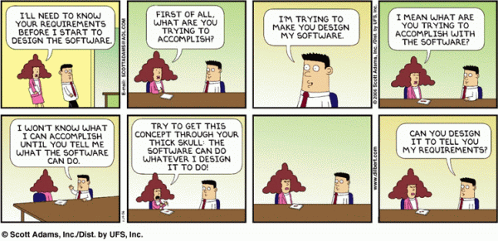
Crash course for initial requirements

Slide 15

Where do I get my requirements from?

Slide 16
To start with requirements – use your customer
You know the domain yourself. Ignore the customer.
You send questions to customer via email.
You create an IM session with the customer.
You call the customer.
You create a teleconference with customer.
You meet customer in person.

Slide 17

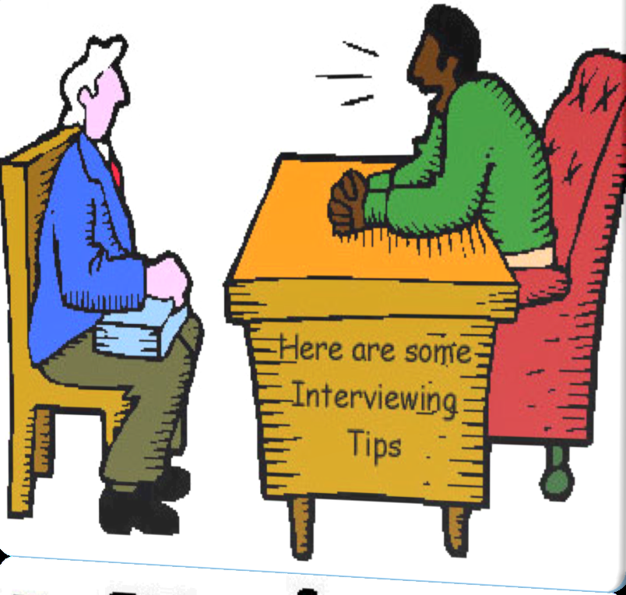
Tip 1
Tell me what you want me to build for you?
versus
What do you want to achieve?

Slide 18
Tip2
Always be prepared.

Slide 19
Tip 3
Have an agenda for the meeting. Do not try to cover everything.

Slide 20
Tip 4
Make notes. At least on what you agree upon.

Slide 21
Tip 5
Use prototyping and other visual concepts while discussing something

Slide 22
Tip 6
Keep asking questions. Including the “Whys”.

Slide 23
Tip 7
Get the feedback for your deliverables. Fast.

Slide 24
Should I just stick with customer interviews?

Slide 25

Read about the domain

Slide 26
Investigate existing solutions
There is always an alternative

Slide 27
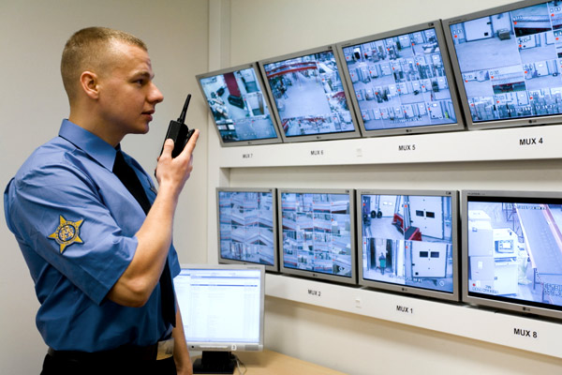
Monitor end user in action

Slide 28
OK, got it. Now what do I do with requirements?
List all requirements. Including NFRS.
Pick a format for detailing the requirements
  Use cases
  User stories
  Specifications
  Wireframing / mockuping
  …
Start detailing and formalizing
… using the selected infrastructure

Slide 29
Important take-aways.
Teams need to form and select a customer TODAY
  If you do not have a team, stay in the class
  If you consider changing a project, stay in the class
Subscribe to the google groups
Book a coaching session, sessions start next week
Contact your customer, latest this week.
  You need to have met at least once before the next Thu
Start investigating the domain and alternative solutions.
Start answering the questions on slides 11-12
We meet next week in a lecture Crash course to the collaboration infrastructure (VCS, issue tracker, wiki). Guest lecturer - Priit Liivak from Nortal.

