Slide 1
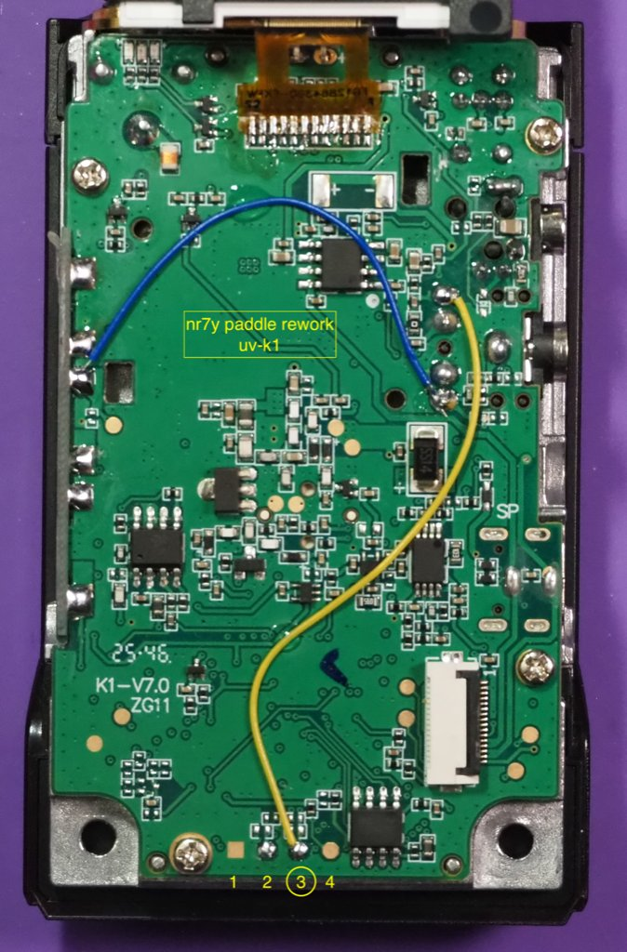
2m CW on a
$30 Handheld
Modifying the Quansheng UV-K1 for real Morse code: the why, the how, the tools, and the parts.
Justin · N9HO
CCARA Monthly Meeting · September 12, 2026
Notes:
Open with the radio in your hand. Hold it up. Tell them it cost thirty dollars, it does real CW, and the goal is that they go home wanting to build one. This is a pitch, not a build night: nobody is soldering tonight. It is about one goal: more operators sending Morse on 2 meters than there were last year. Everything else is a side effect.

Slide 2
On the agenda
1
Why 2 meter CW
$30
the radio
The band is empty, and this mode is local by physics.
2
Why this radio
Thirty dollars, everywhere, and fully open-source firmware.
2
resistors off
3
The firmware
What NR7Y's CW mod turns the radio into.
4
The mod
2
wires on
Tools, parts, and the two-resistor, two-wire rework.
5
Flash, set up, get on the air
uvtools2, the CW menu, and 144.025.
1
evening
6
The Brass Knuckle Gang
Who we are, how you get a number, and an app to learn the code.
Notes:
Roadmap. This is an interest talk, not a workshop, so keep the rework steps brisk and visual. Spend most of the time on the middle three: the firmware, the mod, and getting on the air. The gang is the closer, keep it to a couple of minutes.

Slide 3
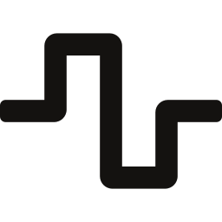


Why 2 meter CW?
One goal: more operators sending Morse on 144 MHz than last year. These are the side effects.
The band is empty
It is local, by physics
Nobody fears a $30 radio
Outside a few repeaters and a net or two, two meters goes days without a signal. The weak-signal end goes weeks.
An active band is far easier to defend than an empty one. Every contact is evidence, and it costs you an evening.
With a handheld and a modest antenna, 2m CW reaches the hams around you, not strangers a thousand miles away.
You cannot grow this without meeting your neighbors: back to the club, talk friends into a radio, get on the air together.
The barrier to tinkering is fear, not skill. Nobody's first soldering job belongs inside a $1,300 HF rig, so the iron stays in the drawer.
When the worst case is ordering another one, people try things. People who try things build things.
Notes:
Three reasons, and the second-order effects are the real pitch to a club. An active band is easier to defend than an empty one. Two meters with a handheld is local, so your contacts are people close enough to have breakfast with, and the recruiting mechanism is by physics community building. And nobody's hands shake over a thirty dollar radio, so people actually open one.

Slide 4

Why the Quansheng?
Out of the box it will not send CW at all. What it has is a price tag and an open-source firmware family.
The firmware lineage
1
DualTachyon
First open-source firmware for the original UV-K5. Paved the way.
Cheap enough to open
About $30 delivered. Less than the club spends on coffee.
Sold everywhere, so a club build night could order five identical radios.
Very easy to open: two screws and a pry at one edge.
The MCU is fully documented by the community, so firmware authors can drive the hardware directly.
If someone destroys one, the club is out $30 and up one member who has seen the inside of a radio.
2
egzumer
The feature-rich custom firmware for the v1 radios.
3
F4HWN "Fusion" (armel + muzkr)
Port to the UV-K5 v3 and UV-K1 with the newer PY32F071 MCU.
4
NR7Y CW mod
Real CW keying, iambic keyer, messages and practice mode layered on Fusion. Apache 2.0.
Notes:
The stock radio will not send CW at all. What makes it interesting is the open-source lineage: DualTachyon reverse engineered the original K5 and released the first open firmware, egzumer built the feature-rich custom firmware everyone knows, F4HWN and muzkr ported it to the newer K5 v3 and K1 hardware as Fusion, and NR7Y layered a real CW transceiver on top of that. All Apache 2.0. NR7Y is also a BKG member, which is a nice line to drop here.

Slide 5

Which radio? Buy the K1.
Three hardware families, two firmware families. Loading the wrong one means a reflash at best.
UV-K5 v1 (original)
UV-K5 v3
UV-K1 (recommended)
Also sold as K5, K5(8), K5(99), K6.
All the colored and clear cases are v1.
Board marked V1.x, DP32G030 MCU.
Needs the separate v1 CW firmware.
Looks identical to the v1 from outside.
Label behind the battery says V3.
Board marked V2.x, PY32F071 MCU.
Same firmware as the K1.
One known target. Order five, get five identical radios.
With or without the chin, same internals.
PY32F071 MCU, same firmware as v3.
Cleanest rework of the three.
The mystery "v2": label says V3, board is silkscreened V1.8, and the MCU is different. It runs neither firmware. Rare, but it exists. Pull the battery and read the label before you order a cable.
Notes:
This is the slide that saves people money. There are three hardware families and two firmware families. The v3 and K1 share firmware. Buy the K1: it is one known target, and the older K5 shipped in several revisions that are hard to tell apart before you buy. Mention the mystery v2: label says V3, board says V1.8, different MCU, runs nothing we have. Check the label behind the battery.

Slide 6

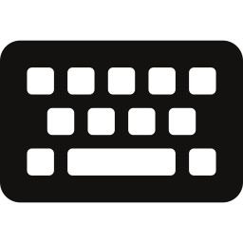






What the CW firmware gives you
True CW keying
Iambic keyer
Sidetone
Message memories
Carrier keyed on and off with fast RX/TX switching and full break-in. Not a tone into an FM mic.
Modes A, B, Ultimatic and Bug. 10 to 45 WPM. Any paddle, straight key, or even PTT and the side button.
450 to 800 Hz in 50 Hz steps, volume off through 6. The tone you hear is the tone you send.
Four slots of 46 characters. Record by keying, then play or repeat. Map them to F1, F2 or M.
Decoder on screen
Code practice oscillator
Filter width
SSB cross-mode
Decodes your sending and what it hears. About 19 characters scroll across the middle line.
No RX, no TX, no license needed. Sidetone plus decode, and it can blink the flashlight LED.
Cycle the IF bandwidth to narrow out a neighbor. Only active in CW mode.
Shifts your CW up by the sidetone so an op on 144.200 USB hears a clean tone without retuning.
Notes:
Emphasize the first one: this is actual carrier keying with fast RX/TX switching, not a tone whistled into the FM microphone. Then the keyer modes, the message memories, and the practice oscillator, which needs no license because it makes no RF and will even blink the flashlight in time with your sending.

Slide 7

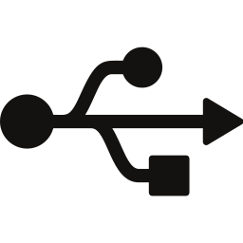

Three ways to key it
Pick by how much you want to open the radio. The rest of this talk walks through the third one.
PTT and side button
USB-C to TRS cable
The rework
No hardware at all
Custom passive cable, radio stays closed
Two resistors off, two wires on
PTT is dah, Side 1 is dit. Iambic keyer still works.
Also "PTT HandKey" for straight-key style.
Try CW the day you flash. Clumsy for real QSOs.
D+ to tip (dit), D- to ring (dah), ground to sleeve.
No electronics. You will have to build it.
Very sensitive to your own RF. Can lock into key-down, so keep it short, use medium power.
Any off-the-shelf TRS paddle plugs straight into the 3.5 mm headset jack.
Rock solid input, no special cable.
Open the case and solder. External mic PTT and SWD debug stop working.
Notes:
You do not have to open the radio to try this. PTT and side button works on a stock radio the day you flash it. The USB-C cable is a passive custom cable, no electronics, but it is very sensitive to RF from your own transmitter and can lock into key-down. The rework is what the rest of the talk walks through: any off-the-shelf paddle plugs straight into the headset jack.

Slide 8
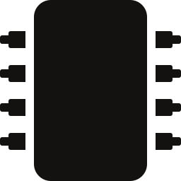
Tools and supplies
Everything on this slide fits in a shoebox. Most of it is already in your junk drawer.
Tools
Parts
Pencil soldering iron. Conical, chisel or bevel tip all work.
Solder, a little flux, fine tweezers.
Thin flathead screwdriver or pry tool for the case.
Plastic spudger for the display frame and ribbon latch.
Magnifier, loupe, or just your phone camera zoomed in.
Isopropyl alcohol and a swab for the pads and the display.
Quansheng UV-K1 (see previous slide).
Two wires, about 2 in and 3 in, 22 AWG or thinner. Strip them out of the USB cable in the box.
A paddle or straight key with a 3.5 mm TRS plug.
K5-style two-pin (Kenwood) programming cable.
Laptop with Chrome or Chromium for the WebSerial flasher.
The firmware file and CHIRP module from the Releases page.
~$30
radio
~$10
programming cable
$0
jumper wire
~$40
iron, if you need one
Notes:
Nothing exotic. NR7Y's own note is that most standard pencil irons will remove the resistors without damaging neighbors, any tip shape works, and the two jumper wires have literally been stripped out of the USB cable that ships in the box. The plastic spudger matters: the display frame releases with a non-metallic tool. The laptop needs Chrome or Chromium because the flashing tool uses WebSerial.

Slide 9
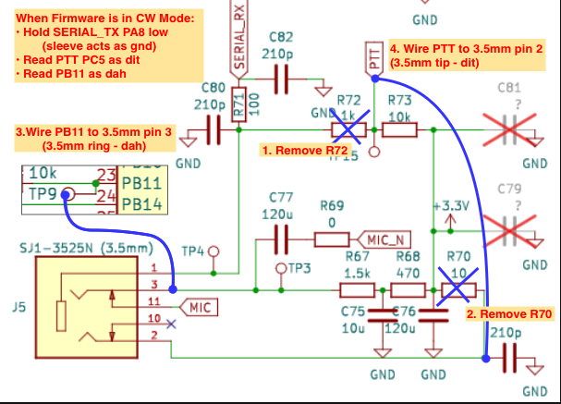
What the mod actually does
Four changes. The firmware does the rest.
1
Remove R72
the 1k pull-up on the PTT line
2
Remove R70
the 10 ohm resistor in the mic ground path
3
Wire PB11 to jack pin 3
the SWDIO pad becomes the ring: dah
4
Wire PTT to jack pin 2
the PTT line becomes the tip: dit
In CW mode the firmware pulls serial TX low so the sleeve acts as ground, then reads PTT as dit and PB11 as dah.
Designators are from the K5 v1 schematic. The K1 moved the parts; the circuit is identical. Costs: external mic PTT, +5 V on the headset port, and SWD debug. Unplug the paddle for FM.
Rework schematic from the NR7Y CW Firmware Docs (CC BY-NC-SA 4.0). Original schematic reverse-engineered by mentalDetector.
Notes:
This is the whole trick. The firmware, when in CW mode, holds the serial TX line low so the sleeve of the headset jack becomes ground. Then it reads the PTT line as dit and PB11, the SWDIO programming pad, as dah. The two resistors that come off are the pull-up on the PTT line and the resistor in the mic ground path. Designators here are from the original K5 schematic; the K1 moved the parts but the circuit is the same. Side effects: an external mic can no longer trigger PTT, the headset port loses its 5 volts, SWD debugging is gone, and you unplug the paddle for FM so the internal mic comes back.

Slide 10
Opening the K1
Two screws, one pry, one ribbon, one display latch. No ring nuts, no front screws.
1
Strip it
5
Respect the flex circuit
Battery, volume knob and antenna off. Leave the ring nuts alone.
A thin ribbon links the board to the front half. Do not over-flex or twist it.
2
Two screws only
6
Unlatch the ribbon
The two behind the battery at the lower edge. The front screws and the ones by the battery release do not matter.
Pry the socket door on the side opposite the ribbon entry. It pivots up and the ribbon slides out. Halves are now separate.
3
Pry the lower edge
7
Free the display
Between the plastic chassis and the inner metal back. Front of the radio facing down so the keypad stays put.
Press in at the lower-left corner of the display frame with a plastic spudger, wiggle, and hinge it up over the top edge.
4
Slide, then stop
The ribbon is the fragile part. One of ours yanked it clean out of the board and now owns a radio that only blinks. Door first, then ribbon.
The inner metal releases and slides down. Only until the volume stem clears the chassis. Do not pull it away yet.
Notes:
Walk this slowly. The two mistakes people make are prying at the wrong edge and torquing the flex circuit between the board and the front half. Slide the inner metal down only until the volume stem clears, then deal with the ribbon: lift the socket door on the side opposite where the ribbon enters, and it slides out. The display frame releases at the lower-left corner with a plastic tool.

Slide 11
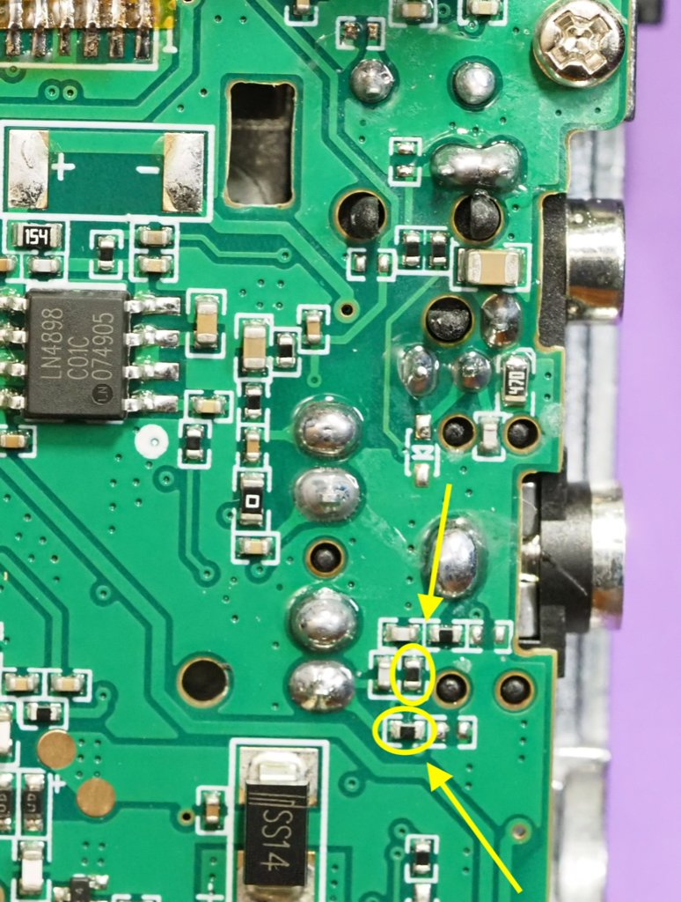

Step one: two resistors off
The only step that needs a steady hand. Two tiny parts, one careful minute.
1
Find them
Two 0402-size resistors on the pads right beside the headset jack, circled in yellow. Confirm with the full-res photo on the docs page before heating anything.
2
Heat, do not pull
Dab of solder on the tip. Heat one end, then the other, until the part slides. Or a wide tip across both ends at once. Lift with tweezers.
3
Check the pads
Both pads still there, no bridges, no stray solder balls. Clean with alcohol. That is the whole step.
"Technically reversible, although the two resistors will vanish the moment you desolder them." And if you lift a pad, the radio is a keychain. Low heat, patience, tweezers.
Photo: NR7Y CW Firmware Docs, UV-K1 rework page (CC BY-NC-SA 4.0). The full-resolution version is on the docs site.
Notes:
Two tiny surface-mount resistors next to the headset jack, circled in the photo. Put a dab of solder on the tip to transfer heat, then heat one end and the other in turn until the part slides off, or lay a wide tip across both ends at once. Lift with tweezers; never pull. The failure mode is lifting the copper pad with the resistor, and one of our members did exactly that: went in for two resistors, came out with zero pads. NR7Y's line: the rework is technically reversible, except the resistors vanish the moment they leave the board.

Slide 12
Step two: two wires on
About 2 in and 3 in of anything 22 AWG or thinner. Tin the ends first.
1
Short wire (blue, ~2 in)
From the solder blob on the left edge of the board over to the pad beside the resistor site next to the headset jack. This carries the PTT line to the jack tip: dit.
2
Long wire (yellow, ~3 in)
From the headset-jack pad down to gold pad 3 of the four along the bottom edge. That pad is SWDIO, which becomes the jack ring: dah.
3
Route and flatten
Run the long wire beside the button pads, never under a key. Keep both flat so the display frame seats over them. Snip strays; stranded wire loves to short.
4
Match the photo
Before closing up, compare against the full-res photo on the docs page. Pad-for-pad. Then a quick continuity check from the jack to each pad.
Photo: NR7Y CW Firmware Docs, UV-K1 rework page (CC BY-NC-SA 4.0). Wire colors are the author's; use whatever you have.
Notes:
Two wires, roughly two and three inches. Follow the photo: the blue wire runs from the solder blob on the left edge over to the pad near the resistor site by the jack, and the yellow wire runs from the headset jack pad down to gold pad number three of the four on the bottom edge, which is the SWDIO pad. Route the long one to the side of the button pads so it never sits under a key, and keep both flat so the display drops back over them. Stranded wire works but watch for stray strands at each end.

Slide 13

Button it up
Reverse order, with two things you cannot fix later.
Reassembly
First power-on
1
Display back in: top-right latch first, then drop the lower-left corner into its hole. Press inward like you did to release it, not straight down on the glass.
Power on with the stock firmware still loaded. It should boot and behave exactly as before.
Internal mic and speaker still work with nothing plugged into the headset jack.
Plug a paddle in. Nothing should happen yet. The firmware does not know about it.
Boots normally? Then nothing is bridged and no ribbon is torn. Now we flash.
Blank screen, no boot, or a flashing screen: open it back up and check the ribbon seat and the pads before anything else.
2
Clean the display now. Fingerprints and dust get sealed behind the chassis window.
3
Socket door up, slide the ribbon's gold fingers in, hinge the door down to latch.
4
Slide the top half of the board and metal back into the chassis, press the bottom in.
5
Two screws. Knob, antenna, battery.
Notes:
Reassembly in reverse, with two things worth saying out loud: clean the display glass now, because it goes behind the chassis window and you will never reach it again; and the ribbon goes into the socket with the door up, then the door latches down. Then the first power-on: it should boot normally on stock firmware. If it does, you did not break anything, and now we flash.

Slide 14

Flash it
Right firmware, right tool, then back up the calibration before you do anything else.
1
2
3
4
5
Identify
Download
Bootloader
uvtools2
Back up
Label behind the battery. K1 or V3 use the k1-k5v3 firmware. Never the v1 file.
Releases page: the .bin for the K1/K5v3 and the matching CHIRP module. No compiling.
Hold PTT and power on. Flashlight LED on, screen blank and unlit. Plug in the programming cable.
Open it in Chrome or Chromium, connect the serial port, pick the file, flash. The LED blinks while it writes.
Reboot to the new firmware, then dump the calibration data with uvtools2. Name the file after the serial number.
Wrong firmware family, or the wrong tool mode, is the most common way to end up with a dead radio, and a few bad flashes have needed aggressive recovery. Calibration is what makes the radio transmit on frequency at the right power; the tools try hard not to touch it, but a backup is the safety net.
Notes:
Three musts from the docs: right firmware family for the radio, right tool for the radio, and back up the calibration data immediately after. Bootloader mode is power on while holding PTT: the flashlight LED lights and the screen stays dark. uvtools2 runs in the browser over WebSerial, so it has to be Chrome or Chromium. The LED flashes while it writes. Then dump the calibration with the same tool and name the file after the serial number. Grab the CHIRP module from the same release, CHIRP needs it.

Slide 15
Set it up
The CW entries are the last ones in the menu. Scroll up from the top and you land on them.
Long press 0
Cycle modulation FM > AM > USB > CW. Squelch opens in CW; Side 1 closes it.
"CW KEY STUCK"
CWkin
Port Iambic for a paddle. Port HandKey for a straight key. Reversed if dit and dah are swapped.
A paddle contact is shorted, the rework is not quite right, or the programming cable was still in at reboot.
Power off, fix the cause, power on. The firmware re-checks the port at every boot.
Trying a Port mode without the rework gives the same message. That is the firmware protecting you.
CWkmod
Mode B is the default. A, Ultimatic and Bug are there if you have opinions.
CWwpm / CWfreq / CWvol
18 WPM, 600 Hz, level 4 by default. Start slower than you think.
Shortcuts worth knowing
CWbkin
ON. Sending keys the transmitter. OFF gives you sidetone only, which is how you practice.
F, then long press 5: code practice oscillator. No RF, blinks the flashlight if you want.
Long press 7: toggle break-in. F, then long press 4: filter width.
CHIRP will not connect while in CW with a Port input. Switch to FM to program memories.
CWmsg1
Record new, key CQ CQ DE CALL, press M to save. Play or Repeat, or map it to F1.
Notes:
Long press zero to cycle modulation until it says CW; squelch opens full time in CW, side button one closes it. The CW menu items are at the very end of the menu, so scroll up from the top. Key input to Port Iambic for a paddle, Port HandKey for a straight key; if dit and dah are swapped, pick Reversed instead of re-soldering. If you see CW KEY STUCK it means a paddle contact is shorted, the rework is not right, or the programming cable was still plugged in when it rebooted. And CHIRP will not connect while the radio is in CW with a port input, so switch modes to program memories.

Slide 16
On the air
144.025 MHz, slow enough for the newest operator in the room.
1
Listen first, then QRL?
144.025
Bylaw III, and this is exactly what it was written for. Somebody working? Move.
2
Inside your privileges
MHz · CW
Your license, your band plan, your responsibility. We are a law-abiding, FCC-respecting gang.
The calling frequency, at the CW and weak-signal end of 2 meters. Shared with EME, so the courtesies are not optional.
Outside the US, check your national band plan.
3
Medium power, modest antenna
It is a local mode. A whip works across town; a small beam works across the valley.
4
QRS is a feature
5 WPM counts as much as 25. Put the club on the frequency and run it at the slowest operator's speed.
5
The honest version
A modified cheap radio, not a weak-signal station, and it behaves like one. That is the point.
Notes:
The grown-up paragraph. The gang calls on 144.025, at the CW and weak-signal end of two meters. That end is shared with EME, so the courtesies matter: listen first, send QRL, and move if somebody is working. Operate inside your privileges and your band plan. Then the honest version: this is a modified cheap radio, not a weak-signal station, and it behaves like one. That is the point. QRS is a feature, not an apology.

Slide 17
Days since we broke a Quansheng
The gang keeps a safety board. Names are named. Every incident is a slide you just saw.
#001
22 Aug 2026 · N9HO
#002
1 Sep 2026 · K3JRZ
#003
11 Sep 2026 · AA1N
Tore the screen clean off one on the floor of the Huntsville Hamfest. At the ARRL National Convention. In front of everybody.
Went in for two resistors, came out with zero pads. Murdered the whole neighborhood. The radio is now a keychain.
Ripped the display ribbon cable clean out of the board. Now enjoying the flashing screen of death.
Lesson
Lesson
Lesson
Pry at the lower edge, front face down, and stop when the volume stem clears.
Heat, do not pull. Dab of solder on the tip, lift with tweezers.
Socket door up first. Then, and only then, the ribbon slides out.
Live sign and incident log: bkg.club/safety.html. Broke one? Confess on Discord and an officer resets the sign.
Notes:
Lighten it up before the closer. The gang keeps a 'days since we broke a Quansheng' sign on the website with an incident log, names named. Three so far, and incident number one is you, so own it: that is the whole point of the board. Each one maps to a step you just saw: pry at the right edge, heat instead of pull, and door before ribbon. If you break one, you confess on Discord and an officer resets the sign.

Slide 18
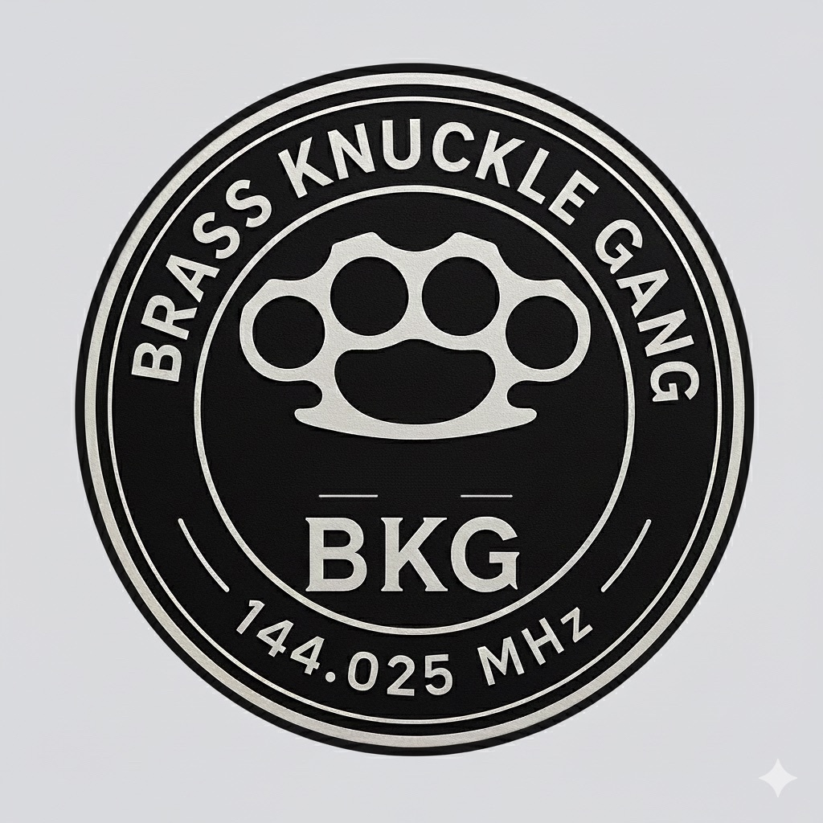


The Brass Knuckle Gang
A law-abiding, FCC-respecting gang for amateur radio operators. 2 meter CW or bust.
The three bylaws
How to get a number
I. Never talk about BKG
1
Make the contact
Except you should, all the time, to everyone. 2m CW needs more operators.
A 2m CW QSO with any member. Watch for us on POTA and SOTA.
II. The proper Roger
2
Send the QSO
At least one thoughtful, proper R per QSO. Failure may result in excommunication.
UTC date, time and band to the member you worked. They submit it on bkg.club.
3
Get your number
III. The QRL? formality
Founded
2025, Northern Utah
An officer assigns it. You land on the roster, the map, and your sponsor's downline.
Always send QRL? before taking a frequency. It is a formality on 2m CW. We do it anyway.
Territory
144 MHz, worldwide
Members
458 and recruiting
Membership is voluntary, every time. Confirm they want in before you submit them.
Reach
42 states, 7 DX countries
Mode
CW only. Manual keys.
Notes:
Closer, two minutes. The Brass Knuckle Gang: pounding brass means sending Morse on a manual key. Founded 2025 in Northern Utah. As of today's site build there are 458 members across 42 states and 7 other countries, and the firmware author NR7Y is on the roster himself. A law-abiding, FCC-respecting gang, and we mean the second part as sincerely as the first. Three bylaws. To join you work an existing member on 2 meter CW, give them the UTC date and time, and you get a number. Membership is voluntary every time; confirm someone wants in before you submit them.

Slide 19

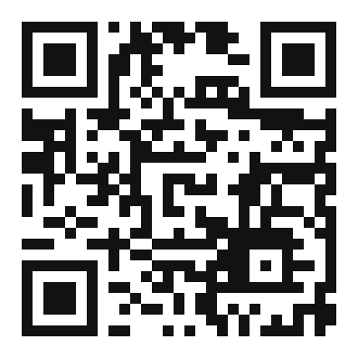
Another Morse Trainer
Learn Morse. Hear Progress. Free and open source, on iPhone and Android.
What it does
Koch method at 33 WPM from day one, with every answer timed so it drills what is still slow.
A guided Journey with an unlock map, confusion drills for the pairs you mix up, and an arcade game or five.
Hands-free Listen & Learn for the car. Code plays, the answer is spoken.
Send it back on a touch key, a MIDI key, or a Vail adapter, with live decode. Live CW with real ops over the Vail network.
Point the mic at your rig and decode off the air. Run a simulated pileup, a timed contest, or the 5/13/20 WPM code exam.
Daily Dit: one five-letter word a day in Morse, same for everyone.
Free and open source (GPL-3). No ads, no subscriptions, same features on both phones.
Scan to join the AMT Discord
discord.gg/qgyk3TPUd9
iPhone & iPad
Beta invites, bug reports, feature chat, and the Android test spots.
Open beta on TestFlight
Android
Closed testing. Ask on the Discord.
anothermorsetrainer.app
Notes:
This one is yours, so say so. Another Morse Trainer is the app you wrote because you spent as much time switching between practice tools as practicing. Koch method at 33 WPM from day one, every answer timed so it drills what is still slow, a guided Journey with an unlock map, confusion drills, hands-free practice for the car, sending on a touch key or a MIDI key or a Vail adapter with live decode, a mic decoder for the rig, pileups and contests, and a word-a-day puzzle. Free, GPL-3, no ads, no subscriptions, same feature set on both phones. iPhone and iPad are in open beta on TestFlight; Android is closed testing and the Discord is where invites go out, so point at the QR code. The vendored CW decoder is Jay Vana's, who is on the BKG roster as W6JY. As of September 11 the builds were iOS 1.3.0 and Android 1.15.0.

Slide 20
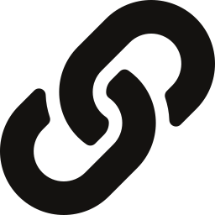
Links, credits, 73
Leave this slide up. Everything in this talk came from these.
The radio
The gang
NR7Y CW firmware docs
Home, bylaws, roster, map
briand.github.io/cw-firmware-docs
bkg.club
Firmware + CHIRP module (Releases)
The pitch for clubs, spelled correctly
github.com/briand/uv-k1-k5v3-firmware-custom
bkg.club/clubs.html
Recruit form, downline tree, nearby finder
uvtools2 flasher and calibration backup
bkg.club/recruit.html · /tree.html · /nearby.html
armel.github.io/uvtools2
Ragchew with the gang
F4HWN Fusion (upstream)
discord.gg/wDs5dth22k
github.com/armel/uv-k1-k5v3-firmware-custom
BKG intro video (YouTube short)
youtube.com/shorts/2ZWex-8fG6M
Photos and schematic: NR7Y CW Firmware Docs, CC BY-NC-SA 4.0. Firmware: NR7Y, on F4HWN Fusion, egzumer and DualTachyon (Apache 2.0). Original K5 schematic by mentalDetector.
Notes:
Leave this up during questions. The docs site has the full-resolution rework photos and the menu reference; the releases page has the firmware and the CHIRP module; uvtools2 is the flasher. bkg.club/clubs.html is the version of this talk you can read out loud at a board meeting.

