Slide 1
Comparison of Crash Injury Predictive Ability using Ordinal Logit and Random Forest
Jonathan Wood

Slide 2
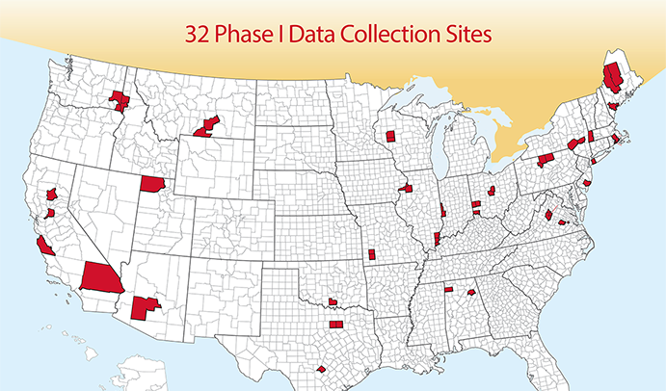
Background – Data: Crash Investigation Sampling System (CISS)
Data collected by the National Highway Traffic Safety Administration (NHTSA)
Purpose: to support scientists and engineers in analyzing motor vehicle crashes and injuries
Sampled crashes from 32 geographical areas
Used data from 2017 (~2,000 Crashes)

Slide 3
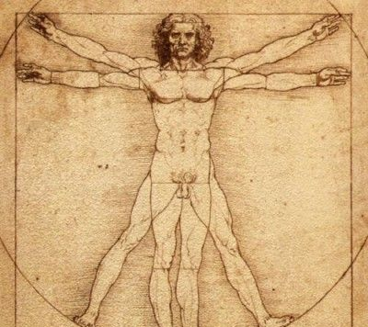
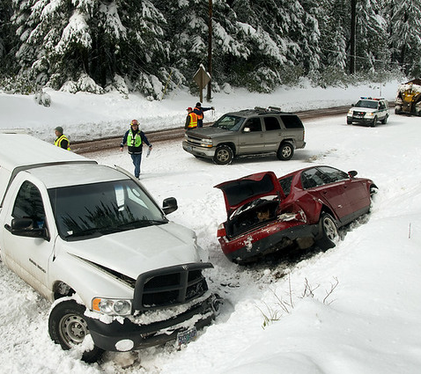
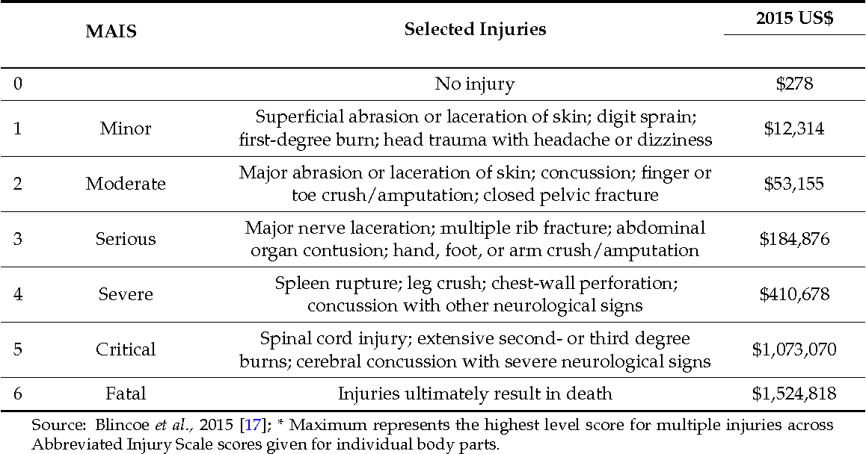
Abbreviated Injury Scale (AIS) is a 6-point ordinal severity scale based on “'threat to life” for a single injury.
MAIS: maximum coded AIS for a person
Target – MAIS
Main Question – Which predicts injury severity better, Ordinal Logit or Random Forest?

Slide 4
Methods
Ordinal Logistic Regression (OLR)
Random Forest (RF)
Partial Dependence Plots (PDP)
Goodman-Kruskal’s (GK) Gamma

Slide 5
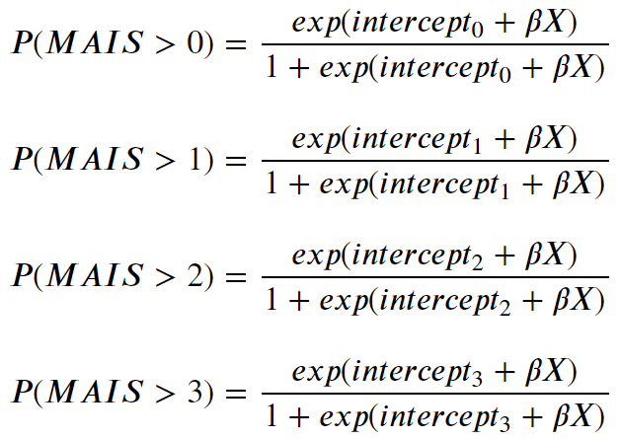

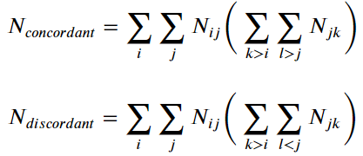
Ordinal Logit & GK Gamma
Ordinal Logistic Regression
Goodman-Kruskal’s (GK) Gamma
GK Gamma is a type of correlation designed for ordinal variables and uses cross-tabulated data
Relies on Concordance and Discordance
Can have values from -1 to 1

Slide 6
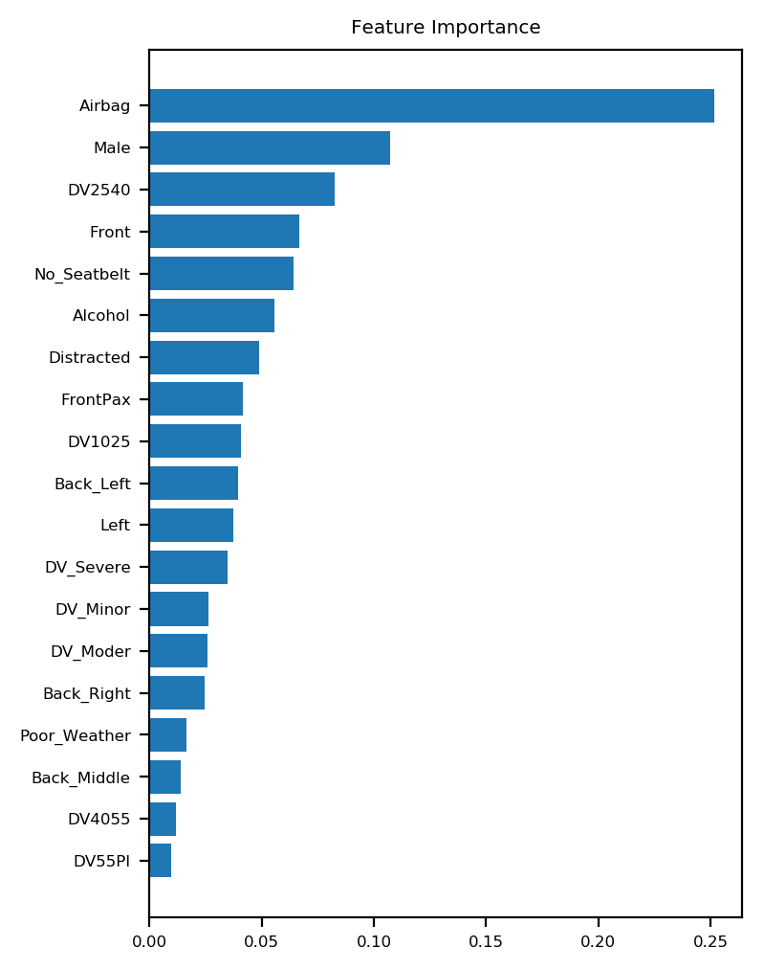
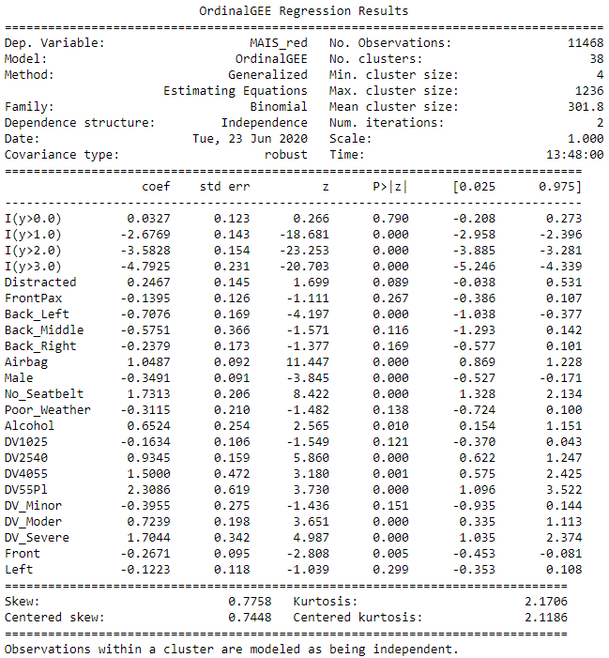
Results (70/30 split train/test)
Note: Grid search resulted in no predicted values for MIAS>2, so additional refinements were made to hyperparameters
Random Forest GK Gamma (test data) = 0.54
Ordinal Logit GK Gamma (test data) = 0.62

Slide 7
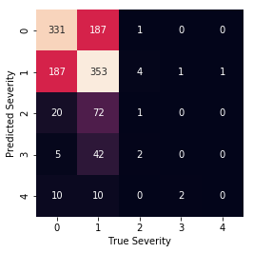
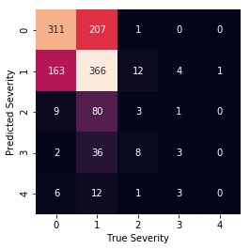
Confusion Matrices
Random Forest GK Gamma (test data) = 0.54
Ordinal Logit GK Gamma (test data) = 0.62

Slide 8
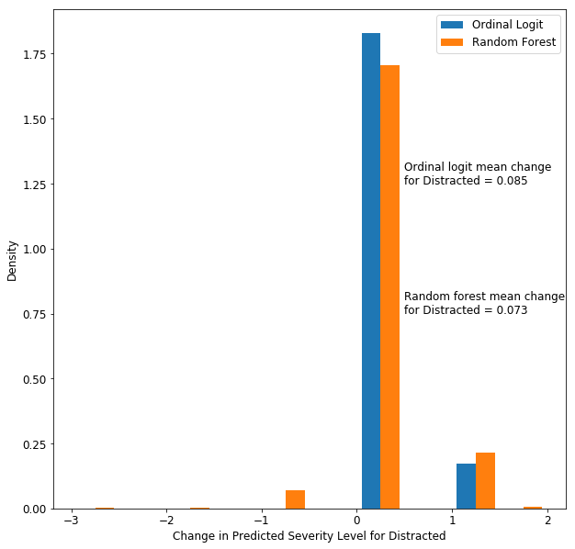
Partial Dependence Plots used on Test Data (i.e., change in predicted class when changing indicators from “0” to “1” Note: OLR has “no effect” or increase in severity while RF has some increase and some decrease

Slide 9
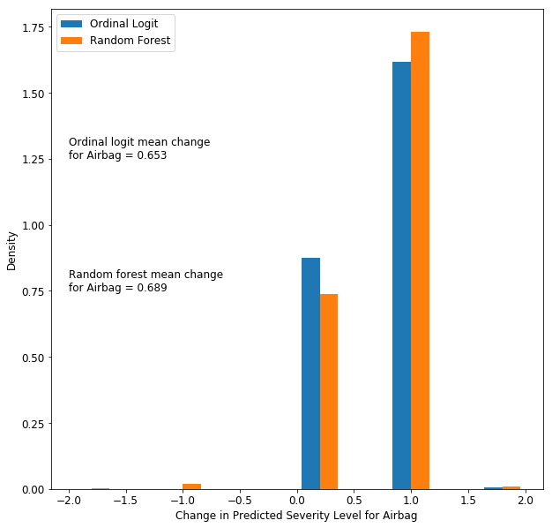
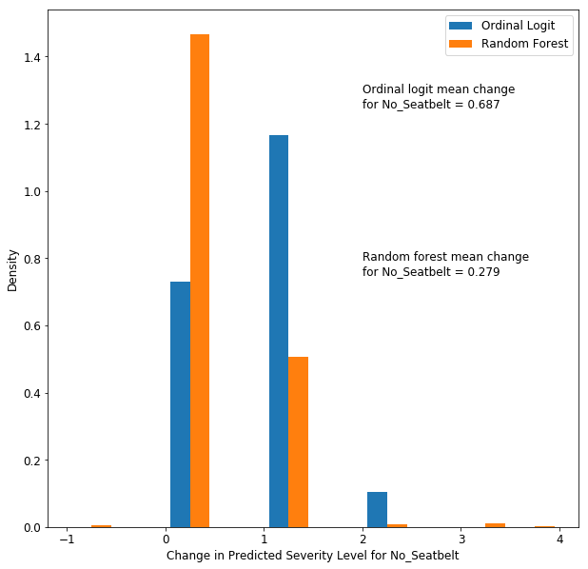
Airbag Deployment & Seatbelt Usage

Slide 10
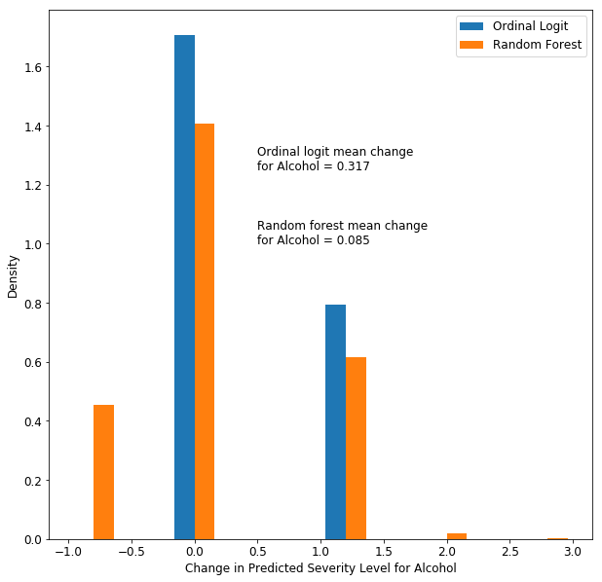
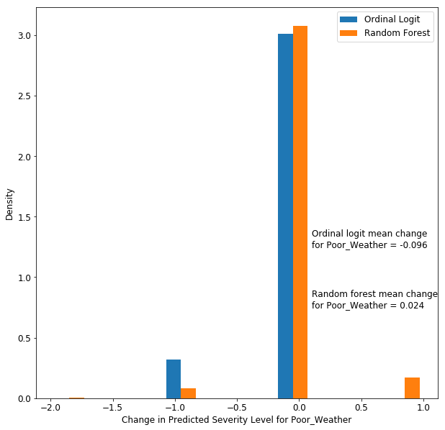
Alcohol Use and Poor Weather Conditions

Slide 11
Conclusions
Ordinal logit has better agreement between predicted and observed injury severities in both the training and test datasets (based on GK Gamma and confusion matrices)
Ordinal logit forces a structure to the model, which may be one reason for the improved performance compared to the Random Forest (particularly when there is a known structure, such as ones based on physics and/or biomechanics - as there is in crashes)
The plots are only for first-level effects. Interactions between variables have not been considered yet. This could be part of the reason that some of the random forest predictions are opposite from the ordinal logit.

Slide 12
Future Directions
Evaluate effects of interactions between predictors
Try up-sampling/down-sampling to improve predictions for MIAS > 2
Use additional years of data to increase sample sizes
Look into observations where the direction of change in predictions is not what would be expected based on biomechanics/physics or the ordinal logit. This could potentially provide insights into real-world interactions and/or situations where technologies can be developed/improved to reduce injury severities
Evaluate other machine learning methods, such as Gradient Boosting
Compare results of machine learning models with other traditional statistical methods, such as mixed logistic regression.

Slide 13

Questions

