Slide 1



组会汇报06
魏建帅
2022年06月12日

Slide 2

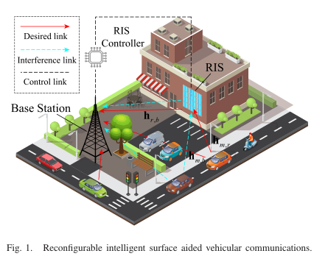
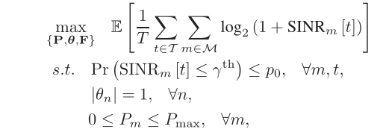
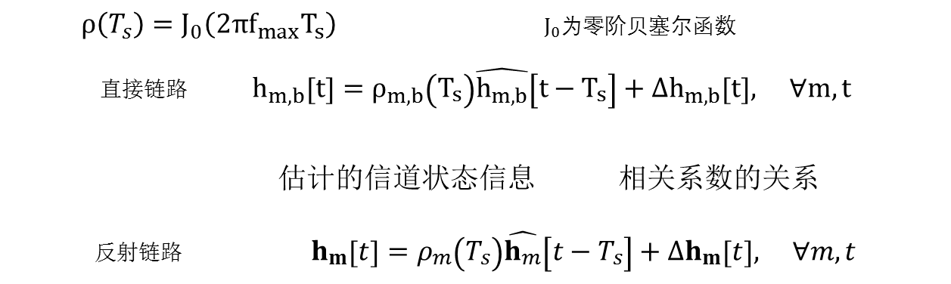
uplink
MISO
车 M = {1, 2, . . . , M}
CSI Error Model
Jakes’ model
$ρ\left(T_{s}\right)=J_{0}\left(2πf_{max}T_{s}\right)$ $J_{0}$为零阶贝塞尔函数
$$直接链路 h_{m,b}\left[t\right]=ρ_{m,b}\left(T_{s}\right)\hat{h_{m,b}}\left[t−T_{s}\right]+Δh_{m,b}\left[t\right], ∀m,t$$
估计的信道状态信息 相关系数的关系
$$反射链路 h_{m}\left[t\right]=ρ_{m}\left(T_{s}\right)\hat{h_{m}}\left[t−T_{s}\right]+Δh_{m}\left[t\right], ∀m,t$$
优化目标与不确定性的概率约束

Slide 3
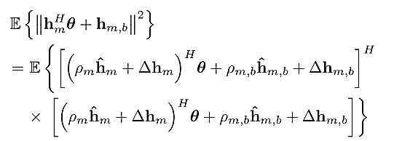


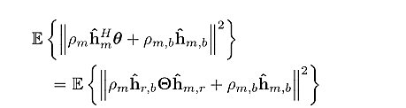
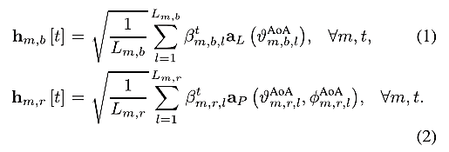
不确定性的概率约束的转化
多径信道统计模型Saleh-Valenzuela

Slide 4



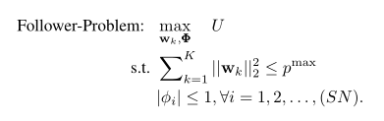




downlink
IRS’s objective
BS equipped with M antennas
K single-antenna mobile users
BS’s utility
范数近似
弗罗贝尼乌斯范数（Frobenius norm）

Slide 5
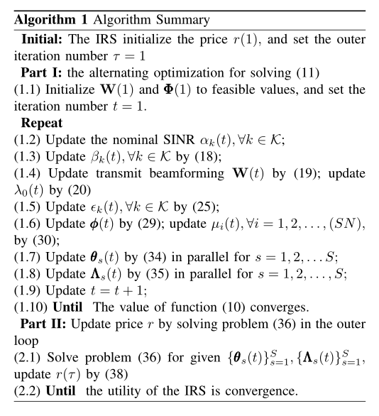
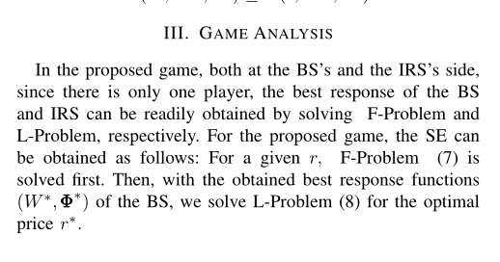
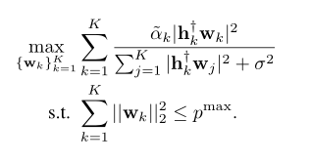

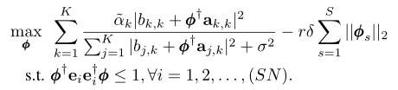


拉格朗日对偶方法转化
given price r
fixed Φ
quadratic transform

Slide 6
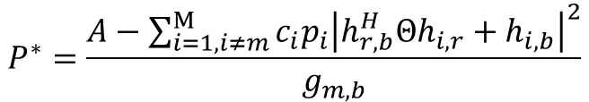
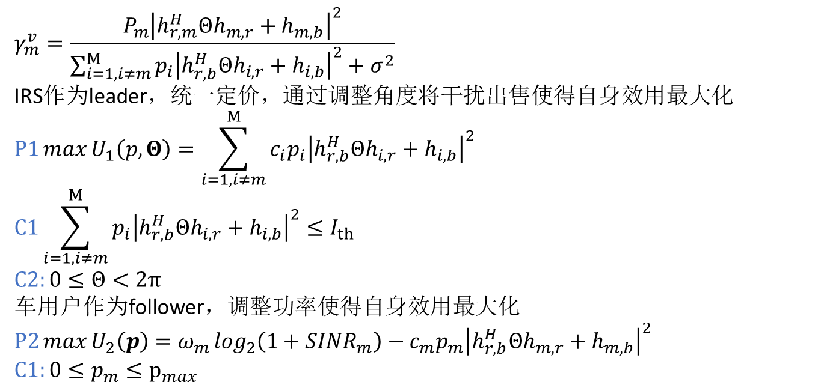
$$γ_{m}^{v}=\frac{P_{m}{\left|h_{r,m}^{H}Θh_{m,r}+h_{m,b}\right|}^{2}}{{\sum_{i=1,i≠m}^{M}{p_{i}{\left|h_{r,b}^{H}Θh_{i,r}+h_{i,b}\right|}^{2}}+σ}^{2}}$$
IRS作为leader，统一定价，通过调整角度将干扰出售使得自身效用最大化
$$P1\max{U_{1}\left(p,Θ\right)}=\sum_{i=1,i≠m}^{M}{c_{i}p_{i}{\left|h_{r,b}^{H}Θh_{i,r}+h_{i,b}\right|}^{2}}$$
$$C1\sum_{i=1,i≠m}^{M}{p_{i}{\left|h_{r,b}^{H}Θh_{i,r}+h_{i,b}\right|}^{2}}≤I_{th}$$
$$C2:0≤Θ<2π$$
车用户作为follower，调整功率使得自身效用最大化
$$P2\max{U_{2}\left(p\right)}=ω_{m}\log_{2}\left(1+SINR_{m}\right)−c_{m}p_{m}{\left|h_{r,b}^{H}Θh_{m,r}+h_{m,b}\right|}^{2}$$
$$C1:0≤p_{m}≤p_{max}$$
$$P^{∗}=\frac{A−\sum_{i=1,i≠m}^{M}{c_{i}p_{i}{\left|h_{r,b}^{H}Θh_{i,r}+h_{i,b}\right|}^{2}}}{g_{m,b}}$$

Slide 7

替换用
参考文献
Y. Gao, C. Yong, Z. Xiong, D. Niyato, Y. Xiao and J. Zhao, "A Stackelberg Game Approach to Resource Allocation for IRS-aided Communications," GLOBECOM 2020 - 2020 IEEE Global Communications Conference, 2020, pp. 1-6, doi: 10.1109/GLOBECOM42002.2020.9322649.
Y. Chen, Y. Wang and L. Jiao, "Robust Transmission for Reconfigurable Intelligent Surface Aided Millimeter Wave Vehicular Communications With Statistical CSI," in IEEE Transactions on Wireless Communications, vol. 21, no. 2, pp. 928-944, Feb. 2022, doi: 10.1109/TWC.2021.3100492.

Slide 8
敬请批评指正

Slide 9
优化问题拆分

