Slide 1



组会汇报07
魏建帅
2022年07月09日

Slide 2


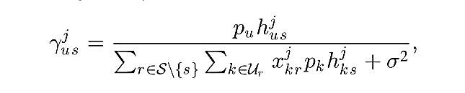
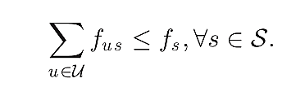

Joint Task Offloading and Resource Allocation for Multi-Server Mobile-Edge Computing Networks
du
the amount of input data necessary to transfer the program
cu
the amount of computation to accomplish the task
t总=t上传+t执行
task Tu from user u is offloaded to BS s

Slide 3
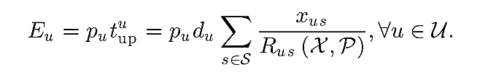

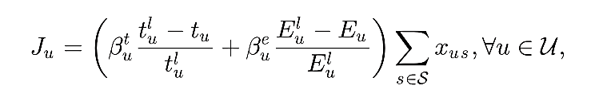
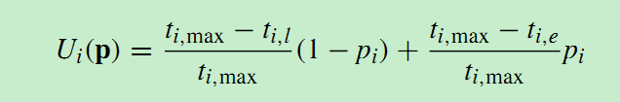
上传的能耗
A Game-Based Computation Offloading Method in Vehicular Multiaccess Edge Computing Networks
上传时间＋处理时间
能量多
βe小点，会增加功率 p 优化第一项
能量少
βt小点，会增加基站计算资源 f 优化第二项

Slide 4
interference link
effective link

Slide 5
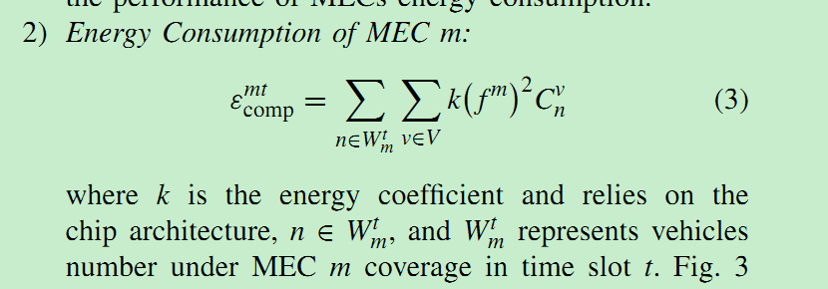

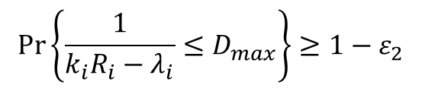

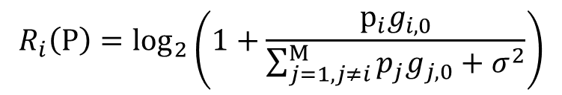
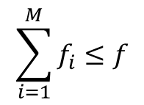


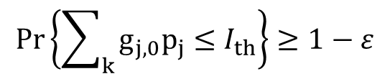
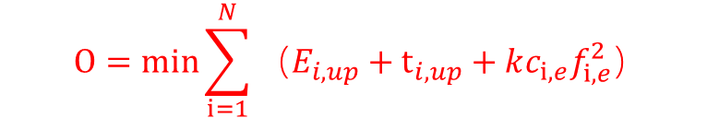
$${R_{i}\left(P\right)=log}_{2}\left(1+\frac{p_{i}g_{i,0}}{{\sum_{j=1,j≠i}^{M}{p_{j}g_{j,0}}+σ}^{2}}\right)$$
the achievable rate [bits/s] of user i sending data to BS
上传时间 $t_{i,up}=\frac{d_{i,up}}{R_{i}\left(P\right)}$ $\frac{up data}{rate}$
$$O=min\sum_{i=1}^{N}{（E_{i,up}}+t_{i,up}+{kc_{i,e}f}_{i,e}^{2}）$$
处理时间 $t_{i,exe}=\frac{c_{i,e}}{f_{i}}$ $\frac{workload}{MEC allocates to user}$
上传能量消耗
$$E_{i,up}=p_{i}∗t_{i,up}$$
Vehicular Task Offloading via Heat-Aware MEC
Cooperation Using Game-Theoretic Method
处理能耗 $E_{i,exe}={kc_{i,e}f}_{i,e}^{2}$ $系数$*工作量*计算速度的平方
约束条件
$$Pr\left\{\sum_{k}{g_{j,0}p_{j}}≤I_{th}\right\}≥1−ε$$
$$Pr\left\{\frac{1}{k_{i}R_{i}−λ_{i}}≤D_{max}\right\}≥1−ε_{2}$$
$$\sum_{i=1}^{M}{f_{i}}≤f$$
$$0≤p≤p_{max}$$

Slide 6
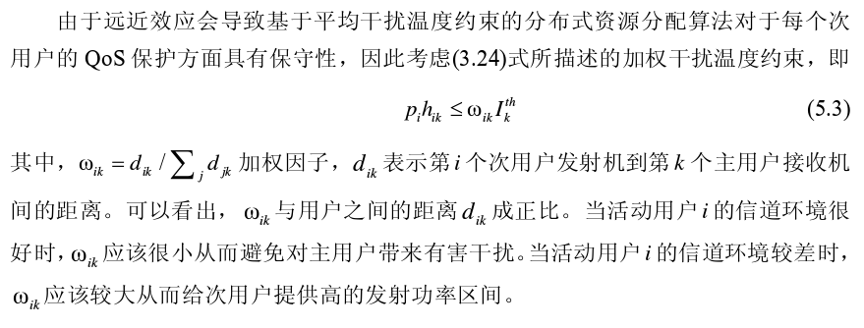
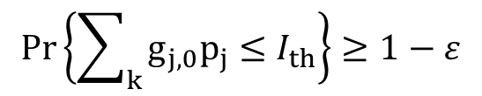
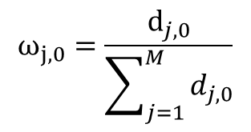

a robust distributed power control algorithm is proposed to solve$Pr\left\{\sum_{k}{g_{j,0}p_{j}}≤I_{th}\right\}≥1−ε$
$$Pr\left\{\sum_{k}{g_{j,0}p_{j}}≤I_{th}\right\}≥1−ε$$
$$Pr\left\{g_{j,0}p_{j}≤{ω_{j,0}I}_{th}\right\}≥1−ε$$
$$ω_{j,0}=\frac{ⅆ_{j,0}}{\sum_{j=1}^{M}{d_{j,0}}}$$
其中

Slide 7
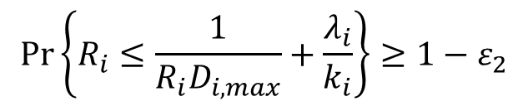
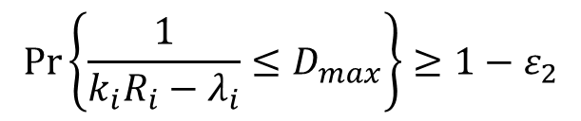
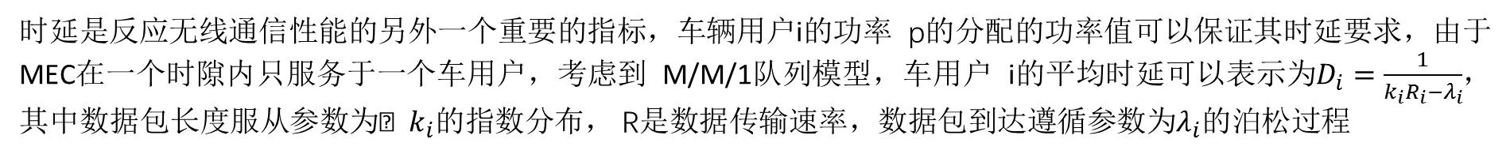
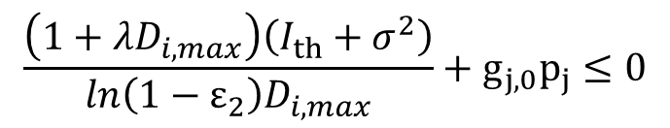
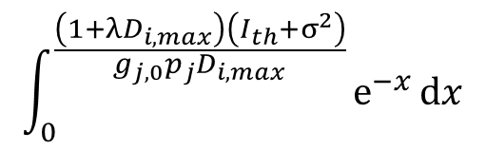
时延是反应无线通信性能的另外一个重要的指标，车辆用户i的功率 p的分配的功率值可以保证其时延要求，由于MEC在一个时隙内只服务于一个车用户，考虑到 M/M/1队列模型，车用户 i的平均时延可以表示为$D_{i}=\frac{1}{k_{i}R_{i}−λ_{i}}$，其中数据包长度服从参数为$k_{i}$的指数分布， R是数据传输速率，数据包到达遵循参数为$λ_{i}$的泊松过程
$$Pr\left\{\frac{1}{k_{i}R_{i}−λ_{i}}≤D_{max}\right\}≥1−ε_{2}$$
Vehicular Task Offloading via Heat-Aware MEC
Cooperation Using Game-Theoretic Method
$$Pr\left\{R_{i}≤\frac{1}{R_{i}D_{i,max}}+\frac{λ_{i}}{k_{i}}\right\}≥1−ε_{2}$$
$$\frac{\left(1+λD_{i,max}\right)\left(I_{th}+σ^{2}\right)}{ln\left(1−ε_{2}\right)D_{i,max}}+g_{j,0}p_{j}≤0$$
$$\int_{0}^{\frac{\left(1+λD_{i,max}\right)\left(I_{th}+σ^{2}\right)}{g_{j,0}p_{j}D_{i,max}}}{ⅇ^{−x}ⅆx}$$

Slide 8
继续阅读相关文献
2. 完善优化问题

Slide 9

替换用
参考文献
Y. Wang et al., "A Game-Based Computation Offloading Method in Vehicular Multiaccess Edge Computing Networks," in IEEE Internet of Things Journal, vol. 7, no. 6, pp. 4987-4996, June 2020, doi: 10.1109/JIOT.2020.2972061.
T. X. Tran and D. Pompili, "Joint Task Offloading and Resource Allocation for Multi-Server Mobile-Edge Computing Networks," in IEEE Transactions on Vehicular Technology, vol. 68, no. 1, pp. 856-868, Jan. 2019, doi: 10.1109/TVT.2018.2881191.
Xu, Y., Zhao, X. Robust Probabilistic Distributed Power Control Algorithm for Underlay Cognitive Radio Networks under Channel Uncertainties. Wireless Pers Commun 78, 1297–1312 (2014). https://doi.org/10.1007/s11277-014-1818-8
Z. Xiao et al., "Vehicular Task Offloading via Heat-Aware MEC Cooperation Using Game-Theoretic Method," in IEEE Internet of Things Journal, vol. 7, no. 3, pp. 2038-2052, March 2020, doi: 10.1109/JIOT.2019.2960631.

Slide 10
敬请批评指正

Slide 13

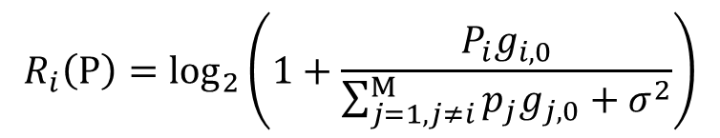
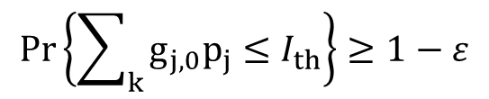

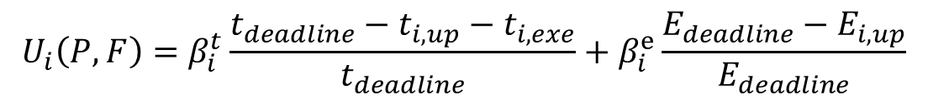
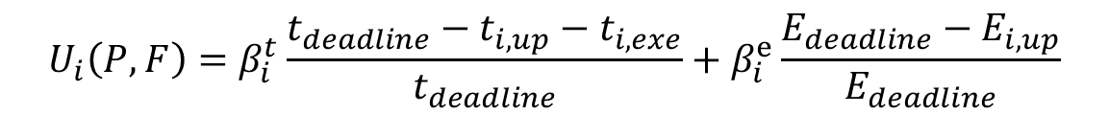
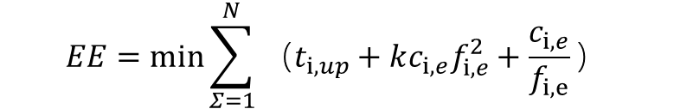
$${R_{i}\left(P\right)=log}_{2}\left(1+\frac{P_{i}g_{i,0}}{{\sum_{j=1,j≠i}^{M}{p_{j}g_{j,0}}+σ}^{2}}\right)$$
the achievable rate [bits/s] of user i sending data to BS
上传时间 $t_{i,up}=\frac{d_{i,up}}{R_{i}\left(P\right)}$ $\frac{up data}{rate}$
处理时间 $t_{i,exe}=\frac{c_{i,e}}{f_{i}}$ $\frac{workload}{MEC allocates to user}$
$$EE=min\sum_{Σ=1}^{N}{（t_{i,up}}+{kc_{i,e}f}_{i,e}^{2}+\frac{c_{i,e}}{f_{i,e}}）$$
上传能量消耗
$$E_{i,up}=p_{i}∗t_{i,up}$$
$$U_{i}\left(P,F\right)=β_{i}^{t}\frac{t_{deadline}−t_{i,up}−t_{i,exe}}{t_{deadline}}+β_{i}^{e}\frac{E_{deadline}−E_{i,up}}{E_{deadline}}$$
效用函数
约束条件
$$Pr\left\{\sum_{k}{g_{j,0}p_{j}}≤I_{th}\right\}≥1−ε$$
$$0≤p≤p_{max}$$
$$U_{i}\left(P,F\right)=β_{i}^{t}\frac{t_{deadline}−t_{i,up}−t_{i,exe}}{t_{deadline}}+β_{i}^{e}\frac{E_{deadline}−E_{i,up}}{E_{deadline}}$$

