Slide 1



组会汇报11
Power Control and Task Offloading for Cloud Assisted MEC in Vehicular Networks
联合功率控制和移动边缘计算资源分配的车联网
魏建帅
2023年02月25日

Slide 2

卸载过程
绿色车辆
路边单元与边缘计算服务器
云端服务器
在RSU的覆盖范围内分成多个地理区域

Slide 3

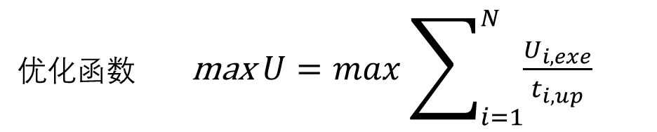

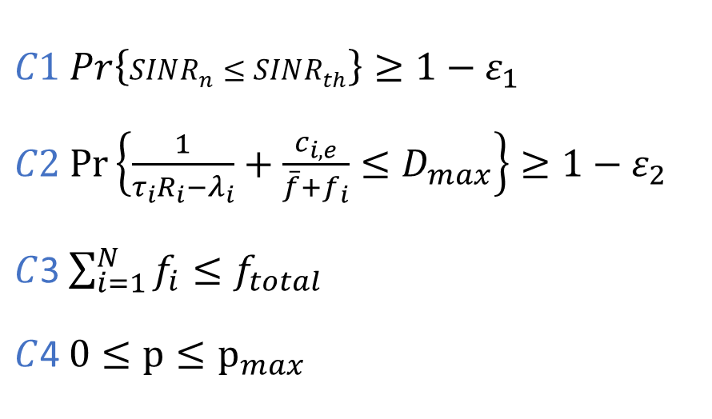

建立了(C-MEC)云边协同模型辅助车辆完成任务卸载并保证通信的质量
处理时间 $t_{i,exe}=\frac{c_{i,e}}{\overline{f}+f_{i}}+T_{c}$
处理的效用 $U_{i,exe}=\frac{t_{max}−t_{i,exe}}{t_{max}}$
考虑车联网场景下车辆高速运动带来的信道不确定性，引入一阶马尔可夫过程描述。
上传时间 $t_{i,up}=\frac{d_{i,up}}{R_{i}\left(P\right)}$
保证了车辆在通信过程中的QoS
优化函数 max $U=max\sum_{i=1}^{N}{\frac{U_{i,exe}}{t_{i,up}}}$
$C1$ $Pr\left\{SINR_{n}≤SINR_{th}\right\}≥1−ε_{1}$
$C2$ $Pr\left\{\frac{1}{τ_{i}R_{i}−λ_{i}}+\frac{c_{i,e}}{\overline{f}+f_{i}}≤D_{max}\right\}≥1−ε_{2}$
$C$3 $\sum_{i=1}^{N}{f_{i}}≤f_{total}$
$C$4 $0≤p≤p_{max}$
保证通信质量
保证处理时间

Slide 4
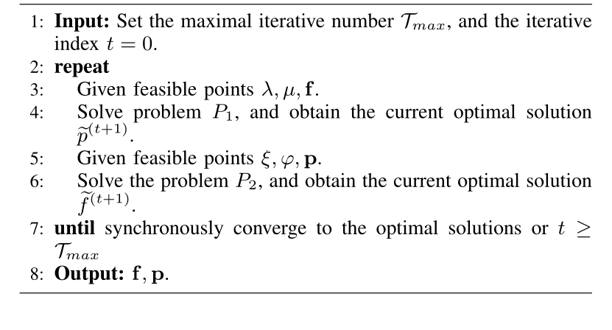
BCD过程
先通过第一个子问题迭代得到功率的最优策略
然后通过第二个子问题得到计算资源分配的最优策略

Slide 5
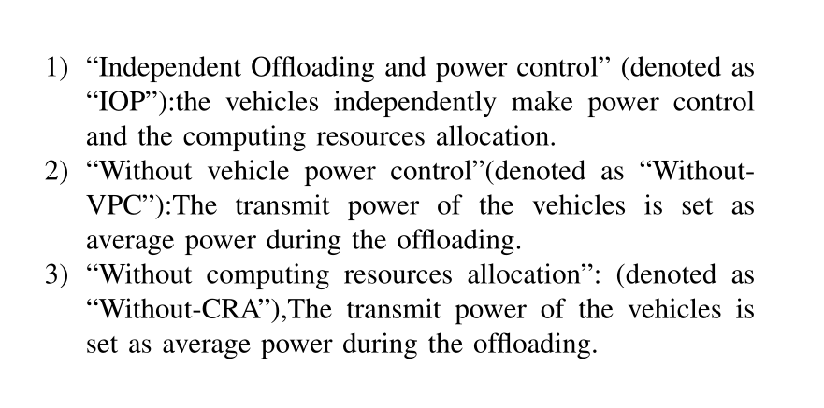
定性的分析
为什么联合优化的方式会比独立优化与只优化一个变量效果更好

Slide 6
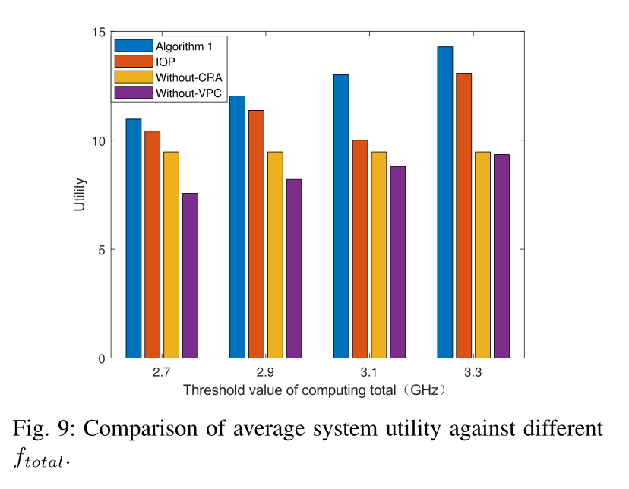
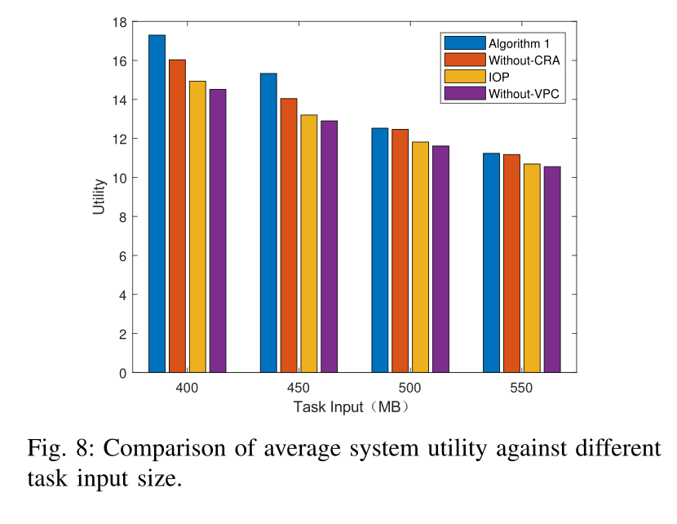

Slide 7

替换用
参考文献
Y. Wang et al., "A Game-Based Computation Offloading Method in Vehicular Multiaccess Edge Computing Networks," in IEEE Internet of Things Journal, vol. 7, no. 6, pp. 4987-4996, June 2020, doi: 10.1109/JIOT.2020.2972061.
T. X. Tran and D. Pompili, "Joint Task Offloading and Resource Allocation for Multi-Server Mobile-Edge Computing Networks," in IEEE Transactions on Vehicular Technology, vol. 68, no. 1, pp. 856-868, Jan. 2019, doi: 10.1109/TVT.2018.2881191.
Xu, Y., Zhao, X. Robust Probabilistic Distributed Power Control Algorithm for Underlay Cognitive Radio Networks under Channel Uncertainties. Wireless Pers Commun 78, 1297–1312 (2014). https://doi.org/10.1007/s11277-014-1818-8
Z. Xiao et al., "Vehicular Task Offloading via Heat-Aware MEC Cooperation Using Game-Theoretic Method," in IEEE Internet of Things Journal, vol. 7, no. 3, pp. 2038-2052, March 2020, doi: 10.1109/JIOT.2019.2960631.

Slide 8
敬请批评指正

Slide 9
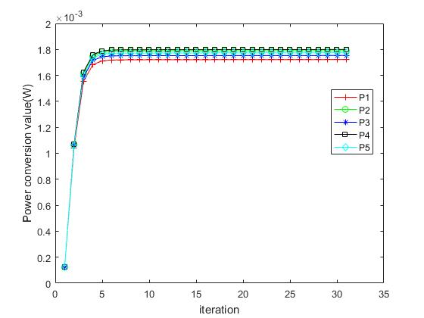

Slide 10
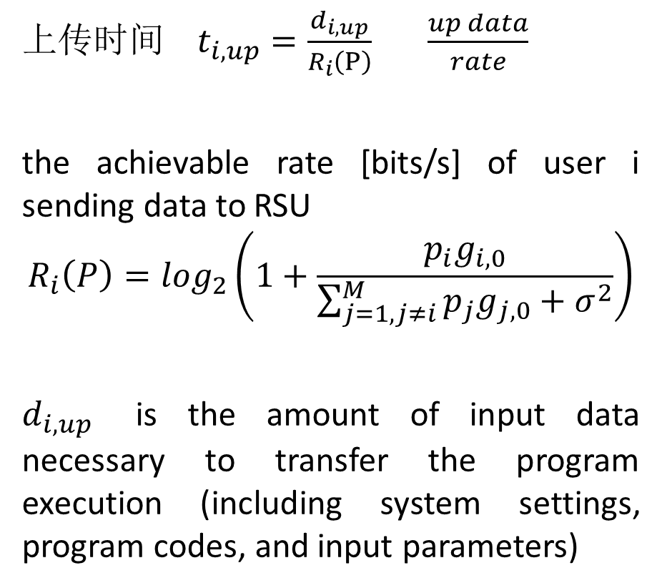
上传时间 $t_{i,up}=\frac{d_{i,up}}{R_{i}\left(P\right)}$ $\frac{up data}{rate}$
the achievable rate [bits/s] of user i sending data to RSU
$${R_{i}\left(P\right)=log}_{2}\left(1+\frac{p_{i}g_{i,0}}{{\sum_{j=1,j≠i}^{M}{p_{j}g_{j,0}}+σ}^{2}}\right)$$
$d_{i,up}$ is the amount of input data necessary to transfer the program execution (including system settings, program codes, and input parameters)

Slide 11

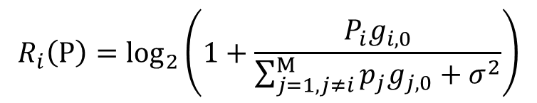
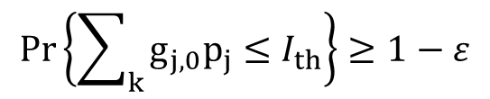

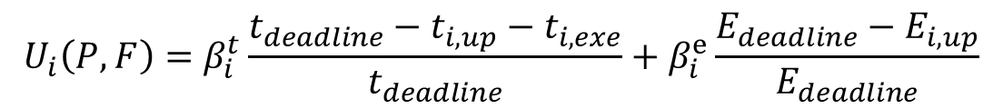

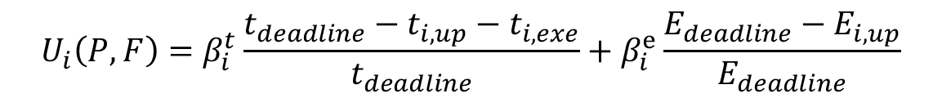

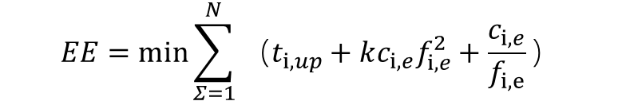
$${R_{i}\left(P\right)=log}_{2}\left(1+\frac{P_{i}g_{i,0}}{{\sum_{j=1,j≠i}^{M}{p_{j}g_{j,0}}+σ}^{2}}\right)$$
the achievable rate [bits/s] of user i sending data to BS
上传时间 $t_{i,up}=\frac{d_{i,up}}{R_{i}\left(P\right)}$ $\frac{up data}{rate}$
处理时间 $t_{i,exe}=\frac{c_{i,e}}{f_{i}}$ $\frac{workload}{MEC allocates to user}$
$$EE=min\sum_{Σ=1}^{N}{（t_{i,up}}+{kc_{i,e}f}_{i,e}^{2}+\frac{c_{i,e}}{f_{i,e}}）$$
上传能量消耗
$$E_{i,up}=p_{i}∗t_{i,up}$$
$$U_{i}\left(P,F\right)=β_{i}^{t}\frac{t_{deadline}−t_{i,up}−t_{i,exe}}{t_{deadline}}+β_{i}^{e}\frac{E_{deadline}−E_{i,up}}{E_{deadline}}$$
效用函数
约束条件
$$Pr\left\{\sum_{k}{g_{j,0}p_{j}}≤I_{th}\right\}≥1−ε$$
$$0≤p≤p_{max}$$
$$U_{i}\left(P,F\right)=β_{i}^{t}\frac{t_{deadline}−t_{i,up}−t_{i,exe}}{t_{deadline}}+β_{i}^{e}\frac{E_{deadline}−E_{i,up}}{E_{deadline}}$$

