Slide 1



组会汇报12
Secure Communication and Task Offloading in Vehicular Networks under RIS and D2D Collaboration
RIS与D2D协作的车联网资源安全通信与任务卸载
魏建帅
2023年03月25日

Slide 2


替换用
参考文献
U. Saleem, Y. Liu, S. Jangsher, Y. Li and T. Jiang, "Mobility-Aware Joint Task Scheduling and Resource Allocation for Cooperative Mobile Edge Computing," in IEEE Transactions on Wireless Communications, vol. 20, no. 1, pp. 360-374, Jan. 2021, doi: 10.1109/TWC.2020.3024538.
.
B. Li, W. Wu, Y. Li and W. Zhao, "Intelligent Reflecting Surface and Artificial-Noise-Assisted Secure Transmission of MEC System," in IEEE Internet of Things Journal, vol. 9, no. 13, pp. 11477-11488, 1 July1, 2022, doi: 10.1109/JIOT.2021.3127534.

Slide 3
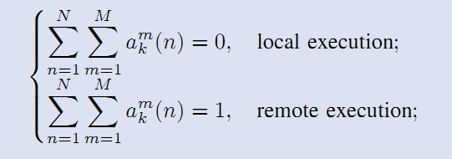


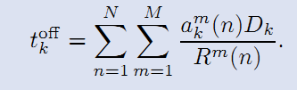
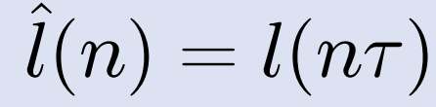

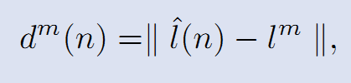









轨迹是可以通过数据采集预测的
$$τ$$
$$τ$$
$$τ$$
$$τ$$
$$⋯$$
$$τ$$
$$τ$$
$$τ$$
N个时隙
horizontal location
distance
phone,tablet, laptop and desktop computer can serve as fog nodes
K个任务，N个时隙，M个D2D接收者

Slide 4
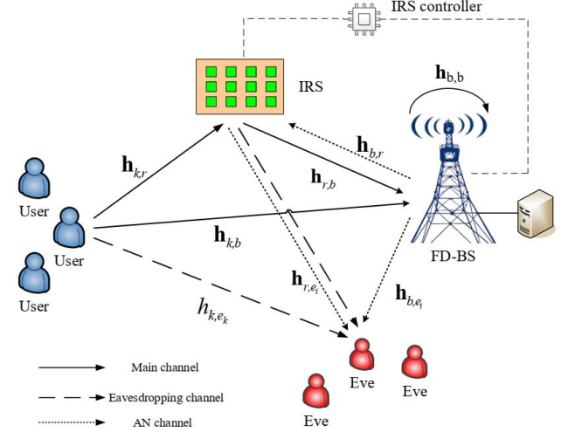

Constraint (8a) ensures that the task Lk − lk bits
can be securely offloaded within time tk.

Slide 5
RIS与D2D协作的车联网资源安全通信与任务卸载
VUE先上传后下载，重点关注下载
通过优化智能反射面的可调相角，D2DT的传输功率。在保证D2DT能在规定的时间内传输完成的前提下去优化主级保密车辆VUE的安全速率。
D2D传输相对安全，不容易受到窃听者窃听，通信链路也不会受到阻挡

Slide 6

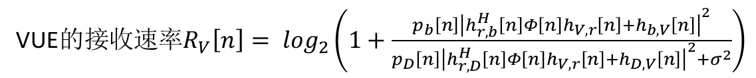


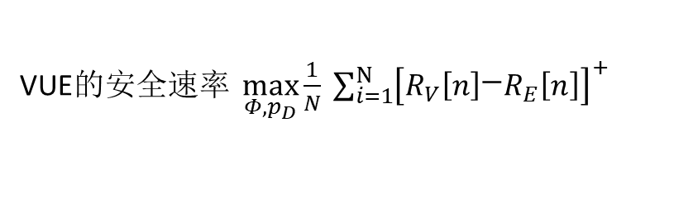
通过优化智能反射面的可调相角，D2DT的传输功率。在保证D2DT能在规定的时间内传输完成的前提下去优化主级保密车辆VUE的安全速率。
D2DR车辆的接收速率$R_{D}\left[n\right]= \log_{2}\left(1+\frac{p_{D}\left[n\right]g_{D}\left[n\right]}{σ^{2}}\right)$
$C1$ 加一个保证时间的约束
VUE的接收速率$R_{V}\left[n\right]= \log_{2}\left(1+\frac{p_{b}\left[n\right]{\left|h_{r,b}^{H}\left[n\right]Φ\left[n\right]h_{V,r}\left[n\right]+h_{b,V}\left[n\right]\right|}^{2}}{p_{D}\left[n\right]{\left|h_{r,D}^{H}\left[n\right]Φ\left[n\right]h_{V,r}\left[n\right]+h_{D,V}\left[n\right]\right|}^{2}+σ^{2}}\right)$
Eva的窃听速率$R_{E}\left[n\right]= \log_{2}\left(1+\frac{p_{b}\left[n\right]{\left|h_{r,b}^{H}\left[n\right]Φ\left[n\right]h_{ⅇ,r}\left[n\right]+h_{b,ⅇ}\left[n\right]\right|}^{2}}{σ^{2}}\right)$
VUE的安全速率 $\max_{Φ,p_{D}}\frac{1}{N} \sum_{i=1}^{N}{{\left[R_{V}\left[n\right]\begin{matrix}−\end{matrix}R_{E}\left[n\right]\right]}^{+}}$
$C2$ RIS相角约束
$C3$ D2DT的发送功率约束

Slide 7
替换用
参考文献
U. Saleem, Y. Liu, S. Jangsher, Y. Li and T. Jiang, "Mobility-Aware Joint Task Scheduling and Resource Allocation for Cooperative Mobile Edge Computing," in IEEE Transactions on Wireless Communications, vol. 20, no. 1, pp. 360-374, Jan. 2021, doi: 10.1109/TWC.2020.3024538.
.
B. Li, W. Wu, Y. Li and W. Zhao, "Intelligent Reflecting Surface and Artificial-Noise-Assisted Secure Transmission of MEC System," in IEEE Internet of Things Journal, vol. 9, no. 13, pp. 11477-11488, 1 July1, 2022, doi: 10.1109/JIOT.2021.3127534.

Slide 8
谢谢观看
敬请批评指正

