Slide 1
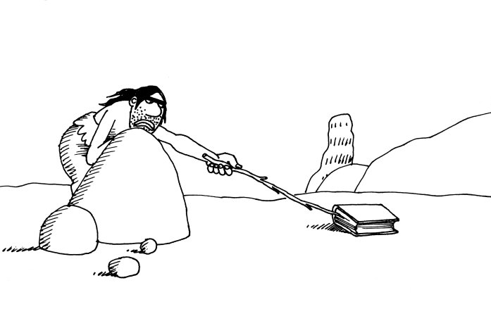
Freshman Orientation
Ms. Swedo
Eat?

Slide 2
JSerra Library Webpages
Main Page:
http://www.jserra.org/library
OPAC:
Library Catalog

Slide 3
The Library
7:30am to 6:00pm ……. Monday – Thursday
7:30am to 3:00pm ……. Friday
Closed Signs
General Rules

Slide 4

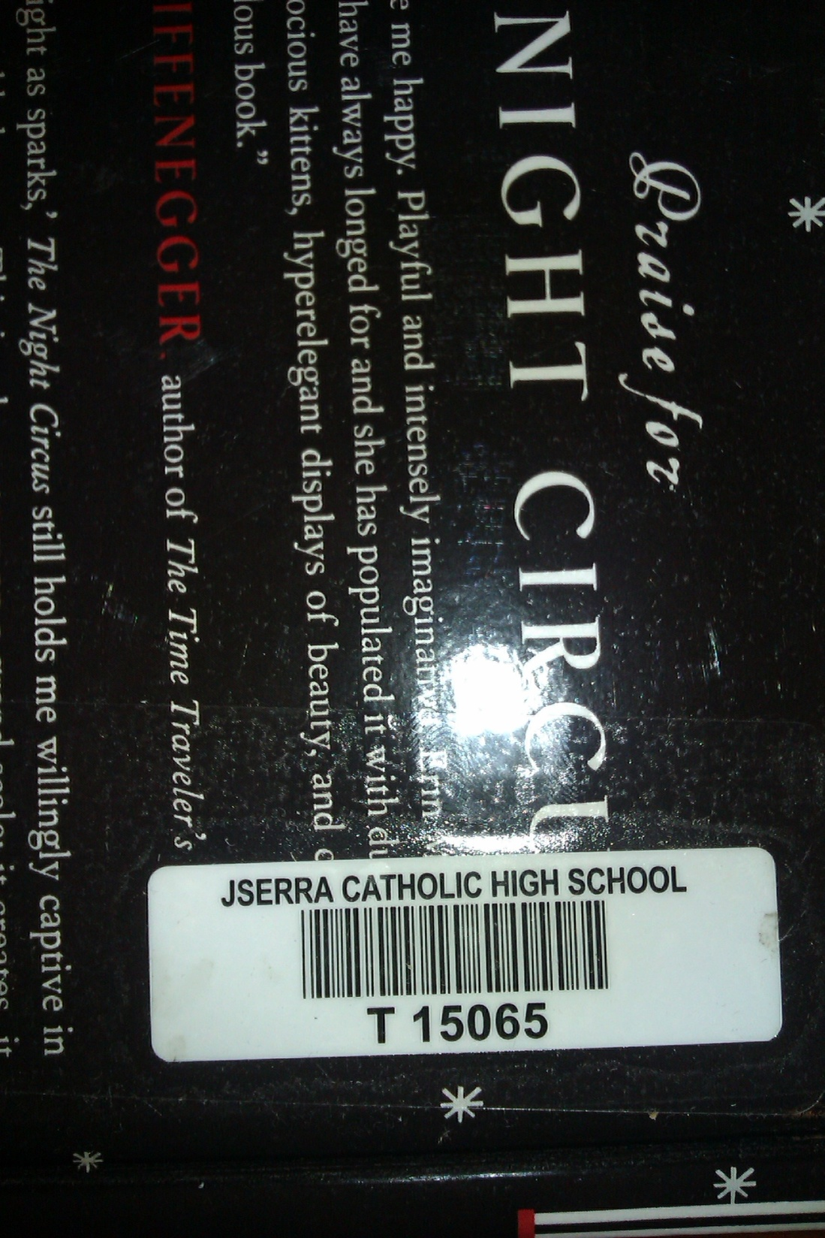

Slide 5
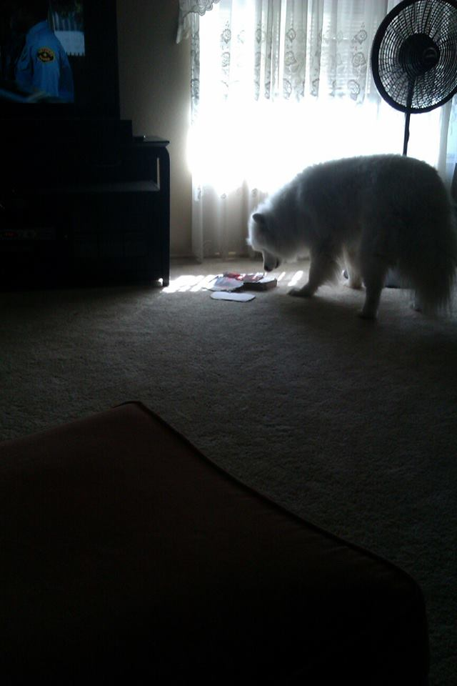
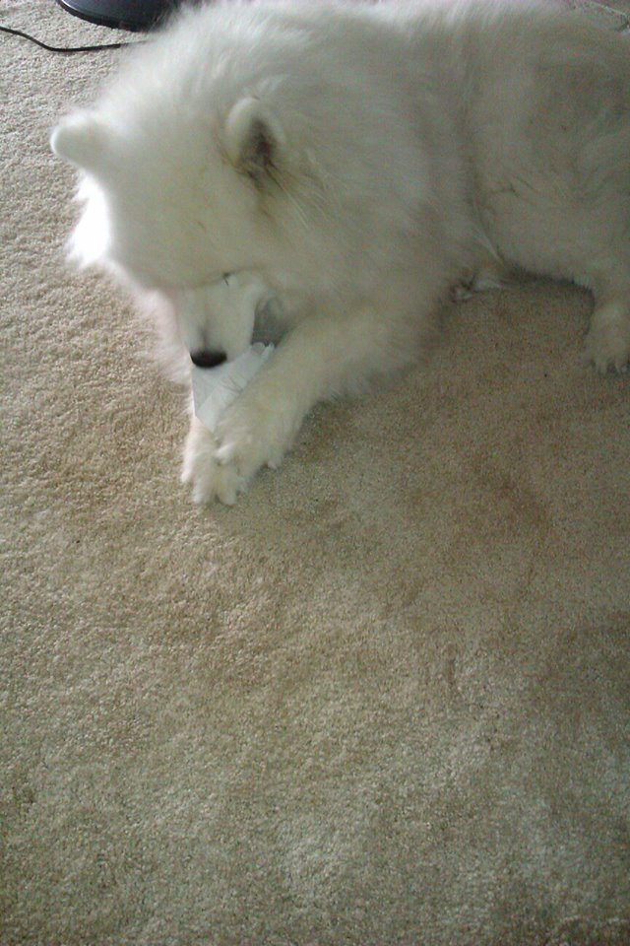
Yuki
An Avid Reader

Slide 6
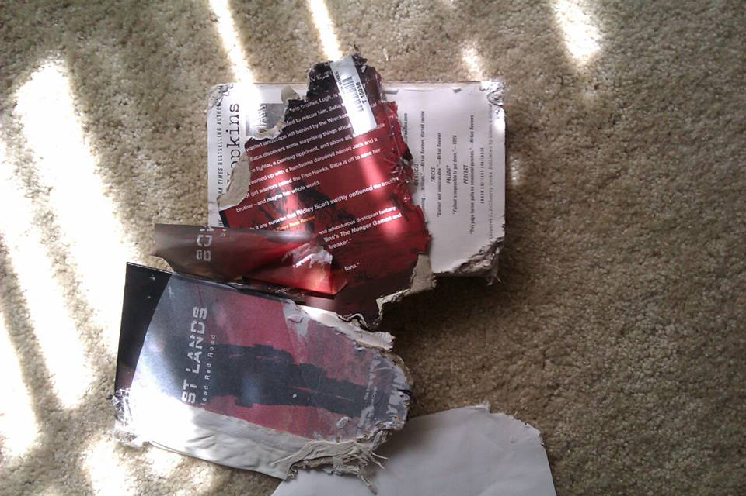

Slide 7

Librarians
Library Navigation
Research
Citation help
General

Slide 8

1st Source of Information
Library
Catalog

Slide 9
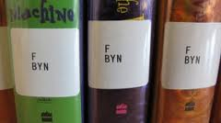
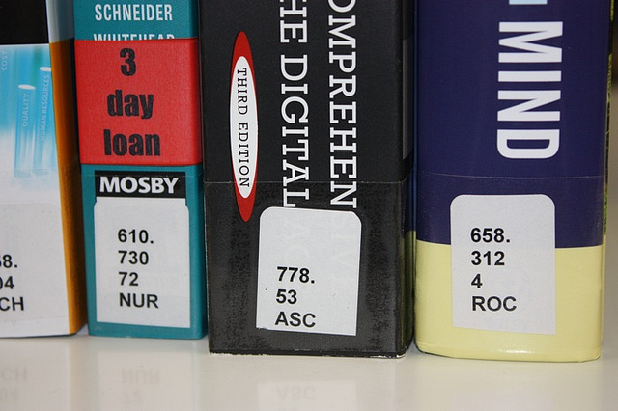
Book Addresses
aka, Call Numbers

Slide 10
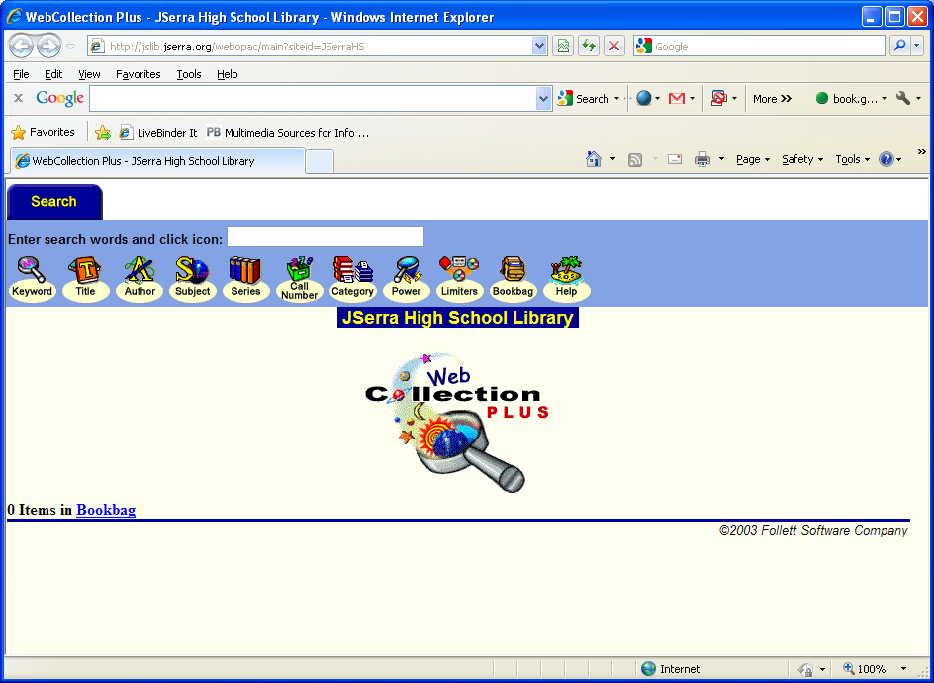
Text box
Search Options

Slide 11


2nd source of info
Databases

Slide 12





Slide 13
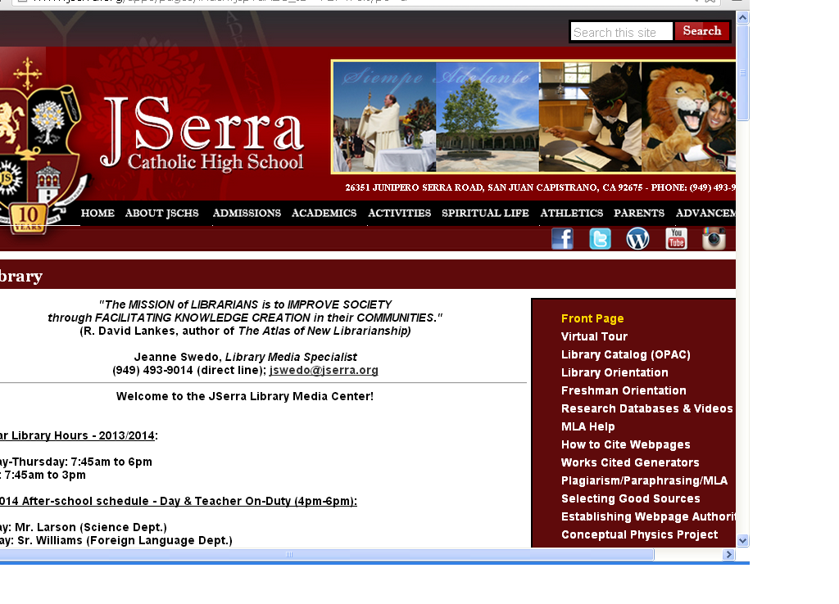
Username: access
Password: database1314

Slide 14
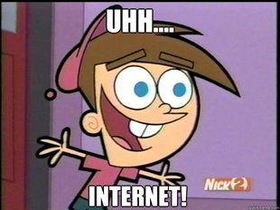
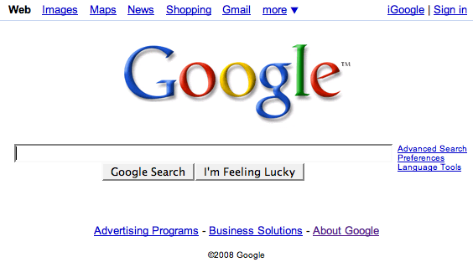
3rd Source of Info
FILTER BUBBLES
Advanced Search
Scholar

Slide 15
Google Search Strategies
1. Keywords
2. quotes
3. - (minus sign)
4. Site operators (.edu, .org, .gov)
5. truncation: *, #, $ (gives you versions of a word
example: racis$: racist, racism….
6. Boolean: and, or, not
7. more: See Link

Slide 16
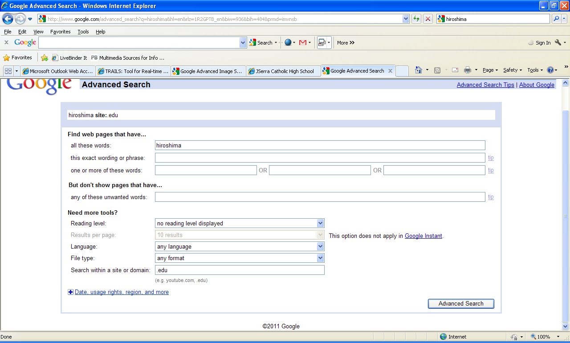
Site limiter

Slide 17
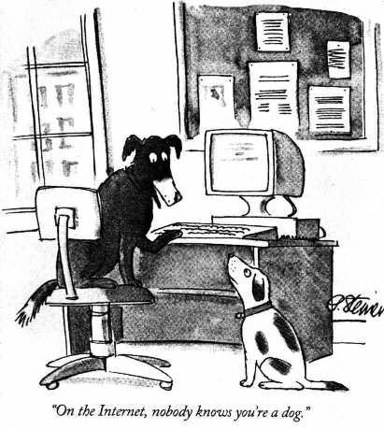
Websites & Credibility
Currency
Authority
Biased (or objective)
Accuracy
Coverage
Easy Who Is
Martin Luther King.org
WHO.int
Personal Webpages: 1 and 2

Slide 18
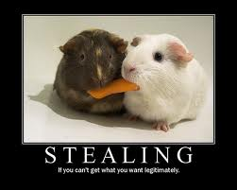
Plagiarism

Slide 19

Intellectual Freedom: Read, seek information, speak freely
Intellectual Property
Automatic
Immediate

Slide 20
Copyright & Fair Use
The guidelines also limit the amount of copyrighted multimedia material that can be included in educational projects to
A film/DVD: Up to three minutes or 10 percent, whichever is less.
up to 10 percent or 1,000 words, whichever is less, of a single copyrighted work of text.
an entire poem of less than 250 words or up to 250 words of a longer poem but no more than three poems by one poet or five poems by different poets from a single anthology.
A song: Up to 30 seconds or 10 percent of the song’s length , whichever is less.
up to five photographs or illustrations by one person and no more than 15 images or 10 percent, whichever is less, of the photographs or illustrations from a single published work.
up to 2,500 fields or cell entries or 10 percent, whichever is less, from a numerical database or data table.

Slide 21
Citing Sources
MLA paper
NoodleTools – Go to the Research Databases & NoodleTools webpage from the JSerra Library.

