Slide 1
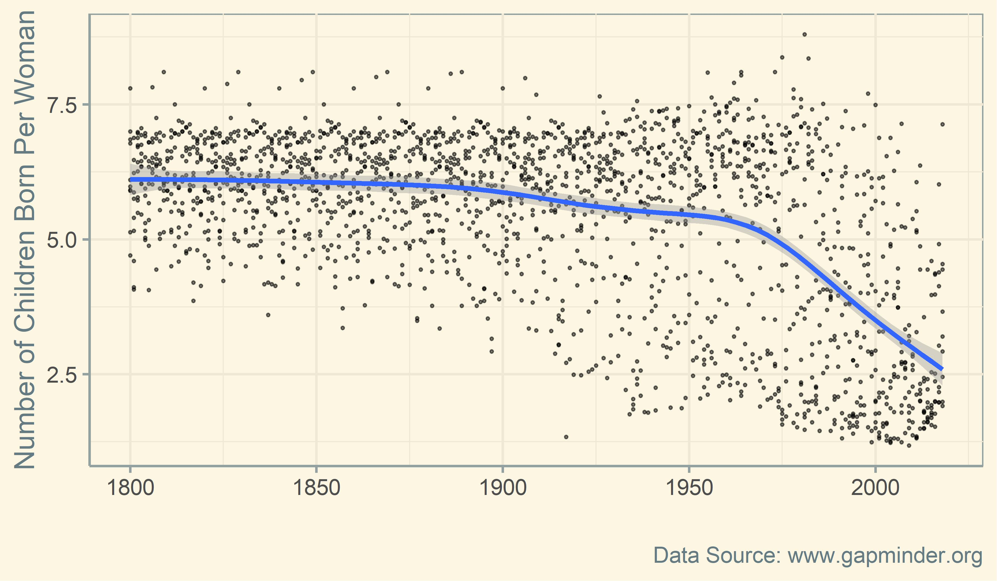
Inquiry and Analysis in Biology
Jeff Wesner and Joseph Raiche

