Slide 1
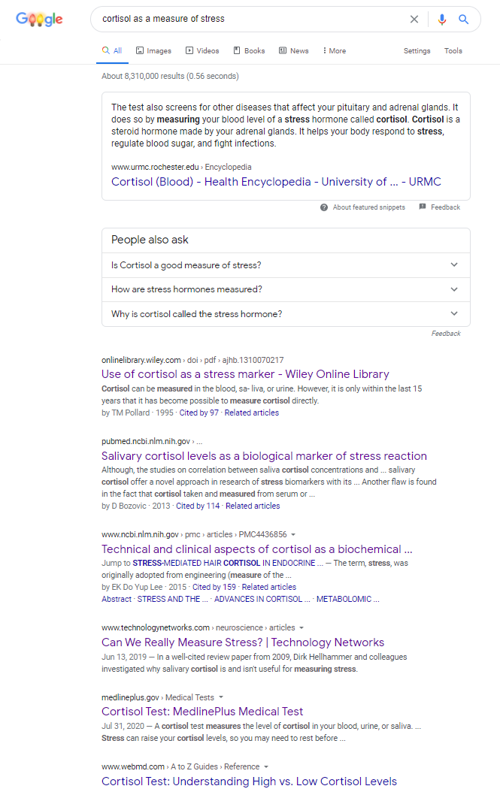
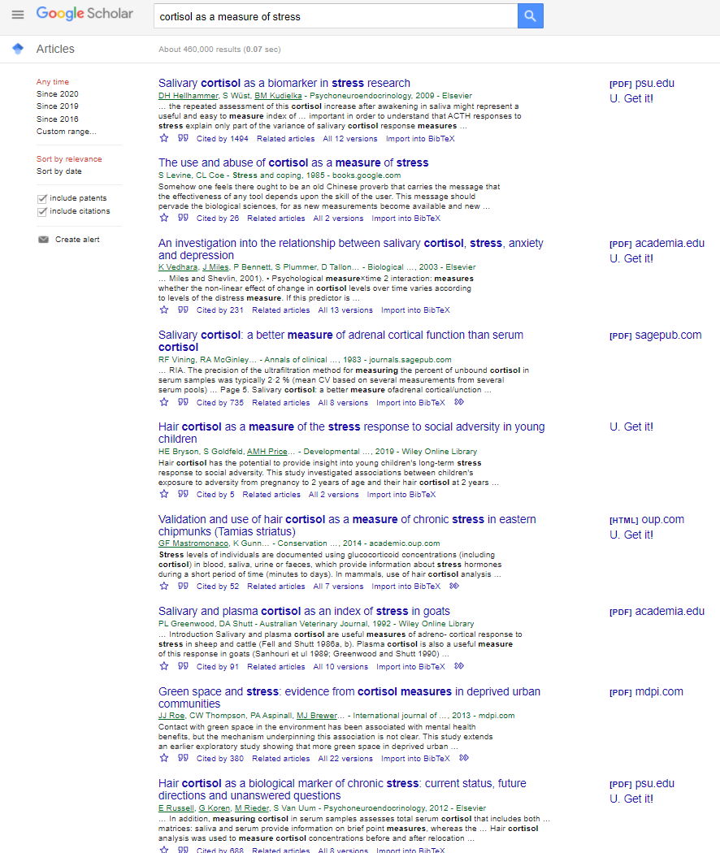
Just a website
Peer-reviewed review paper
Peer-reviewed review paper
Peer-reviewed review paper
Just a website
Just a website
Just a website

Slide 2
Peer-reviewed review paper
Not peer-reviewed book chapter
Peer-reviewed primary paper
Peer-reviewed primary paper
Peer-reviewed primary paper
Peer-reviewed primary paper
Peer-reviewed primary paper
Peer-reviewed primary paper
Peer-reviewed review paper

