Slide 1
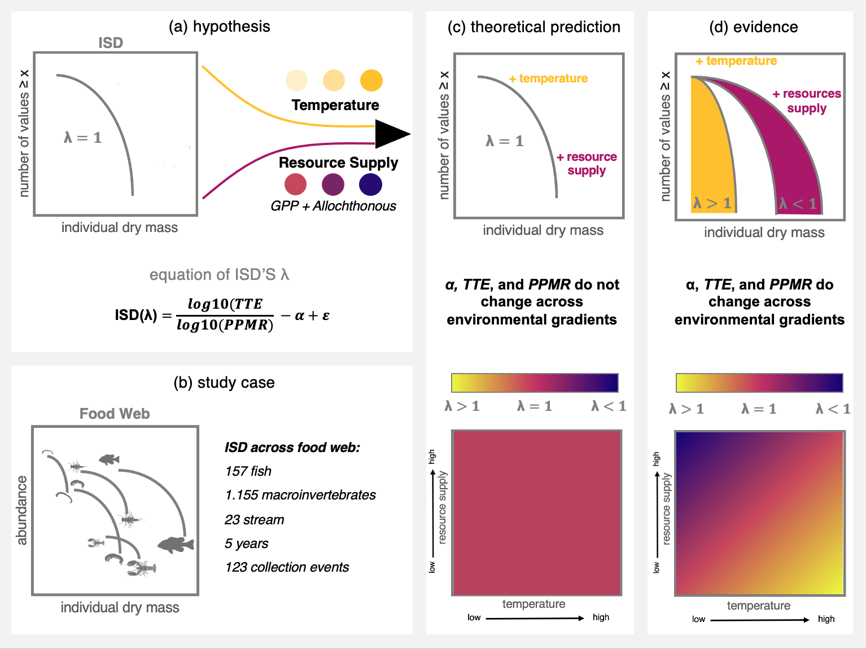
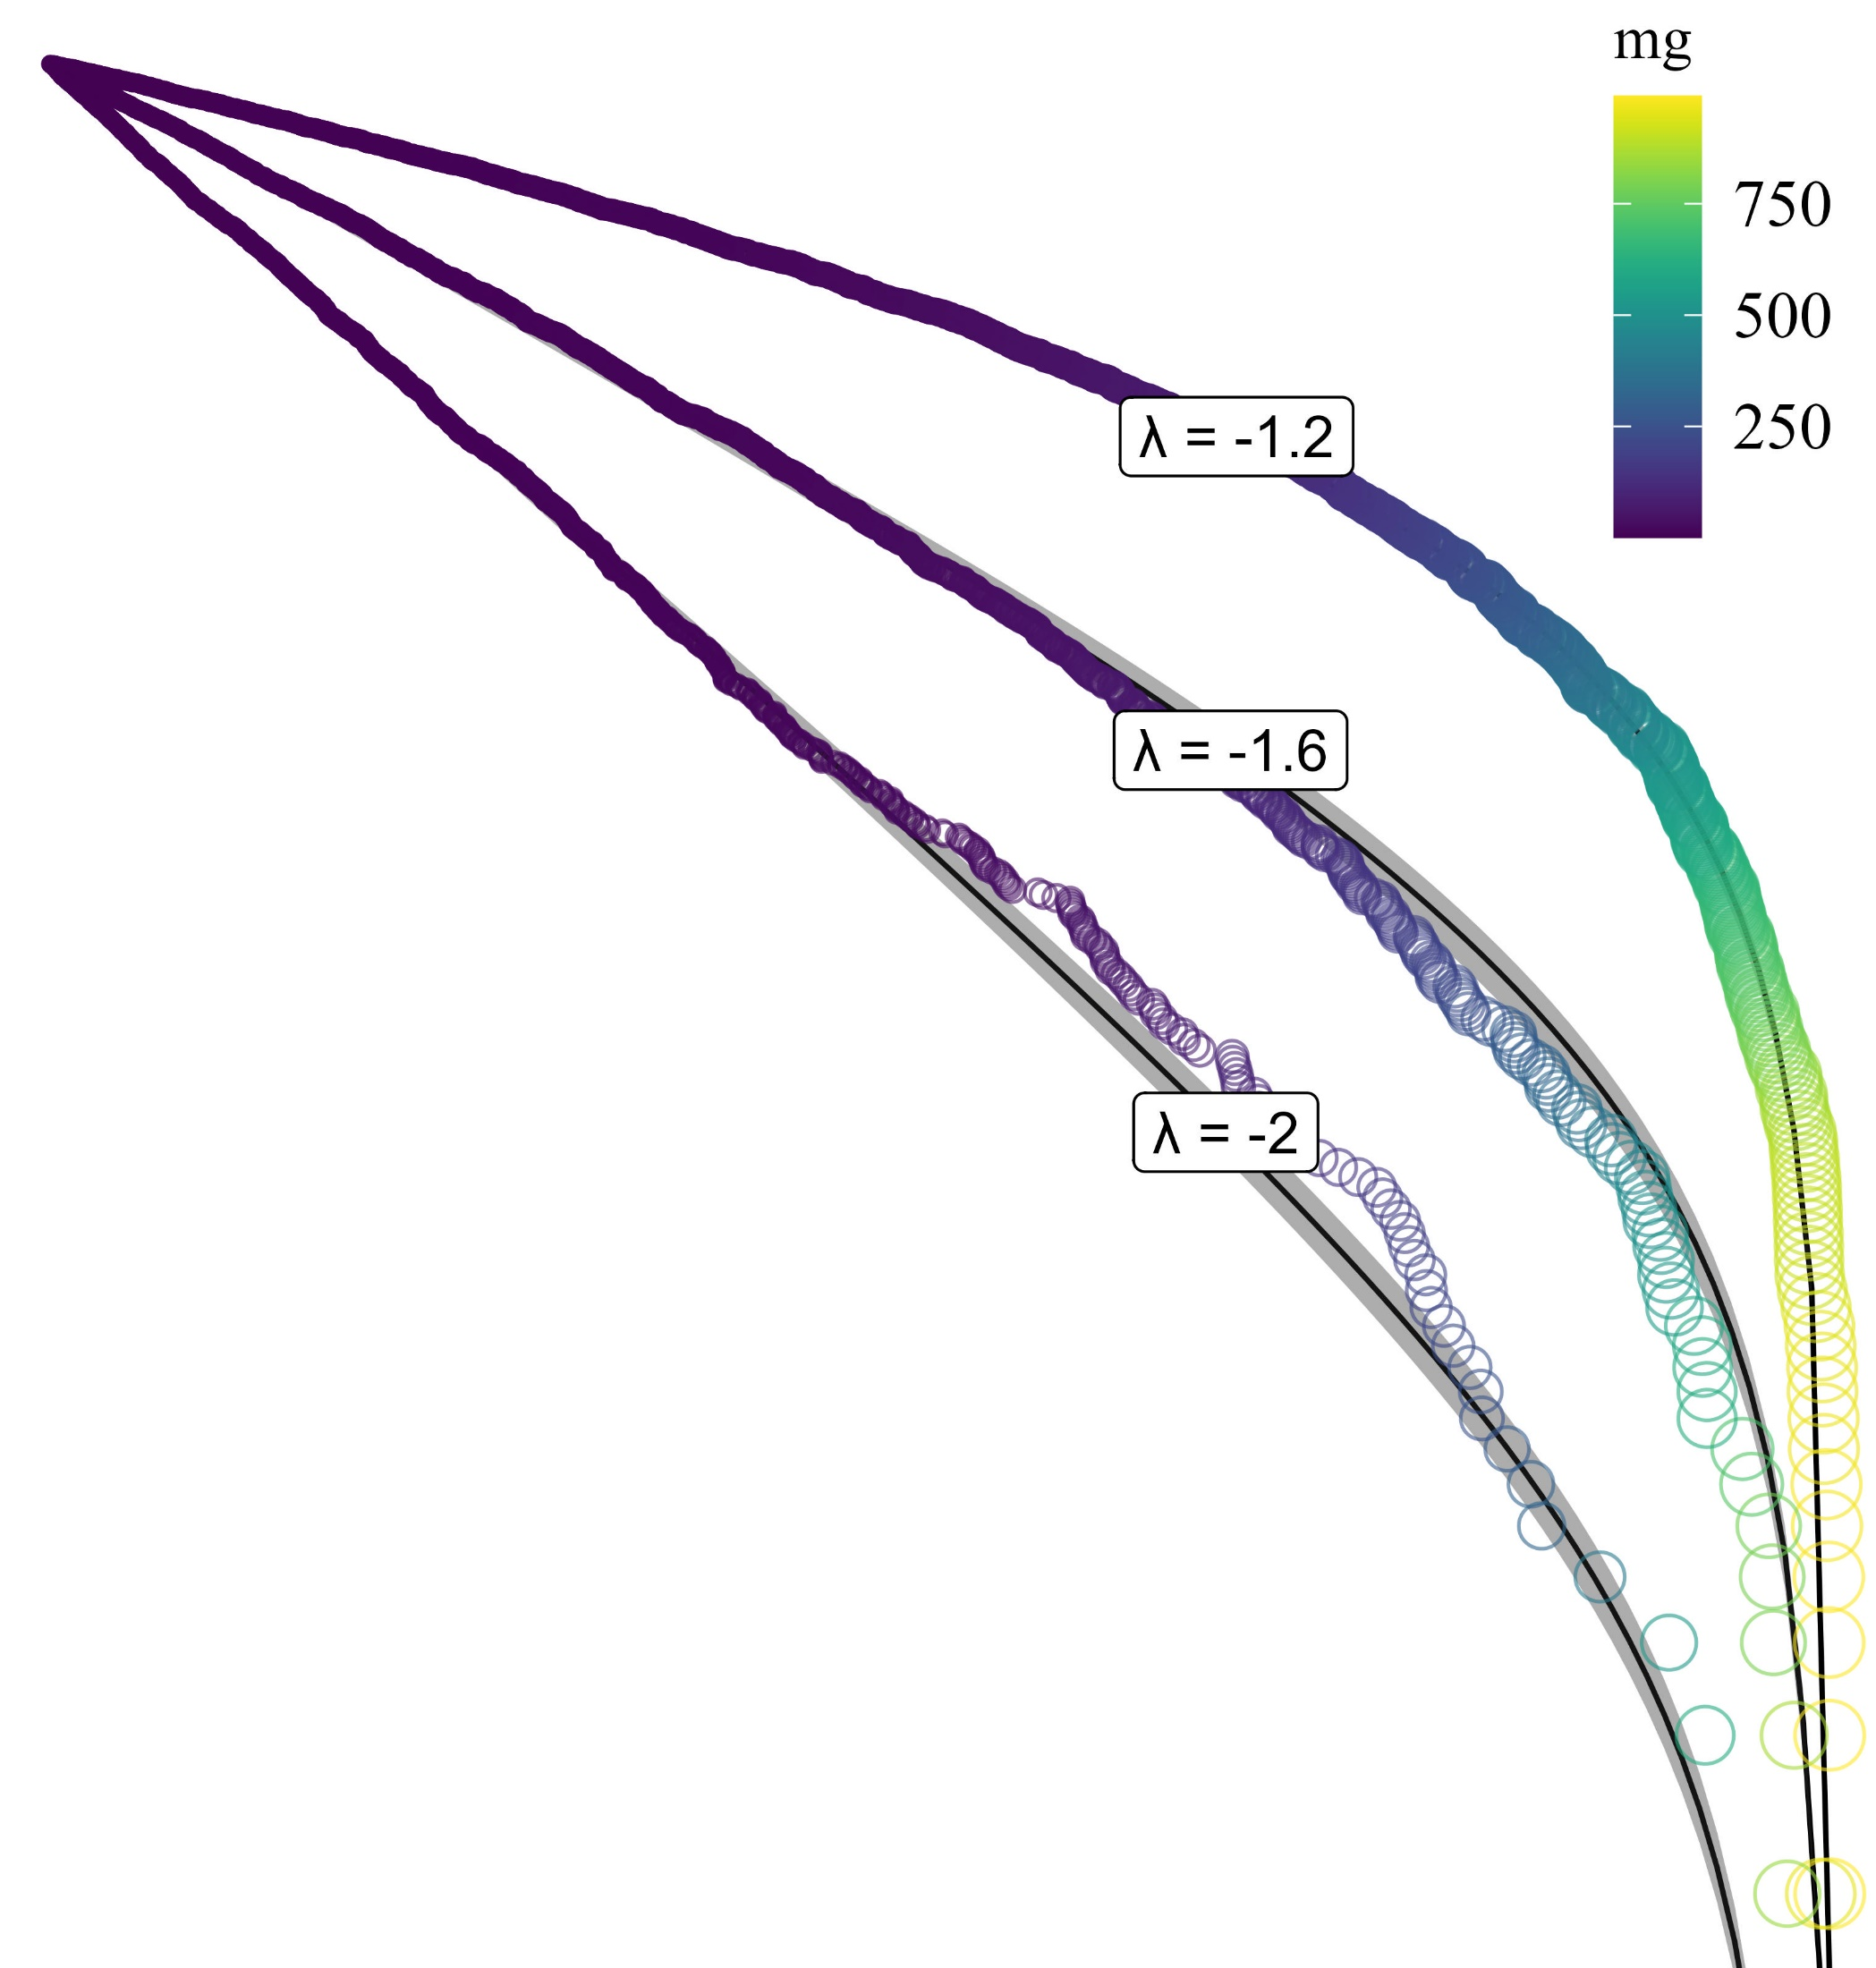
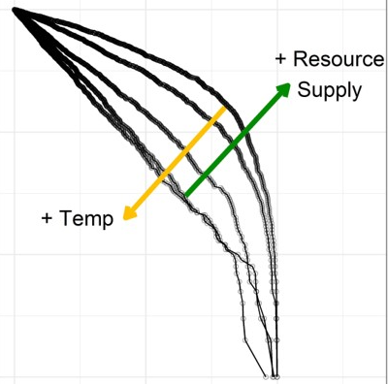
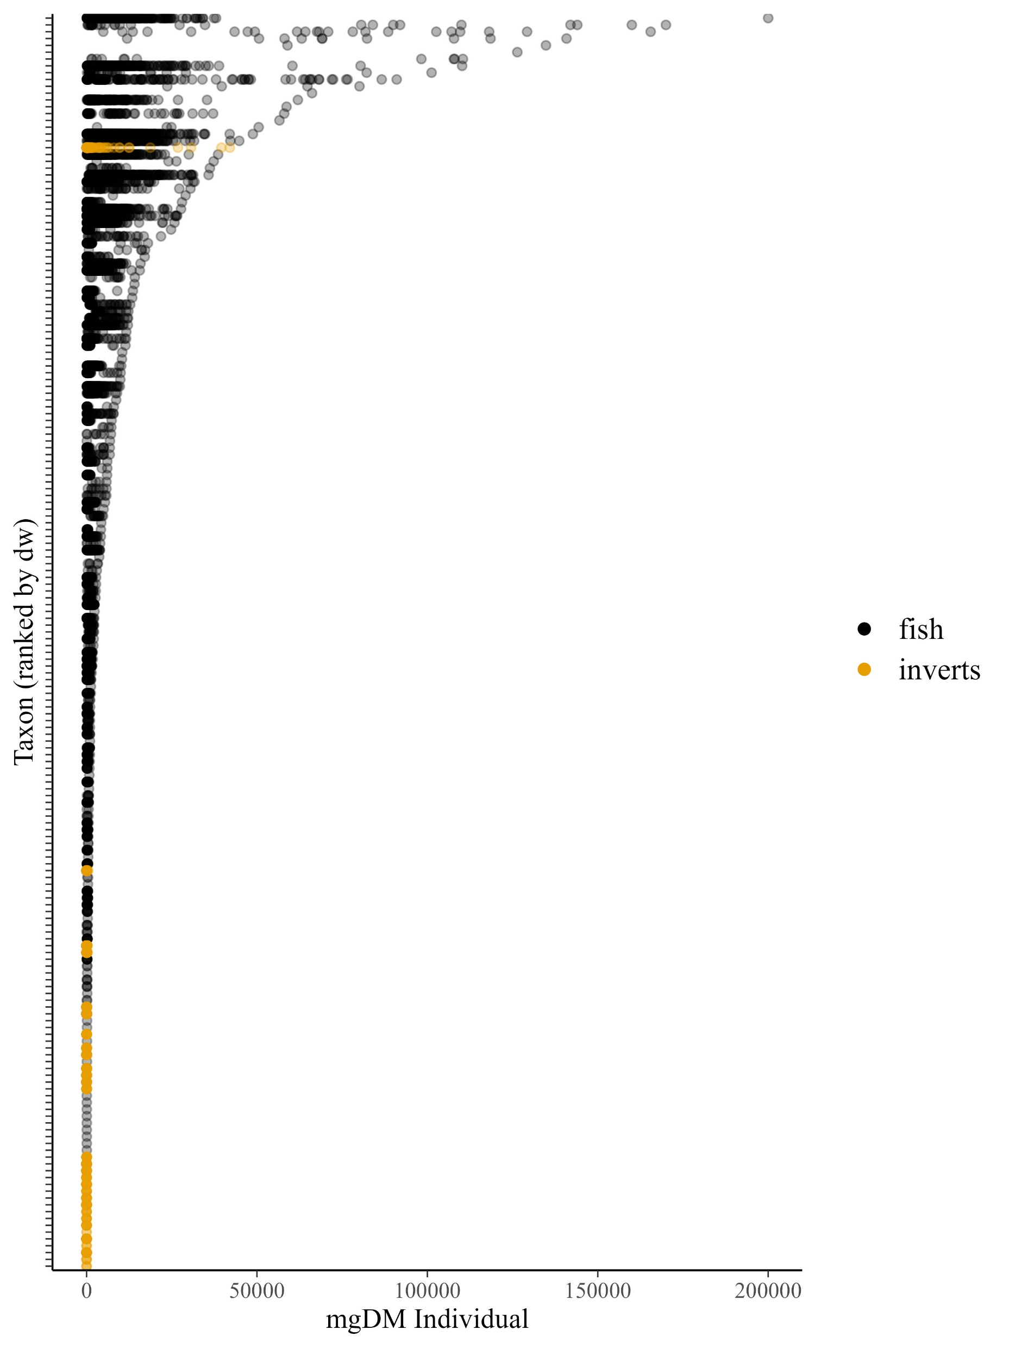








Increased temperature causes λ to decline. But the effect is counteracted by increases in resource supply.
$$λ=\frac{\log_{10}TTE}{\log_{10}PPMR} − α$$
λ should vary across gradients of temperature and resource supply.
2,468,683 individual sizes
1,155 invertebrate species
157 fish species
132 collections
22 freshwater streams
9 orders of magnitude (size)
5 years
λ = - 1
Taxon (ranked by size)
λ = -1.5
λ = - 2
<0.003
100,000
300,000
mgDM Individual

