Slide 1

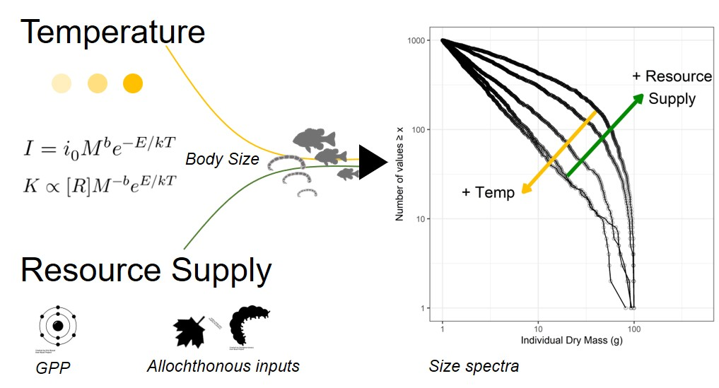
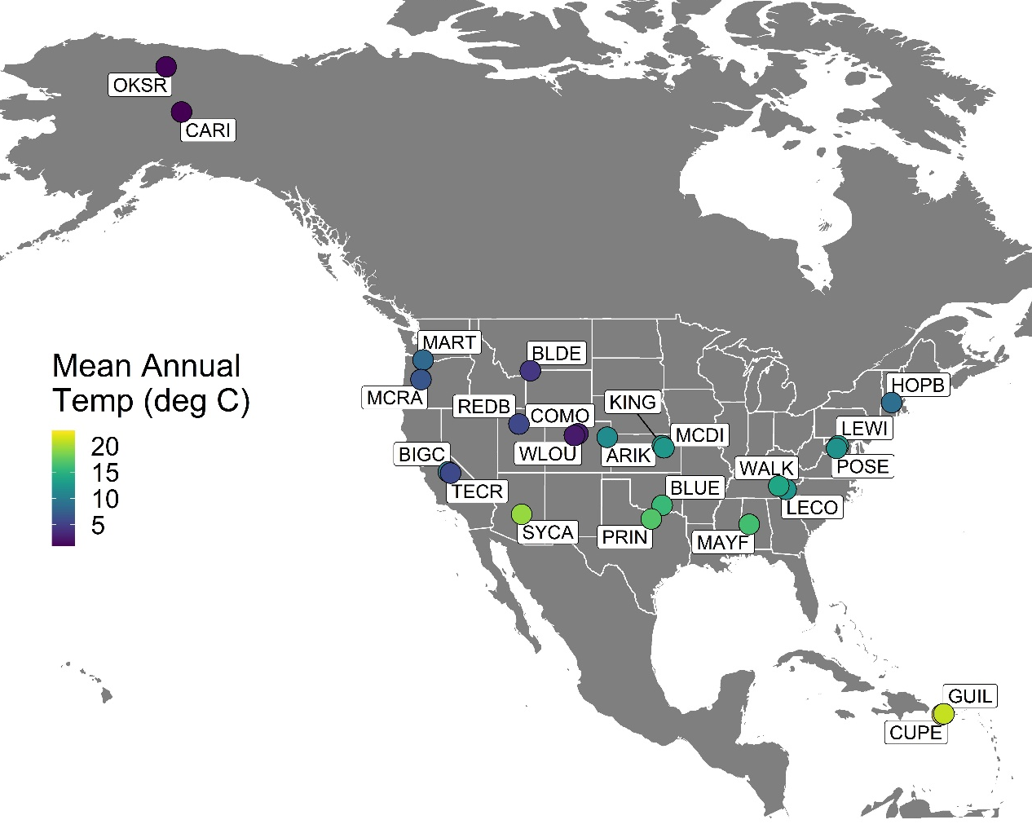
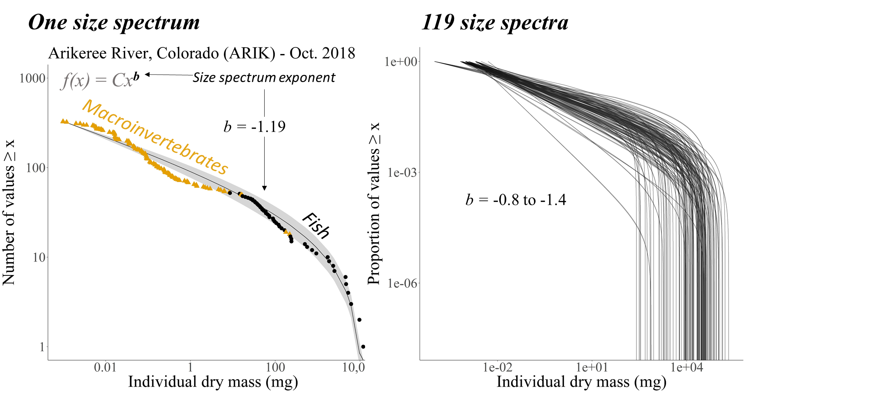
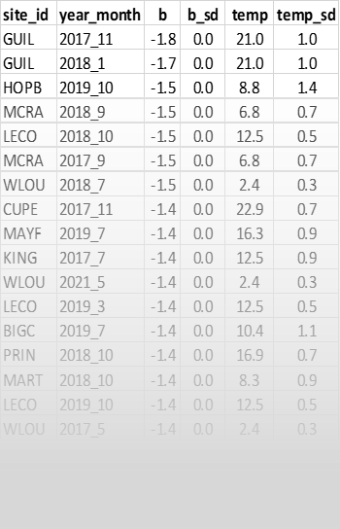
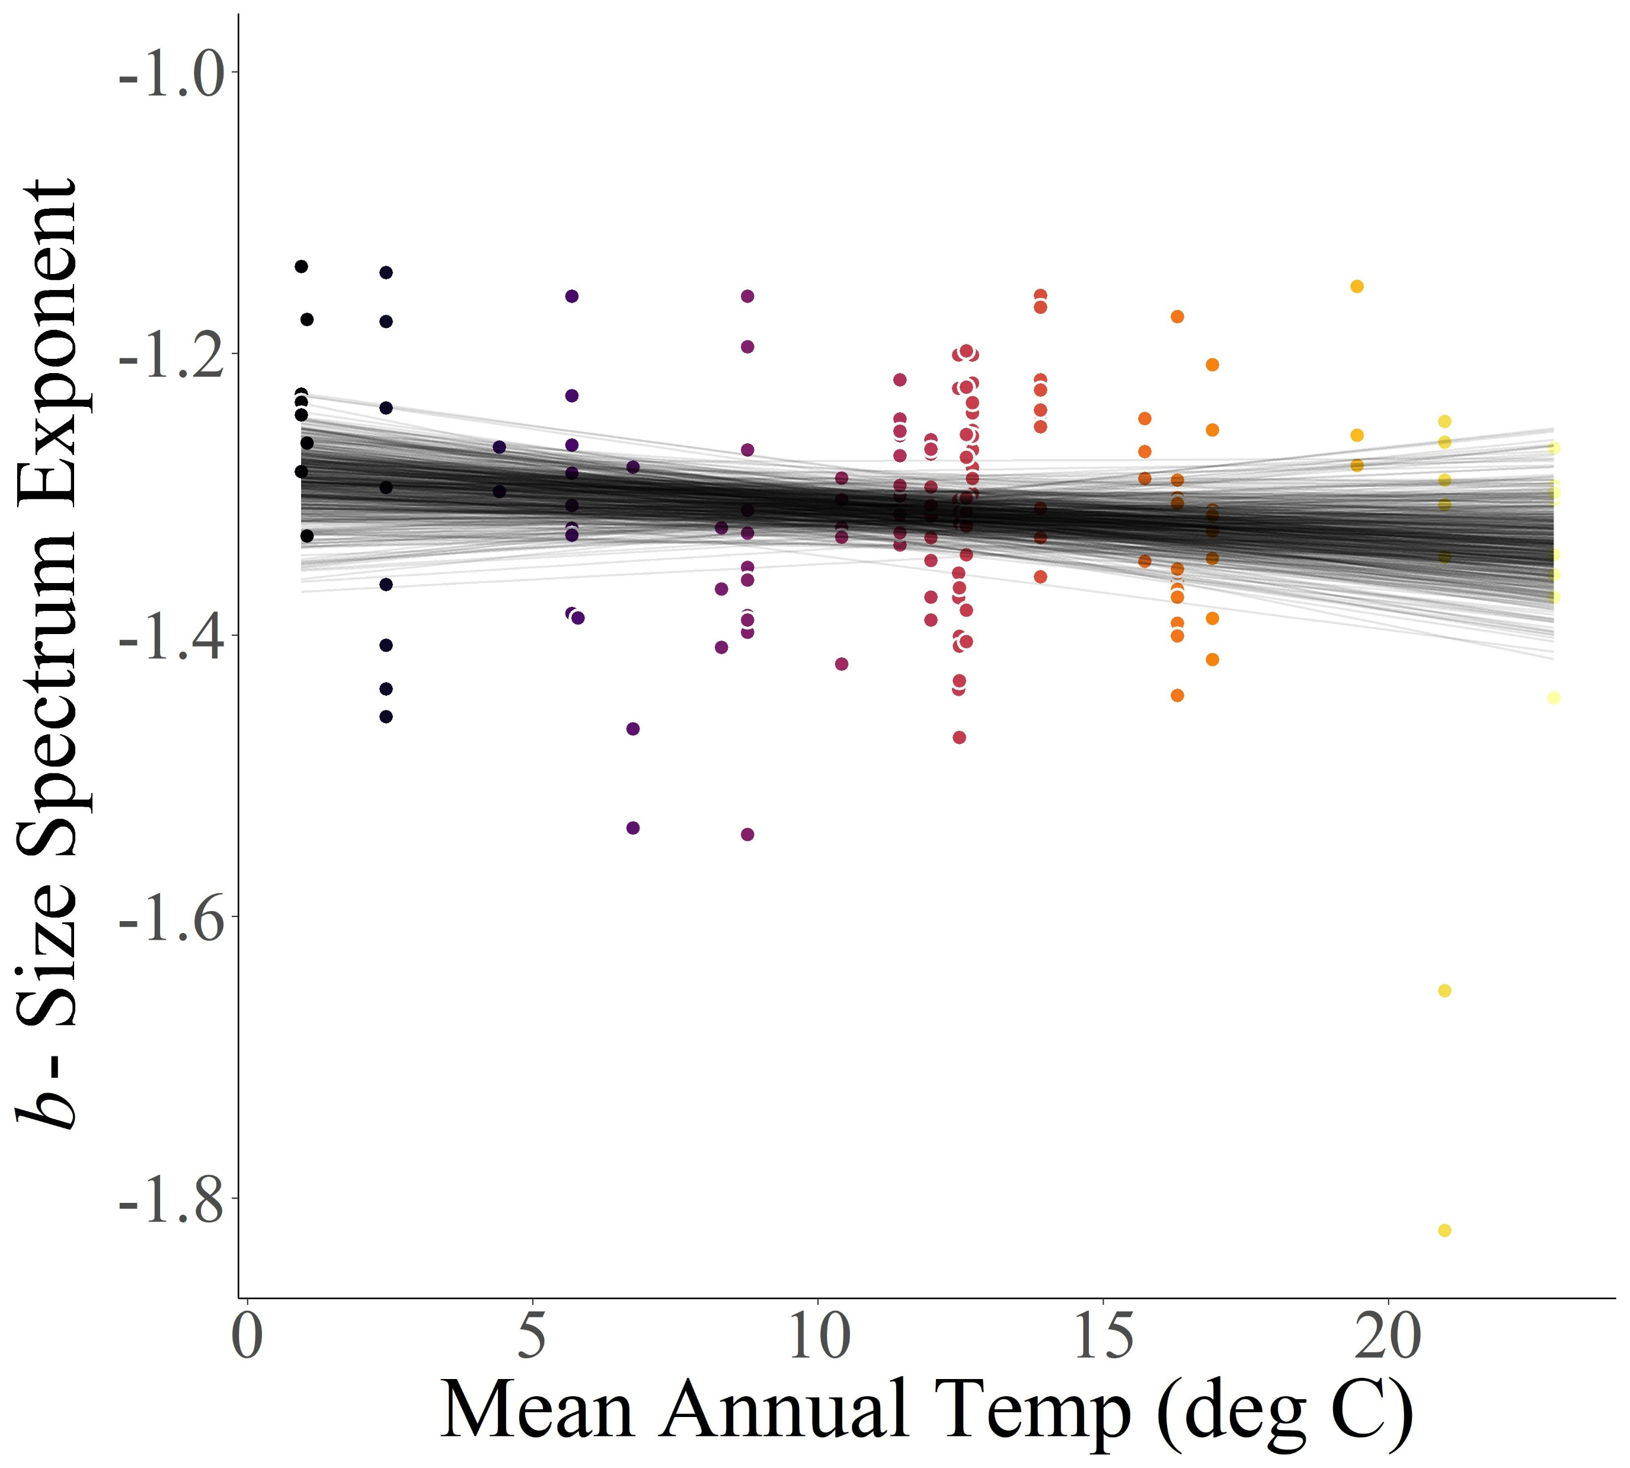
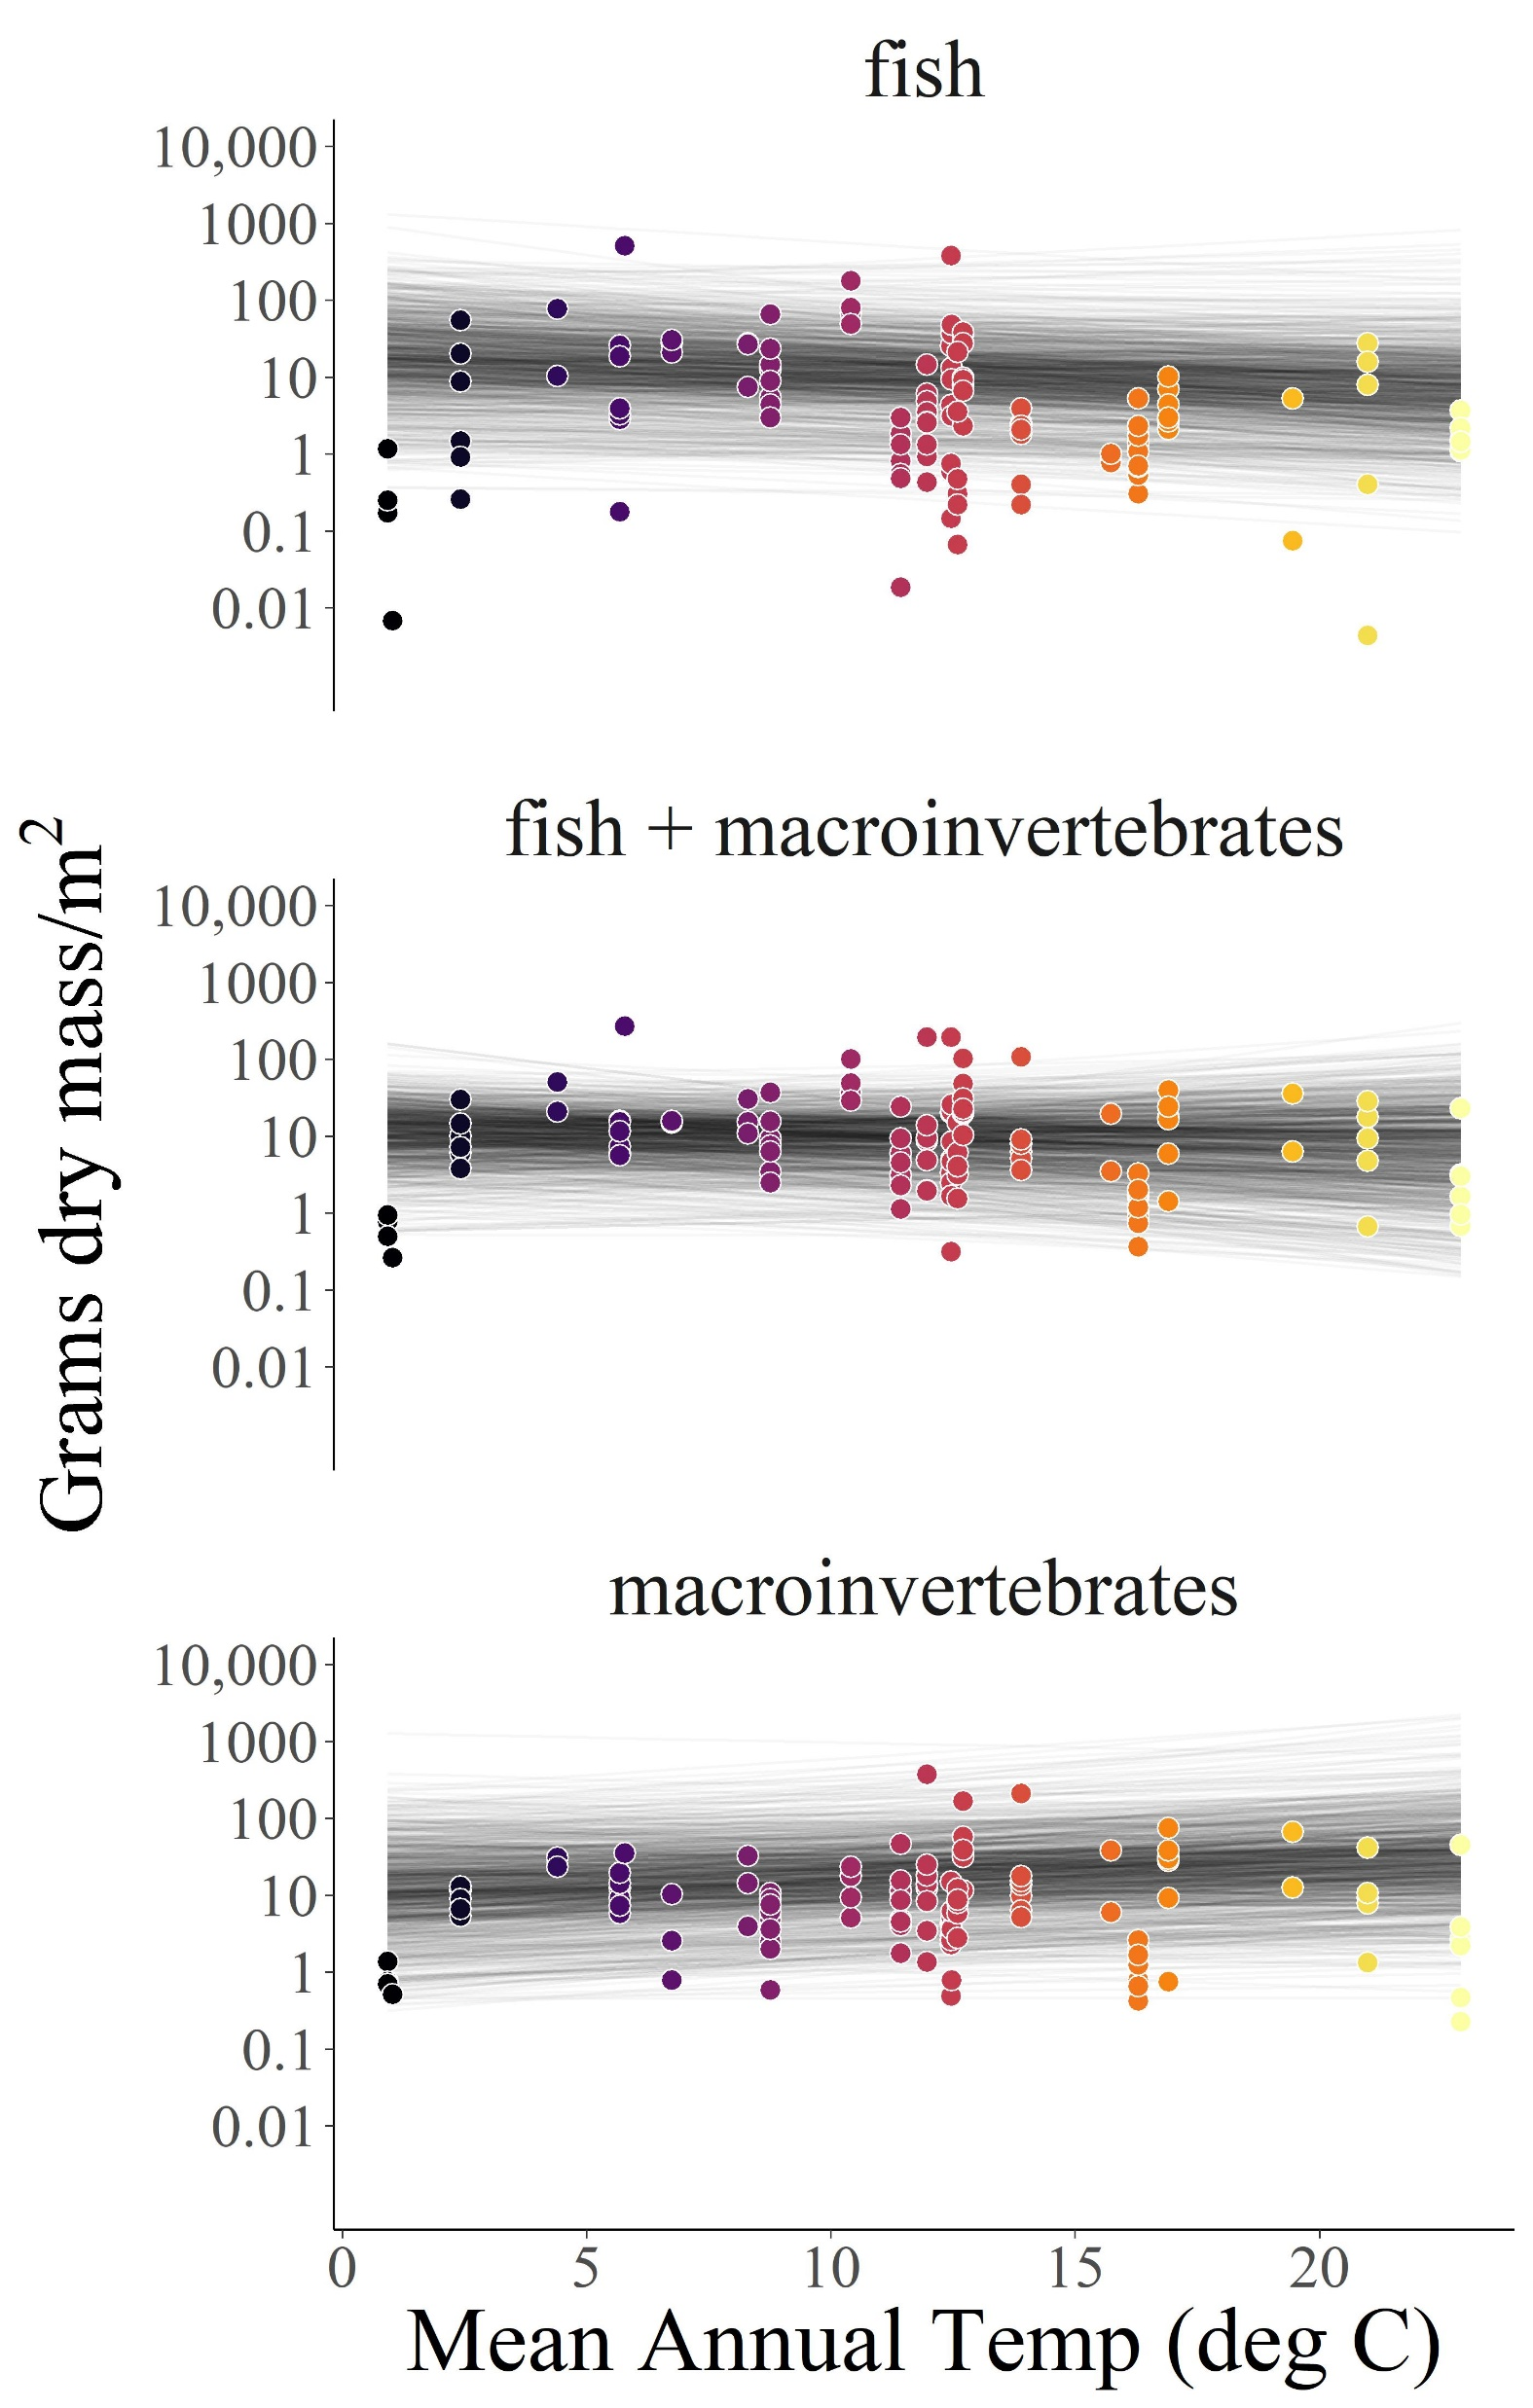
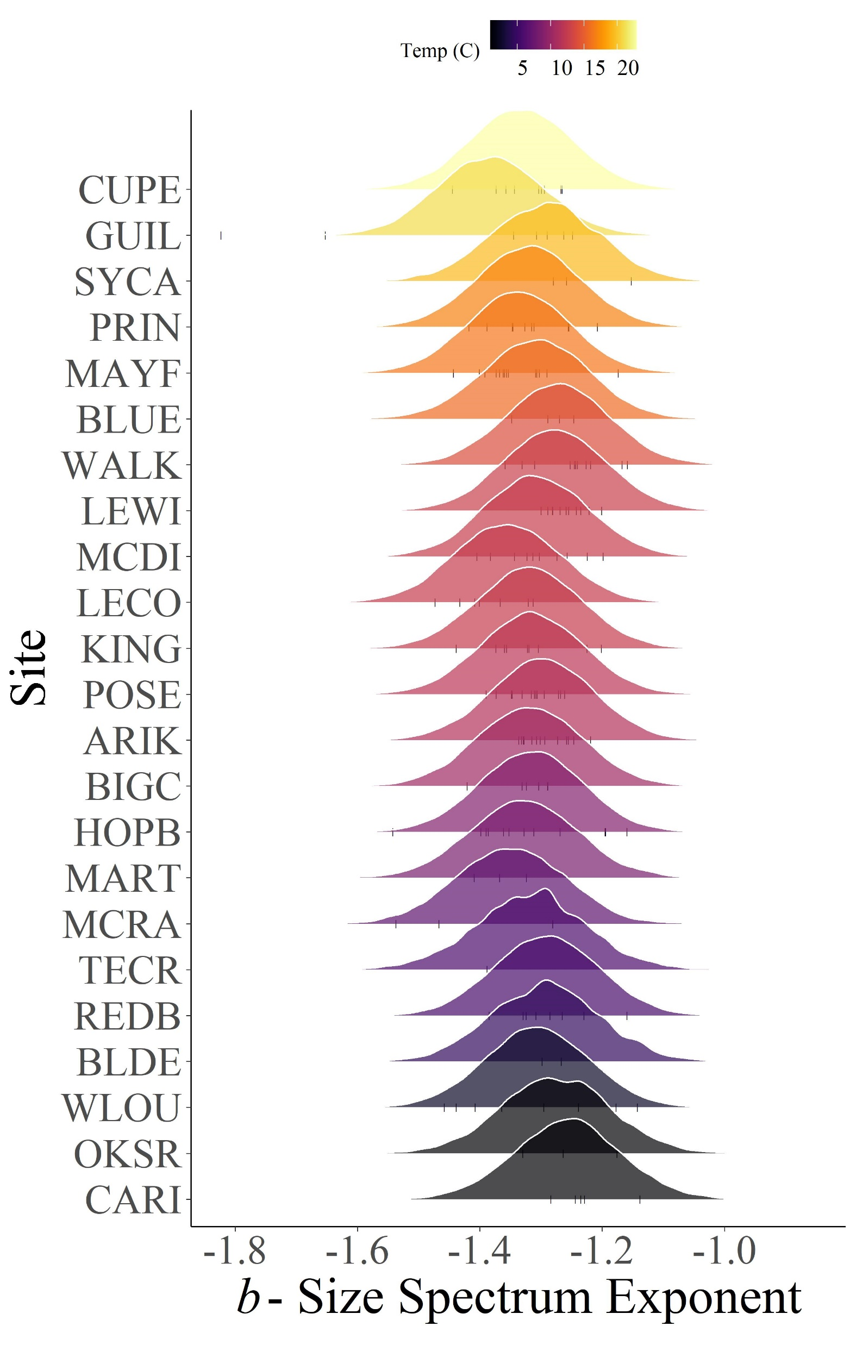




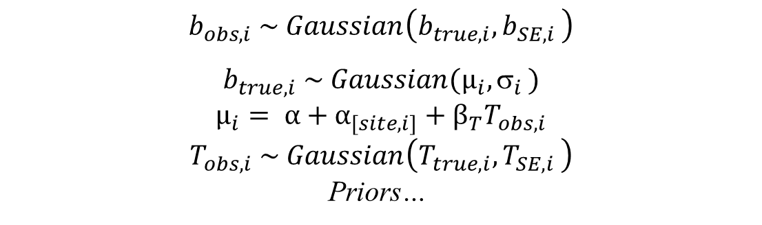

The influence of temperature and resource supply on stream size spectra
Jeff Wesner: Department of Biology, University of South Dakota
Justin Pomeranz: Department of Biology, Colorado Mesa University
Jim Junker: Louisiana University Marine Consortium
Theory + Approach
1) Theory: Contrasting influence of temperature and resource supply on individual size distributions via Metabolic Theory of Ecology
2) Collect NEON data
3) Estimate size spectrum exponents
4) Model b as a function of temperature T
Macroinvertebrate body sizes
Fish body sizes
Stream temperatures
GPP (in progress)
24 sites
5 years
2-3 seasons per year
120 samples
Data
Model
$$b_{obs, i} \sim Gaussian\left(b_{true, i}{, b}_{SE, i}\right)$$
$$b_{true, i} \sim Gaussian(µ_{i}{, σ}_{i})$$
$$µ_{i}= α+α_{[site,i]}+β_{T}T_{obs, i}$$
$$T_{obs, i} \sim Gaussian\left(T_{true,i}{, T}_{SE,i}\right)$$
Priors…
Bayesian linear regression with errors in variables and varying intercepts by site.
Preliminary results
4) Weak negative relationship between temperature and size spectra
5) No relationship between temperature and standing stock biomass
6) Predicting size spectra in the future
7) Next steps
$${Slope β}_{T}: −0.002 (−0.006, 0.002)$$
$Mean$ ($95\% Credible Interval)$
$${Slope β}_{T}: −0.02 (−0.15, 0.1)$$
$${Slope β}_{T}: −0.02 (−0.14 0.11)$$
$${Slope β}_{T}: 0.06 (−0.05, 0.21)$$
Size-spectrum exponents b were negatively related to temperature, but only weakly. Across the 22 degree gradient in mean annual stream temperature, average b exponents declined from -1.29 to -1.33, with an 88% probability of a negative slope. By comparison, among sample variation ranged from -1.13 to -1.82.
Contrary to predictions, temperature was unrelated to standing stock biomass density overall. However, it was positively related to. However, for macroinvertebrates only, there was a 94% probability of a positive relationship, opposite of theoretical predictions.
One outcome of our model is a prediction of future size spectra at each site. The plot above shows posterior predictions of size spectra exponents. In future years, NEON data will be tested against these predictions. Strong deviations from predictions may indicate disturbances to stream ecosystems.
We hypothesize that the weak relationship between temperature and size spectra may be masked by resource supply. We will measure resource supply by estimating GPP and organic matter inputs at NEON sites.
Why it matters
Acknowledgments
All ecologists learn that large organisms are usually less abundant that small organisms. Large organisms also tend to eat smaller organisms. Size spectra place these qualitative generalities into a quantitative metric. The most interesting result of our study is the limited variation in body size spectra across a wide range of ecological conditions. Despite wide latitudinal variation, temperature variation, and complete taxonomic turnover among streams, distributions of body sizes remain remarkably stable. Future monitoring of body size spectra, especially when they deviate from these stable predictions, may indicate large underlying shifts in ecosystem functioning. Moreover, because size spectra change in response to changing trophic transfer efficiencies, an ability to predict them from ecological variables enables prediction of ecosystem function at the meta-ecosystem scale.
Acknowledgements
We thank the National Park Service, Missouri River Institute, and the National Science Foundation (NSF DBI-1560048) for the continued support of this research.
Funding: NSF Award #2106067. We thank the NEON Biorepository for loaning streams samples to JSW.

Slide 2
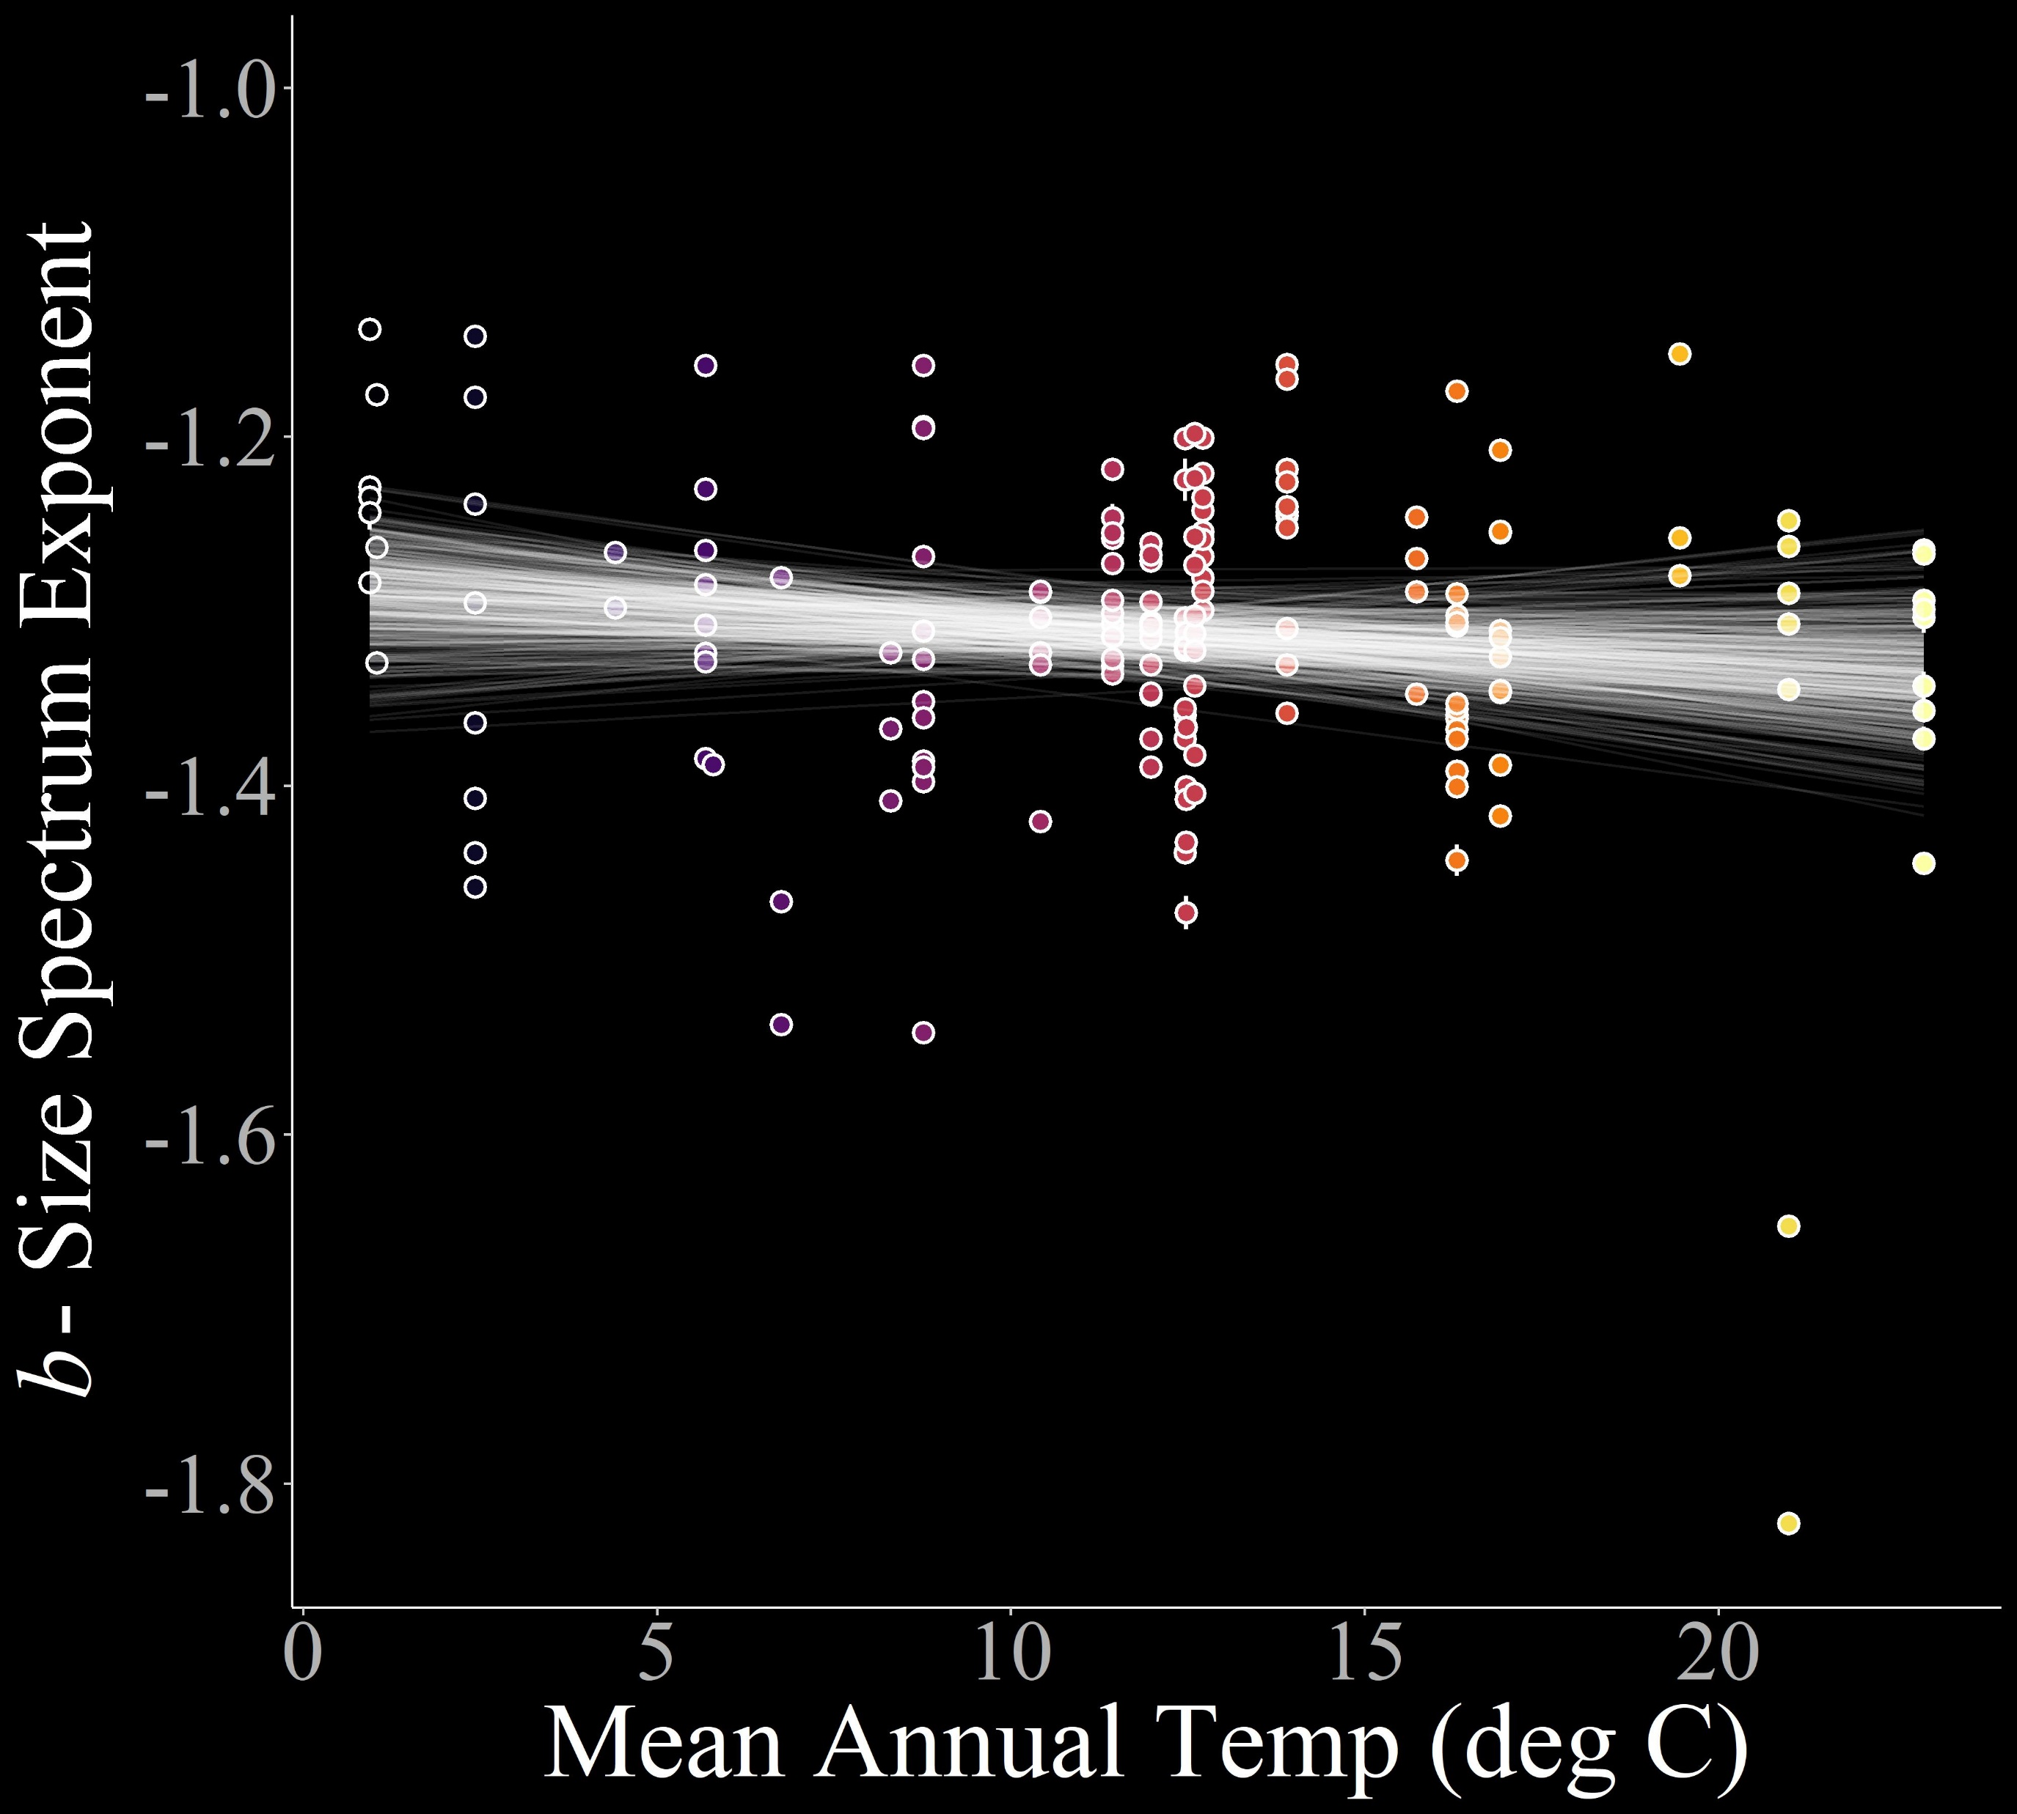
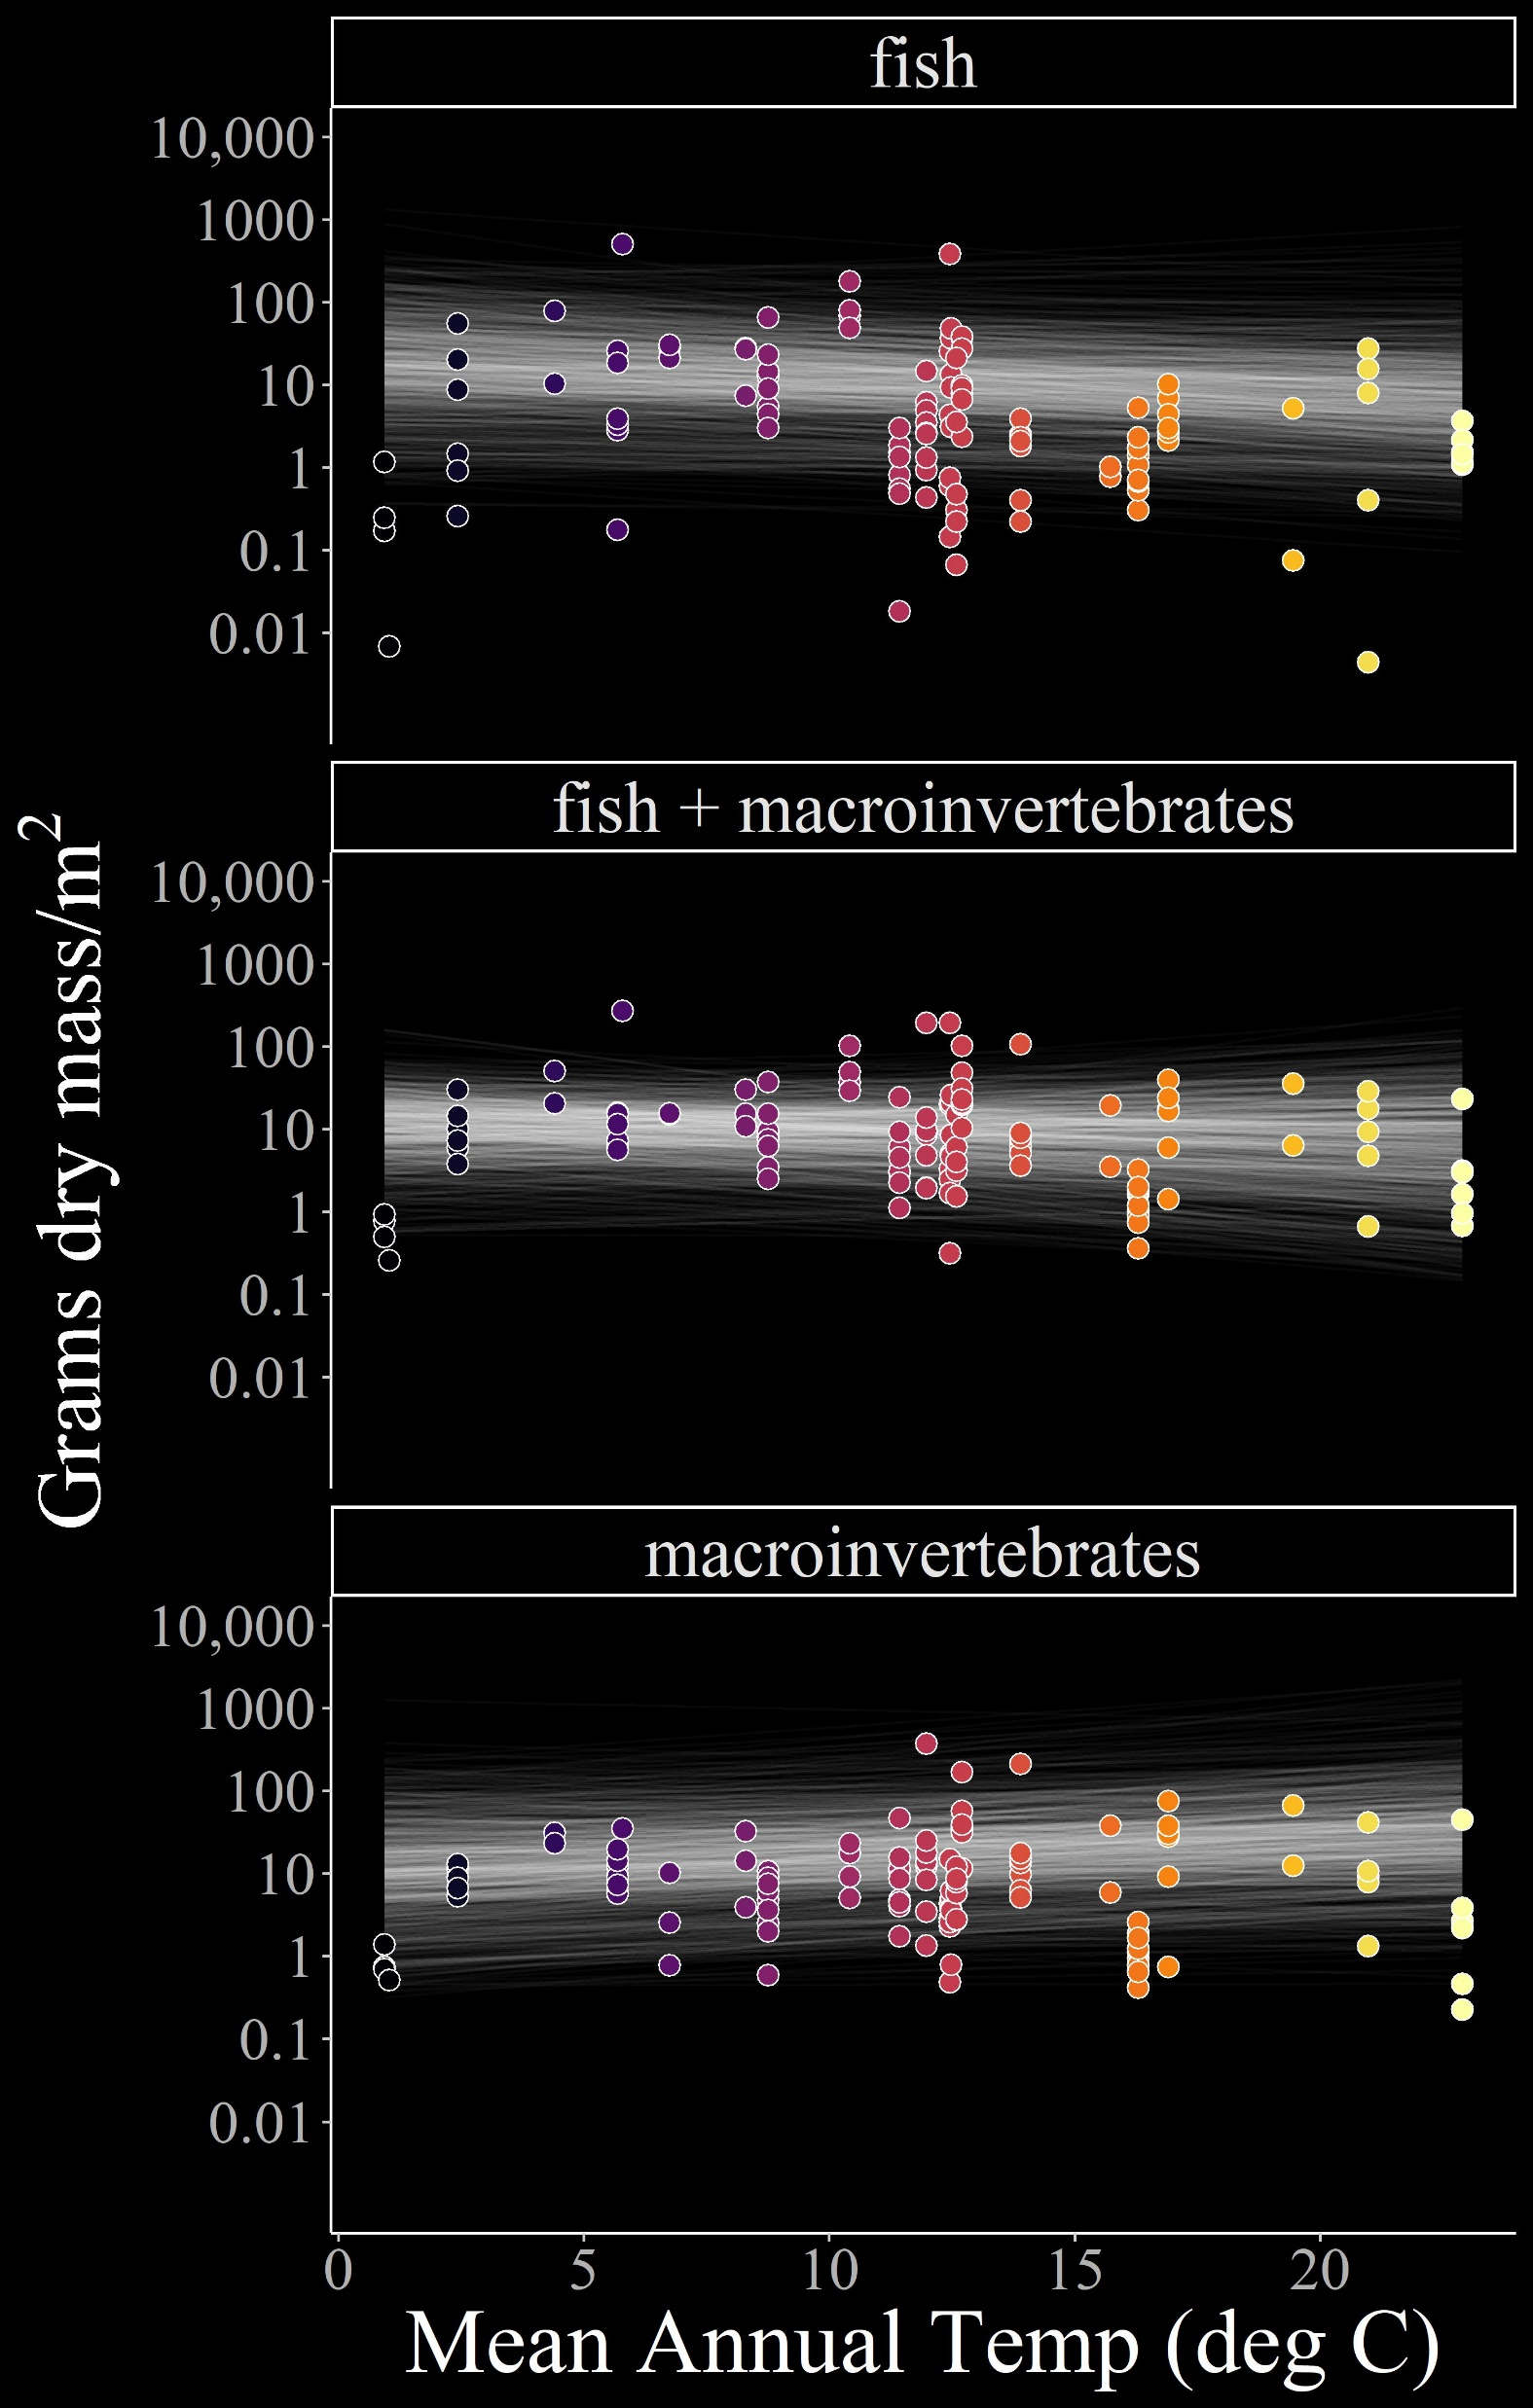
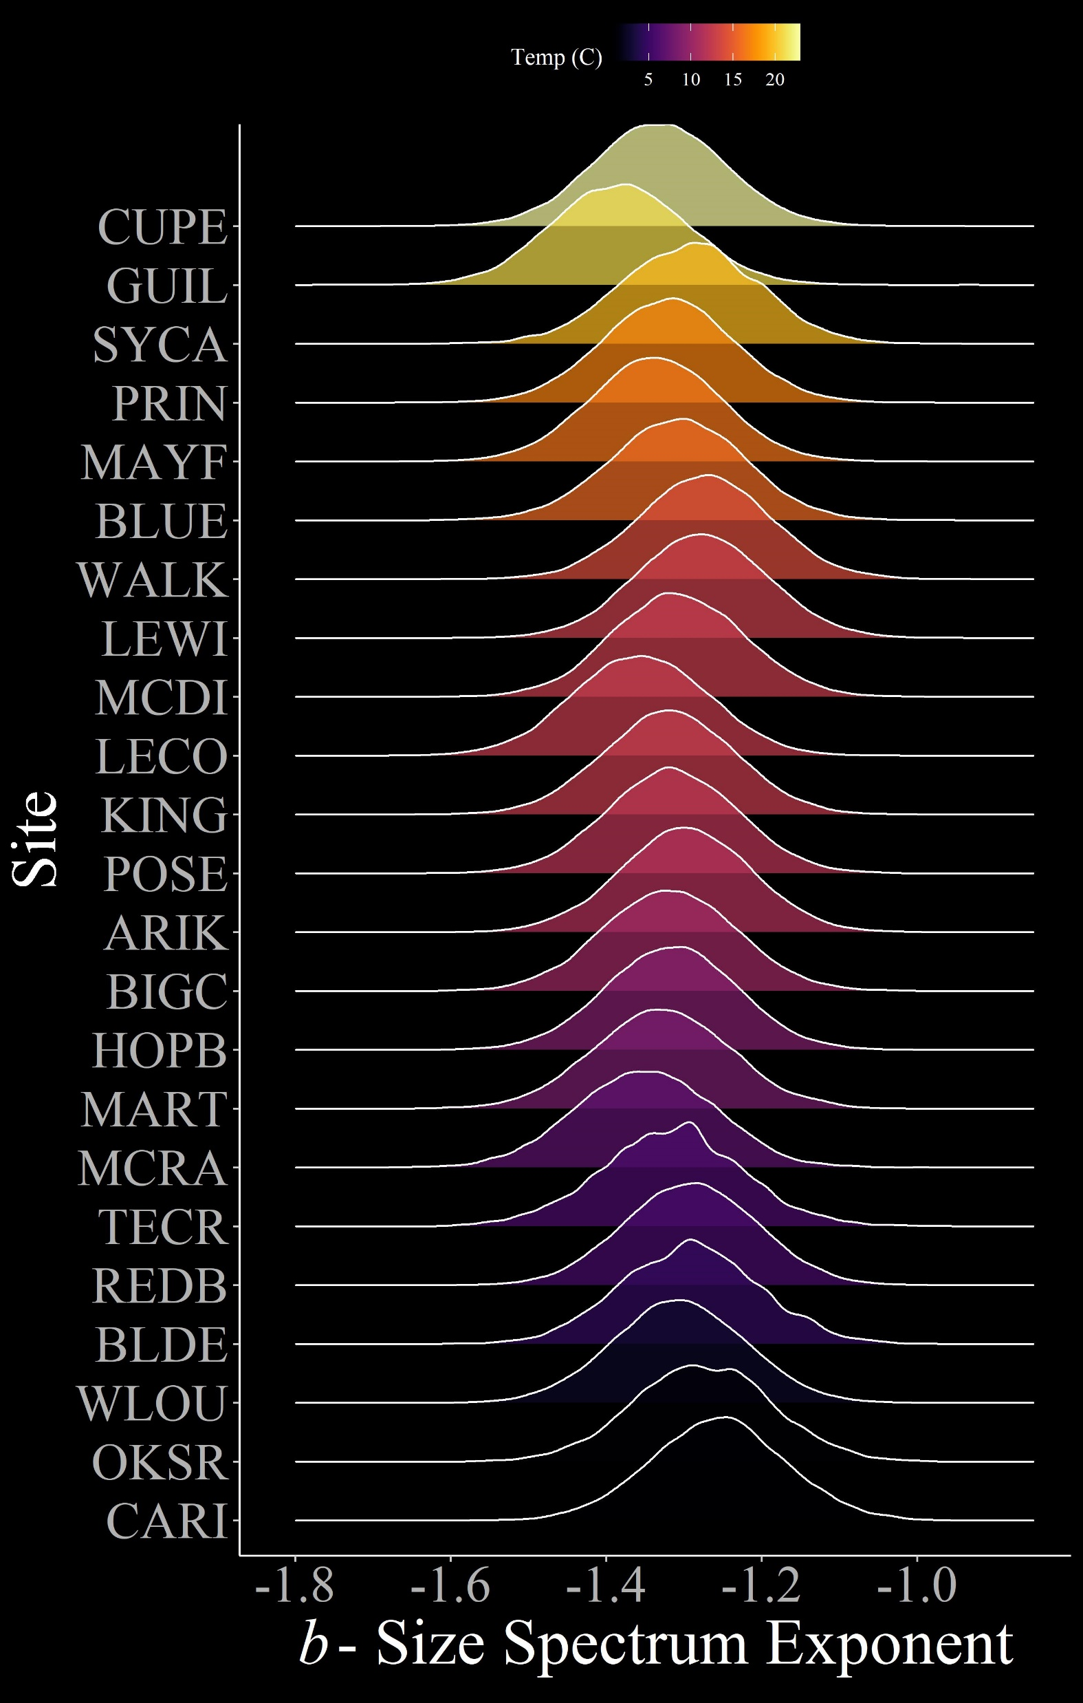





The influence of temperature and resource supply on stream size spectra
Jeff Wesner: Department of Biology, University of South Dakota
Justin Pomeranz: Department of Biology, Colorado Mesa University
Jim Junker: Louisiana University Marine Consortium
Theory + Approach
1) Theory: Contrasting influence of temperature and resource supply on individual size distributions via Metabolic Theory of Ecology
2) Collect NEON data
3) Estimate size spectrum exponents
4) Model b as a function of temperature T
Macroinvertebrate body sizes
Fish body sizes
Stream temperatures
GPP (in progress)
24 sites
5 years
2-3 seasons per year
120 samples
Data
Model
$$b_{obs, i} \sim Gaussian\left(b_{true, i}{, b}_{SE, i}\right)$$
$$b_{true, i} \sim Gaussian(µ_{i}{, σ}_{i})$$
$$µ_{i}= α+α_{[site,i]}+β_{T}T_{obs, i}$$
$$T_{obs, i} \sim Gaussian\left(T_{true,i}{, T}_{SE,i}\right)$$
Priors…
Bayesian linear regression with errors in variables and varying intercepts by site.
Preliminary results
4) Weak negative relationship between temperature and size spectra
5) No relationship between temperature and standing stock biomass
6) Predicting size spectra in the future
7) Next steps
$${Slope β}_{T}: −0.002 (−0.006, 0.002)$$
$Mean$ ($95\% Credible Interval)$
$${Slope β}_{T}: −0.02 (−0.15, 0.1)$$
$${Slope β}_{T}: −0.02 (−0.14 0.11)$$
$${Slope β}_{T}: 0.06 (−0.05, 0.21)$$
Size-spectrum exponents b were negatively related to temperature, but only weakly. Across the 22 degree gradient in mean annual stream temperature, average b exponents declined from -1.29 to -1.33, with an 88% probability of a negative slope. By comparison, among sample variation ranged from -1.13 to -1.82.
Contrary to predictions, temperature was unrelated to standing stock biomass density overall. However, it was positively related to. However, for macroinvertebrates only, there was a 94% probability of a positive relationship, opposite of theoretical predictions.
One outcome of our model is a prediction of future size spectra at each site. The plot above shows posterior predictions of size spectra exponents. In future years, NEON data will be tested against these predictions. Strong deviations from predictions may indicate disturbances to stream ecosystems.
We hypothesize that the weak relationship between temperature and size spectra may be masked by resource supply. We will measure resource supply by estimating GPP and organic matter inputs at NEON sites.
Why it matters
Acknowledgments
All ecologists learn that large organisms are usually less abundant that small organisms. Large organisms also tend to eat smaller organisms. Size spectra place these qualitative generalities into a quantitative metric. The most interesting result of our study is the limited variation in body size spectra across a wide range of ecological conditions. Despite wide latitudinal variation, temperature variation, and complete taxonomic turnover among streams, distributions of body sizes remain remarkably stable. Future monitoring of body size spectra, especially when they deviate from these stable predictions, may indicate large underlying shifts in ecosystem functioning. Moreover, because size spectra change in response to changing trophic transfer efficiencies, an ability to predict them from ecological variables enables prediction of ecosystem function at the meta-ecosystem scale.
Acknowledgements
We thank the National Park Service, Missouri River Institute, and the National Science Foundation (NSF DBI-1560048) for the continued support of this research.
Funding: NSF Award #2106067. We thank the NEON Biorepository for loaning streams samples to JSW.

