Slide 1
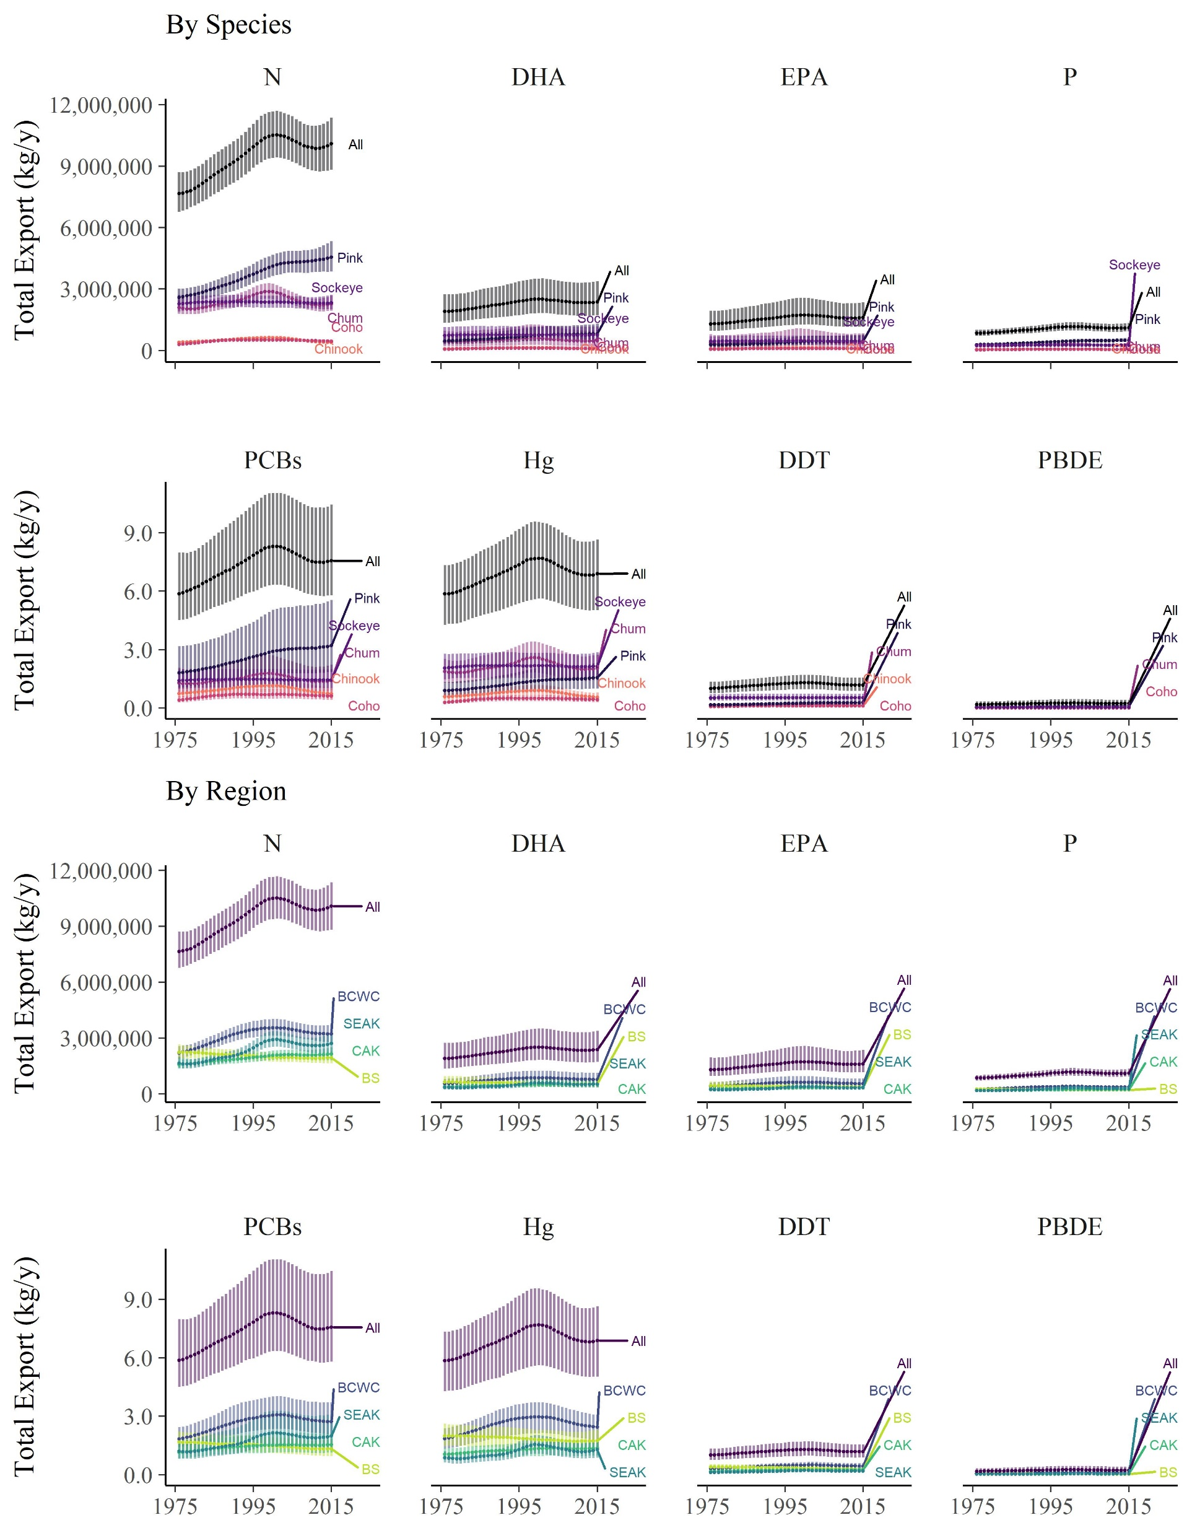
With raw scale on y -axis

Slide 2
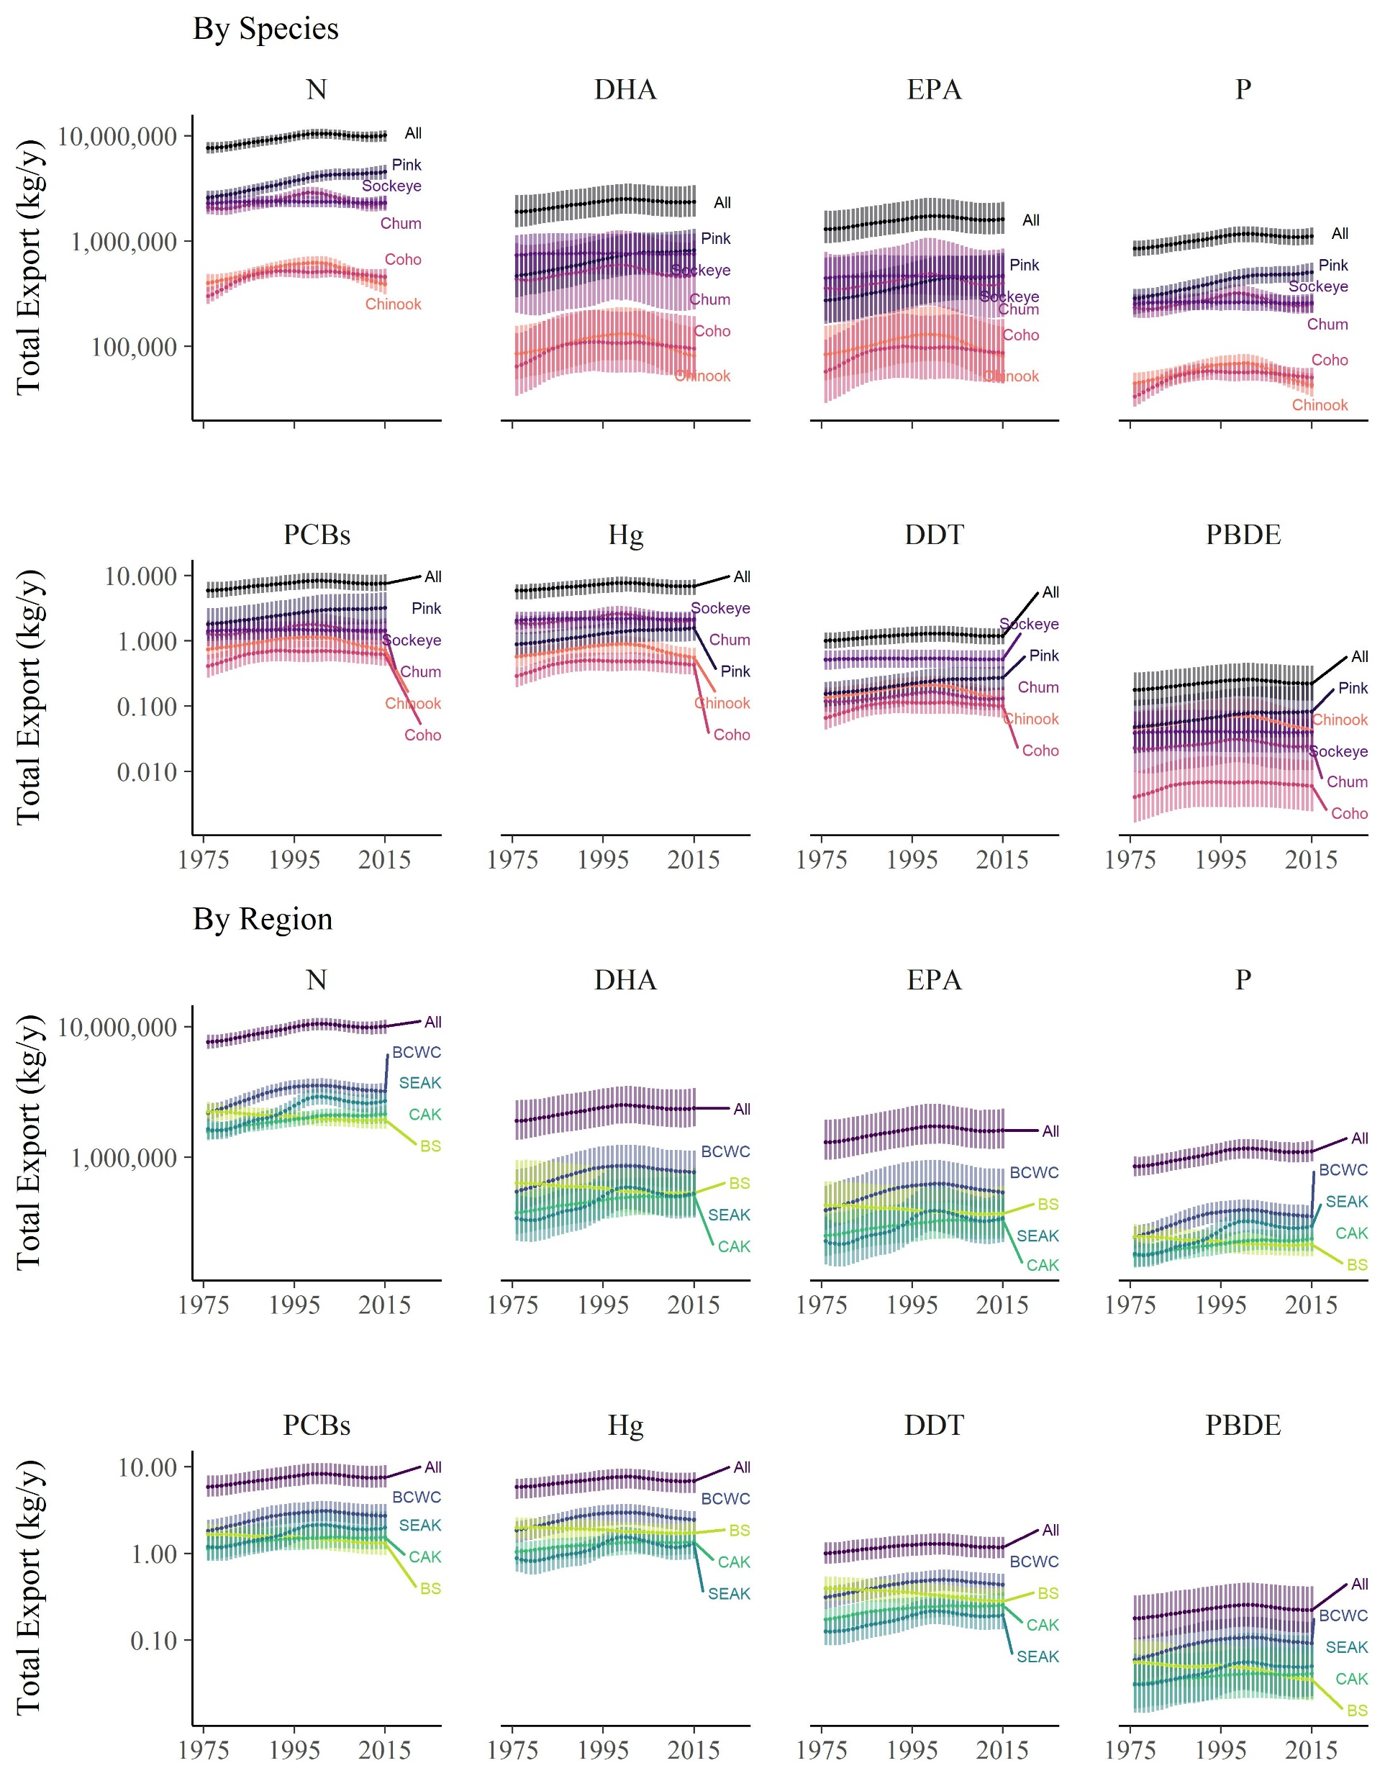
With log scale on y -axis

Slide 3
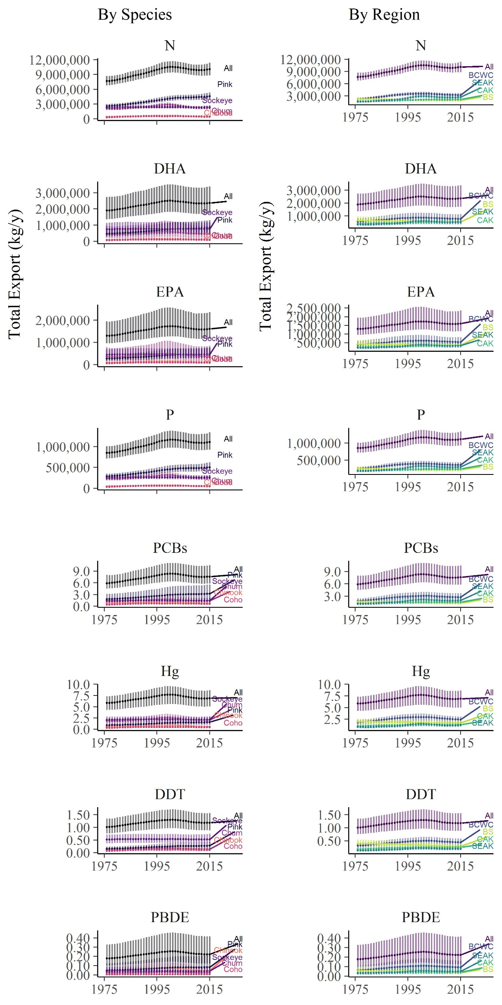
Similar to original, just with the totals added to each plot instead of a 3rd column

