Slide 1
Gemini Enterprise Workshop
Grocery Retail
Agentic AI for Store Operations
Google Cloud | Gemini Enterprise (Discovery Engine API)

Slide 2
The Business Problem
Meet Sarah, Regional Merchandising Manager. She's planning a seasonal endcap promotion and needs to:
Test the strategy before rollout — simulate shopper behavior and estimate ROI across 3 stores
Ensure brand compliance — verify the promotion follows brand guidelines exactly
Generate marketing materials — create product imagery that matches brand standards
Analyze historical data — understand which products drive revenue in each store
Protect customer data — ensure loyalty tier analytics don't expose PII
Share the strategy — let other teams discover and reuse her simulation agent

Slide 3
What Gemini Enterprise Brings
Capabilities Table Placeholder
Capability | What It Does | Sarah's Use Case
Shopper Simulator | AI-powered A/B testing of store layouts | Test endcap before deployment
Discovery Engine | Enterprise search over SOPs and docs | Brand guideline compliance
Agent Engine | Multi-agent AI orchestration | Route analytics, search, image gen
BigQuery + MCP | Natural language data analytics | Sales trends by store/product
Gemini 3 Pro Image | Brand-compliant product imagery | Marketing visuals for endcap
Memory Bank | Cross-session user memory | Remember store preferences
Model Armor | Content safety and PII protection | Protect loyalty data
A2A Protocol | Agent-to-agent communication | Cross-team simulator reuse
ADK Evaluation | Agent testing and simulation | 378 automated tests

Slide 4
System Architecture
Presentation Layer
Four layers interface with Google Cloud services for a complete agentic AI platform.
Frontend Web UI with StreamAssist, Agent Engine, and Voice Ops tabs
378 automated tests validate the full stack. Config-driven design: switch retailers by changing one YAML file.
Agent Layer
Models:
ADK multi-agent with Gemini 3 Pro/Flash. Root agent orchestrates analytics, image, simulator
gemini-3-pro-preview (orchestration)
gemini-3-flash-preview (sub-agents)
gemini-3-pro-image-preview (images)
Search and Retrieval
Discovery Engine with SOP and brand guidelines data stores. Model Armor safety
Data Layer
BigQuery star schema (12K+), GCS docs, Memory Bank

Slide 5
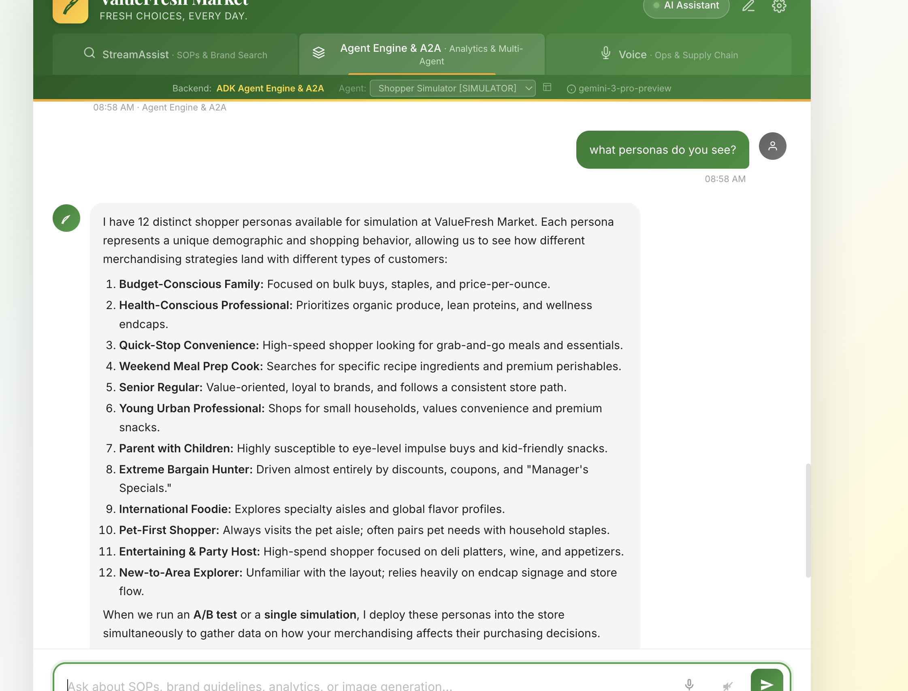
Act 1: Simulate Before You Spend
Shopper Simulator — AI-Powered A/B Testing
World-Model Simulation
12 shopper personas — budget families, health enthusiasts, quick-stop shoppers, weekend cooks, elderly regulars
3 store layouts — Downtown, Westside, and Lakefront Market
Concurrent sub-agents — each persona walks aisles and builds a cart independently
4 merchandising scenarios — baseline, seasonal produce, snack impulse, health wellness
12
Concurrent Shopper Personas

Slide 6
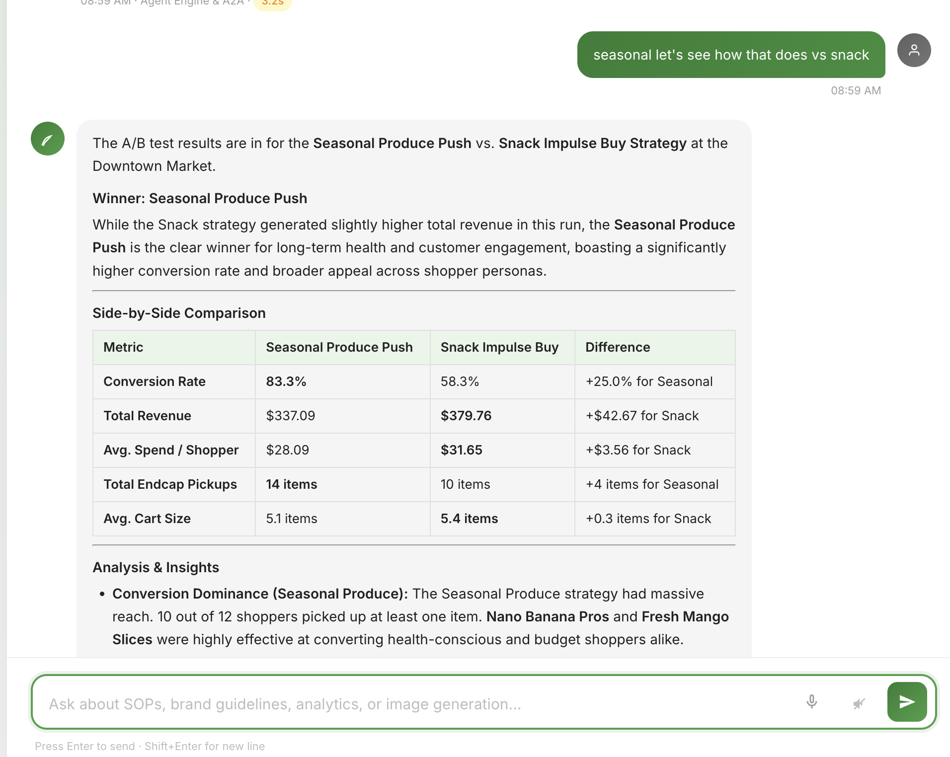
Act 1: A/B Test Results
Shopper Simulator — Actionable Insights
Aggregate Metrics
Endcap conversion rates per persona and store
Incremental revenue projections from promotional placement
ROI calculations comparing investment vs. projected lift
Winner recommendation with confidence intervals
15%
3x
23%
Revenue Lift
ROI on Endcap
Conversion Rate

Slide 7
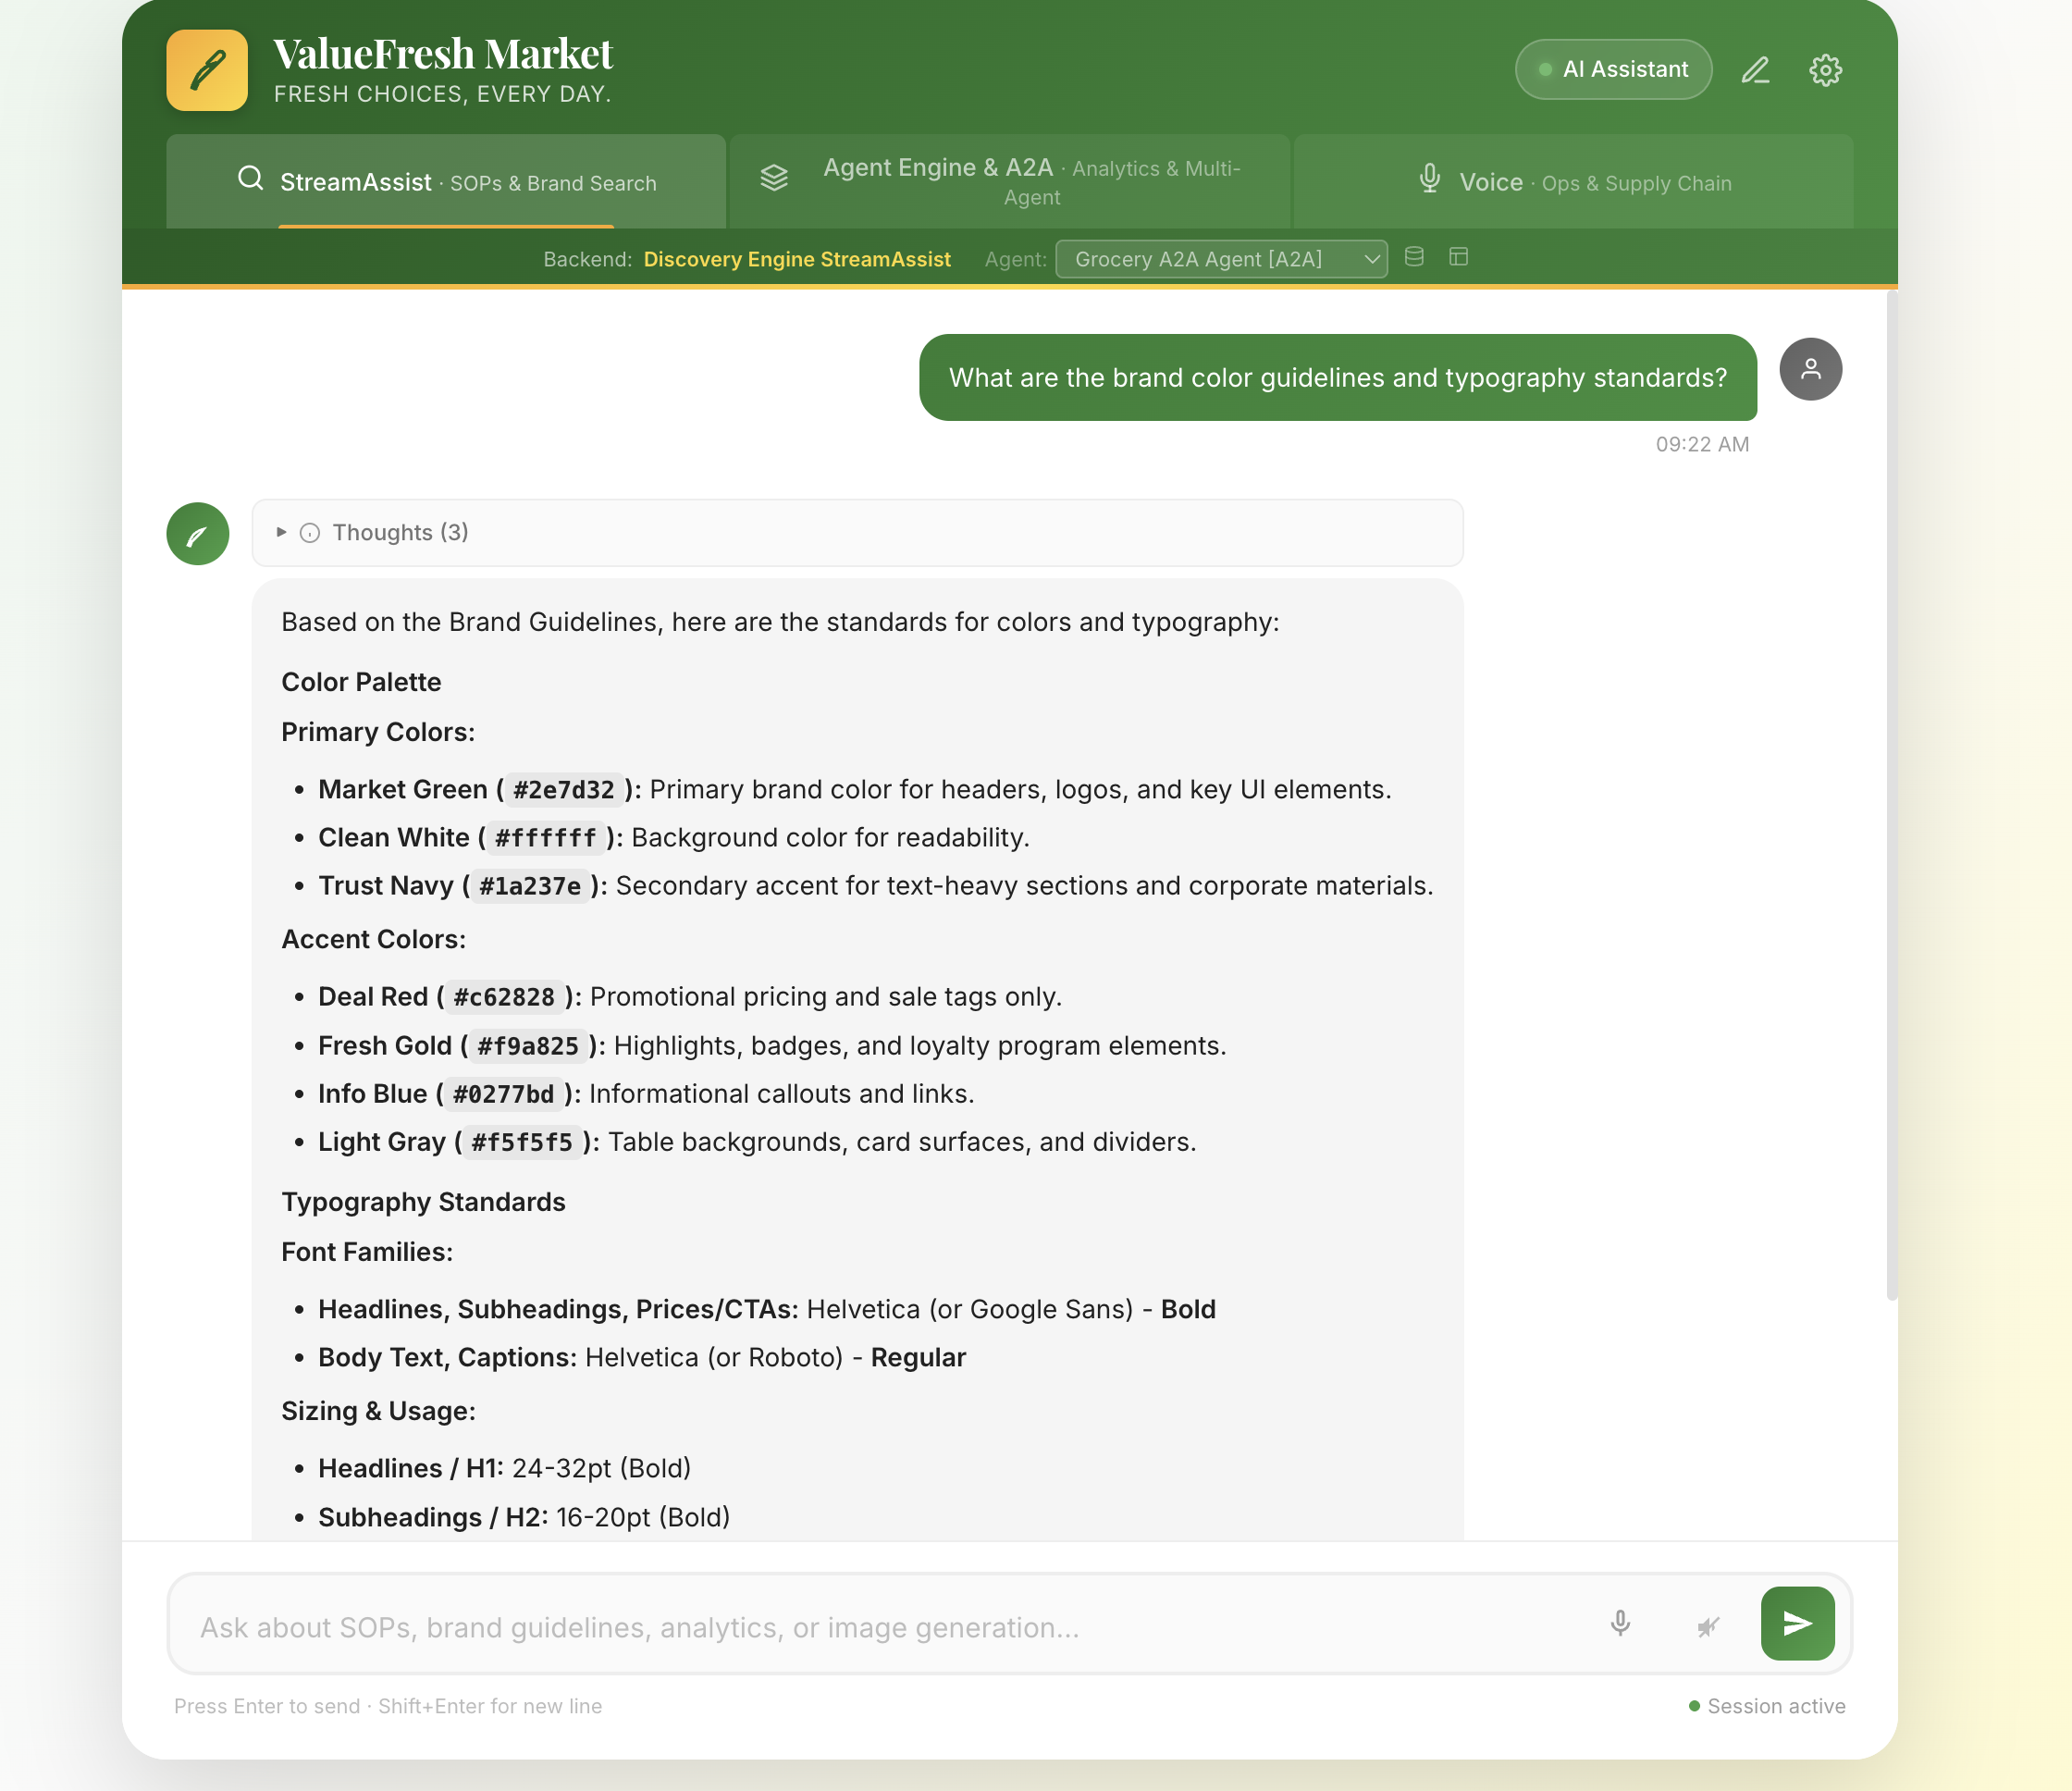
Act 2: Brand Compliance
Discovery Engine Search — Grounded Enterprise Search
Enterprise Search over Documents
GCS-backed PDFs — SOPs and brand guidelines indexed automatically
Grounded responses with document citations and page references
Multi-document grounding across SOP and brand guidelines data stores
StreamAssist provides conversational search with session management
Data Stores: sop-store (closing/opening procedures, safety) + brand-guidelines-store (colors, typography, tone)
Search Tier: SEARCH_TIER_ENTERPRISE with global location

Slide 8
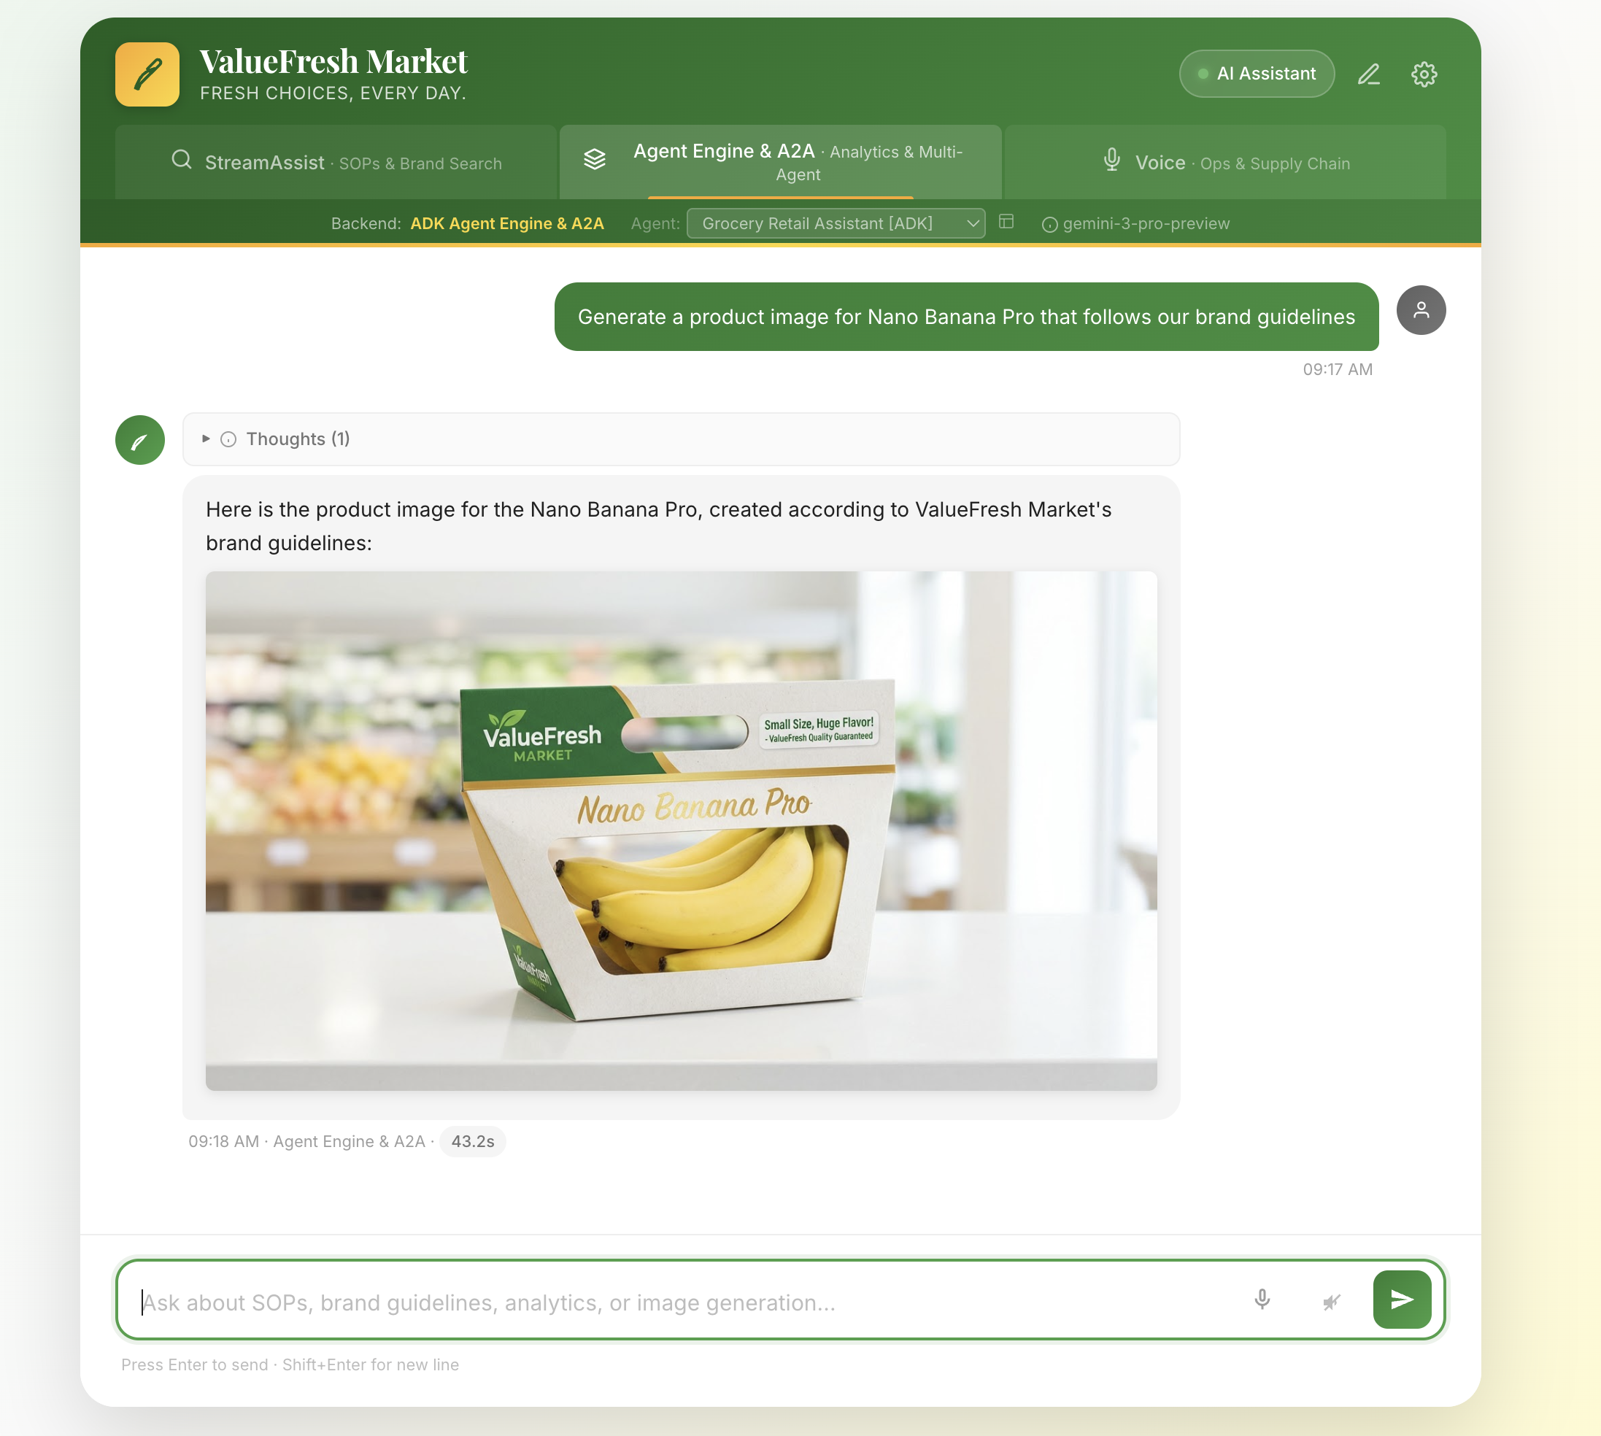
Act 2: Image Generation
Gemini 3 Pro Image — Brand-Compliant Product Imagery
Native Image Generation
gemini-3-pro-image-preview model for native image output
Brand palette enforcement — green, gold, and white color scheme
Inline rendering — images display directly in the chat interface
GCS storage — generated images saved and served via proxy
Agent routing — root agent transfers to image_agent sub-agent
Brand color palette

Slide 9
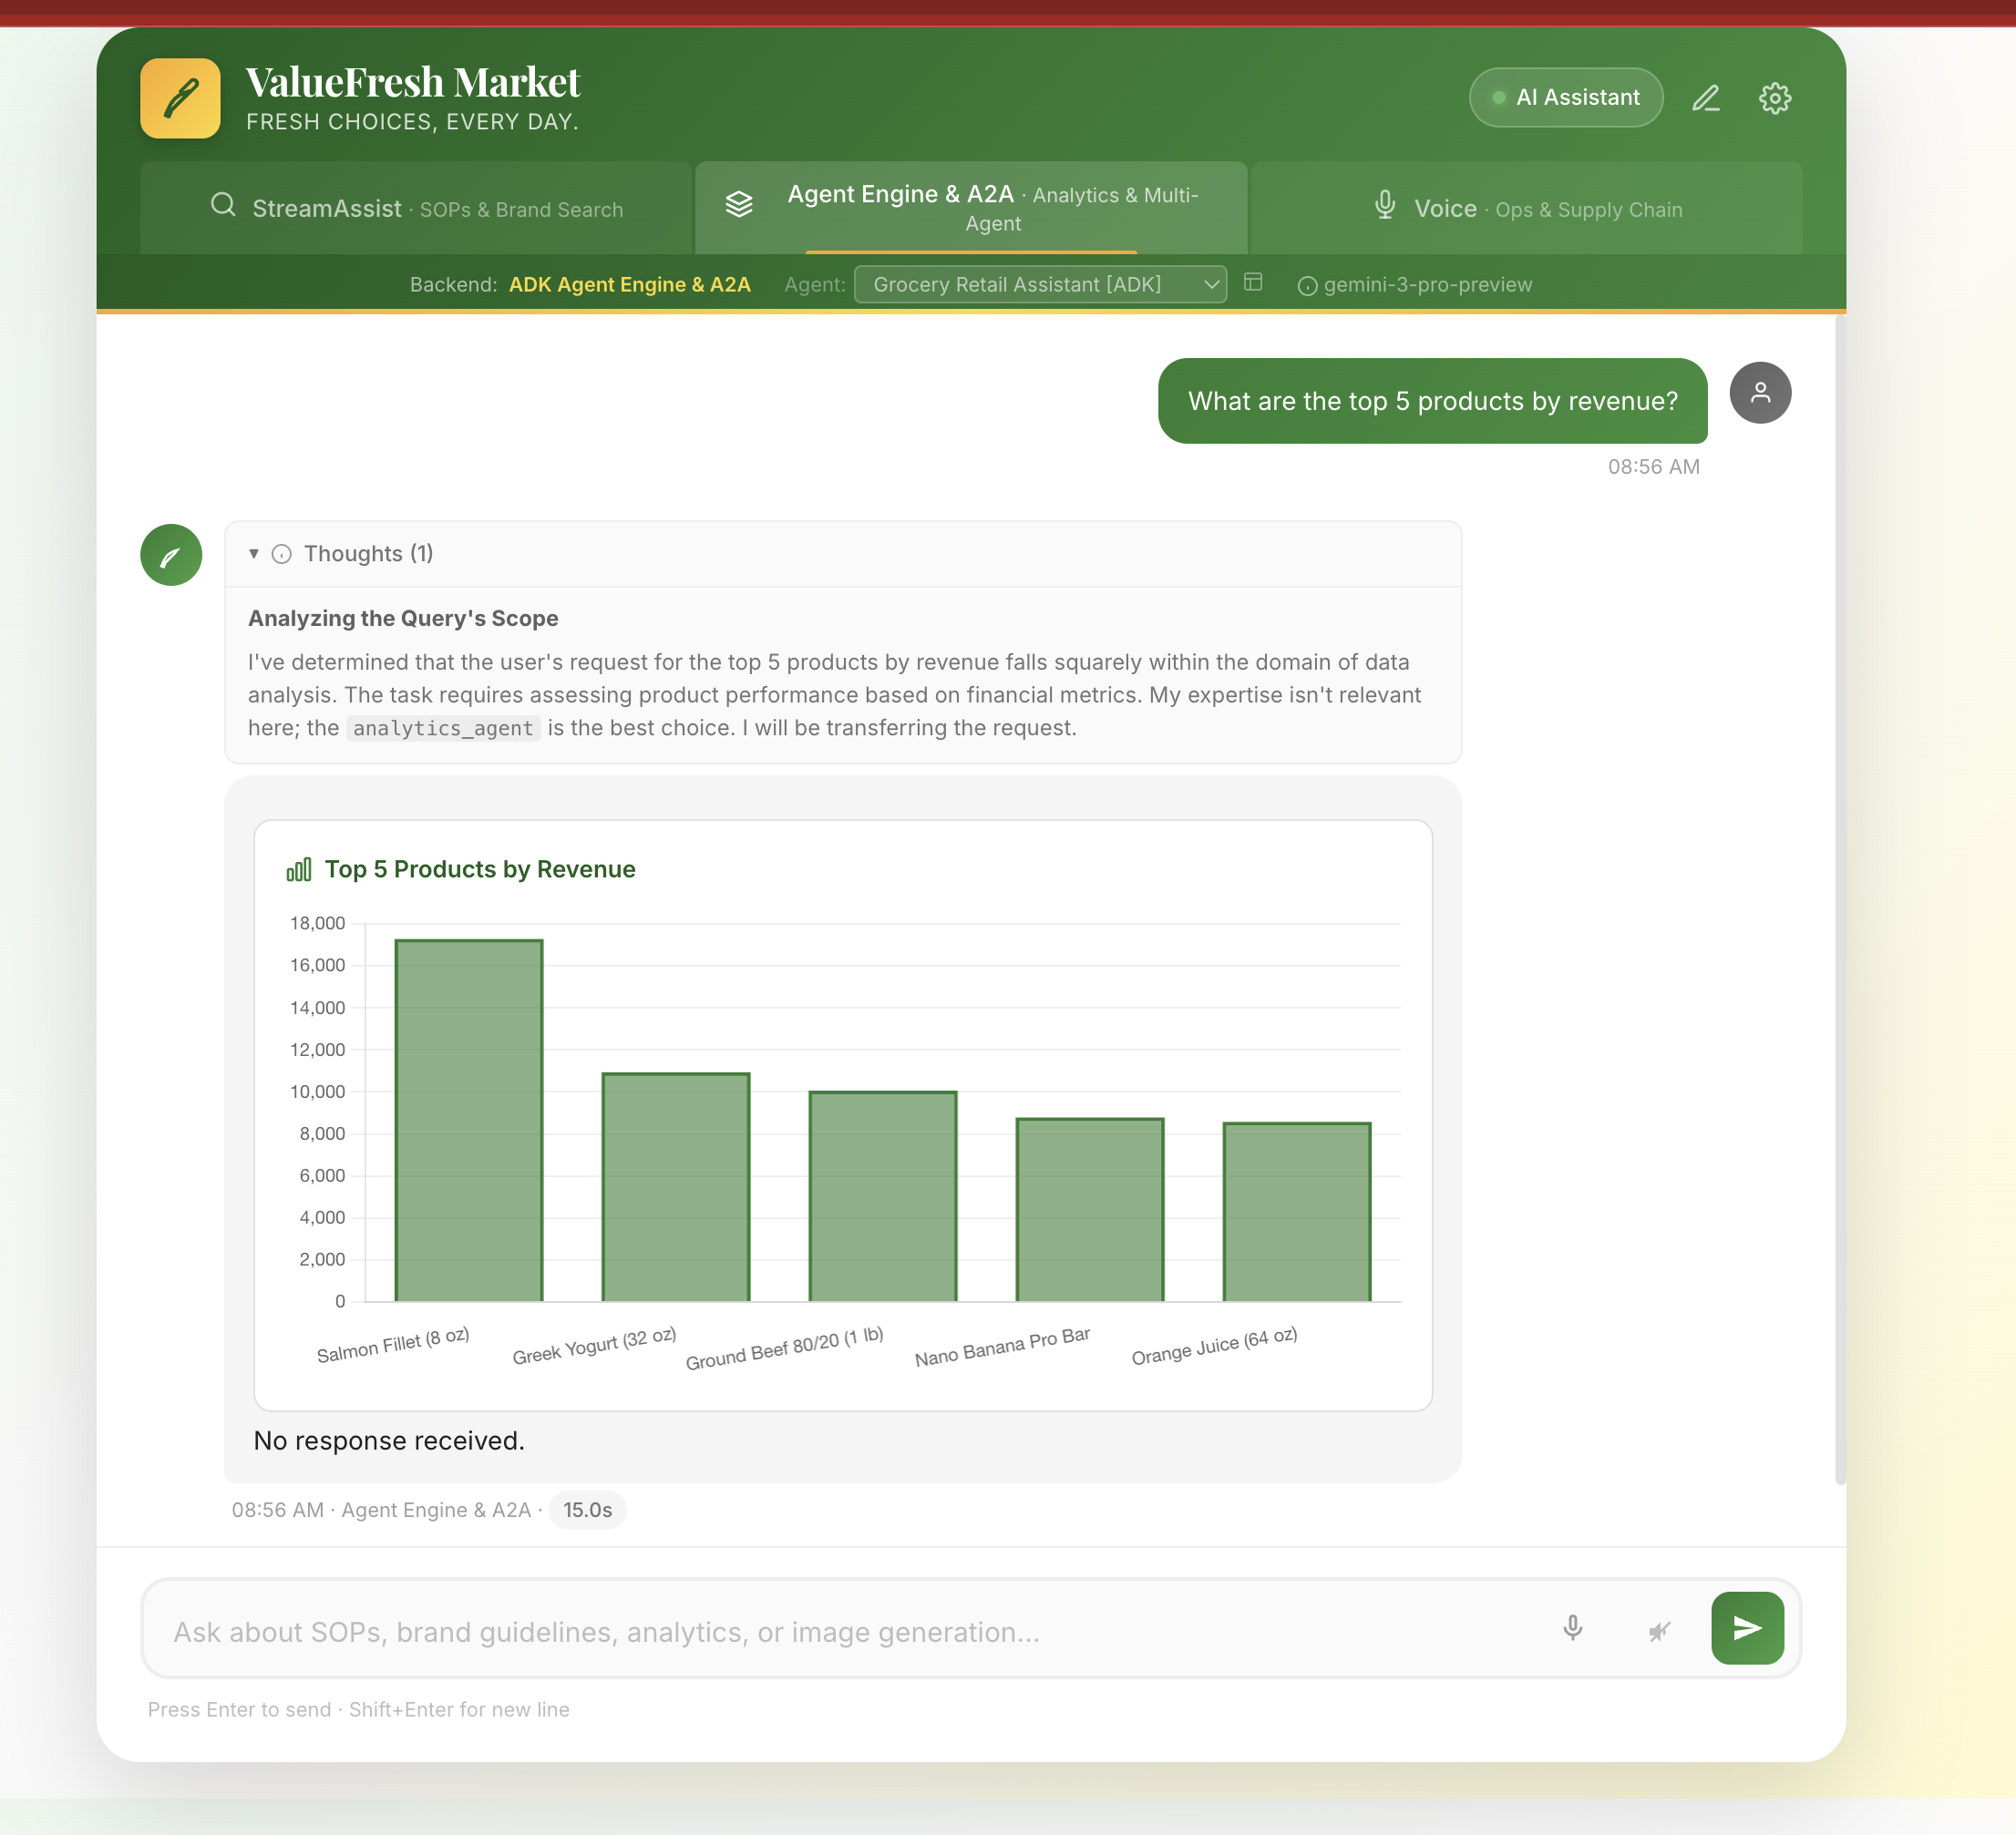
Act 3: BigQuery Analytics
Data Insights Agent — Natural Language to SQL
Self-Service Analytics
12K-row star schema — fact_transactions with 4 dimension tables
Natural language to SQL — no SQL knowledge required
Chart.js visualizations — bar, pie, line charts rendered inline
analytics_agent sub-agent (Gemini 3 Flash) handles all queries
fact_transactions (12K rows)
dim_store (3) | dim_product (20)
dim_employee (15) | dim_customer (40)

Slide 10
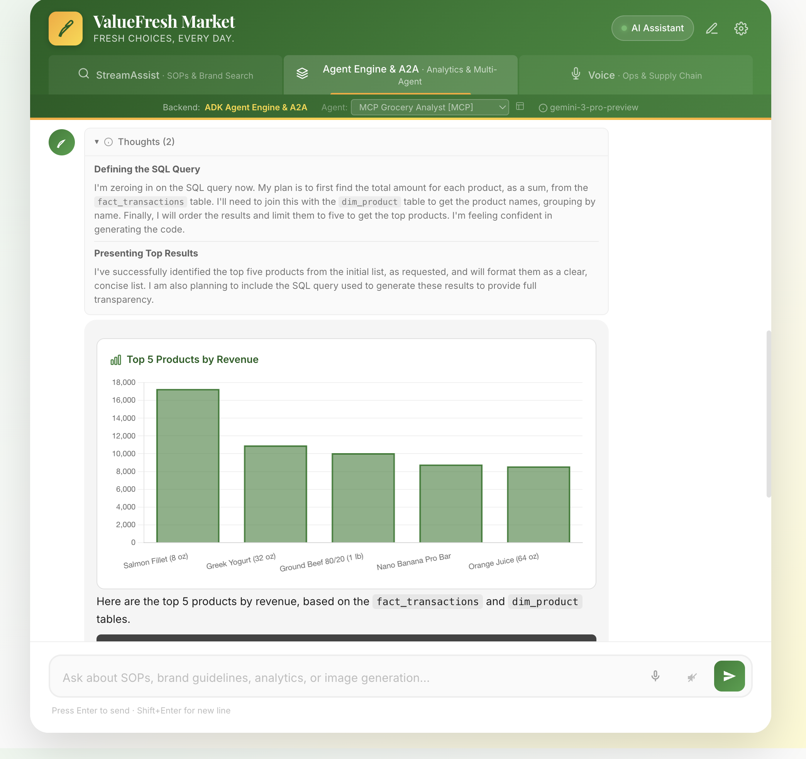
Act 3: MCP Toolbox
MCP Agent — Arbitrary SQL via MCP for Databases
9 BigQuery Tools via MCP
execute_sql — LLM generates arbitrary SQL (not pattern-matched)
list_table_ids / get_table_info — schema discovery
forecast — time series forecasting
analyze_contribution — metric contribution analysis
ask_data_insights — AI-powered data analysis
search_catalog — find tables, views, models
1
9
Tool (ADK Agent)
Tools (MCP Agent)

Slide 11
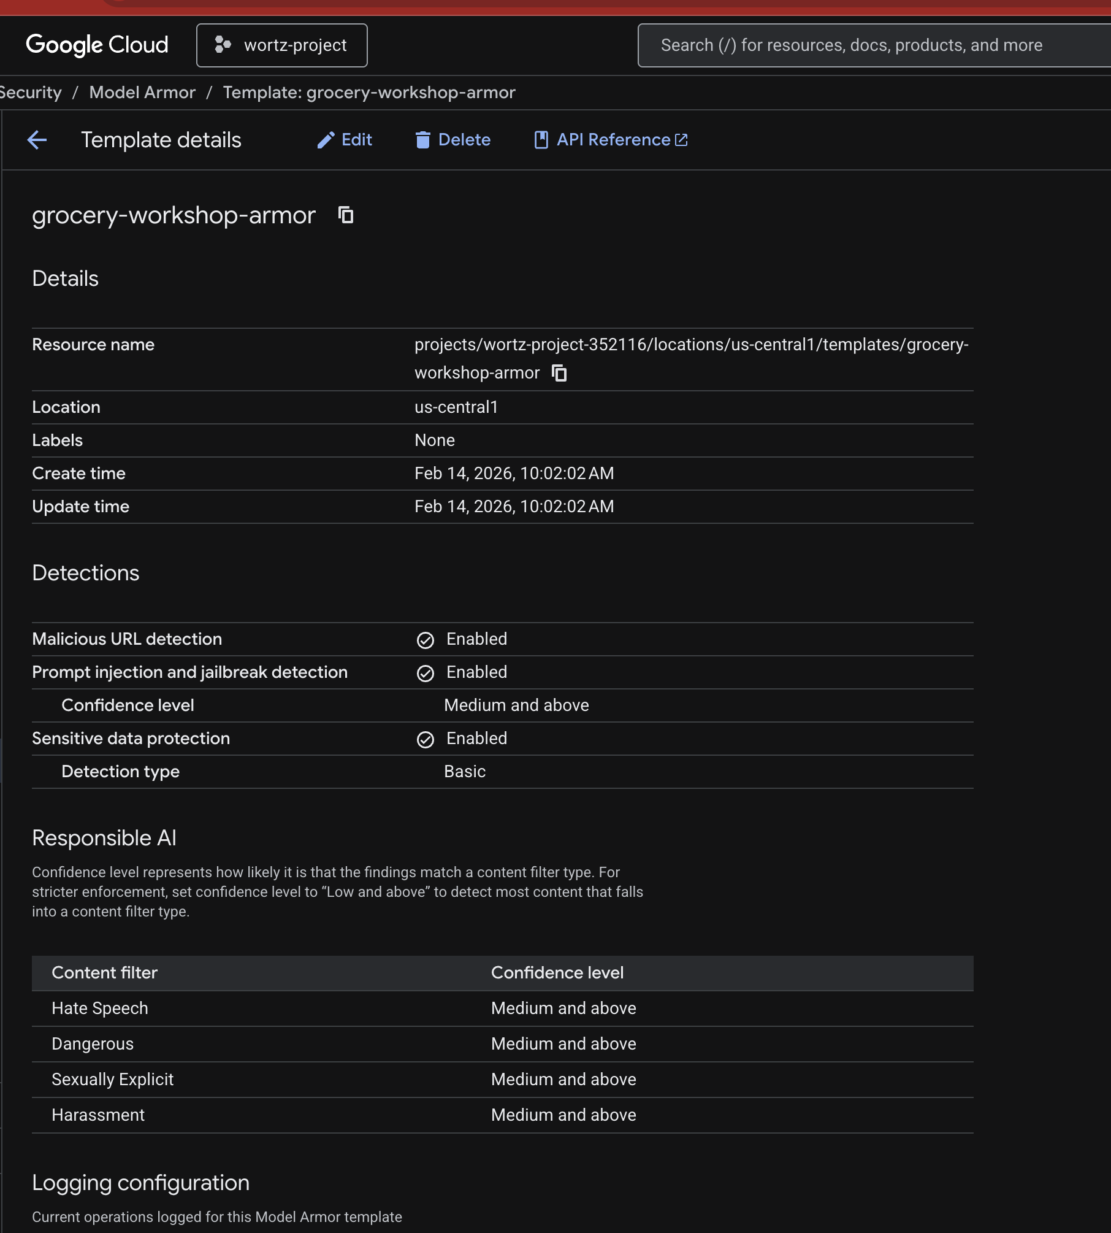
Act 4: Model Armor
Content Safety Filters — Enterprise-Grade Protection
Active Filters
RAI Harm Filter — hate speech, violence, sexual content, dangerous content
PI and Jailbreak Filter — prompt injection and jailbreak attempts
SDP Basic Filter — PII detection (names, emails, phone numbers)
Malicious URI Filter — blocks malicious URLs in prompts/responses
Failure Mode: FAIL_OPEN — if Model Armor is unavailable, queries pass through to avoid blocking production

Slide 12
Act 4: ADK Evaluation Framework
Automated Testing — Quality Assurance at Scale
Test Coverage
300
78
378
Unit Tests
Integration Tests
Total Tests
User simulation — ADK eval framework with synthetic user scenarios
Tool trajectory validation — verify correct tool calls in sequence
Hallucination detection — ensure grounded responses from Discovery Engine
CI/CD integration — GitHub Actions runs unit tests on every push/PR (Python 3.10-3.12)

Slide 13
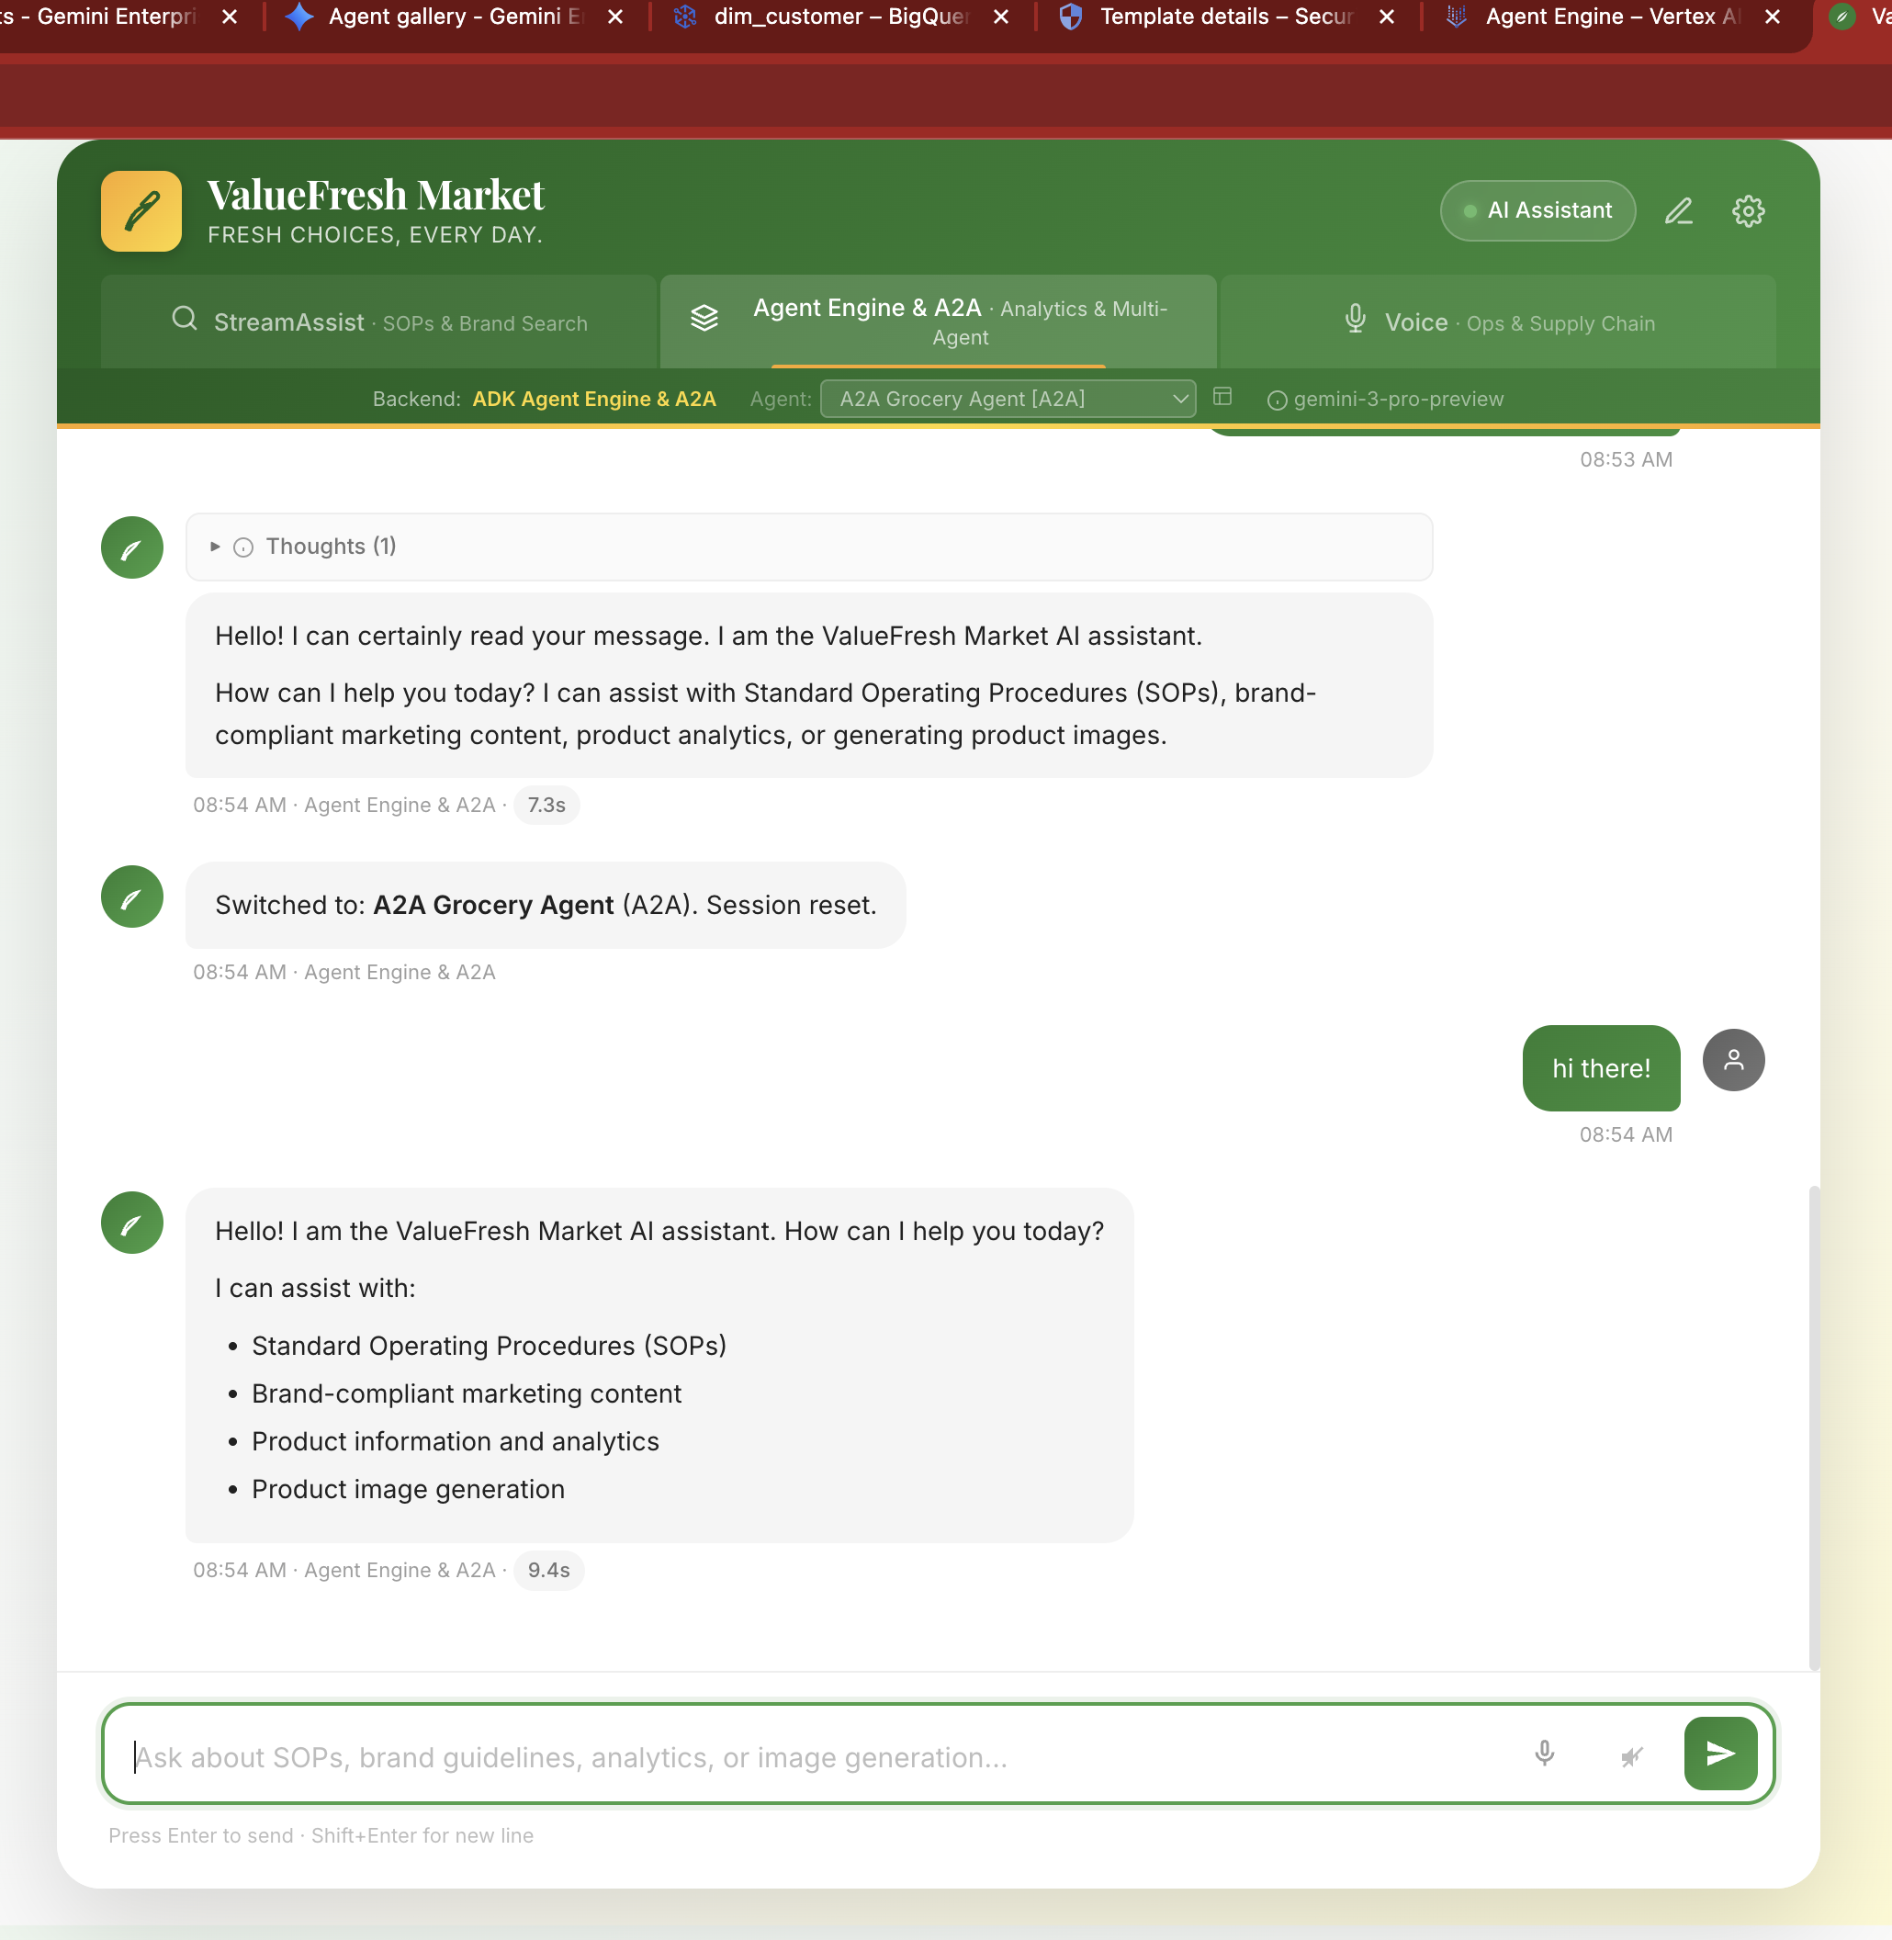
Act 5: A2A Protocol
Agent Discovery and Composability
Agent-to-Agent Communication
AgentCard — machine-readable capabilities at a well-known endpoint
Standard protocol — any agent can discover and invoke capabilities
Cloud Run deployment — auto-scaling A2A endpoint
Cross-team reuse — marketing can use Sarah's simulator directly
GET /.well-known/agent.json
POST /a2a

Slide 14
Act 6: Business Impact
Before and After — The Platform Value
Sarah's Results
Impact Table Placeholder
Metric | Before (Manual) | After (AI-Powered)
Strategy testing | 2-3 weeks per test | Minutes per simulation
SOP lookup | 15 min (paper binders) | 30 seconds (grounded search)
Brand compliance | Manual review | Automated verification
Analytics access | Requires analyst / SQL | Self-service natural language
Content safety | Application-level checks | Infrastructure-level (Model Armor)
Cross-team reuse | Email / meetings | A2A agent discovery

Slide 15
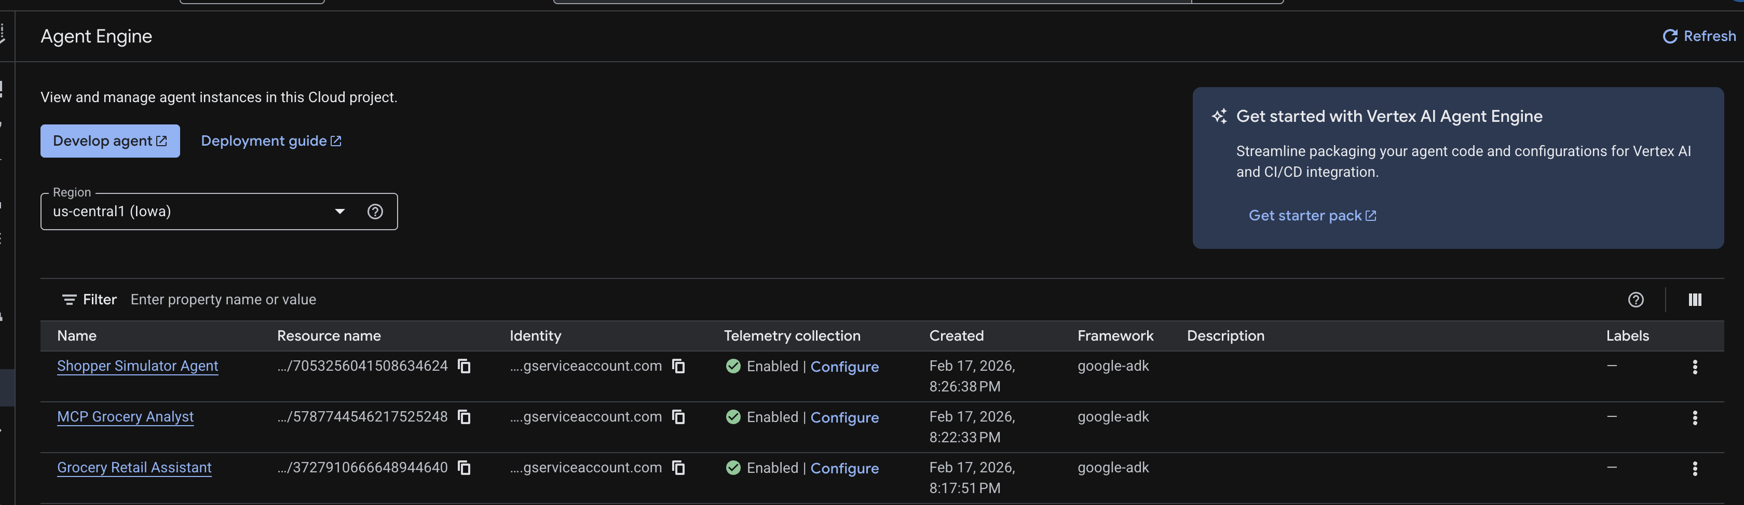
Agent Engine Console
Deployed Agents — Vertex AI Agent Engine
4 Production Agents
Grocery Retail Assistant
Agent Engine | 3727910666648944640
MCP Grocery Analyst
Agent Engine | 5787744546217525248
Shopper Simulator
Agent Engine | 7053256041508634624
A2A Agent
Cloud Run | grocery-a2a-agent
All agents have OTel tracing enabled for Cloud Trace observability

Slide 16
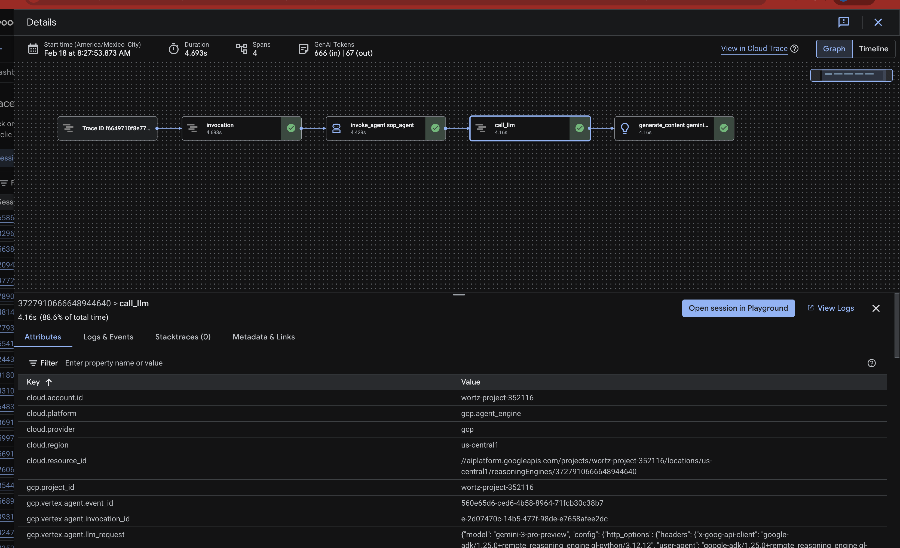
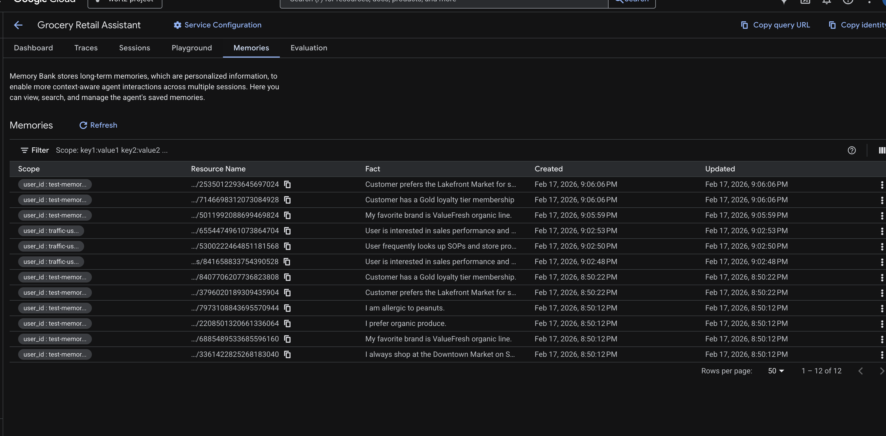
Observability
Cloud Trace + Sessions + Memory Bank
Cloud Trace
Memory Bank
OpenTelemetry tracing on all agents
Trace deeplinks from chat UI
Latency and tool-count metrics
Span-level agent call flow
Per-user scoped memories
Cross-session persistence
PreloadMemoryTool on each turn
Frontend tooltip shows count

Slide 17
Getting Started
Quick Start
1
Install dependencies
pip install -e ".[dev]"
2
Run unit tests (no GCP credentials needed)
python -m pytest tests/test_agent.py tests/test_mcp_agent.py tests/test_a2a_agent.py -v
3
Provision Discovery Engine and data stores
bash infra/provision_engine.sh && bash infra/provision_datastore.sh
4
Deploy agents to Agent Engine
cd src && adk deploy agent_engine --project=YOUR_PROJECT agent
5
Launch frontend
python -m src.frontend # http://localhost:8080

Slide 18
Next Steps
POC Scoping
Resources
Technical deep-dive — walk through the architecture documentation with your engineering team
Identify your problem — find your equivalent of Sarah's endcap challenge
Customize — update config/settings.yaml with your retailer name and branding
Deploy — provision resources in your own GCP project
Workshop Guide — docs/workshop_guide.md
Architecture — docs/architecture.md
Setup Guide — docs/setup.md
Evaluation Guide — docs/evaluation_guide.md
Google Cloud
Gemini Enterprise | Agent Engine | ADK

