Slide 1
☁ Google Cloud Gemini Enterprise Agent Platform › Optimize › Evaluation
1 / 7
GEMINI ENTERPRISE AGENT PLATFORM
Evaluating Agents on the Agent Platform
The Quality Flywheel. Measure, monitor, and keep improving agent quality end to end. A hands-on walkthrough that covers everything in the Optimize / Evaluation docs, run against real deployed agents.
Design › Execution › Scoring › Refinement
$ uv run python -m src.eval.demo.full_eval_demo --agent-id $AGENT_ENGINE_ID
Docs: Optimize / Evaluation ↗ · github.com/jswortz/geap-tour ↗ · Demo walkthrough ↗

Slide 2
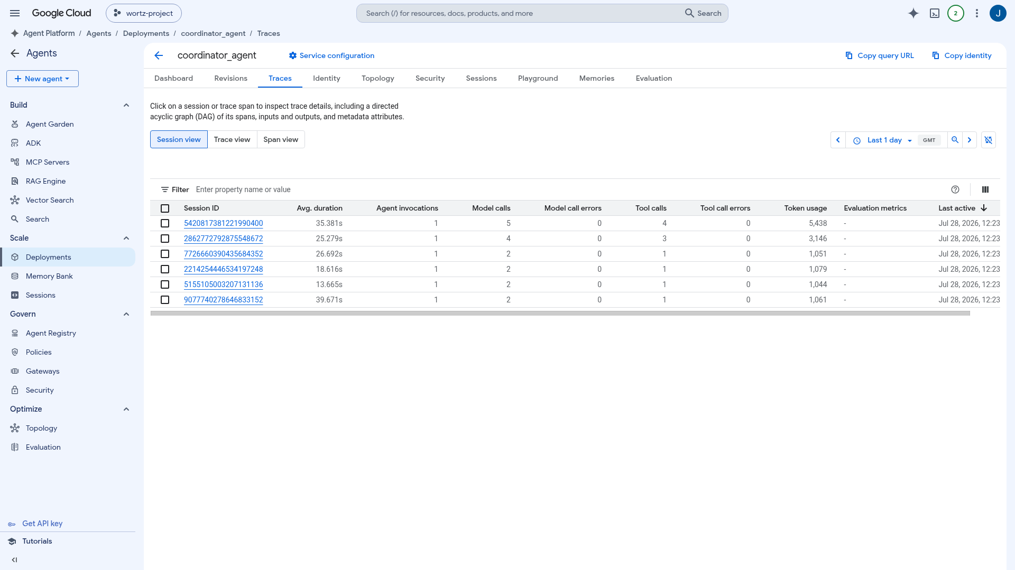
☁ Google Cloud Gemini Enterprise Agent Platform › Optimize › Evaluation
2 / 7
THE QUALITY FLYWHEEL
Evaluating agents on the Agent Platform
Turn “it seems to work” into something you can measure. Evaluation is a loop across four phases: Design, Execution, Scoring, Refinement.
● Define eval cases and metrics, run inferences to produce traces, score them with autoraters, then analyze and optimize. Repeat.
● Covers all 9 of the “Optimize / Evaluation” doc pages, running against real deployed agents.
● Run it: uv run python -m src.eval.demo.full_eval_demo --agent-id $AGENT_ENGINE_ID
Docs: Agent evaluation overview ↗
</> docs/evaluation_demo.md </> docs/eval_operations.md

Slide 3
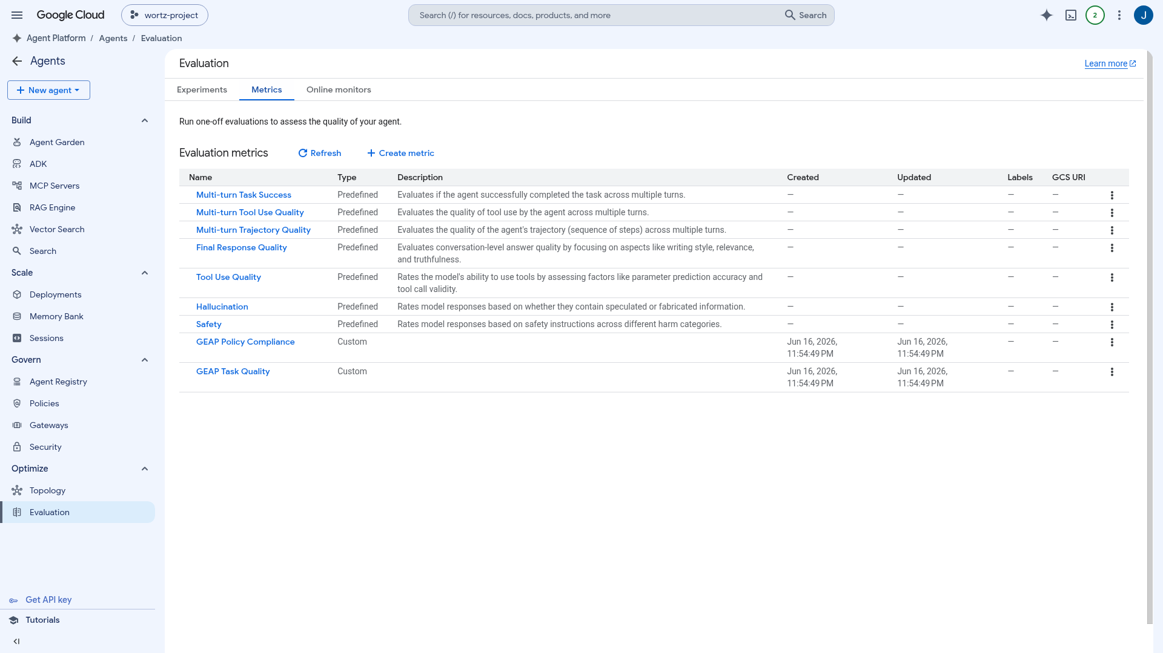
☁ Google Cloud Phase 1 · Design
3 / 7
DEFINE “GOOD” · METRIC REGISTRY
Pick a metric, or write your own
Define a metric once and reuse it across offline runs and online monitors. There are three kinds, plus the split between reference-based and reference-free.
● Predefined rubric: single-turn (Final Response Quality, Hallucination, Tool Use, Safety) and multi-turn (Task Success, Tool Use, Trajectory).
● Adaptive rubrics write their own criteria; static ones score 0 to 1.
● Custom LLM-as-judge (types.LLMMetric) and custom code (types.CodeExecutionMetric).
● Reference-based Exact Match vs reference-free rubrics.
Docs: Manage evaluation metrics ↗
</> src/eval/metric_registry.py </> src/eval/agent_eval_configs.py

Slide 4
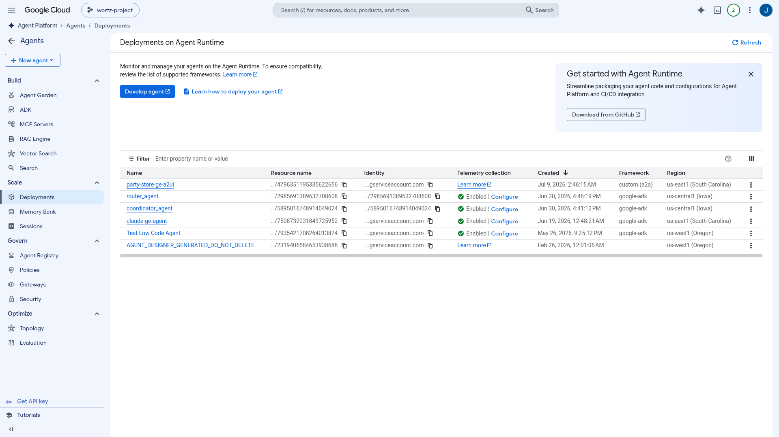
☁ Google Cloud Phase 2 · Execution
4 / 7
GENERATE TRACES
Three ways to exercise the agent
A trace is the record of one run: the model inputs, the responses, and the tool calls. Produce them whichever way fits the stage.
● Batch / test-case: run inference over a fixed suite for regression testing in CI.
● Simulated: generate multi-turn scenarios and let an LLM play the user, grounded by environment_context. Inject mocked tools or 503s.
● Offline: score already-recorded historical traces and sessions in Cloud Trace and BigQuery, with no new inference.
Docs: Run evaluation / Simulate / Offline ↗
</> multi_agent_batch_eval.py </> simulated_eval.py </> env_simulation.py </> offline_trace_eval.py

Slide 5
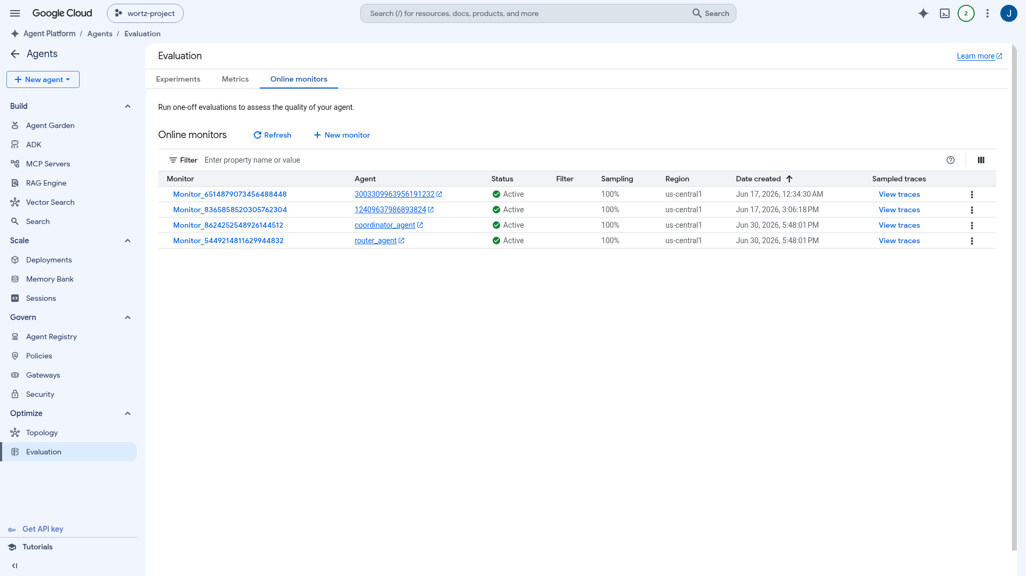
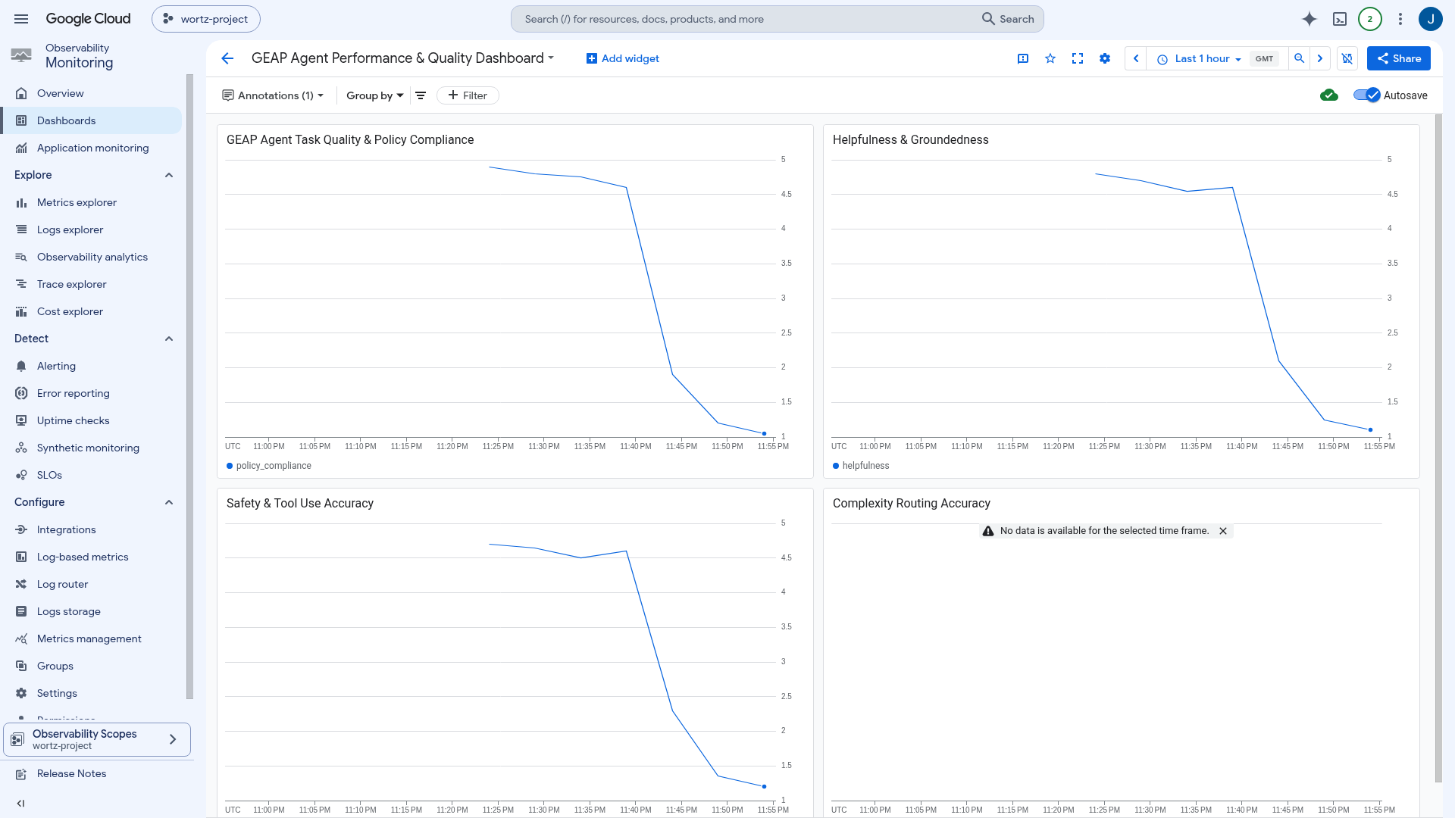
☁ Google Cloud Phase 3 · Scoring in production
5 / 7
CONTINUOUS EVAL & GUARDRAILS
Watch quality in production
Online Monitors score live traffic as it comes in and send the scores to Cloud Monitoring, so you catch quality drift before users do.
● Online Monitors: a roughly 10-minute loop that queries traffic, evaluates it, and reports. Sampling is configurable, and results land in Logging and Monitoring.
● Metrics Explorer and dashboards: every score becomes a Cloud Monitoring metric (agent_eval/*, online_evaluator/scores), so you can chart, compare, and share it.
● Quality-drift alerts: a per-monitor policy, the dashboard's Recommended Alerts, or gcloud / monitoring_v3.
Docs: Online monitors / Quality alerts ↗
</> setup_online_evaluators.py </> publish_metrics.py </> quality_alerts.py

Slide 6
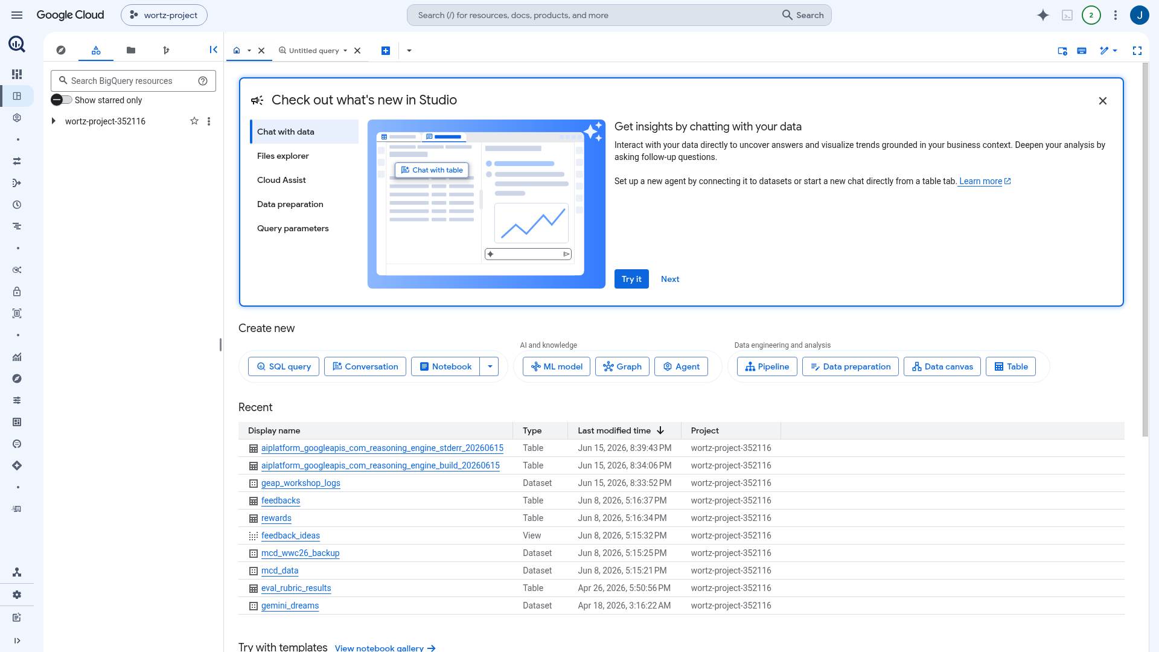
☁ Google Cloud Phase 4 · Refinement
6 / 7
ANALYZE, OPTIMIZE, REPEAT
Close the flywheel
Don’t just learn that the agent failed. Learn why, then fix it.
● Optimize: refine root instructions with GEPA or SimplePromptOptimizer, or drive the loop from an assistant with agents-cli eval.
● Re-evaluate: score the tuned agent against the same suite and compare, closing the loop.
● Built clean: current Google clients from PyPI, with 161 passing tests.
Docs: Optimize agent prompts ↗
</> sdk_optimize.py </> run_optimize.py </> agents_cli_demo.sh

Slide 7
☁ Google Cloud Summary
7 / 7
THE QUALITY FLYWHEEL IN ONE VIEW
From “seems to work” to measured & monitored
● Design: a reusable Metric Registry with predefined rubrics, custom LLM-as-judge, custom code, and reference-based Exact Match.
● Execution: generate traces three ways, batch in CI, simulated (with user and environment simulation), and offline over historical traces.
● Scoring: Online Monitors export every score as a Cloud Monitoring metric, visible in Metrics Explorer, dashboards, and drift alerts.
● Refinement: optimize the agent's instructions with GEPA, SimplePromptOptimizer, or agents-cli, then re-evaluate. Repeat.
Built clean: current Google clients from PyPI, with 161 passing tests.
$ uv run python -m src.eval.demo.full_eval_demo --agent-id $AGENT_ENGINE_ID
Docs: Optimize / Evaluation ↗ · Coverage matrix (§0) ↗ · Demo walkthrough ↗

