Slide 1
Google Cloud Workshop
Gemini Enterprise Agent Platform Tour
Build, Deploy, Govern, Evaluate, and Optimize AI Agents
ADK Agents • MCP Servers • Agent Gateway • Agent Registry • Model Armor • Evaluation Pipeline
https://github.com/jswortz/geap-tour
Google Cloud
Notes:
Welcome everyone to the Gemini Enterprise Agent Platform workshop. Today we'll go from zero to a fully deployed, governed, and evaluated multi-agent system on Google Cloud. We'll build real ADK agents, connect them via MCP servers, deploy to Agent Runtime, set up dual-mode gateway governance, run evaluations, and configure Model Armor for content safety. This is a hands-on workshop — you'll be writing and deploying code throughout.

Slide 2
Table of Contents
Four sessions — from building agents to securing them in production
1
AI Gateway / MCP Gateway
Multi-agent architecture • MCP tool servers • ADK agents • Deployment • Workload identity
2
AI Gateway — Governance & Eval
Agent Gateway (dual mode) • Three-tier evaluation • Observability • GEPA optimization
3
Agent Registry
Agent registration & discovery • Toolspec association • Lifecycle governance
4
Model Security / Model Armor
Input/output screening • Prompt injection detection • Guardrail callbacks
Google Cloud
Notes:
Four sessions today. Session 1 is the longest — we'll build the full agent stack from scratch. Session 2 continues with governance, evaluation, and observability. Sessions 3 and 4 are shorter focused deep-dives on Agent Registry and Model Armor. There's a lunch break between sessions 1 and 2, and a short break before the final wrap-up.

Slide 3
Platform Architecture
Agent Registry
AI Security
Access Authorization
Agent Gateway
(Ingress)
Agent Identity
Agent Gateway
(Egress)
Frontend
Web / Mobile / API
Agent Platform Runtime
Agents
User
Agent
Profile, goals, skills, instructions, tools...
Model-based reasoning/planning and task execution loop
Tools
Models
APIs
Memory & Sessions
Models (Gemini / 3P)
AI Observability
Governing AI Agents with Google Cloud
Google Cloud
Notes:
This is the high-level architecture of GEAP. Key point: the Agent Gateway sits at the network boundary — all traffic between users, agents, and external services flows through it. The Agent Identity layer (powered by SPIFFE) gives each agent its own cryptographic identity. This means we can write policies about WHICH agent can call WHICH tool — not just which user.

Slide 4
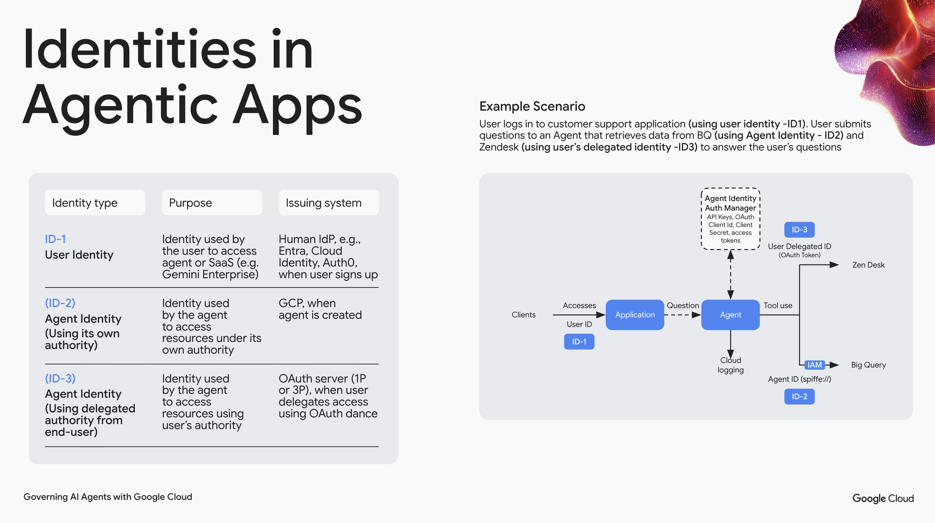
Agent Identity Model
Google Cloud
Notes:
Three identity types are critical to understand. ID-1 is the human user's identity — standard OAuth/OIDC. ID-2 is the agent's own identity — a SPIFFE ID issued at deploy time. ID-3 is delegated — the agent acting on behalf of a user with constrained permissions. This tri-modal identity model is what makes fine-grained governance possible.

Slide 5
Session 1
AI Gateway / MCP Gateway
Build, connect, and deploy agents with MCP tool servers
Multi-agent architecture with MCP connectivity
FastMCP tool servers on Cloud Run
ADK agents deployed to Agent Runtime
SPIFFE-based workload identity
https://github.com/jswortz/geap-tour
Google Cloud
Notes:
Session 1 is where we build everything. By the end of this session you'll have: three MCP tool servers running on Cloud Run, three ADK agents deployed to Agent Runtime, and workload identity configured for secure agent-to-service communication. We'll start with the architecture, then write code, then deploy.

Slide 6
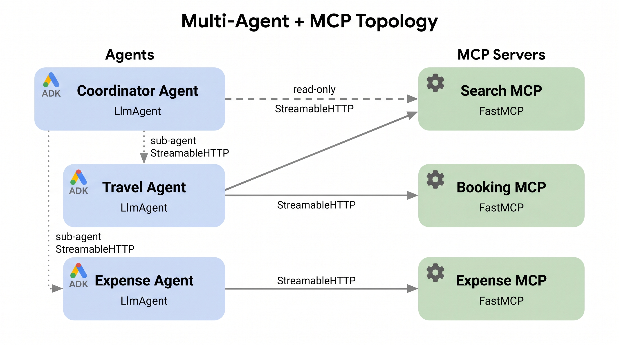
Multi-Agent Topology
Three ADK Agents
Coordinator Agent — routes requests to specialists
Travel Agent — searches flights/hotels, makes bookings
Expense Agent — submits expenses, enforces policy limits
Three MCP Servers
Search MCP — shared by Travel + Coordinator
Booking MCP — flight/hotel reservations
Expense MCP — expense submission + policy checks
Google Cloud
Notes:
Our workshop builds a corporate travel assistant. The Coordinator agent routes requests to either the Travel agent (flights, hotels) or the Expense agent (reimbursements). Notice the MCP servers are shared — the Search MCP is used by both Travel and Coordinator. This is a key MCP advantage: tools are deployed once and shared across agents.

Slide 7
MCP Server Development
FastMCP Pattern
StreamableHTTP Transport
MCP servers run as standard HTTP services on Cloud Run with automatic scaling
from fastmcp import FastMCP
mcp = FastMCP("search-mcp")
@mcp.tool()
def search_flights(
origin: str,
destination: str,
date: str | None = None
) -> list[dict]:
"""Search available flights."""
return flight_db.search(
origin, destination, date
)
Tool Discovery
Agents dynamically discover available tools via MCP protocol introspection
1-to-Many Topology
Multiple agents can share the same MCP server — no duplication needed
https://github.com/jswortz/geap-tour/src/mcp_servers/search/server.py
Google Cloud
Notes:
FastMCP makes building tool servers trivial — it's a single decorator on a Python function. The @mcp.tool() decorator handles schema generation, input validation, and protocol compliance. We use StreamableHTTP transport so these run as standard HTTP services on Cloud Run. DEMO: Walk through the search_flights tool code and show how MCP introspection exposes the tool schema.

Slide 8
ADK Agent Architecture
Agent Definition
Coordinator Pattern
Root agent uses sub_agents=[travel, expense] to delegate by intent
from google.adk.agents import LlmAgent
from google.adk.integrations\
.agent_registry import AgentRegistry
registry = AgentRegistry(
project_id=PROJECT, location="global"
)
travel_agent = LlmAgent(
name="travel_agent",
model="gemini-2.5-flash",
instruction="""You are a travel
assistant...""",
tools=[
registry.get_mcp_toolset(
SEARCH_MCP_SERVER
)
]
)
Session Management
Each user gets isolated sessions with conversation history and state
OTel Tracing
Every agent call produces OpenTelemetry spans — exported to Cloud Trace automatically
https://github.com/jswortz/geap-tour/src/agents/coordinator_agent.py
Google Cloud
Notes:
ADK agents use LlmAgent as the base class. The key config: model, instruction, and tools. Agents discover MCP servers via the Agent Registry using registry.get_mcp_toolset() — no hardcoded URLs. The registry resolves the server's resource name to a live connection. The Coordinator pattern uses sub_agents to delegate: it doesn't call tools directly, it routes to the specialist agent best suited for the user's intent. OTel tracing is built in — every agent call automatically generates spans.

Slide 9
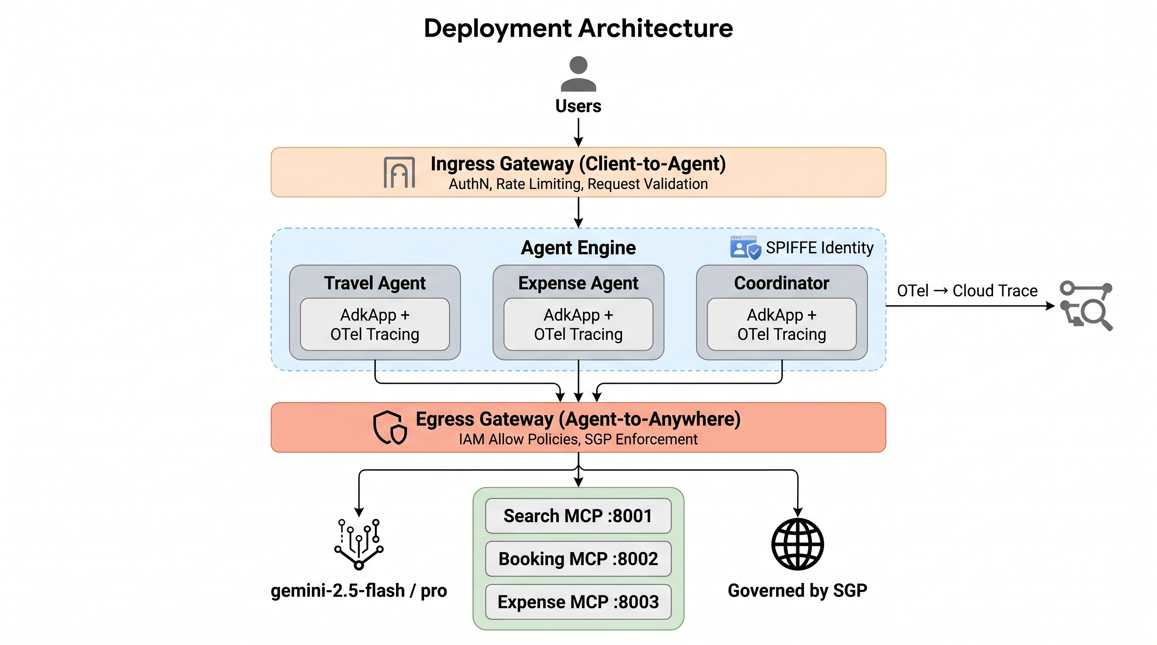
Deployment Architecture
Cloud Run — MCP Servers
StreamableHTTP transport, auto-scaling, IAM-secured endpoints
Agent Runtime — ADK Agents
Vertex AI Agent Engine with built-in session management and memory
One command deploy: bash scripts/deploy_all.sh Deploys 3 MCP servers + coordinator agent in sequence
Google Cloud
Notes:
Two deployment targets: Cloud Run for MCP servers (stateless HTTP services) and Agent Runtime (Vertex AI Agent Engine) for ADK agents (stateful, with session management). The deploy_all.sh script deploys everything in sequence — MCP servers first, then agents. DEMO: Run the deployment script and show the output as services come online.

Slide 10
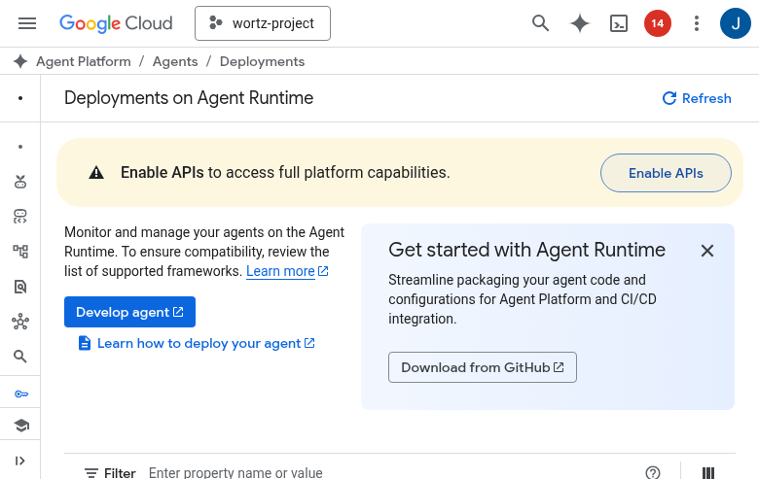
Console: Deployments on Agent Runtime
Open in Cloud Console
Google Cloud
Notes:
CONSOLE DEMO: Show the Agent Engine console page. Point out the deployed agent, its status, the model it's using, and the session management configuration. Highlight that Agent Runtime handles scaling, session persistence, and health checks automatically.

Slide 11
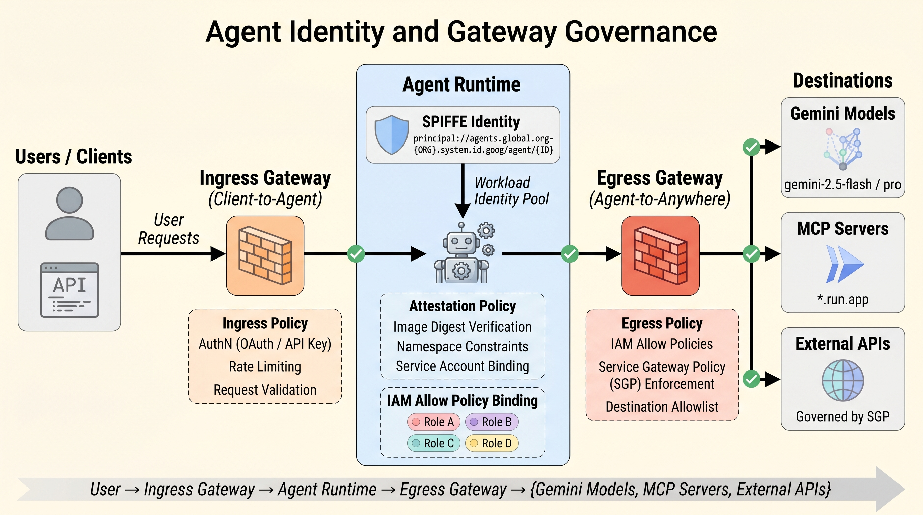
Agent Identity — SPIFFE
Workload Identity Federation
Each agent gets a SPIFFE ID at deployment
Attestation policies verify agent identity at runtime
Agent Gateway enforces identity at network boundary
Type | Purpose
ID-1: User | Human accessing the app
ID-2: Agent | Agent's own authority
ID-3: Delegated | Agent on behalf of user
Google Cloud
Notes:
SPIFFE gives every agent a cryptographic identity — not just a service account. This enables fine-grained policies: 'Agent X can call Tool Y but Agent Z cannot.' The three identity types map to real scenarios: user browsing the app (ID-1), agent autonomously running a scheduled task (ID-2), agent booking a flight for a specific user (ID-3). Agent Gateway enforces these identities at the network boundary.

Slide 12
Workload Identity — Setup & Verification
Create Identity Pool & Provider
Pool = Trust Boundary
Each pool groups external identities from one trust domain — agents get their own pool
# Create workload identity pool
gcloud iam workload-identity-pools \
create geap-agent-pool \
--location="global" \
--display-name="GEAP Agent Pool"
# Create OIDC provider
gcloud iam workload-identity-pools \
providers create-oidc agent-provider \
--workload-identity-pool=geap-agent-pool \
--issuer-uri="https://accounts.google.com" \
--location="global"
Provider = Auth Source
OIDC or SAML provider that issues tokens to agents — verified at runtime by GCP
Token Exchange
External token → STS → short-lived GCP credential — no service account keys needed
Verify token exchange: IAM & Admin > Workload Identity Federation
https://github.com/jswortz/geap-tour/scripts/setup_agent_identity.sh
Google Cloud
Notes:
Walk through the gcloud commands to create a workload identity pool and OIDC provider. Key concepts: the pool is a trust boundary (group external identities), the provider is the auth source (OIDC token issuer). The token exchange flow: external token goes through STS and comes back as a short-lived GCP credential. No long-lived service account keys needed — this is the security win.

Slide 13
Session 2
AI Gateway / MCP Gateway (continued)
Gateway, evaluation, observability, and optimization
Agent Gateway for ingress/egress control
Three-tier evaluation pipeline
Online monitors and failure cluster analysis
Agent optimization with GEPA algorithm
https://github.com/jswortz/geap-tour
Google Cloud
Notes:
Session 2 builds on the deployed system from Session 1. We'll add governance (Agent Gateway controlling what agents can do), evaluation (three-tier pipeline from manual to CI/CD), observability (Cloud Trace + BigQuery analytics), and optimization (GEPA evolutionary prompt tuning). This is where the platform becomes production-ready.

Slide 14
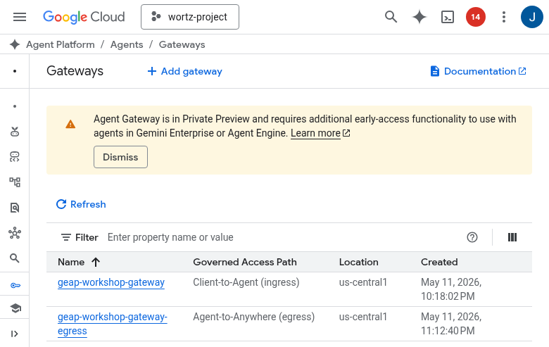
Agent Gateway — Dual Mode
Ingress + Egress Governance
Mode | Gateway | Controls
Client-to-Agent | geap-workshop-gateway | Inbound user requests
Agent-to-Anywhere | geap-workshop-gateway-egress | Gemini model calls, MCP tools, external APIs
With egress gateway, ALL outbound traffic — including Gemini model calls — routes through governance (IAM Allow + SGP + Model Armor)
config = {
"agent_gateway_config": {
"client_to_agent_config": {"agent_gateway": INGRESS},
"agent_to_anywhere_config": {"agent_gateway": EGRESS},
},
"identity_type": "AGENT_IDENTITY",
}
Requires Private Preview — gateway attachment via REST API PATCH
https://github.com/jswortz/geap-tour/scripts/setup_agent_gateway.sh
Google Cloud
Notes:
The dual-mode gateway is a key differentiator. Ingress gateway controls who can talk to your agents. Egress gateway controls what your agents can talk to — including Gemini model calls. This means ALL outbound traffic flows through governance: IAM Allow policies, Semantic Governance Policies, and Model Armor screening. Note: Egress gateway requires Private Preview access — the attachment uses a REST API PATCH. DEMO: Show the gateway configuration and the console view.

Slide 15
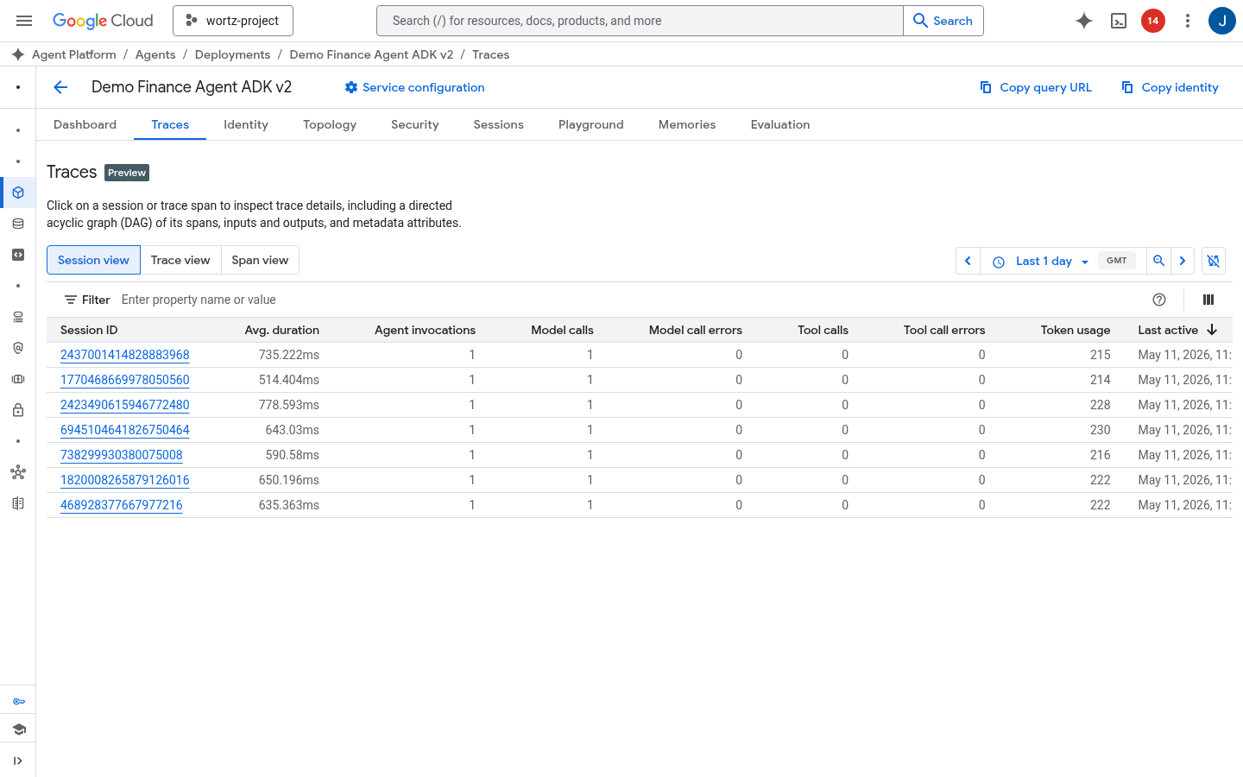
Console: Agent Traces
Session view showing model calls, tool calls, token usage, and duration per trace
Open in Cloud Console
Google Cloud
Notes:
CONSOLE DEMO: Show the Cloud Trace view of an agent interaction. Point out the trace waterfall: the root span is the user request, child spans show agent routing, model calls, and tool invocations. Highlight token usage and latency per span. This is where you debug slow responses or unexpected agent behavior.

Slide 16
Governance — Three Policy Layers
IAM Allow Policy (CEL)
Layer | Type | Enforces
IAM Allow | Static (CEL rules) | Which MCP servers an agent can call
SGP | Runtime (natural language) | Business rules — e.g. "Booking < $5,000"
Model Armor | Content screening | Prompt injection, jailbreak, PII, harmful content
resource.type == "networkservices"
&& resource.service in [
"search-mcp",
"booking-mcp",
"expense-mcp"
]
Semantic Governance Policy
Layered defense: IAM Allow restricts where agents connect, SGP restricts what agents do, Model Armor restricts how content is screened
name: "geap-expense-limit"
constraint: "Disallow expense
submissions exceeding $200
for meals, $500 for
entertainment"
verdict: DENY
https://github.com/jswortz/geap-tour/scripts/setup_governance_policies.sh
Google Cloud
Notes:
Three layers of governance, each catching different problems. IAM Allow is static — CEL rules that restrict which services an agent can connect to. SGP (Semantic Governance Policies) is runtime — natural language rules evaluated against live tool calls. Model Armor is content screening — catching prompt injection, jailbreaks, and harmful content. Together they form defense-in-depth: where you connect, what you do, and how content is screened. We have 5 SGP policies configured: (1) business hours restriction, (2) expense amount limits, (3) booking confirmation required, (4) anti-exfiltration guard, (5) multi-intent complexity guard. SGP verdicts are ALLOW, DENY, or ALLOW_IF_CONFIRMED (human-in-the-loop pause). Note: SGP evaluates tool calls, not raw prompts — it sees context but targets tool-call behavior.

Slide 17
Delegating Authorization to the Gateway
Authz Extensions wire governance into the request path
Request Flow Through Gateway
Extension | Profile | What It Sees | Service
IAP | REQUEST_AUTHZ | Headers only | iap.googleapis.com
Model Armor | CONTENT_AUTHZ | Full request + response body | modelarmor.REGION.rep.googleapis.com
SGP | CONTENT_AUTHZ | Full request + response body | SGP engine (VPC DNS)
Custom | Either | Configurable | Your FQDN (VPC)
Request arrives
│
├─ REQUEST_AUTHZ ◄── IAP
│ (identity + CEL conditions)
│
├─ Route to agent/MCP
│
├─ CONTENT_AUTHZ ◄── Model Armor
│ (prompt/response screening)
│
└─ CONTENT_AUTHZ ◄── SGP
(semantic business rules)
Max 4 policies per gateway | REQUEST_AUTHZ runs first | CONTENT_AUTHZ sees bodies
Setup (REST API)
MCP Tool-Level Policies (inline, no extension)
# 1. Create extension
POST networkservices/v1beta1/
.../authzExtensions
{service, failOpen, timeout}
# 2. Create policy
POST networksecurity/v1beta1/
.../authzPolicies
{target, policyProfile, action}
httpRules:
- to:
operations:
- mcp:
baseProtocolMethodsOption:
MATCH_BASE_PROTOCOL_METHODS
methods:
- name: "tools/call"
params: ["search_flights"]
Google Cloud
Notes:
This slide explains the WIRING — how you connect IAP, Model Armor, and SGP to the gateway. Each governance layer runs as an authz extension, intercepting traffic at the gateway. Two profiles: REQUEST_AUTHZ sees headers only (fast, for identity checks like IAP), CONTENT_AUTHZ sees full request and response bodies (for content screening like Model Armor and SGP). Key limits: max 4 authz policies per gateway. REQUEST_AUTHZ always runs first. For Google API services (IAP, Model Armor), omit the 'authority' field and use REST API — the gcloud CLI requires an undocumented 'loadBalancingScheme' field. MCP tool-level policies can ALLOW/DENY specific tools without needing an extension. Always include baseProtocolMethodsOption: MATCH_BASE_PROTOCOL_METHODS in ALLOW rules or the MCP session will break (initialize, ping, notifications blocked). Defense-in-depth: combine REQUEST_AUTHZ (IAP for who) + CONTENT_AUTHZ (Model Armor for what content + SGP for what behavior). Docs: https://cloud.google.com/gemini-enterprise-agent-platform/govern/gateways/delegate-authorization

Slide 18
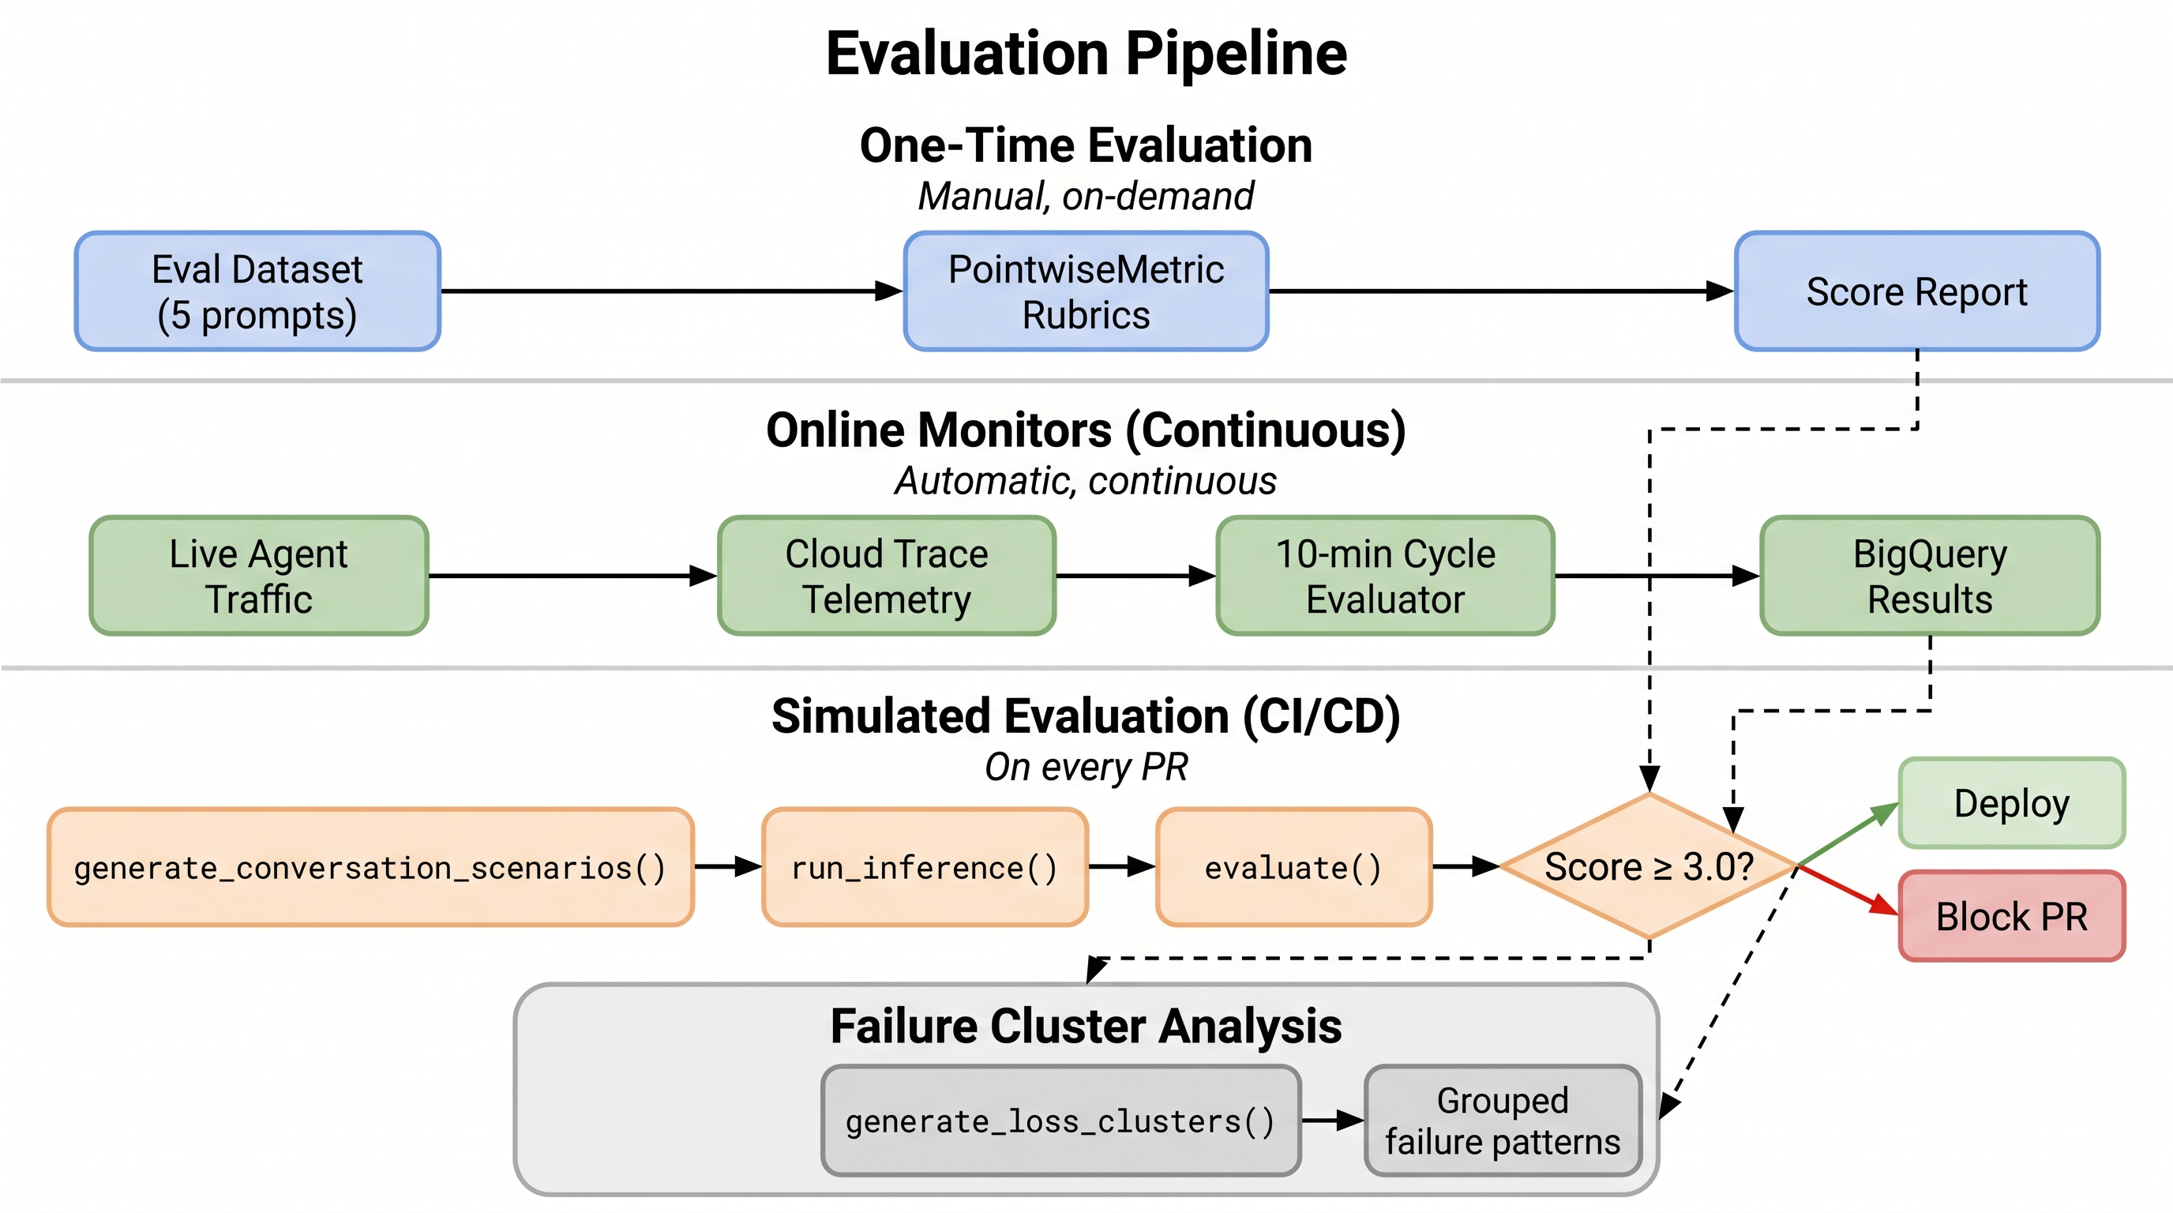
Three-Tier Evaluation Pipeline
One-Time Eval
Manual, on-demand evaluation with PointwiseMetric rubrics against a curated dataset
Online Monitors
Continuous evaluation of live traffic via Cloud Trace telemetry on 10-min cycles
Simulated (CI/CD)
Automated eval gate on PRs — score ≥ 3.0 to merge, blocks otherwise
https://github.com/jswortz/geap-tour/src/eval/
Google Cloud
Notes:
Three evaluation tiers, each serving a different purpose. One-Time Eval: manual, on-demand — you curate test cases and run PointwiseMetric rubrics. Online Monitors: continuous — evaluates live production traffic on 10-minute cycles using Cloud Trace data. Simulated (CI/CD): automated gate — blocks PRs that score below 3.0 on eval metrics. The progression is: manual validation → continuous monitoring → automated enforcement.

Slide 19
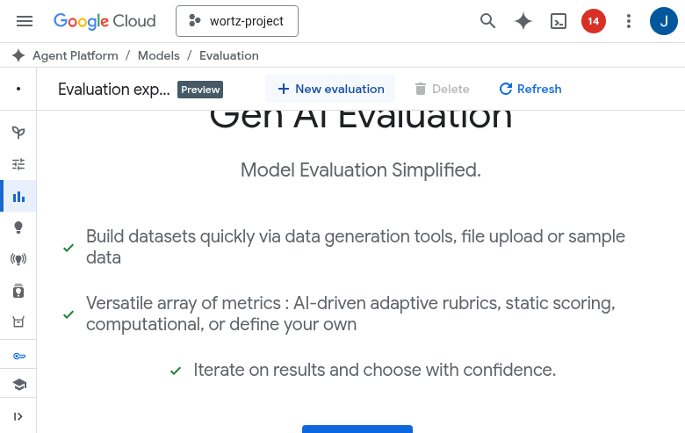
Console: Evaluation Experiments
Open in Cloud Console
Google Cloud
Notes:
CONSOLE DEMO: Show the Evaluation Experiments page. Walk through an experiment: the eval dataset, the metrics used, and the score distribution. Point out how you can compare different agent versions side-by-side.

Slide 20
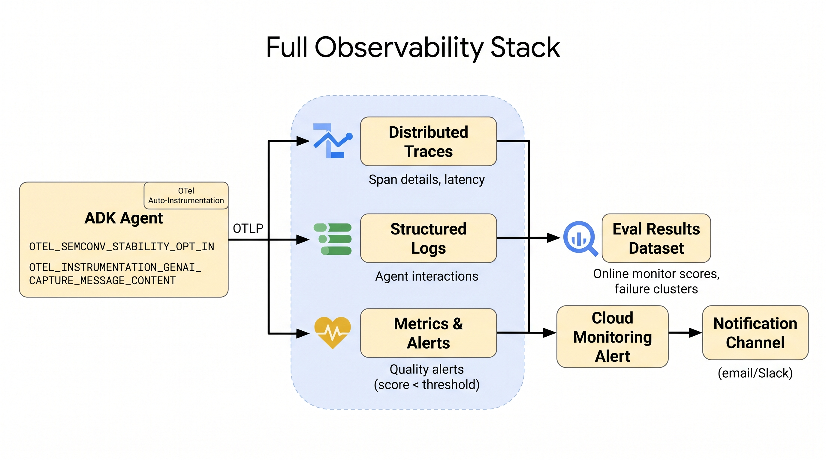
Observability Stack
End-to-End Tracing
Agent Call → OTel Spans → Cloud Trace → BigQuery
Data Pipeline
Cloud Trace captures every agent + tool call
Log sink exports structured data to BigQuery
Cloud Monitoring alerts on anomalies
Failure cluster analysis groups error patterns
Google Cloud
Notes:
The observability pipeline: agent calls produce OTel spans automatically (built into ADK), spans are exported to Cloud Trace, a log sink copies structured data to BigQuery for analytics, and Cloud Monitoring alerts on anomalies. The failure cluster analysis is particularly useful — it groups similar errors to surface systemic issues rather than forcing you to debug individual traces.

Slide 21
Failure Clusters & Quality Alerts
Automated Error Analysis
Failure Clusters
Semantic grouping of eval failures into themes: tool misuse, routing errors, policy violations. Each cluster includes sample count, avg score, and representative examples.
clusters = client.evals
.generate_loss_clusters(
src=eval_result_name
)
for cluster in clusters:
print(cluster.title)
print(cluster.description)
print(f"Samples: {cluster.sample_count}")
print(f"Avg score: {cluster.avg_score}")
Quality Alerts
Cloud Monitoring alert policies fire when eval scores drop below threshold. 10-minute aggregation window with custom metric: agent_eval/{metric_name}.
Groups similar failures by semantic similarity — surface systemic issues instead of debugging one trace at a time
https://github.com/jswortz/geap-tour/src/eval/quality_alerts.py
Google Cloud
Notes:
Failure cluster analysis is the bridge between raw eval results and actionable insights. Instead of reviewing 20+ individual failure traces, clusters group semantically similar failures: 'tool misuse cluster', 'routing confusion cluster', 'policy violation cluster'. Each cluster has a title, description, sample count, and average score. Quality alerts complement this with proactive monitoring — Cloud Monitoring alert policies fire when the custom metric agent_eval/{metric_name} drops below your threshold. The 10-minute aggregation window catches quality degradation before users notice. Code: src/eval/quality_alerts.py — loss clusters via client.evals.generate_loss_clusters()

Slide 22
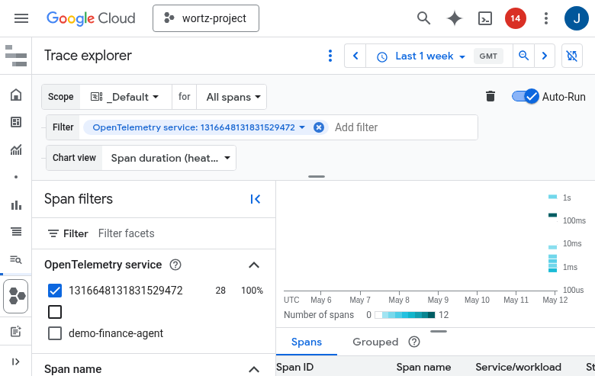
Console: Cloud Trace
Open in Cloud Console
Google Cloud
Notes:
CONSOLE DEMO: Open Cloud Trace and show a real agent trace. Walk through the span hierarchy, point out model call latency, tool call duration, and token counts. This is the single most useful debugging tool for agent systems.

Slide 23
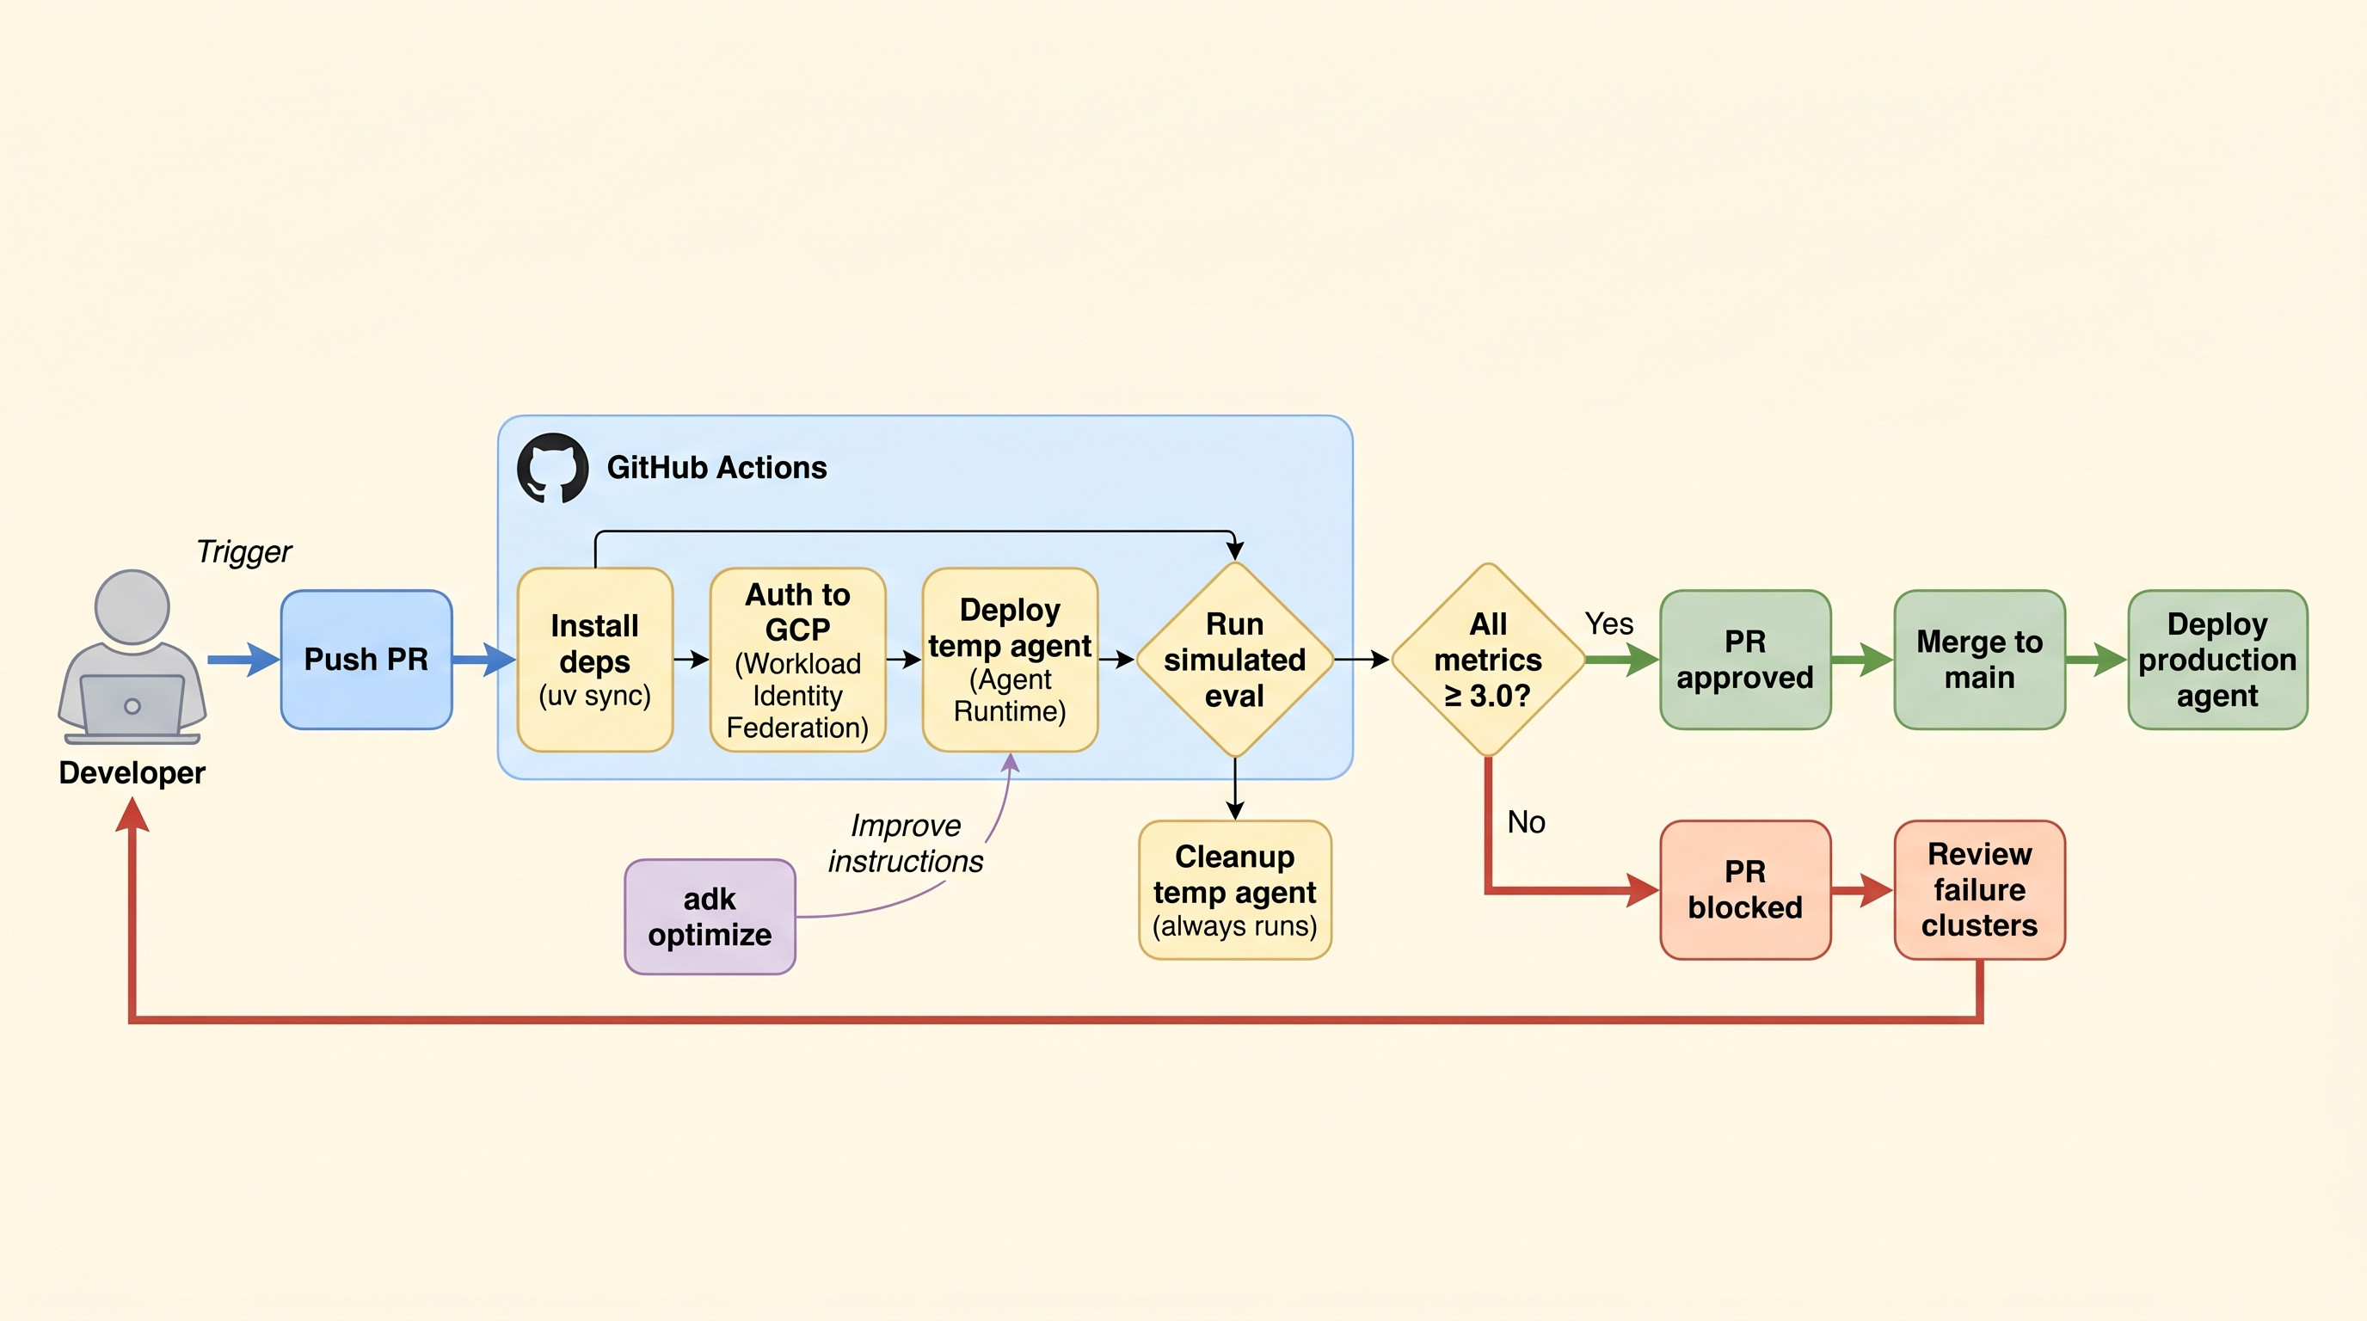
CI/CD — Simulated Eval Gate
GitHub Actions Workflow
PR Opened → Generate Scenarios → Run Inference → Evaluate → Score ≥ 3.0?
✅ Pass — Merge allowed ❌ Fail — PR blocked with failure report
Google Cloud
Notes:
The CI/CD eval gate is the automated enforcement layer. When a PR is opened, GitHub Actions generates test scenarios, runs inference against the agent, evaluates responses using PointwiseMetric rubrics, and blocks the merge if score < 3.0. This prevents regressions from shipping — the same principle as unit tests but for agent quality.

Slide 24
Agent Optimization — GEPA Algorithm
Configuration
Gemini Evolutionary Prompt Algorithm
Generate prompt variants using LLM mutation
Evaluate each variant against test scenarios
Select top performers based on eval scores
Evolve over multiple generations
optimizer = AgentOptimizer(
agent=coordinator_agent,
eval_dataset=eval_data,
metrics=[
"response_quality",
"tool_selection",
"safety"
],
generations=5,
population_size=4
)
Result: Automatically discovers better agent instructions without manual prompt engineering
https://github.com/jswortz/geap-tour/src/optimize/run_optimize.py
Google Cloud
Notes:
GEPA — Gemini Evolutionary Prompt Algorithm — automates prompt engineering. Instead of manually tuning agent instructions, GEPA generates prompt variants, evaluates each against test scenarios, selects top performers, and evolves over generations. Think of it as genetic algorithms applied to prompt optimization. The AgentOptimizer class wraps this: you provide the agent, eval data, and metrics — it finds better instructions.

Slide 25
Multi-Model Router
Complexity-Based Routing Table
before_agent_callback
Complexity | Model | Score Range | Use Case
Low | Flash Lite | < 0.35 | Simple lookups
Medium | Gemini Flash | 0.35 – 0.64 | Multi-step queries
High | Claude Opus | ≥ 0.65 | Deep analysis
async def complexity_router_callback(
callback_context=None, **kwargs
):
user_message = ""
if callback_context.user_content:
for part in callback_context.user_content.parts:
if part.text:
user_message += part.text
result = await classify_complexity(user_message)
ctx = callback_context.state
ctx["complexity_level"] = result.level
ctx["complexity_score"] = result.score
return None
Cost savings: 60-80% by routing simple queries to lightweight models
https://github.com/jswortz/geap-tour/src/router/agents.py
Google Cloud
Notes:
The multi-model router uses a before_agent_callback to classify prompt complexity before the agent runs. classify_complexity() uses a lightweight Gemini call to score 0-1. Based on the score, the router delegates to lite_agent (Flash Lite), flash_agent (Flash), or opus_agent (Claude Opus via LiteLLM). This cuts costs 60-80% by sending simple queries to cheap models while reserving expensive models for complex reasoning. The callback stores the classification in session state so the router agent's instruction can read it.

Slide 26
Memory Bank & User Namespaces
coordinator_agent = LlmAgent(
model=AGENT_MODEL,
name="coordinator_agent",
tools=[
get_mcp_tools(SEARCH_MCP_SERVER),
# Retrieves relevant memories at
# turn start, injects into system
# instruction
PreloadMemoryTool(),
],
after_agent_callback=
save_memories_callback,
)
async def save_memories_callback(ctx):
await ctx.add_events_to_memory(
events=ctx.session.events,
custom_metadata={"wait_for_completion": True}
)
return None
Memory Recall
PreloadMemoryTool retrieves relevant memories at turn start and injects them into the system instruction — the agent has user context before it responds
User Namespaces
Memories are scoped to {user_id, app_name} — each user gets an isolated memory space with no cross-contamination
https://github.com/jswortz/geap-tour/src/agents/coordinator_agent.py
Google Cloud
Notes:
Memory Bank gives agents persistent memory across sessions. Two key pieces: PreloadMemoryTool automatically retrieves relevant past interactions at turn start and injects them into the system instruction — the agent sees user context before responding. save_memories_callback runs after each turn via after_agent_callback, persisting new session events to Memory Bank for future recall. Critical: memories are scoped to {user_id, app_name} namespaces. Each user gets isolated memory — no cross-contamination between users or apps.

Slide 27
Session 3
Agent Registry
Agent registration, discovery, and governance
https://github.com/jswortz/geap-tour
Google Cloud
Notes:
Quick session on Agent Registry — the catalog for your agent fleet. If you have dozens of agents across teams, you need a way to discover, version, and govern them.

Slide 28
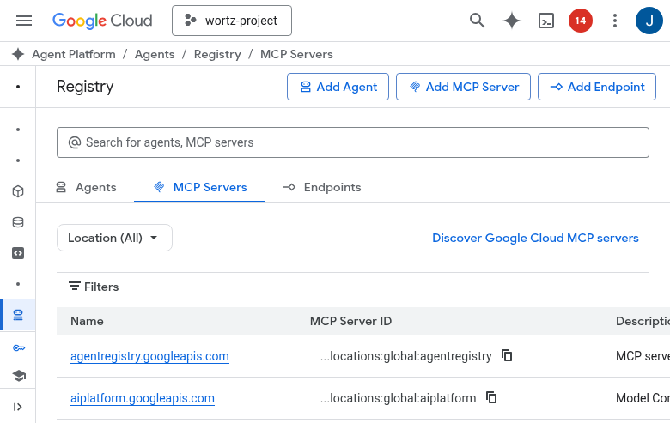
Agent Registry & Discovery
Registry Capabilities
Register agents with metadata, toolspecs, and versioning
Discover available agents and their capabilities
Associate MCP tool specifications with agents
Govern agent lifecycle and access control
Toolspec Association
gcloud agent-platform agent-registry \
toolspecs associate \
--agent=geap-coordinator \
--toolspec=search-mcp-spec.yaml
Google Cloud
Notes:
Agent Registry provides four capabilities: registration (with metadata and versioning), discovery (search by capability), toolspec association (link MCP specs to agents), and lifecycle governance (access control on who can deploy or modify agents). The gcloud command shows how to associate an MCP toolspec with a registered agent. DEMO: Show the registry console and the MCP toolspec association.

Slide 29
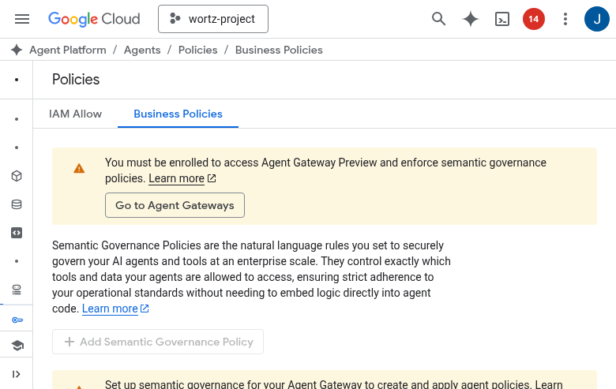
Console: Business Policies
Open in Cloud Console
Google Cloud
Notes:
CONSOLE DEMO: Show the business policies page. Walk through an example policy — how it's defined, what it enforces, and how violations are handled.

Slide 30
Session 4
Model Security / Model Armor
Input/output screening, guardrails, and content safety
https://github.com/jswortz/geap-tour
Google Cloud
Notes:
Final session — the security layer. Model Armor provides content safety for your agent system. This is critical for production: agents that talk to users need protection against prompt injection, jailbreaks, PII leakage, and harmful content generation.

Slide 31
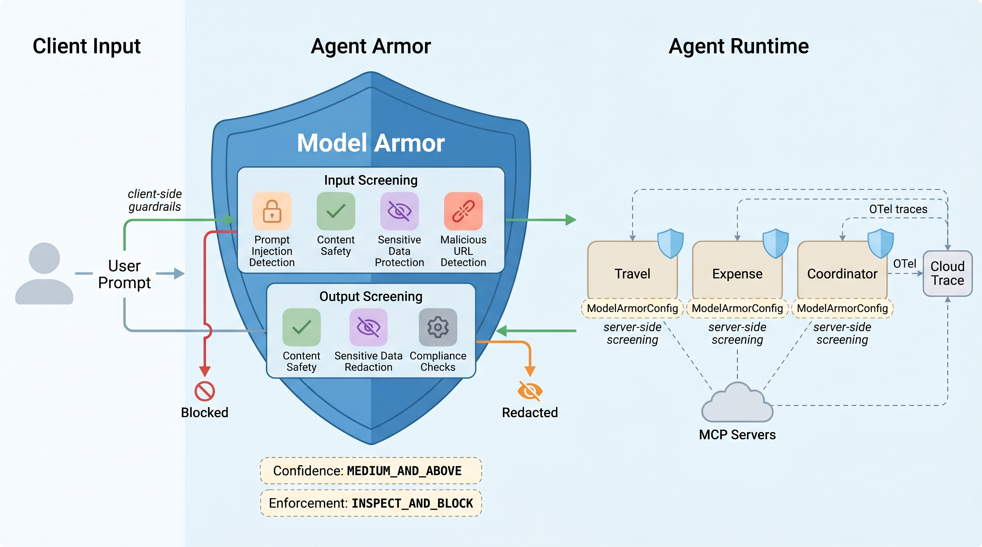
Model Armor — Content Safety Integration
Input Screening
Prompt injection detection, jailbreak prevention, PII filtering before model call
Output Screening
Harmful content filtering, hallucination flags, safety score thresholds
ADK Guardrail Callbacks
before_model_callback and after_model_callback hooks integrated into agent lifecycle
Google Cloud
Notes:
Model Armor works at two points: input screening (before the model call) and output screening (after). Input: catches prompt injection, jailbreak attempts, PII in prompts. Output: filters harmful content, flags hallucinations, enforces safety scores. In ADK, this integrates via before_model_callback and after_model_callback — the guardrails run as part of the agent lifecycle, not as a separate service.

Slide 32
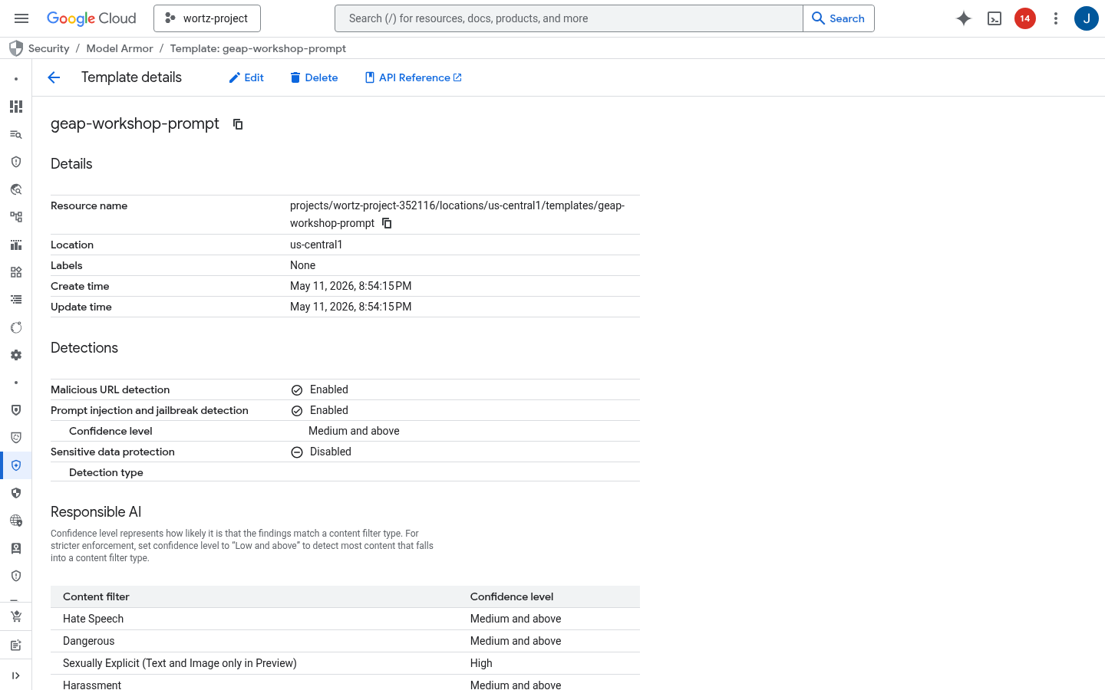
Console: Model Armor
Open in Cloud Console
Google Cloud
Notes:
CONSOLE DEMO: Show the Model Armor configuration page. Walk through a template: the screening rules, the severity thresholds, and what happens when content is flagged (block vs. warn vs. log).

Slide 33
Platform Summary
Build
• ADK agents with LlmAgent
• FastMCP tool servers
• Memory Bank + Router
Deploy
• Cloud Run (MCP servers)
• Agent Runtime (agents)
• One-command deployment
Govern
• SPIFFE identity
• Agent Gateway (dual)
• Agent Registry
Secure
• Model Armor templates
• Input/output screening
• Guardrail callbacks
Evaluate
• One-time eval
• Failure clusters
• CI/CD eval gate
Optimize
• GEPA algorithm
• Multi-model routing
• OTel observability
Google Cloud
Notes:
Recap the six pillars: Build (ADK + MCP), Deploy (Cloud Run + Agent Runtime), Govern (SPIFFE + Gateway + Registry), Secure (Model Armor), Evaluate (three-tier pipeline), Optimize (GEPA). Each pillar connects to the others — this is an integrated platform, not a collection of standalone tools.

Slide 34
Hands-On: Two SDK-First Notebooks
Learn the platform by running L1-SDK code — build first, then measure quality
① Build → Deploy → Register
src/deploy/demo/platform_sdk_demo.ipynb — MCP tools → ADK agents → run → deploy to Agent Engine → register to Gemini Enterprise → multi-model routing & cost. Mutating steps are guarded (GEAP_RUN_DEPLOY / GEAP_PUBLISH).
② Evaluate — the Quality Flywheel
src/eval/demo/evaluation_sdk_demo.ipynb — every phase calls client.evals.* / vertexai.types.* inline: metrics, rapid/regression/simulated/offline scoring, online monitors, optimization, and quality alerts.
Both are flat, SDK-first, and validated end-to-end via nbconvert; custom/infra code is marked 🔧.
https://github.com/jswortz/geap-tour/src/
Google Cloud
Notes:
Point attendees at the two notebooks. The build notebook takes them from tools to a registered Gemini Enterprise agent; the eval notebook is the Quality Flywheel. Both are SDK-first so learners see exactly which client.* / ADK calls do the work — no hidden framework.

Slide 35
Resources
Get Started
Workshop repo: https://github.com/jswortz/geap-tour
Workshop guide: docs/workshop_guide.md
Build notebook: src/deploy/demo/platform_sdk_demo.ipynb
Eval notebook: src/eval/demo/evaluation_sdk_demo.ipynb
Agent Development Kit: google.github.io/adk-docs
MCP Protocol: modelcontextprotocol.io
Agent Platform: cloud.google.com/agent-platform
Thank you!
Google Cloud
Notes:
Share these resources with attendees. The workshop repo has all the code they ran today. The workshop guide has step-by-step instructions they can follow at their own pace. ADK docs and MCP protocol specs are the canonical references for building new agents. Thank everyone for their time and open the floor for Q&A.

