Slide 1
Step 1 Train the model locally – here’s the code:
library("e1071")
data <- iris
# Split the data
set.seed(123)
sample <- sample.int(n = nrow(data), size = floor(.75*nrow(data)), replace = F)
train <- data[sample, ]
test <- data[-sample, ]
# OK now we save the data for later use
write.table(train, file="irisAzure/trainingdata.csv", sep=',', row.names = FALSE)
write.table(test, file="irisAzure/testingdata.csv", sep=',', row.names = FALSE)
# Create model
svm_model <- svm(Species ~ ., data=iris)
summary(svm_model)
# serialize the model object -
# reference http://www.fromthebottomoftheheap.net/2012/04/01/saving-and-loading-r-objects/
saveRDS(svm_model, "irisAzure/svm_model")
# Done, now to make the scoring code

Slide 2
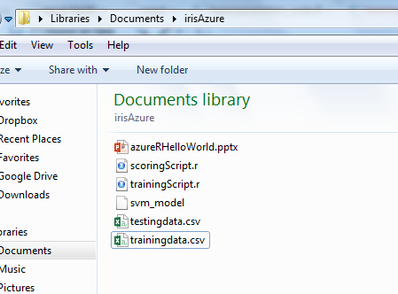
Note we stored the data locally and serialized the R objects

Slide 3
Next, locally create the scoring code to make sure it works ok – we have to still put in the RODBC hooks
library(e1071)
# load up the training data
# TODO: THis will be repalced with SQL Server data
test <- read.table("irisAzure/testingdata.csv", header=TRUE, sep = ',')
# load the serialized model
svm_model <- readRDS("irisAzure/svm_model")
predictions <- predict(svm_model,test)
predData <- cbind(test,predictions)
# TODO: write to sql server using RODBC
# Future use R services in SQL Serve

Slide 4
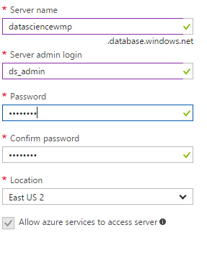
Provision SQL Server in Azure – Note server name and connection string from overview page after creation
ds_admin – admin uid
Welcome1 – password
Note – created a data_science resource group for future use if needed

Slide 5
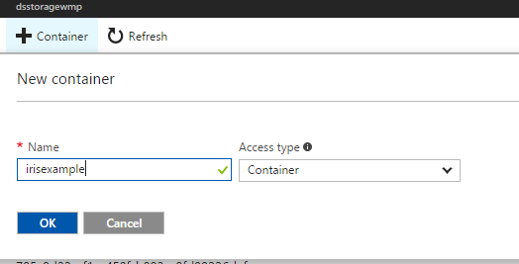
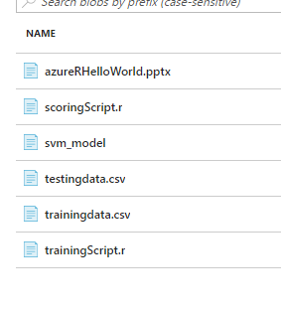
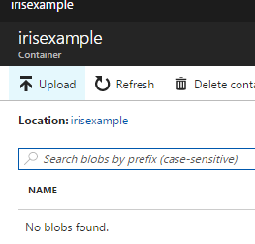
Create blob storage on azure - in same data_science resource group, upload files
Access Key: 7VoyLu/zFEQQfxBMCSQ7Pts9rSm1obr6CHvlA5Wdx9Zh5zqjH/sl1VyCsQlS5AtGO3cL/tjpSza7OHl4wA9P9Q==
Note file urls for later use

Slide 6
Create table from training – insert records into SQL Server
https://dsstoragewmp.blob.core.windows.net/irisexample/testingdata.csv
CREATE TABLE input_records
(
Sepal_Length Float,
Sepal_Width Float,
Petal_Length Float,
Petal_Width Float,
Species Varchar(20)
);

Slide 7
Credential to create access to blob storage
CREATE MASTER KEY ENCRYPTION BY PASSWORD = 'Welcome1';
CREATE DATABASE SCOPED CREDENTIAL MyAzureBlobStorageCredential
WITH IDENTITY = 'SHARED ACCESS SIGNATURE',
SECRET = '7VoyLu/zFEQQfxBMCSQ7Pts9rSm1obr6CHvlA5Wdx9Zh5zqjH/sl1VyCsQlS5AtGO3cL/tjpSza7OHl4wA9P9Q=='

Slide 8
Insert Records (we had to get rid of the header record for it to work)
CREATE EXTERNAL DATA SOURCE input_data2
WITH ( TYPE = BLOB_STORAGE,
LOCATION = 'https://dsstoragewmp.blob.core.windows.net',
CREDENTIAL= MyAzureBlobStorageCredential);
bulk insert input_records
FROM 'irisexample/testingdata.csv'
WITH (DATA_SOURCE = 'input_data2',
FORMAT = 'CSV');

Slide 9
Last, create the destination table for scored records
https://dsstoragewmp.blob.core.windows.net/irisexample/testingdata.csv
CREATE TABLE output_records
(
Sepal_Length Float,
Sepal_Width Float,
Petal_Length Float,
Petal_Width Float,
Prediction Varchar(20)
);

Slide 10
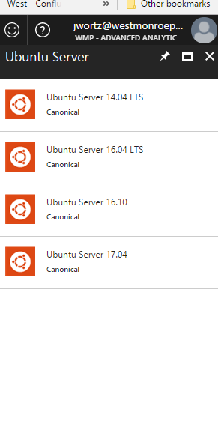
Create new VM to host R, run scripts (Ubuntu in this example)

Slide 11
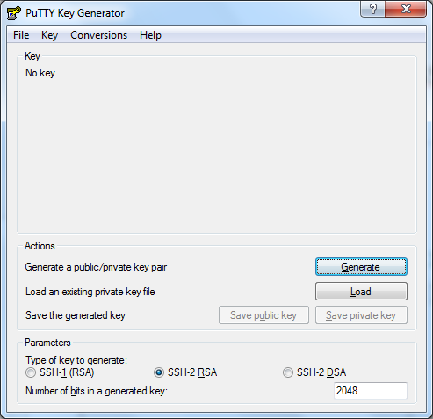
Use puttygen to create ssh key when creating instance – use this key in putty to connect
dsuser is the uid

Slide 12
Install sql server drivers:
sudo su
curl https://packages.microsoft.com/keys/microsoft.asc | apt-key add -
curl https://packages.microsoft.com/config/ubuntu/16.10/prod.list > /etc/apt/sources.list.d/mssql-release.list
exit
sudo apt-get update
sudo ACCEPT_EULA=Y apt-get install msodbcsql
# optional: for bcp and sqlcmd
sudo ACCEPT_EULA=Y apt-get install mssql-tools
echo 'export PATH="$PATH:/opt/mssql-tools/bin"' >> ~/.bash_profile
echo 'export PATH="$PATH:/opt/mssql-tools/bin"' >> ~/.bashrc
source ~/.bashrc
# optional: for unixODBC development headers
sudo apt-get install unixodbc-dev
https://docs.microsoft.com/en-us/sql/connect/odbc/linux-mac/installing-the-microsoft-odbc-driver-for-sql-server

Slide 13
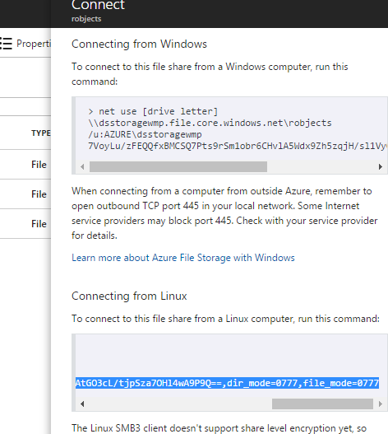
Mount the Azure storage (from file system)
sudo mount -t cifs //dsstoragewmp.file.core.windows.net/robjects /rStuff -o vers=3.0,username=dsstoragewmp,password=7VoyLu/zFEQQfxBMCSQ7Pts9rSm1obr6CHvlA5Wdx9Zh5zqjH/sl1VyCsQlS5AtGO3cL/tjpSza7OHl4wA9P9Q==,dir_mode=0777,file_mode=0777

Slide 14
In R… Connect to sql server on azure, get data – the connection string is from Sql server
dbhandle <- odbcDriverConnect('Driver={ODBC Driver 13 for SQL Server};Server=tcp:datasciencewmp.database.windows.net,1433;Database=irisHelloWorld;Uid=ds_admin@datasciencewmp;Pwd=Welcome1;Encrypt=yes;TrustServerCertificate=no;Connection Timeout=30;')
res <- sqlQuery(dbhandle, 'select * from input_records')

Slide 15
Score job… the R code
library(e1071)
library(RODBC)
dbhandle <- odbcDriverConnect('Driver={ODBC Driver 13 for SQL Server};Server=tcp:datasciencewmp.database.windows.net,1433;Database=irisHelloWorld;Uid=ds_admin@datasciencewmp;Pwd=Welcome1;Encrypt=yes;TrustServerCertificate=no;Connection Timeout=30;')
res <- sqlQuery(dbhandle, 'select * from input_records')
svmModel <- readRDS('/rStuff/svm_model')
colnames(res) <- c("Sepal.Length", "Sepal.Width", "Petal.Length", "Petal.Width", "Species")
res <- subset(res, select = -c(Species))
Prediction <- predict(svmModel, res)
final <- cbind(res,Prediction)
colnames(final) <- c("Sepal_Length", "Sepal_Width", "Petal_Length", "Petal_Width", "Prediction")
sqlSave(dbhandle, final, tablename ="output_records",rownames=FALSE, append = TRUE)
odbcClose(dbhandle)

Slide 16
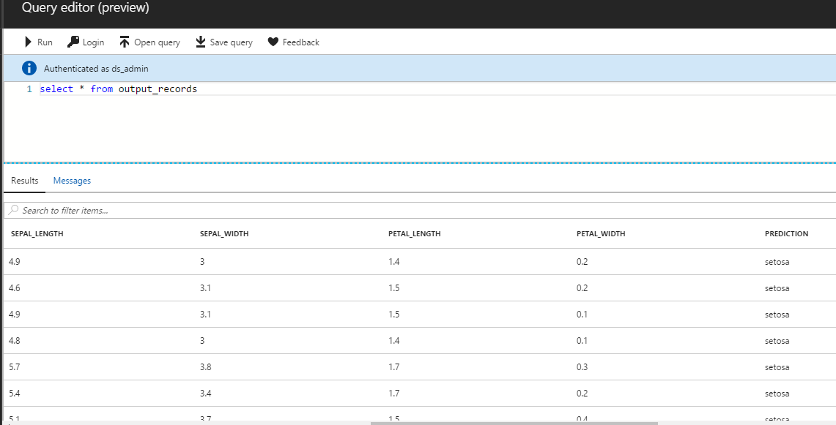
Final result

Slide 17
Next steps – automation
#!/bin/bash
sudo mount -t cifs //dsstoragewmp.file.core.windows.net/robjects /rStuff -o vers=3.0,username=dsstoragewmp,password=7VoyLu/zFEQQfxBMCSQ7Pts9rSm1obr6CHvlA5Wdx9Zh5zqjH/sl1VyCsQlS5AtGO3cL/tjpSza7OHl4wA9P9Q==,dir_mode=0777,file_mode=0777
R < irisHelloWorld.r --no-save
Run this to run the script every time…

