Slide 1

NYC HOUSe sale price prediction
Shangxing jiang
Wenxi zheng
Xiaoning zhou

Slide 2
INTRODUCTION
House price changes are caused by various economic factors, by predicting the price we can understand
Real estate industry development trend,
the development of the market economy
The prediction of house price can use on the financial market

Slide 3
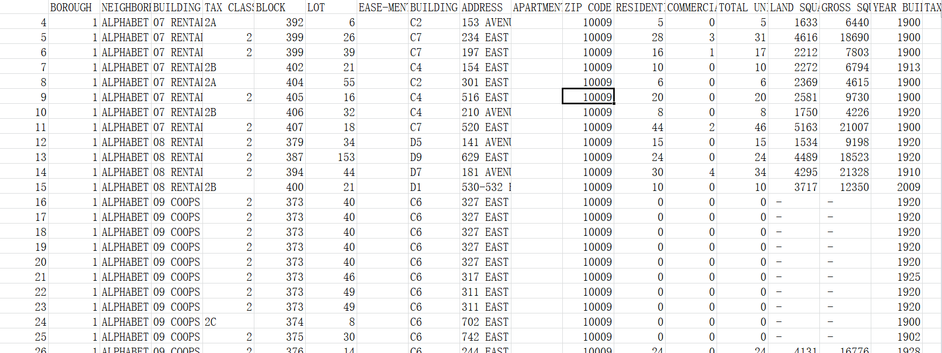
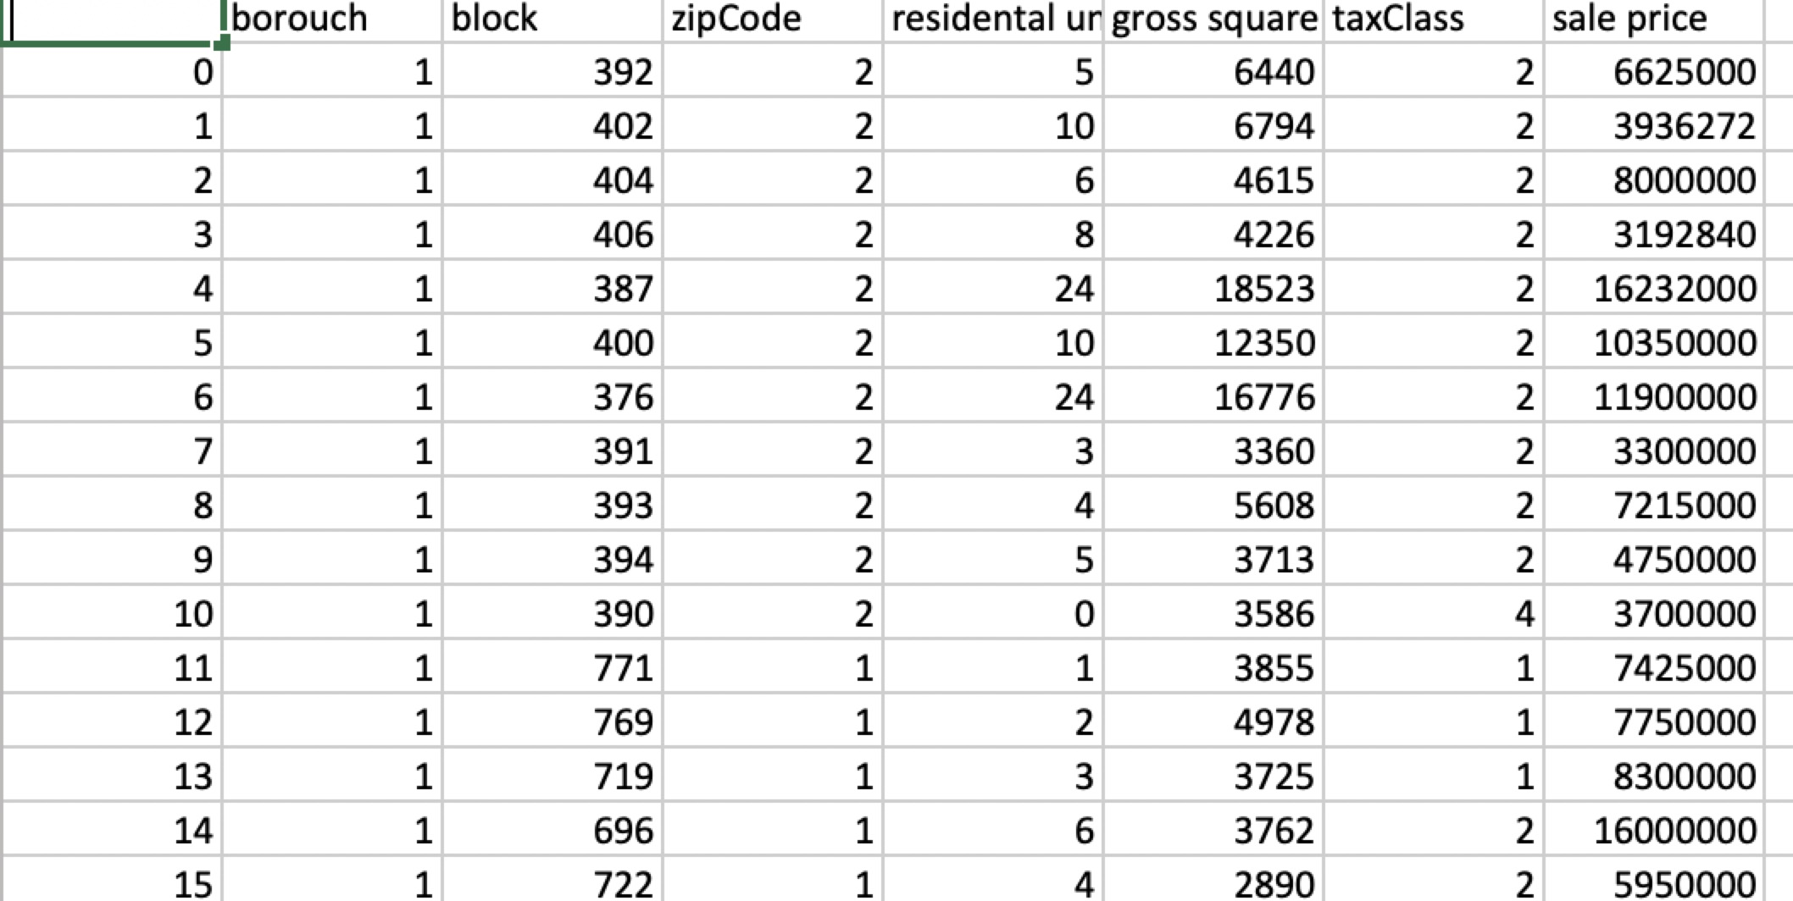
Raw data
Final data

Slide 4
Source of Dataset
Real estate database:
Raw data contains a lot of irrelevant information.
First, manually filtered some data based on common sense.
Second, use python to handle outliers.

Slide 5
The method of selecting and processing the data:
For selecting data by common sense:
We draw a tree map based on the data we collected form the Internet in order to find the main factors and the branch factors that affect the result.
Since we are considering the general impact on real estate, we decided to eliminate nearly all the branch factors that are useless or too complex to handle such as the number of the residence. And we also deleted some data that are too relevant to each other that they have the very similar impact on the result such as the zip code and the address.
Also, we divided New York into 7 zones regardless of it own division.

Slide 6
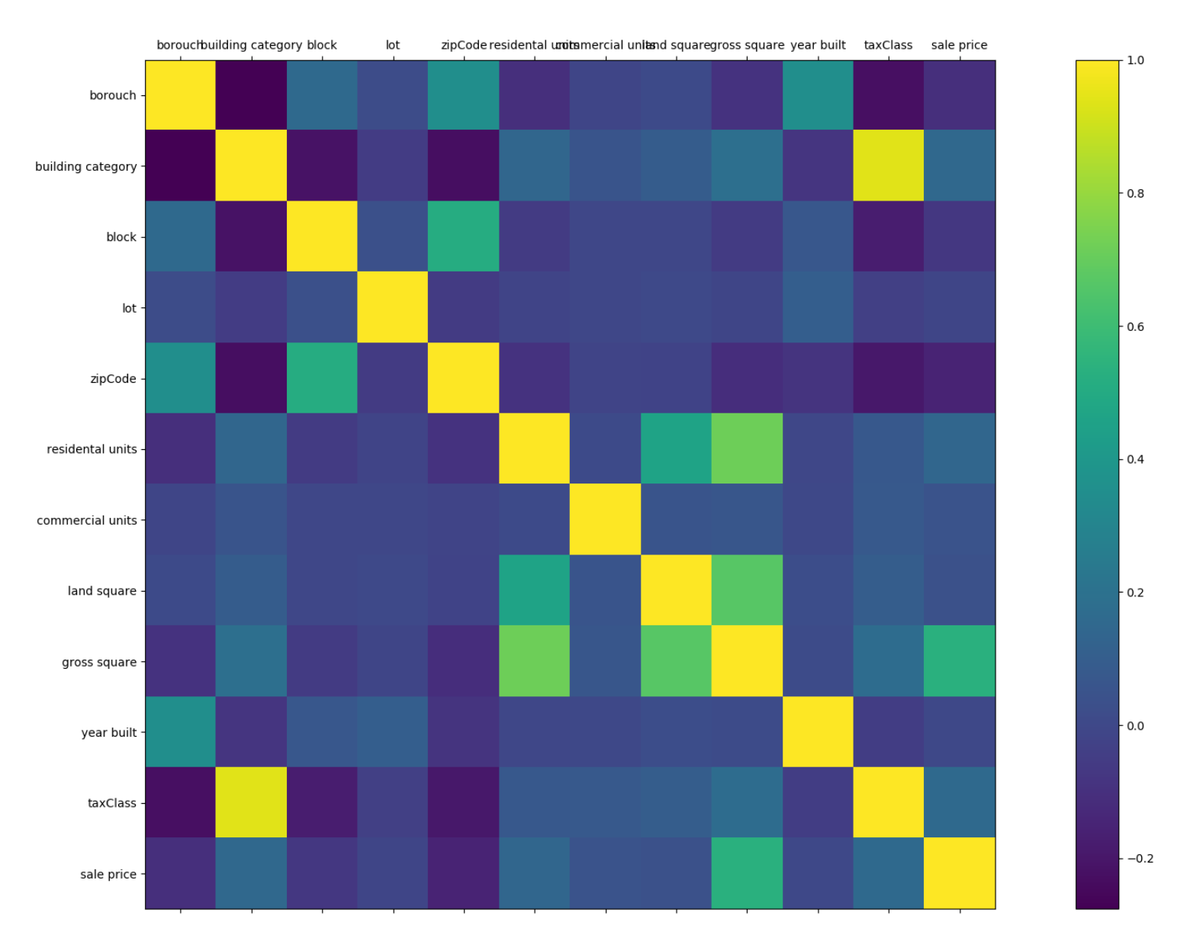
For the part of processing data with python:
We put the data into python and use its specific function to handle the data. We build dictionaries and lists to prepare for the data processing, and we use this optimized data to do the advanced analysis such as the correlation.
We eliminate some data that have very Low correlation as it is not relevant to the result and may add errors to the result.
And also we deleted some data that are too relevant since the factors should be independent with each other or it may cause coherent problems.

Slide 7
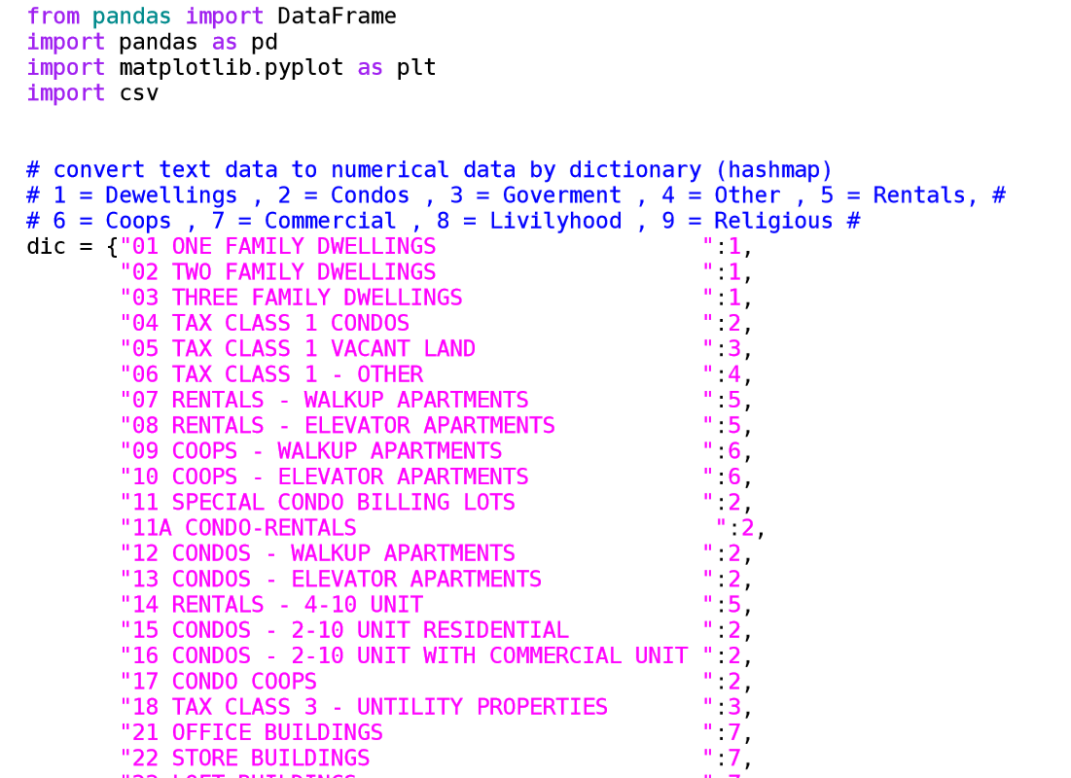
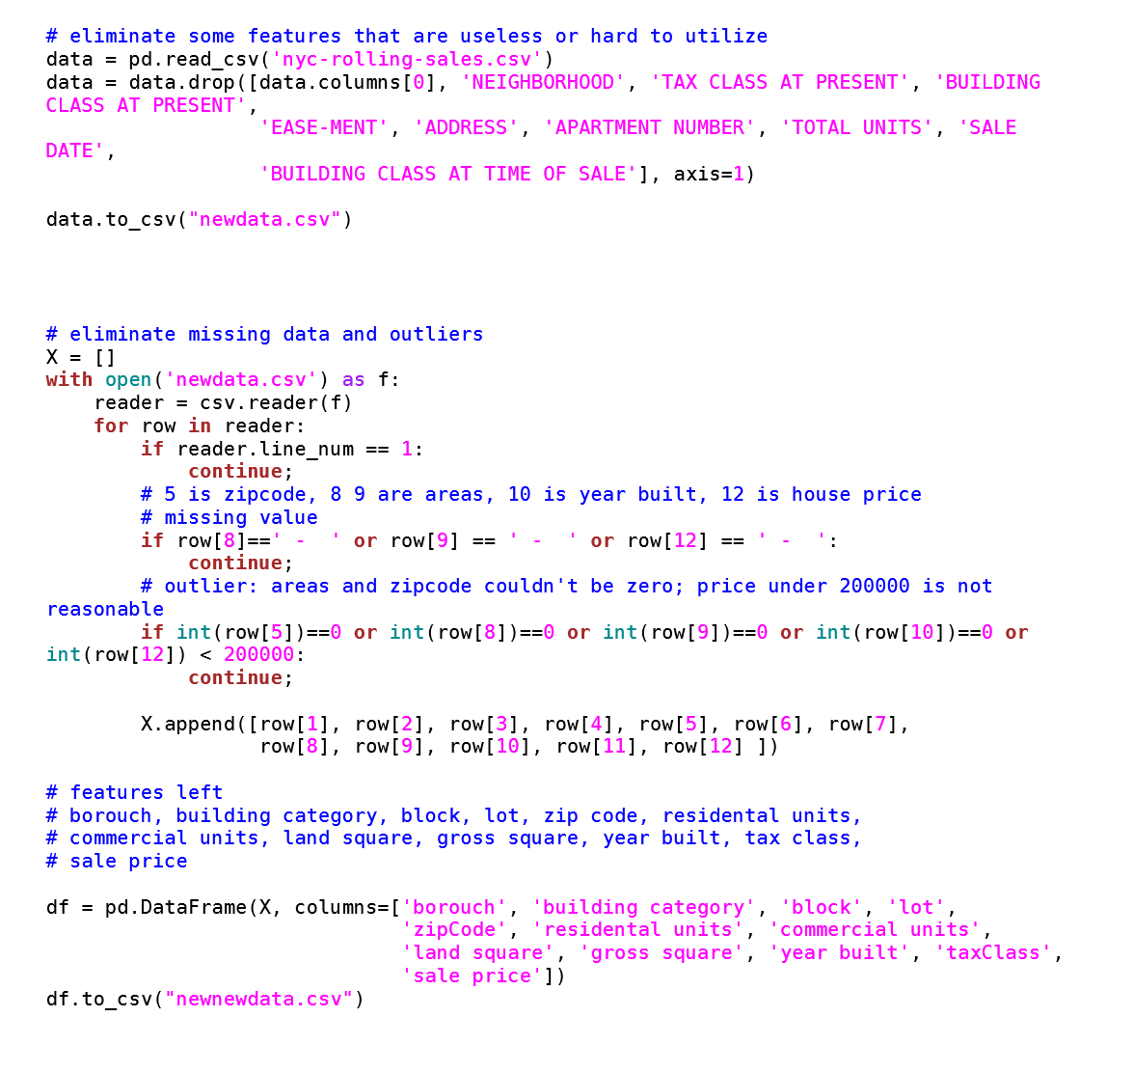
Processing the data with python

Slide 8
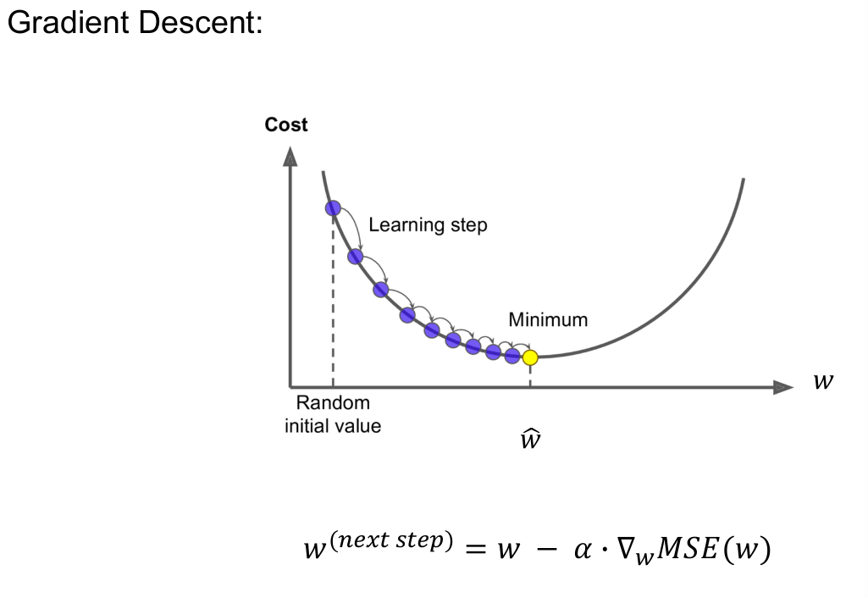
Linear Regression

Slide 9
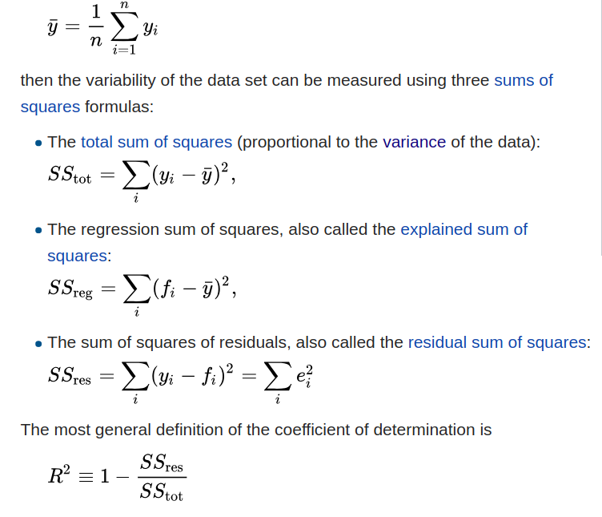
R^2 variance

Slide 10
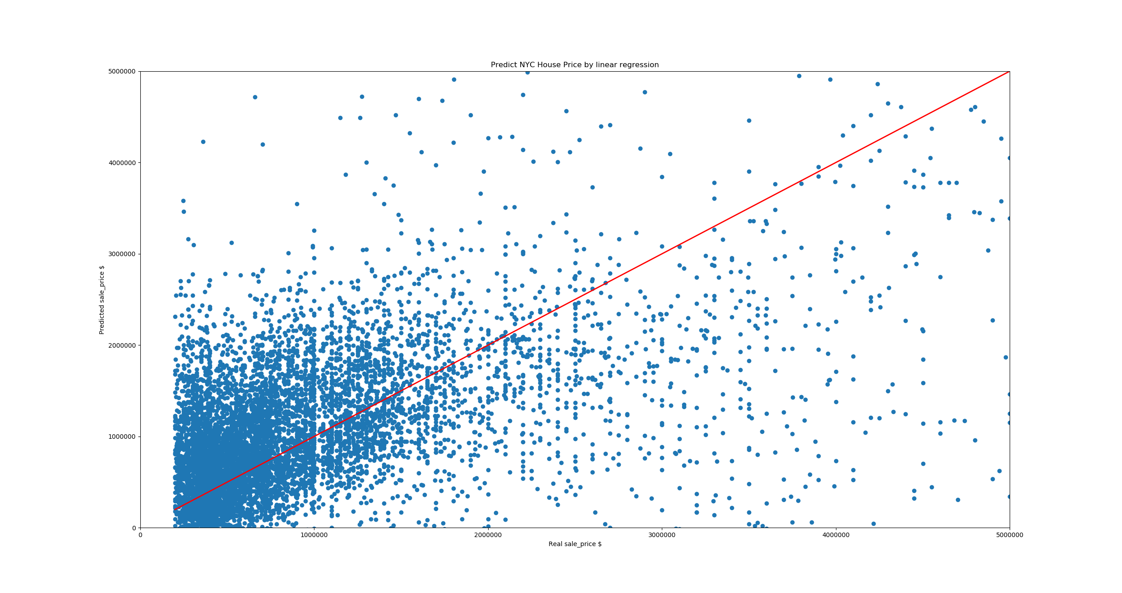
Linear Regression
Score : 0.6714874629993289

Slide 11
Random Forest Regression
Ensemble learning: average the outputs of many decision trees.
For every decision tree, classify every attribute into several categories. Then for the same category, average the target value as output

Slide 12
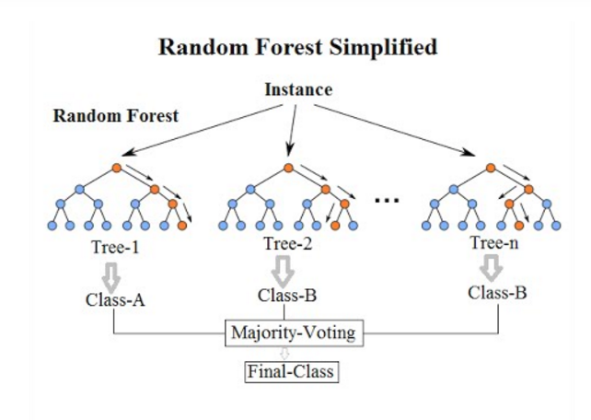
Random Forest Regression

Slide 13
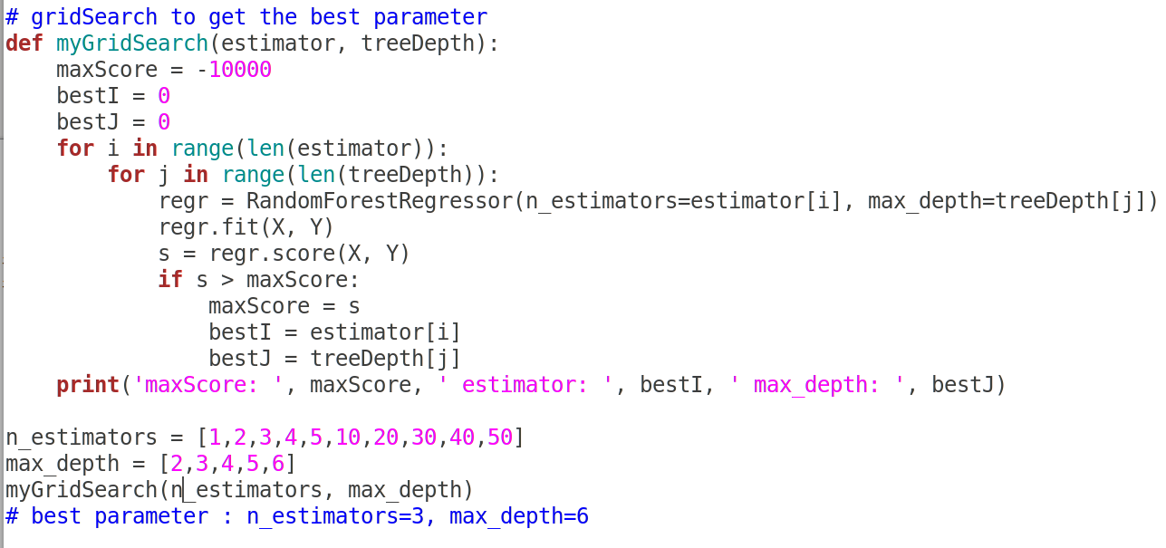
Random Forest Regression

Slide 14
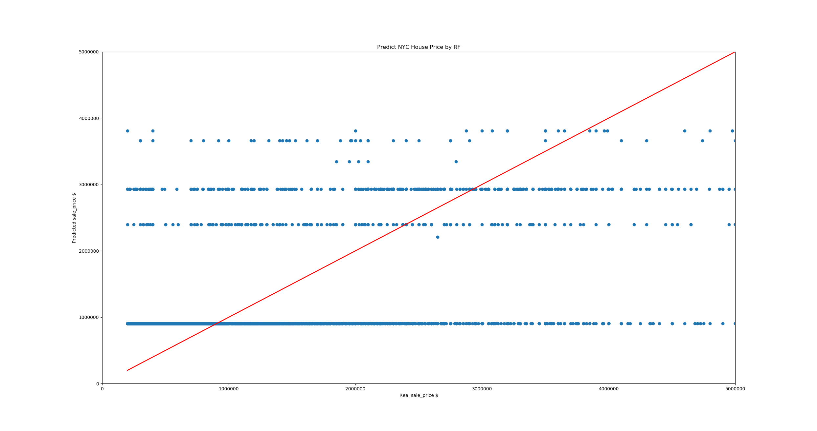
Random Forest Regression
Score: 0.868

Slide 15
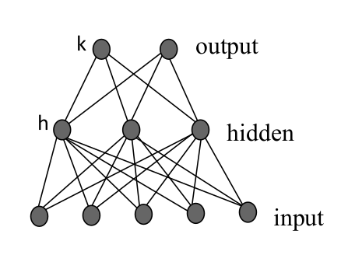
Multi-layer Perceptron

Slide 16
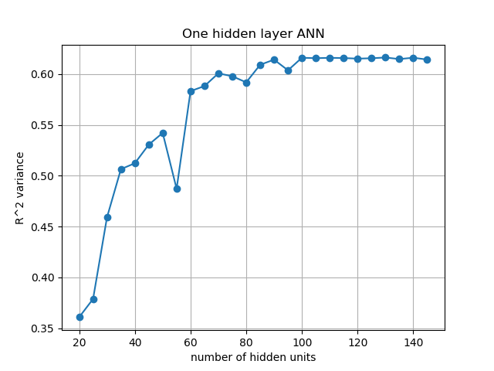
Multi-layer Perceptron

Slide 17
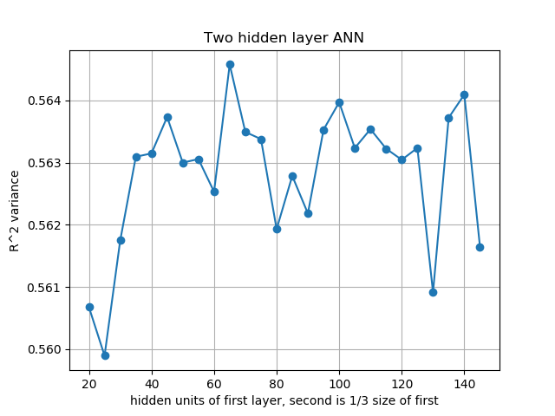
Multi-layer Perceptron

Slide 18
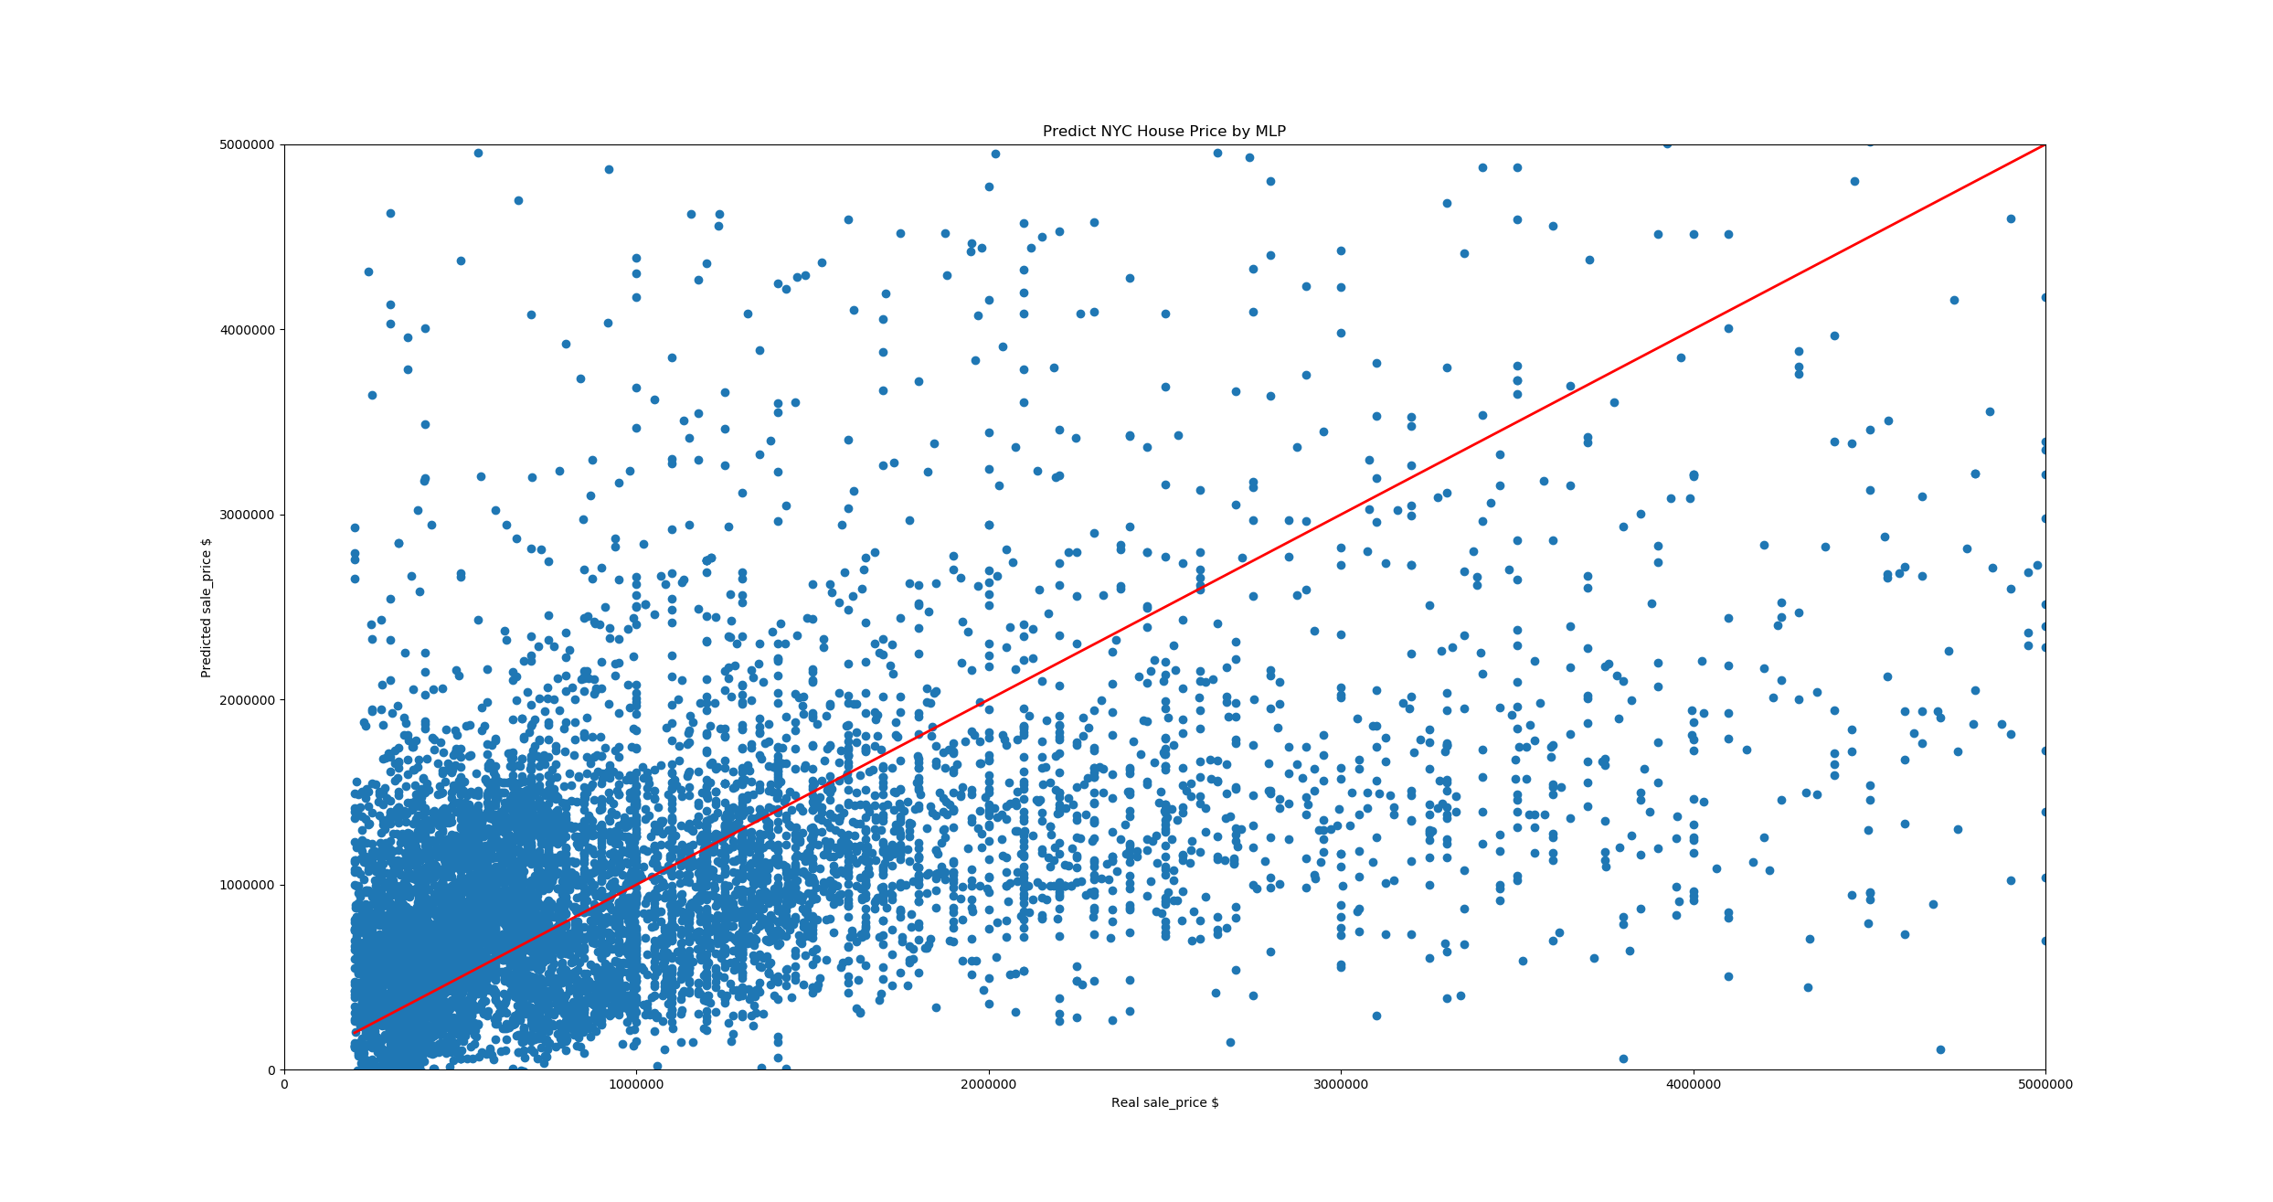
Multi-layer Perceptron
score: 0.625

Slide 19
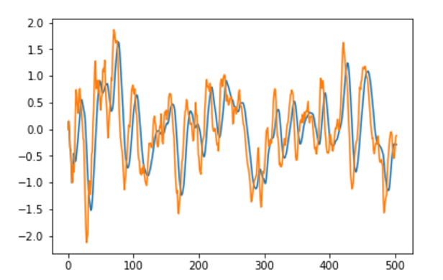
Part2 ETF

Slide 20
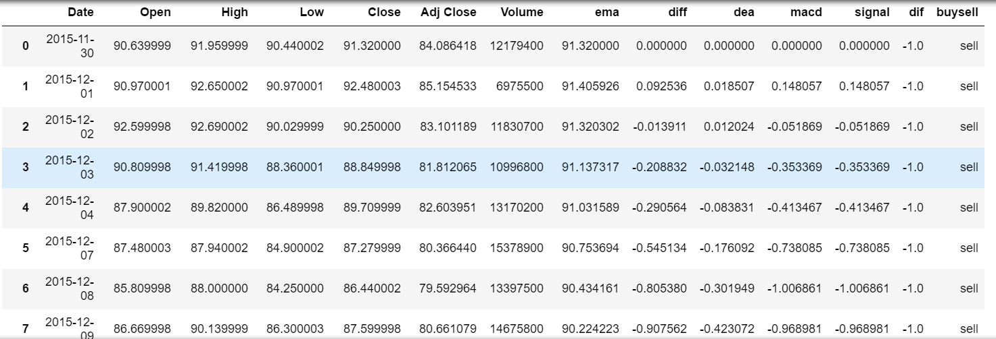

Slide 21

Thank you

