Slide 1
Forecast the house price
Shangxing jiang
Wenxi zheng
Xiaoning zhou

Slide 2
INTRODUCTION
House price changes are caused by various economic factors, by predicting the price we can understand
Real estate industry development trend,
the development of the market economy
The prediction of house price can use on the financial market

Slide 3
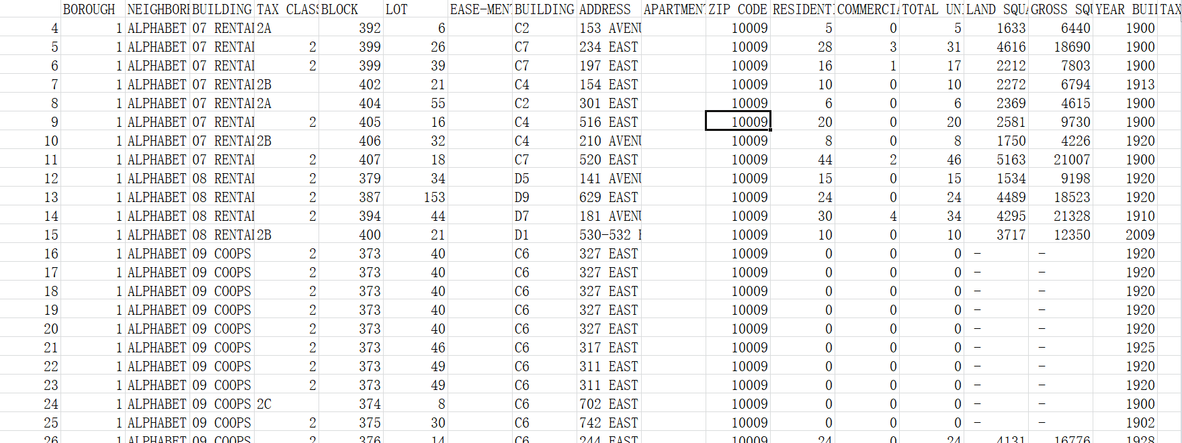
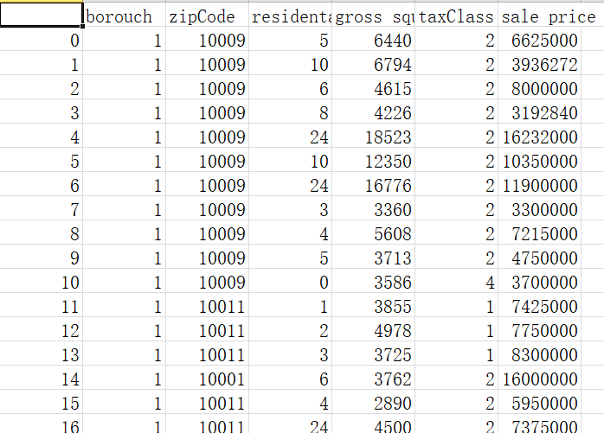
Raw data
Final data

Slide 4
Source of Dataset
Real estate database:
Raw data contains a lot of irrelevant information.
First, manually filtered some data based on common sense.
Second, use python to handle outliers.

Slide 5
Extraction of Dataset
Extract 10000 samples randomly from MNIST digit database as training data, where the number of every digit (0~9) is 1000.
Extract 2000 samples as testing as well as above.
Split the testing dataset to ten files (0~9), which is used to test the accuracy of a certain digit.

Slide 6
用哪些方法筛选数据

Slide 8
算法（三个）

Slide 9
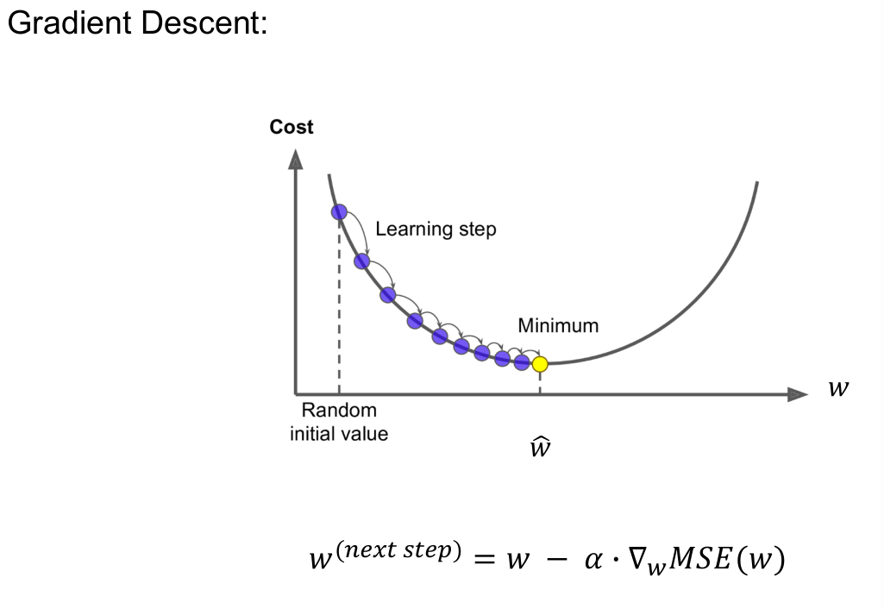
Linear Regression

Slide 10
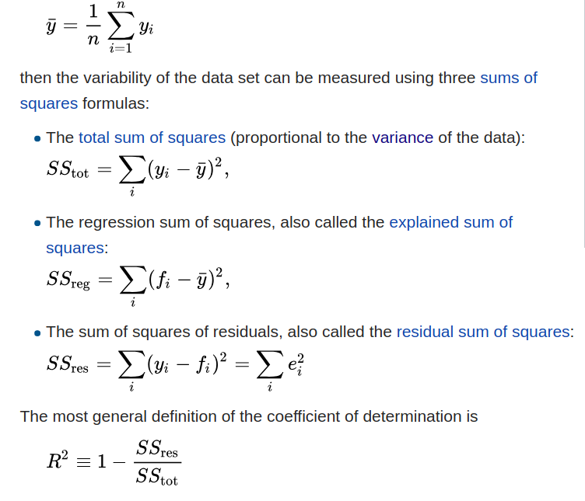
R^2 variance

Slide 11
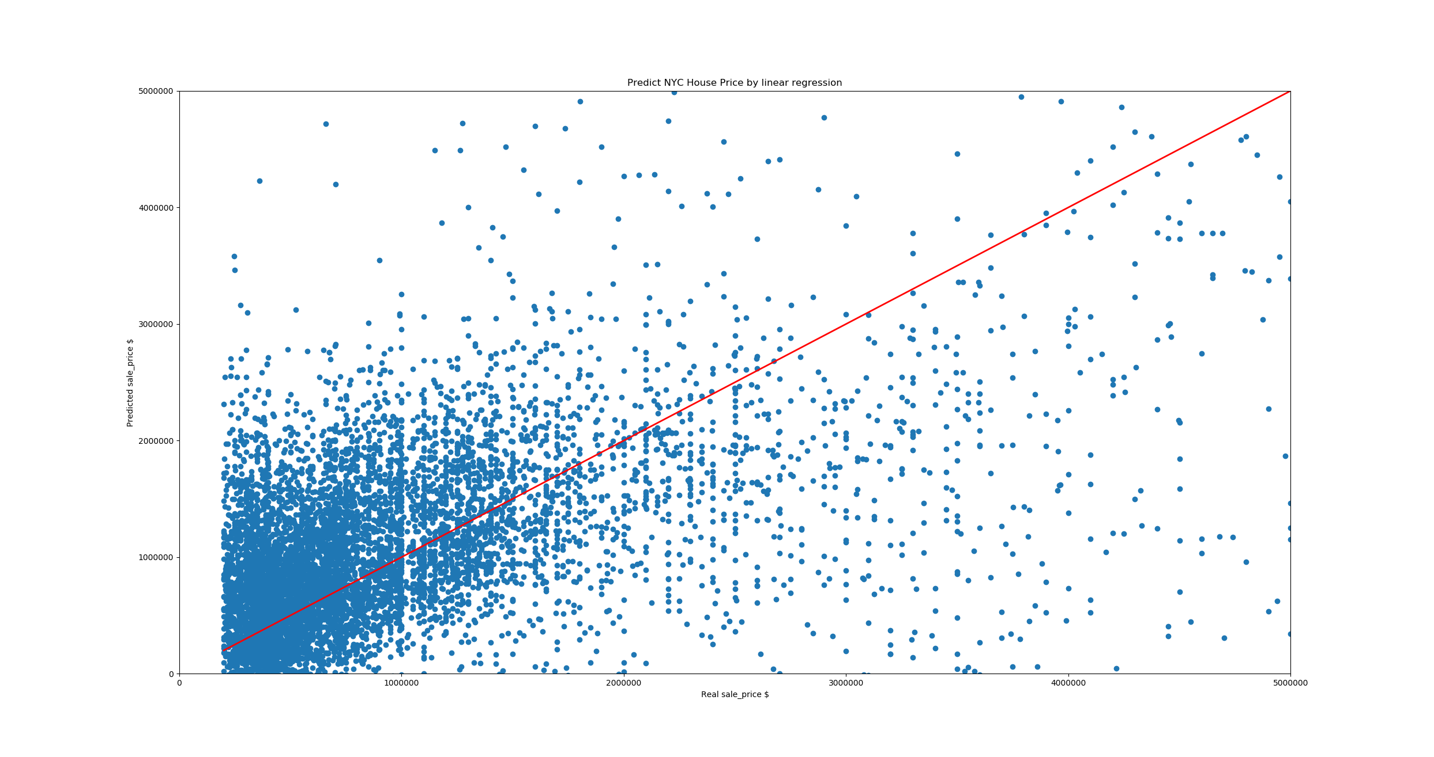
Score : 0.6714874629993289

Slide 12
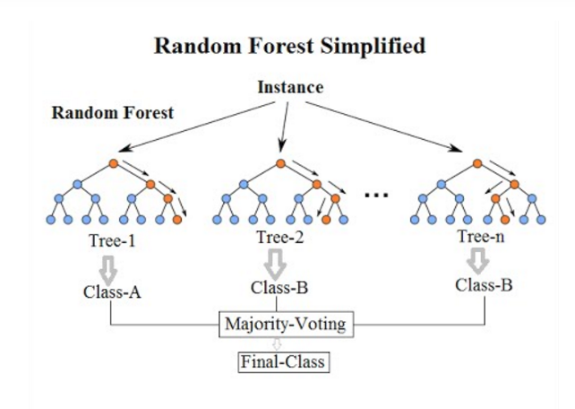
Random Forest Regression
Score: 0.868

Slide 13
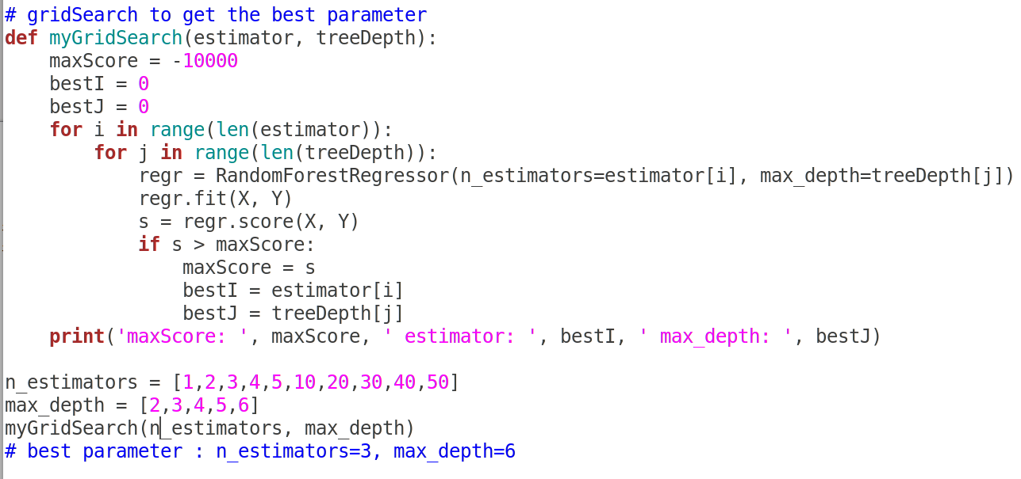
# Ensemble learning: average the outputs of many decision trees
# For every decision tree, classify every attribute into several categories,
then for the same category, average the target value as output

Slide 14
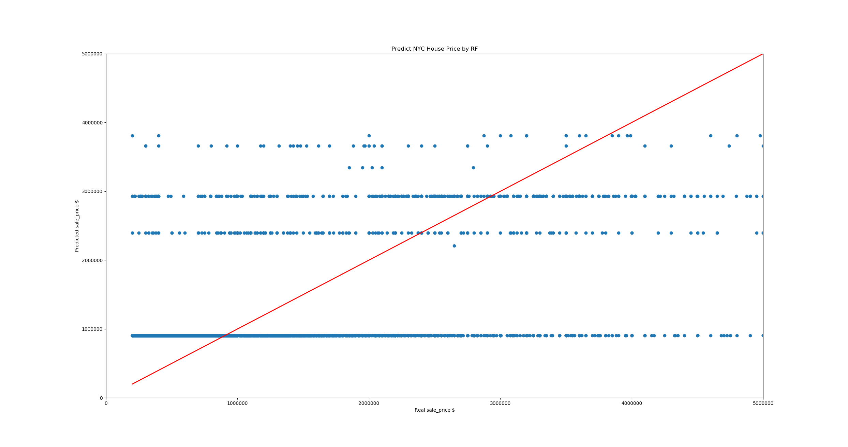

Slide 15
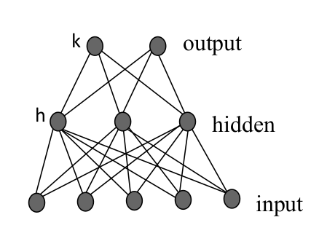
Multi-layer Perceptron

Slide 16
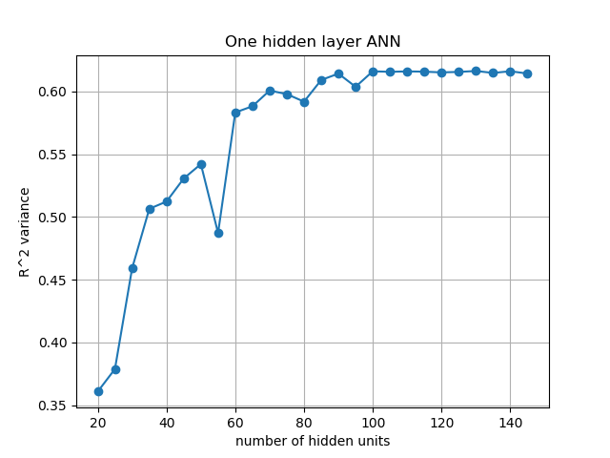

Slide 17
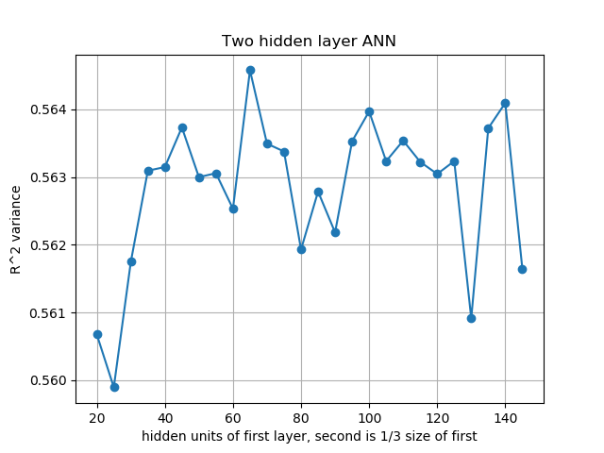

Slide 18
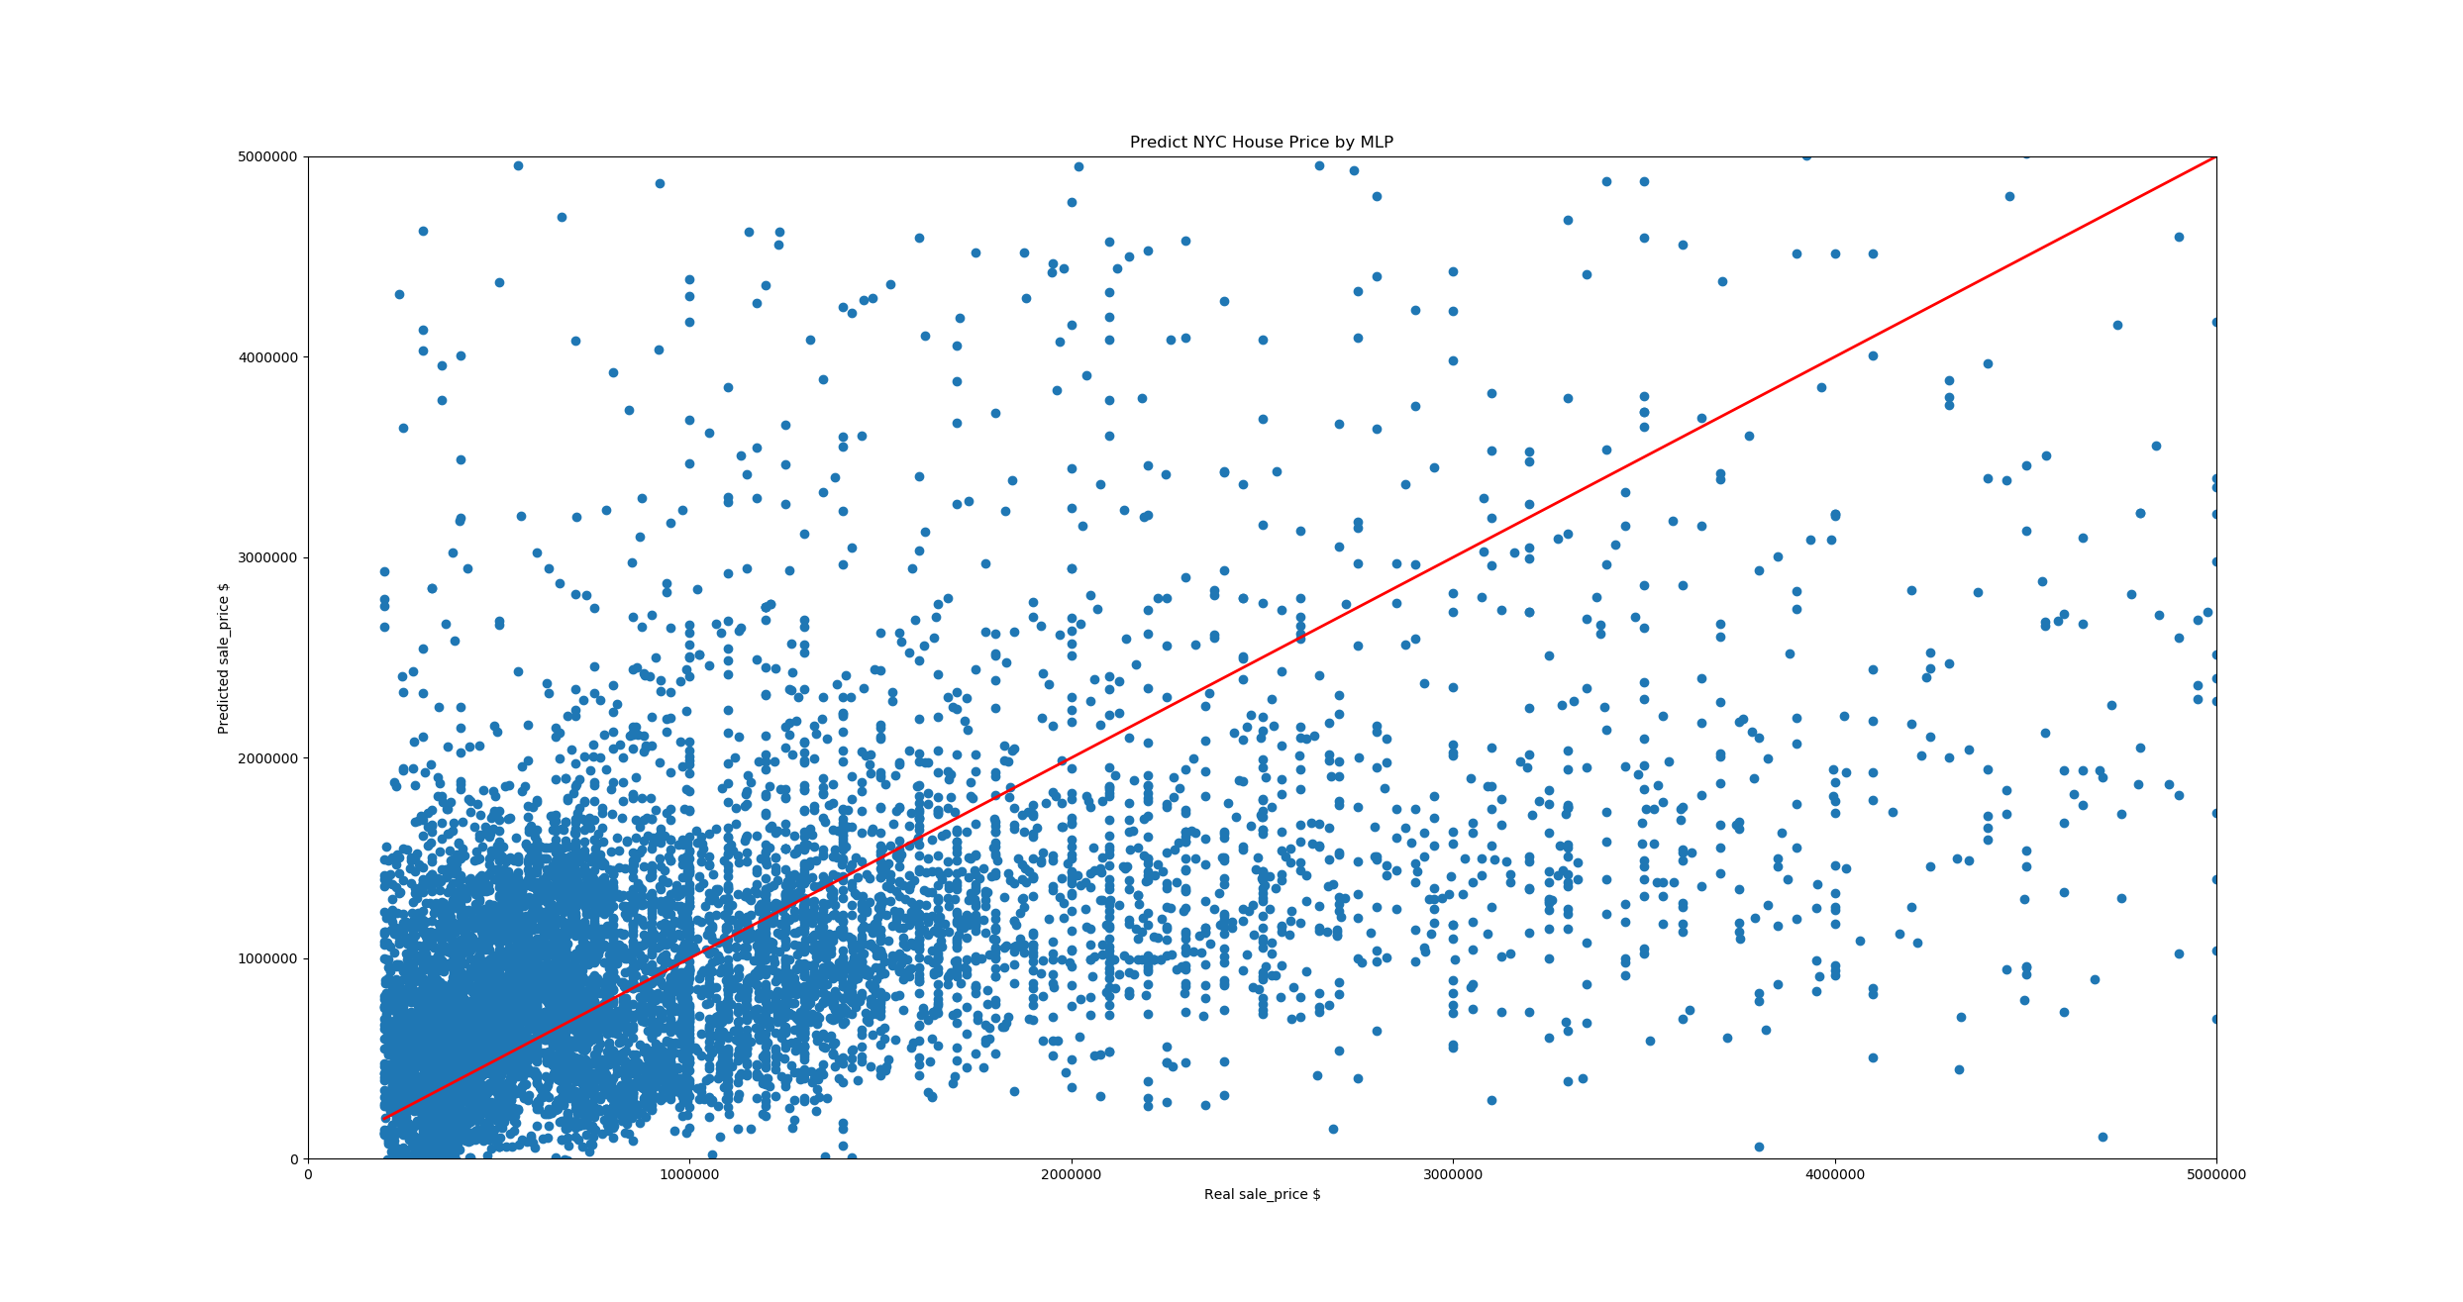
score: 0.625

Slide 19
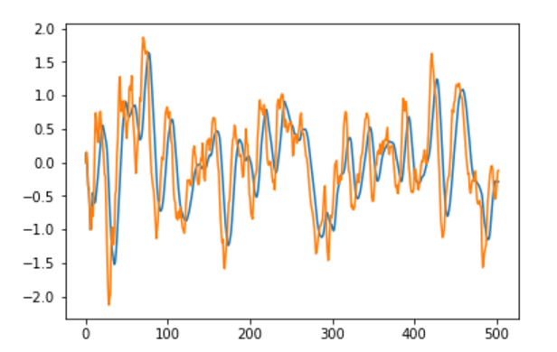
Part2 ETF

Slide 20
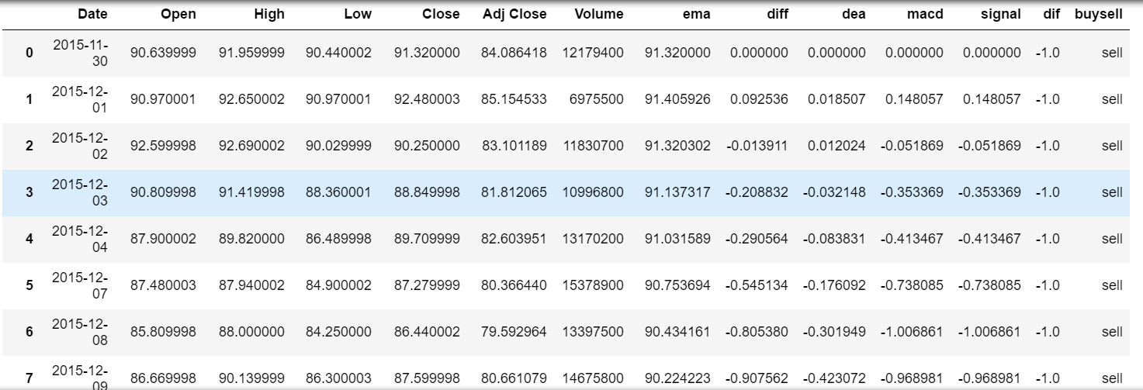

Slide 21
Thank you !

