Slide 1
DT
Vehicle Silhouettes
Notes:
anoyous(

Slide 2
Data Background
Vehicle data were collected to study how well 3D objects could be distinguished by their 2D silhouette images.
There are four classes of objects:
Opel Manta car (opel, 212 images)
Saab 9000 car (saab, 217 images)
double-decker bus (bus, 218 images)
Chevrolet van (van, 199 images)
Theory

Slide 3


Data Background
Vehicle Data
Each object was viewed by a camera from many different angles and elevations.
Total of 846 images.
Theory

Slide 4
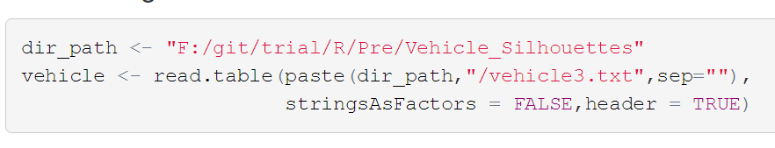
Data Introduction
Enter the following code to set the path reading the data.
Code

Slide 5
Data Introduction
Next we check the structure of the whole data set.
Because the variables of the dataset is too long, we omit some result in the following picture.
You can see more details entering the code in your R workspace.
Theory

Slide 6
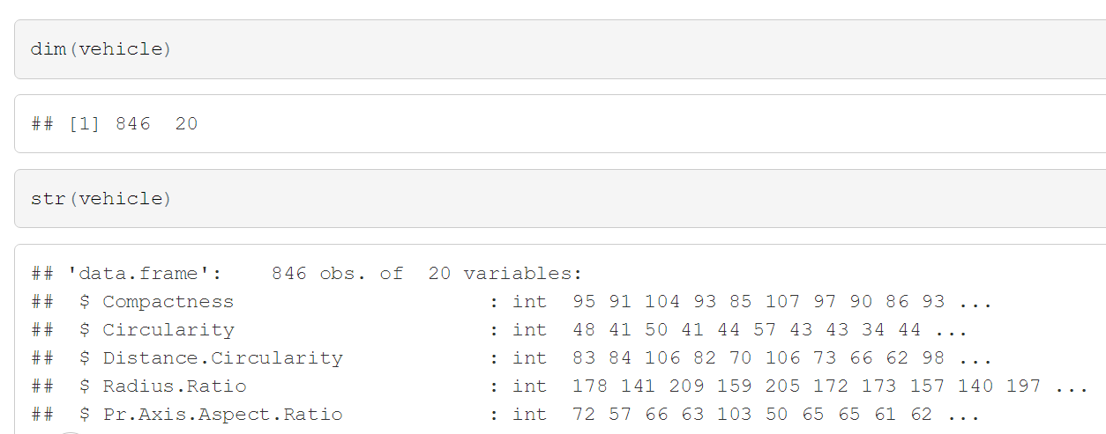
Data Introduction
Code

Slide 7
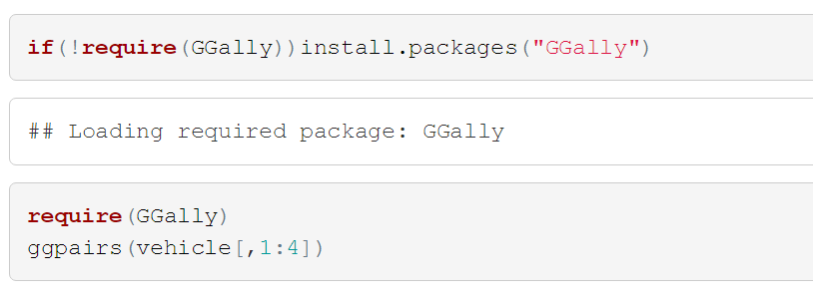

Data Introduction
Many pairs of the 20 variables are highly correlated.
Because there are too many variables, we just show the first four variables correlation.
Code

Slide 8
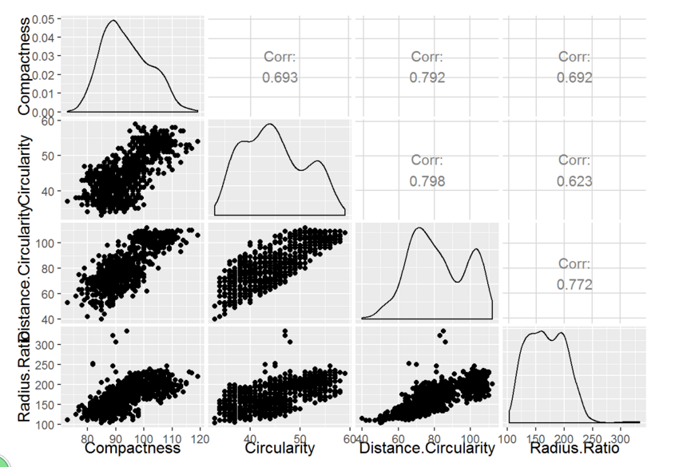
Data Introduction
Result

Slide 9
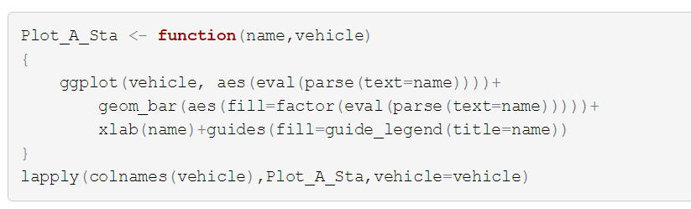
Data Introduction
We show the bar chart of each variables.
Code

Slide 10
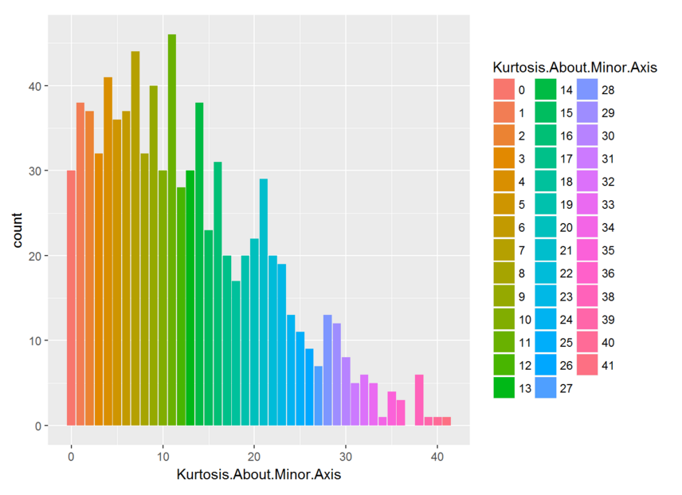
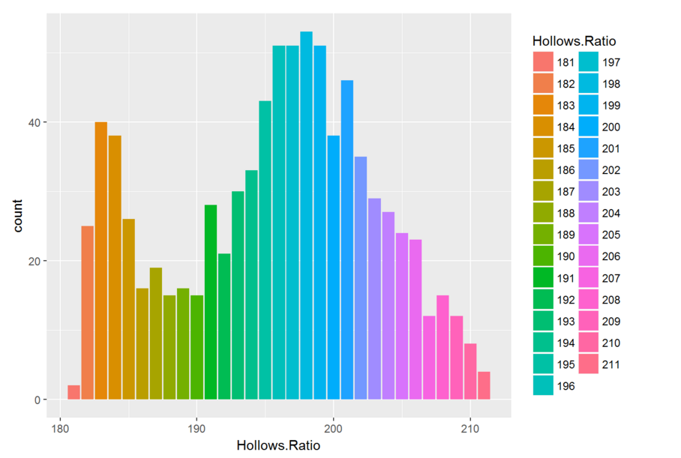
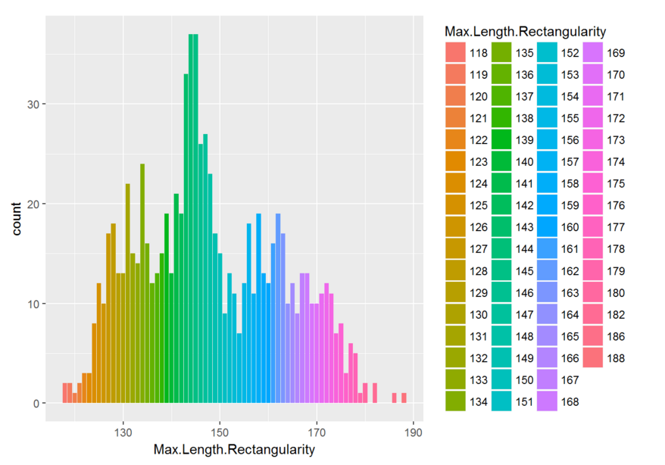
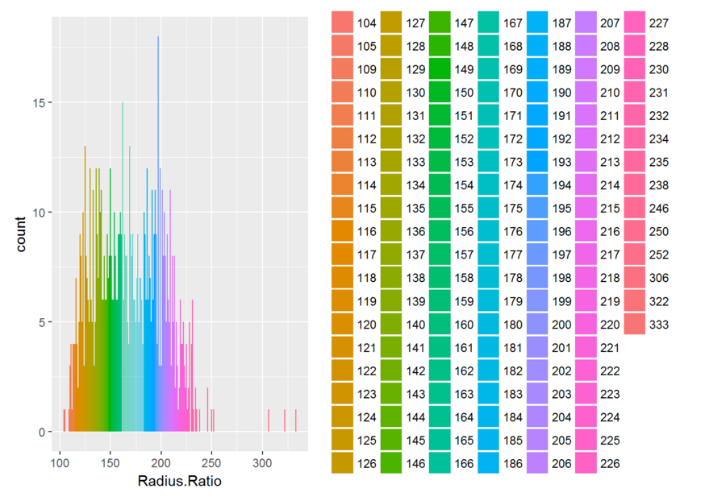
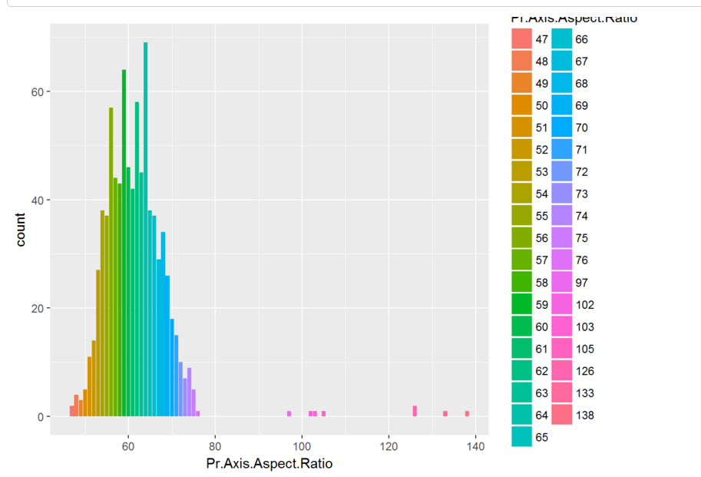
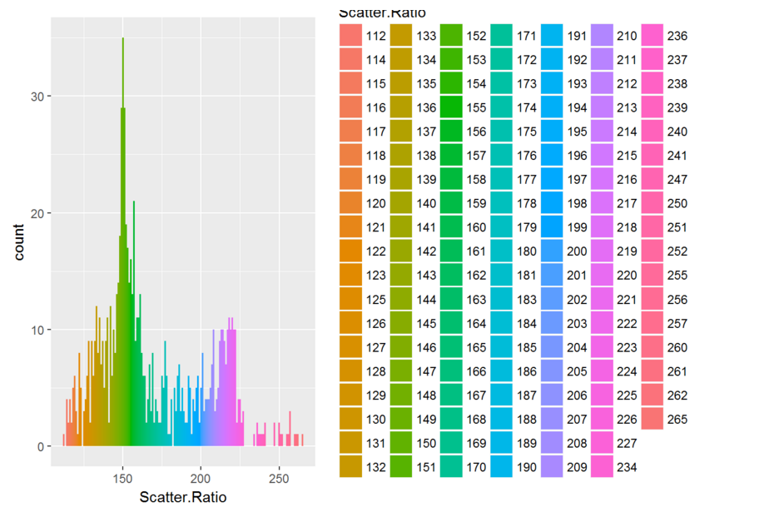
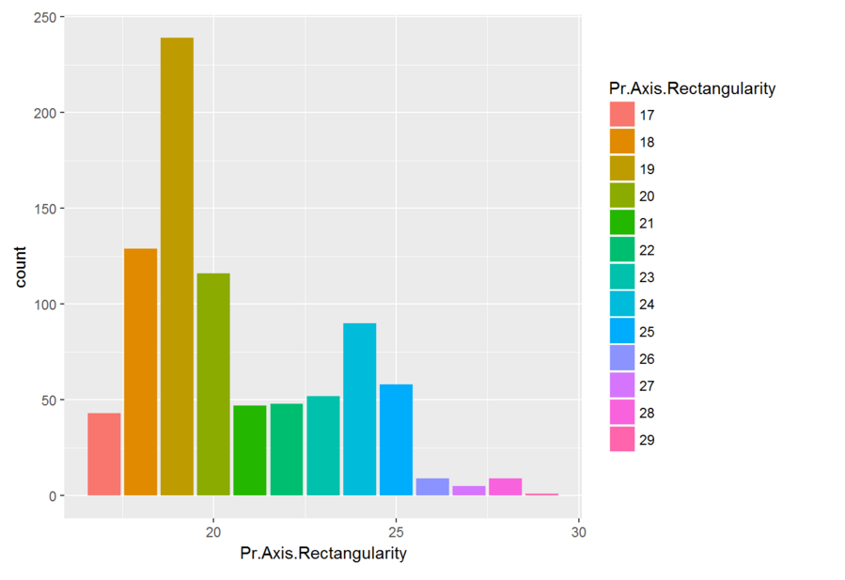
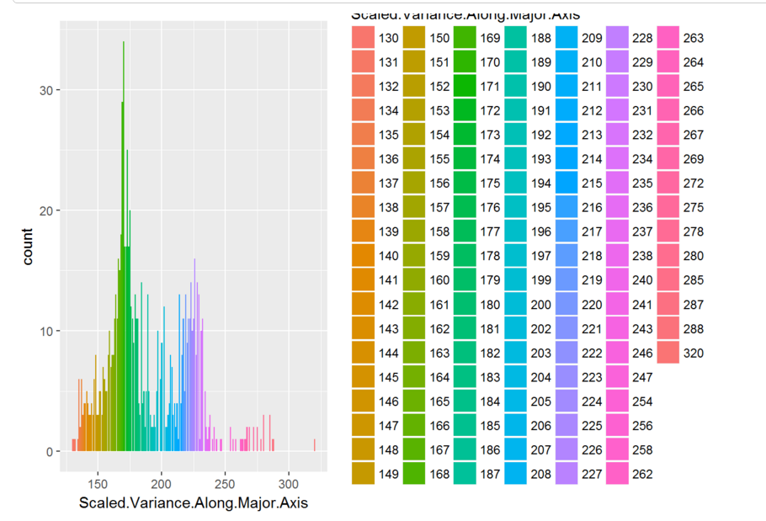
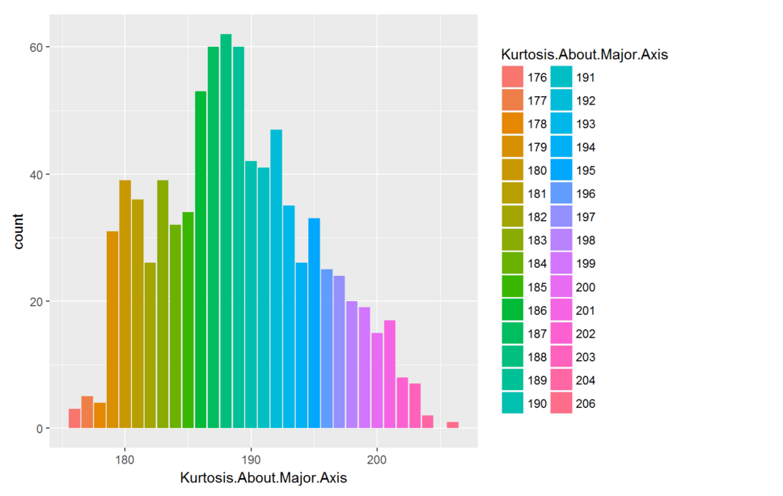
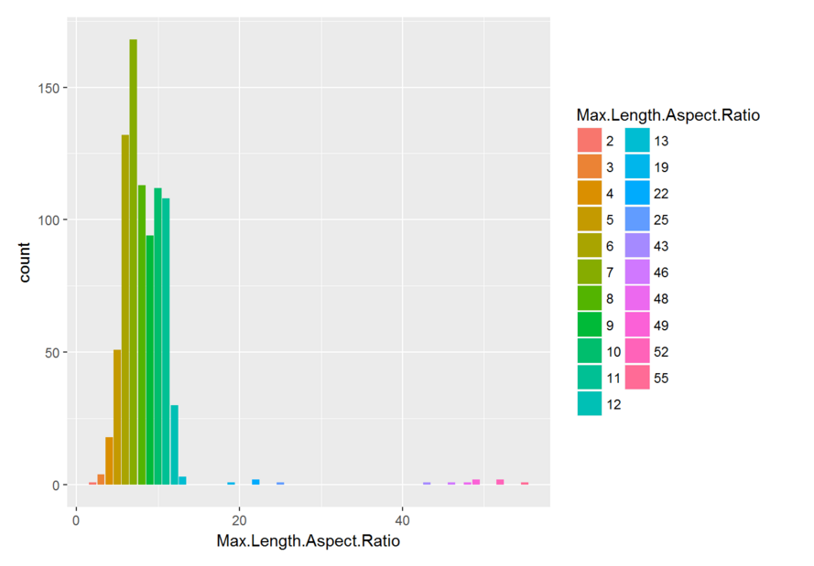
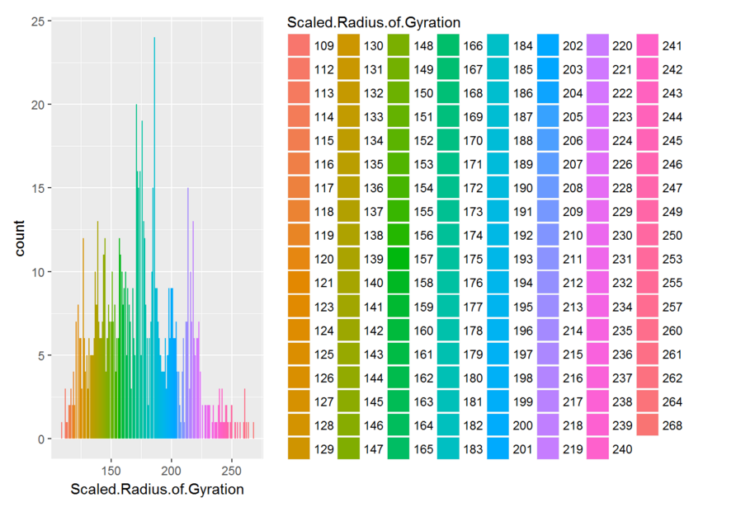
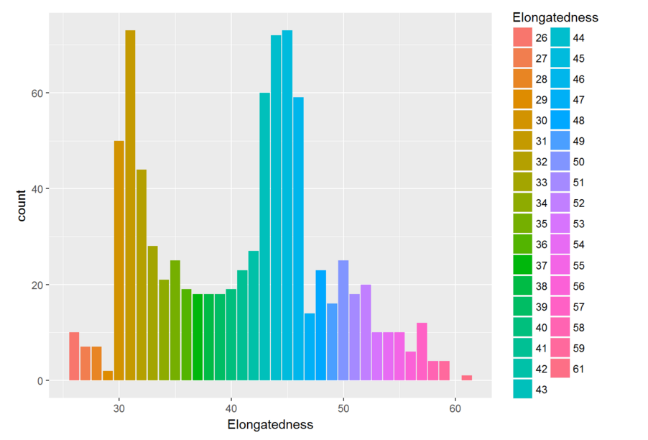
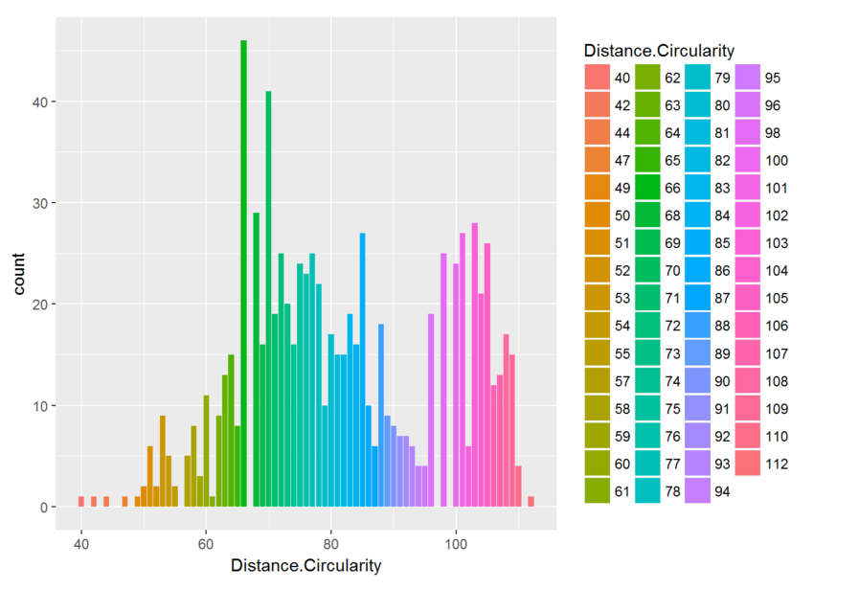
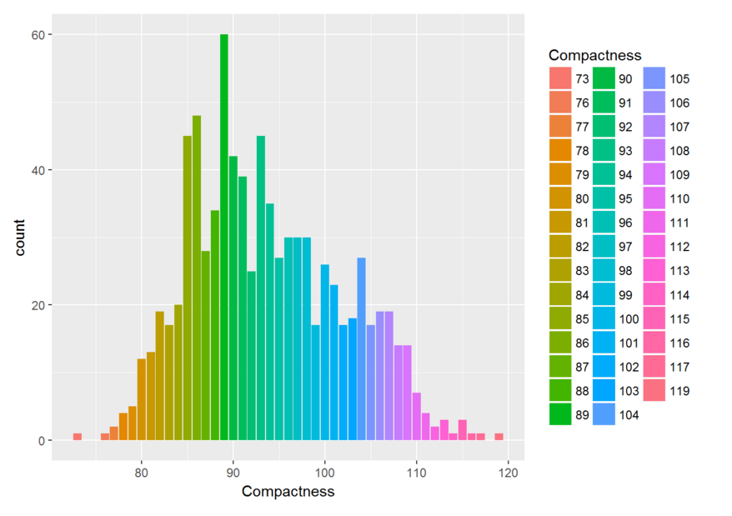
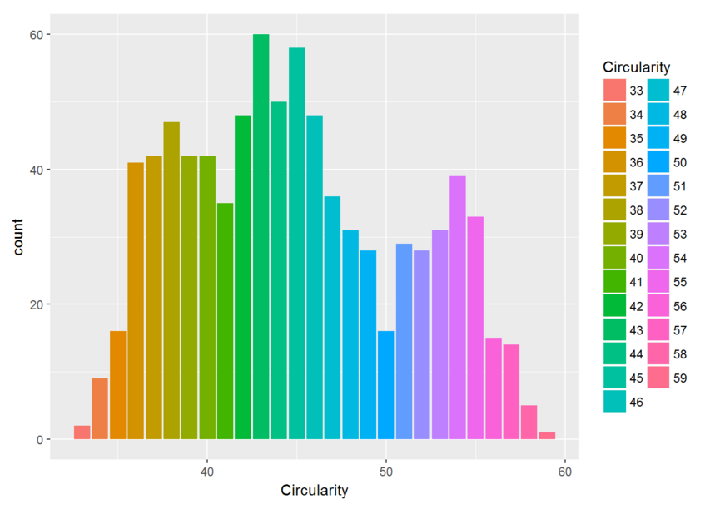
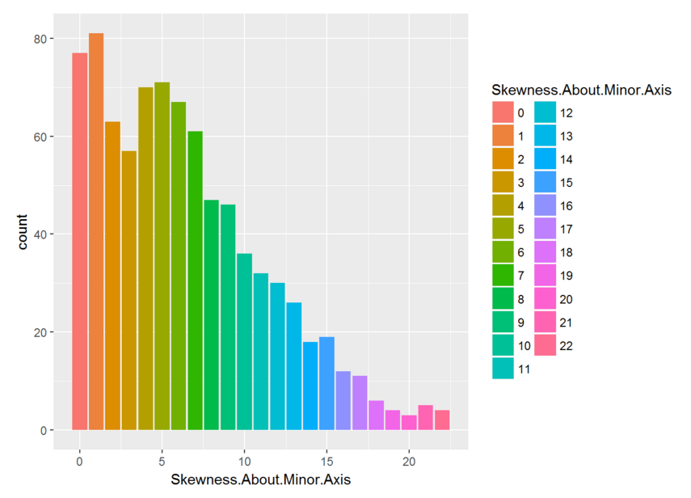
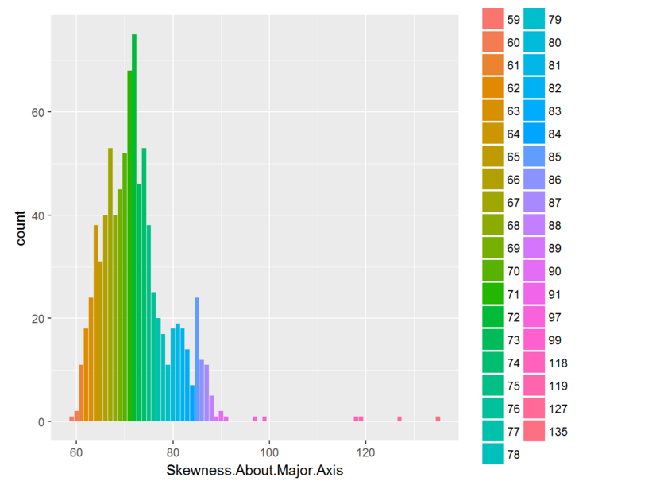
DT
Result

Slide 11
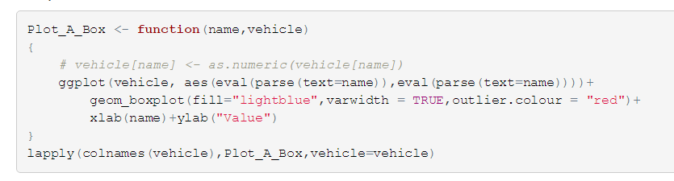
Data Introduction
We show the boxplot of each variables.
Code

Slide 12
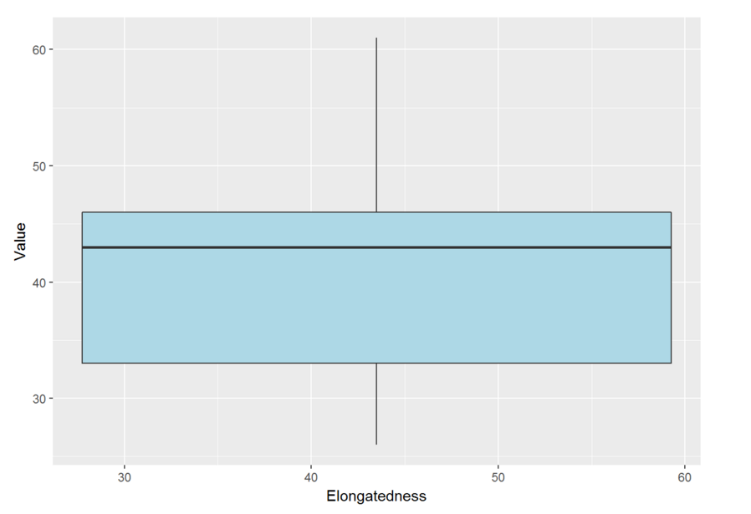
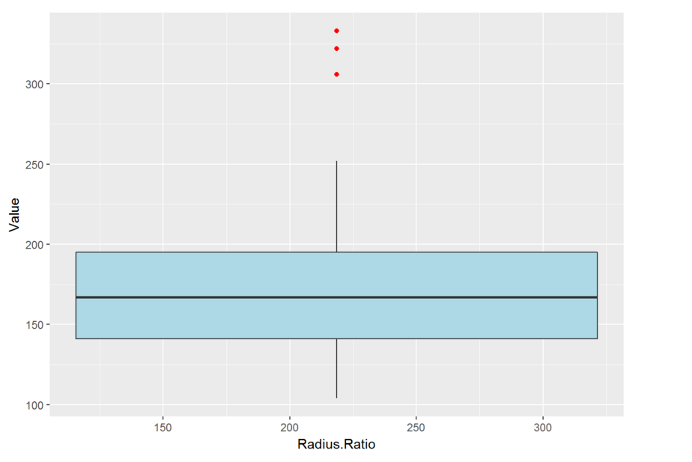
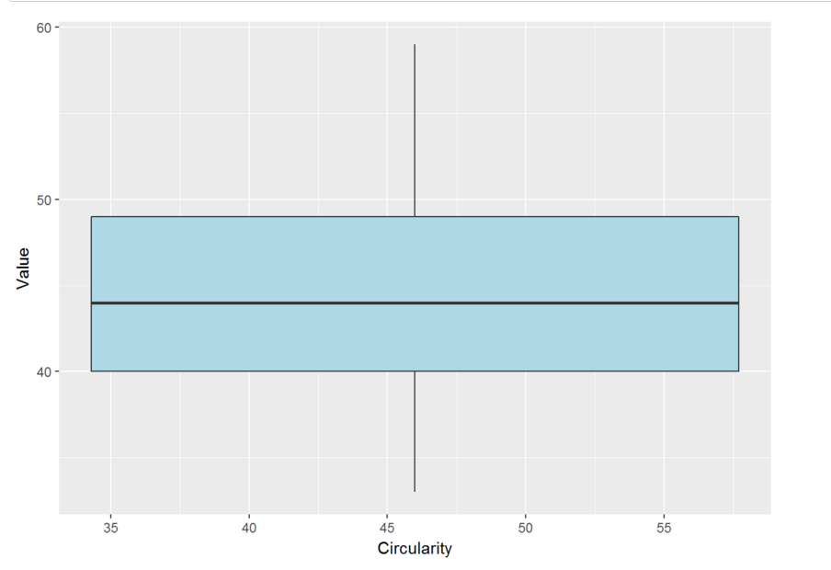
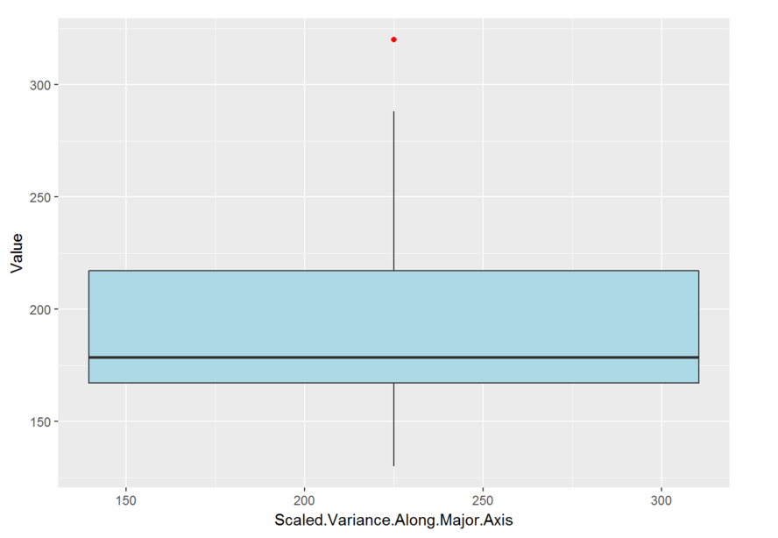
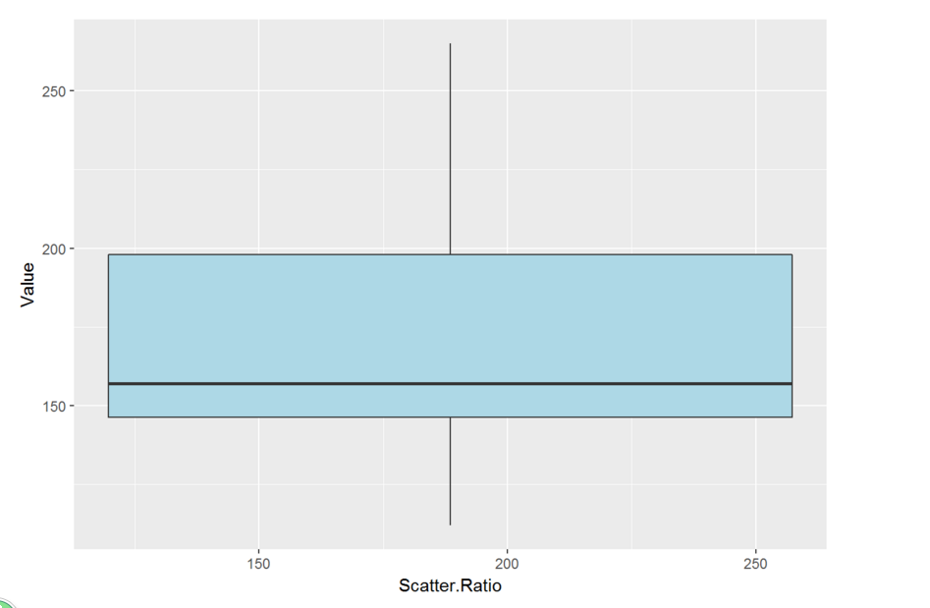
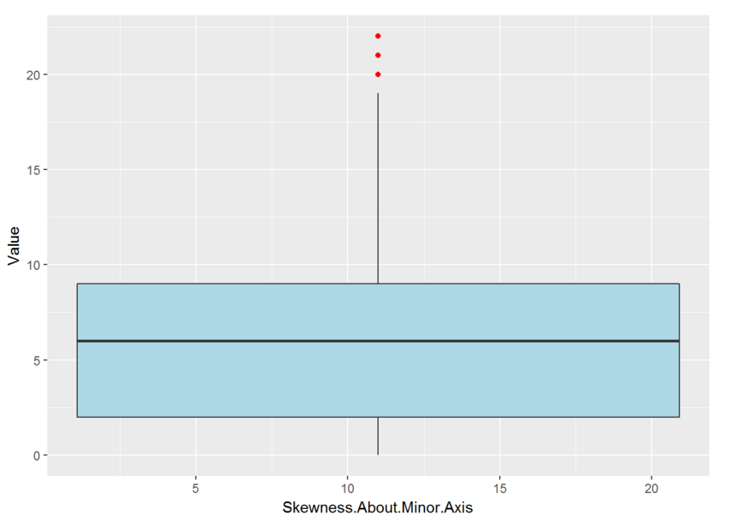
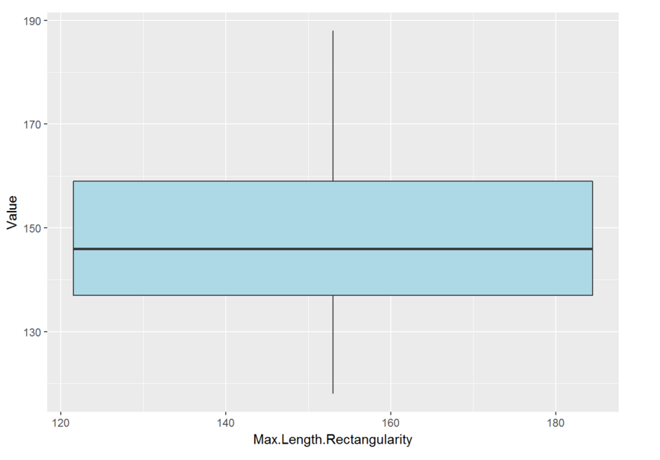
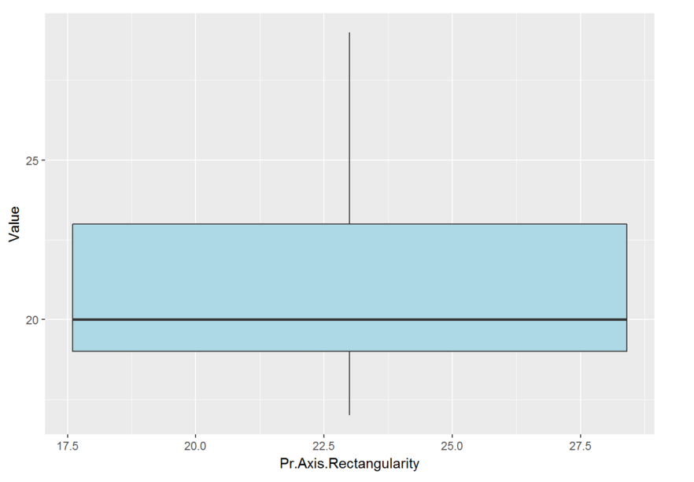
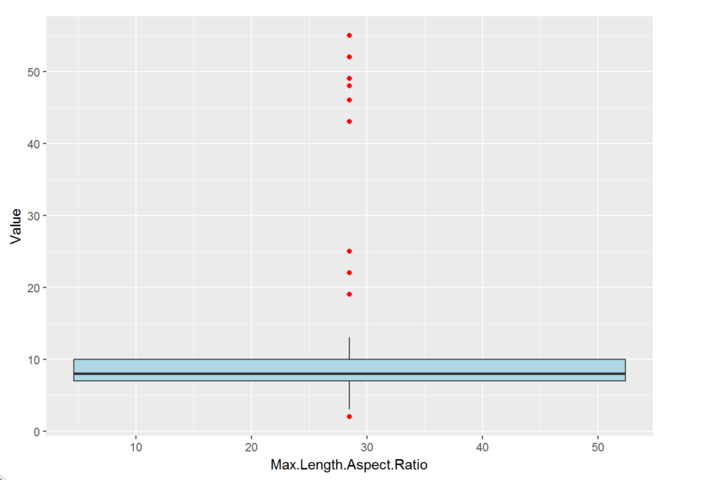
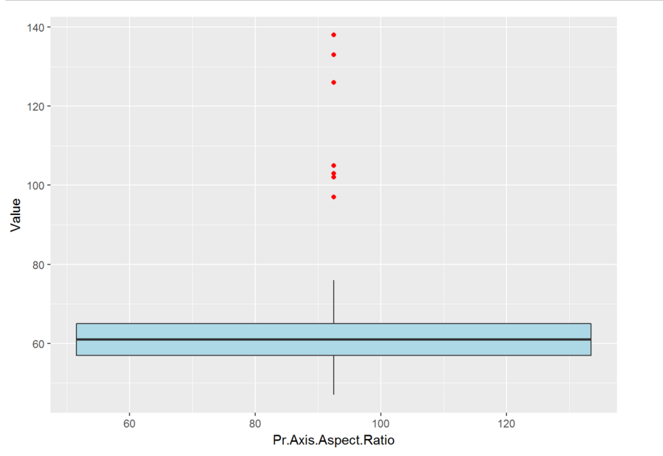
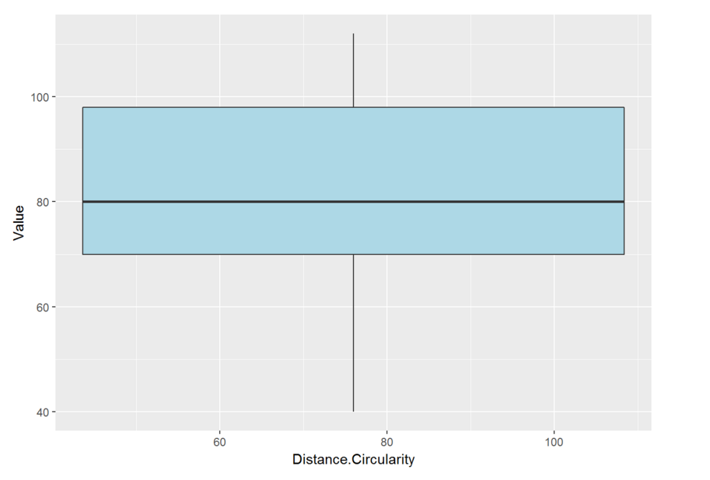
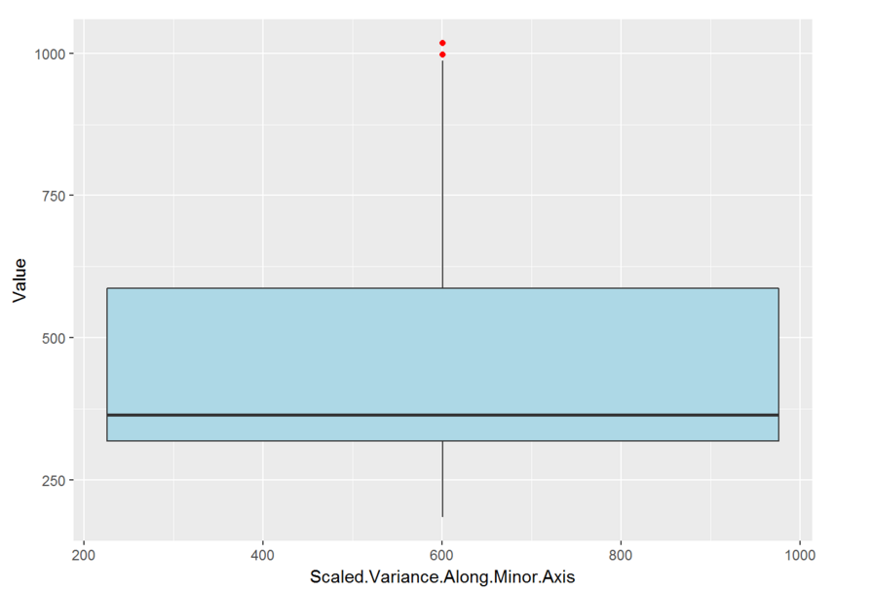
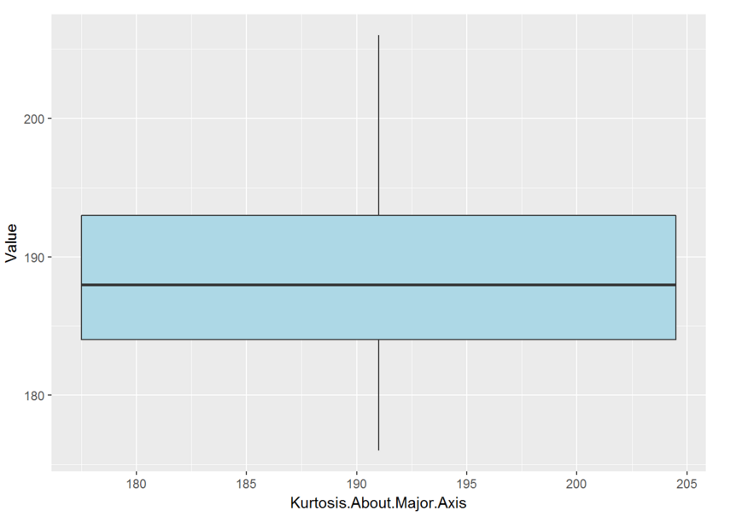
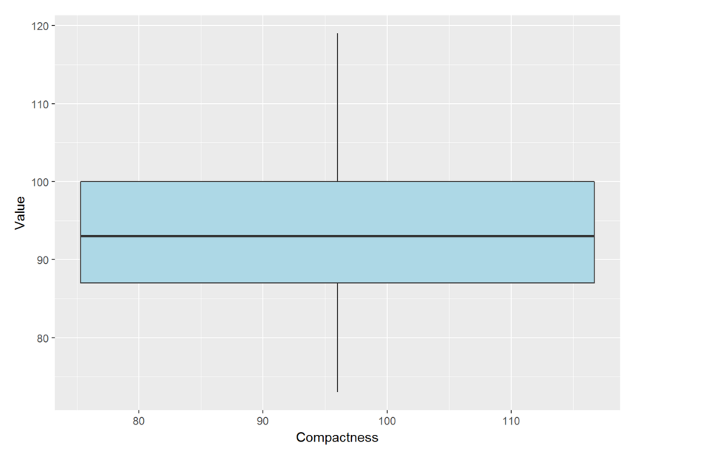
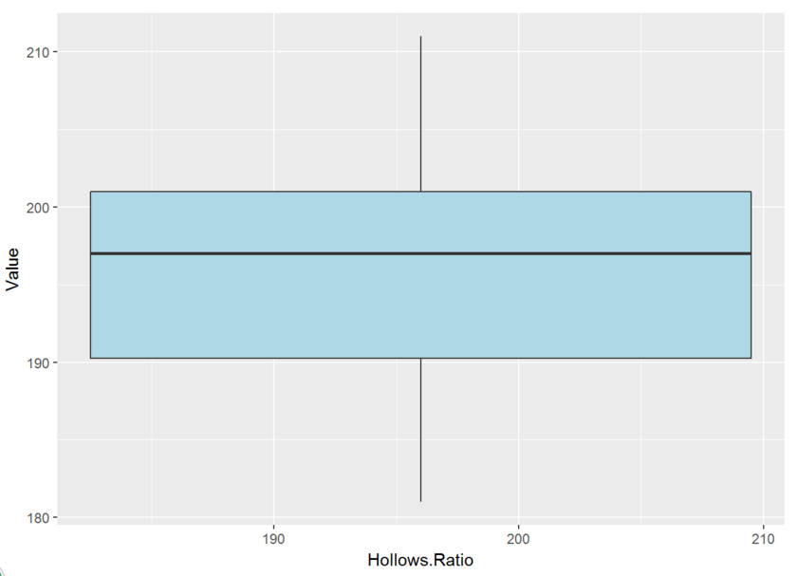
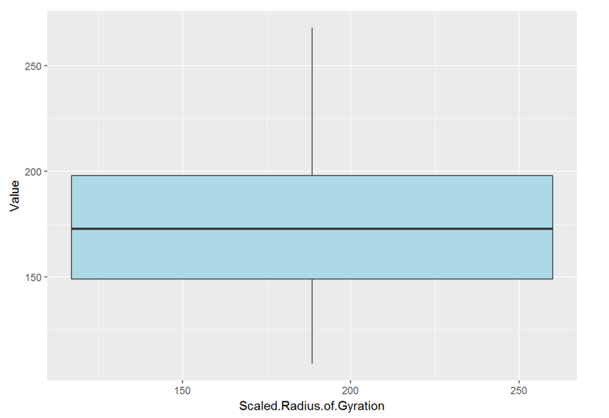
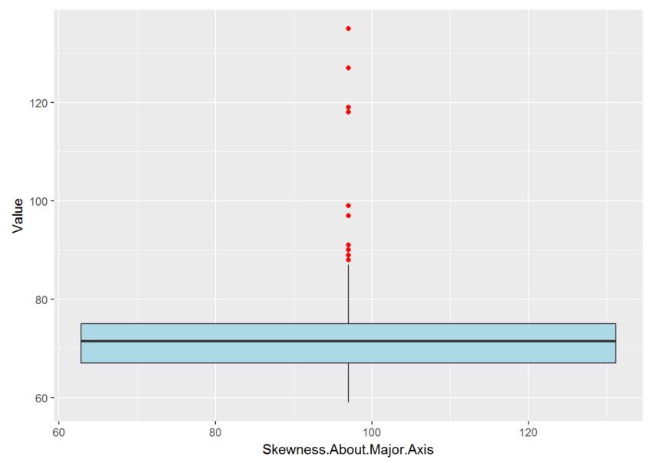
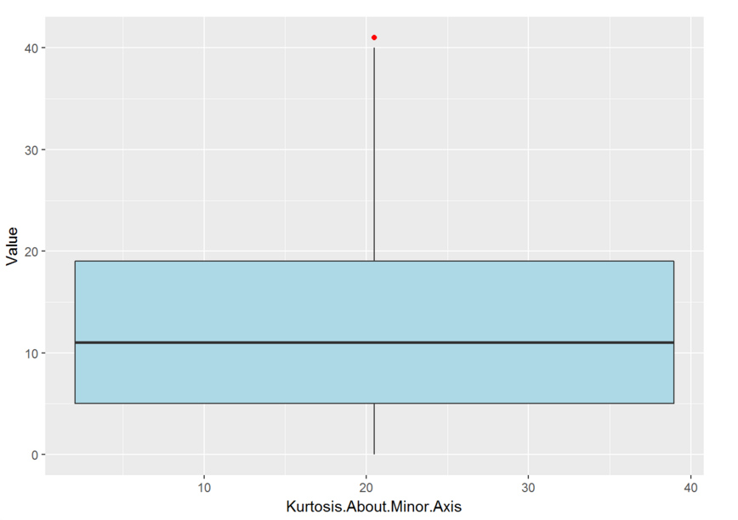

DT
Result

Slide 13
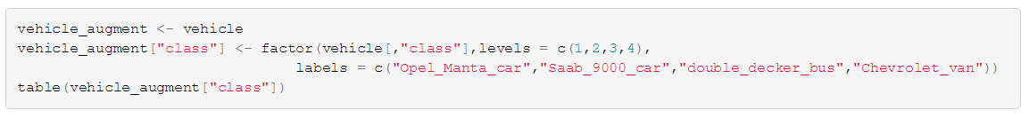

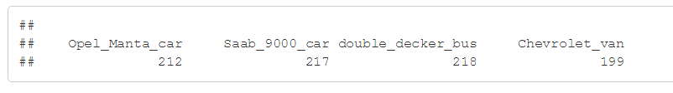
DT
We do more for the convenience of the data.
We check the distribution of the target variables.
Code

Slide 14
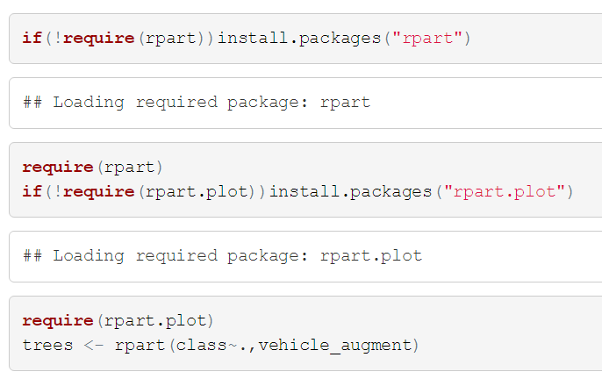
DT
We build the tree with the data vehicle_augment.
Code

Slide 15
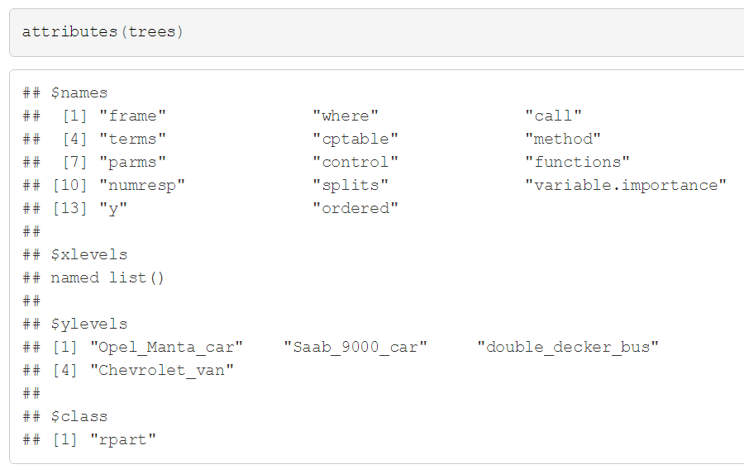

DT
We check the result.
Code

Slide 16

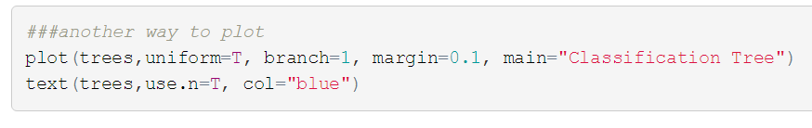
DT
We show the tree with the following two ways.
Code

Slide 17
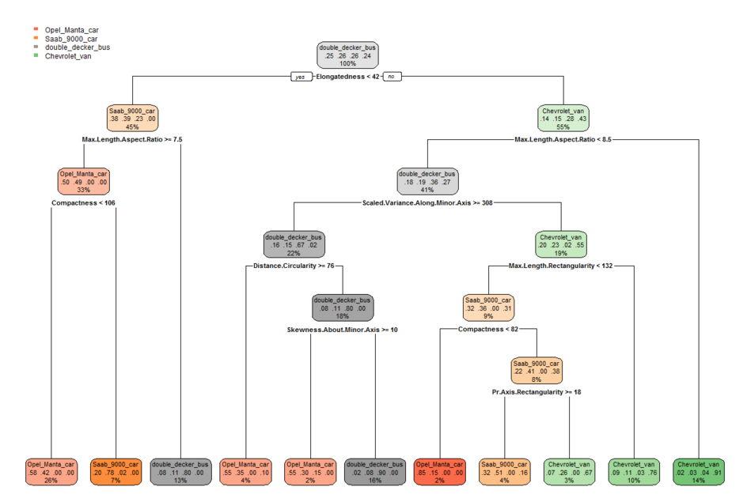
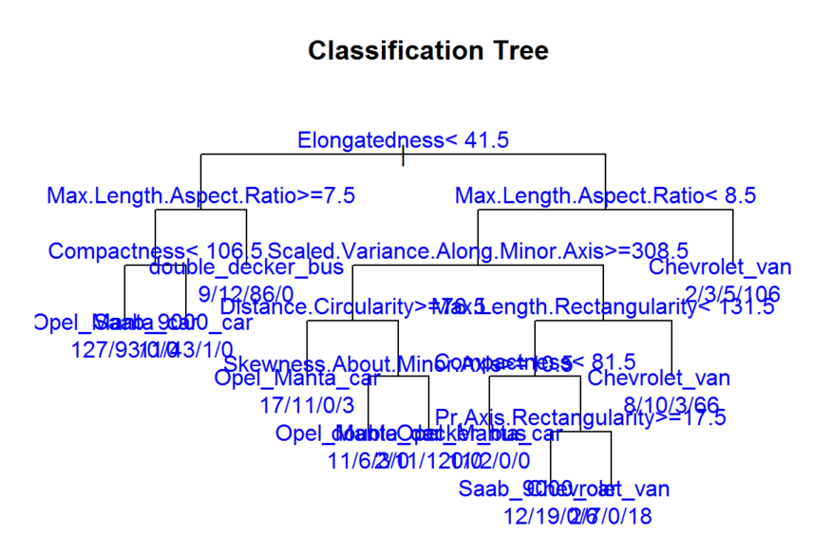

DT
Result

Slide 18
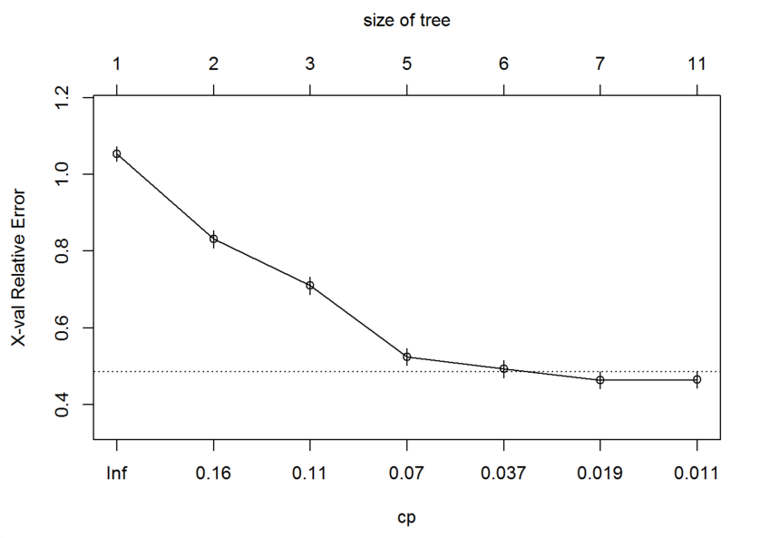
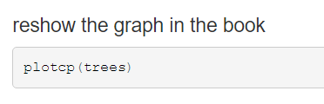
DT
Code

Slide 19

DT
We show the confusion matrix of the tree.
Code

Slide 20
DT
The result is too long and we split it into two part.
The result following not only show the confusion matrix but the performance of every class.
Theory

Slide 21


DT
Result

Slide 22

DT
We prune the tree according to the rule 1-SE.
First we show the relevant result.
We can see the minimum xerror is in the seventh line.
xerror+sd(xerror)=0.42+0.21=0.636.
0.636 is between line 3 and line 4.
Thus we choose the cp value larger than line 4 but smaller than line 3.
We may make the cp=0.07.
Theory

Slide 23



DT
Result

Slide 24
DT
Again, we check the confusion matrix of the pruned tree.
We can see the structure of the tree become more simpler though the accuracy is decreasing.
Result

Slide 25


DT
Result

Slide 26



DT
At the last we do the cross validation of 10 fold.
Theory

Slide 27

DT
We plot the 10-fold validation error of different max depths.
Code

Slide 28

DT
CV
Result

Slide 29
DT
Thanks
Notes:
anoyous(

