Slide 1






The Nutritional of food

Slide 2

Data Introduction
Nutritional data from 961 food items are listed alphabetically in this data set. The nutritional components of each food item are given by the following seven variables:
fat (grams), food energy (calories), carbohydrates(grams), protein (grams), cholesterol (milligrams), weight (grams),and saturated fat (grams).

Slide 3
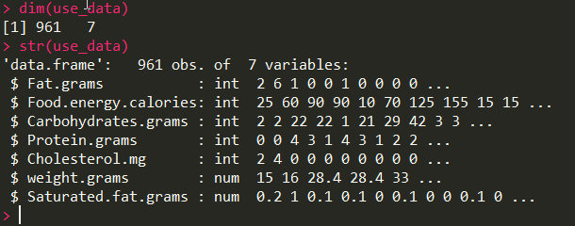
Data Introduction
After input the data, we have a data subset that we concerned saved as “use_data”.
We show some information about the data.

Slide 4
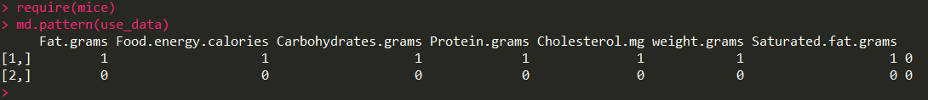
Data Introduction
From the above we can tell there are no missing values in this data
Because we show the density lines of all variables in the same plot, thus we omit the tail of some lines for a better show of picture.
We will have a whole picture about the distribution of the data.We first show a plot with all density lines and then we show it one by one.

Slide 5
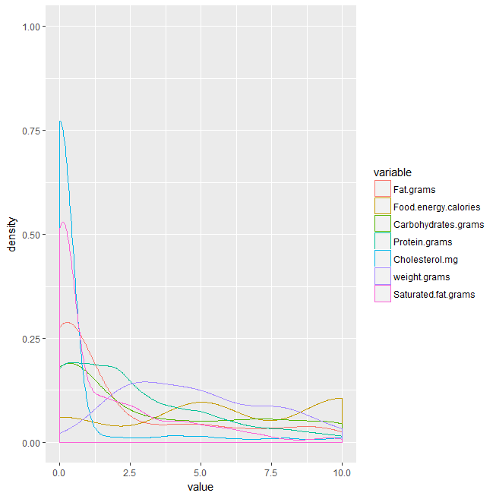
Data Introduction

Slide 6
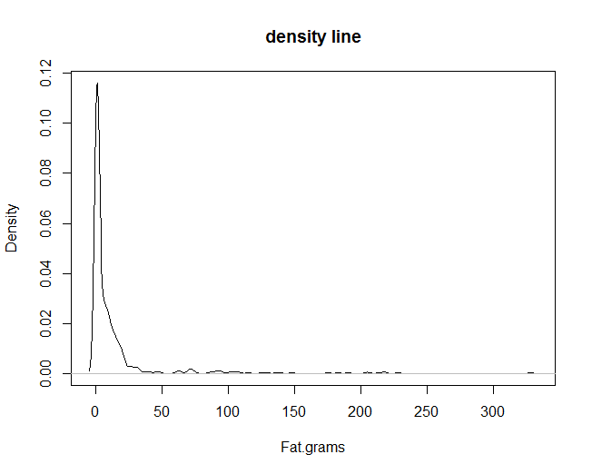
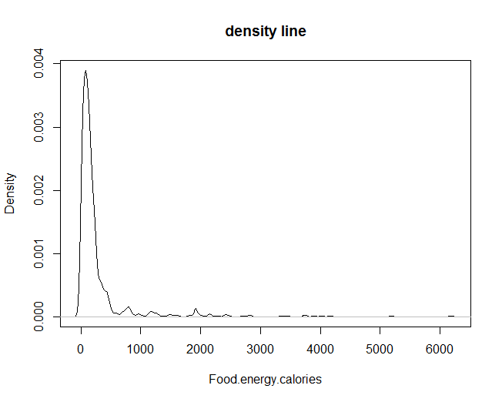
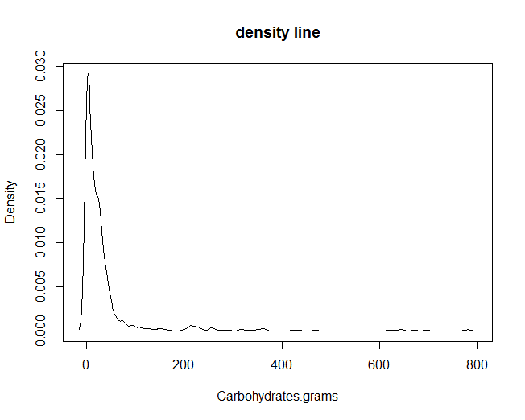
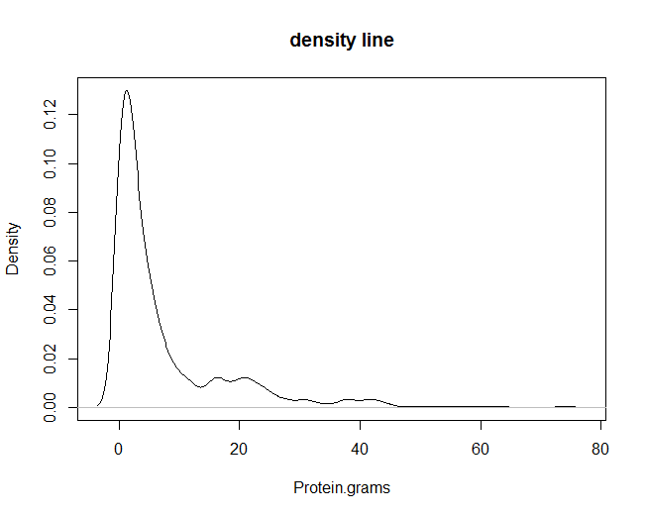
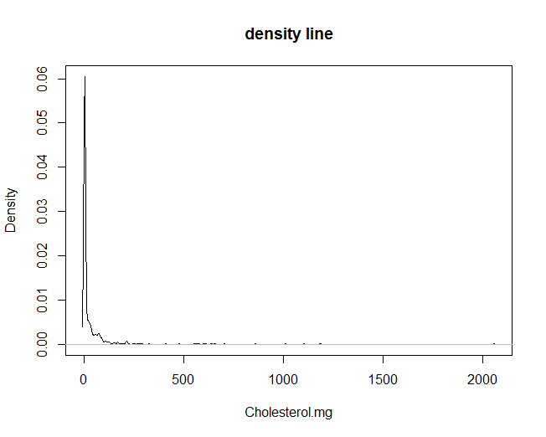
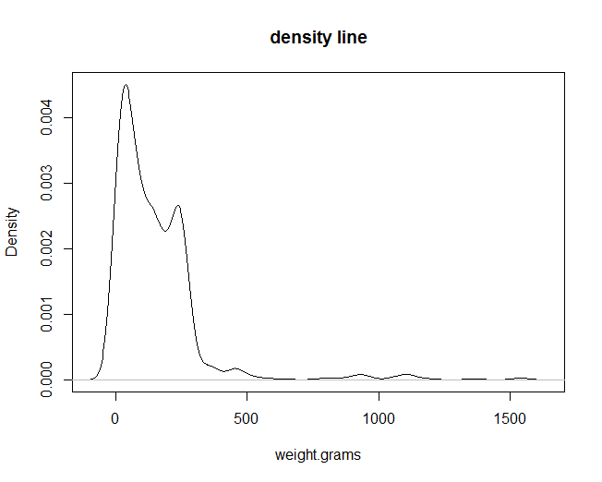
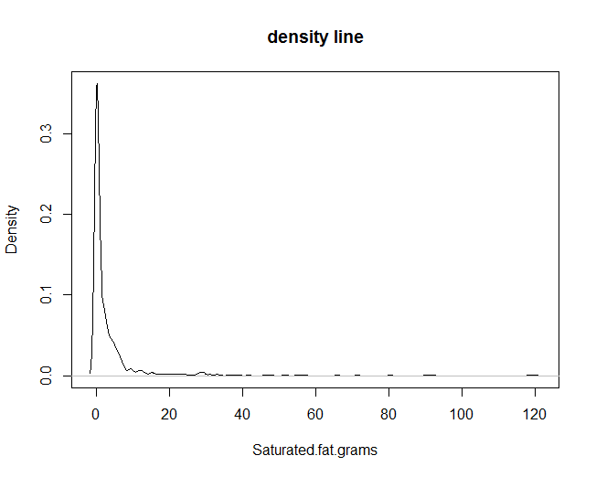
Data Introduction

Slide 7
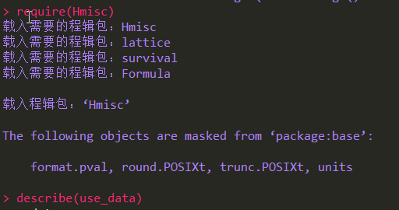
Data Introduction
We see more detail about the data .Using the code following we will have some responses. We just show two of them and others follows.

Slide 8
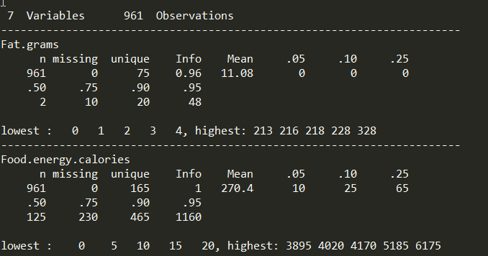
Data Introduction
Notice: The last two row of the main form show the quantitle.

Slide 9
PCA
To equalize out the different types of servings for each food, we first divide each variable by weight of the food item (which leaves us with 6 variables), and then, because of wide variations in the different variables, each variable is
Using the following code we can finished the job and perform PCA

Slide 10
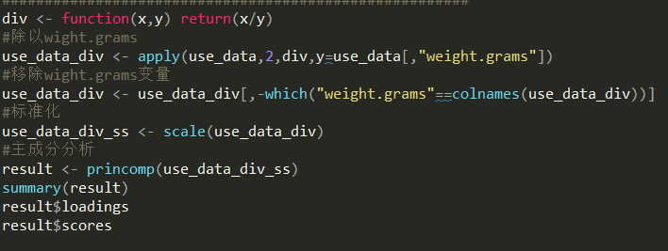
PCA

Slide 11
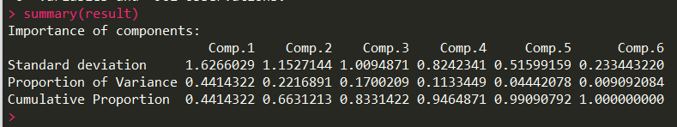
Result
A PCA of the transformed data yields six principal components ordered by decreasing variances. The first three principal components, Comp.1, Comp.2, and Comp.3, which account for more than 83% of the total variance,

Slide 12
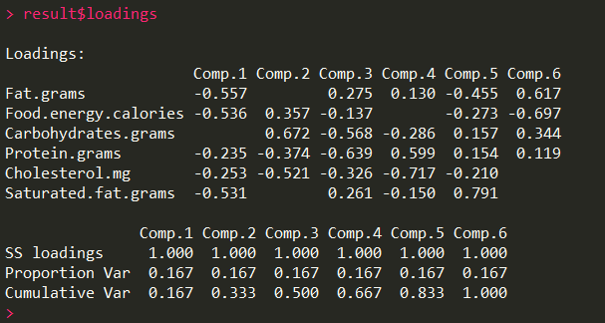
Result

Slide 13
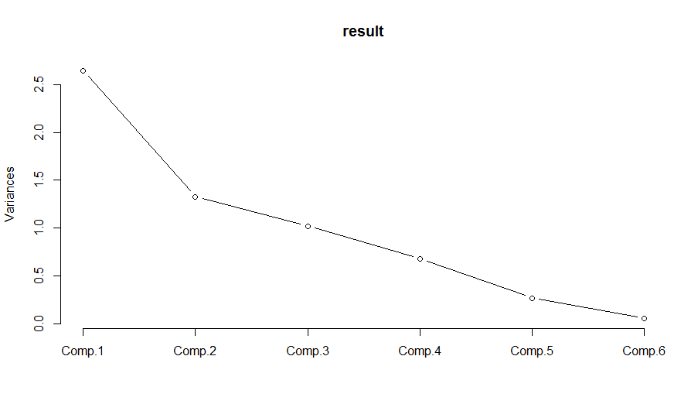
Result

Slide 14
Thanks

