Slide 1
PCA
Face Recognition
Notes:
anoyous(

Slide 2
Data Introduction
In this example, we apply PCA to a single face photographed under n=11 illuminations.
Each picture is expressed as a 320×243 matrix of intensity values.
Each value in the matrix is quantized to 8-bit grayscale (0–255,with 0 as black and 255 as white).
Each picture is translated into a stacked vector of length 77,760.
Theory

Slide 3
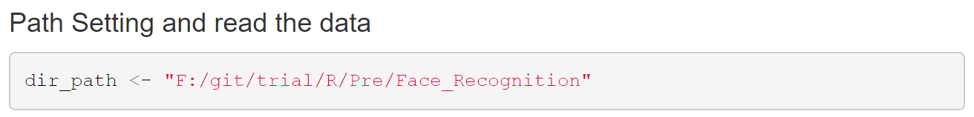
Data Introduction
Firstly, we need to read load the data in our workspace.
Enter the following code to set the path.
Reading the data requires special technique.
Code

Slide 4
Data Introduction
In order to read the data, we need a package bmp, which is design for reading picture data.
Every picture consist of a matrix with dimension 243*320*3.
We read 11 pictures and we only use one layer of every picture.
We unstack the into one matrix with dimension 11*77760.
Theory

Slide 5
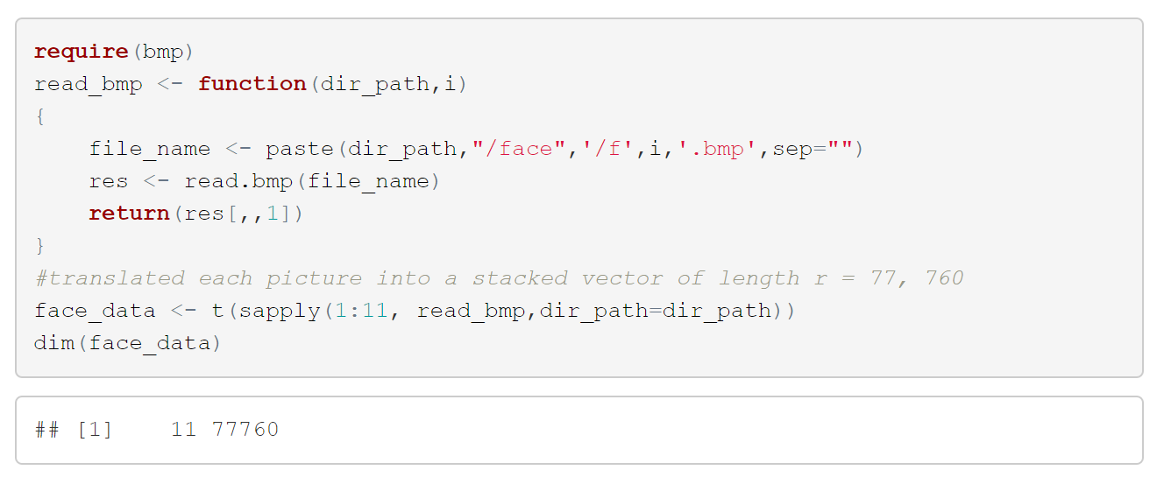
Data Introduction
Read the data and see the dimension of the data.
Code

Slide 6

Data Introduction
In face recognition, the“average”face is important.
The“average”face is the columns means of the matrix.
We show the average”face picture in the next.
To show translate the matrix into a picture require the another R package named“pixmap”.
Theory

Slide 7
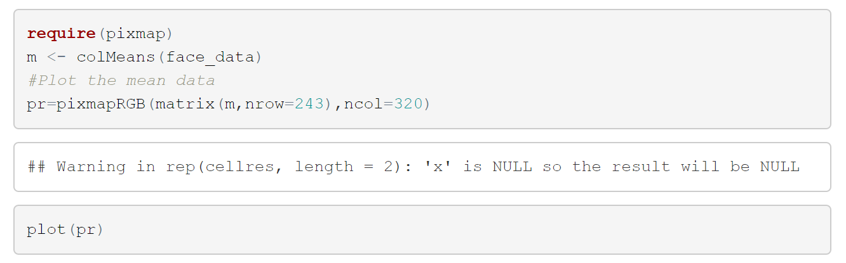
Data Introduction
Enter the Following code.
Code

Slide 8
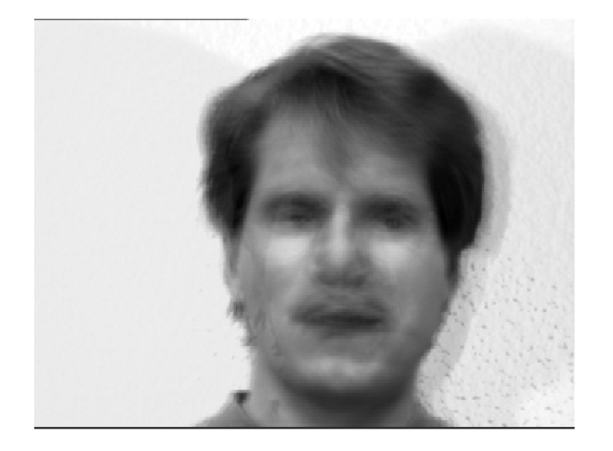

PCA
“ghostly” face.
Code

Slide 9

PCA
Next we deal with the matrix .
Firstly, we center the matrix by columns .
Secondly, we calculate the correlation matrix, whose dimension is 11*11.
Thirdly, we calculate the eigenvalues and eigenvectors.
Theory

Slide 10
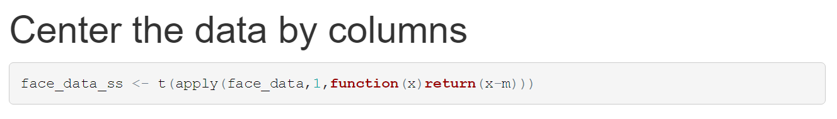
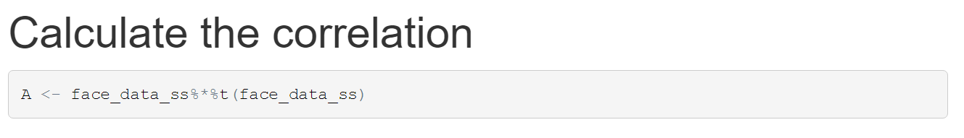
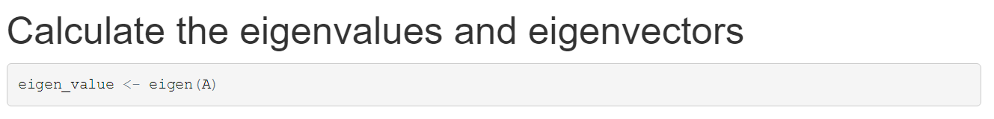
PCA
Code

Slide 11
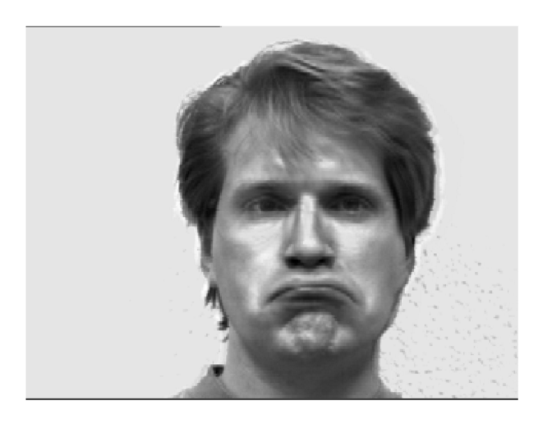
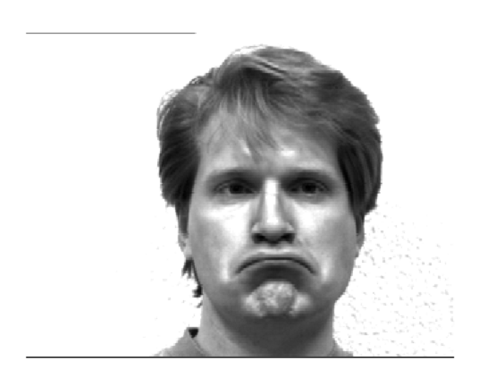
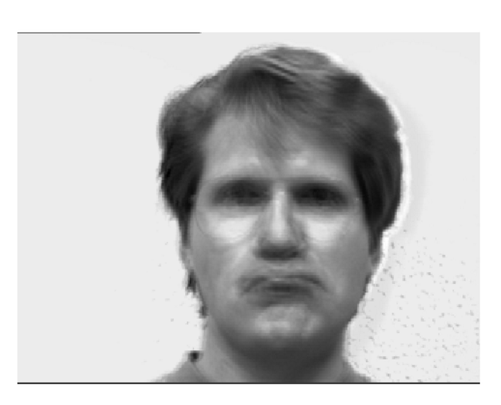
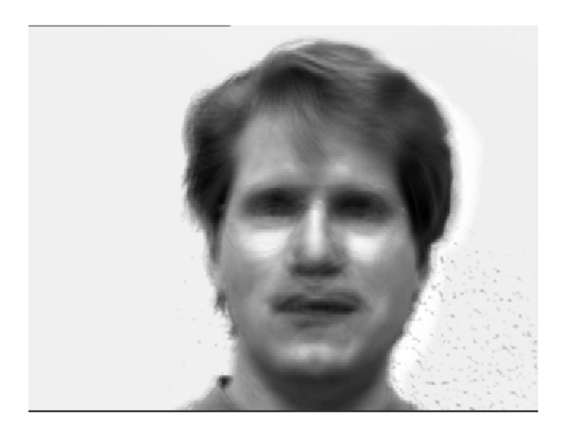
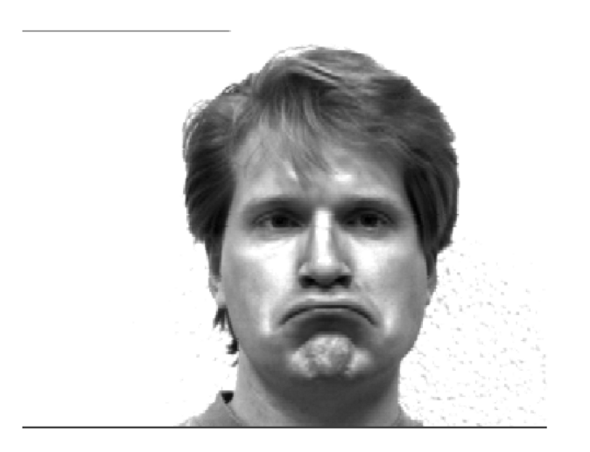
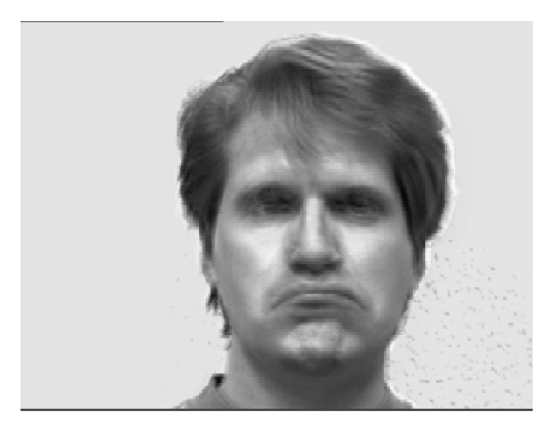
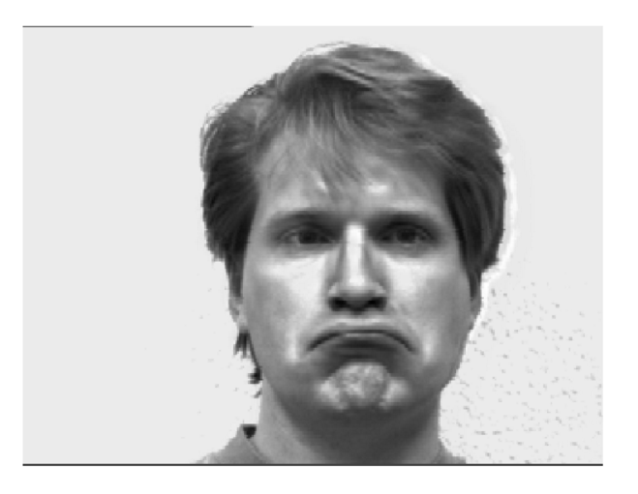
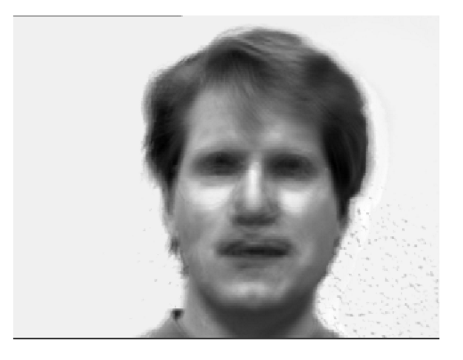
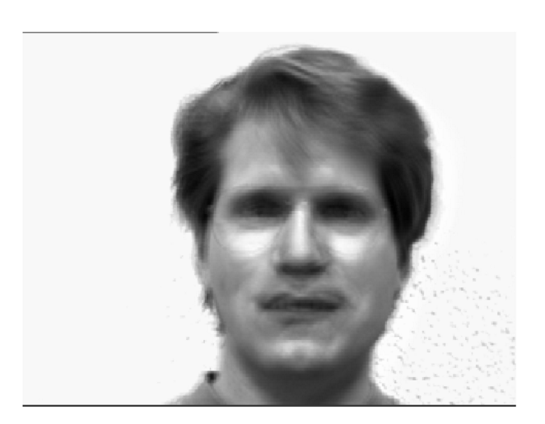
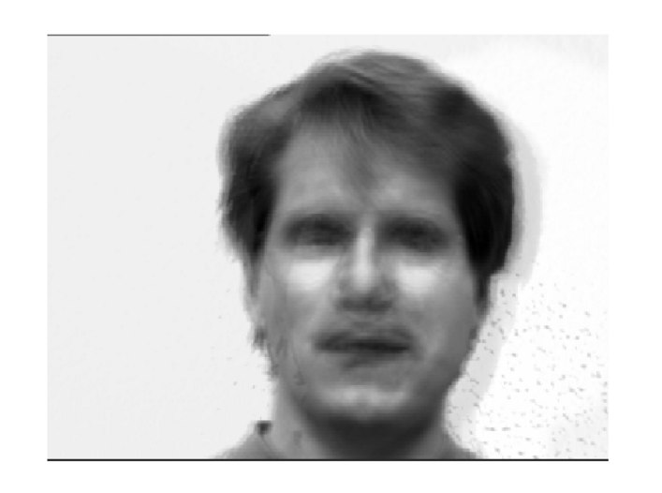
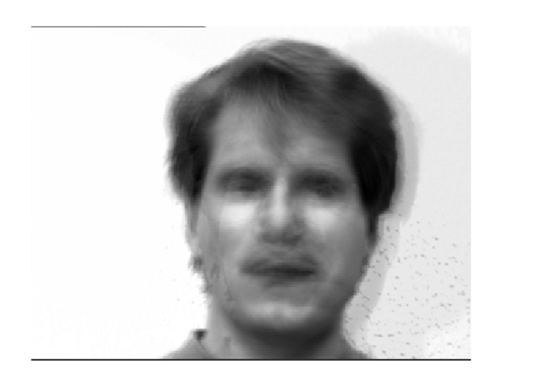
PCA
All of the components.
Code

Slide 12
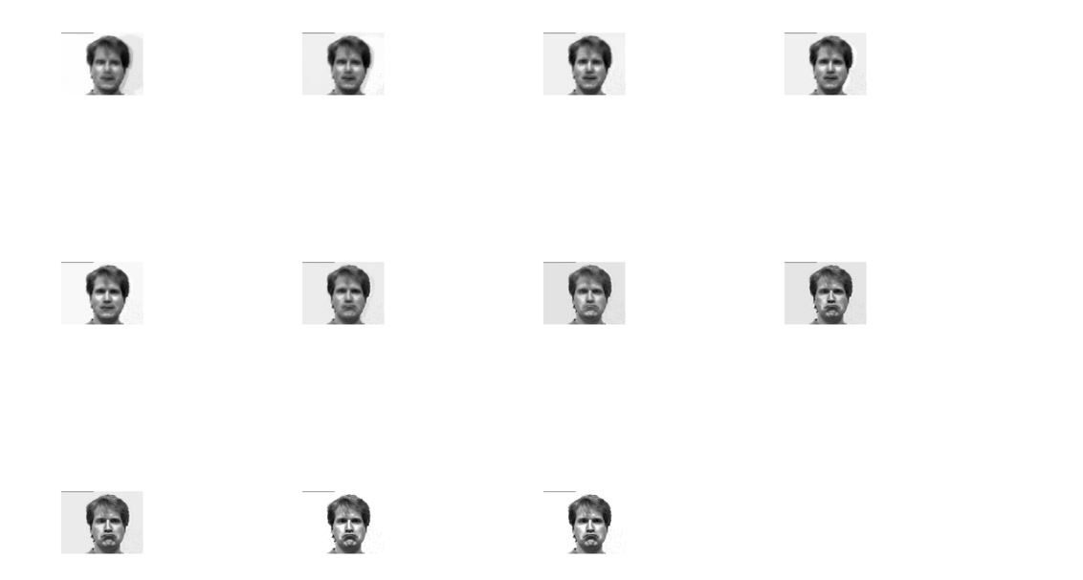
PCA

Slide 13
PCA
Thanks
Notes:
anoyous(

