Slide 1
LDA
WDBC
Notes:
anoyous(

Slide 2
Data Background
An image from the FNA is transferred to a workstation by a video camera mounted on a microscope.
The exact boundaries of the nuclei are determined.
For each image consisting of 10–40 nuclei, the mean value, extreme value and standard deviation of each of these cellular features are computed.
Resulting in a total of 30 real-valued variables.
Theory

Slide 3

Data Background
Wisconsin Diagnostic Breast Cancer Data
The variables of the nucleus of each cell are computed from fluid samples.
The variables are constructed so that larger values would typically indicate a higher likelihood of malignancy.
Based on the data we establish a classifier to separate the malignant from the benign lumps.
Theory

Slide 4
Data Introduction
In this example, we apply linear discriminant analysis on Wisconsin Diagnostic Breast Cancer Data.
WDBC data is a two dimension data set with 569 observations of 32 variables.
WDBC data is based on one of the three methods of diagnosing breast cancer: fine needle aspirate (FNA) with visual interpretation.
Theory

Slide 5
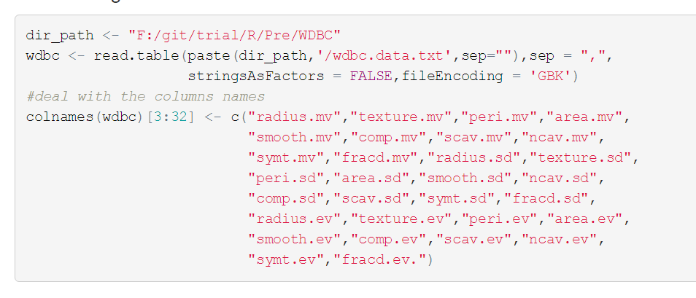

Data Introduction
Enter the following code to set the path reading the data and adjust the columns names.
Code

Slide 6

Data Introduction
Next we check the structure of the whole data set.
Because the variables of the dataset is too long, we omit some result in the following picture.
You can see more details entering the code in your R workspace.
Theory

Slide 7
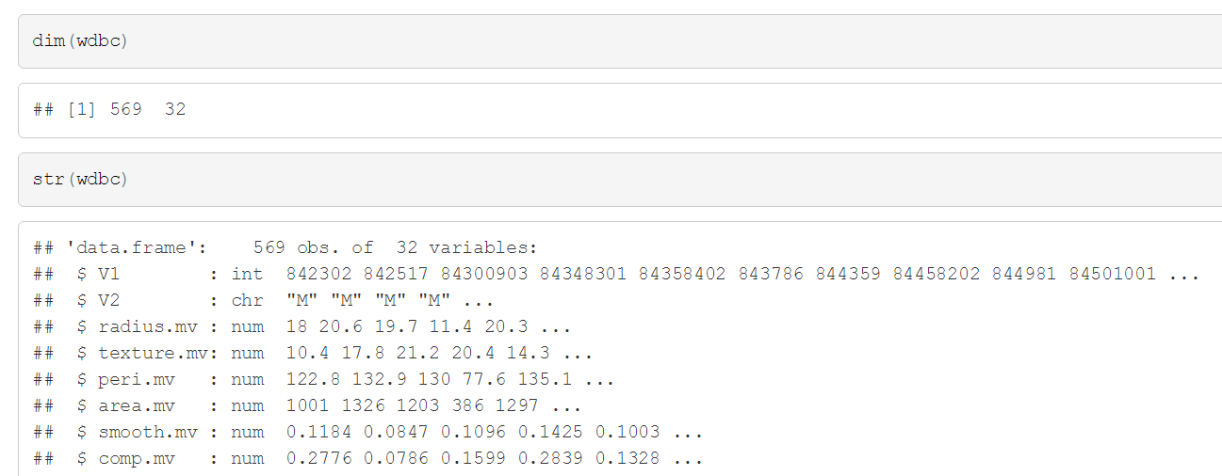
Data Introduction
Notice: V1 is the category variable and V2 is the label.
Code

Slide 8
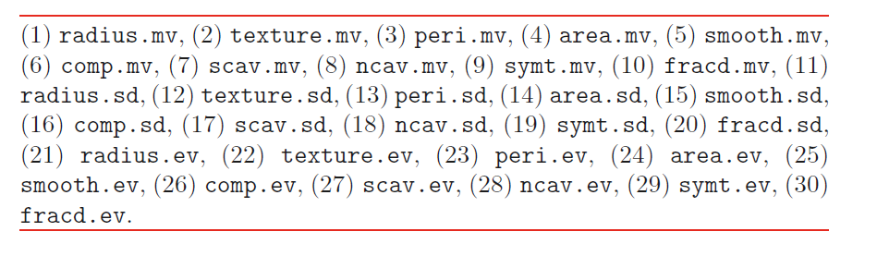
Data Introduction
Beside the first two variables, the rest of variables are the following.
Theory

Slide 9
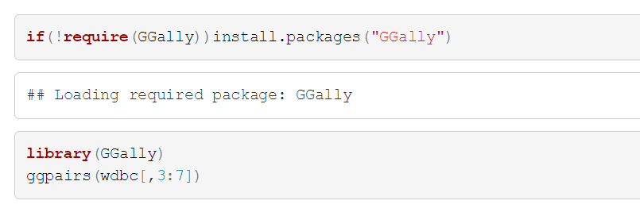

Data Introduction
Many pairs of the 30 variables are highly correlated.
For example, 19 correlations are between 0.8 and 0.9, and 25 correlations are greater than 0.9 (six of which are greater than 0.99).
Because there are too many variables, we just show the first five variables correlation.
Code

Slide 10
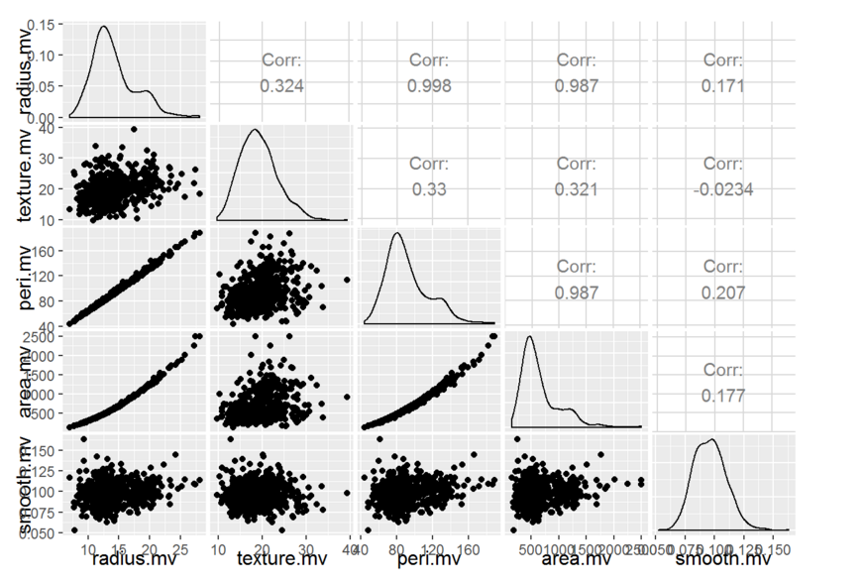
Data Introduction
Result

Slide 11

Data Introduction
Two special process.
We took natural logarithms of each variable before analyzing for convenience.
Data values of zero were replaced by the value 0.001 prior to transforming.
Theory

Slide 12
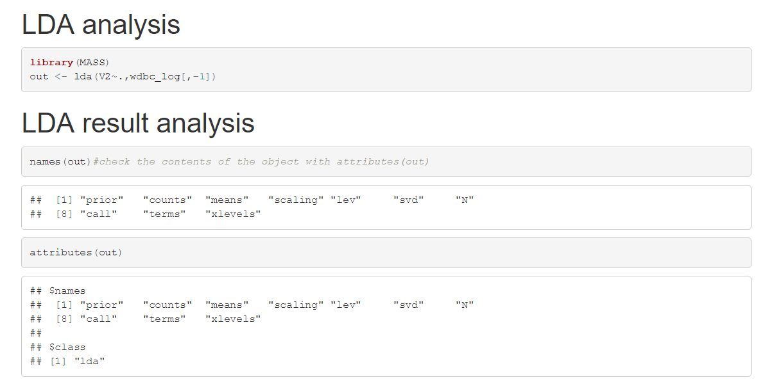
LDA
Code

Slide 13

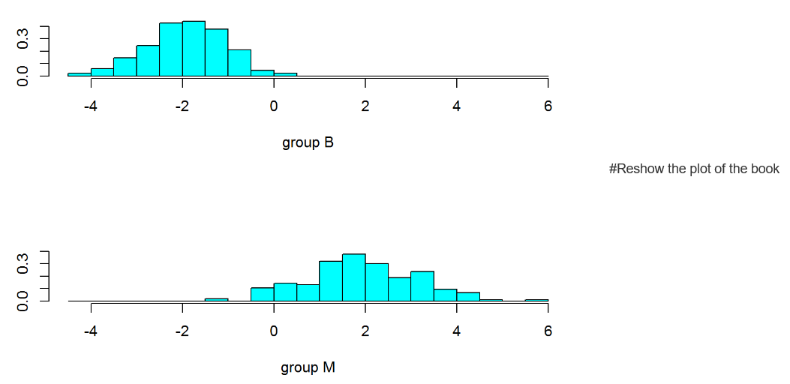
LDA
Result

Slide 14
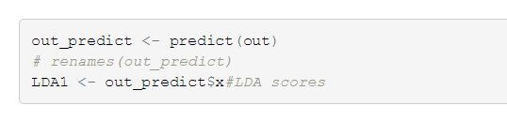



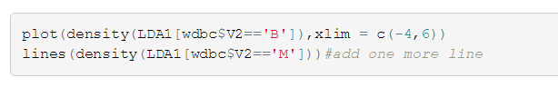
LDA
We do some calculation and show the scores of the samples.
Code

Slide 15
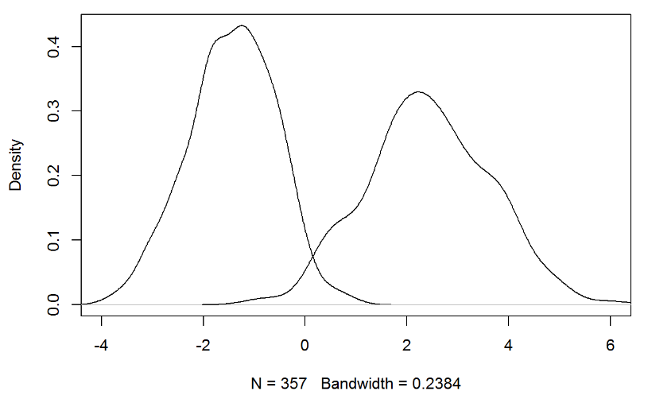
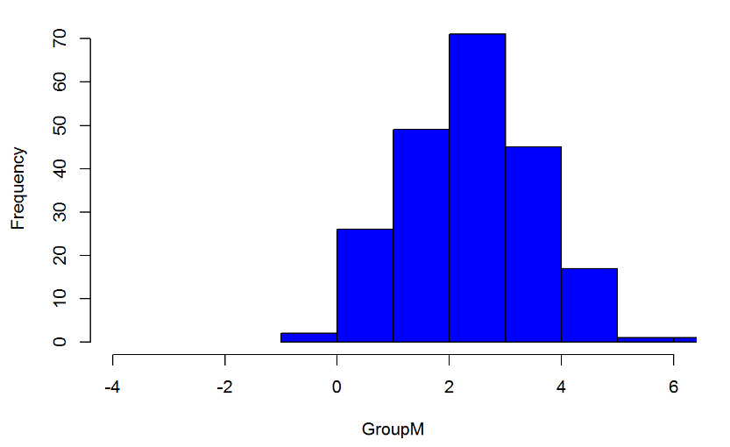
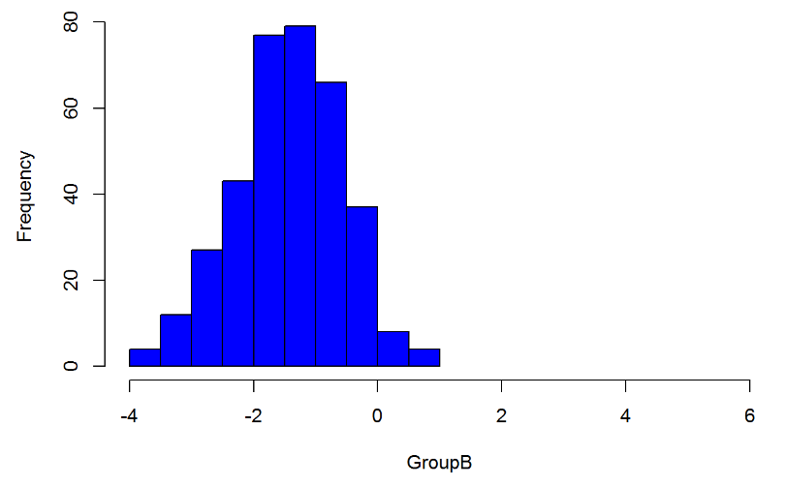
LDA
Result

Slide 16
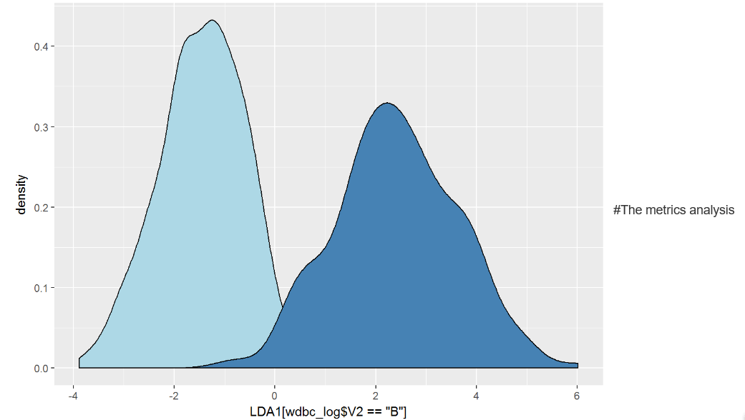
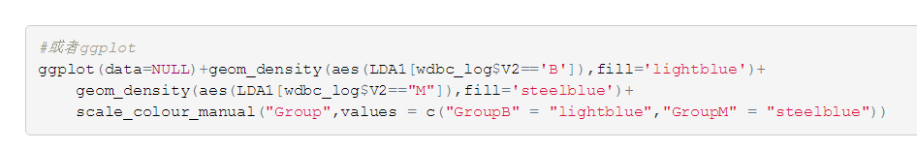
LDA
Or we can use the ggplot2 to plot the density line.
Result

Slide 17

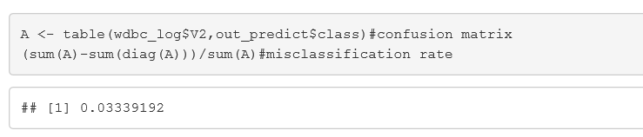
LDA
We check the error rate of the classifier.
Code

Slide 18
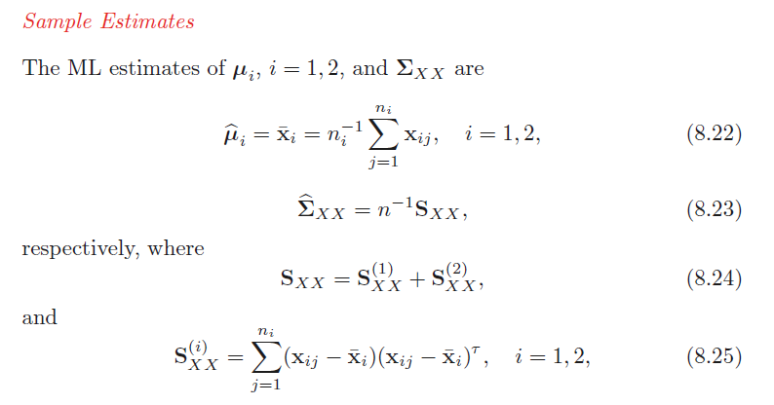
Sample Estimates
Some calculation.
Theory

Slide 19
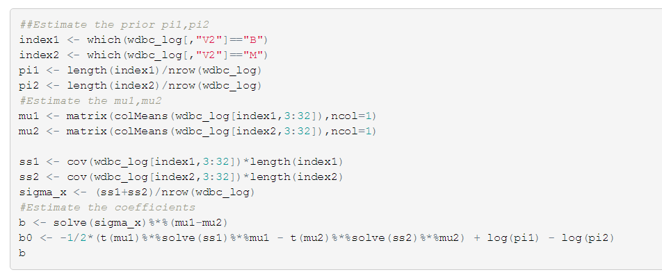
Sample Estimates
Codes follows.
Code

Slide 20
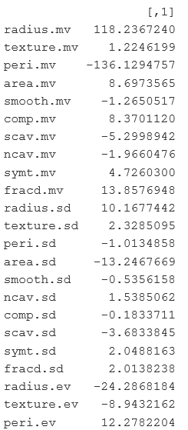
Sample Estimates
The result is too long and we only show a part of them.
Result

Slide 21
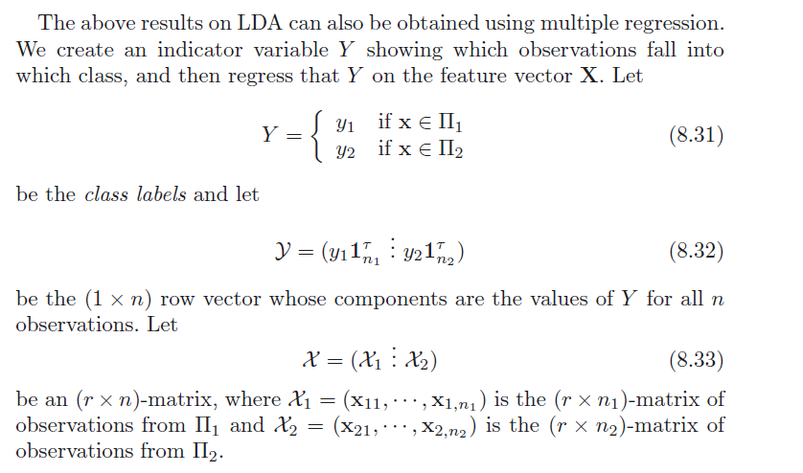
LDA via Multiple Regression
We regress Y (1 if the patient’s tumor is malignant and 0 otherwise) on each of the 30 (log-transformed) variables one at a time.
Theory

Slide 22
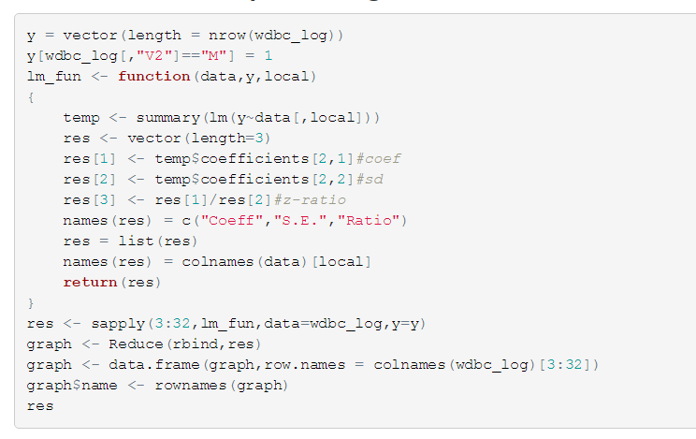
LDA via Multiple Regression
Code

Slide 23
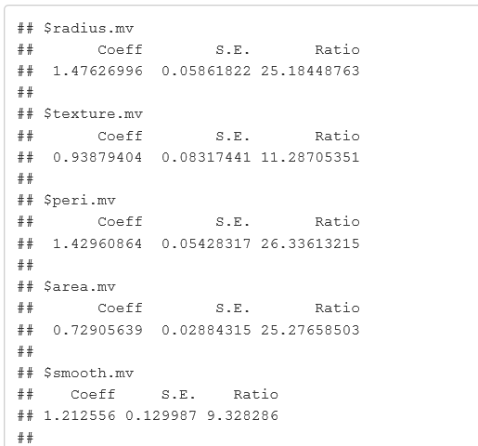
LDA via Multiple Regression
Again, we only show part of the result.
We plot the picture according to the coefficients next page.
Result

Slide 24
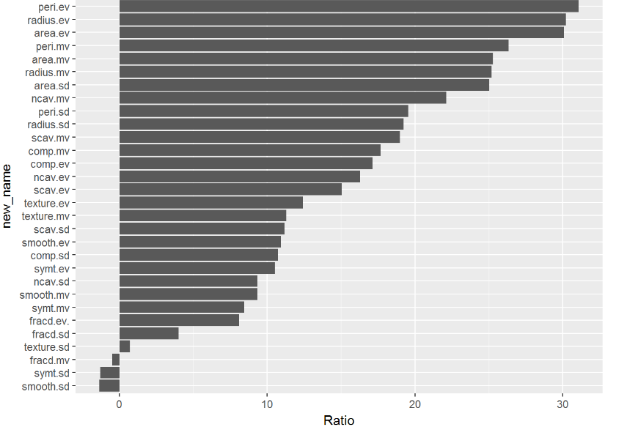
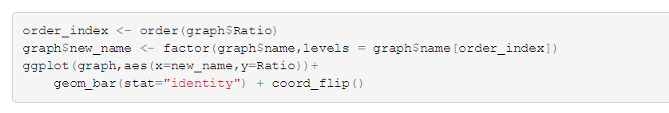
LDA via Multiple Regression
Result

Slide 25
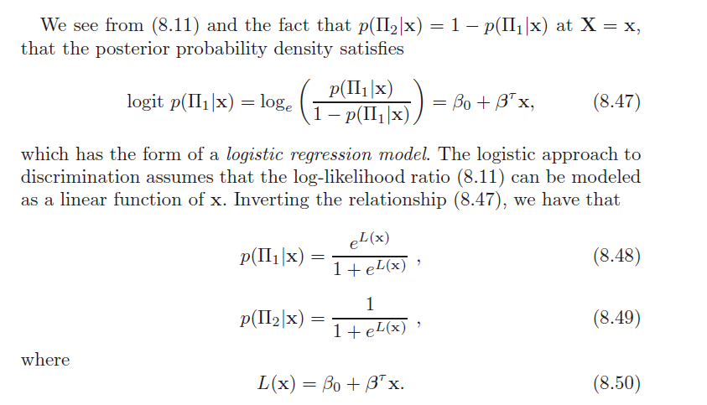


Logistic Discrimination
Theory

Slide 26
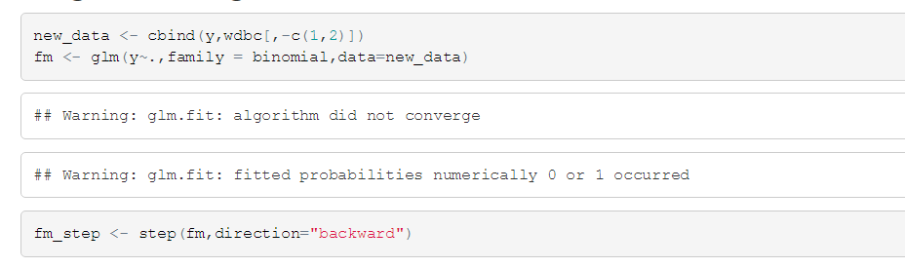
Logistic Discrimination
We perform LR and do variable selection through backward step regression.
Code

Slide 27
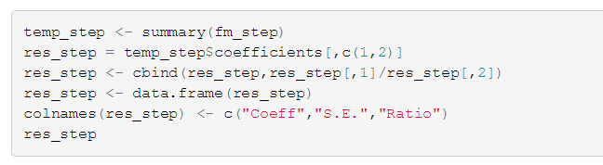
Logistic Discrimination
To see the same result in the book we may need to do some extra work.
Code

Slide 28
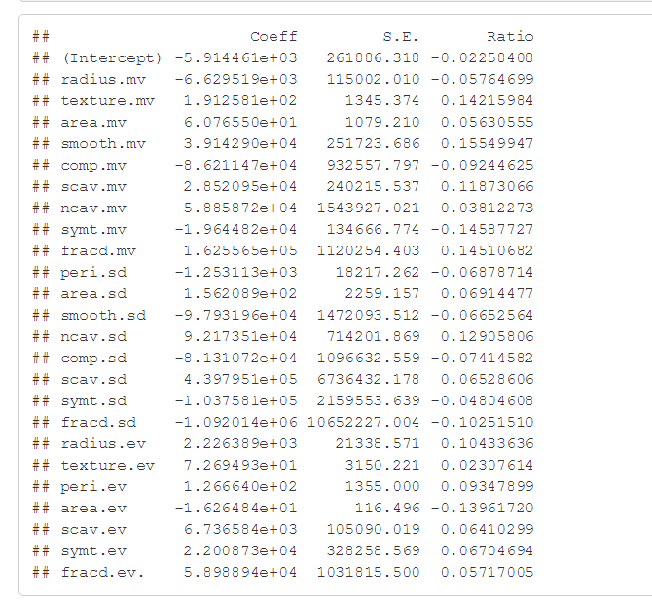
Logistic Discrimination
Step Regression.
Result

Slide 29
LDA
Thanks
Notes:
anoyous(

