Slide 1
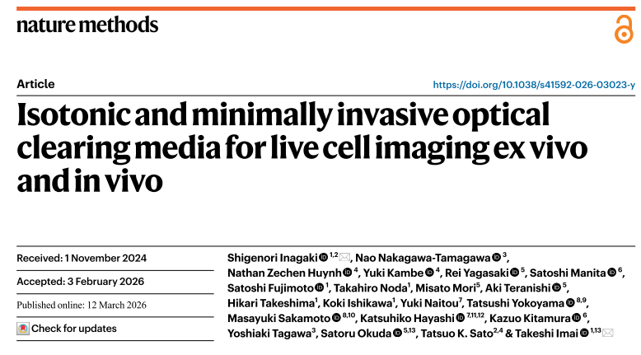
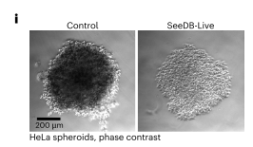
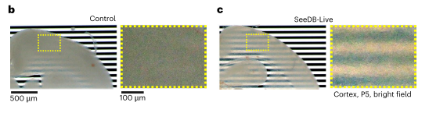
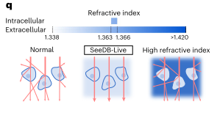
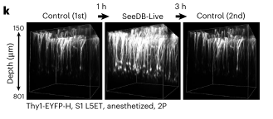
Clearing agents developed for fixed tissues are toxic to live cells, authors developed SeeDB-Live for clearing mammalian cells and tissues.
    Contains a mixture of bovine serum (BSA).
Is replacing the extracellular medium with BSA instead of PBS disrupting cell signaling?

