Slide 1

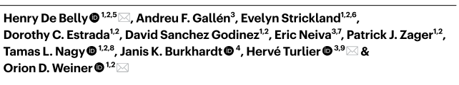
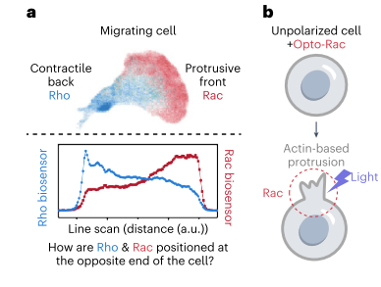
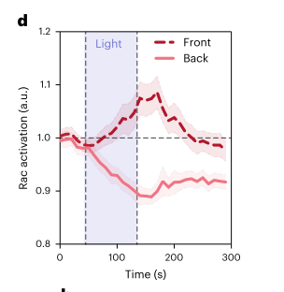
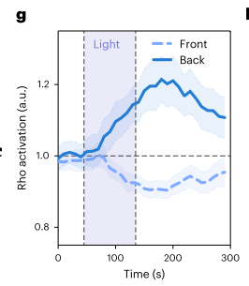
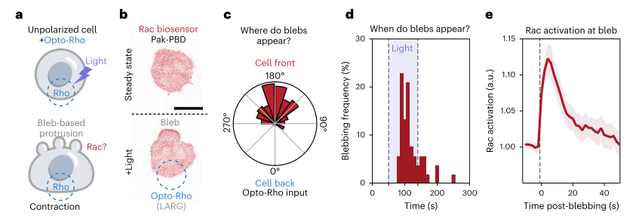
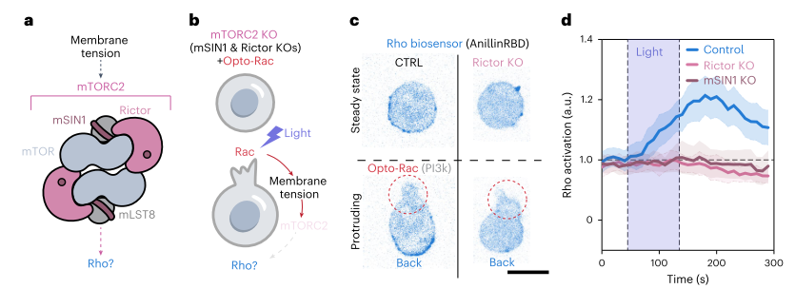
Long Range Rho Activation at Rear of Cell from OptoRac1 light induced activation at the front of the cell.
Utilization of Optogenetic Rac1 and RhoA analogs
Multiplexed with biosensors for Rac1 and RhoA.
HL-60 Cells immature myeloid leukemia cells.
Long Range Rac1 Activation at Rear of Cell from OptoRho light induced activation at the front of the cell.
Long Range Activation is Mediated by Membrane tension and mTORC2 pathway

