Slide 1
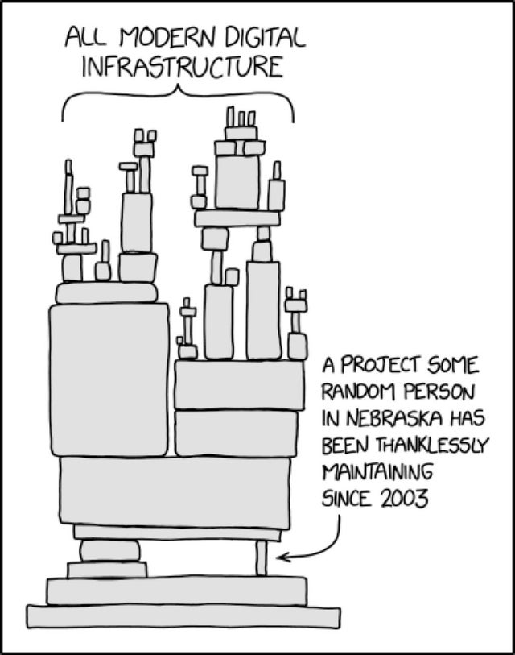


Log4Shell
Bad vulnerability
Systemic failure
An open source tool
A symptom of a larger problem
An important lesson
CVE-2021-44228

Slide 2
How do developers secure software?
Software vulnerabilities largely fall into two categories: memory safety and logical errors.
Memory safety has been more or less solved through better programming languages such as Rust, Go, C#, Java, Swift, Python, and others. However, the problem will be relevant for the foreseeable future since many programs are built on memory-unsafe languages such as C and C++.
Log4J falls into the logical error category. The developers wrote a logging function (which should be expected to receive untrusted user-input) that would in some cases execute that input.

Slide 3
How do developers secure software?
To prevent mistakes like this, organizations implement security controls which include fuzzing.
Fuzzing is the practice of sending a range of potentially unexpected input to a function and watching for any unexpected outcome.
This is a highly effective strategy that has uncovered tens of thousands of logical errors for individual organizations and is widely accepted as an important aspect of security.
Most open-source developers do not fuzz their code or at the very least, might not do it as thoroughly as another organization does.

Slide 4
Fuzzing
Fuzzing isn't a magic wand.
Developers or other security personnel must understand code and manually write code which will properly use a fuzzer against their function based on their expected outcome range.
Understanding code takes time and highly skilled labor.
Herein lies the systemic problem which resulted in the massive Log4J crisis.

Slide 5
Open-source software is a good thing...
Open-source software is everywhere.
Log4J is an open-source software library written by a decentralized group of volunteer developers: The Apache Software Foundation.
Software development (even in secure environments) commonly relies on the work of volunteers like Apache, because it's typically free and solves time-consuming problems.
Open-source software is a good thing...

Slide 6
…But has some consequences.
It means a lot of the code used by a product hasn't been constrained by the developer's own security controls and policies.
This creates potentially unsecured attack surface that can be leveraged to exploit thousands or millions of programs re-using the vulnerable code.
In other words, Log4J wasn't fuzzed, or wasn't fuzzed properly. Doing so would've taken time and resources by either Apache or everyone else.

Slide 7
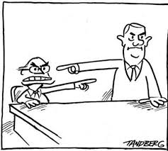
So... Whose responsibility is it?
Should the decentralized group of volunteers, Apache, be responsible for securing the code they publish free of charge?
Or should tens of thousands of other organizations who rely on their code be responsible for securing the code they're using to make profits?

Slide 8
So... Whose responsibility is it?
It would be obviously more efficient for Apache to secure its code once, rather than 10,000 other companies doing it individually, but again, Apache is a decentralized group of volunteers. No one can force them to do anything.
Also, how would everyone agree on exactly which constraints to apply?
This is the important discussion to initiate in the wake of the Log4j vulnerability.

