Slide 1
CUFindIt.tech
By Jack Tabb, Chris Crawford, Henry McGee, Reed Bender

Slide 2

The Goal...
Make a scavenger hunt around Clemson!
Find the Place…

Slide 3
The Goal...
Make a scavenger hunt around Clemson!
Find the Place…
Take the Picture…

Slide 4
The Goal...
Make a scavenger hunt around Clemson!
Find the Place…
Take the Picture…
Get the Next Clue!

Slide 5



The Tech...
React frontend for UI image upload
Docker-containerized server instances for data transfer on AWS
Image classification Neural Network

Slide 6
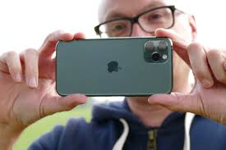
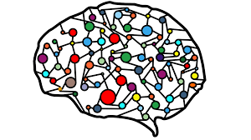
EC2 AWS Instance
Portainer Container Orchestration
React Frontend Server
Nginx Proxy Server
Python Flask Server hosting Network

Slide 7

The Frontend...
Simple ReactJs and html elements
Javascript ajax request sending image to web server
Change visible elements based on ajax response
Files are sent by http post and json response is sent back to the client

Slide 8
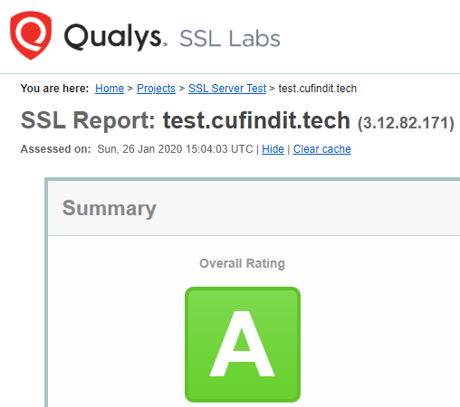
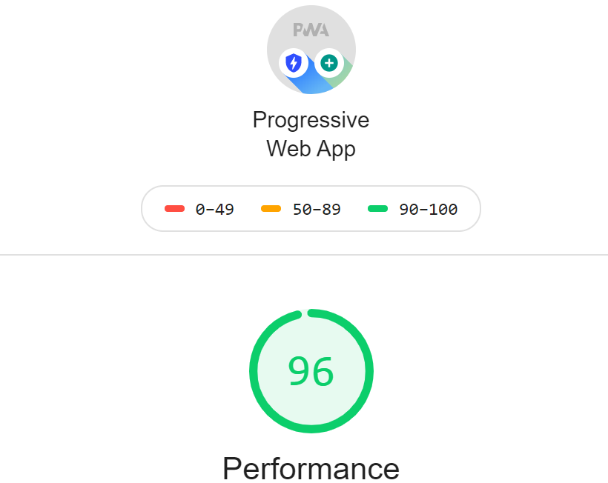
What’s Special About a Progressive Web App (PWA)?

Slide 9
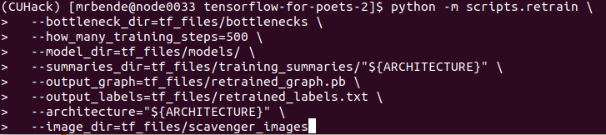
The Neural Network...
6 classes with ~100 images each
Solution to small dataset…
Transfer Learning with tensorflow-for-poets pretrained network, classifying ~1000 classes of images
Trained on Clemson’s Palmetto Cluster

Slide 10
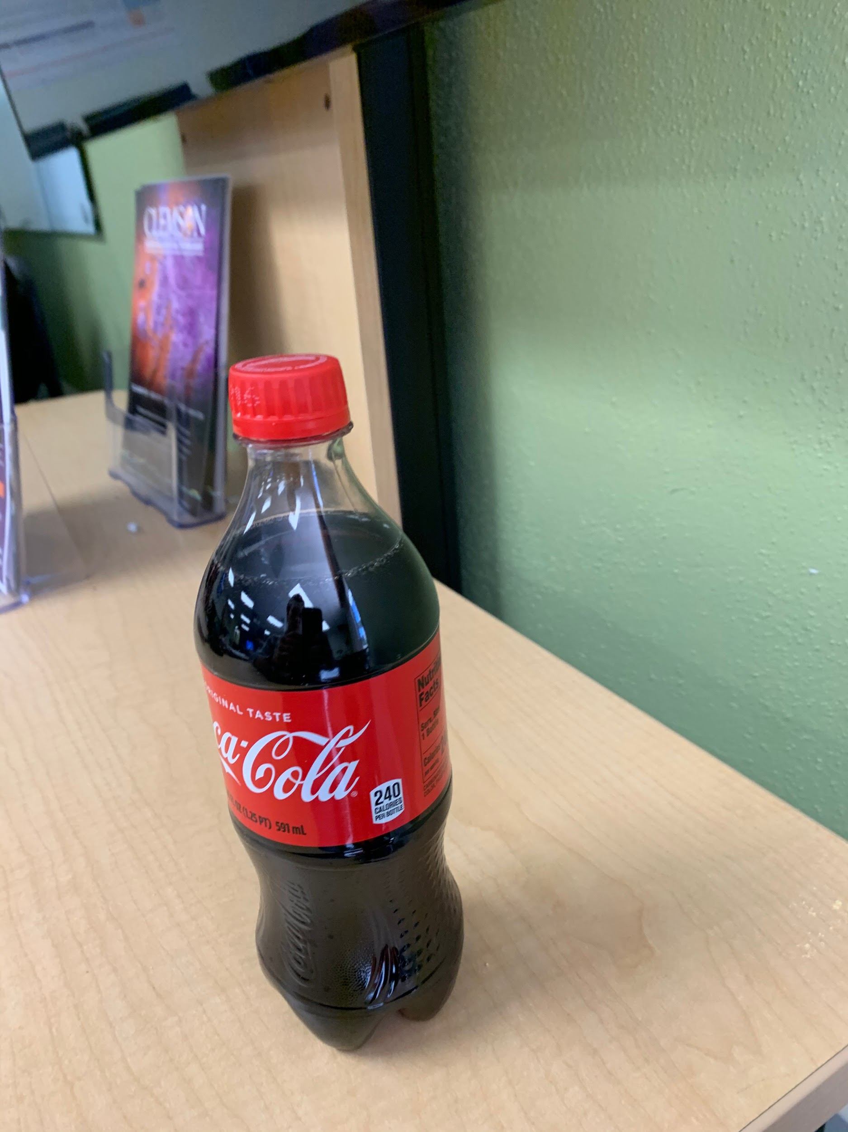
Use it Yourself!
Upload this image into our URL (or take a picture of a coke bottle yourself) and begin your scavenger hunt…
CUFindIt.tech

Slide 11
Future
Model is finicky
Colors throw off the detection. We should only care about shape. Do grayscale.
Some pictures are rotated 90°. The neural network was not trained with this in mind.
It will not recognize a statue if the statue is rotated 90°
Yes, we are aware of the issue of overfitting the model. Transfer learning helped, but it’s a hackathon… We hacked it...
IPhones use heic instead of jpeg and some computers upload png or gif instead of jpeg. Need to convert all to jpeg, jpg, or png
Add more scavenger-hunt-esque parts to the front end user experience.

