Slide 1
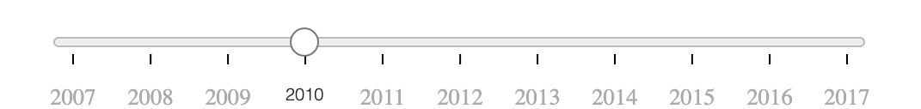
Factor Selector
Choropleth
Box-Plot Small Multiples
Time Slider
Starplot
Scatterplot Small Multiples

