Slide 1
Databases Final Project:
Recipe Application
Anna Smith, Jalen Tacsiat

Slide 2
Goal: A Simple Application for Storing and Searching for Recipes
Create your own profile or login to an existing profile
Specific, useful search filters
Search for both recipes and meals
Create and view recipes and meals or your own

Slide 3
Technology Used
Front End:
Python 3
Tkinter Libraries
Back End:
MySQL
Gonzaga Database Servers

Slide 4
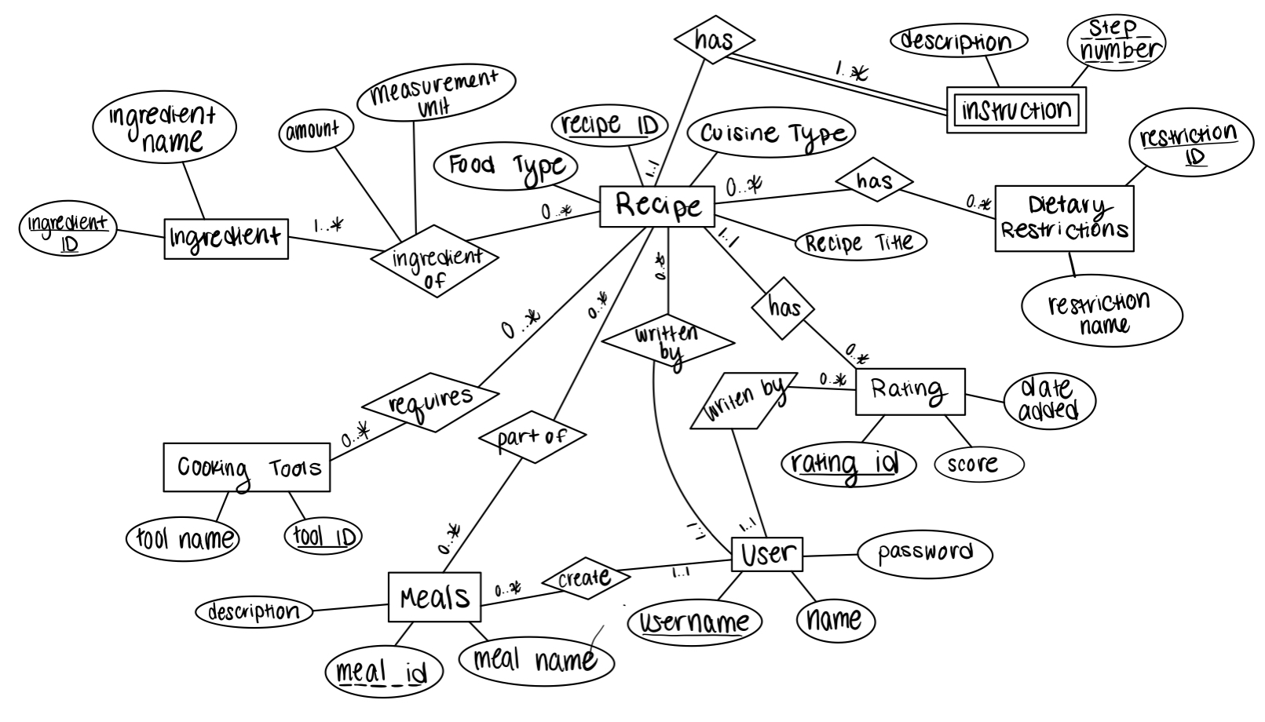
ER Diagram

Slide 5
Complex Queries
(Will Be Shown In Demo)
One large search query for recipes
One large search query for meals

Slide 6
Anticipated Workload & Indexes
Generated Fake Info:
100 Users
1000 Recipes (10/per user)
Each user has between 1 and 20 meals
15 Cooking Tools
6 Possible Dietary Restrictions
7 Possible Cuisines
70 ingredients across 7 cuisines
30 reviews for each recipe given random 1-5 scores
Indexes:
Index on Cuisines
Will divide Query Time by 7
Index on Average Rating

