Slide 1
John Paul Aguinaldo Post-Graduate Diploma in AI and Machine Learning March 2026
CAPSTONE PROJECT - EXECUTIVE PRESENTATION Fraud Detection Using Machine Learning

Slide 2



BUSINESS PROBLEM
Smarter fraud detection is needed to mitigate financial loss, manage operational efficiency, and improve customer experience.
PROBLEM CONTEXT
Credit Card Fraud
OPPORTUNITY
Machine Learning
SUCCESS MEASURES
KPIs
Direct financial losses
Manual investigation costs
Customer friction and dissatisfaction
Reputational and regulatory risk
Early fraud detection
Reduced false alarms
Scalable decision-making
Fraud detection rate
False positive rate
Operational efficiency

Slide 3




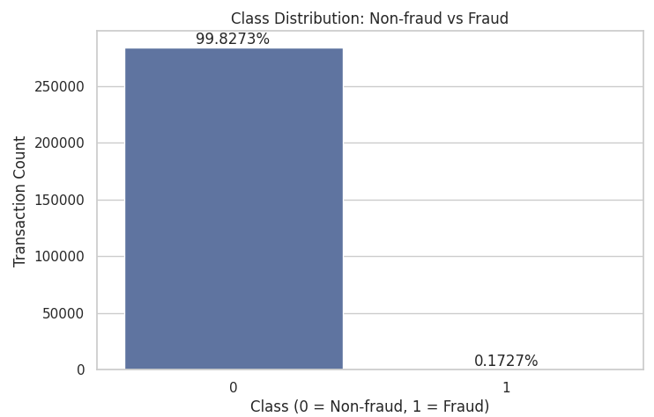
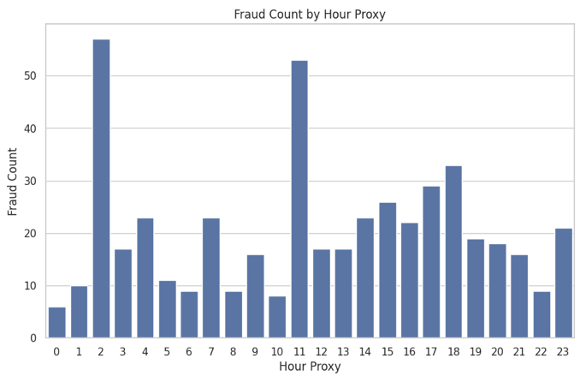
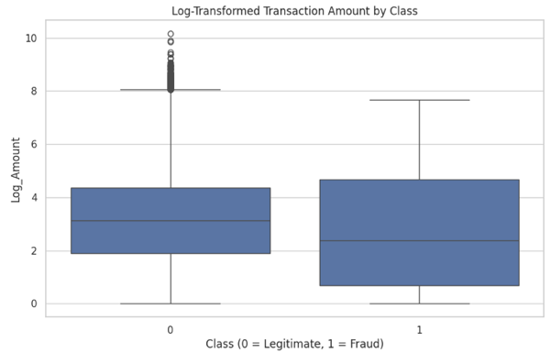
DATA AND INSIGHTS
Credit card fraud is rare but exhibits detectable behavioral patterns.
DATASET
Credit Card Fraud Detection
~285K
TRANSACTIONS
0.17%
FRAUD RATE
0
MISSING DATA
1,081
DUPLICATE TRANSACTIONS
Fraud is highly imbalanced and difficult to detect.
Fraud risk is higher at night (12:00 a.m. to 5:00 a.m.).
Fraud occurs across transaction sizes.

Slide 4



MACHINE LEARNING SOLUTION
A structured machine learning (ML) approach was used to identify high-risk transactions and improve fraud detection accuracy.
Solution Design Principles
Prioritize fraud detection
Balance with operational efficiency
INPUT
Historical data
PROCESS
Learn fraud behavior based on:
Timing of transactions
Transaction characteristics
Hidden patterns in the data
OUTPUT
Fraud or Legitimate?
HOW IT WORKS
Machine Learning
PREPARATION
Cleaning and preparation of transaction data
IMPLEMENTATION
Tested multiple analytical approaches
MODEL SELECTION
Selected approach with best balance between
Fraud detection
Operational efficiency
WHAT WAS DONE
Modeling Pipeline

Slide 5

MODEL PERFORMANCE
The final model produces highly reliable fraud alerts while capturing most fraudulent transactions.
Final Model Performance
Detects majority
of fraudulent transactions
Generates
high-confidence alerts
Flags
few false alarms
Performance Metric | Interpretation | What This Means
Precision 0.96 | Very few false alarms 96% of flagged transactions are truly fraudulent. | Fraud teams can focus on higher quality cases. Customers experience fewer unnecessary disruptions.
Recall 0.79 | Detects a majority of fraud cases 79% of fraud is detected. | Strong fraud protection. BUT some fraud may still be missed.

Slide 6


BUSINESS IMPACT & ROI
The model reduces costs and improves efficiency while maintaining strong fraud protection.
MACHINE LEARNING MODEL
Value Proposition
ML MODEL INTEGRATION
Efficiency Gains
Reduced fraud losses: More fraud cases detected early
Lower operational costs: Fewer false alarms → less manual review
Better customer experience: Fewer unnecessary transaction disruptions
More efficient fraud investigation process
Scalable fraud detection capability
Better resource allocation

Slide 7

RISKS AND LIMITATIONS
Key risks must be actively managed to protect ROI and ensure fairness.
Performance Risks
Missed fraud cases (false negatives)
Uneven detection across time segments
Fairness & Governance Risks
IMPLICATION
Model cannot operate independently without safeguards.
Variability in subgroup performance
Limited ability to fully assess fairness
Interpretability Risks
Model is technically explainable but not directly actionable due to anonymized features

Slide 8



STRATEGY & RECOMMENDATIONS
Adopt a multi-layered strategy to maximize the model’s value and manage fraud risk effectively.
Fraud Detection Strategy
Risk Management Strategy
Deploy model as primary fraud detection layer.
Adjust thresholds based on risk appetite.
Implement continuous monitoring of key metrics:
Model Performance: Recall, Precision, PR-AUC
Fairness: Subgroup Performance
Decision
Strategy
Governance & Ethical AI
Implement a tiered decision framework:
High-risk → Block
Medium-risk → Review
Low-risk → Approve
Maintain audit logs and model transparency
Monitor fairness and bias
Enable human oversight for critical decisions

