Slide 1
John Paul Aguinaldo Post-Graduate Diploma in AI and Machine Learning March 2026
CAPSTONE PROJECT - TECHNICAL PRESENTATION Fraud Detection Using Machine Learning

Slide 2
PROBLEM DEFINITION
BUSINESS PROBLEM
Credit Card Fraud
DATA SCIENCE SOLUTION
Machine Learning Model for Fraud Detection
Business Impact
Direct financial losses
Additional operating costs
Customer dissatisfaction
Regulatory scrutiny
Reputational damage
Binary Classification
Outcome: Legitimate or Fraud
Supervised Learning
Labeled outcomes are available
Credit Card Fraud Classification Model
Informs decisions to address
Model Evaluation
Recall: Primary metric for fraud capture
Precision: Controls false positives
F1 Score: Balances recall and precision
Business KPIs
Fraud loss prevention rate
Fraud detection rate
False positive rate
Manual review efficiency
enables
Model Comparison
ROC-AUC: Overall discrimination
PR-AUC: Preferred ranking metric under class imbalance
supports

Slide 3
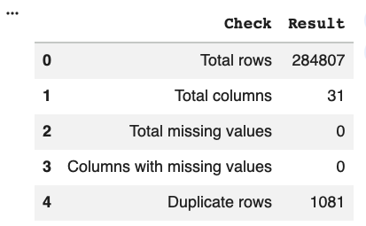
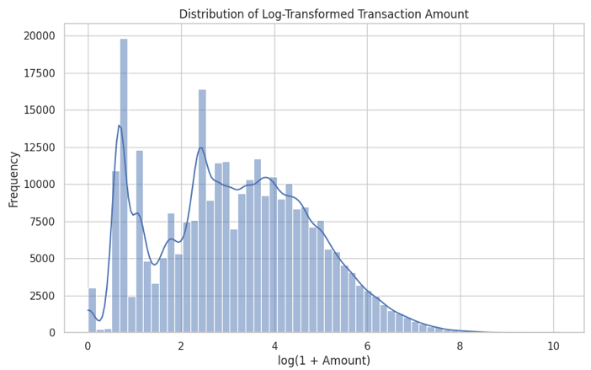
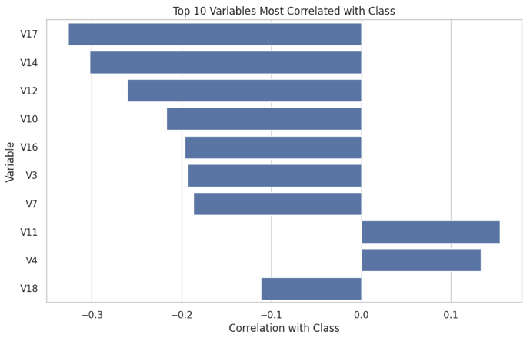
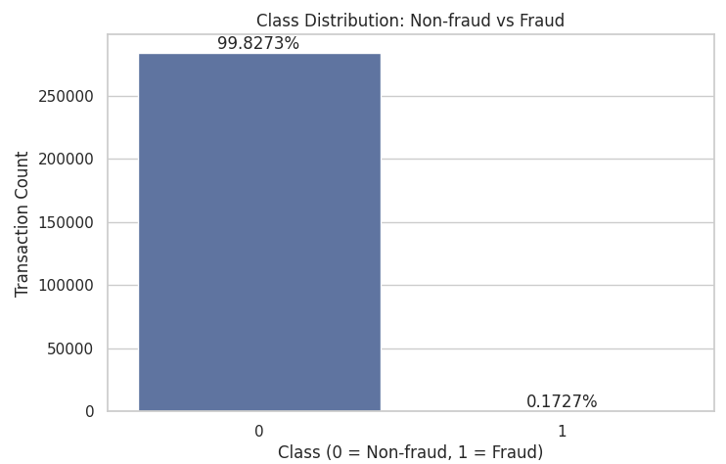
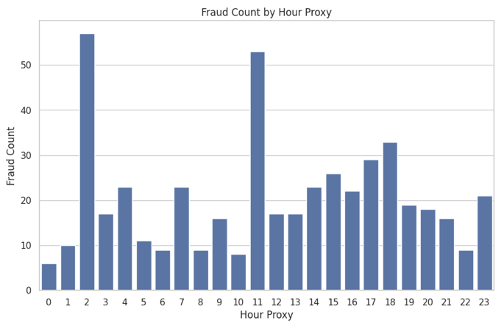
DATASET OVERVIEW AND EDA
Dataset Description
Name: Credit Card Fraud Detection
Source: Kaggle
Description: Real-world European credit card transactions made in two days in September 2013
Variable |  | Type | Description
Target | Class | Integer | Fraud label: 0 = legitimate, 1 = fraud
Predictors | Time | Float | Elapsed time in seconds since the first recorded transaction
 | Amount | Float | Transaction amount (Euros)
 | V1-V30 | Float | PCA-transformed features, anonymized for data privacy
Database Size
~285K transactions
Data Quality
No missing values,
~1K duplicate rows
Amount Distribution
Highly right-skewed, with high-value outliers
Class Distribution
Severe class imbalance (~0.17% fraud)
Time Distribution
Potentially useful time patterns
Correlation Patterns
Some transformed variables (V) are meaningfully correlated with fraud
Implication
Additional feature engineering is required

Slide 4
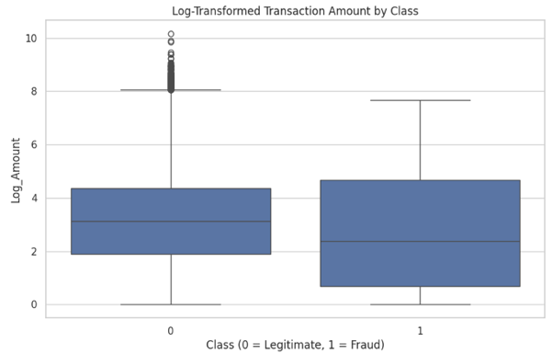
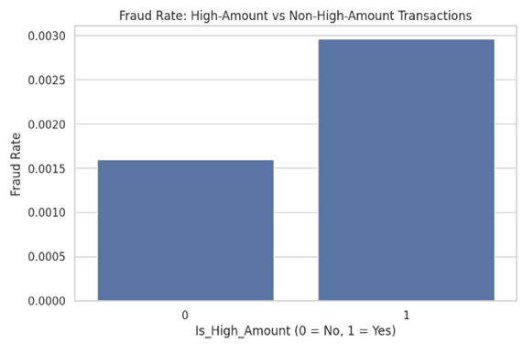
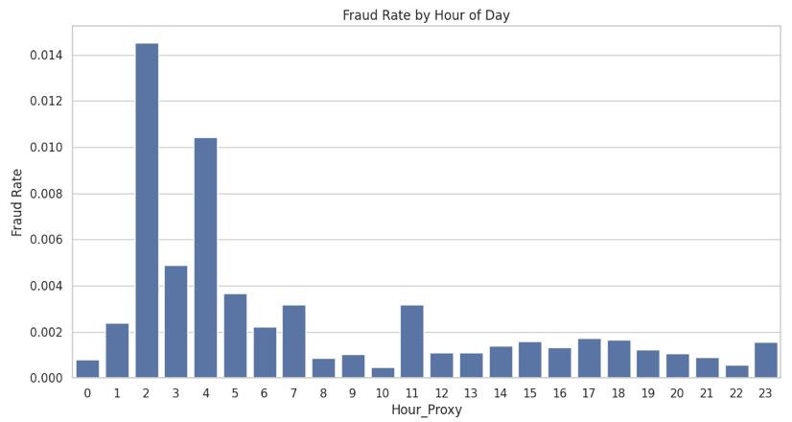
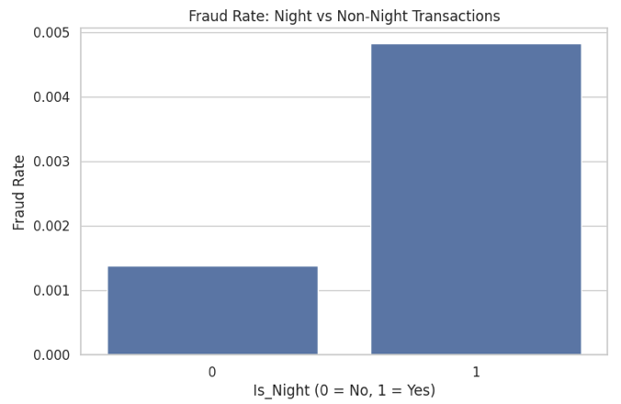
FEATURE ENGINEERING
Data Handling
Nulls: None (no missing values)
Outliers: Retained but will be transformed and scaled
Duplicates: Removed from working dataset
Engineered Amount Features
Engineered Time Features
Log_Amount
Logarithmic transformation of Amount
Reduces influence of extreme values without removing them
Observations
Fraud transactions more dispersed
Fraud not just concentrated on large amounts
Is_High_Amount
Binary: 1 if Amount ≥ 95th percentile
Explores fraud signal of outliers
Observation: Slightly higher fraud rate for high-amount transactions
Hour_Proxy
Transforms Time into approx. hourly-cycle proxy
Improves interpretability of timing patterns
Hour_Sin & Hour_Cos
Transforms Hour_Proxy into a cyclical variable
Captures 24-hr nature of time
Observation: Fraud rates higher from Hours 1 to 7 and Hour 11
Is_Night
Binary: 1 if transaction is between midnight (Hour 0) and 5 a.m. (Hour 5)
Explores fraud signal of unusual timing
Observation: Significantly higher fraud rate for night transactions

Slide 5
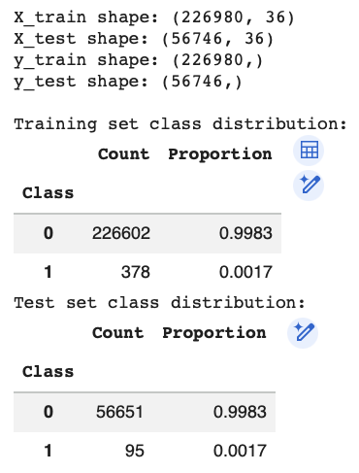
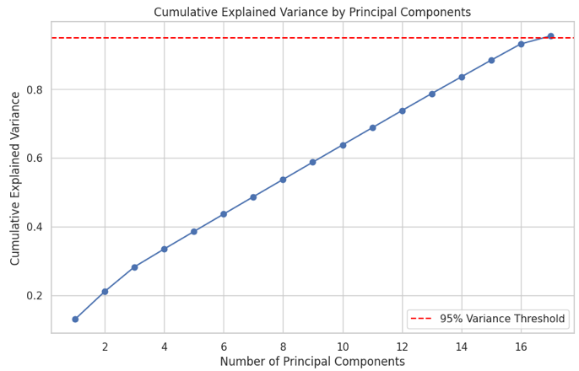
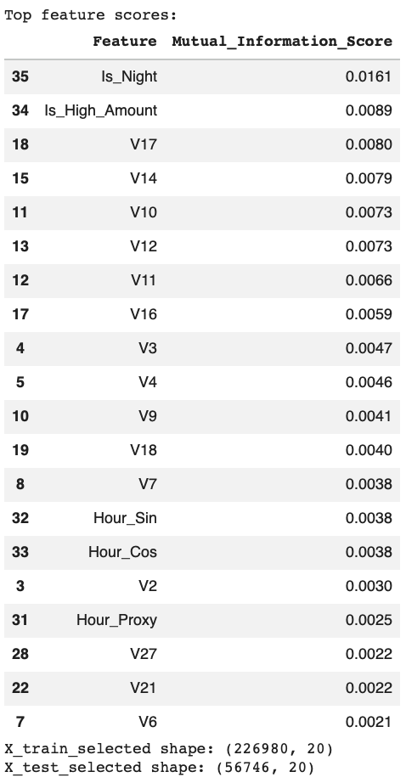
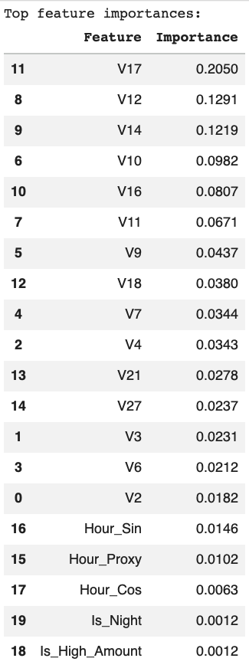
DATA PREPROCESSING
Pipeline: Engineered Dataset → Split → Scale → Select → Transform
Train-Test Split
80:20 ratio with stratified sampling
Preserved class distribution
Feature Selection
Reduced number of predictors from 36 to 20
Captured both independent and interaction-driven fraud signals
Dimensionality Reduction
Performed Principal Component Analysis (PCA)
Retained at least 95% of explained variance
Result: 17 principal components
1. Mutual Information
Filter-based feature selection
Captures linear & non-linear dependencies
2. Random Forest
Model-based feature importance
Captures interactions between variables
Feature Scaling
Standard scaling of predictors
Fit on training set only to prevent leakage
Datasets for Modeling
Original feature set (36 features
Selected feature set (top 20 features)
PCA-transformed set (17 principal components)

Slide 6
MODELING STRATEGY AND EXPERIMENTAL DESIGN
Model Implementation
Model | Type | Rationale
Logistic Regression (LR) | Linear | Baseline model for comparison
Decision Tree (DT) | Tree-Based | Benchmark for non-linear models
Random Forest (RF) | Ensemble (Bagging) | Baseline ensemble model
Gradient Boosting (GB) | Ensemble (Boosting) | Test for boosting behavior
XGBoost (XGB) | Advanced Boosting | High potential for optimization
Model Evaluation & Comparison
Hyperparameter Tuning
RandomizedSearchCV on top models, optimize F1
Model Selection
Best F1 + PR-AUC
Metric | Strengths in Fraud Context | Rationale
Recall (Fraud) | Minimizes missed fraud | Critical for risk mitigation
Precision (Fraud) | Reduces false alarms | Evaluation of operational efficiency
F1-Score | Captures recall-precision trade-off | Primary optimization metric
PR-AUC | Robust to imbalance | Model ranking metric
ROC-AUC | Benchmark for overall separability | Secondary reference
Threshold Optimization
Threshold tuning (0.1 to 0.9), maximize F1
Final Model

Slide 7
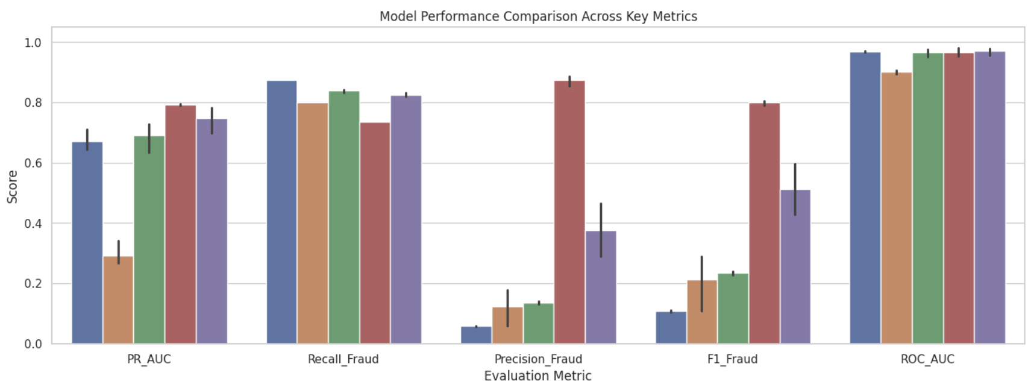
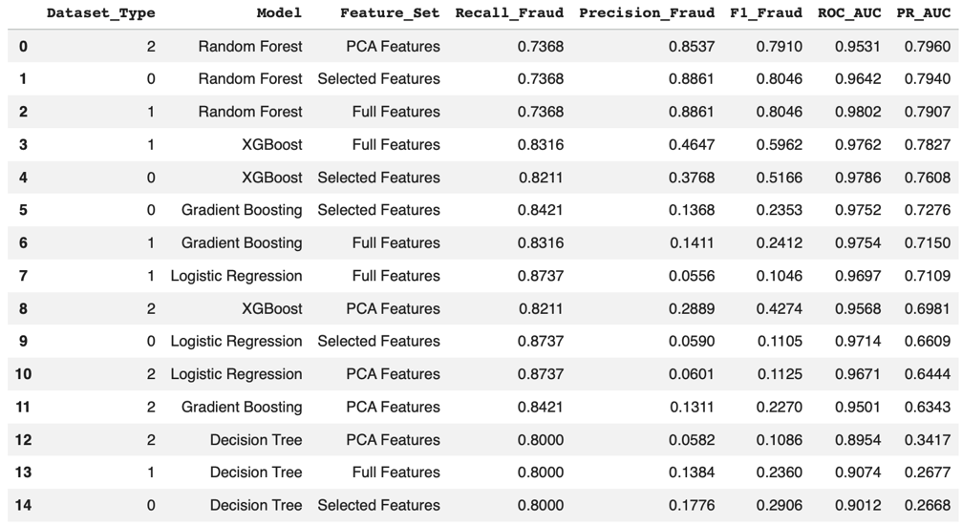
MODEL IMPLEMENTATION AND EVALUATION
Findings per Model
LR: High recall, lowest precision → high operational burden
DT: High recall, weakest overall performance
RF: Best untuned balance → strong potential for tuning
GB: Good PR-AUC, low precision → high operational burden
XGB: Strong recall, good PR-AUC → high tuning potential
LR DT RF GB XGB
Selected Models for Hyperparameter Tuning
Model | Feature Set | Rationale
Random Forest | PCA | Best untuned performance
Random Forest | Full | Second best performance
XGBoost | Full | Stronger recall vs. RF models

Slide 8
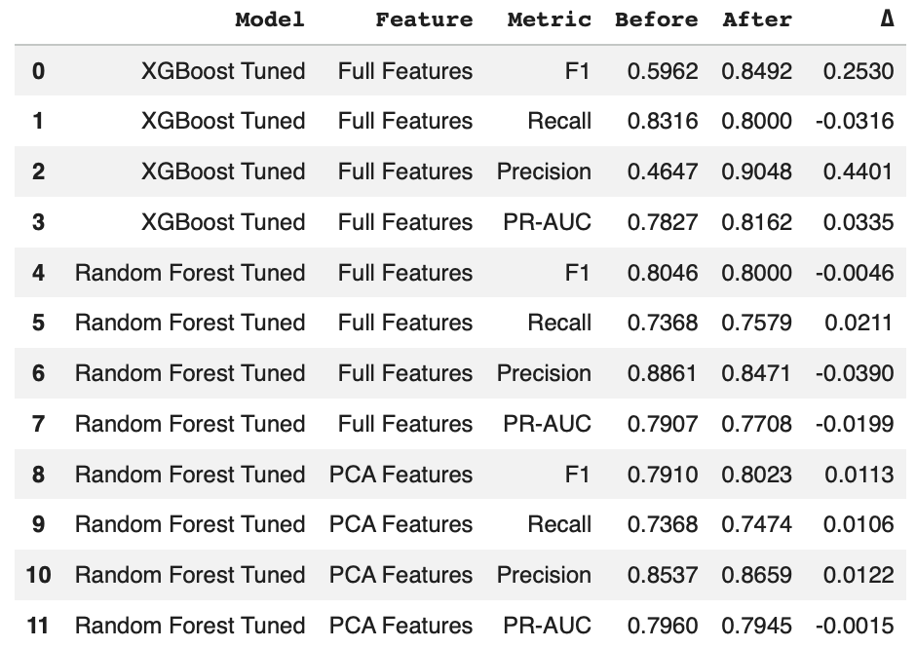
HYPERPARAMETER TUNING
Tuning Strategy
RandomizedSearchCV: 10 parameter combinations using 3-fold stratified CV
StratifiedKFold to preserve class distribution across folds
Optimized for F1-Score to balance recall (minimize fraud) and precision (operational efficiency)
Selected Model
Tuned XGBoost – Full Features
Highest PR-AUC: Best performance across classification thresholds in an imbalanced setting
Highest F1-Score: Strong balance between fraud detection and operational efficiency (low false positives)
Summary of Performance Metrics – Before vs. After Tuning
Rank 1: Tuned XGBoost – Full Features Model
Best overall performance
Significant improvement in precision with minimal recall reduction
Rank 3: Tuned Random Forest – Full Features Model
Weakest performance among tuned models
Slight increase in recall offset by slight precision reduction
Rank 2: Tuned Random Forest – PCA Features Model
Almost no change after tuning → baseline already strong
Negligible PR-AUC change, slight improvement in recall & precision

Slide 9
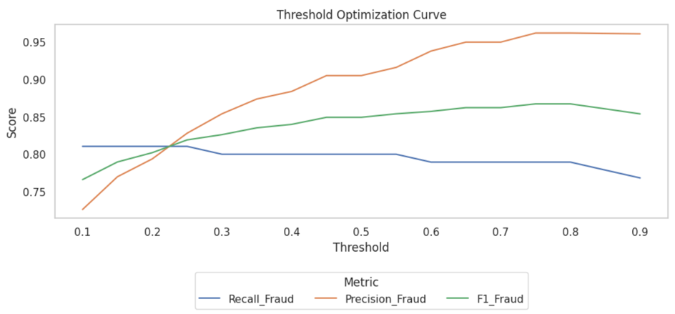
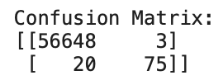
MODEL FINALIZATION
Threshold Optimization
Optimal Threshold = 0.75
More conservative model (fewer false positives)
Slightly more missed fraud cases (reduced recall)
Better balance of recall-precision trade-off
Model | Threshold = 0.75 | Threshold = 0.50 | Rationale
Precision | 0.9615 | 0.9048 | Significant improvement
Recall | 0.7895 | 0.8000 | Slight trade-off
F1-Score | 0.8671 | 0.8492 | Better overall balance
Final Model
Tuned XGBoost, Full Feature Set, Threshold = 0.75
High precision
More reliable fraud alerts → Reduced operational burden and customer friction
Slightly lower recall
Some undetected fraud → Need complementary mechanisms to manage missed fraud

Slide 10
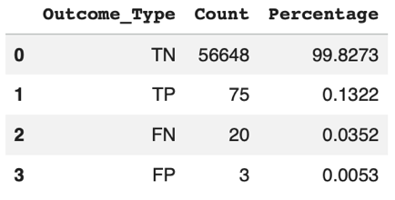
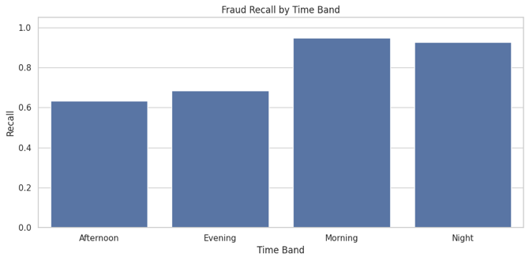
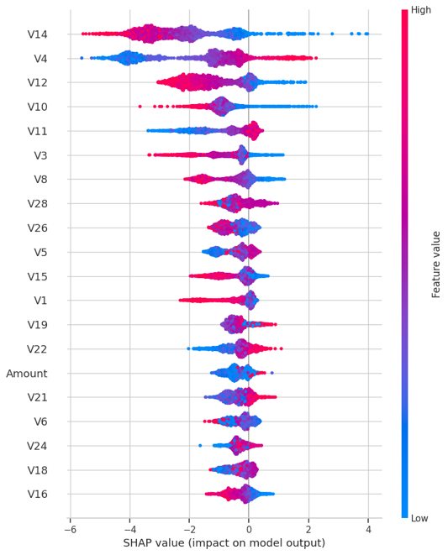
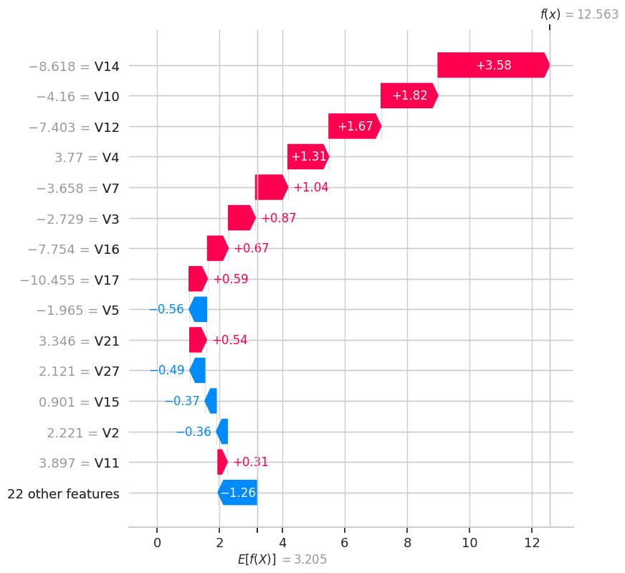
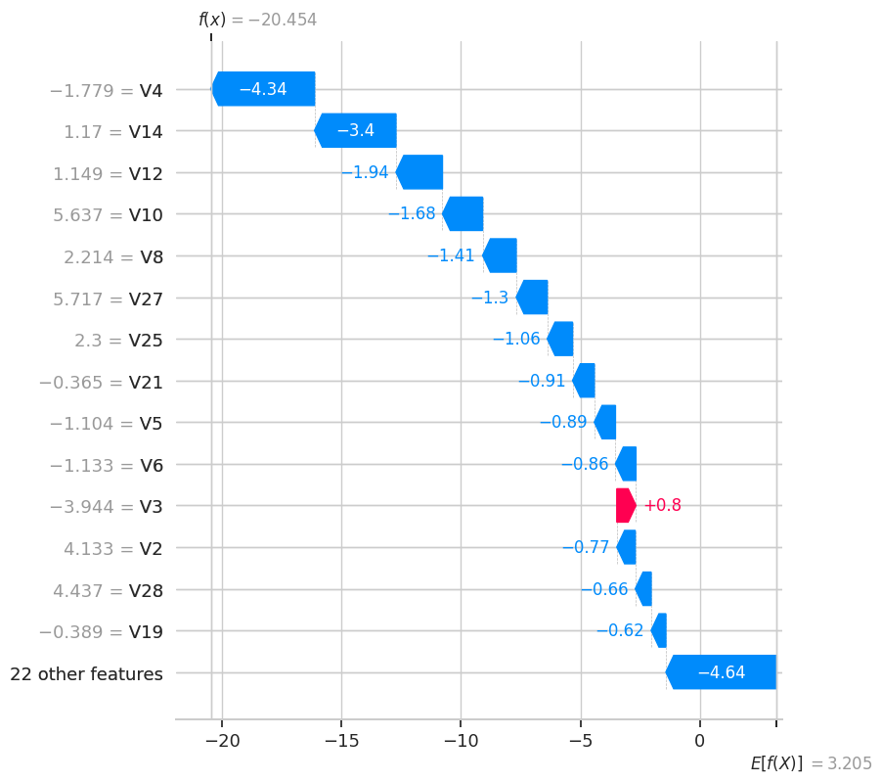
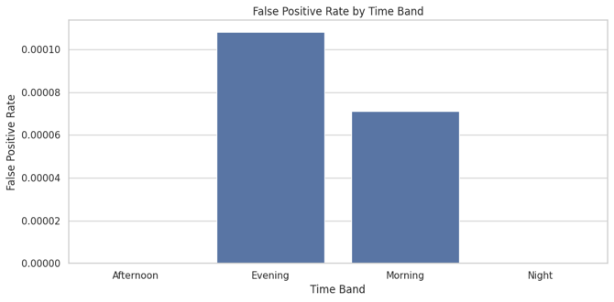
MODEL LIMITATIONS
Model Performance Limitations
False negatives → Missed fraud transactions
False positives → Operational burden, customer friction
Fairness and Subgroup Limitations
Uneven fraud detection across time bands
Threshold adjustment did not resolve subgroup disparities
Unobserved demographic groups may also show disparities
Interpretability and Transparency Limitations
Key predictors are PCA-transformed → Explainable but not actionable
SHAP explains model behavior, but not business meaning
Limited ability to translate model outputs into actionable insights
Global Explainability
Key variables strongly influence predictions.
Local Explainability
Individual decisions are explainable at the transaction level.

Slide 11
RISK MITIGATION AND ETHICAL AI
Priority | Risk Area | Mitigation | Ethical AI Considerations
High | Missed fraudulent transactions | Feature engineering | Transparency: Document model limitations
High | Uneven fraud detection performance across transaction segments | Feature engineering Regular fairness monitoring | Fairness Monitoring: Track subgroup performance
High | Limitation of threshold-based optimization | Multi-stage or context-aware decision framework | Balanced Decisioning: Avoid systemic bias
High | Need for continuous governance and fairness monitoring | Metrics monitoring system across relevant segments | Auditability: Maintain logs and model tracking
Medium | Operational impact of false positives | Tiered decision framework | Customer Impact: Reduce friction
Medium | Limited business interpretability of anonymized and transformed features | Interpretable monitoring features Business-facing explanation layers | Human Oversight: Enable explainability

