Slide 1
Does Where You Live Predict
How Well You Learn?
State Socioeconomic Conditions and NAEP Math Scores
Taj Horowitz · QSS 20 · June 2026
Notes:
I looked at whether where you grow up — specifically the socioeconomic conditions of your state — predicts how well you perform on a national math test. And more specifically, whether it's the wealth of your state or the education level of the adults around you that matters more.

Slide 2
Data & Approach
DATA SOURCES
APPROACH
NAEP Mathematics, 2013-2019
Merged NAEP + ACS into panel dataset
Grades 4 & 8, all 50 states
Bivariate scatters with 95% CI bands
400 state-grade-year observations
OLS regression, standardized predictors
ACS 2018 five-year estimates
Two theories tested head-to-head:
Income, education, poverty by state
Scarcity-stress: income predicts
Human capital: education predicts
Notes:
The NAEP — National Assessment of Educational Progress — is basically the national standardized math test, given every two years to 4th and 8th graders across all 50 states. I pulled scores from 2013 to 2019, four test cycles, which gives me 400 rows once I combine grades and years. The ACS is the Census Bureau's annual survey — I used the 2018 five-year estimates for state-level income, education, and poverty data. I merged these two datasets and then ran scatter plots and a regression to see which socioeconomic factor best predicts math performance.

Slide 3
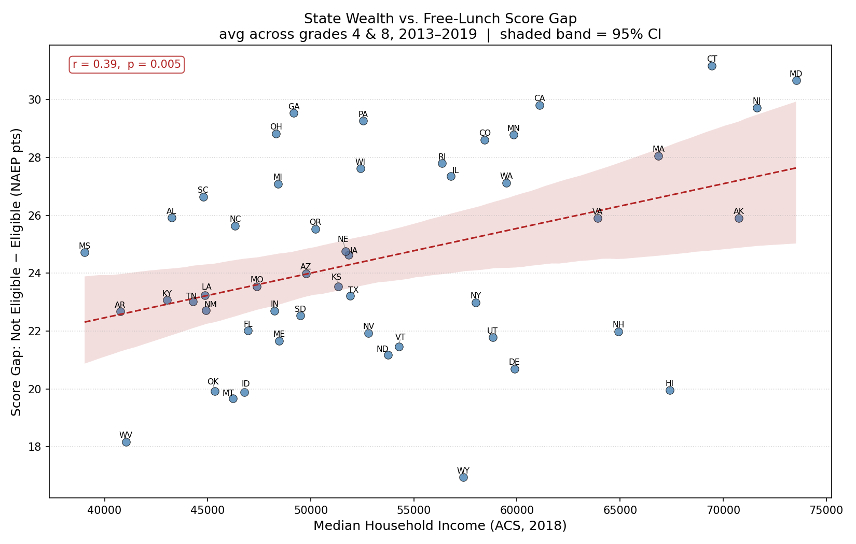
Wealthier States Produce Larger Achievement Gaps
r = 0.39 | p = 0.005
Notes:
HOW TO READ THIS CHART: Each dot is one state. The x-axis is that state's median household income. The y-axis is the score gap between students NOT eligible for free lunch (wealthier kids) and students who ARE eligible (lower-income kids) — so a higher y value means a bigger divide between rich and poor students within that state. The dashed red line is the best-fit regression line, and the pink shaded band around it is the 95% confidence interval — meaning we're 95% sure the true relationship falls somewhere in that shaded zone.
WHAT TO SAY: The r value of 0.39 is the Pearson correlation — it ranges from -1 to +1, and 0.39 is a moderate positive relationship. The p-value of 0.005 means there's less than a 1 in 200 chance this pattern is just random noise. What's interesting is that the relationship is positive — wealthier states actually have bigger gaps between their rich and poor students, not smaller ones. Connecticut and Maryland are way up in the top right — rich states with huge internal inequality. West Virginia is bottom left — poor state but also a relatively small gap. The wide confidence band tells you this relationship is real but noisy — lots of state variation income can't explain.

Slide 4
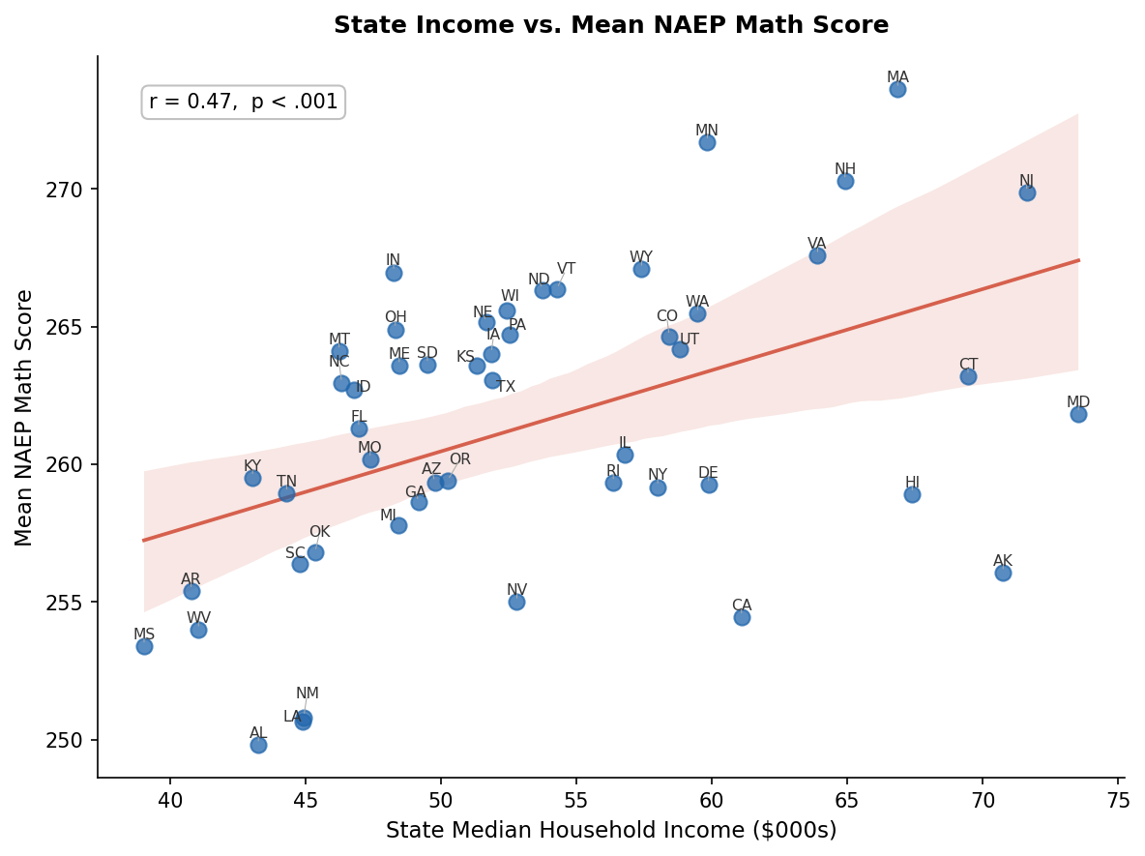
State Income Predicts Math Scores — But Loosely
r = 0.47 | p < 0.001
Notes:
HOW TO READ THIS CHART: Same setup — each dot is a state, x-axis is median household income in thousands of dollars, y-axis is the mean NAEP math score averaged across grades 4 and 8 and all four test years. The dashed line is the OLS fit, the shaded band is the 95% CI.
WHAT TO SAY: r = 0.47 is a moderate-to-strong positive correlation, and p < 0.001 means this is highly statistically significant — essentially zero chance it's random. Richer states do tend to score higher. But look at how spread out the dots are around that line — the confidence band is wide. Indiana scores around 267 despite being a middle-income state. California scores near the bottom despite being one of the wealthiest. That spread is the story — income is predictive but far from deterministic. Something else must be doing more of the work.

Slide 5
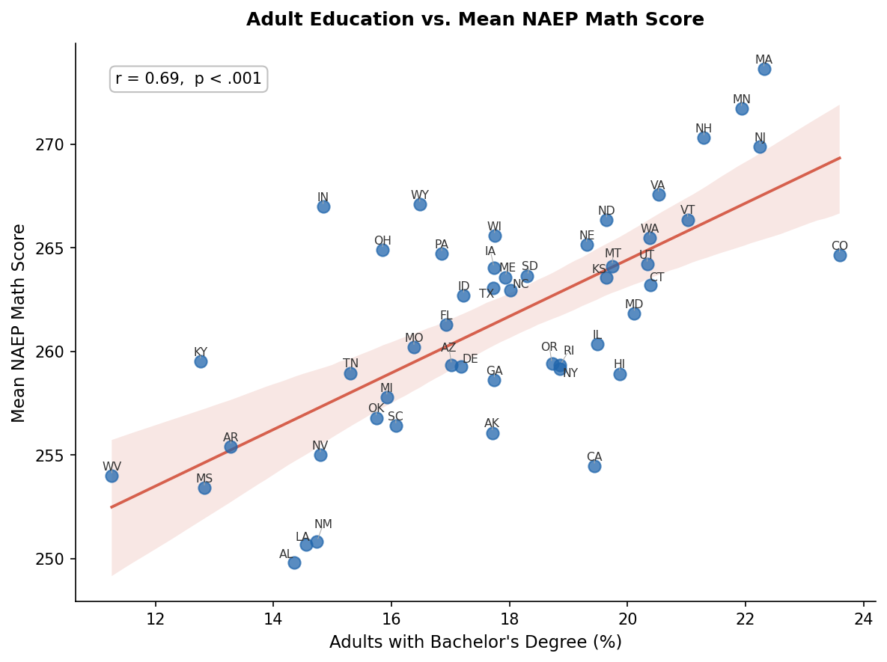
Adult Education Is a Stronger Signal
r = 0.69 | p < 0.001
Notes:
HOW TO READ THIS CHART: Same structure, but now the x-axis is the share of adults in each state with a bachelor's degree — expressed as a percentage. So a state at x=22 means 22% of its adult population has at least a four-year college degree.
WHAT TO SAY: The jump here is the key finding. r goes from 0.47 with income to 0.69 with education — that's a substantially tighter relationship. Notice how much narrower the confidence band is, and how the dots cluster closer to the line. Massachusetts is top right — highly educated state, highest scores. West Virginia and Alabama are bottom left. The fit is just cleaner across the board. This is consistent with what researchers call human capital transmission — educated parents read more to their kids, engage more with schoolwork, create learning-rich environments at home. That mechanism shows up in the data more clearly than raw household income does.

Slide 6
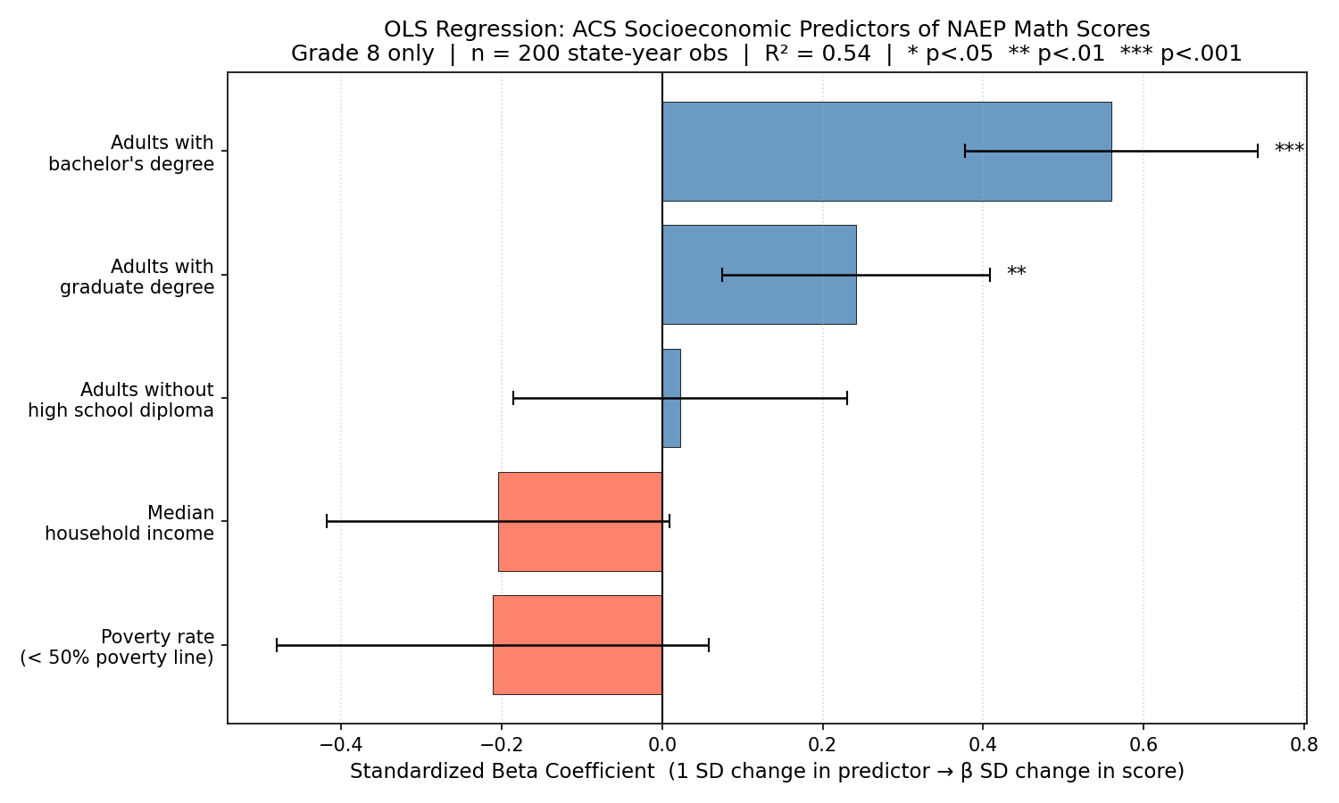
Formal Test: Education Wins When Everything Competes
R² = 0.53 | Grade 8
Notes:
HOW TO READ THIS CHART: This is a coefficient plot from a multivariate OLS regression — meaning all five predictors are in the model at the same time, competing against each other. Each bar shows the standardized beta coefficient for that predictor. Standardized means every variable has been converted to z-scores so they're on the same scale — a beta of 0.5 means a one standard deviation increase in that predictor is associated with a half standard deviation increase in scores. Blue bars are positive associations, red/salmon bars are negative. The horizontal error bars are 95% confidence intervals — if the bar's error bar crosses the zero line, that predictor is not statistically significant. The stars (*, **, ***) indicate significance levels.
WHAT TO SAY: R-squared of 0.53 means the model explains 53% of the variance in state math scores — that's pretty strong for a social science model. The only two significant predictors are adults with a bachelor's degree (beta = 0.55, p < 0.001) and adults with a graduate degree (p < 0.01). Median household income actually has a slightly negative coefficient once education is controlled for — though its confidence interval crosses zero, so it's not significant. That's the smoking gun: in a direct competition, education absorbs all the predictive power that income had.

Slide 7
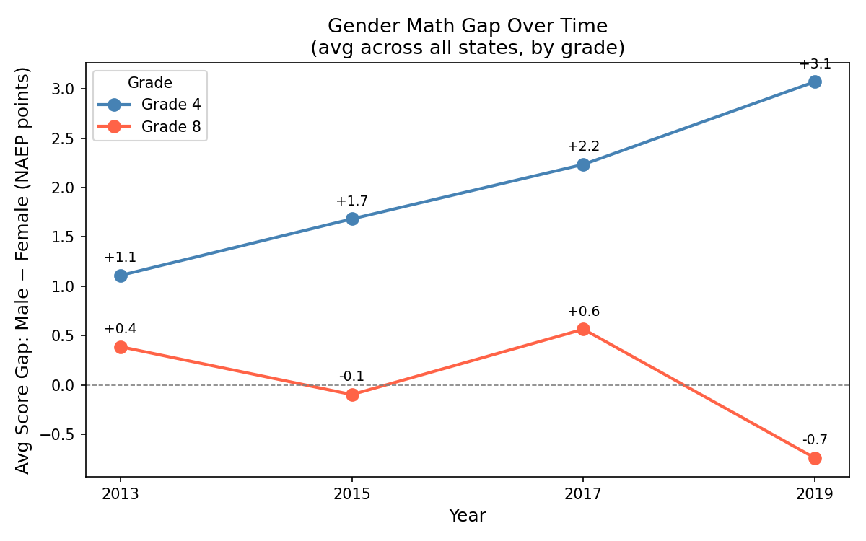
A Secondary Finding: The Gender Gap Is Moving in Opposite Directions
Grade 4: +1.1 to +3.1
Notes:
HOW TO READ THIS CHART: The y-axis shows the average gap between male and female NAEP scores — calculated as male minus female. So a positive number means boys scored higher on average; a negative number means girls scored higher. The two lines track grade 4 (blue) and grade 8 (orange) separately across the four test years.
WHAT TO SAY: At grade 4, the male advantage has been growing steadily — from just 1.1 points in 2013 to 3.1 by 2019. That's nearly a threefold increase in six years. At grade 8 it's a completely different story — the gap started at +0.4, basically even, and by 2019 flipped to -0.7, meaning girls are now outperforming boys. The two grades diverging like this wasn't something I went in looking for, but it raises a real question about whether socioeconomic pressures affect boys and girls differently depending on where they are developmentally.

Slide 8
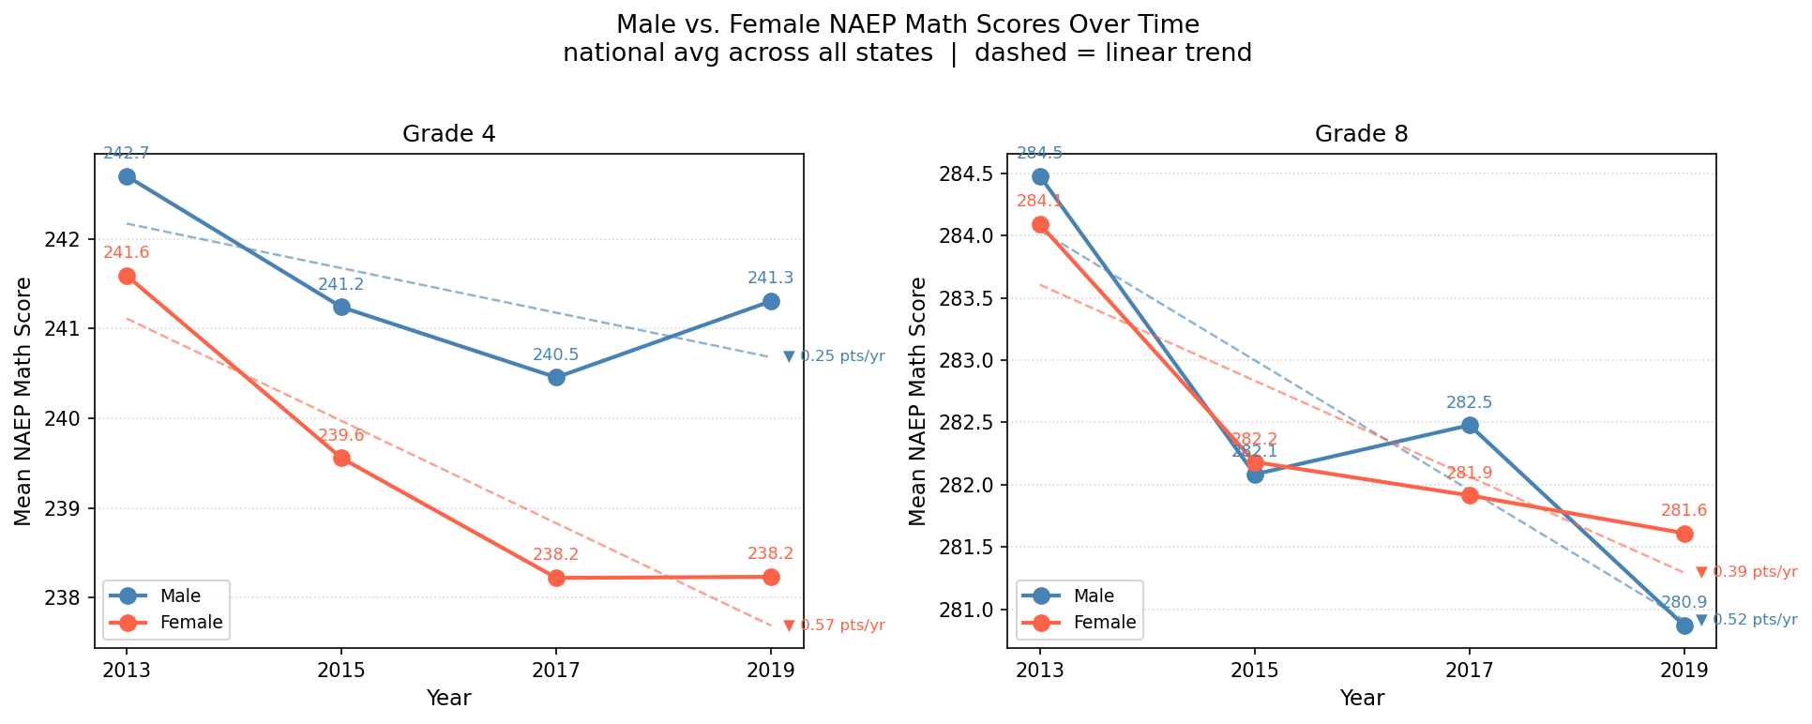
Both Groups Are Declining — Just at Different Rates
Female: -0.57 pts/yr (Gr.4)
Notes:
HOW TO READ THIS CHART: These are the actual NAEP score values — not gaps — split by grade. Blue line is male, orange is female. The dashed lines are linear trend lines fitted to each series, and the slope annotations (the triangles with numbers) show how fast scores are changing per year. A negative slope means scores are declining over time.
WHAT TO SAY: What this chart shows is that both boys and girls are scoring lower over time — this isn't a story of one group winning. At grade 4, female scores are falling at 0.57 points per year while male scores fall at only 0.25 — that faster female decline is what drives the widening gap. At grade 8 it flips: male scores drop at 0.52 per year, female at 0.39 — so boys are falling faster, which is why girls end up ahead by 2019. The overall decline across both groups could be connected to broader socioeconomic trends in the states, which is worth exploring in future work.

Slide 9
Takeaway
Education matters more than money
States where more adults hold college degrees consistently score higher on the NAEP and that relationship holds even after controlling for income. The correlation with education (r = 0.69) is much stronger than just income alone (r = 0.47), and in the full regression income loses its significance entirely once education is in the model.
It's about what happens at home
When education and income compete in the same model, education wins decisively. This points toward human capital transmission. Educated parents create richer learning environments at home, read more, engage more with schoolwork, and model academic habits from an early age. The data favor this over the scarcity-stress theory, which would predict income as the dominant predictor with the cognitive bandwidth tax.
Limitation
The real unit of analysis here is the state, and there are only 50 of them, so the results can't rule out confounders like school quality or state policy. That said, the pattern is strong and consistent across scatter plots, regression, and both grade levels. Fifty states with a coherent, theory-consistent finding is a meaningful result. And there are still ~400 test results contributing the the scores.
Notes:
The short version: if you want to know which states will score highest on the NAEP, don't just look at how rich the state is — look at how educated the adults are. That relationship is stronger at every level of analysis, and in the regression income basically disappears once education is included. The caveat is an honest one — fifty states isn't a huge sample, the ACS data is a single snapshot, and correlation isn't causation. But the pattern is clear and consistent.

