Slide 1
“Aliphatics” use case
PCSpace v 0.0.0.77

Slide 2
What is aliphatics?
A datasource containing:CID, SMILES, IUPAC, Carbon count, Primary carbon count, secondary carbon count, tertiary carbon count, activity, vendor
Activity is just the row number
Vendor is one of 4: StriaghtChain, Inc, Cyclonics, Inc. Symetro, Inc, Branchables

Slide 3
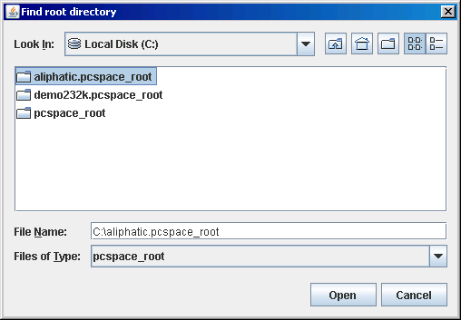
Unzip aliphatics.pcspace, then start PCSpace v77

Slide 4
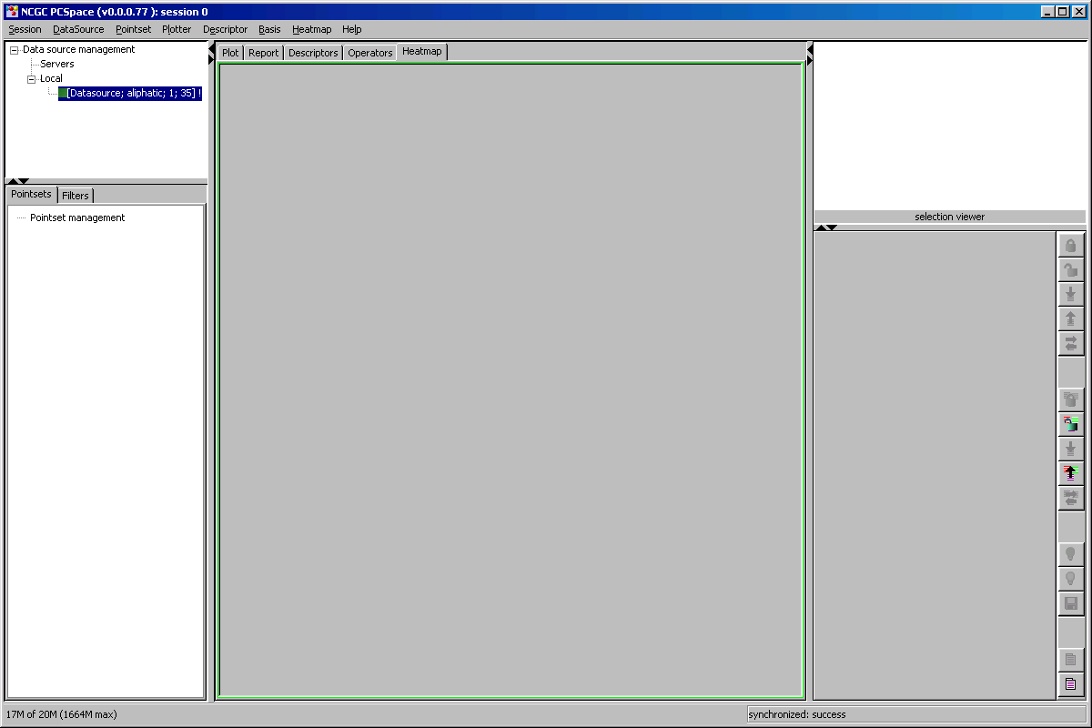
Right click Datasource = Aliphatics then create pointset

Slide 5
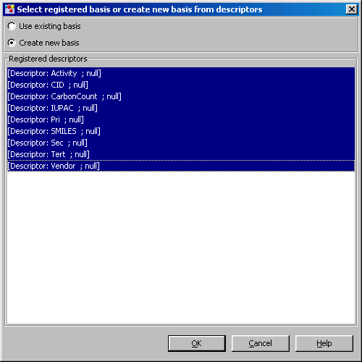
To create a pointset, we must supply a basis. A basis is a collection of distinct descriptors. The descriptors are already defined in the “aliphatics.pcroot” directory. Select all descriptors.

Slide 6
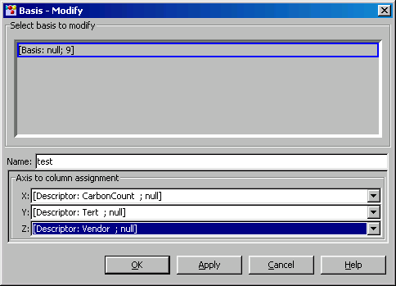
A basis (chemspace) is a permanent entity that the user can reuse, but we need to define some of its properties before proceeding. Supply a NAME and Axis-to –column-assignment, which will be explained later..

Slide 7
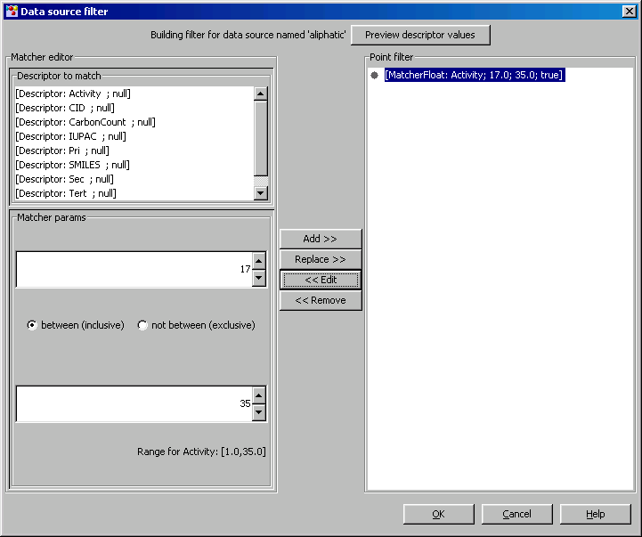
Now the user may want to construct a “point filter”, which decides which molecules are passed from the data source. Here, we say we want all aliphatics with activities between 17 and 35.

Slide 8
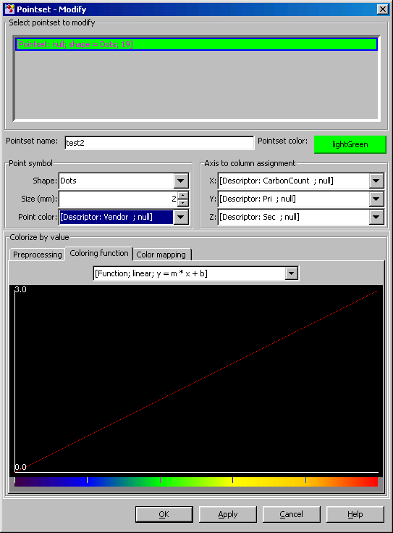
PCSpace now gets all the descriptors and molecules (rows and columns) from the data source, But the new Pointset needs to have more properties defined. Note that we are coloring by vendor.

Slide 9
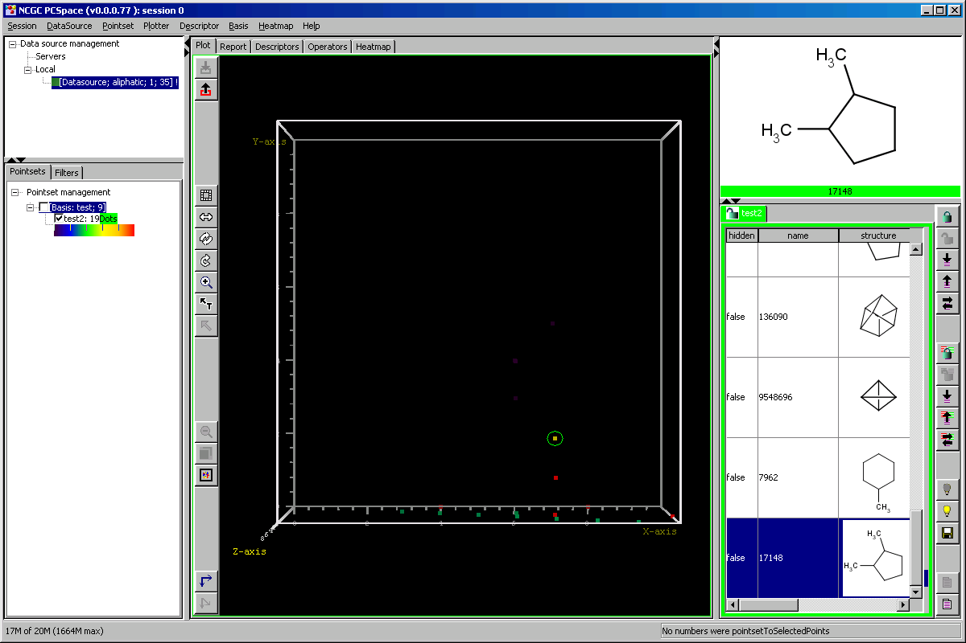
Now you will see the plot colored by vendor. You can always go back to pointset/modify and change how you color the points. Experiment with the improved/debugged selections tools. Note that the colorizer map is now readily available on the left. Click the Basis test check box, this makes it visible. If a Basis is visible, all Pointsets are plotted with the same descriptors, for direct comparison. If the Basis is invisible, the Pointsets can be “overlayed” as raw numbers. Note that a String descriptor forms coordinates too.

Slide 10
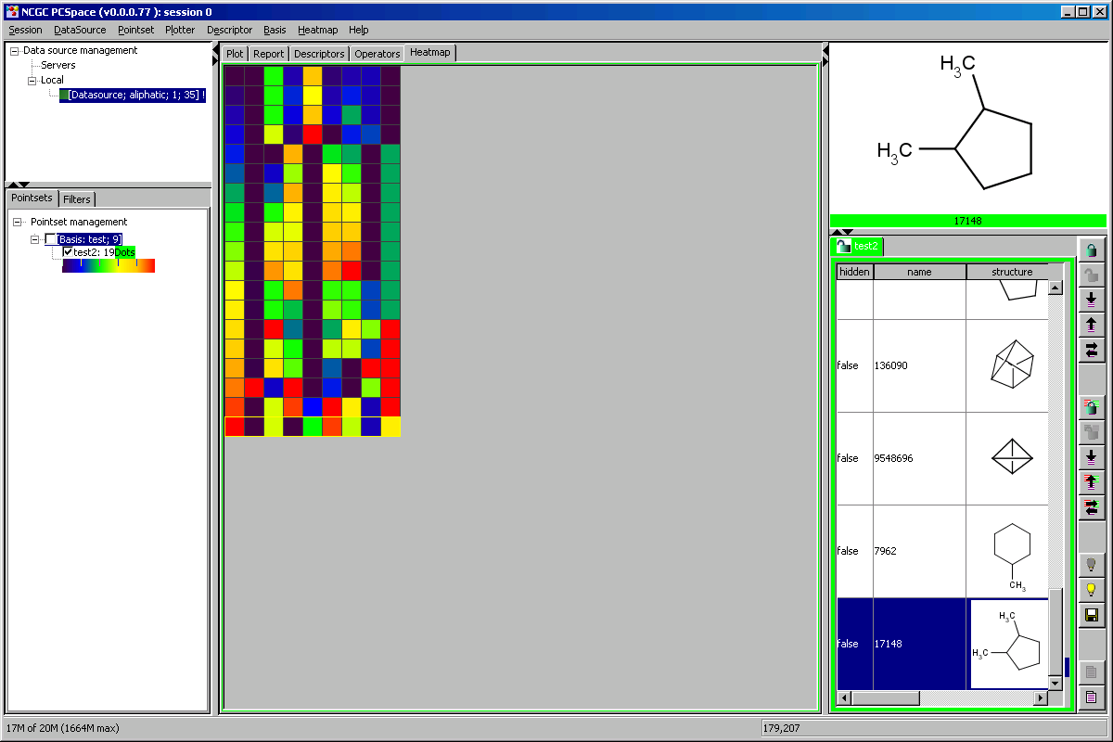
Switch to the heat map. This shows ALL descriptors in the Basis. Note that the row selection process is very similar to the plot, synchronized between table and the heatmap. BTW, you can double click the selection viewer label, and it will bring you to a real PubChem page. Hover the mouse over the heatmap. Plus key zooms, minus key unzooms. Mouse drag pans if scrollbars showing, but buggy.

Slide 11
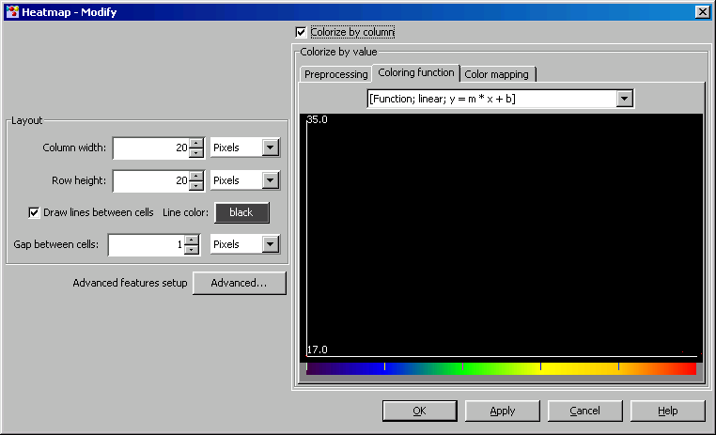
Modify the heatmap. Up will come a dialog that is self explanatory. The colorizer is the same as in pointset/modify. It has three parts.

Slide 12
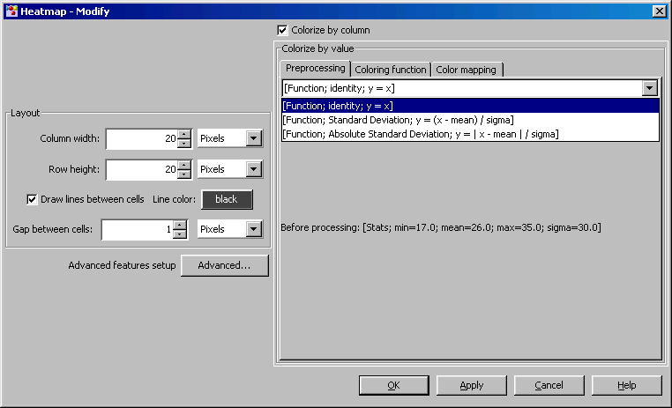
The first part is “preprocessing” where a function is applied to the numbers getting colorized. Identity means no preprocessing. Standard deviation is what you called Yuhong’s method.

Slide 13
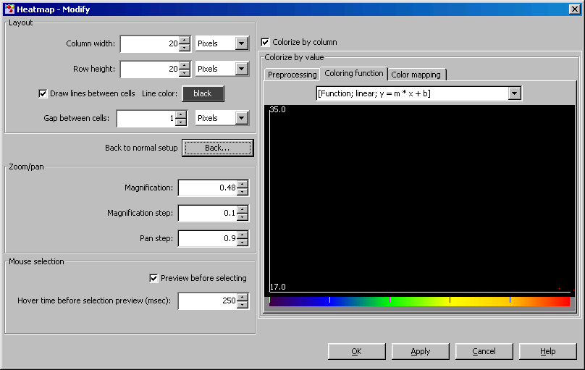
The coloring function maps the value (17-35) here to the color bar at the bottom. The is a BUG: the function should be plotted, probably due to the new string descriptor development not well tested. BTW, the new functions are easily implemented

Slide 14
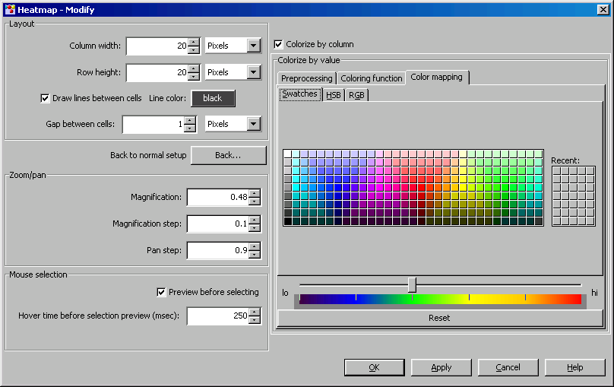
The color bar can be modified by creating a list of “waypoints”, signified y tic marks on the color bar. Move the slider to where you want the waypoint, and select a color. The waypoint will be added. Colors are interpolated between the waypoints’ color value.

Slide 15
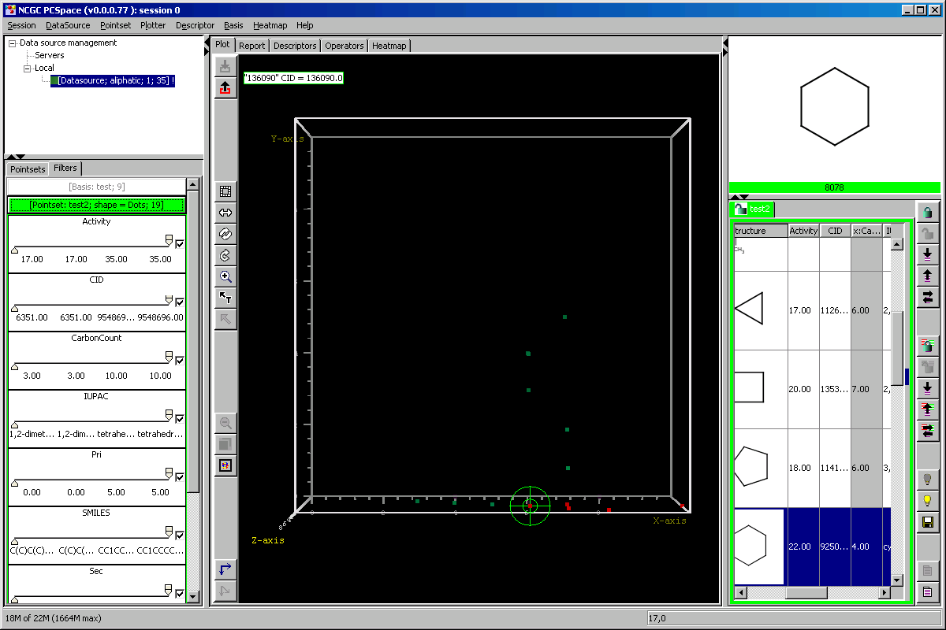
Return to the plot and click the filter’s tab. You will see a double slider for each descriptor. If the value of the point is between the sliders, it is plotted, else it is invisible. The checkbox inverts to “outside” of the double sliders. String descriptor not fully tested.

