Slide 1

Development of a software tool to explore chemistry space
Joe Talafous
UX Developer candidate
CD-adapco
Lebanon, NH
May 2014

Slide 2
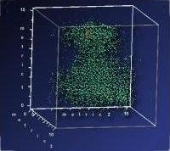
DiverseSolutions (DVS)
2001: Descriptors and UT/Bob’s BCUTs
DVS evolved into UNIX toolkit
Bob needs “webifying” DVS for the masses
Pure Java Swing – desktop/applet/web start
Visualizing descriptors embedded in a “chemspace” became very prevalent

Slide 3
National Institutes of Health
“Micropharma” for orphan drugs - uHTS
Chemists synthesize drug candidates
Biologists make assays to test candidate
Robotics measure activity assay
Informaticians curate data and develop tools to support decisions to select drug candidates
Enterprise infrastructure with Java

Slide 4
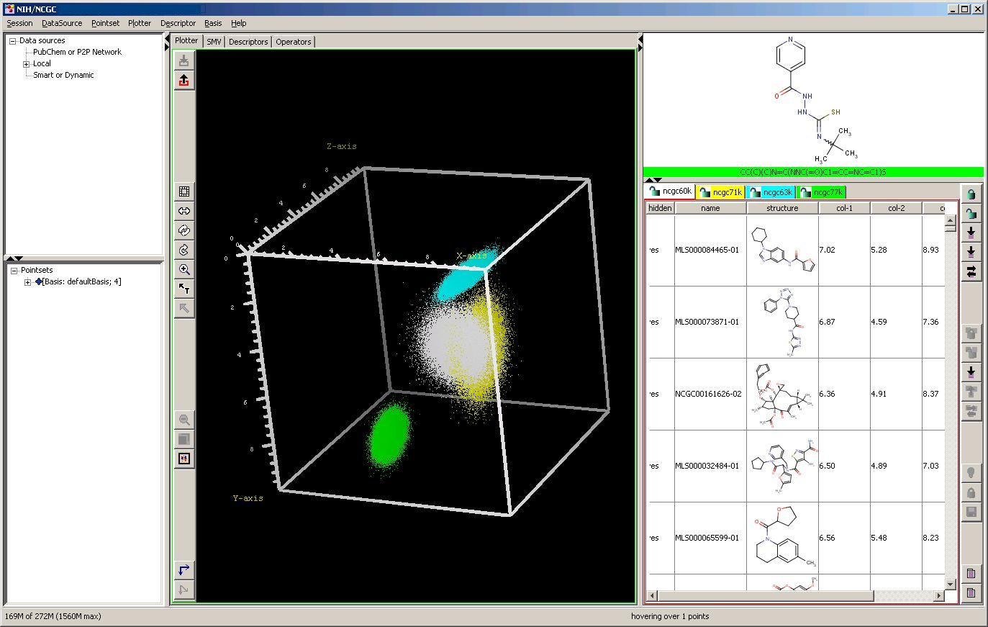
Intro screenshot

Slide 5
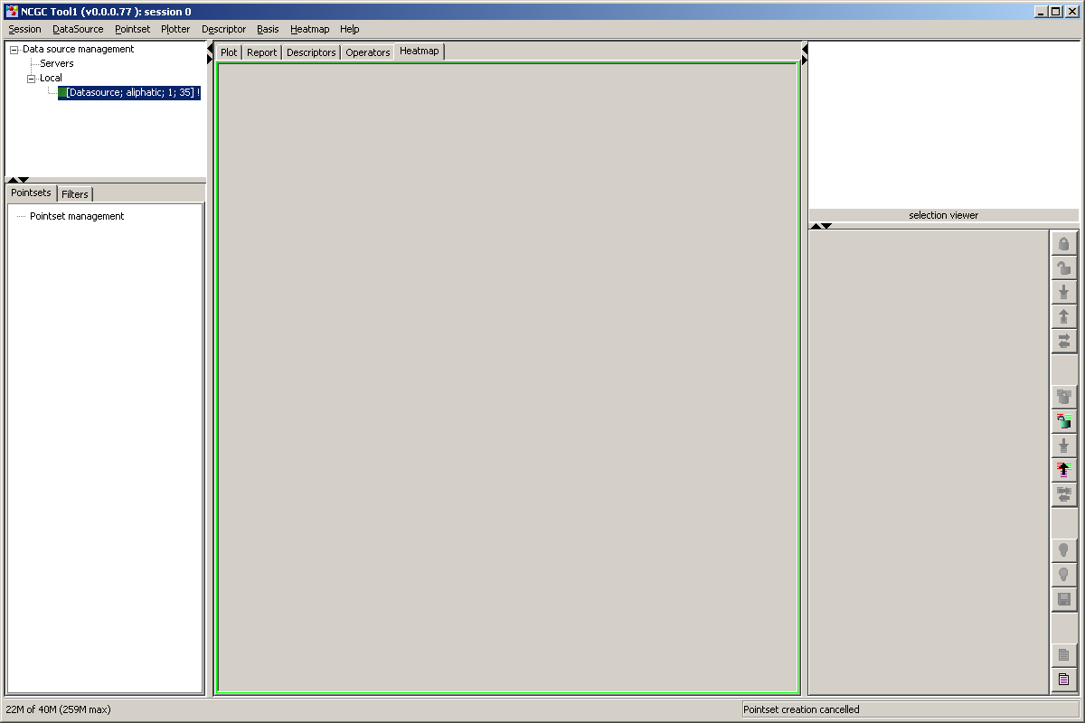
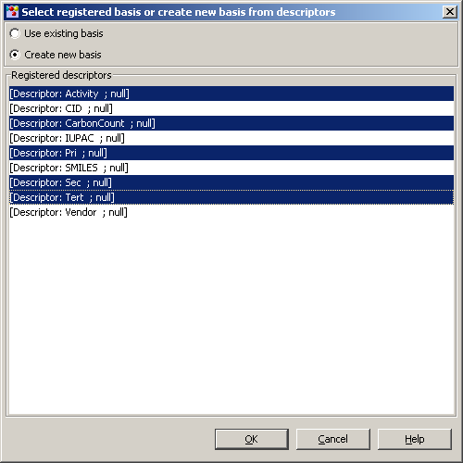
Loading

Slide 6
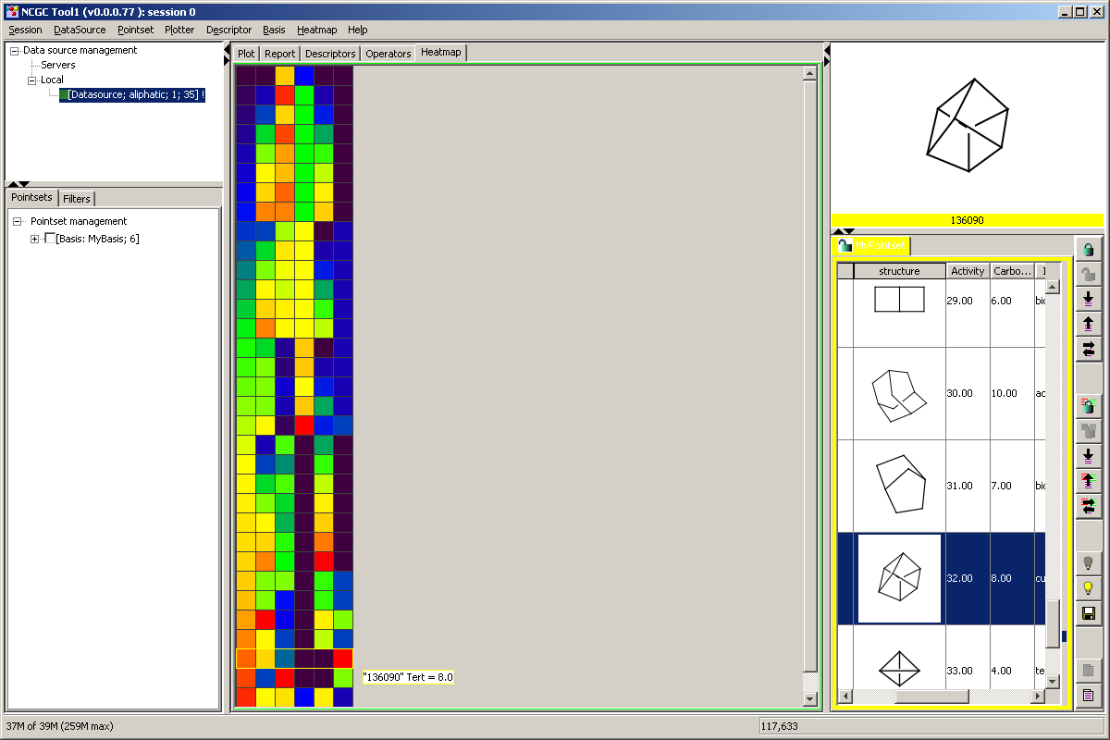
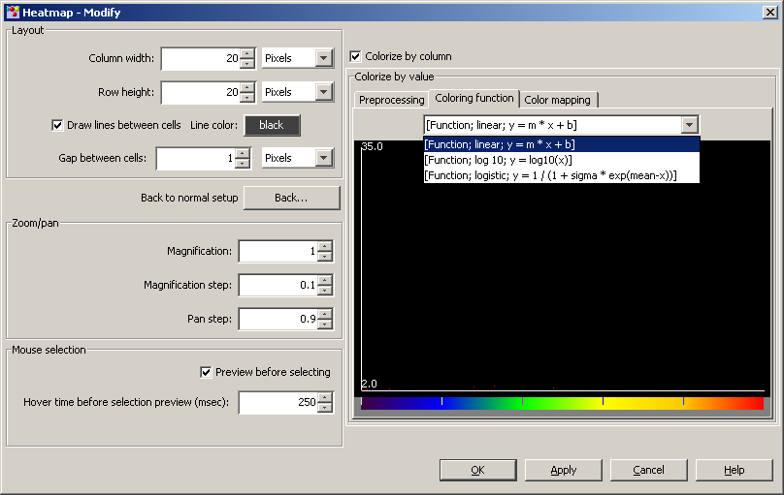
Heatmap

Slide 7
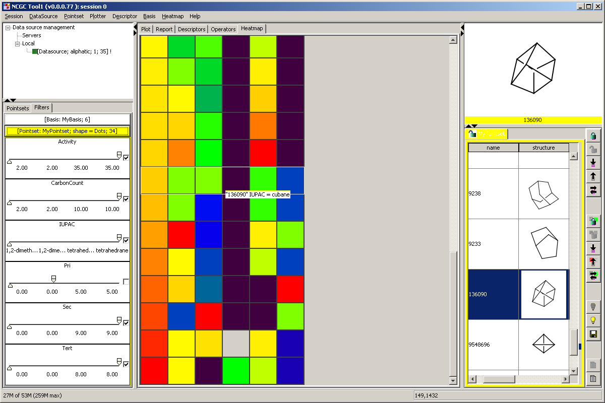
Heatmap zoom + Filters
Notes:
Here we show the heat map with
Pan and zoom.
Filtering.

Slide 8
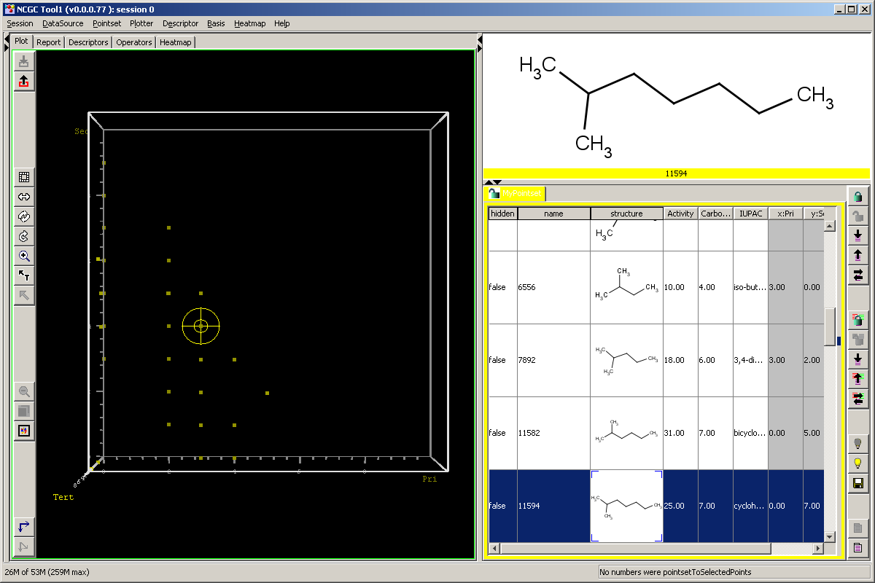
Plot

Slide 9
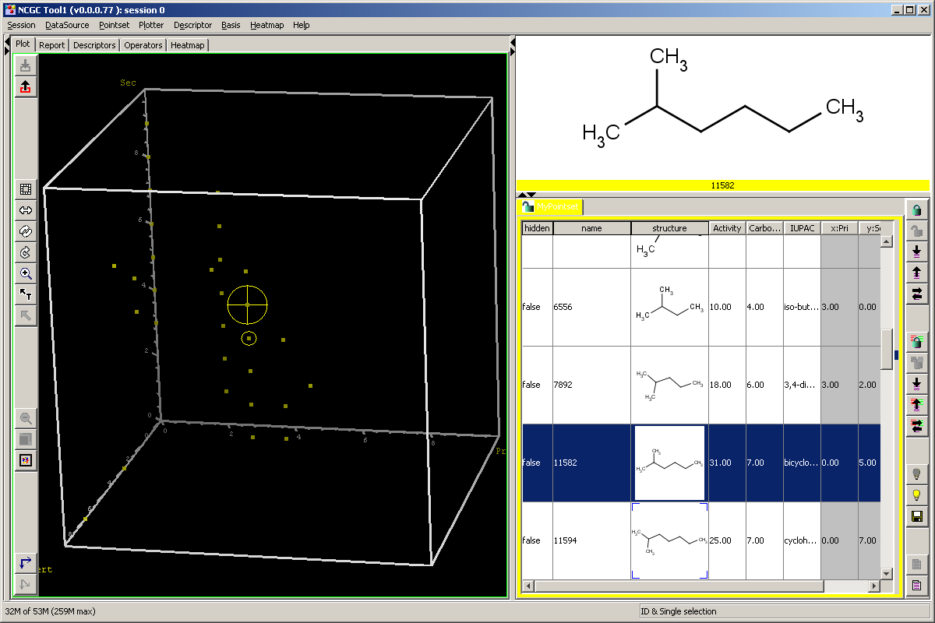
Plot selection
Notes:
SYNCRONIZATION between Spreadsheet and Plot

Slide 10
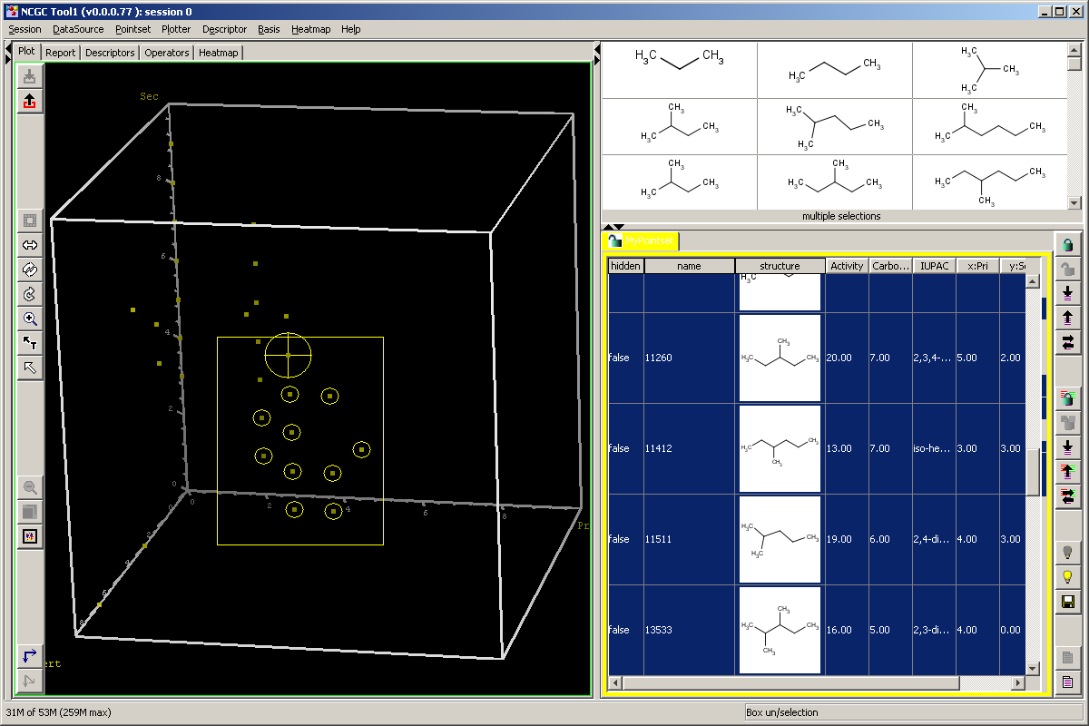
Rubber band

Slide 11

Plot zoom

Slide 12
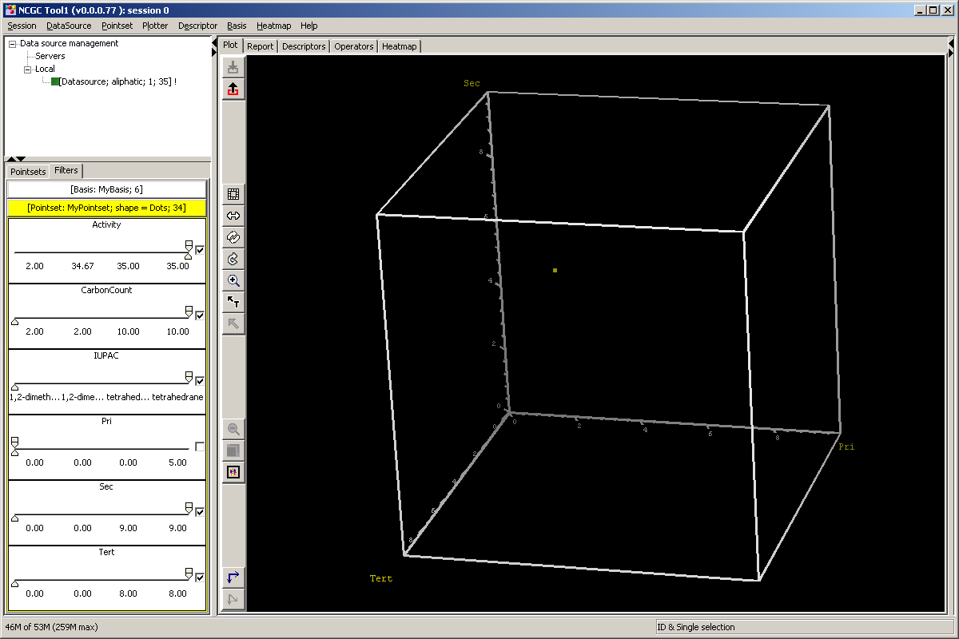
Plot filtering

Slide 13
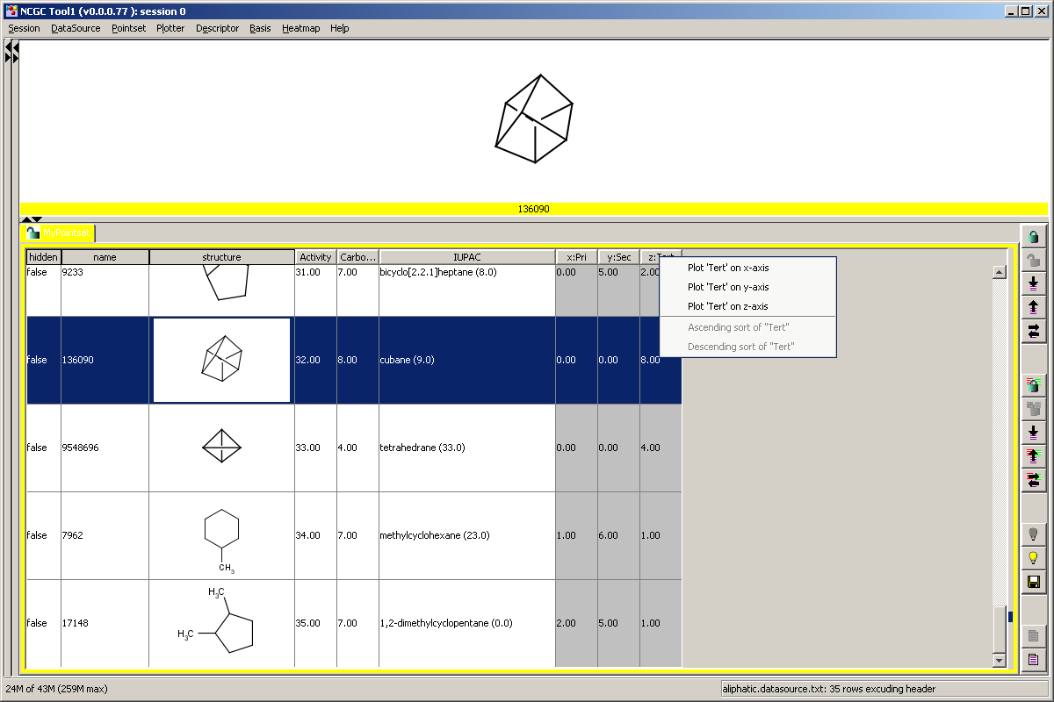
Tables
Notes:
SPREADSHEET
All the columns are considered descriptors.
Axes Selection

Slide 14
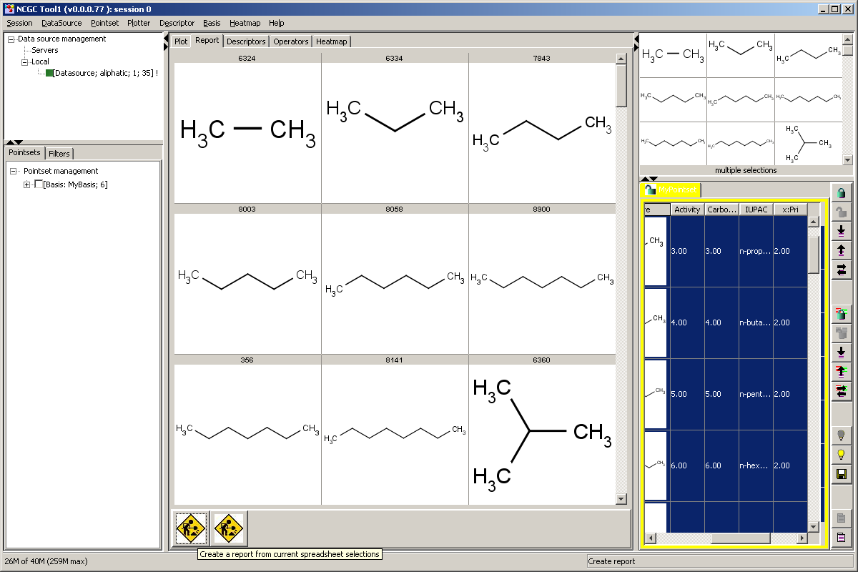
Reports

Slide 15
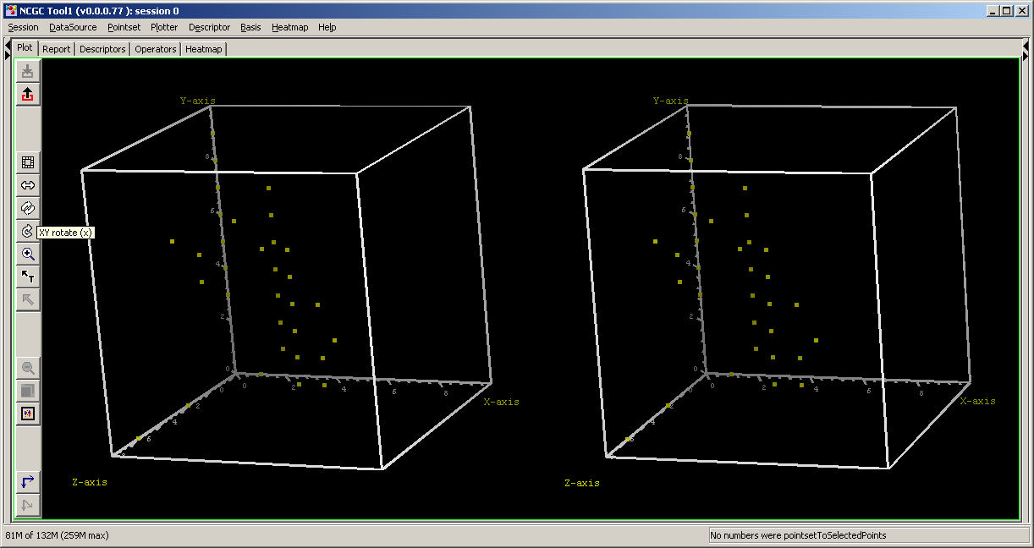
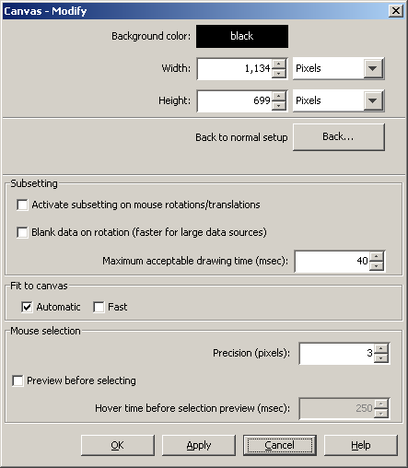
Canvas
Notes:
CANVAS – Bottleneck and show stopper. Above all it had to be very very fast to handle the highest possible number of molecule points.
OpenGL slow. But I used what I learned to make it better.
The algorithm was based on Java2D. Every pixel was drawn by my low-level algorithms.
Essentially, every mouse and key event used the current parameters to draw a 2D image.
This required not only a ton of linear algebra, but also be quite creative about performance issues.
It is a great study in algorithm development. How did this algorithm get developed?
It really was all in keeping track of its timings during its growth.
You start with the algorithm doing the bare minimum and creatively converge by profiling to a fast solution.
For example, OpenGL wants to do a lot for you, whereas all we need for Tool1 is to draw a symbol with a few points. This is what Xplotter did.
So you focus on doing that as fast as you can. This includes number of mathematical operations, as well as loop structure.
Then you start evolving the algorithm to accommodate the next required feature while keeping the performance ground you gained in the last step.
At each step you basically really pay close attention to how long every thing takes and are ultra frugal.
Some of the features you start adding in are perspective. True perspective is somewhat costly, but there is a trick by Renaissance painters called Thales perspective, which is just a few extra operations.
DEPTH-PERCEPTION
Z-Buffering -
ROTATION – mouse, keys, inertia, sterio
SUBSETTING -

Slide 16
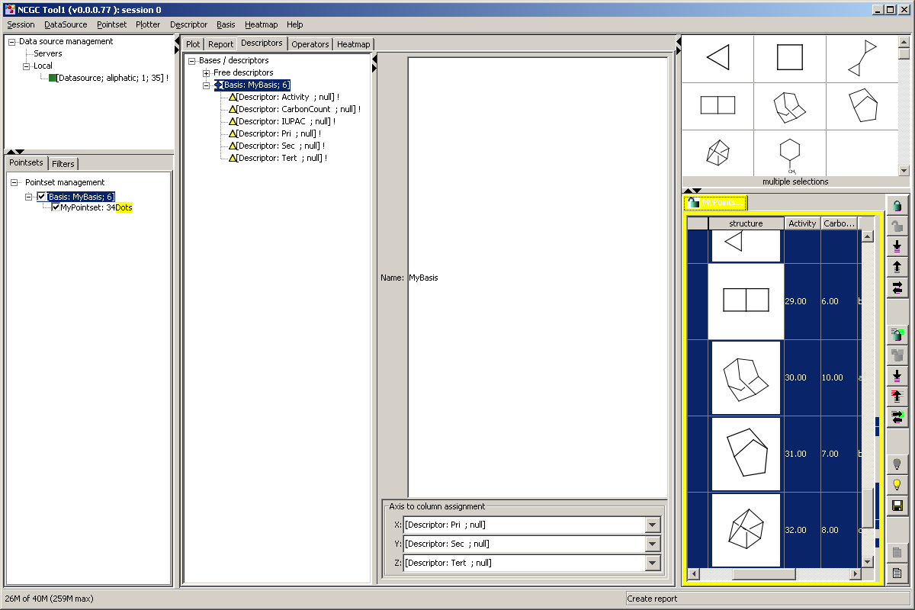

Descriptors
Notes:
Activities are treated by PCSpace to also be molecular descriptors, but they are "calculated" by Mother Nature. The source of data is anywhere the molecular descriptors are calculated, which can be PubChem or other service. PCSpace has a calculation engine which calculates descriptors in the background and can distribute this load to other machines running PCSpace.
Todechini
Bases are simply collections of descriptors.
Share bases with other scientists.
Provide “preset” bases
Calculation engine

Slide 17
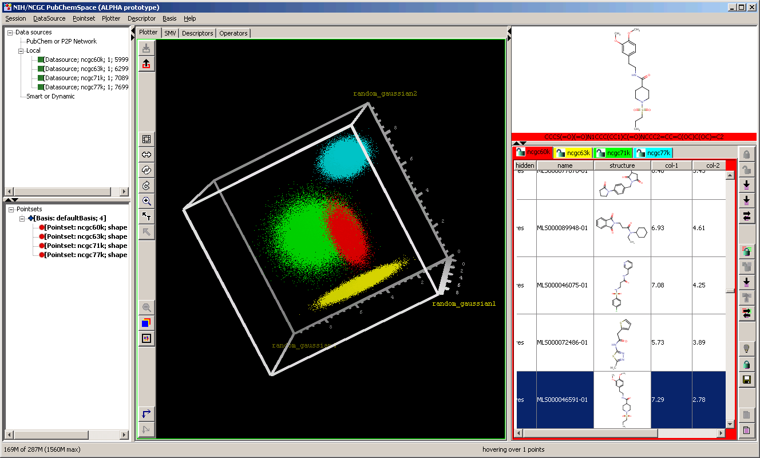
Summary screenshot
Notes:
Taking it all together we get this. Here I generated 4 synthetic pointsets with about 75K molecules each. Notice they are differently colored.
Performance
Multidata pointsets
Remember that this could be run in the browser and as an applet.

Slide 18

Conclusion
More at: https://www.youtube.com/watch?v=nU67vIe0vvY
Comments and questions
Notes:
Link provides a 7 minute video demo of the aliphatic set I just showed you.
Very useful to see 3D in action.
It’s low video quality, but you get to hear a great Beethoven tune for your trouble.

Slide 19
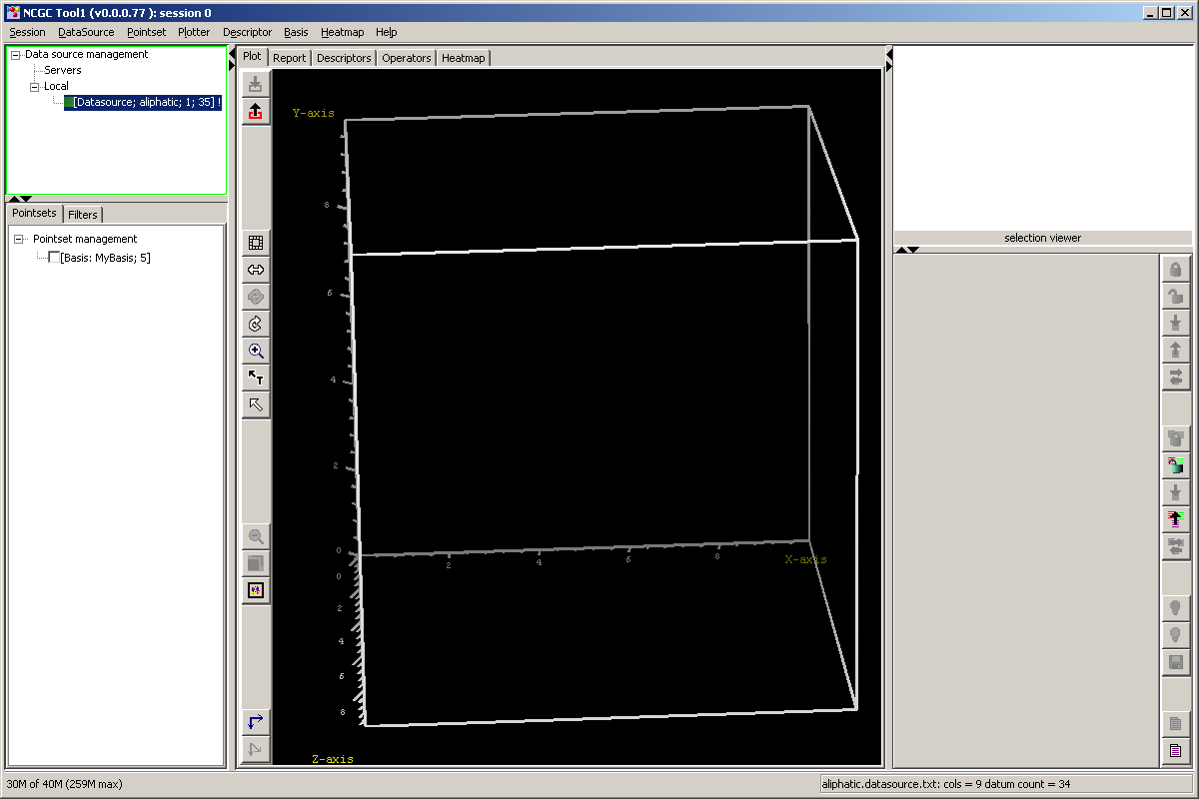
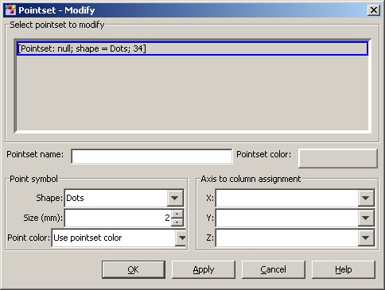
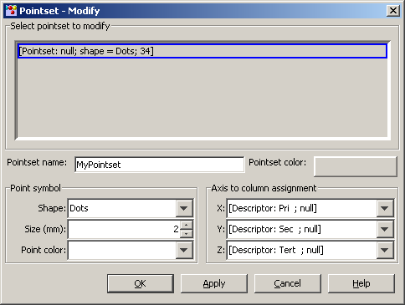
Pointset

Slide 20
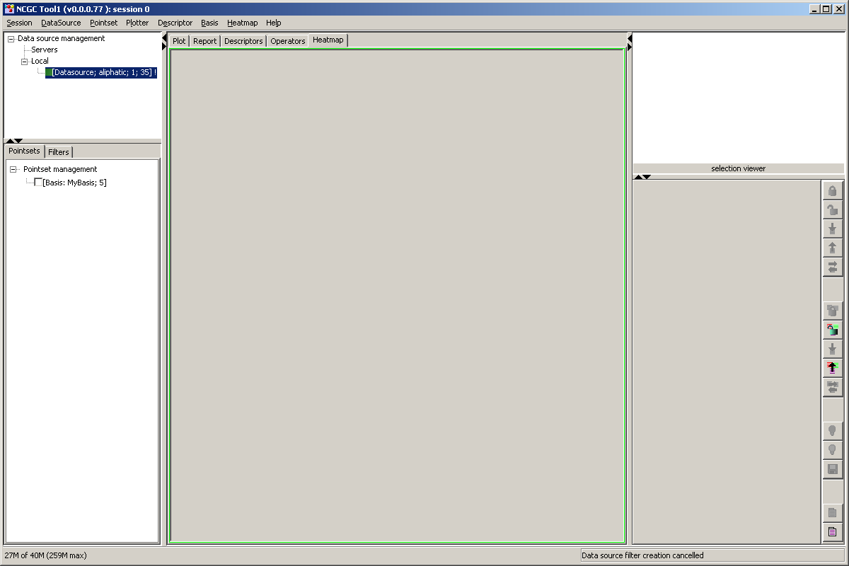
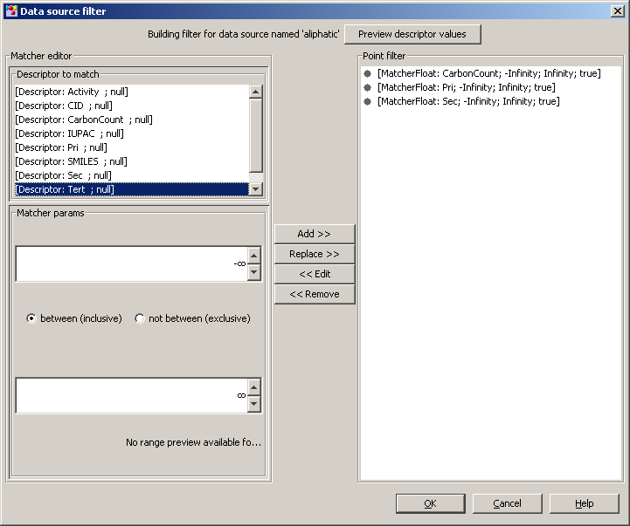
Filters

